Slide 1
Crash Course on Representations and Features
Contd.
Many slides from S. Seitz, A. Torralba, L. Lazebnik, Derek Hoiem, K. Grauman, Yang Wang and many others

Slide 2
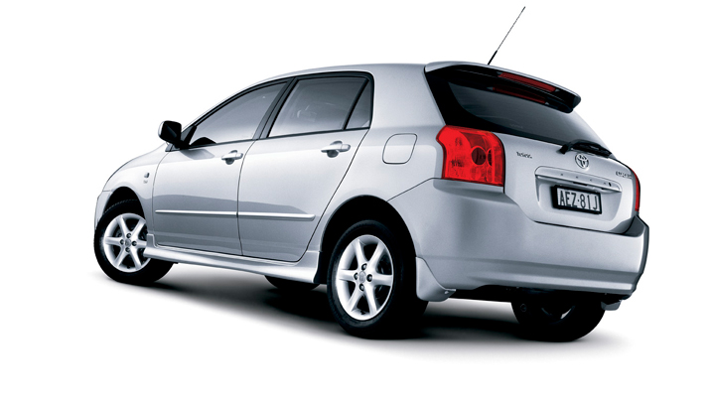
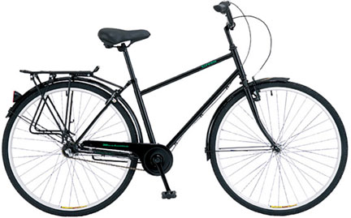
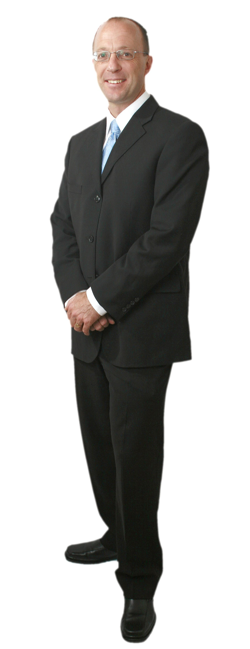
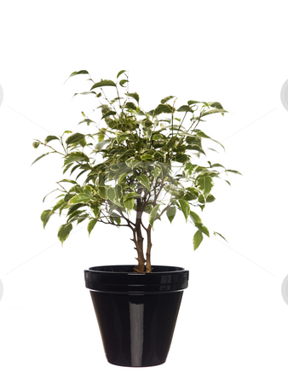

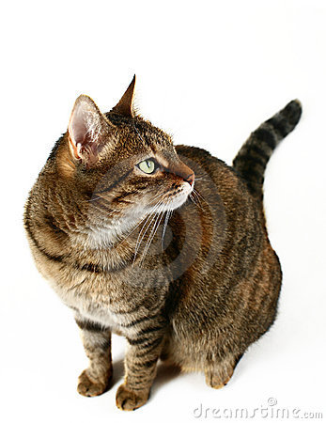

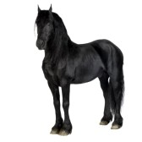
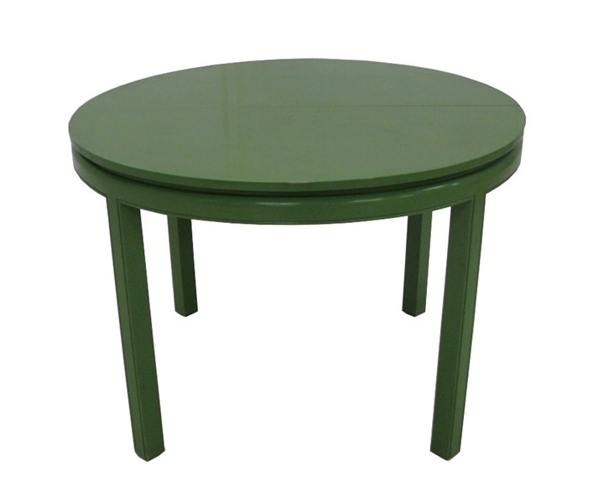
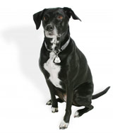
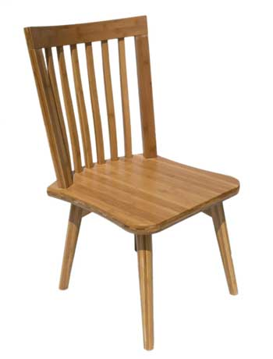
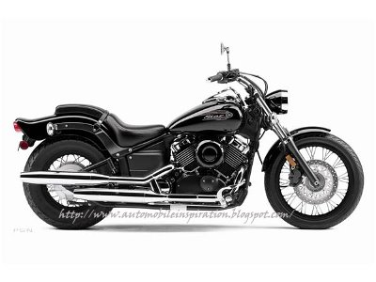
Typical Paradigms of Recognition
Feature Computation
Model

Slide 3
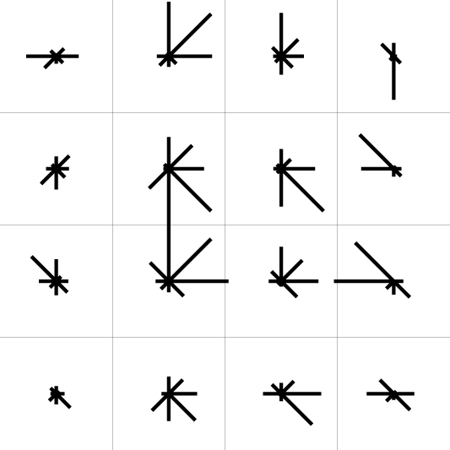
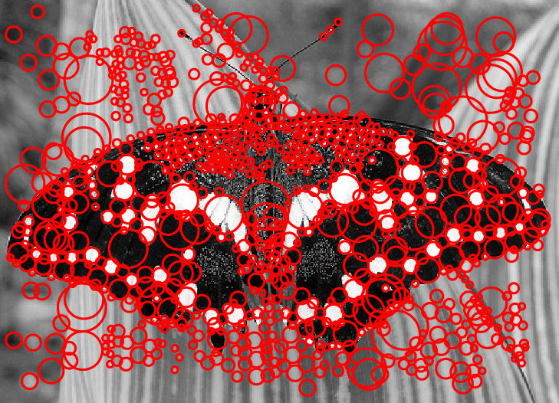

Slide 4
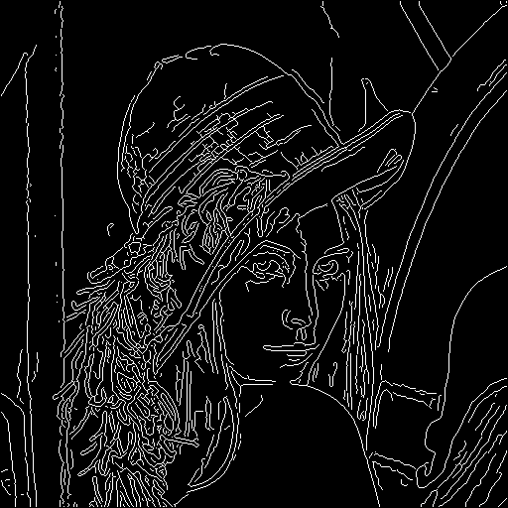


Slide 5




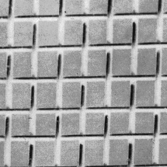
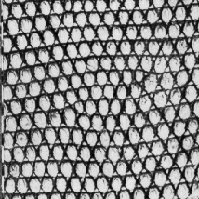
histogram
Universal texton dictionary
Julesz, 1981; Cula & Dana, 2001; Leung & Malik 2001; Mori, Belongie & Malik, 2001; Schmid 2001; Varma & Zisserman, 2002, 2003; Lazebnik, Schmid & Ponce, 2003

Slide 6
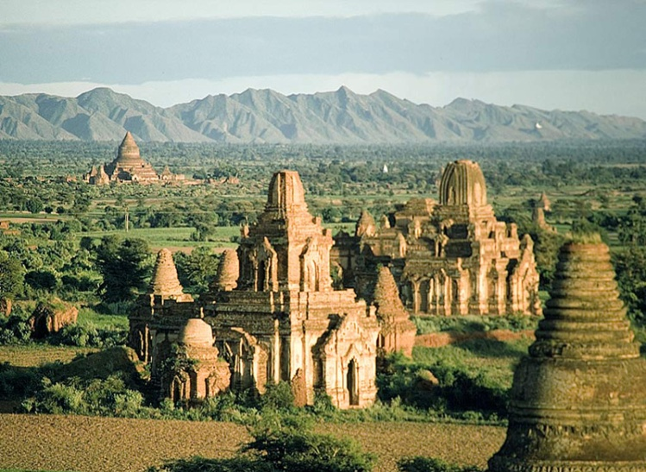
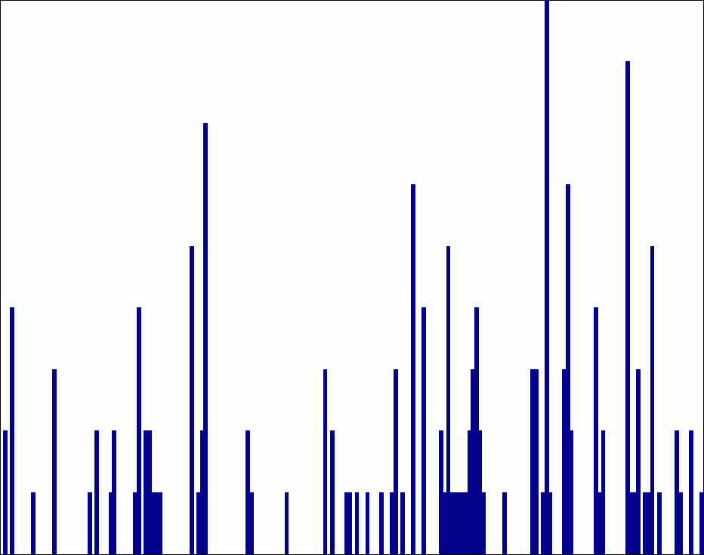











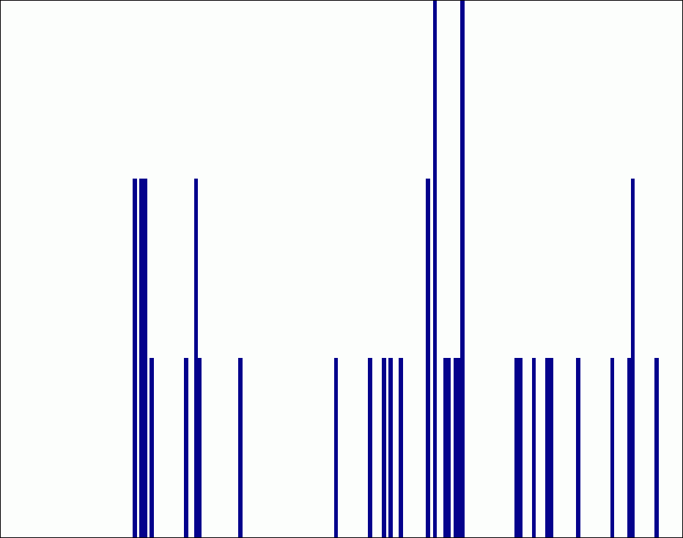








level 0
level 1
level 2
Lazebnik, Schmid & Ponce (CVPR 2006)

Slide 7
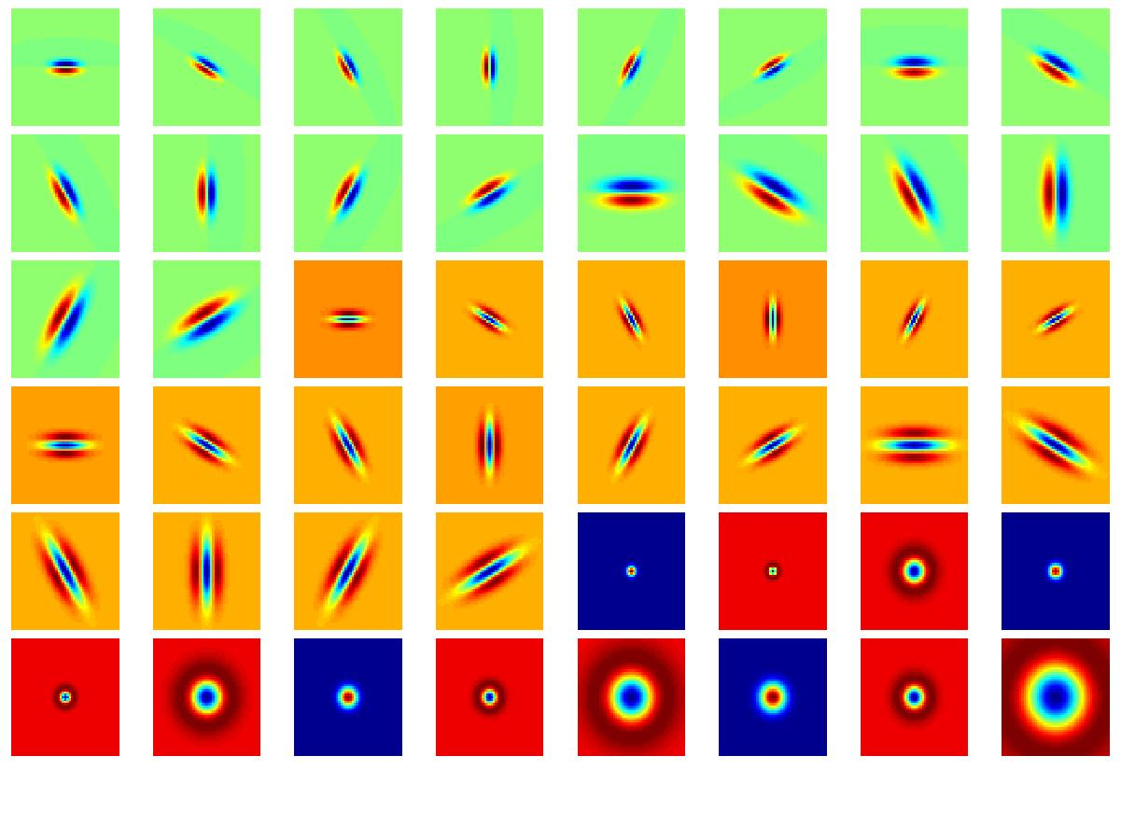
Filter bank

Slide 8

Image filtering
1
1
1
1
1
1
1
1
1
0 | 0 | 0 | 0 | 0 | 0 | 0 | 0 | 0 | 0
0 | 0 | 0 | 0 | 0 | 0 | 0 | 0 | 0 | 0
0 | 0 | 0 | 90 | 90 | 90 | 90 | 90 | 0 | 0
0 | 0 | 0 | 90 | 90 | 90 | 90 | 90 | 0 | 0
0 | 0 | 0 | 90 | 90 | 90 | 90 | 90 | 0 | 0
0 | 0 | 0 | 90 | 0 | 90 | 90 | 90 | 0 | 0
0 | 0 | 0 | 90 | 90 | 90 | 90 | 90 | 0 | 0
0 | 0 | 0 | 0 | 0 | 0 | 0 | 0 | 0 | 0
0 | 0 | 90 | 0 | 0 | 0 | 0 | 0 | 0 | 0
0 | 0 | 0 | 0 | 0 | 0 | 0 | 0 | 0 | 0
 | 0
0 | 0 | 0 | 0 | 0 | 0 | 0 | 0 | 0 | 0
0 | 0 | 0 | 0 | 0 | 0 | 0 | 0 | 0 | 0
0 | 0 | 0 | 90 | 90 | 90 | 90 | 90 | 0 | 0
0 | 0 | 0 | 90 | 90 | 90 | 90 | 90 | 0 | 0
0 | 0 | 0 | 90 | 90 | 90 | 90 | 90 | 0 | 0
0 | 0 | 0 | 90 | 0 | 90 | 90 | 90 | 0 | 0
0 | 0 | 0 | 90 | 90 | 90 | 90 | 90 | 0 | 0
0 | 0 | 0 | 0 | 0 | 0 | 0 | 0 | 0 | 0
0 | 0 | 90 | 0 | 0 | 0 | 0 | 0 | 0 | 0
0 | 0 | 0 | 0 | 0 | 0 | 0 | 0 | 0 | 0
Credit: S. Seitz

Slide 9
Image filtering
1
1
1
1
1
1
1
1
1
0 | 0 | 0 | 0 | 0 | 0 | 0 | 0 | 0 | 0
0 | 0 | 0 | 0 | 0 | 0 | 0 | 0 | 0 | 0
0 | 0 | 0 | 90 | 90 | 90 | 90 | 90 | 0 | 0
0 | 0 | 0 | 90 | 90 | 90 | 90 | 90 | 0 | 0
0 | 0 | 0 | 90 | 90 | 90 | 90 | 90 | 0 | 0
0 | 0 | 0 | 90 | 0 | 90 | 90 | 90 | 0 | 0
0 | 0 | 0 | 90 | 90 | 90 | 90 | 90 | 0 | 0
0 | 0 | 0 | 0 | 0 | 0 | 0 | 0 | 0 | 0
0 | 0 | 90 | 0 | 0 | 0 | 0 | 0 | 0 | 0
0 | 0 | 0 | 0 | 0 | 0 | 0 | 0 | 0 | 0
 | 0 | 10
0 | 0 | 0 | 0 | 0 | 0 | 0 | 0 | 0 | 0
0 | 0 | 0 | 0 | 0 | 0 | 0 | 0 | 0 | 0
0 | 0 | 0 | 90 | 90 | 90 | 90 | 90 | 0 | 0
0 | 0 | 0 | 90 | 90 | 90 | 90 | 90 | 0 | 0
0 | 0 | 0 | 90 | 90 | 90 | 90 | 90 | 0 | 0
0 | 0 | 0 | 90 | 0 | 90 | 90 | 90 | 0 | 0
0 | 0 | 0 | 90 | 90 | 90 | 90 | 90 | 0 | 0
0 | 0 | 0 | 0 | 0 | 0 | 0 | 0 | 0 | 0
0 | 0 | 90 | 0 | 0 | 0 | 0 | 0 | 0 | 0
0 | 0 | 0 | 0 | 0 | 0 | 0 | 0 | 0 | 0
Credit: S. Seitz
Notes:
ones, divide by 9

Slide 10
Image filtering
1
1
1
1
1
1
1
1
1
0 | 0 | 0 | 0 | 0 | 0 | 0 | 0 | 0 | 0
0 | 0 | 0 | 0 | 0 | 0 | 0 | 0 | 0 | 0
0 | 0 | 0 | 90 | 90 | 90 | 90 | 90 | 0 | 0
0 | 0 | 0 | 90 | 90 | 90 | 90 | 90 | 0 | 0
0 | 0 | 0 | 90 | 90 | 90 | 90 | 90 | 0 | 0
0 | 0 | 0 | 90 | 0 | 90 | 90 | 90 | 0 | 0
0 | 0 | 0 | 90 | 90 | 90 | 90 | 90 | 0 | 0
0 | 0 | 0 | 0 | 0 | 0 | 0 | 0 | 0 | 0
0 | 0 | 90 | 0 | 0 | 0 | 0 | 0 | 0 | 0
0 | 0 | 0 | 0 | 0 | 0 | 0 | 0 | 0 | 0
 | 0 | 10 | 20
0 | 0 | 0 | 0 | 0 | 0 | 0 | 0 | 0 | 0
0 | 0 | 0 | 0 | 0 | 0 | 0 | 0 | 0 | 0
0 | 0 | 0 | 90 | 90 | 90 | 90 | 90 | 0 | 0
0 | 0 | 0 | 90 | 90 | 90 | 90 | 90 | 0 | 0
0 | 0 | 0 | 90 | 90 | 90 | 90 | 90 | 0 | 0
0 | 0 | 0 | 90 | 0 | 90 | 90 | 90 | 0 | 0
0 | 0 | 0 | 90 | 90 | 90 | 90 | 90 | 0 | 0
0 | 0 | 0 | 0 | 0 | 0 | 0 | 0 | 0 | 0
0 | 0 | 90 | 0 | 0 | 0 | 0 | 0 | 0 | 0
0 | 0 | 0 | 0 | 0 | 0 | 0 | 0 | 0 | 0
Credit: S. Seitz
Notes:
ones, divide by 9

Slide 11
Image filtering
1
1
1
1
1
1
1
1
1
0 | 0 | 0 | 0 | 0 | 0 | 0 | 0 | 0 | 0
0 | 0 | 0 | 0 | 0 | 0 | 0 | 0 | 0 | 0
0 | 0 | 0 | 90 | 90 | 90 | 90 | 90 | 0 | 0
0 | 0 | 0 | 90 | 90 | 90 | 90 | 90 | 0 | 0
0 | 0 | 0 | 90 | 90 | 90 | 90 | 90 | 0 | 0
0 | 0 | 0 | 90 | 0 | 90 | 90 | 90 | 0 | 0
0 | 0 | 0 | 90 | 90 | 90 | 90 | 90 | 0 | 0
0 | 0 | 0 | 0 | 0 | 0 | 0 | 0 | 0 | 0
0 | 0 | 90 | 0 | 0 | 0 | 0 | 0 | 0 | 0
0 | 0 | 0 | 0 | 0 | 0 | 0 | 0 | 0 | 0
 | 0 | 10 | 20 | 30
0 | 0 | 0 | 0 | 0 | 0 | 0 | 0 | 0 | 0
0 | 0 | 0 | 0 | 0 | 0 | 0 | 0 | 0 | 0
0 | 0 | 0 | 90 | 90 | 90 | 90 | 90 | 0 | 0
0 | 0 | 0 | 90 | 90 | 90 | 90 | 90 | 0 | 0
0 | 0 | 0 | 90 | 90 | 90 | 90 | 90 | 0 | 0
0 | 0 | 0 | 90 | 0 | 90 | 90 | 90 | 0 | 0
0 | 0 | 0 | 90 | 90 | 90 | 90 | 90 | 0 | 0
0 | 0 | 0 | 0 | 0 | 0 | 0 | 0 | 0 | 0
0 | 0 | 90 | 0 | 0 | 0 | 0 | 0 | 0 | 0
0 | 0 | 0 | 0 | 0 | 0 | 0 | 0 | 0 | 0
Credit: S. Seitz

Slide 12
Image filtering
1
1
1
1
1
1
1
1
1
0 | 0 | 0 | 0 | 0 | 0 | 0 | 0 | 0 | 0
0 | 0 | 0 | 0 | 0 | 0 | 0 | 0 | 0 | 0
0 | 0 | 0 | 90 | 90 | 90 | 90 | 90 | 0 | 0
0 | 0 | 0 | 90 | 90 | 90 | 90 | 90 | 0 | 0
0 | 0 | 0 | 90 | 90 | 90 | 90 | 90 | 0 | 0
0 | 0 | 0 | 90 | 0 | 90 | 90 | 90 | 0 | 0
0 | 0 | 0 | 90 | 90 | 90 | 90 | 90 | 0 | 0
0 | 0 | 0 | 0 | 0 | 0 | 0 | 0 | 0 | 0
0 | 0 | 90 | 0 | 0 | 0 | 0 | 0 | 0 | 0
0 | 0 | 0 | 0 | 0 | 0 | 0 | 0 | 0 | 0
 | 0 | 10 | 20 | 30 | 30
Credit: S. Seitz

Slide 13
Image filtering
1
1
1
1
1
1
1
1
1
0 | 0 | 0 | 0 | 0 | 0 | 0 | 0 | 0 | 0
0 | 0 | 0 | 0 | 0 | 0 | 0 | 0 | 0 | 0
0 | 0 | 0 | 90 | 90 | 90 | 90 | 90 | 0 | 0
0 | 0 | 0 | 90 | 90 | 90 | 90 | 90 | 0 | 0
0 | 0 | 0 | 90 | 90 | 90 | 90 | 90 | 0 | 0
0 | 0 | 0 | 90 | 0 | 90 | 90 | 90 | 0 | 0
0 | 0 | 0 | 90 | 90 | 90 | 90 | 90 | 0 | 0
0 | 0 | 0 | 0 | 0 | 0 | 0 | 0 | 0 | 0
0 | 0 | 90 | 0 | 0 | 0 | 0 | 0 | 0 | 0
0 | 0 | 0 | 0 | 0 | 0 | 0 | 0 | 0 | 0
 | 0 | 10 | 20 | 30 | 30
?
Credit: S. Seitz

Slide 14
Image filtering
1
1
1
1
1
1
1
1
1
0 | 0 | 0 | 0 | 0 | 0 | 0 | 0 | 0 | 0
0 | 0 | 0 | 0 | 0 | 0 | 0 | 0 | 0 | 0
0 | 0 | 0 | 90 | 90 | 90 | 90 | 90 | 0 | 0
0 | 0 | 0 | 90 | 90 | 90 | 90 | 90 | 0 | 0
0 | 0 | 0 | 90 | 90 | 90 | 90 | 90 | 0 | 0
0 | 0 | 0 | 90 | 0 | 90 | 90 | 90 | 0 | 0
0 | 0 | 0 | 90 | 90 | 90 | 90 | 90 | 0 | 0
0 | 0 | 0 | 0 | 0 | 0 | 0 | 0 | 0 | 0
0 | 0 | 90 | 0 | 0 | 0 | 0 | 0 | 0 | 0
0 | 0 | 0 | 0 | 0 | 0 | 0 | 0 | 0 | 0
 | 0 | 10 | 20 | 30 | 30
 |  |  |  | 50
?
Credit: S. Seitz

Slide 15
Image filtering
1
1
1
1
1
1
1
1
1
0 | 0 | 0 | 0 | 0 | 0 | 0 | 0 | 0 | 0
0 | 0 | 0 | 0 | 0 | 0 | 0 | 0 | 0 | 0
0 | 0 | 0 | 90 | 90 | 90 | 90 | 90 | 0 | 0
0 | 0 | 0 | 90 | 90 | 90 | 90 | 90 | 0 | 0
0 | 0 | 0 | 90 | 90 | 90 | 90 | 90 | 0 | 0
0 | 0 | 0 | 90 | 0 | 90 | 90 | 90 | 0 | 0
0 | 0 | 0 | 90 | 90 | 90 | 90 | 90 | 0 | 0
0 | 0 | 0 | 0 | 0 | 0 | 0 | 0 | 0 | 0
0 | 0 | 90 | 0 | 0 | 0 | 0 | 0 | 0 | 0
0 | 0 | 0 | 0 | 0 | 0 | 0 | 0 | 0 | 0
 | 0 | 10 | 20 | 30 | 30 | 30 | 20 | 10
 | 0 | 20 | 40 | 60 | 60 | 60 | 40 | 20
 | 0 | 30 | 60 | 90 | 90 | 90 | 60 | 30
 | 0 | 30 | 50 | 80 | 80 | 90 | 60 | 30
 | 0 | 30 | 50 | 80 | 80 | 90 | 60 | 30
 | 0 | 20 | 30 | 50 | 50 | 60 | 40 | 20
 | 10 | 20 | 30 | 30 | 30 | 30 | 20 | 10
 | 10 | 10 | 10 | 0 | 0 | 0 | 0 | 0
Credit: S. Seitz

Slide 16
Box Filter
What does it do?
Replaces each pixel with an average of its neighborhood
Achieve smoothing effect (remove sharp features)
1
1
1
1
1
1
1
1
1
Slide credit: David Lowe (UBC)

Slide 17


Smoothing with box filter

Slide 18

Practice with linear filters
0
0
0
?
0
1
0
0
0
0
Original
Source: D. Lowe

Slide 19
Practice with linear filters
0
0
0
0
1
0
0
0
0
Original
Filtered
(no change)
Source: D. Lowe

Slide 20
Practice with linear filters
0
0
0
?
0
0
1
0
0
0
Original
Source: D. Lowe

Slide 21
Practice with linear filters
0
0
0
0
0
1
0
0
0
Original
Shifted left
By 1 pixel
Source: D. Lowe

Slide 22
Practice with linear filters
0
0
0
-
1
1
1
?
0
2
0
1
1
1
0
0
0
1
1
1
(Note that filter sums to 1)
Original
Source: D. Lowe

Slide 23

Practice with linear filters
0
0
0
-
1
1
1
0
2
0
1
1
1
0
0
0
1
1
1
Original
Sharpening filter
  Accentuates differences with local average
Source: D. Lowe

Slide 24

Sharpening
Source: D. Lowe

Slide 25


Other filters
1
0
-1
2
0
-2
1
0
-1
Sobel
Vertical Edge
(absolute value)

Slide 26

Other filters
1
2
1
0
0
0
-1
-2
-1
Sobel
Horizontal Edge
(absolute value)

Slide 27
Basic gradient filters
Horizontal Gradient
Vertical Gradient
0
0
0
0
1
0
-1
0
1
-1
0
1
0
0
0
or
0
0
0
0
-1
0
or
-1
0
1

Slide 28

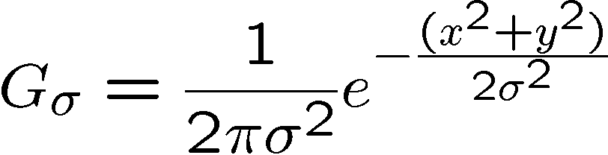
Important filter: Gaussian
Spatially-weighted average
0.003 0.013 0.022 0.013 0.003
0.013 0.059 0.097 0.059 0.013
0.022 0.097 0.159 0.097 0.022
0.013 0.059 0.097 0.059 0.013
0.003 0.013 0.022 0.013 0.003
5 x 5, σ = 1
Slide credit: Christopher Rasmussen

Slide 29

Smoothing with Gaussian filter

Slide 30
Smoothing with box filter

Slide 31
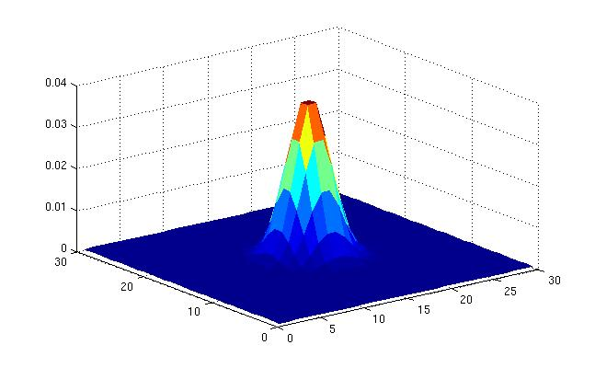
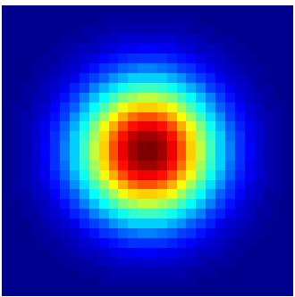
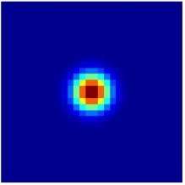
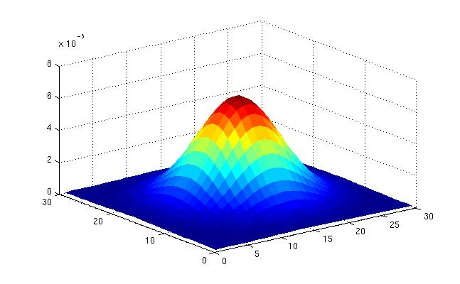
Gaussian filters
What parameters matter here?
Variance of Gaussian: determines extent of smoothing
Source: K. Grauman

Slide 32






Smoothing with a Gaussian
Parameter σ is the “scale” / “width” / “spread” of the Gaussian kernel, and controls the amount of smoothing.
…
Source: K. Grauman

Slide 33
Filter bank

Slide 34
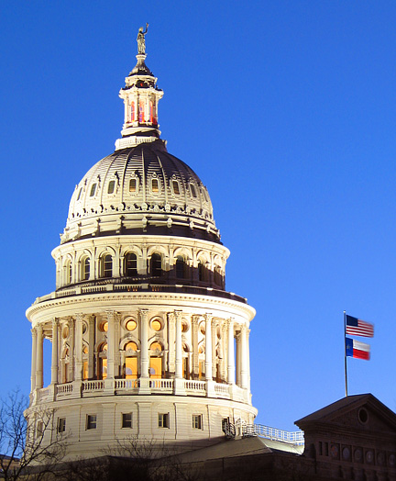
Image from http://www.texasexplorer.com/austincap2.jpg
Kristen Grauman

Slide 35
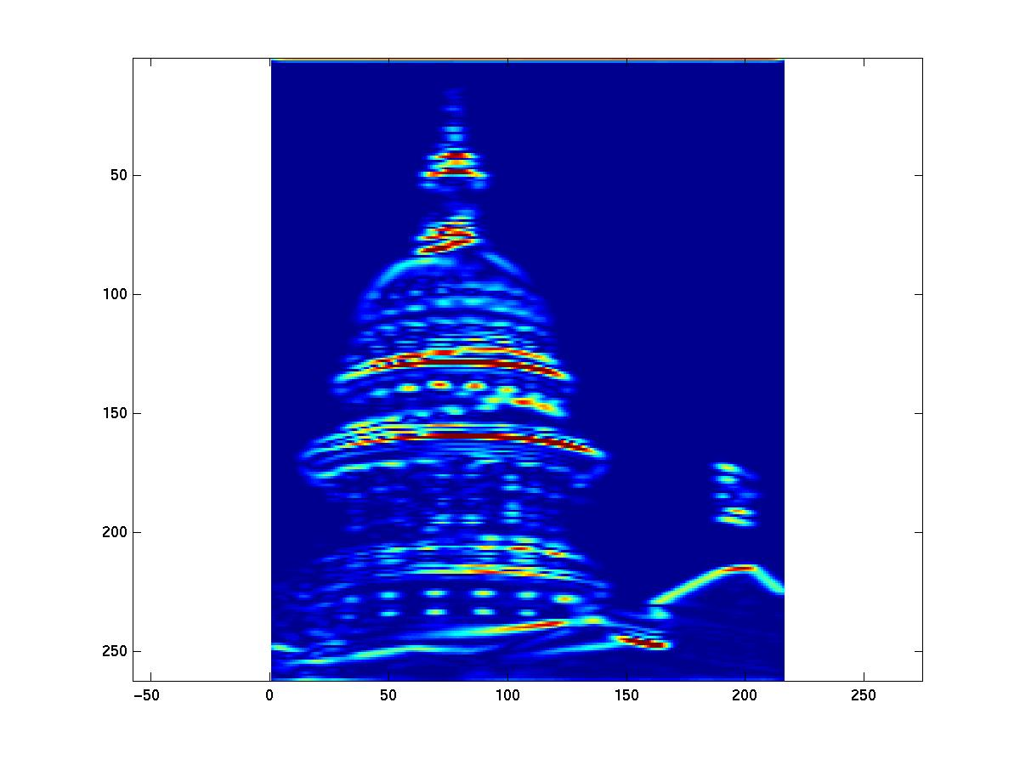
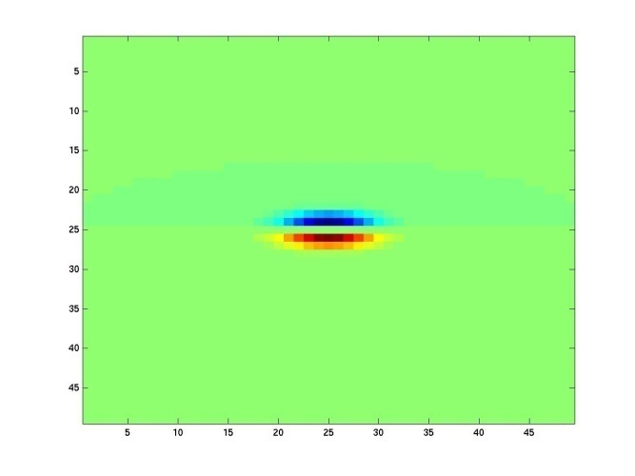
Showing magnitude of responses
Kristen Grauman

Slide 36
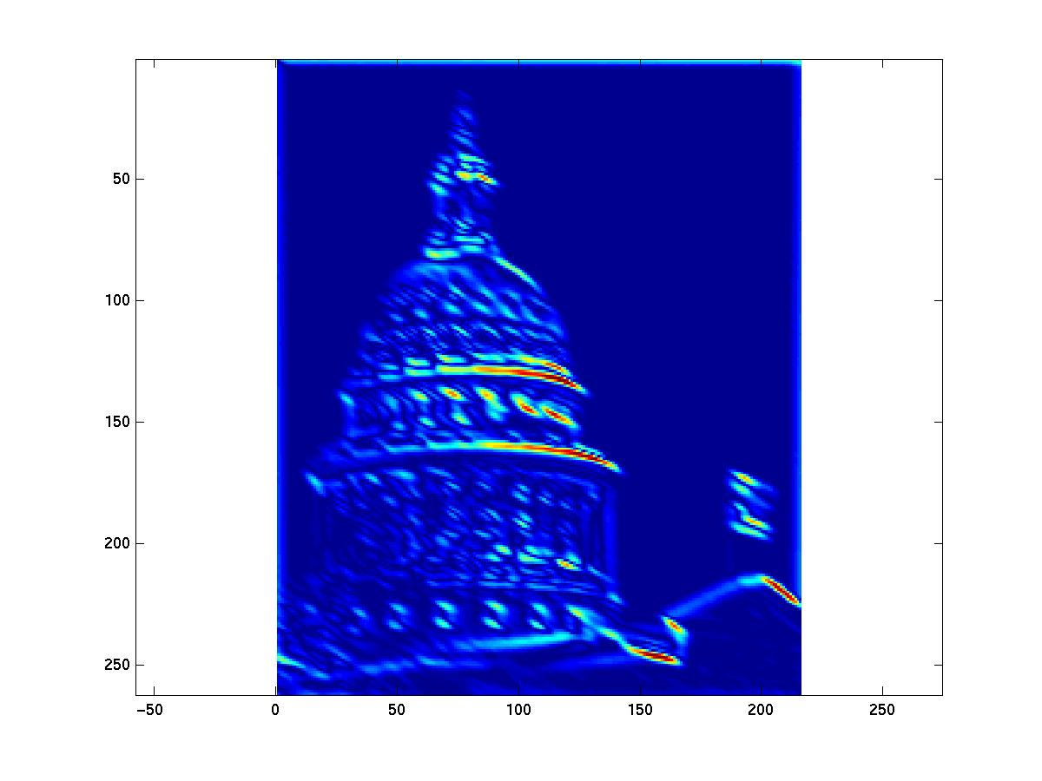
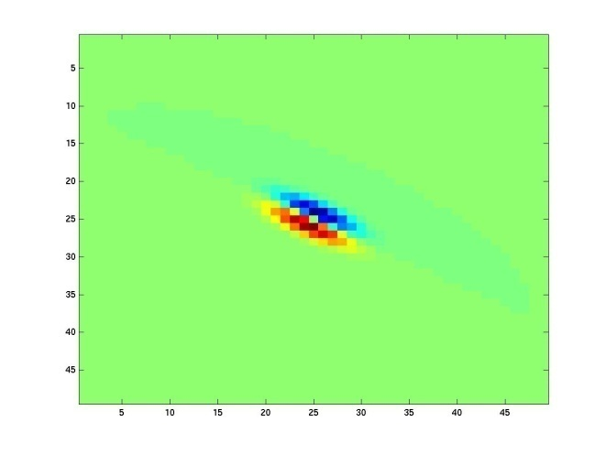
Kristen Grauman
Notes:
2

Slide 37
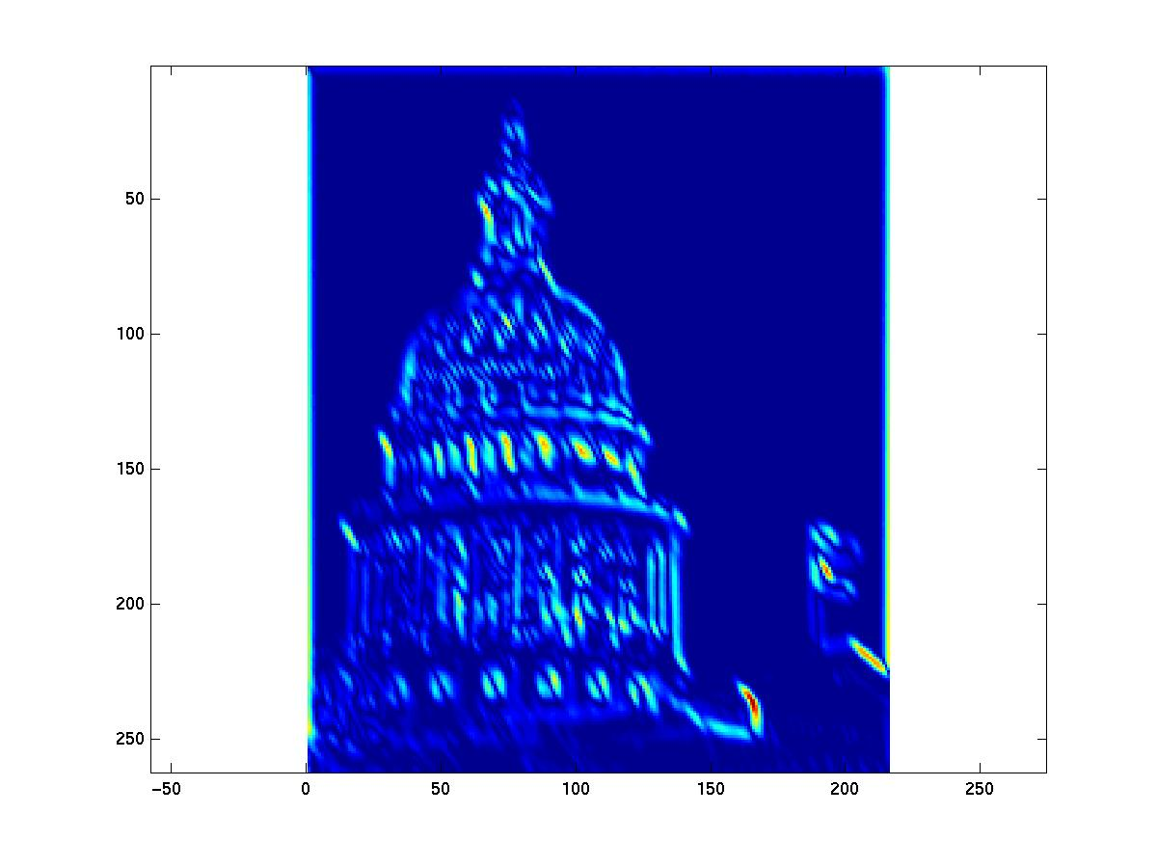
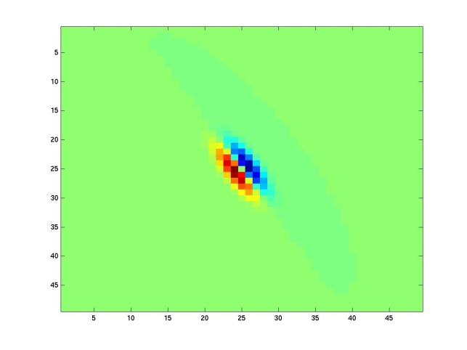
Kristen Grauman
Notes:
3

Slide 38
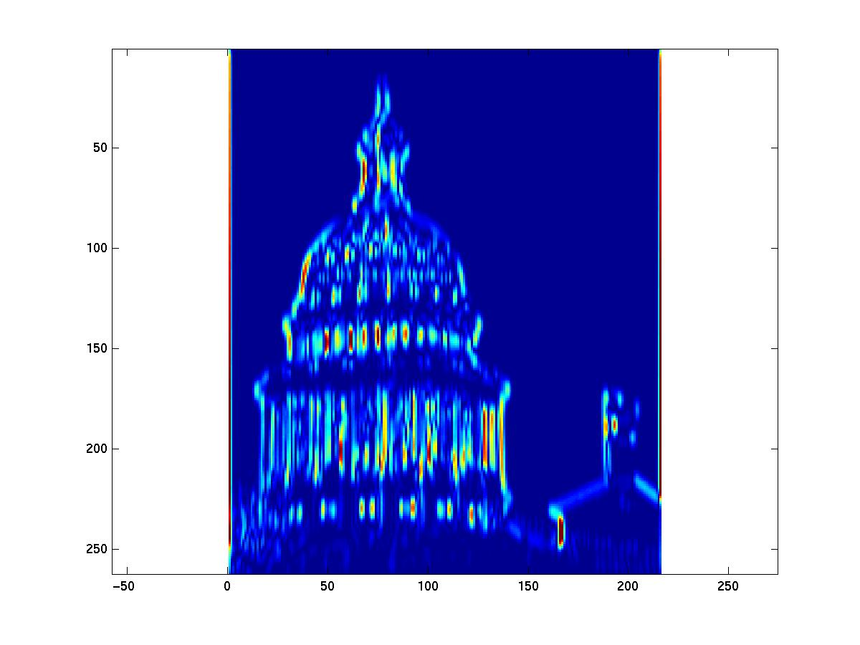
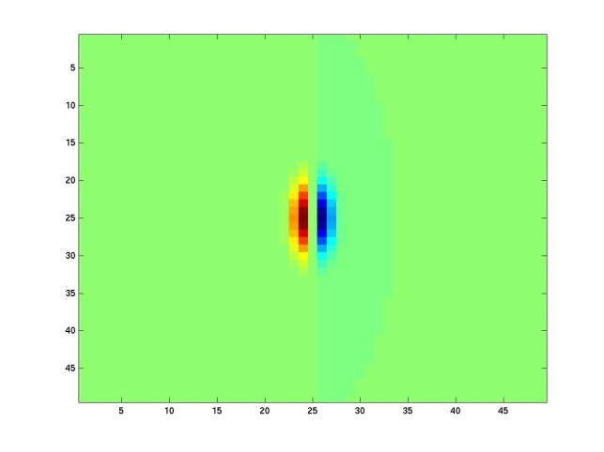
Kristen Grauman
Notes:
4

Slide 39
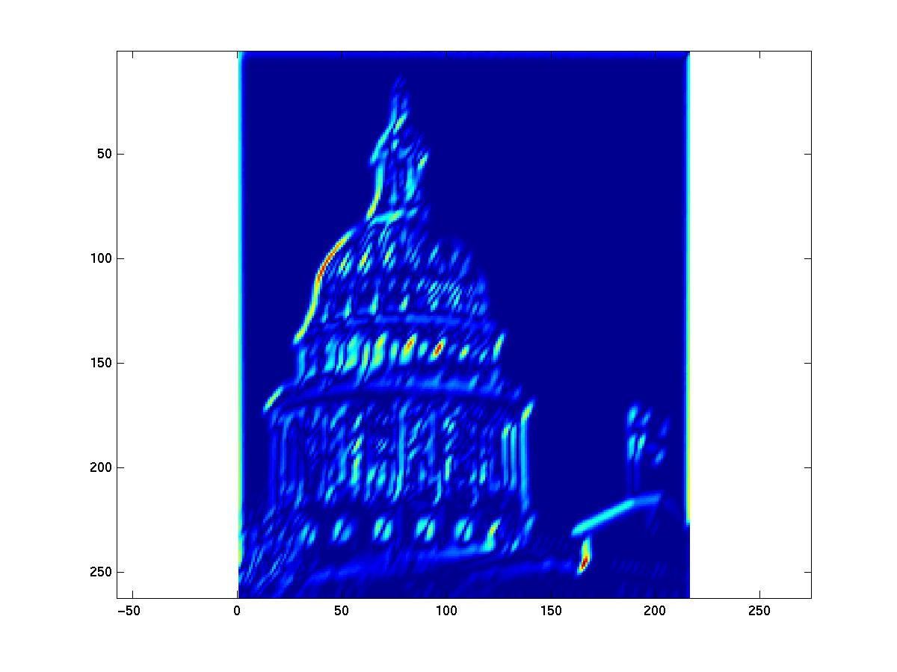
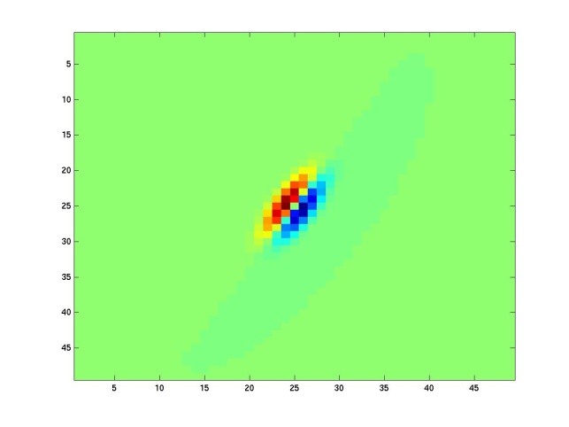
Kristen Grauman

Slide 40
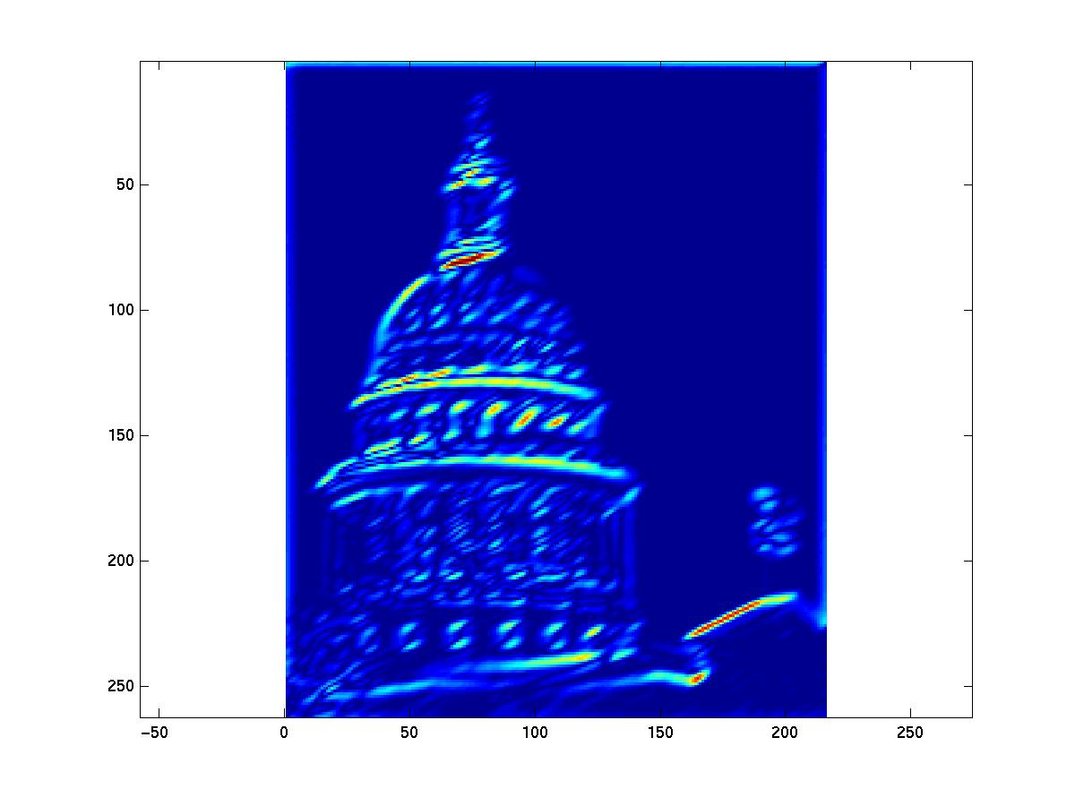
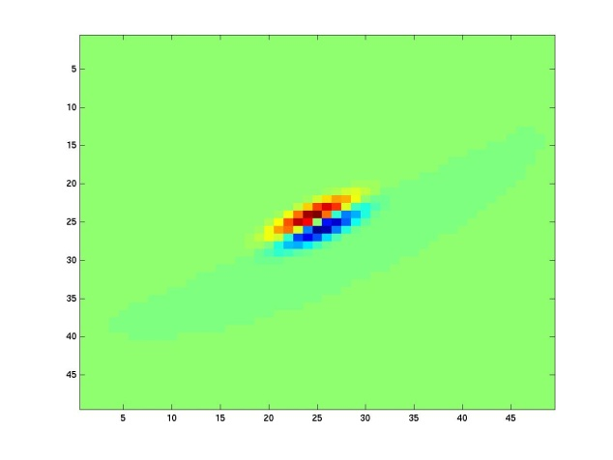
Kristen Grauman
Notes:
6

Slide 41
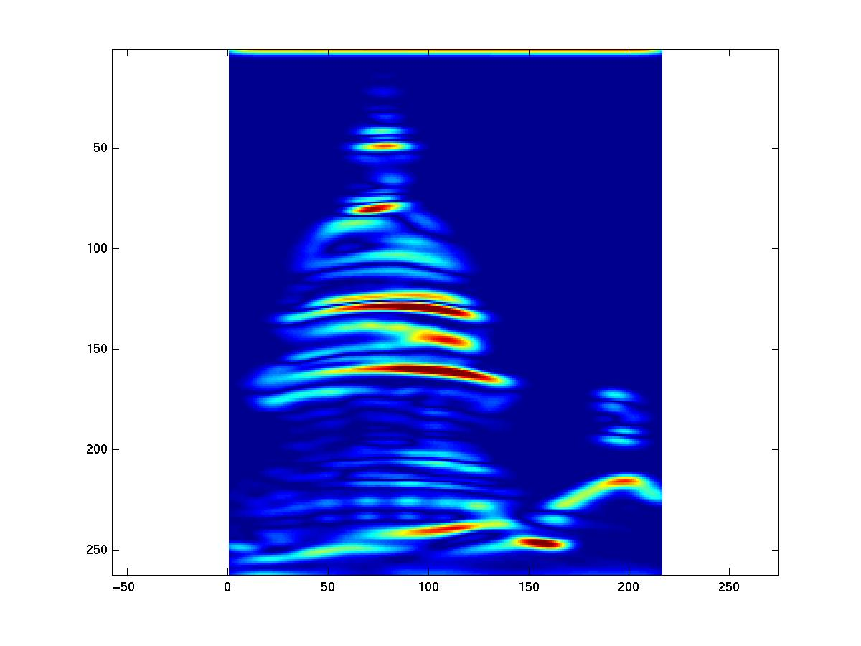
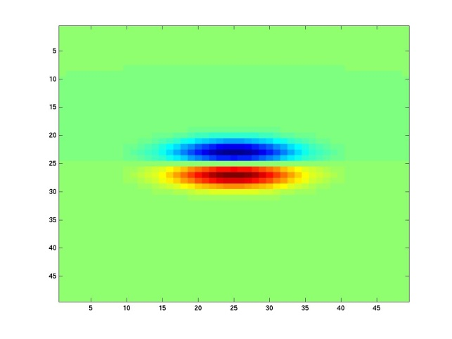
Kristen Grauman
Notes:
7

Slide 42
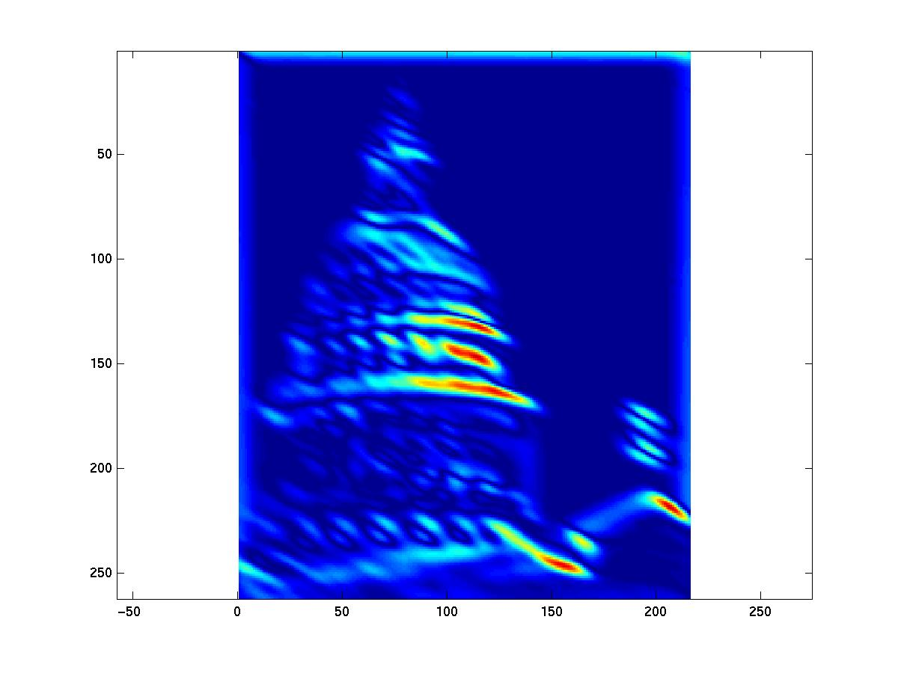
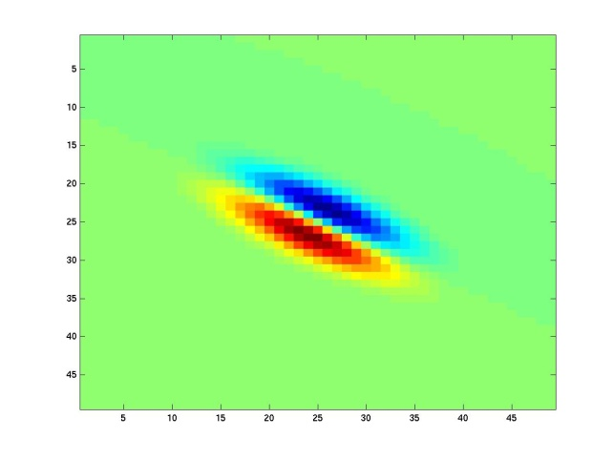
Kristen Grauman
Notes:
8

Slide 43
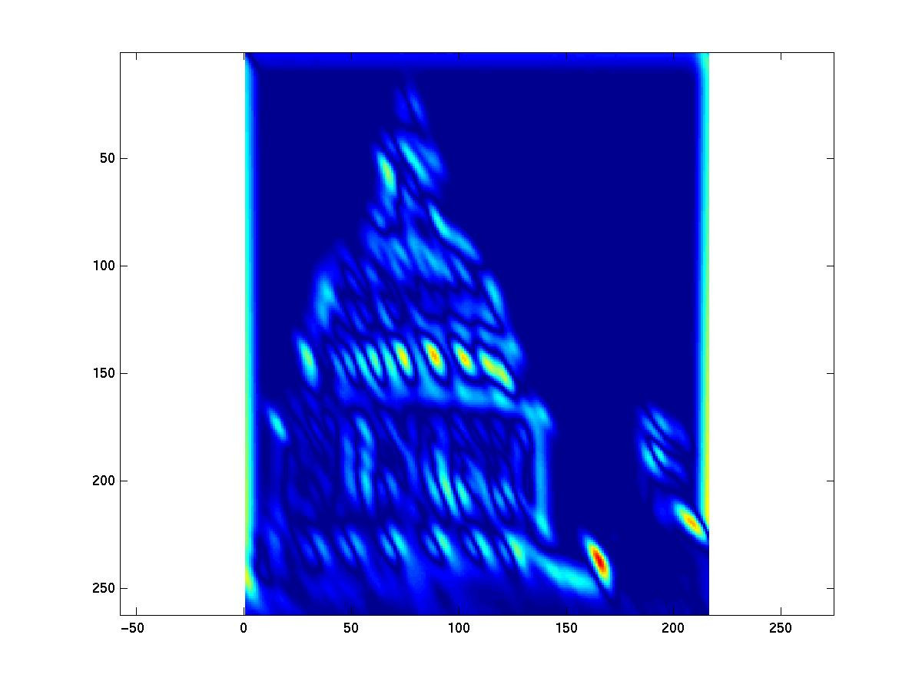
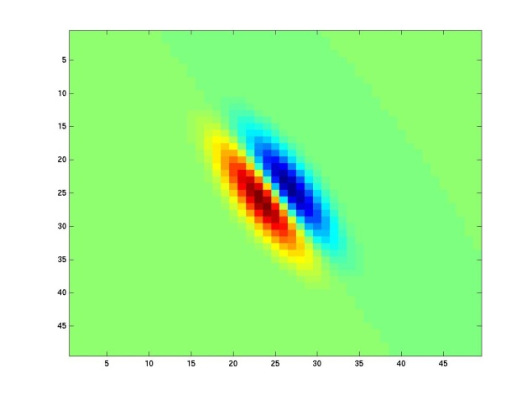
Kristen Grauman
Notes:
9

Slide 44
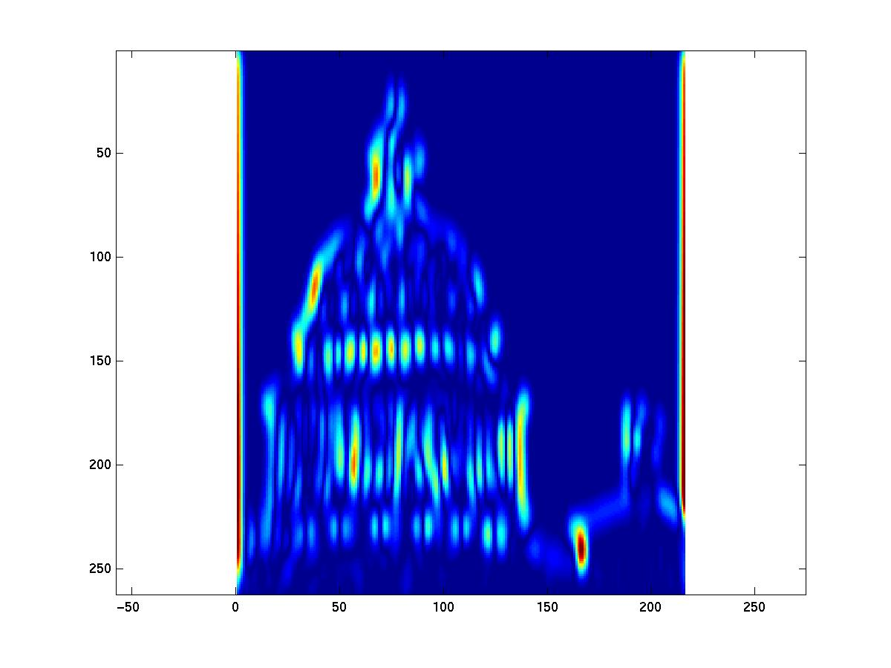
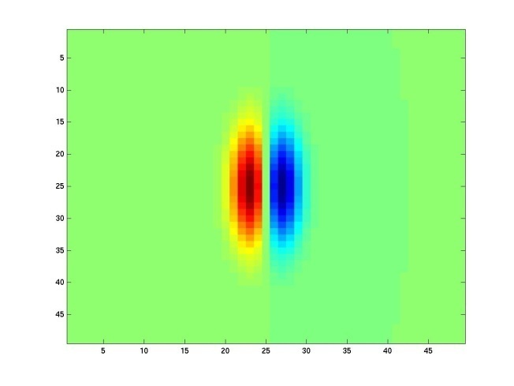
Kristen Grauman
Notes:
10

Slide 45
How can we represent texture?
Measure responses of various filters at different orientations and scales
Idea 1: Record simple statistics (e.g., mean, std.) of absolute filter responses

Slide 46
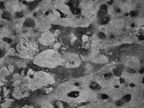
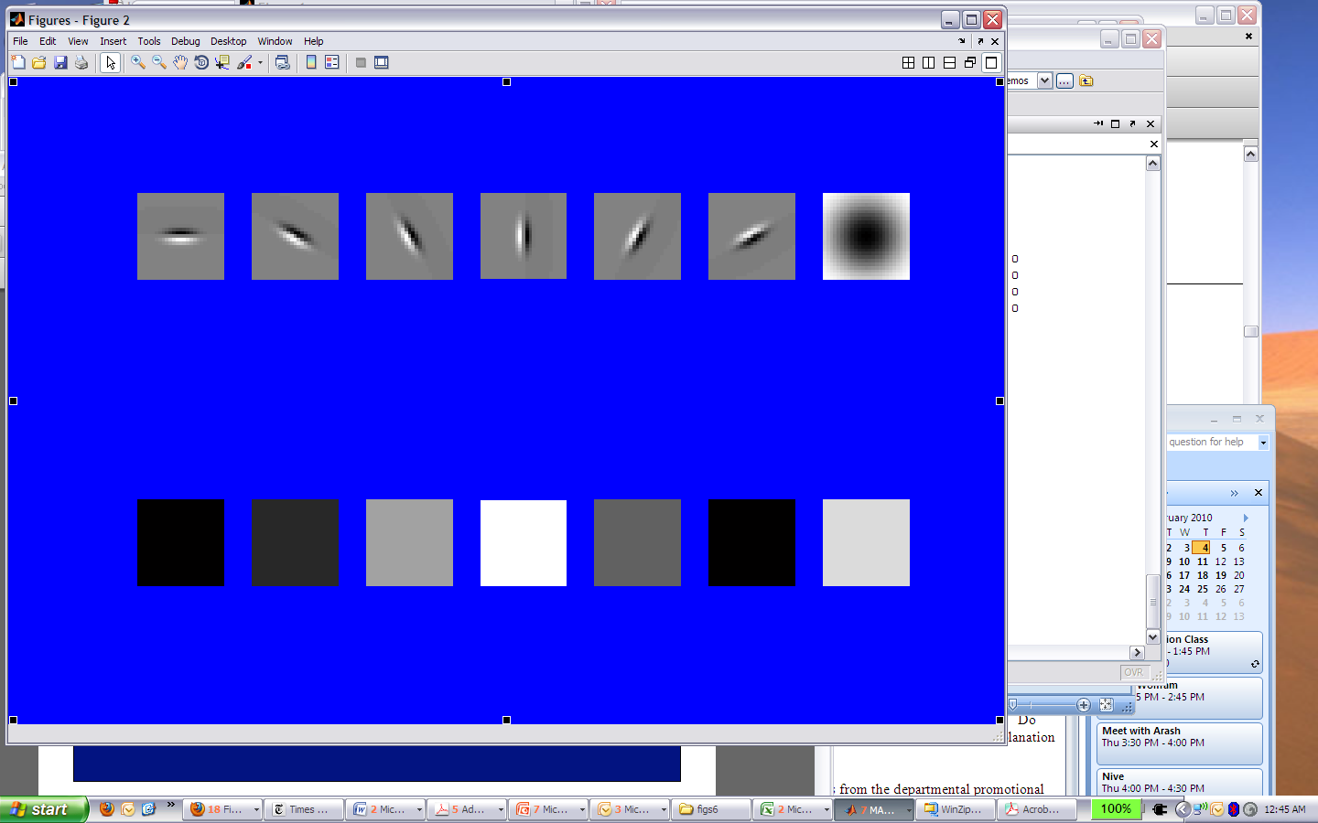
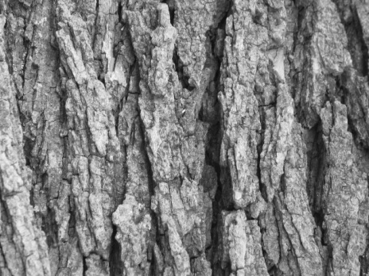
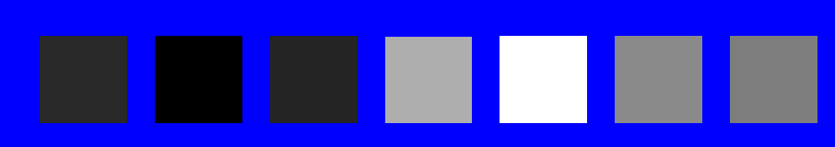
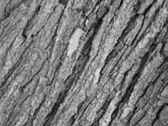

Can you match the texture to the response?
Filters
A
B
1
2
C
3
Mean abs responses

Slide 47

Representing texture by mean abs response
Filters
Mean abs responses

Slide 48


Representing texture
Idea 2: take vectors of filter responses at each pixel and cluster them, then take histograms

Slide 49

Representing texture
clustering

Slide 50

What about Scenes?

Slide 51
Demo : Rapid image understanding
By Aude Oliva
Instructions: 9 photographs will be shown for half a second each. Your task is to memorize these pictures

Slide 52

Credit: A. Torralba

Slide 53

Credit: A. Torralba

Slide 54

Credit: A. Torralba

Slide 55

Credit: A. Torralba

Slide 56

Credit: A. Torralba

Slide 57

Credit: A. Torralba

Slide 58

Credit: A. Torralba

Slide 59

Credit: A. Torralba

Slide 60

Credit: A. Torralba

Slide 62
Which of the following pictures have you seen ?
If you have seen the image clap your hands once
If you have not seen the image do nothing
Memory Test
Credit: A. Torralba

Slide 63

Have you seen this picture ?
Credit: A. Torralba

Slide 64
NO
Credit: A. Torralba

Slide 65

Have you seen this picture ?
Credit: A. Torralba

Slide 66
NO

Slide 67

Have you seen this picture ?

Slide 68
NO

Slide 69

Have you seen this picture ?

Slide 70
NO
Credit: A. Torralba

Slide 71
Have you seen this picture ?

Slide 72
Yes
Credit: A. Torralba

Slide 73

Have you seen this picture ?
Credit: A. Torralba

Slide 74
NO
Credit: A. Torralba

Slide 75
You have seen these pictures
You were tested with these pictures

Slide 76
The gist of the scene
In a glance, we remember the meaning of an image and its global layout but some objects and details are forgotten

Slide 77

Which are the important elements?
Ceiling
Ceiling
Lamp
wall
Light
painting
Door
Door
Painting
mirror
Door
mirror
Wall
Door
Wall
Door
wall
wall
Lamp
phone
Fireplace
Bed
alarm
armchair
armchair
Floor
Side-table
Coffee table
carpet
Different content (i.e. objects), different spatial layout
Notes:
77
Let’s look at some examples,
We have these 3 images. what are the differences between these 3images? Everything is different, the textures are different, the objects are differemt, the space is different, it does not matter what info you use, you will always find differences between these three images.
------------------------------------------------------
one view if we have these images: what makes then diffeent? Evertyhing, the objects, layout,
Obviously objects and spatial layout are very important in distinguishing the differences between different scene types.

Slide 78

Which are the important elements?
cabinets
ceiling
cabinets
ceiling
ceiling
cabinets
cabinets
wall
screen
window
window
window
column
seat
seat
window
seat
seat
window
seat
seat
seat
seat
seat
seat
seat
seat
seat
seat
seat
seat
seat
seat
seat
seat
seat
seat
seat
seat
seat
seat
seat
seat
seat
seat
seat
seat
Similar objects, and similar spatial layout
Different lighting, different materials, different “stuff”
Notes:
78

Slide 79
What can be an alternative to objects?

Slide 80

Holistic scene representation
Shape of a scene
Finding a low-dimensional “scene space”
Clustering by humans
  Split images into groups
  ignore objects, categories

Slide 81


Spatial envelope properties
Naturalness
  natural vs. man-made environments

Slide 82


Spatial envelope properties
Openness
  decreases as number of boundary elements increases

Slide 83


Spatial envelope properties
Roughness
  size of elements at each spatial scale, related to fractal dimension

Slide 84


Spatial envelope properties
Expansion (man-made environments)
  depth gradient of the space

Slide 85


Spatial envelope properties
Ruggedness (natural environments)
  deviation of ground relative to horizon

Slide 86
Scene statistics
DFT (energy spectrum)
  throw out phase function (represents local properties)
Windowed DFT (spectrogram)
  Coarse local information
  8x8 grid for these results

Slide 87

Scene statistics

Slide 88

Scene classification from statistics
Different scene categories have different spectral signatures
  Amplitude captures roughness
  Orientation captures dominant edges

Slide 89

Scene classification from statistics
Open environments have non-stationary second-order statistics
  support surfaces
Closed environments exhibit stationary second-order statistics
a) man-made open environments
b) urban vertically structured environments
c) perspective views of streets
d) far view of city-center buildings
e) close-up views of urban structures
f) natural open environments
g) natural closed environments
h) mountainous landscapes
i) enclosed forests
j) close-up views of non-textured scenes

Slide 90
Learning the spatial envelope
Use linear regression to learn
  DST (discriminant spectral template)
  WDST (windowed discriminant spectral template)
Relate spectral representation to each spatial envelope feature

Slide 91
Learning the spatial envelope
Primacy of Man-made vs. Natural distinction
  Linear Discriminant analysis
  93.5% correct classification
Role of spatial information
  WDST not much better than DST
  Loschky, et al., scene inversion

Slide 92


Learning the spatial envelope
Other properties calculated separately for natural, man-made environments

Slide 93
Spatial envelope and categories
Choose random scene and seven neighbors in scene space
If >= 4 neighbors have same semantic category, image is “correctly recognized”
  WDST: 92%
  DST: 86%

Slide 94

Applications
Depth Estimation (Torralba & Oliva)

Slide 95




Gist descriptor
Oliva and Torralba, 2001
8 orientations
4 scales
x 16 bins
512 dimensions
Similar to SIFT (Lowe 1999) applied to the entire image
M. Gorkani, R. Picard, ICPR 1994; Walker, Malik. Vision Research 2004; Vogel et al. 2004;
Fei-Fei and Perona, CVPR 2005; S. Lazebnik, et al, CVPR 2006; …
Notes:
95
Here is one example of global representation. Most of other approaches follow a very similar structure. The next slide shows why it makes sense.

Slide 96

Gist descriptor

Slide 97
Gist descriptor
V = {energy at each orientation and scale} = 6 x 4 dimensions
80 features
| v_{t} |
PCA
G
Oliva, Torralba. IJCV 2001

Slide 98
Example visual gists
Oliva & Torralba (2001)

Slide 99

Global features
Rob Pepperell
“The viewer is presented with a ‘potential image’, that is, a complex multiplicity of possible images, none of which ever finally resolves”.
Notes:
Pepperell’s paintings and drawings are the result of intensive experimentation in materials and methods designed to evoke a very specific, though elusive, state of mind. The works induce a disrupted perceptual condition in which what we see cannot be matched with what we know. Instead of a recognisable depiction the viewer is presented with — what the art historian Dario Gamboni has called — a ‘potential image’, that is, a complex multiplicity of possible images, none of which ever finally resolves. Engaging in an ongoing dialogue with art of the past, particularly the Baroque and early Cubism, the works on canvas, panel and paper weave a complex web of impossible and contradictory passages suggesting erotic or heroic dramas with both bestial and transcendent overtones. The images, when seen in real life, are compelling and often disturbing despite the traditional aesthetic framework they occupy.

Slide 100

Training images
Abbey
Airplane cabin
Airport terminal
Alley
Amphitheater
Xiao, Hays, Ehinger, Oliva, Torralba; maybe 2010

Slide 101
Training images
Correct classifications
Abbey
Airplane cabin
Airport terminal
Alley
Amphitheater
Xiao, Hays, Ehinger, Oliva, Torralba; maybe 2010

Slide 102
Training images
Correct classifications
Miss-classifications
Monastery
Cathedral
Castle
Abbey
Toy shop
Van
Discotheque
Airplane cabin
Subway
Stage
Restaurant
Airport terminal
Restaurant
patio
Courtyard
Canal
Alley
Harbor
Coast
Athletic
field
Amphitheater
Xiao, Hays, Ehinger, Oliva, Torralba; maybe 2010

Slide 103



Features
Where:
  Interest points
    Corners
    Blobs
  Grid
  Spatial Pyramids
  Global
What: (Descriptors)
  Sift, HOG
  Shape Context
  Bag of words
  Filter banks

Slide 104


Often used features
Scene: GIST, Spatial pyramid BoW
Object: Spatial pyramid BoW, HOG
Material: texture
    Any other cue?
    What about color?

Slide 105



Color Spaces
RGB
HSV
Opponent

Slide 106

Color Descriptors
Opponent color space
intensity information is represented by channel O3
color information is represented by channel O1 and O2
O1 and O2 are invariant to offset

Slide 107
Color Descriptors
RGB color histogram
Opponent O1, O2
Color moments
  Use all generalized color moments up to the second degree and the first order.
  Gives information on the distribution of the colors.

Slide 108
Color Descriptors
RGB-SIFT descriptors are computed for every RGB channel independently
  Normalize each channel separately
  Invariant to light color change
rg-SIFT - SIFT descriptors over to r and g channels of the normalized-RGB space (2x128 dimensions per descriptor)
OpponentSIFT - describes all the channels in the opponent color space
C-SIFT - Use O1/O3 and O2/O3 of the opponent color space
(2x128 dimensions per descriptor)
  Scale-invariant with respect to light intensity.
  Due to the definition of the color space, the offset does not cancel out when taking the derivative
  G. J. Burghouts and J. M. Geusebroek
  Performance evaluation of local color invariants 2009

Slide 109





Color Descriptors
Studies the invariance properties and the distinctiveness of color descriptors
Light color change | Light intensity change
Light color change and shift | Light intensity shift
 | Light intensity shift and change

Slide 110

Color Descriptors

Slide 111



Color Descriptors

Slide 112



Color Descriptors
Increased invariance can reduce discriminative power

Slide 113

Color Descriptors
Descriptor performance on image benchmark

Slide 114







Color Descriptors

Slide 115

What about motion?

Slide 116
Motion and perceptual organization
Sometimes, motion is the only cue

Slide 117

Motion and perceptual organization
Even “impoverished” motion data can evoke a strong percept

Slide 118
Motion and perceptual organization
Even “impoverished” motion data can evoke a strong percept

Slide 119

Video
A video is a sequence of frames captured over time
Now our image data is a function of space
(x, y) and time (t)

Slide 120


Slide 122
Motion estimation techniques
Feature-based methods
  Extract visual features (corners, textured areas) and track them over multiple frames
  Sparse motion fields, but more robust tracking
  Suitable when image motion is large (10s of pixels)
Direct methods
  Directly recover image motion at each pixel from spatio-temporal image brightness variations
  Dense motion fields, but sensitive to appearance variations
  Suitable for video and when image motion is small

Slide 123

Feature-based matching for motion
Time t
Time t+1
(Tx,Ty)
(Hx,Hy)

Slide 124

Tracked Points
Matikainen et al. 2009
Notes:
Point tracks reflect long-term motions

Slide 125


Optical flow
How to estimate pixel motion from image H to image I?
  Solve pixel correspondence problem
    given a pixel in H, look for nearby pixels of the same color in I
Key assumptions
  color constancy: a point in H looks the same in I
    For grayscale images, this is brightness constancy
  small motion: points do not move very far
This is called the optical flow problem

Slide 126

What is Optical Flow?
Optical Flow
Velocity vectors

Slide 127

Efros et al. 2003

Slide 128

Block-based motion prediction
Break image up into square blocks
Estimate translation for each bloc

Slide 129
How to describe a video?

Slide 130
Video Descriptors
Where:
Interest points
Grid
What:
Descriptors

Slide 131





Space-Time Features: Detector
• Space-time corner detector
[Laptev, IJCV 2005]
• Dense scale sampling (no explicit scale selection)

Slide 132
Space-Time Interest Points
Consider a synthetic sequence of a ball moving towards a wall and colliding with it
An interest point is detected at the collision point

Slide 133
Space-Time Interest Points
Consider a synthetic sequence of 2 balls moving towards each other
Different interest points are calculated at different spatial and temporal scales
coarser scale

Slide 134

Representing Motion
Space-Time Interest Points
Corner detectors in space-time
Laptev 2005

Slide 135

Space-Time Interest Points
Laptev 2005
Notes:
Detect interest points in time and position

Slide 136


Spatio-Temporal grids
In the spatial domain:
  1x1 (standard BoF)
  2x2, o2x2 (50% overlap)
  h3x1 (horizontal), v1x3 (vertical)
  3x3
In the temporal domain:
  t1 (standard BoF), t2, t3
• • •

Slide 137
Video Descriptors
Where:
Interest points
Grid
What:
Descriptors

Slide 138


Video Descriptors
Space-Time SIFT
64-directions histogram
P. Scovanner, S. Ali, M. Shah
A 3-dimensional sift descriptor and its application to action recognition - 2007

Slide 139

Space-Time Features: Descriptor
Multi-scale space-time patches from corner detector
Histogram of oriented spatial grad. (HOG)‏
Histogram of optical flow (HOF)‏
•
Public code available at www.irisa.fr/vista/actions
3x3x2x4bins HOG descriptor
3x3x2x5bins HOF descriptor

Slide 140


Space-Time Volumes
Blank et al. 2005

Slide 141

3D Shape Context
Represent an action in a video sequence by a 3D point cloud extracted by sampling 2D silhouettes over time
M. Grundmann, F. Meier, and I. Essa (2008) “3D Shape Context and Distance Transform for Action Recognition”

Slide 142











Bag of space-time features
Collection of space-time patches
Histogram of visual words
HOG & HOF
patch descriptors
Visual vocabulary
[Schuldt’04, Niebles’06, Zhang’07]

Slide 143


Slide 144






What are the best Features to represent/find furry stuff?

Slide 145






What about Wheel?

Slide 146






What about Wood?c

Slide 147






What about Robin?

