Slide 1
CSE599S
Computing and Global Health – Addressing the global pandemic

Slide 2
Administrivia
M, W, 3:00-4:20, Lowe 101
Expectations
Class readings
Research course topics
Maybe a project
Help with class write up

Slide 3
Computing and global health
Growing work in health information systems to support public health programs in LMICs (Low and middle income countries)
Global development – top down work supported by global organizations, donors and NGOs
ICTD – bottom up technology innovation work

Slide 4
Covid
Global pandemic with substantial regional variation in impact and action
Recognition that the entire world needs to bring Covid under control, but nations target own interests first
Covid mitigation is a mix of policy, technology, and ideology

Slide 5
What I am interested in
What is the role of computing technology in mitigating and understanding covid on a global scale
Emphasis on Developing Countries and how the issues relate to “Global Good” technology solutions

Slide 6
What I am thinking of for this class
Desk research on Computing and Covid
Conduct assessments of various computing challenges for Covid
Produce a write up of what we learn
Reference for others
White paper or position paper
Research Agenda

Slide 7
Topics
Health data reporting
Epidemiological modeling
Immunization logistics
Immunization planning
Vaccine passports
Contact tracing

Slide 8
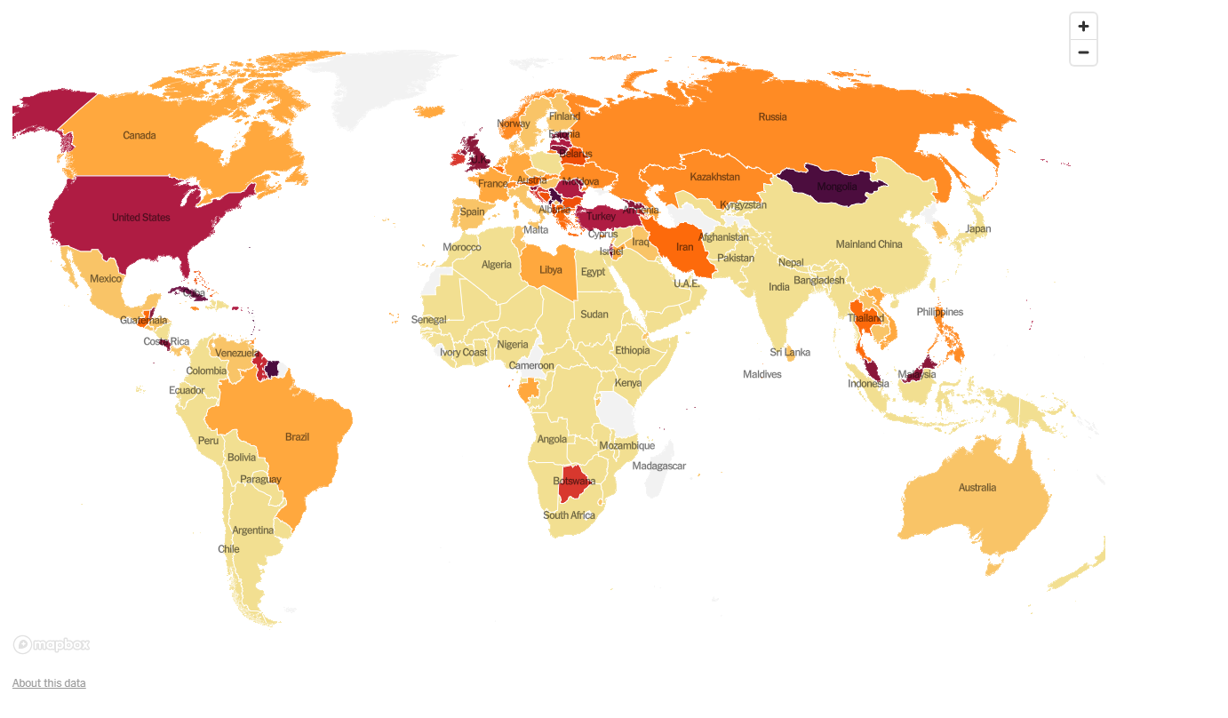
Health data reporting preview
Where does this data come from? Is it meaningful?

Slide 9
Aggregate counting of disease incidence
Standard activity of government health organizations
Used for public health interventions, science, and reporting
Different diseases are handled very differently
Small Pox, Polio, Echinococcosis, Dengue, Malaria, HIV, TB, influenza, rhinovirus
Basic reporting problem
Count cases locally and report up the hierarchy
DHIS2 has become a major system for this (we will talk lots more about this)
Aggregate reporting versus case tracking

Slide 10
Reporting and Covid: Questions
What data do you actually report
What are the main indicators for impact of Covid
How do you assess accuracy and completeness
What are the technologies to use for reporting
What are the other ways of assessing impact
Count of excess deaths
Sampling

