Slide 1
Recitation4 for BigData
MapReduce
Jay Gu
Feb 7 2013

Slide 2
Homework 1 Review
Logistic Regression
  Linear separable case, how many solutions?
Suppose wx = 0 is the decision boundary,
(a * w)x = 0 will have the same boundary, but more compact level set.
wx=0
2wx=0

Slide 3
Homework 1 Review
Sparse level set
wx=0
2wx=0
Dense level set
When Y = 1
When Y = 0
If sign(wx) = y, then Increase w increase the likelihood exponentially.
If sign(wx) <> y, then increase w decreases the likelihood exponentially.
When linearly separable, every point is classified correctly. Increase w will always in creasing the total likelihood. Therefore, the sup is attained at w = infty.

Slide 4
Outline
  Hadoop Word Count Example
  High level pictures of EM, Sampling and Variational Methods

Slide 5
Hadoop
Demo

Slide 6
Fully Observed Model
Latent Variable Models
Parameter unknown.
Parameter and Latent variable unknown.
Frequentist
Not convex, hard to optimize.
Bayesian
“Divide and Conquer”
First attack the uncertainty at Z.
Easy to compute
Next, attack the uncertainty at
Conjugate prior
Repeat…

Slide 7
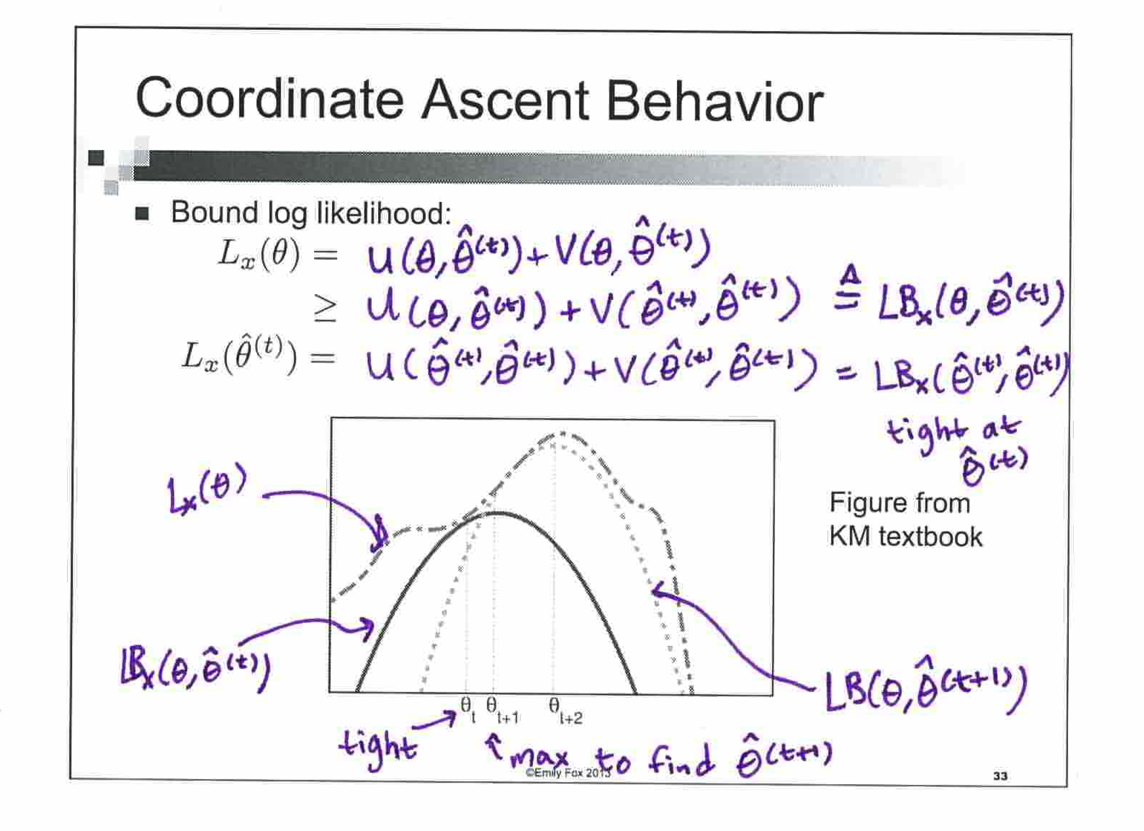
EM: algorithm
Goal:
Draw lower bounds of the data likelihood
Close the gap at current
Move

Slide 8
EM
Treating Z as hidden variable (Bayesian)
But treating as parameter. (Freq)
- More uncertainty, because only inferred from one data
- Less uncertainty, because inferred from all data
What about kmeans?
Too simple, not enough fun
Let’s go full Bayesian!
Notes:
Two folds:
makes the algorithm very easy
Uncertainty of theta is small

Slide 9
Full Bayesian
Treating both as hidden variatables, making them equally uncertain.
Goal: Learn
Challenge: posterior is hard to compute exactly.
Sampling
  Approximate by drawing samples
Variational Methods
  Use a nice family of distributions to approximate.
  Find the distribution q in the family to minimize KL(q || p).

Slide 10
 | EM | Sampling | Variational
Goal | Infer | Approx | Approx
Objective |  | NA
Algorithm complexity | low | Very high | High
Issues | E step may not be tractable depending on how you distinguish the latent variable from the parameters. | Slow mixing rate Hard to validate | Quality of the approximation depends on Q. Complicated to derive

Slide 11
Estep and Variational method
Notes:
l(x | \phi, \pi) &= \sum_z l(x,z|\phi,\pi)\\
&= \sum_z q(z) \frac {l(x,z|\phi,\pi)}{q(z)}\\
& \geq \sum_z q(z) \log \frac{p(z|x,\pi)p(x|\phi)}{q(z)}\\
&= -KL(q || p(z|x,\pi)) + \log p(x|\phi)

Slide 12
Same framework, but different goal and different challenge
In Estep, we want to tighten the lower bound at a given parameter. Because the parameter is given, and also the posterior is easy to compute, we can directly set to exactly close the gap:
In variational method, being full Bayesian, we want
However, since all the effort is spent on minimizing the gap:
In both cases, the L(q) is a lower bound of L(x).

