Slide 1
Assessing the Quality of Actions
By Hamed pirsiavash, Carl Vondrick, and Antonio Torralba
MIT, ECCV 2014
Presentation by Nancy Wang

Slide 2
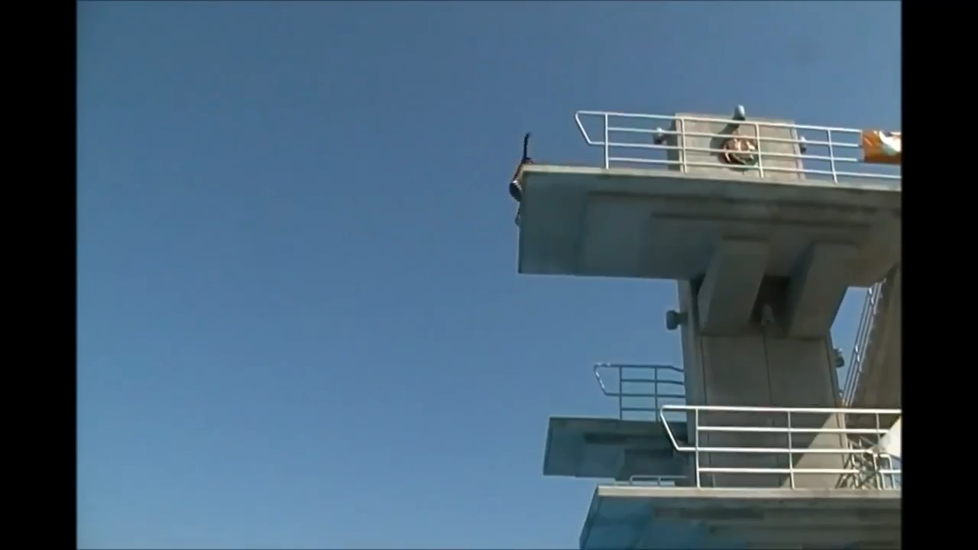
How to automate quality assessment of action performance?

Slide 3
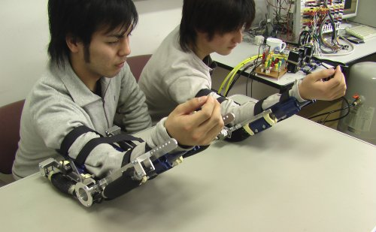
Example Problem Domains
1. Health care: Monitoring patients performing tasks
2. Judged sports

Slide 4
Related work
  No previous work on generic action assessment
  Distinct from action recognition
  Uses some features also used for action recognition

Slide 5
Possible Learning algorithms for quality
  1. Relying on domain knowledge
  -> expensive and hard to scale
2. Prototypical example
-> actions can have multiple prototypes

Slide 6
General approach
Data driven (L-SVR)
Domain-free
Interpretable (Human poses)

Slide 7
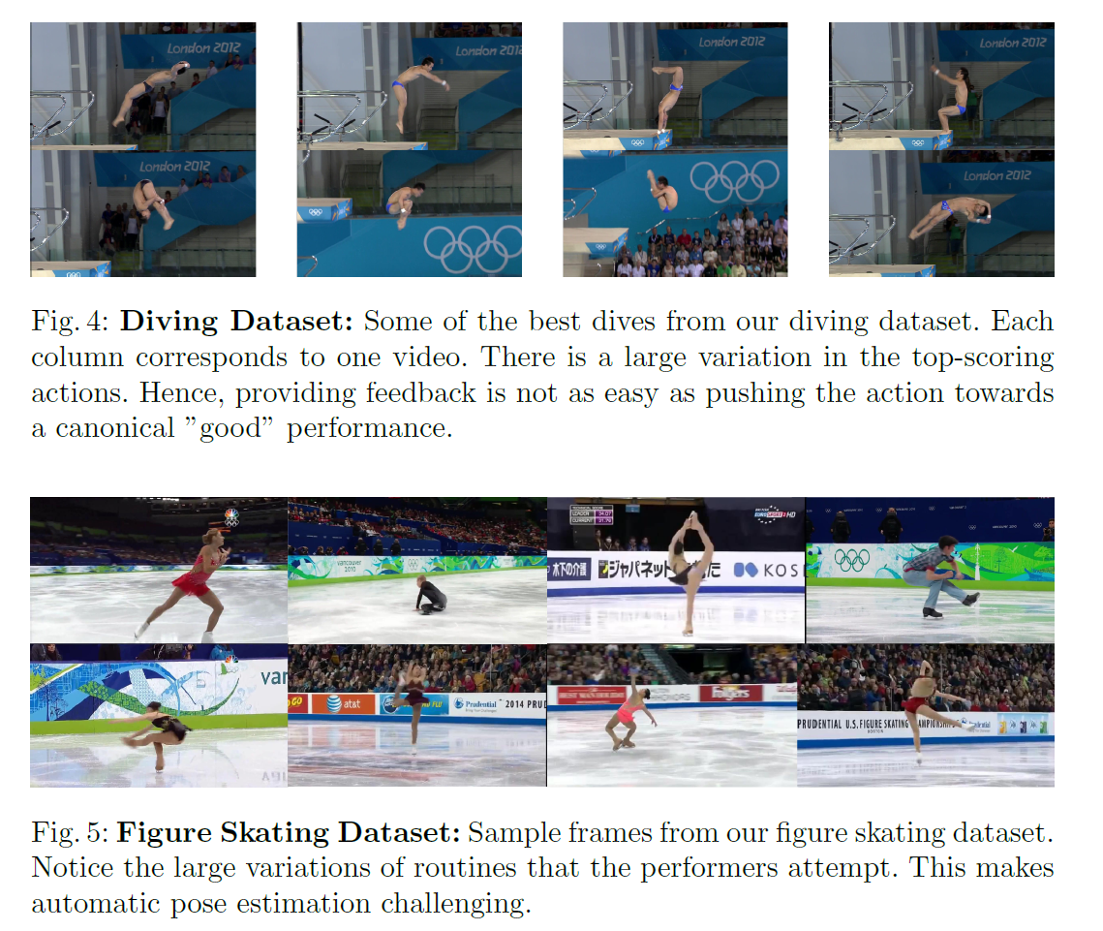
Datasets
Diving Dataset
New Olympic dataset
Diving->159 videos
Figure skating->150 videos
Figure Skating Dataset

Slide 8
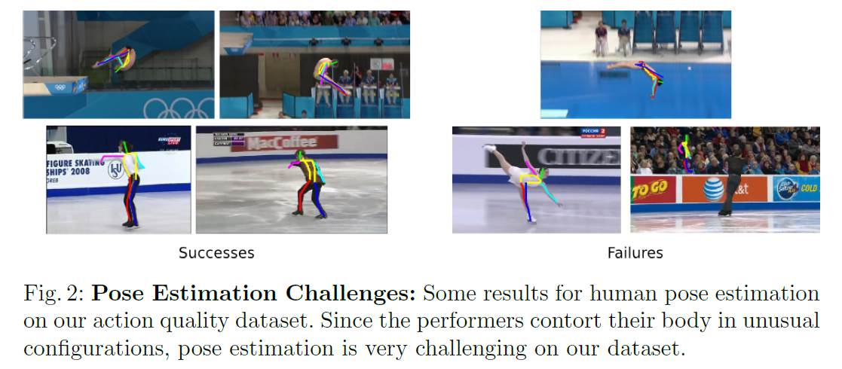
Features from video input
  Low level : Hierarchical feature consisting of spatio-temporal Gabor-like filters
  High level: Low frequencies of DCT/DFT of all joint positions relative to head position
      Obtained from automatic pose estimation of N-best pose solutions per frame to find smoothest track across video

Slide 9
Quality Assessment results
Rank Correlations
Best results in diving-> Pose + DCT using SVR: 0.41
Best results in skating-> Hierarchical using SVR: 0.45
Non-expert annotators: 0.19
Judges: 0.96

Slide 10
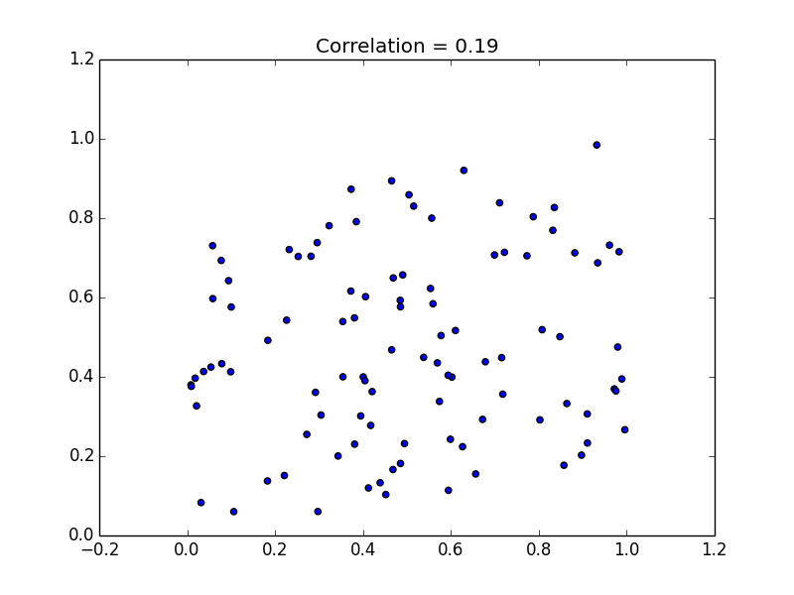
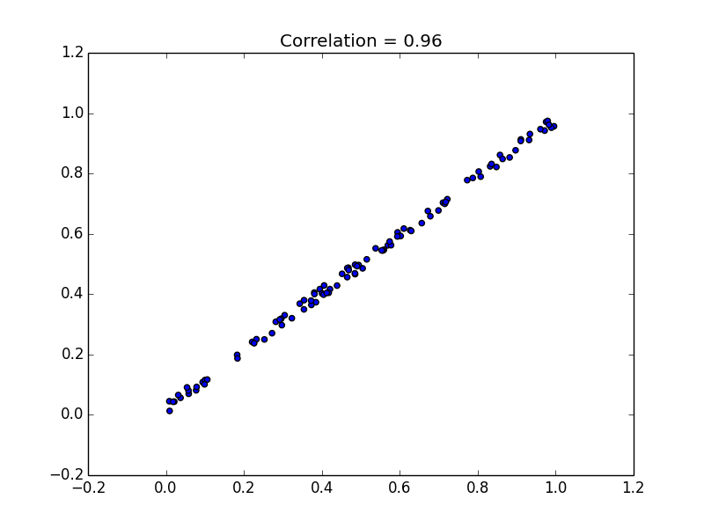
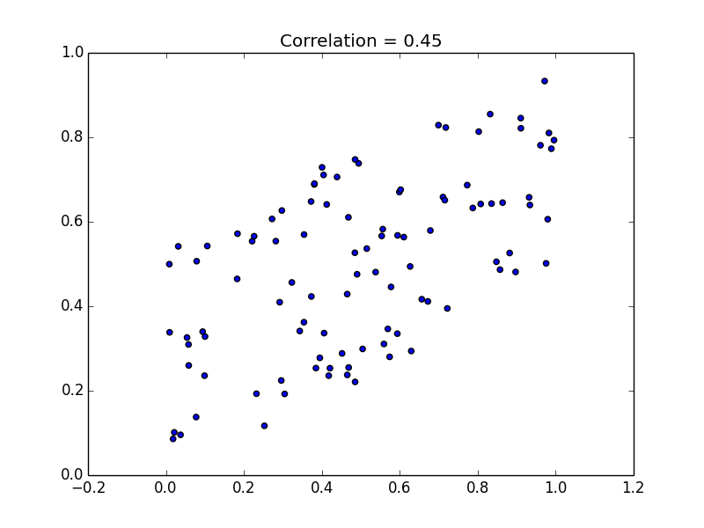
Algorithm
Non-Expert
Judges

Slide 11
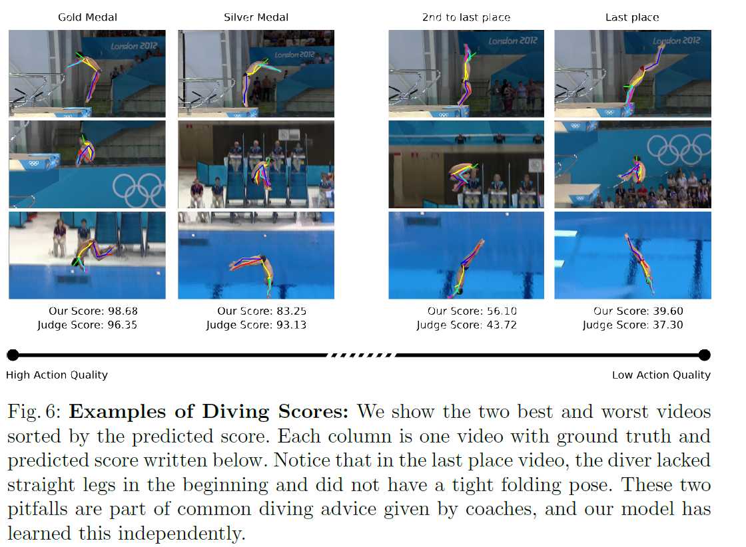
Examples of Diving Scores

Slide 12
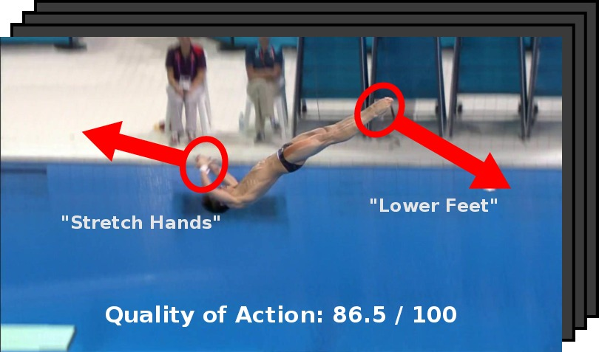

Slide 13
Feedback proposal method
  Gives feedback to performer based on how to move (direction and joint) to maximize score
  Calculate maximum gradient of the score with respect to location of each joint

Slide 14
Feedback proposals
Compared with diving coach feedback
  Coach feedback translated into three classes: adjust upper body, lower body or maintain same pose
  Results: 53.19% vs 27% chance accuracy

Slide 15
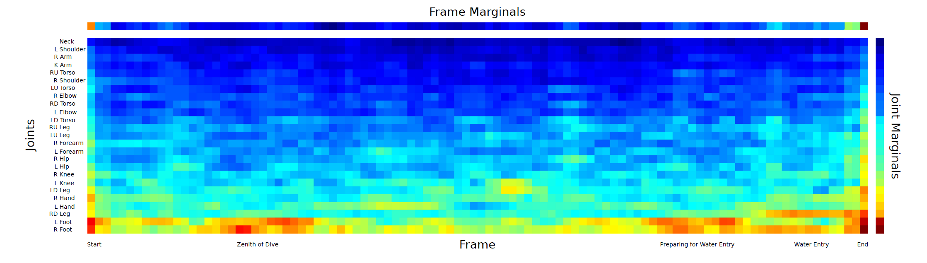
Most common feedback
Diver feet have most suggestions

Slide 17
  Drawback: no model for physical laws

Slide 18
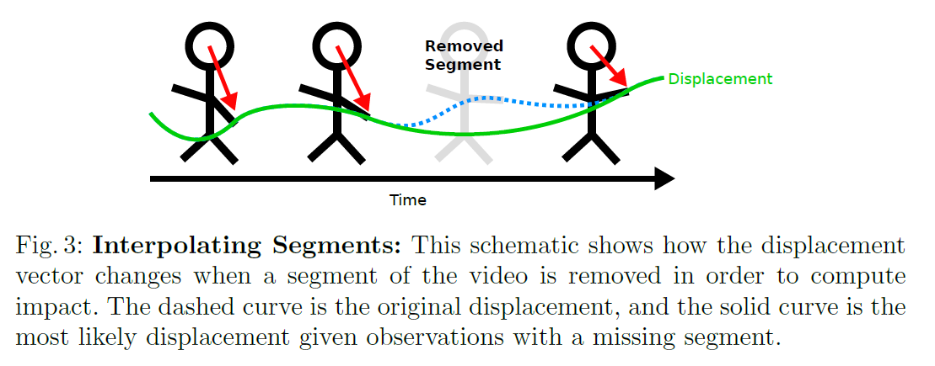
Video Highlights method
Measure impact in removing segment of video by difference in scores

Slide 19
Highlighting video
Useful for video summarization
Finds jumps and twists of figure skater to be most impactful on score

Slide 20
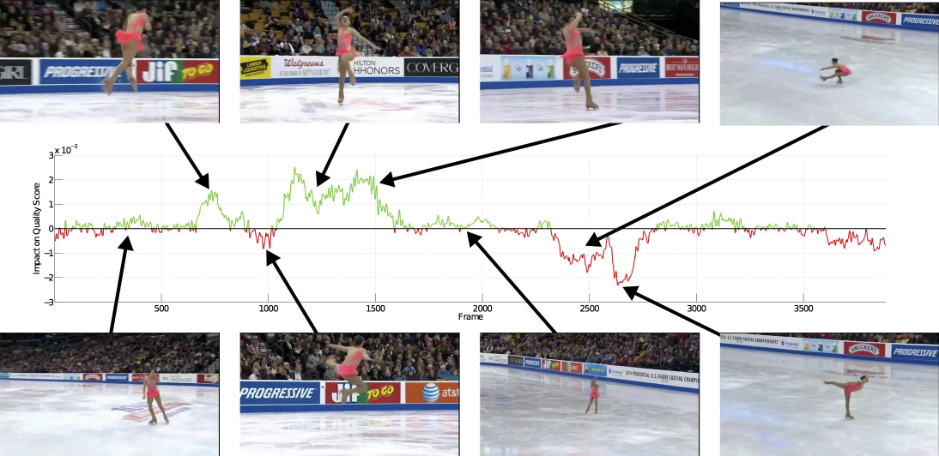

Slide 21
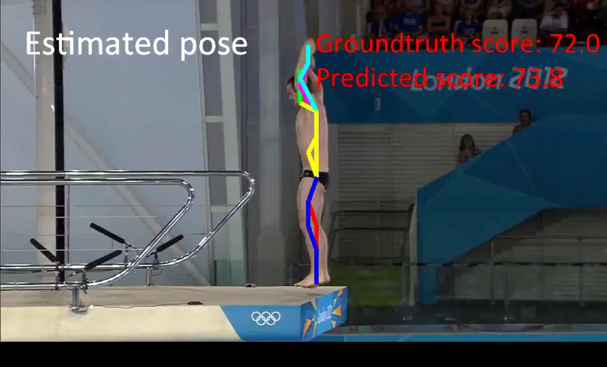
Demonstration of all three results on sample video

Slide 22
Limitations
1. Better pose estimation needed
2. Single human performer only
3. Does not model objects and physical outcomes
4. Does not model joint synchronizations

Slide 23
Discussion
- Lots of potential for improvement
- May still be useful to incorporate some prototypical examples
- Would method still work on videos of variable lengths? Actions with no ordering constraint?

