Slide 1
Pose Estimation and Segmentation of People in 3D Movies
Karteek Alahari, Guillaume Seguin, Josef Sivic, Ivan Laptev
Inria, Ecole Normale Superieure
ICCV 2013
Presented by Yao Lu

Slide 2
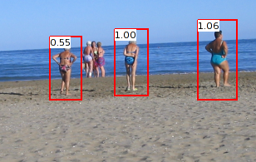
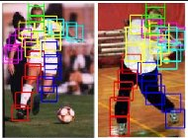
Motivation
We already have person detectors
Also quite good pose detectors
Challenges:
Pixel-wise segmentation of multiple people
Partial occlusion and depth ordering of people. Depth from stereo video is much noisier.

Slide 3
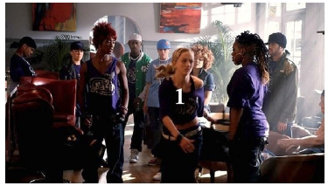
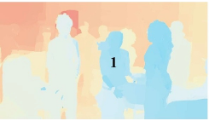
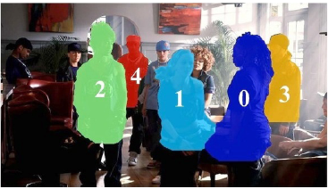
Target
Supervised pixel-wise segmentation and pose estimation of multiple people
Input: disparity RGB camera video
Dataset: from 2 stereoscopic movies

Slide 4
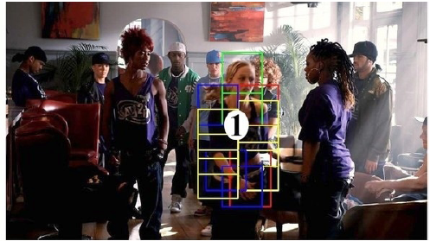
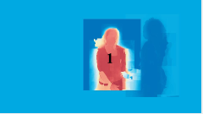
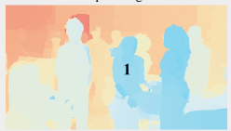
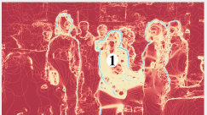
General framework
Given an image, use Felzenswalb’s deformable part model to locate bounding box of human
For each bounding box detected, run an articulated pose detector. [Y. Yang and D. Ramanan, CVPR 2011]
Do pixel-wise segmentation using
different cues.

Slide 5
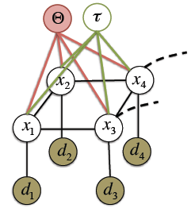
Model for pixel-wise segmentation
Label {0, 1, …, L} for each pixel i. L denotes background
Cost of assigning a pixel
: pose parameters
: disparity parameters

Slide 6
Model
: Unary term. Cost of pixel i taking label xi
: Spatial smoothness cost of assigning label xi and xj to neighboring pixels i and j.
: Temporal smoothness cost.
Goal:
Estimate pose parameters first. Then:

Slide 7
Estimation of Ɵ
To simplify the optimization of the whole cost function
Articulated pose mask
Step 1. Obtain candidate bounding boxes of people using Felzenswalb’s part-based person detector, with HOG feature on grayscale image and disparity maps.
Step 2. Estimate pose within each bounding box using a pose detector [Y. Yang and D. Ramanan, CVPR 2011]

Slide 8
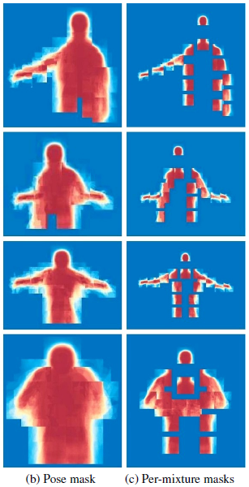
Estimation of Ɵ (cont)
After step 1+2, 18 body parts for each person are located. 10 annotated joints, head, neck, 2 shoulders, 2 elbows, 2 wrists, 2 hips
Each part is characterized by a set of mixtures.
An average mask is obtained for each mixture component from pixel-wise annotation
The value at pixel i: frequency of that pixel belongs to the person
Just limit the detection to the upper body
Then given an estimated pose at test time

Slide 9
Model
: Unary term. Cost of pixel i taking label xi
: Spatial smoothness cost of assigning label xi and xj to neighboring pixels i and j.
: Temporal smoothness cost.
Estimate pose parameters first. Then:

Slide 10
Unary term
Occlusion-based unary costs:
: likelihood of pixel i taking label l.
Use a depth-ordering term
Sufficient confidence for label l
Low evidence for other labels m

Slide 11
Unary term
Define:
: Articulated pose mask already described.
: Disparity potential to encode depth ordering
Set for the background pixels.

Slide 12
Model
: Unary term. Cost of pixel i taking label xi
: Spatial smoothness cost of assigning label xi and xj to neighboring pixels i and j.
: Temporal smoothness cost.
Estimate pose parameters first. Then:

Slide 13
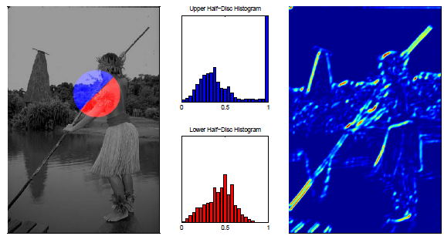
Spatial smoothness cost
Spatial smoothness cost of assigning xi, xj to pixel i, j
d: disparity value
v: motion vector
pb: Pb feature
Pb feature: difference of brightness, color and texture gradients histograms (oriented)
P. Arbelaez, M. Maire, C. Fowlkes, J. Malik. Contour detection
and hierarchical image segmentation. PAMI 2011
Motion vector describes the 2D transformation from a frame to the next. Use block matching.

Slide 14
Temporal smoothness cost
Define temporal smoothness cost as difference of Pb features between pixel i and k connected temporally by the motion vector vi
Put temporal and spatial smoothness cost together we get:

Slide 15
Inference
To infer
Step 1. Estimate optimal disparity parameters for all the people in a frame
Approximate by only using unary term.
Disparity is inversely related to depth and determine front-to-back order of people.
Using this cue to limit searching set.
Step 2. Compute with fixed. for each pixel using α-expansion algorithm.
Y. Boykov, O. Veksler, R. Zabih. Fast approximate energy minimization via graph cuts. PAMI 2001.

Slide 16
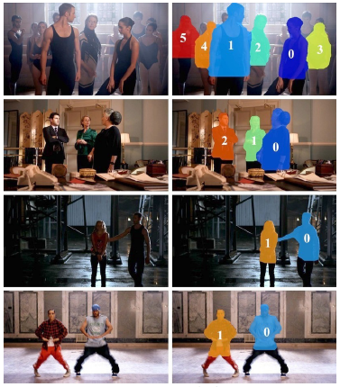
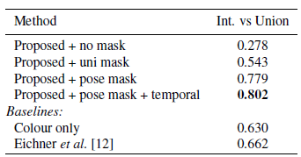
Experiments
Train: 265 frames, 520 bounding boxes and pose. Neg 247 images with no people.
Test for person detection: 193 frames, 638 person bounding boxes
Test for pixel-wise person segmentation: 180 frames, 464 person
Precision = (Detected $∩$ GT)/(Detected U GT)
Speed on a 960*540 frame using Matlab.
13s detect and track people.
8s estimate pose. 30s per frame to segment

