Slide 1
Discrete-Continuous Optimization for Large-scale Structure from Motion
David Crandall, Andrew Owens, Noah Snavely, Dan Huttenlocher
Presented by: Rahul Garg

Slide 2
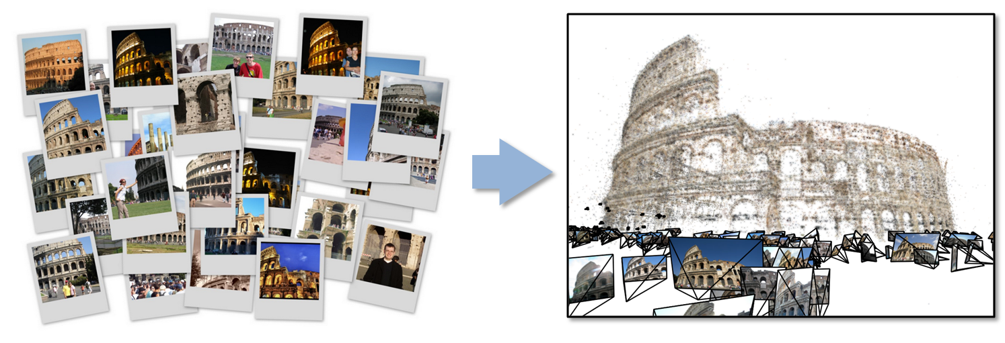
SfM from Internet Images
Recent work has built 3D models from large, unstructured online image collections
[Snavely06], [Li08], [Agarwal09], [Frahm10], Microsoft’s PhotoSynth, …
SfM is a key part of these reconstruction pipelines
[Slide from authors]

Slide 3
Structure from Motion
p₄
p₁
p₃
minimize
p₂
f (R, T, P)
p₅
p₇
p₆
Camera 1
Camera 3
R₁,t₁
R₃,t₃
Camera 2
R₂,t₂
[Slide from authors]
Notes:
Structure from motion solves the following problem:
Given a set of images of a static scene with 2D points in correspondence, shown here as color-coded points, find…
a set of 3D points P and
a rotation R and position t of the cameras that explain the observed correspondences. In other words, when we project a point into any of the cameras, the reprojection error between the projected and observed 2D points is low.
This problem can be formulated as an optimization problem where we want to find the rotations R, positions t, and 3D point locations P that minimize sum of squared reprojection errors f. This is a non-linear least squares problem and can be solved with algorithms such as Levenberg-Marquart. However, because the problem is non-linear, it can be susceptible to local minima. Therefore, it’s important to initialize the parameters of the system carefully. In addition, we need to be able to deal with erroneous correspondences.

Slide 4
Reconstruction pipeline
Feature detection
Feature matching
Find scene points seen by
multiple cameras
Initialization
Robustly estimate camera
poses and/or scene points
Incremental
Bundle Adjustment (IBA)
Bundle adjustment
Refine camera poses R, T
and scene structure P
[Slide from authors]

Slide 5
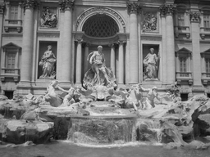
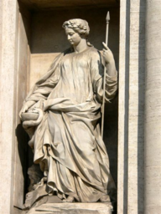
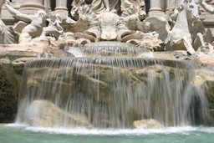
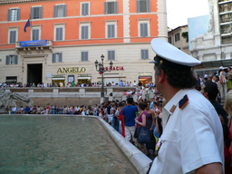
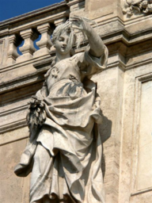
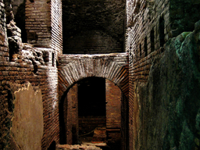
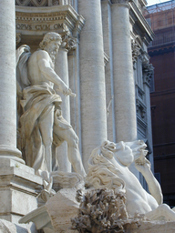
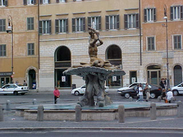
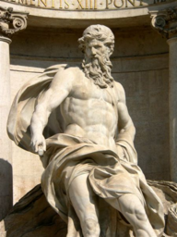
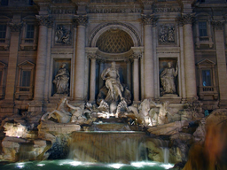
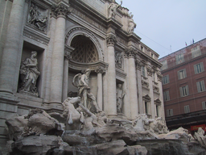
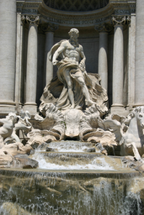
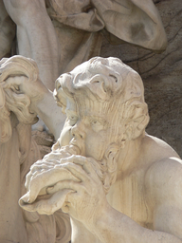
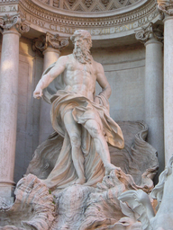
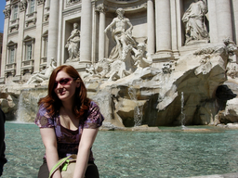
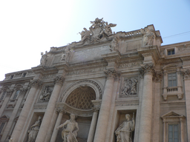
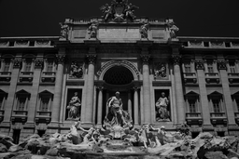
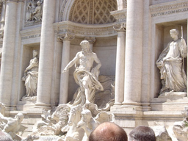
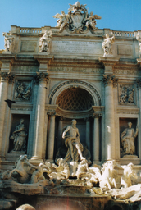
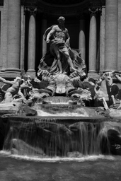
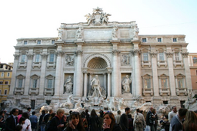
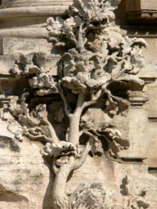
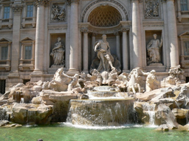
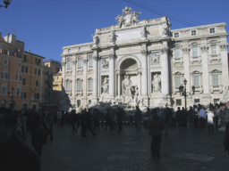
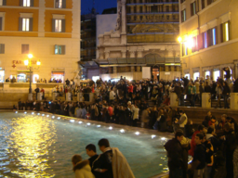
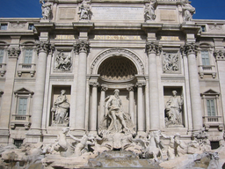
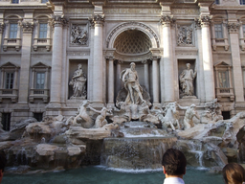
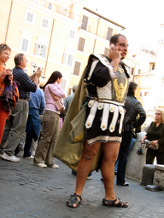
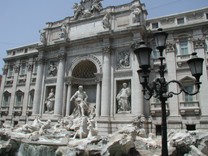
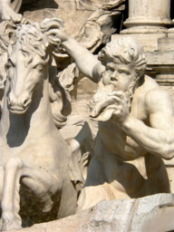
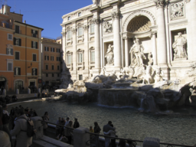
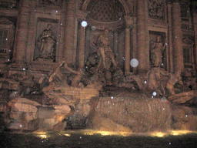
How IBA Works
Image graph with pairwise point correspondences
Notes:
Mention discretization of space
Analogy is not correct. Add additional explanation/figure
IBA on this model – build this model incrementally
Animation showing how IBA works
How will you incorporate GPS info – how will you add in the IBA
See this slide as first showing how IBA works, then ask if how one can do it at once -- MRF’s. Then mention discrete state space is required. R : pan, tilt, twist, T : x, y,z
6 dimensional space – separate into R and T
Mention that we can remove twist and z for translation
Show a twisted image
Have a running counter of number of dimensions as you change the counter
Add points in the animation too
Look into how 3D points can be projected to 2D as well

Slide 6
How IBA Works
R₁, t₁
R₂, t₂
Constraints from
correspondences
Start with a seed pair

Slide 7
How IBA works
R₁, t₁
R₂, t₂
R₃, t₃
Add new cameras to the seed

Slide 8
How IBA works
R₁, t₁
R₂, t₂
(x,y,z)
R₃, t₃
Add new cameras to the seed

Slide 9
How IBA works
R₁, t₁
R₂, t₂
(x,y,z)
R₃, t₃
Also calculate 3D positions of points that cameras see

Slide 10
How IBA works
R₁, t₁
R₂, t₂
(x,y,z)
R₃, t₃
Wiggle solution periodically to get a better solution

Slide 11
How IBA works
R₁, t₁
R₂, t₂
(x,y,z)
R₃, t₃
Wiggle solution periodically to get a better solution

Slide 12
How IBA works
R₁, t₁
R₂, t₂
(x,y,z)
R₃, t₃
Wiggle (Bundle adjust) solution periodically to get a
better solution

Slide 13
How IBA works
R₁, t₁
R₂, t₂
(x,y,z)
R₄, t₄
R₃, t₃
Keep adding more cameras

Slide 14
Problems with IBA
R₁, t₁
R₂, t₂
(x,y,z)
R₄, t₄
R₃, t₃
Incremental, prone to drifts and local minima

Slide 15
Problems with IBA
R₁, t₁
R₂, t₂
(x,y,z)
R₄, t₄
R₃, t₃
Incremental, prone to drifts and local minima

Slide 16
Problems with IBA
R₁, t₁
R₂, t₂
(x,y,z)
R₄, t₄
R₃, t₃
t₄ from GPS
R₄ from Vanishing Points
No easy way to incorporate priors (GPS info, etc.)

Slide 17
Initializing bundle adjustment
Incremental BA
Works very well for many scenes
Poor scalability, much use of bundle adjustment
Poor results if a bad seed image set is chosen
Drift and bad local minima for some scenes
No way to add priors
[Slide from authors]

Slide 18
Our Approach
R₁, t₁
R₂, t₂
(x,y,z)
R₃, t₃
R₄, t₄
Solve for everything simultaneously

Slide 19
Our Approach
Pose the problem as an MRF
Nodes – Cameras and 3D Points
Labels – Discretized Pose and 3D locations
R₁, t₁
R₂, t₂
(x,y,z)
R₃, t₃
R₄, t₄

Slide 20
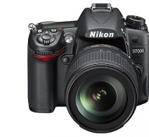
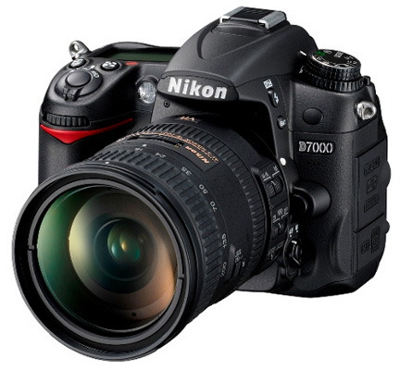
The MRF model
Input: set of images with correspondence
binary constraints: pairwise camera transformations
unary constraints: pose estimates (e.g., GPS, heading info)
3D points can also be modeled
[Slide from authors]
Notes:
Tie to normal MRFs.

Slide 21
Making MRF Tractable
Label Space:
3 unknowns for rotation
3 unknowns for translation
Dimensionality of State space: 6

Slide 22
Making MRF Tractable
First solve for rotation
Label Space:
3 unknowns for rotation
3 unknowns for translation
Dimensionality of State space: 3 + 3

Slide 23
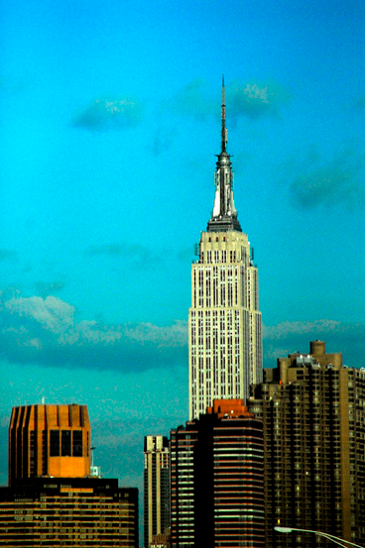
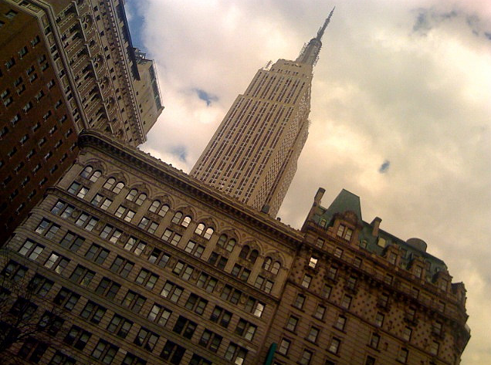
Making MRF Tractable
First solve for rotation
Assume twist = 0
Label Space:
2 unknowns for rotation
3 unknowns for translation
Dimensionality of State space: 2 + 3

Slide 24
Making MRF Tractable
First solve for rotation
Assume twist = 0
Assume cameras are on the ground
Label Space:
2 unknowns for rotation
2 unknowns for translation
Dimensionality of State space: 2 + 2

Slide 25
Making MRF Tractable
First solve for rotation
Assume twist = 0
Assume cameras are near ground
Solve using parallelizable BP on a cluster, use distance transforms to speed up message passing
Label Space:
2 unknowns for rotation
2 unknowns for translation
Dimensionality of State space: 2 + 2

Slide 26
Refining the MRF Solution
Use Non Linear Least Squares to refine the MRF solution (Discrete => Continuous space)

Slide 27
Overall Approach
Pairwise reconstructions, geotags, VPs
Discrete BP optimization over viewing directions
Initial rotations
NLLS refinement of rotations
Discrete BP optimization over 2D translations
Refined rotations
Initial translations, 2D points
NLLS refinement of 3D translations
Initial 3D camera poses, 3D points
[Slide from authors]

Slide 28
SfM on unstructured photo collections
Feature point detection
Image matching
Find scene points seen by
multiple cameras
Discrete optimization over viewing directions
Initialization
Robustly estimate camera
poses and/or scene points
NLLS refinement of rotations
Discrete optimization over 2D translations
Bundle adjustment
Refine camera poses R, T
and scene structure P
NLLS refinement of 3D translations
[Slide from authors]

Slide 29
Experimental results
Evaluated on several Flickr datasets
Download photos (highest resolution available) & geotags (if available)
Removed images with missing EXIF focal lengths
Removed panoramic and high-twist images
[Slide from authors]

Slide 30
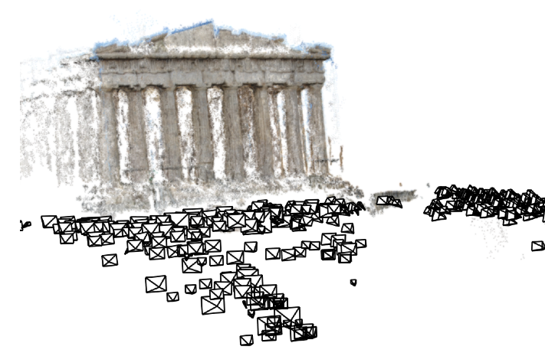
Acropolis Reconstructed images: 454 Edges in MRF: 65,097
Median camera pose difference
wrt IBA: 0.1m
[Slide from authors]

Slide 31
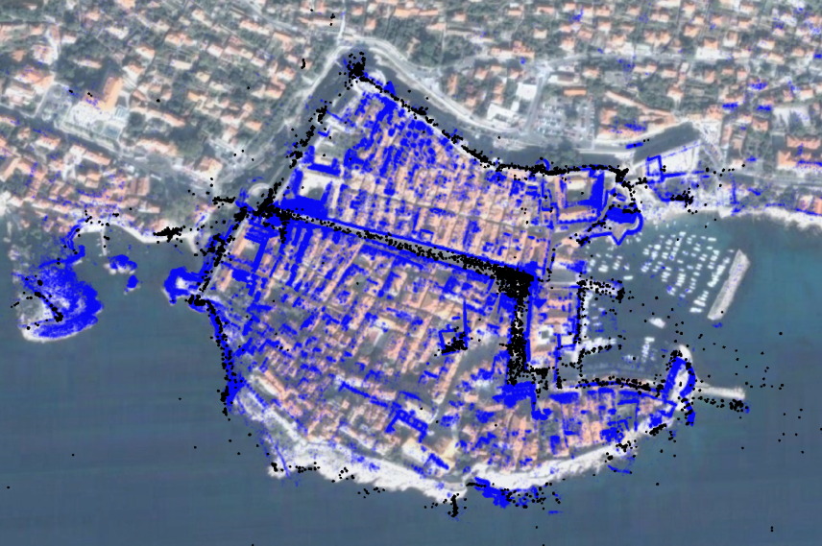
Dubrovnik (Croatia) Reconstructed images: 6,532 Edges in MRF: 1,835,488
Median camera pose difference wrt IBA: 1.0m
[Slide from authors]

Slide 32
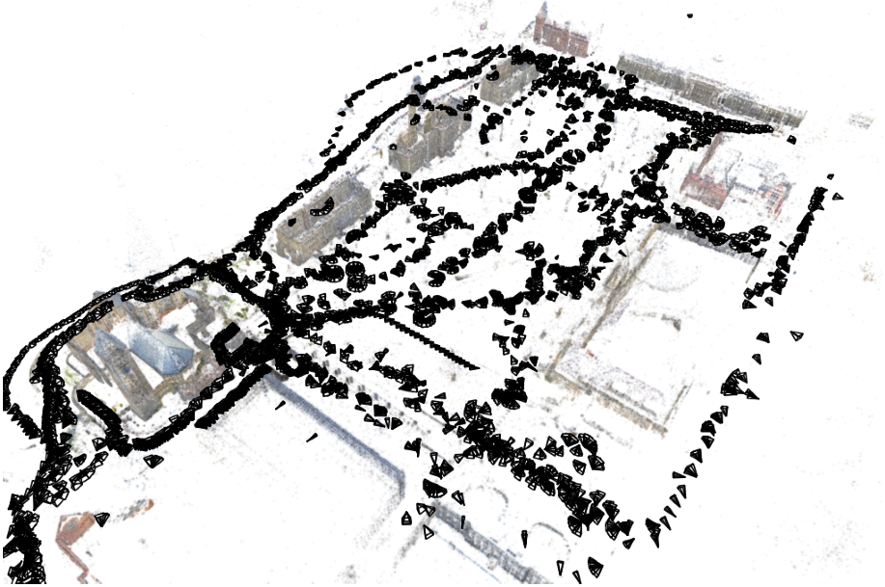
Quad Total images: 6,514 Reconstructed images: 5,233 Edges in MRF: 995,734
Ground truth for 348 cameras
Median error wrt ground truth:
1.16m (vs 1.01 for IBA)
[Slide from authors]
Notes:
Show this slide
Mention this is public

Slide 33
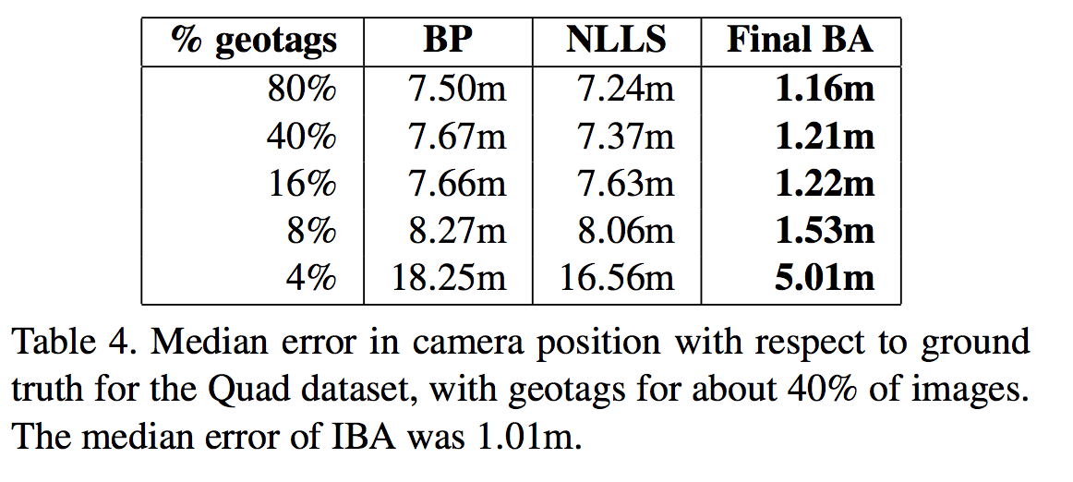
Quad results
[Slide from authors]
Notes:
Show this slide along with the dataset

Slide 34
Central Rome Reconstructed images: 14,754 Edges in MRF: 2,258,416
[Slide from authors]

Slide 35
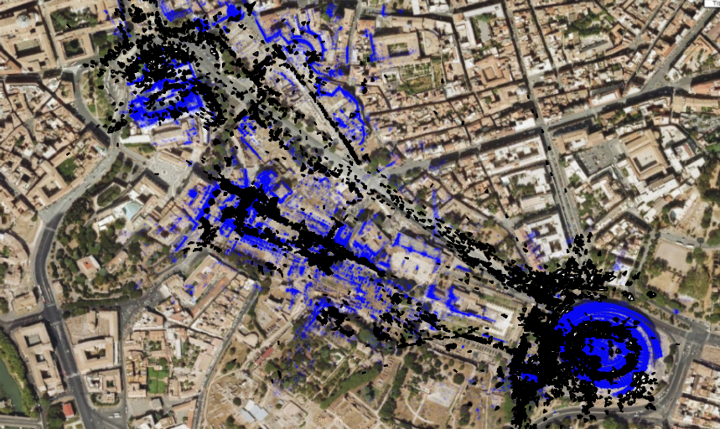
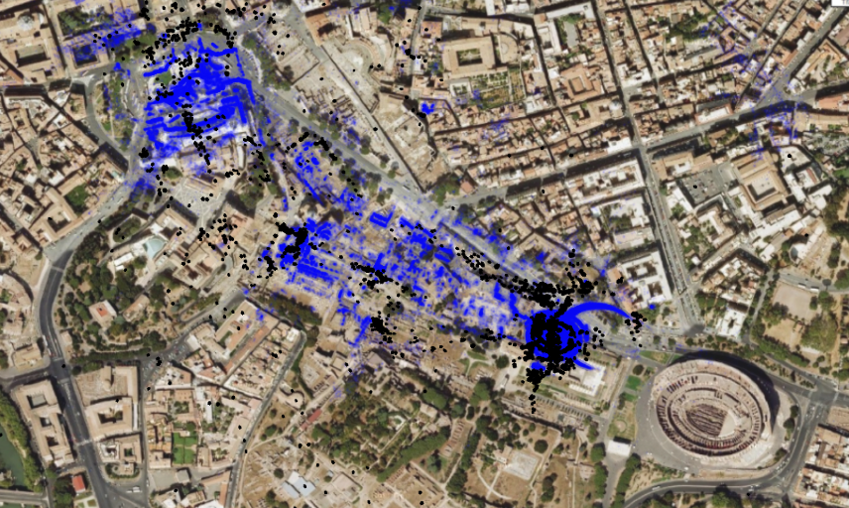
Central Rome Reconstructed images: 14,754 Edges in MRF: 2,258,416
Median camera pose difference
wrt IBA: 25.0m
Our result
Incremental
Bundle Adjustment
[Agarwal09]
[Slide from authors]

Slide 36
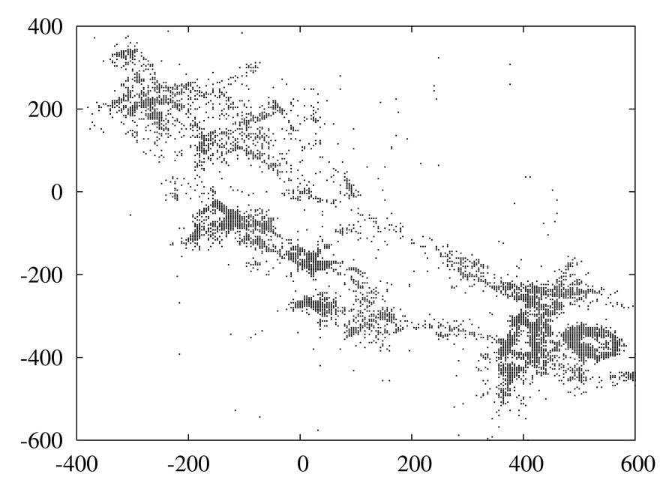
After discrete BP
[Slide from authors]

Slide 37
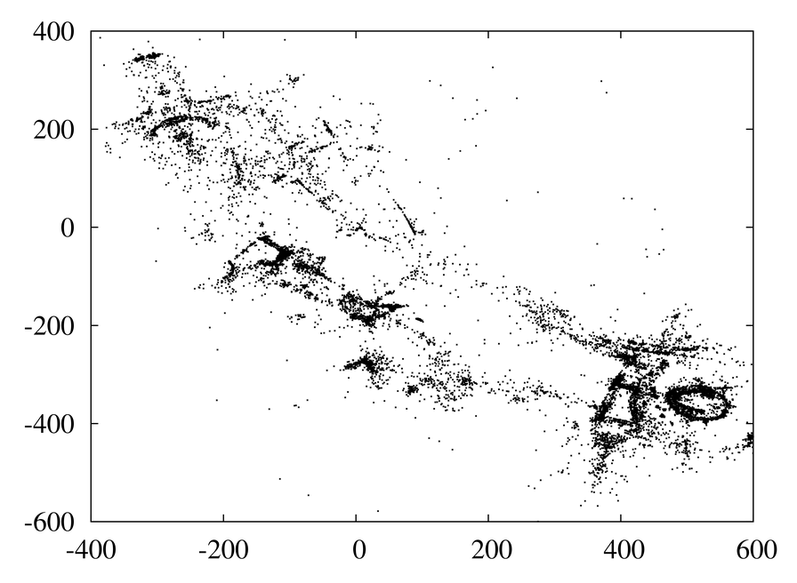
After NNLS
[Slide from authors]

Slide 38
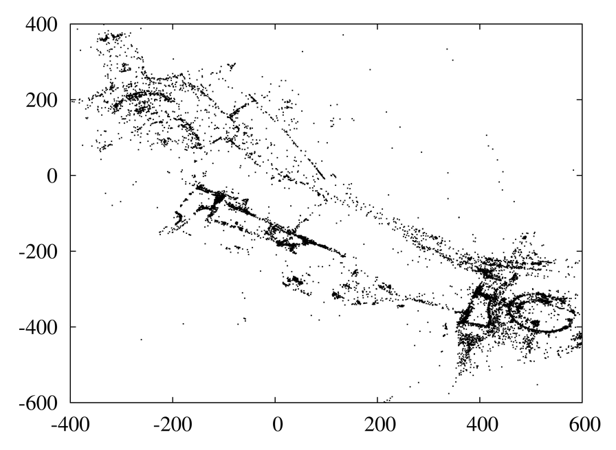
After final BA
[Slide from authors]

Slide 39
Running times
Our results are about as good as or better than IBA, but at a fraction of the computational cost
Favorable asymptotic complexity
BP is easy to parallelize on a cluster, unlike BA
Notes:
Replace by break up times. And the other table. Then have the summary – comparison with IBA

Slide 40
IBA vs Our Approach
IBA
Prone to drift, local minima
Dependent upon seed set
Not robust to outliers
No easy way to add priors (GPS tags, etc.)
Not Parallelizable
Our Approach
Simultaneously solve for global optima
Objective function robust to outliers
Easy to add priors
Parallelizable

Slide 41
Discussion
Pairwise reconstructions, geotags, VPs
Discrete BP optimization over viewing directions
Parallelizable!
Easily incorporates noisy GPS info
Initial rotations
NLLS refinement of rotations
Discrete BP optimization over 2D translations
Refined rotations
Initial translations, 2D points
Non Parallelizable
NLLS refinement of 3D translations
Initial 3D camera poses, 3D points
Notes:
Show it in two steps – show that where this plugs in and that we still need a final BA

Slide 42
Discussion
Two step process for finding R and T. Is that why final BA is required?
Final BA is still the bottleneck – not parallelizable
Notes:
Why is IBA still better? Is it because still separating R and T?
Are intermediate NLLS step needed?

Slide 43
Thank You

Slide 44
References
Photo Tourism: Exploring Image Collections in 3D.
Noah Snavely, Steven M. Seitz, Richard Szeliski. SIGGRAPH 2006
Building Rome in a Day Sameer Agarwal, Noah Snavely, Ian Simon, Steven M. Seitz and Richard Szeliski, ICCV 2009
Building Rome on a Cloudless Day
Jan-Michael Frahm, Pierre Georgel, David Gallup, Tim Johnson, Rahul Raguram, Changchang Wu, Yi-Hung Jen, Enrique Dunn, Brian Clipp, Svetlana Lazebnik, Marc Pollefeys, ECCV 2010

