Slide 1
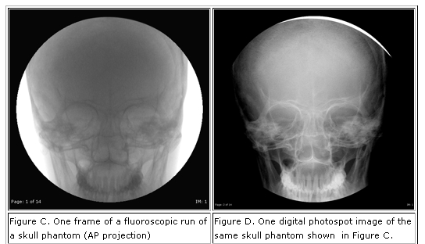
Common Low-level Operations for Processing & Enhancement

Slide 2
Histogram Equalization
A histogram of image I is a data structure h
in which h(i) is the number of pixels in I that
have value i. Usually 0 <= i <= 255.
A normalized histogram is a histogram in which
each value is divided by the total number of
pixels in the image. These normalized values
are often thought of as probabilities Pr(i) of the
different pixel values.

Slide 3
Example of Normalization
3
.3
2 2 2 .2 .2 .2
1 .1
0 1 2 3 4
0 1 2 3 4
original histogram normalized histogram
5 gray tones, 10 pixels probability of each gray tone
What’s the probability of a pixel having value 3 in the image?

Slide 4
Histogram Equalization Operator
Goal: transform the gray tones of the image so that
they are all approximately equally likely
Method: use a transformation function T(r) to
transform each gray tone r of the L gray tones.
r
w=0
T(r) = (L – 1) ∑ Pr(w) discrete form we use
T(r) = (L – 1) Pr(w) dw continous form (CDF)
r
0

Slide 5
Small Example
3
.5
.33
2
.17
1
0 1 2 L = 3 graytones
T(0) = 2(.33) = .66 = 1
T(1) = 2(.33 + .5) = 1.66 = 2
T(2) = 2(.33 + .5 + .17) = 2.0 = 2
Why is the new histogram not a perfect uniform distribution?

Slide 6
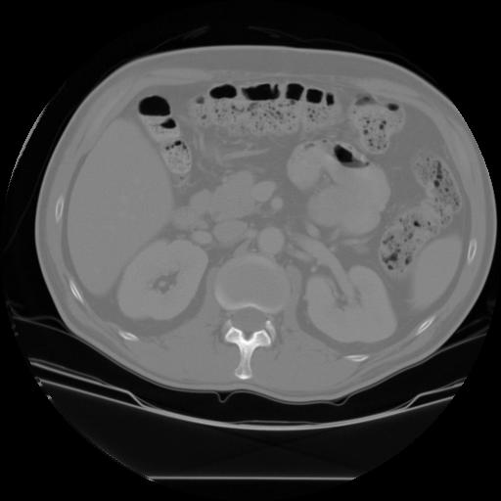
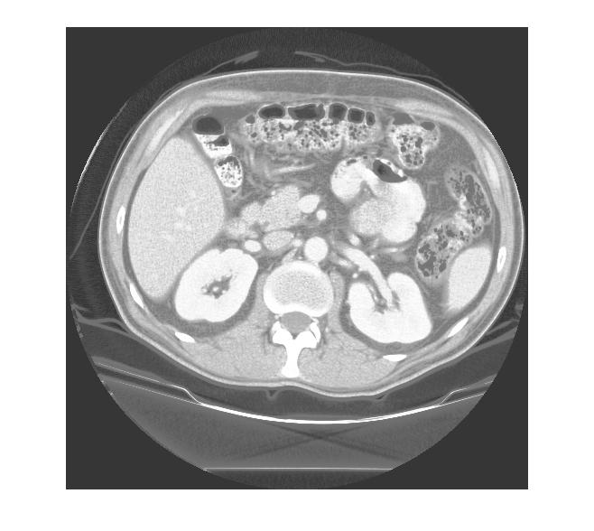
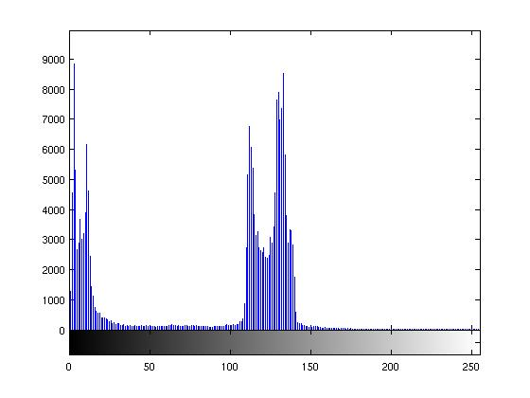
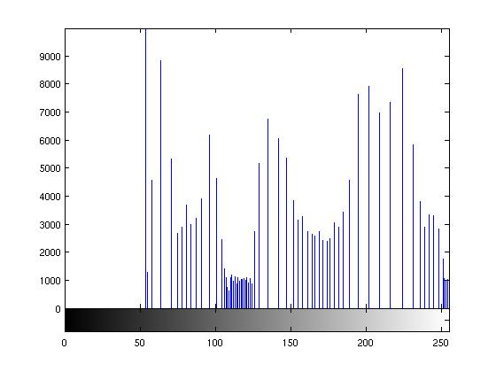
CT Abdomen Image Example
original image equalized image
and histogram and histogram

Slide 7
Images and Histograms*
CT MRI
*from Medical Image Analysis by Dhawan

Slide 8
Histogram Equalization

Slide 9
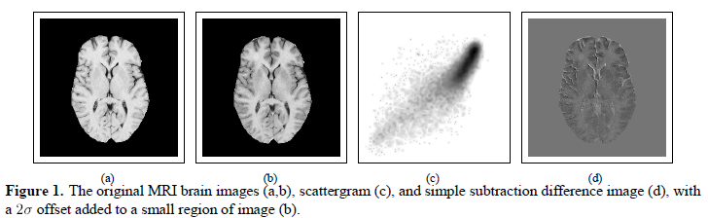
Image Averaging and Subtraction
If images are noisy, multiple images may be taken and
averaged to produce a new image that is smoothed.
Image subtraction to show differences over time or
with and without a dye or tracer.
two separate images subtraction

Slide 10
Image Averaging Masks
For each pixel of the input, the output is the mean of the pixels in
its 4-neighborhood or 8-neighborhood.
f_{(-1,0)}
f_{(-1,-1)}
f_{(-1,0)}
f_{(-1,0)}
f_{(0,-1)}
f_{(0,0)}
f_{(0,1)}
f_{(0,-1)}
f_{(0,0)}
f_{(0,1)}
f_{(1,0)}
f_{(0,-1)}
f_{(1,0)}
f_{(1,1)}

Slide 11
Weighted Image Averaging
1
2
1
2
4
2
1
2
1
original image f output image g

Slide 12
Median Filter

Slide 13
Laplacian: Second Order Gradient for Edge Detection
-1
-1
4
-1
-1

Slide 14
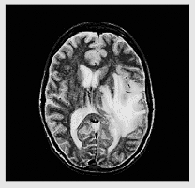
Image Sharpening with Laplacian
-1
-1
-1
Apply a Laplacian and
add it to the original
image to enhance the
edges.
-1
9
-1
-1
-1
-1

Slide 15
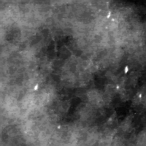
Micro-calcification Enhancement*
original mammogram enhancement histogram equalization
* Using adaptive neighborhood processing, from Dhawan book.

Slide 16
Frequency-Domain Methods
Convert the image from the spatial domain to the
frequency domain via a Fourier Transform
Apply filters in the frequency domain
Convert back to the spatial domain
Used to emphasize or de-emphasize specified frequency
components

Slide 17
Fourier Transform Basics
complex numbers
complex exponentials
Euler’s formula
n^{th} roots of unity
orthogonal basis
1D discrete Fourier transform
2D discrete Fourier transform
examples

Slide 18
Complex Numbers (Review)
Some equations have no real roots: x² = -1
Mathematicians handle this by defining an
imaginary number i which is the square root of -1
Complex numbers are of the form a + bi, where a and b are real
Complex numbers may be added and multiplied
The complex number a + bi can be viewed as a 2D vector [a,b]
Complex numbers are used heavily in physics and EE.

Slide 19
Complex Exponentials
Euler’s Formula: e^{iθ} = cos θ + i sin θ
Thus raising e to a power corresponds to taking
the sine and cosine of an angle
e^{iθ} is a periodic function; when θ = 0 or multiples
of 2π, it has value 1.
ω = e^{-2π} ^{i/n} is an n-th root of one for any integer n
Example with n = 8
ω⁰ = (e^{-2π i/8})⁰ = 1
ω¹ = (e^{-2π i/8})¹ = e^{(-π/4)i} = cos(-π/4) + isin(-π/4) =
sqrt(2)/2 – sqrt(2)/2i
ω² = (e^{-2π i/8})² = e^{(-π/2)i} = cos(-π/2) + isin(-π/2) = -i
etc.

Slide 20
n^{th} roots of unity for n = 8
ω⁶ = i
ω⁵
ω⁷
ω⁴ = -1
ω⁰ = 1
ω³
ω¹
ω² = -i
Generated from the principal root ω = e^{-2π} ^{i/n}

Slide 21
Orthogonal Basis
Start with the first root (1) and take its first n powers to
get the n-dimensional vector [1, 1, 1, ... , 1]
Repeat with each of the other roots for a given n. The
second root ω gives the vector [1, ω, ω², ..., ω^{n-1}].
For the example n=8, there are 8 orthogonal vectors:
  [1, 1, 1, 1, 1, 1, 1, 1]
  [1, ω, ω², ..., ω⁷]
  [1, ω², ω^{4,} ..., ω¹⁴]
  [1, ω³, ω^{6,} ..., ω²¹]
  ...
  [1, ω⁷, ω^{14,} ..., ω⁴⁹]

Slide 22
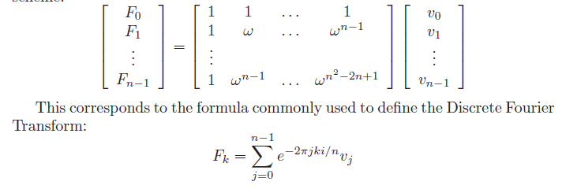
1D Discrete Fourier Transform
Fourier
coefficients
original
vector
basis as a matrix

Slide 23
2D Discrete Fourier Transform
Detect the frequency components of the image in both the
horizontal and vertical directions
First apply the 1D discrete Fourier transform to each row of
the image, producing an intermediate image or row transforms
Then apply the 1D discrete Fourier transform to each column
of the intermediate image
The result is the 2D discrete Fourier transform of the image,
which is an image in the frequency domain.

Slide 24
Filtering with the Fourier Transform
Compute the 2D discrete Fourier transform of the image
Apply an image operator to the transformed image
Computer the inverse 2D discrete Fourier transform of
the result of the image operator
Two most common filters:
  low-pass filtering zeroes out the frequency
  components above a threshold
  high-pass filtering zeroes out the frequency
  components below a threshold

Slide 25
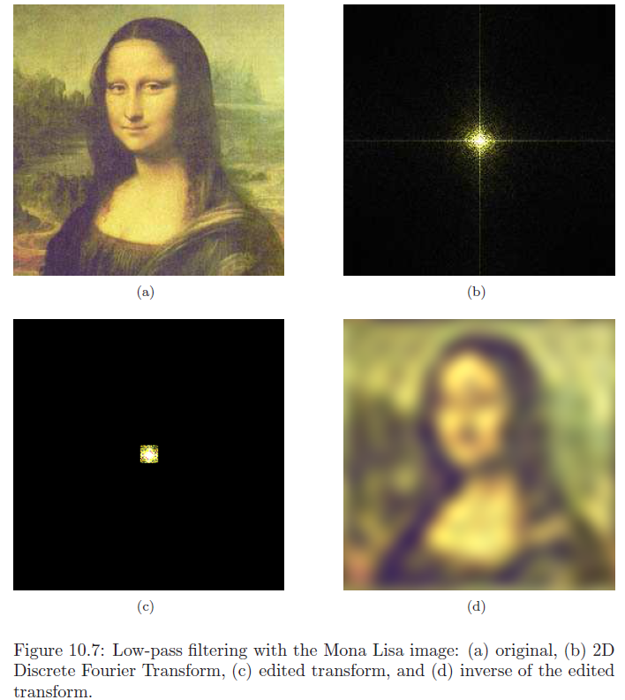
Example from Steve Tanimoto’s Book
Low-Pass Filter: Smooths

Slide 26
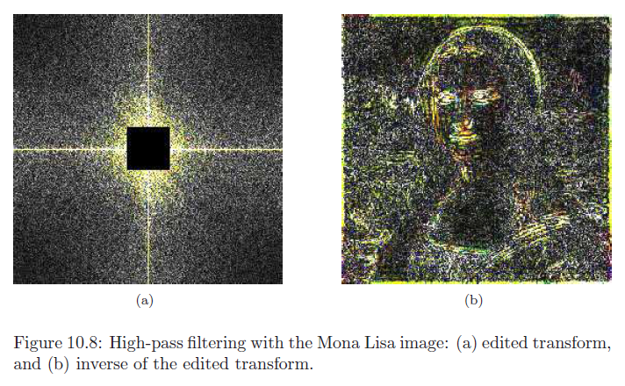
High-Pass Filter: Finds Edges

Slide 27
Low-Pass Filtering
low-pass filter H(u,v) in the filtered MRI brain image
frequency domain
Fourier transform of original image Fourier transform of filtered image

Slide 28
High-Pass Filtering
high-pass filter filtered image
Fourier transform of filtered image

Slide 29
Wavelet Transform
Fourier Transform only provides frequency information.
Wavelet Transform is a method for complete time-frequency localization for signal analysis and characterization.
Wavelet Transform : works like a microscope focusing on finer time resolution as the scale becomes small to see how the impulse gets better localized at higher frequency permitting a local characterization

Slide 30
Basics of Wavelets*
Wavelets are a mathematical tool for hierarchically
decomposing functions.
They allow a function to be described in terms of
a coarse overall shape, plus details than range from
narrow to broad.
Wavelets represent the signal or image as a linear
combination of basis functions.
The simplest basis is the Haar wavelet basis.
* Material from Stollnitz et al., Wavelets for Computer Graphics: A Primer Part 1.

Slide 31
How the Haar Wavelet Transform Works in 1D
Image Pyramid
level 2: original signal with 4 pixels: [9 7 3 5]
level 1: averaged image with 2 pixels: [ 8 4 ]
level 0: averaged image with 1 pixel: [ 6 ]
To recover the original four pixels in level 2 from the two
pixels at level 1, use two detail coefficients +1 and -1.
  9 = 8 + (+1)
  7 = 8 – (+1)
  3 = 4 + (-1)
  5 = 4 – (-1)

Slide 32
level 2: [9 7 3 5]
level 1: [ 8 4 ]
level 0: [ 6 ]
To recover the two pixels in level 1 from the one
pixels at level 0, use one detail coefficient of 2.
8 = 6 + 2
4 = 6 - 2
The wavelet transform of the original 4-pixel image is
[ 6 2 1 -1 ]
It has the same number of coefficients as the original
image, but it lets us reconstruct the image at any resolution.

Slide 33
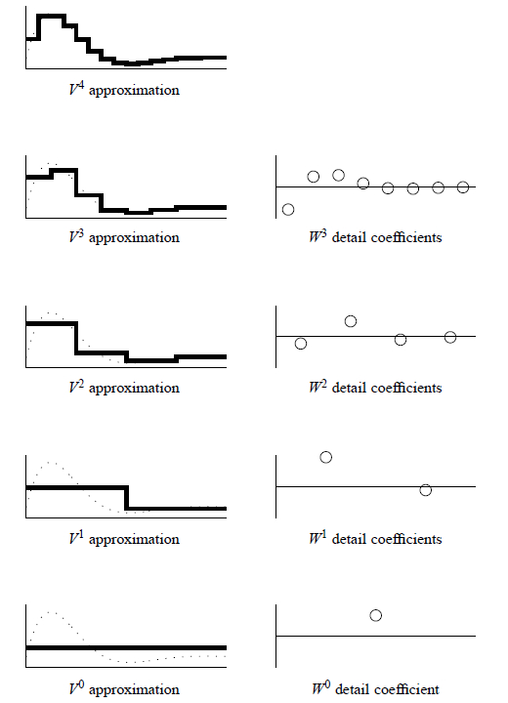
Idea of the Wavelet Hierarchy
level 4
level 3
level 2
level 1
level 0

Slide 34
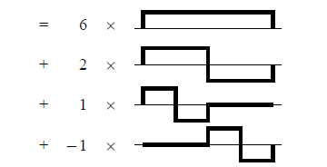
Haar Wavelet Decomposition of [9 7 3 5]
[9 7 3 5]

Slide 35
Two-Dimensional Haar Wavelet Transform: Standard Decomposition
First apply the 1D wavelet transform to each row of pixel values
This gives an average value along with detail coefficients for
each row
Next treat these transformed rows as an image and apply the
1D transform to each column
The resulting values are all detail coefficients except for the
single overall average coefficient

Slide 36
Wavelet Decomposition of MRI Brain Image
3 –level decomposition
the original MRI image

Slide 37
Binary Image Analysis
used in a variety of applications:
  part inspection
  riveting
  fish counting
  document processing
consists of a set of image analysis operations
that are used to produce or process binary
images, usually images of 0’s and 1’s.
00010010001000
00011110001000
00010010001000

Slide 38
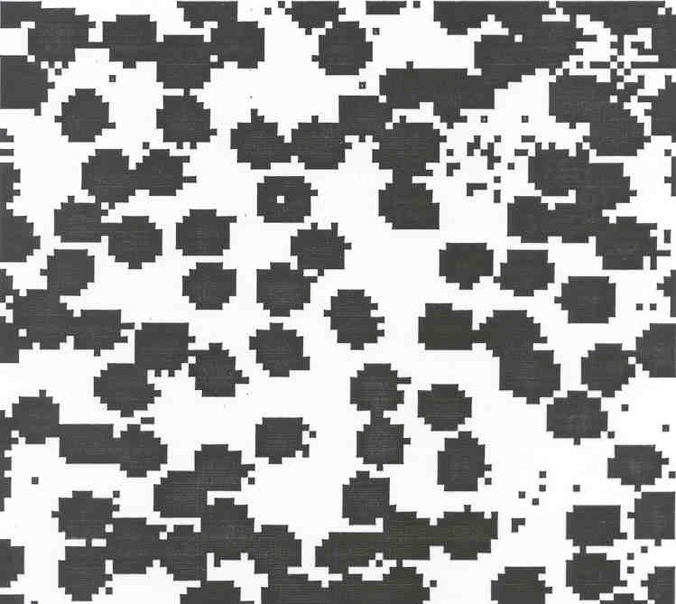
Example: red blood cell image
Many blood cells are separate objects
Many touch – bad!
Salt and pepper noise from thresholding
What operations are
needed to clean it up?

Slide 39
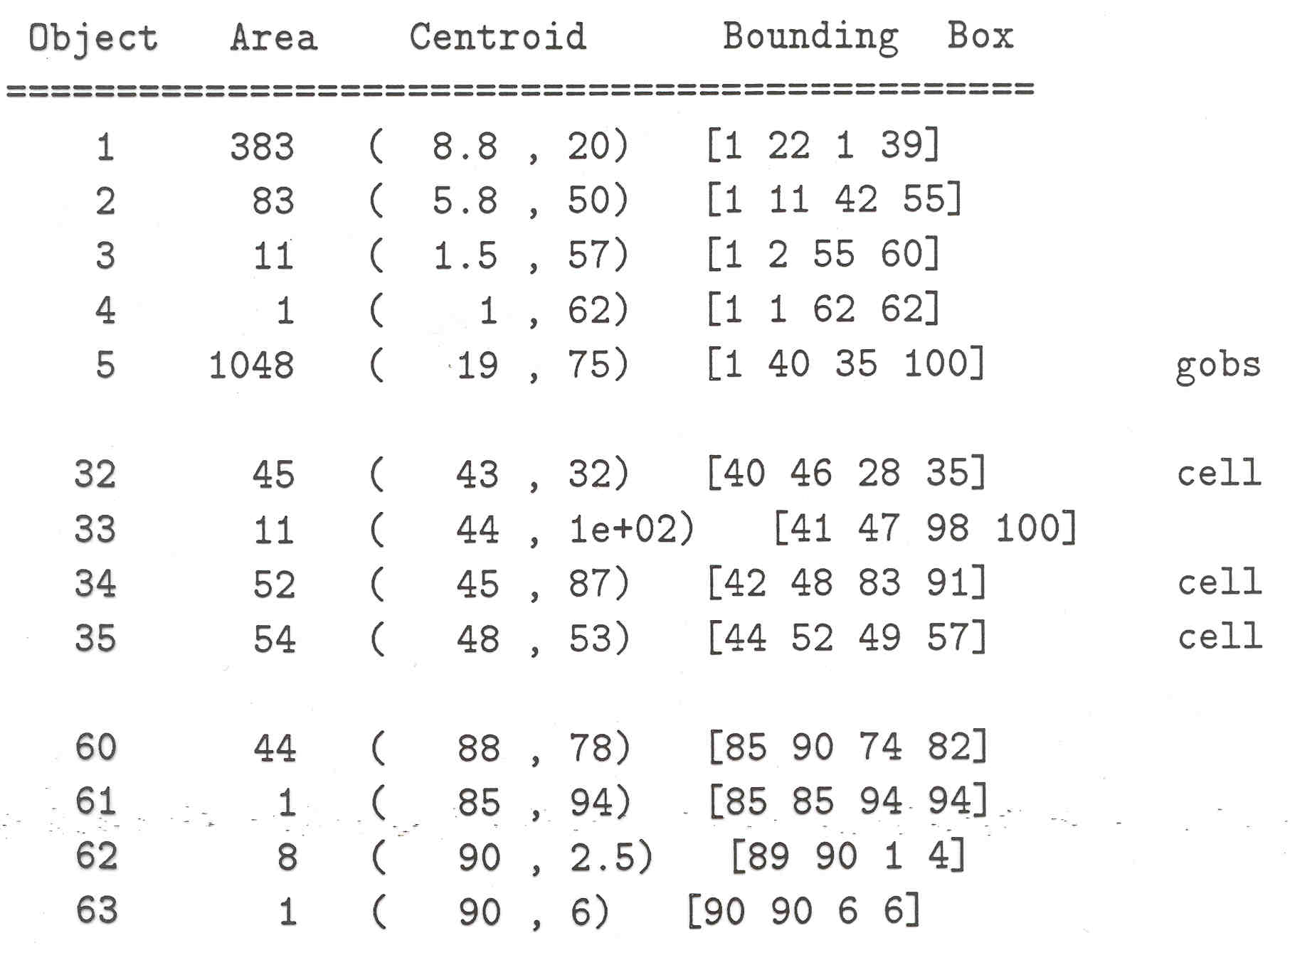
Results of analysis
63 separate objects detected
Single cells have area about 50
Noise spots
Gobs of cells

Slide 40
Useful Operations
Thresholding a gray-tone image
Determining good thresholds
Filtering with mathematical morphology
Connected components analysis
Numeric feature extraction
  location features
  gray-tone features
  shape features ...

Slide 41
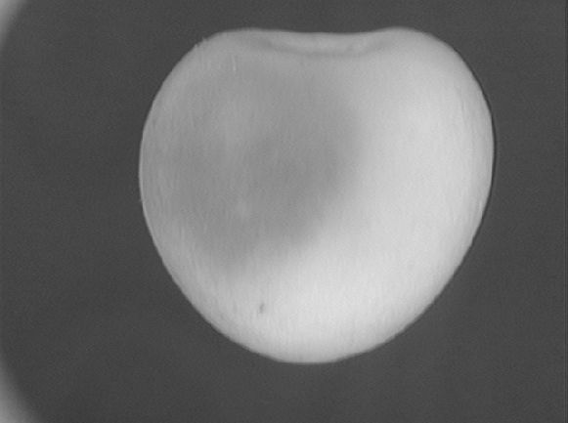
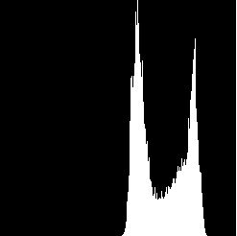
Thresholding
Background is black
Healthy cherry is bright
Bruise is medium dark
Histogram shows two cherry regions (black background has been removed)
pixel
counts
0
gray-tone values
256

Slide 42
Histogram-Directed Thresholding
How can we use a histogram to separate an
image into 2 (or several) different regions?
Is there a single clear threshold? 2? 3?

Slide 43
Automatic Thresholding: Otsu’s Method
Assumption: the histogram is bimodal
Grp 1 Grp 2
t
Method: find the threshold t that minimizes
the weighted sum of within-group variances
for the two groups that result from separating
the gray tones at value t.

Slide 44
Computing Within-Group Variance
For each possible threshold t
For each group i (1 and 2)
  compute the variance of its gray tones σ_{i}²(t)
  compute its weight q_{i}(t) = ∑ P(τ)
where P(τ) is the normalized histogram value for
gray tone τ, normalized by sum of all gray tones
in the image and called the probability of τ.
Within-group variance = q₁(t) σ₁²(t) + q₂(t) σ₂²(t)
Grp 1 Grp 2
in Grp i
0 255
t
See S&S text (Section 3.8) for the efficient recurrence relations;
in practice, this operator works very well for true bimodal
distributions and not too badly for others, but not the CTs.

Slide 45

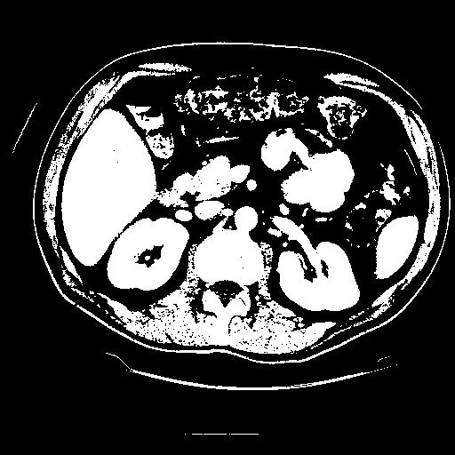
Thresholding Example
original image pixels above threshold

Slide 46
Mathematical Morphology
(Dilation, Erosion, Closing, Opening)
Dilation
Dilation expands the connected sets of 1s of a binary image.
It can be used for
1. growing features
2. filling holes and gaps

Slide 47
Erosion
Erosion shrinks the connected sets of 1s of a binary image.
It can be used for
1. shrinking features
2. Removing bridges, branches and small protrusions

Slide 48
Structuring Elements
A structuring element is a shape mask used in
the basic morphological operations.
They can be any shape and size that is
digitally representable, and each has an origin.
box
hexagon
disk
something
box(length,width) disk(diameter)

Slide 49
Dilation with Structuring Elements
The arguments to dilation and erosion are
a binary image B
a structuring element S
dilate(B,S) takes binary image B, places the origin
of structuring element S over each 1-pixel, and ORs
the structuring element S into the output image at
the corresponding position.
0 0 0 0
0 1 1 0
0 0 0 0
dilate
0 1 1 0
0 1 1 1
0 0 0 0
1
1 1
S
B
origin
B ⊕ S

Slide 50
Erosion with Structuring Elements
erode(B,S) takes a binary image B, places the origin
of structuring element S over every pixel position, and
ORs a binary 1 into that position of the output image only if
every position of S (with a 1) covers a 1 in B.
origin
0 0 1 1 0
0 0 1 1 0
0 0 1 1 0
1 1 1 1 1
0 0 0 0 0
0 0 1 1 0
0 0 1 1 0
0 0 0 0 0
1
1
1
erode
B
S
B S

Slide 51
Opening and Closing
Closing is the compound operation of dilation followed
by erosion (with the same structuring element)
Opening is the compound operation of erosion followed
by dilation (with the same structuring element)

Slide 52
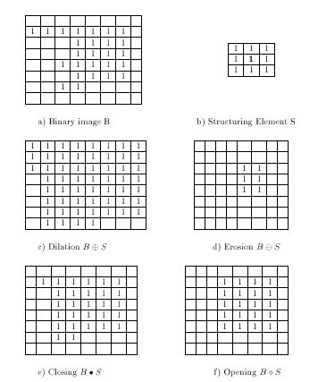

Slide 53


Connected Components Labeling
Once you have a binary image, you can identify and
then analyze each connected set of pixels.
The connected components operation takes in a binary image
and produces a labeled image in which each pixel has the
integer label of either the background (0) or a component.
original thresholded opening+closing components

Slide 54
Methods for CC Analysis
Recursive Tracking (almost never used)
Parallel Growing (needs parallel hardware)
Row-by-Row (most common)
  a. propagate labels down to the bottom,
  recording equivalences
  b. Compute equivalence classes
  c. Replace each labeled pixel with the
  label of its equivalence class.

Slide 55
Equivalent Labels
Original Binary Image
0 0 0 1 1 1 0 0 0 0 1 1 1 1 0 0 0 0 1
0 0 0 1 1 1 1 0 0 0 1 1 1 1 0 0 0 1 1
0 0 0 1 1 1 1 1 0 0 1 1 1 1 0 0 1 1 1
0 0 0 1 1 1 1 1 1 0 1 1 1 1 0 0 1 1 1
0 0 0 1 1 1 1 1 1 1 1 1 1 1 0 0 1 1 1
0 0 0 1 1 1 1 1 1 1 1 1 1 1 0 0 1 1 1
0 0 0 1 1 1 1 1 1 1 1 1 1 1 1 1 1 1 1
0 0 0 1 1 1 1 1 1 1 1 1 1 1 1 1 1 1 1
0 0 0 1 1 1 1 1 1 0 0 0 0 0 1 1 1 1 1

Slide 56
Equivalent Labels
The Labeling Process:
Left to Right, Top to Bottom
0 0 0 1 1 1 0 0 0 0 2 2 2 2 0 0 0 0 3
0 0 0 1 1 1 1 0 0 0 2 2 2 2 0 0 0 3 3
0 0 0 1 1 1 1 1 0 0 2 2 2 2 0 0 3 3 3
0 0 0 1 1 1 1 1 1 0 2 2 2 2 0 0 3 3 3
0 0 0 1 1 1 1 1 1 1 1 1 1 1 0 0 3 3 3
0 0 0 1 1 1 1 1 1 1 1 1 1 1 0 0 3 3 3
0 0 0 1 1 1 1 1 1 1 1 1 1 1 1 1 1 1 1
0 0 0 1 1 1 1 1 1 1 1 1 1 1 1 1 1 1 1
0 0 0 1 1 1 1 1 1 0 0 0 0 0 1 1 1 1 1
1 ≡ 2
1 ≡ 3

Slide 57

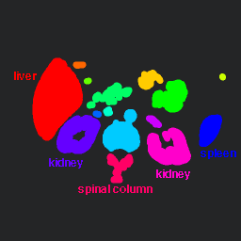

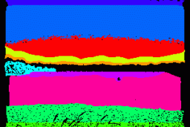
Labeling shown as Pseudo-Color
connected
components
of 1’s from
thresholded
image
connected
components
of cluster
labels

Slide 58
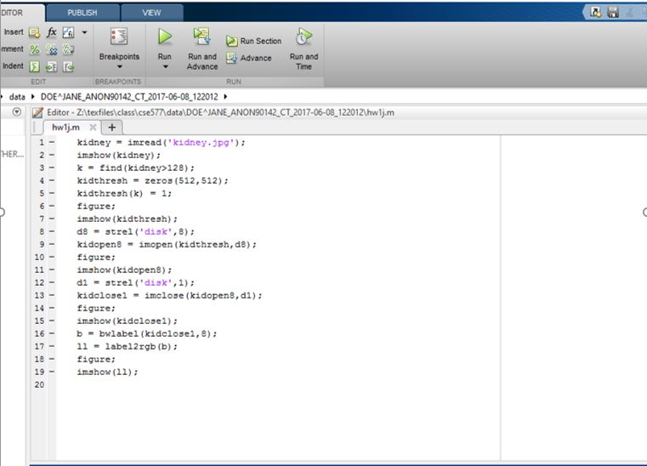
Matlab Exercise

Slide 59
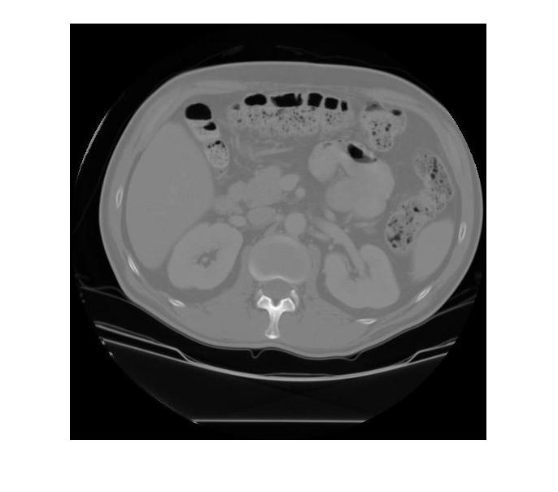
original image kidney.jpg

Slide 60
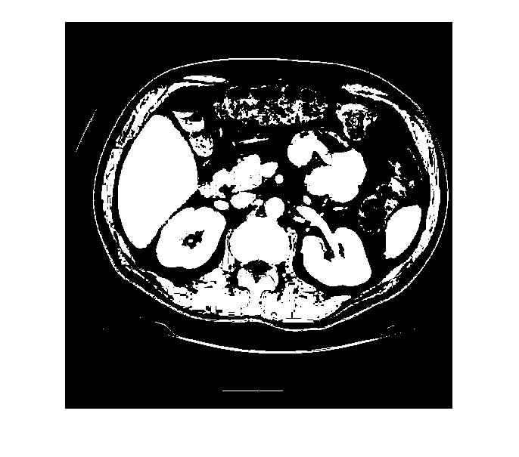
result of thresholding pixels > 128

Slide 61

result of opening with a disk of radius 8

Slide 62

and closing with a disk of radius 1

Slide 63

result of connected components labeling
and coloring the labels.

