Slide 1
3D Mesh Data for Face and Head Analysis

Slide 2
3D Head Mesh Data
Stereo Vision
Active Stereo
3D Reconstruction
3dMD System

Slide 3
Data Types
Volumetric Data
Voxel grids
Occupancy
Density
Surface Data
Point clouds
Range images (range maps)

Slide 4
Range Acquisition Taxonomy
Mechanical (CMM, jointed arm)
Inertial (gyroscope, accelerometer)
Contact
Ultrasonic trackers
Magnetic trackers
Industrial CT
Range acquisition
Transmissive
Ultrasound
MRI
Radar
Non-optical
Reflective
Sonar
Optical

Slide 5
Range Acquisition Taxonomy
Shape from X:
stereo
motion
shading
texture
focus
defocus
Passive
Optical methods
Active variants of passive methods
Stereo w. projected texture
Active depth from defocus
Photometric stereo
Active
Time of flight
Triangulation

Slide 6
Optical Range Scanning Methods
Advantages:
Non-contact
Safe
Usually inexpensive
Usually fast
Disadvantages:
Sensitive to transparency
Confused by specularity and interreflection
Texture (helps some methods, hurts others)

Slide 7
Stereo
Find feature in one image, search along epipole in other image for correspondence

Slide 8
Depth Perception from Stereo Simple Model: Parallel Optic Axes
image plane
z
Z
camera
L
f
xl
baseline
b
f
camera
R
xr
x-b
X
P=(x,z)
z x
f xl
z x-b
f xr
z y y
f yl yr
y-axis is
perpendicular
to the page.
=
=
=
=

Slide 9
Resultant Depth Calculation
For stereo cameras with parallel optical axes, focal length f,
baseline b, corresponding image points (xl,yl) and (xr,yr)
with disparity d:
z = f*b / (xl - xr) = f*b/d
x = xl*z/f or b + xr*z/f
y = yl*z/f or yr*z/f
This method of
determining depth
from disparity is
called triangulation.

Slide 10
Epipolar Geometry Constraint: 1. Normal Pair of Images
The epipolar plane cuts through the image plane(s)
forming 2 epipolar lines.
P
y1
z1
z2
y2
epipolar
plane
P1
x
P2
C1
b
C2
The match for P1 (or P2) in the other image,
must lie on the same epipolar line.

Slide 11
Epipolar Geometry: General Case
P
y1
y2
P2
x2
P1
e2
e1
x1
C1
C2

Slide 12
Constraints
1. Epipolar Constraint:
Matching points lie on
corresponding epipolar
lines.
2. Ordering Constraint:
Usually in the same
order across the lines.
P
Q
e2
e1
C1
C2

Slide 13
Finding Correspondences
If the correspondence is correct, triangulation works VERY well.
But correspondence finding is not perfectly solved.
For some very specific applications, it can be solved
for those specific kind of images, e.g. windshield of a
car where the opening shows up as a clear horizontal line.
General passive stereo matching is not precise enough for
the head meshes used at Children’s Research Institute.

Slide 14
Shape from Motion
Track a feature in a video sequence
For n frames and f features, have 2⋅n⋅f knowns, 6⋅n+3⋅f unknowns
Solve for the 3D parameters

Slide 15
Shape from Motion
Advantages:
Feature tracking easier than correspondence in far-away views
Mathematically more stable (large baseline)
Disadvantages:
Does not accommodate object motion
Still problems in areas of low texture, in non-diffuse regions, and around silhouettes

Slide 16
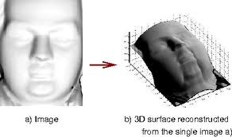
Shape from Shading
Given: image of surface with known, constant reflectance under known point light
Estimate normals, integrate to find surface
Problems: most real images don’t satisfy the assumptions; there is ambiguity in the process

Slide 17
Shape from Shading
Advantages:
Single image
No correspondences
Analogue in human vision
Disadvantages:
Mathematically unstable
Can’t have texture
Not really practical
But see photometric stereo

Slide 18
Active Optical Methods
Advantages:
Usually can get dense data
Usually much more robust and accurate than passive techniques
Disadvantages:
Introduces light into scene (distracting, etc.)
Not motivated by human vision

Slide 19
Active Variants of Passive Techniques
Active depth from defocus
Known pattern helps to estimate defocus
Photometric stereo
Shape from shading with multiple known lights
Regular stereo with projected texture
Provides features for correspondence

Slide 20
What Kinds of Patterns
Most common: light stripes
Variation: colored light stripes
Variation: grids of light stripes
Variation: point patterns

Slide 21
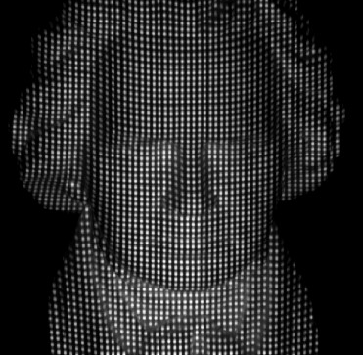
Multiple Stripes
Project multiple stripes
But which stripe is which?
Answer #1: assume surface continuity

Slide 22
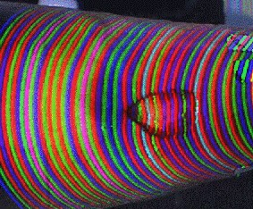
Colored Multiple Stripes
To go faster, project multiple stripes
But which stripe is which?
Answer #2: colored stripes (or dots)

Slide 25
3D Reconstruction Color Images
Perform point matching; obtain depth images.

Slide 26
Depth Images
Use the depth, plus the direction from which each
image was taken to carve out 3D space to find the object.

Slide 27
Space Carving
All of 3D space is made up of cubes. Use the known location of
each cubes and known depth values in each image of the object
to decide if the cube is behind, in front of, or part of the object.

Slide 28
Space Carving
Case 1:
cube in front
of object
Case 2:
cube behind
object
Case 3:
cube on
boundary

Slide 29
Space Carving Algorithm
for each level of cube resolution from large to small
for each cube in 3D space at this resolution
if the cube lies in front of the object for any camera
carve it away
if the cube lies behind the object for all cameras
make it part of the object
else call it on the boundary of the object at this level
and go on to the next finer level of resolution

Slide 30
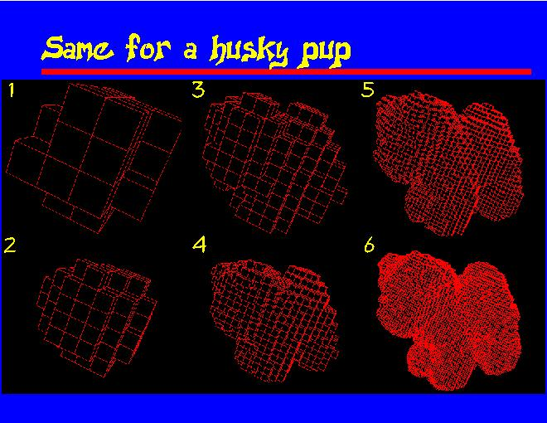
Husky Puppy

Slide 31
From Voxels to 3D Mesh
Space carving leaves us with a voxel representation.
Medical imaging modalities also give us a voxel representation.
We can work with voxels, but it is often more convenient to
convert to a 3D triangular mesh as is used in graphics.
The most common algorithm for producing a mesh from a
voxel representation is the Marching Cubes algorithm.

Slide 32
Marching Cubes
Marching Cubes is an algorithm which “creates triangle models of constant density surfaces from 3D medical data.”

Slide 33
What does that mean?
Medical Data
+ Marching Cubes
= Pretty Pictures
= Visualization

Slide 34
Visualization Process
Medical Data Acquisition
Image Processing
Surface Construction
Display

Slide 35
Medical Data Acquisition
Computed Tomography (CT)
Magnetic Resonance (MR)
Single-Photon Emission Computed Tomography (SPECT)
Each scanning process results in two dimensional “slices” of data.

Slide 36
Surface Construction
Construction/Reconstruction of scanned surfaces or objects.
Problem of interpreting/interpolating 2D data into 3D visuals.
Marching Cubes provides a method of creating 3D surfaces.

Slide 37
Marching Cubes Explained
High resolution surface construction algorithm.
Extracts surfaces from adjacent pairs of data slices using cubes.
Cubes “march” through the pair of slices until the entire surface of both slices has been examined.

Slide 38
Marching Cubes Overview
1. Load slices.
2. Create a cube from pixels on adjacent slices.
3. Find vertices on the surfaces.
4. Determine the intersection edges.
5. Interpolate the edge intersections.
6. Calculate vertex normals.
7. Output triangles and normals.

Slide 39
How Are Cubes Constructed
Uses identical squares of four pixels connected between adjacent slices.
Each cube vertex is examined to see if it lies on or off of the surface.

Slide 40
How Are The Cubes Used
Pixels on the slice surfaces determine 3D surfaces.
256 surface permutations, but only 14 unique patterns.
A normal is calculated for each triangle vertex for rendering.

Slide 41
Triangle Creation
1. Determine triangles contained by a cube.
2. Determine which cube edges are intersected.
3. Interpolate intersection point using pixel density.
4. Calculate unit normals for each triangle vertex using the gradient vector.

Slide 42
Improvements Over Other Methods
Utilizes pixel, line and slice coherency to minimize the number of calculations.
Can provide solid modeling.
Can use conventional rendering techniques and hardware.
No user interaction necessary.
Enables selective displays.
Can be used with other density values.

Slide 43
Examples

Slide 44
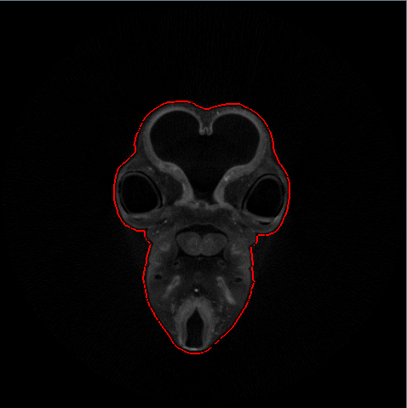
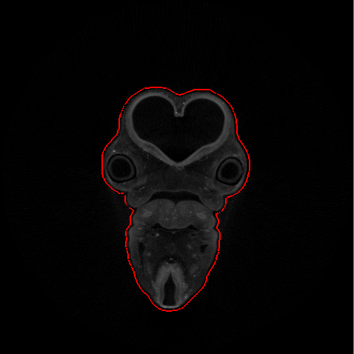
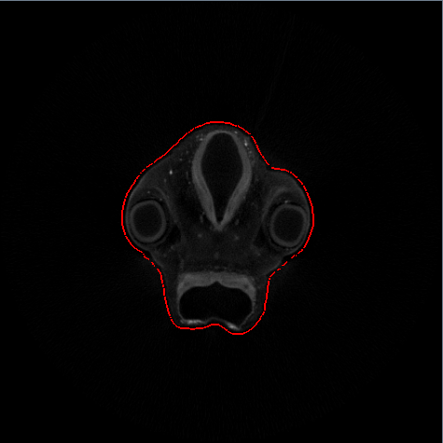
3D Surface from MicroCT Images of a Chicken Embryo

Slide 45
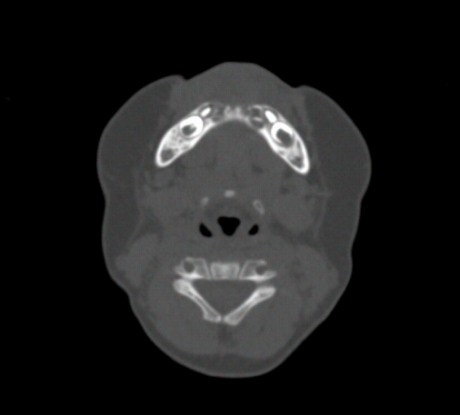
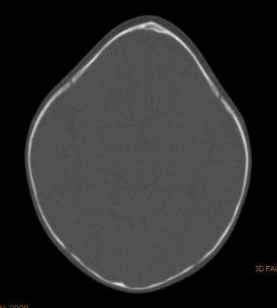
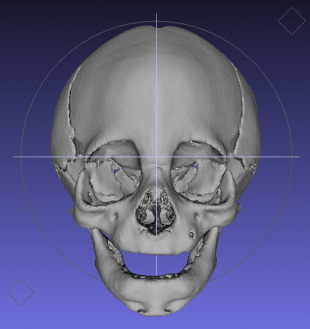
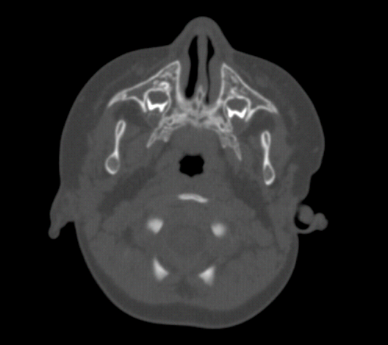
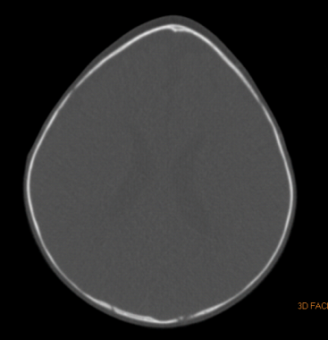
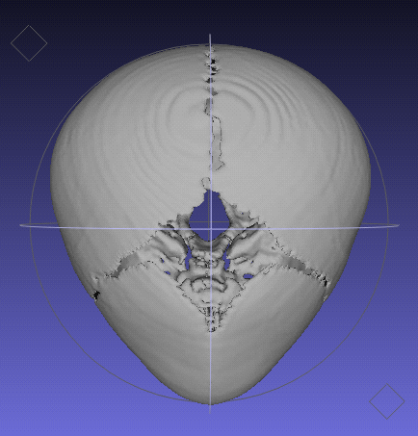
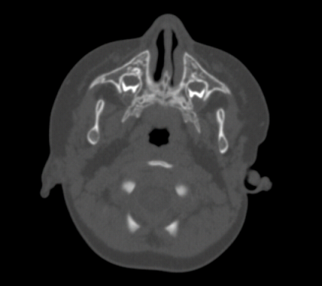
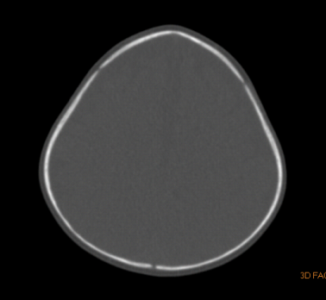
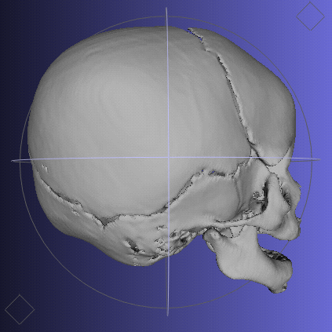
3D Skulls from Human CT Images

Slide 46
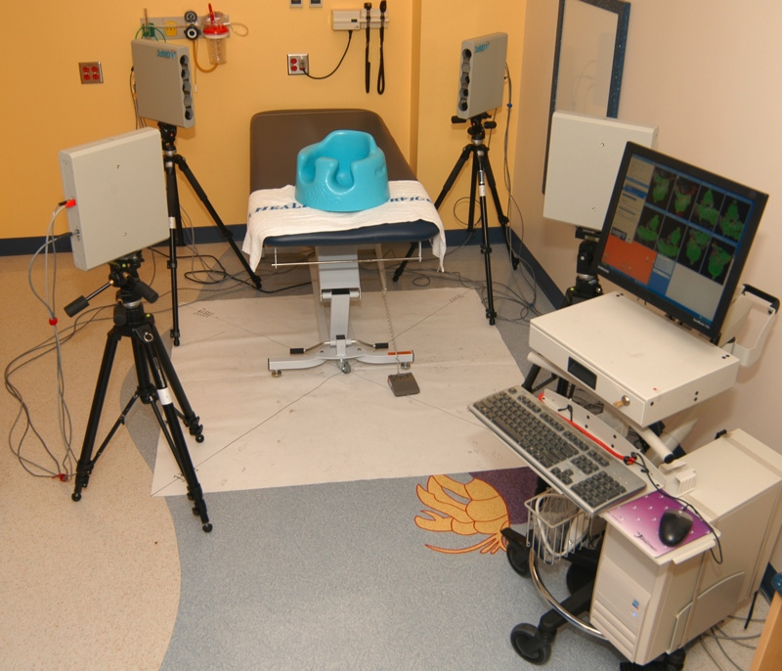
The 3dMD 3D Scanning System

Slide 47
Characteristics
multiple cameras take color photos
active stereo using a point pattern for mathing
rapid image acquisition: 1.5 ms.
high precision: accurate to within .2mm RMS
accurate texture mapping of color photos to mesh
supports multiple file formats
used in hospitals, clinics, medical research institutes
used at both Seattle Children’s Hospital and
Children’s Research Institute

Slide 48
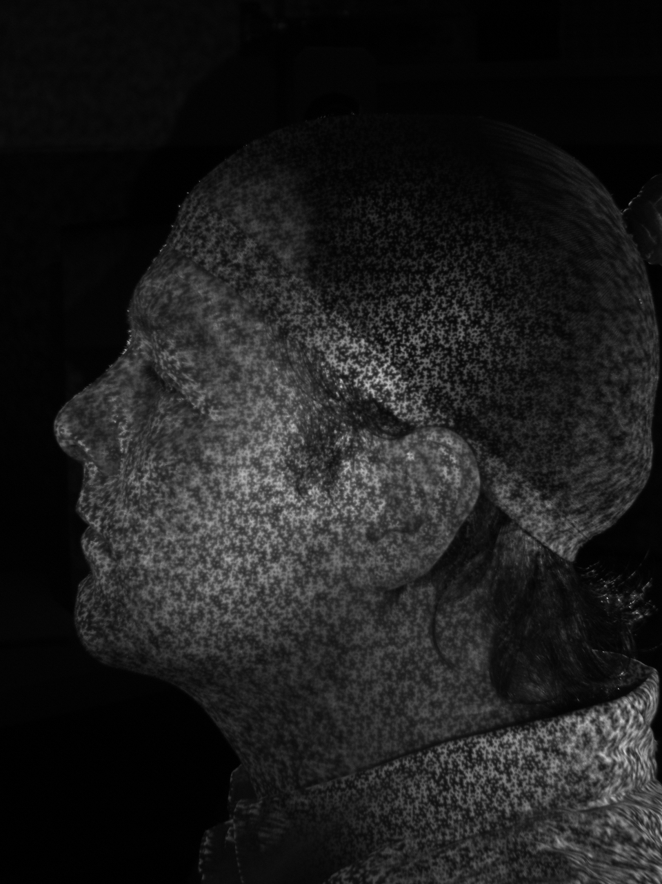
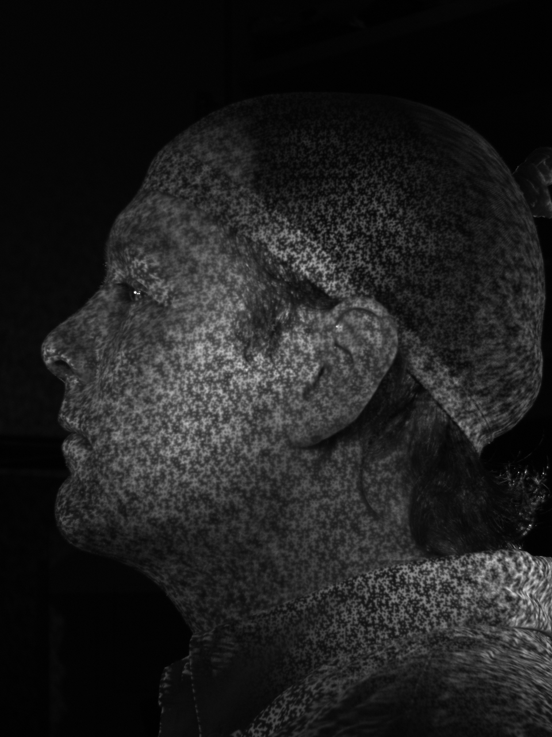
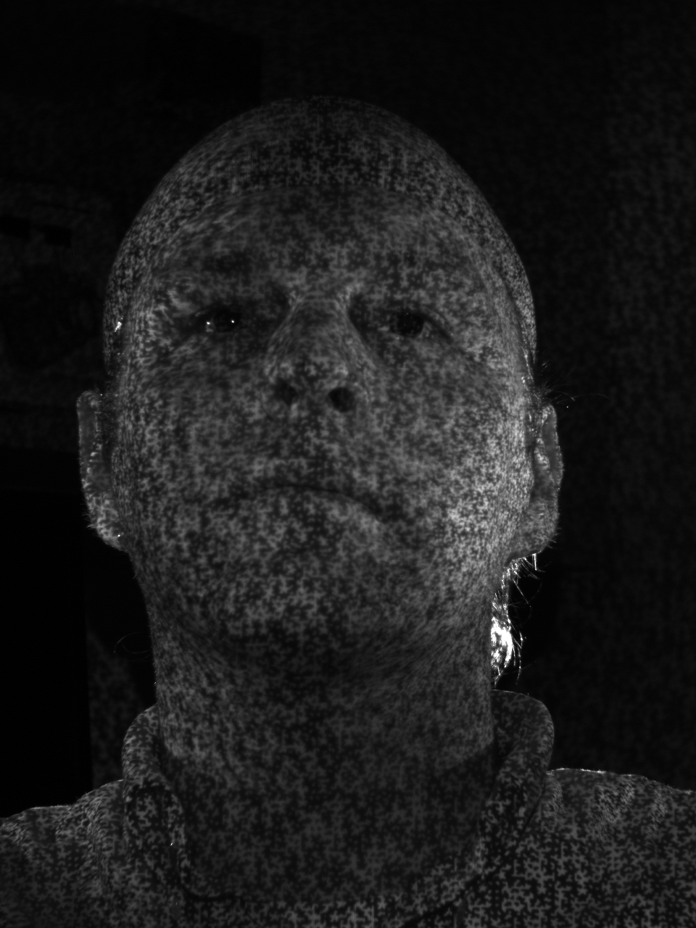
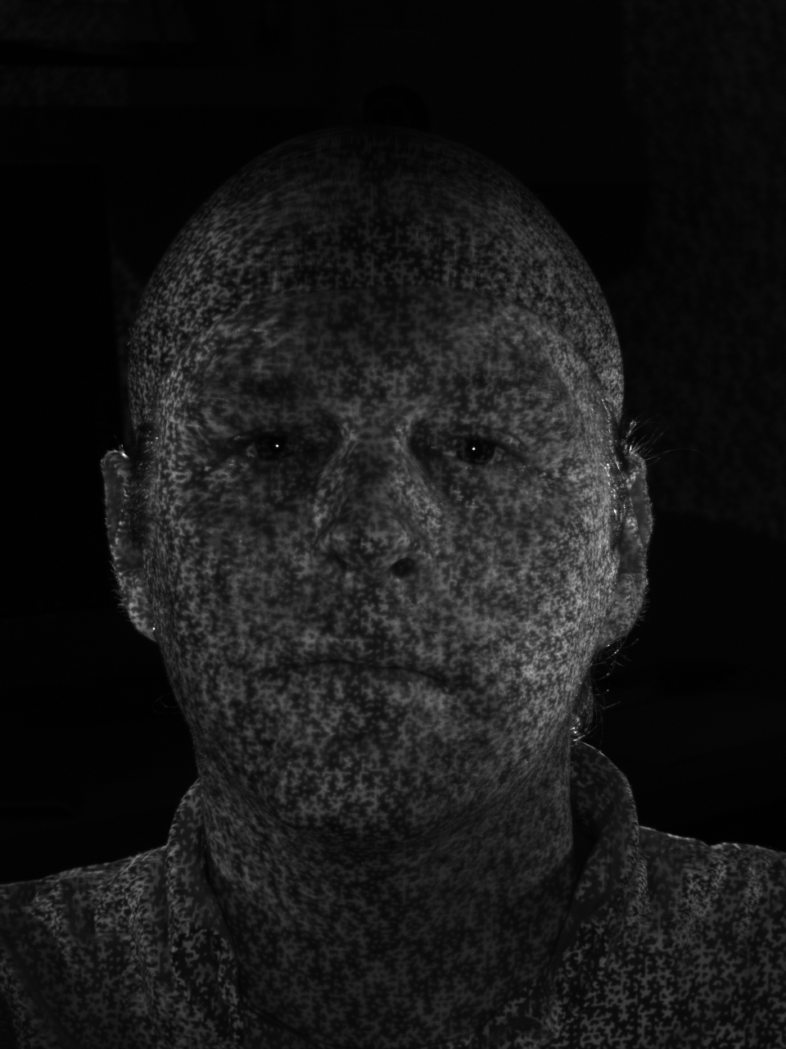
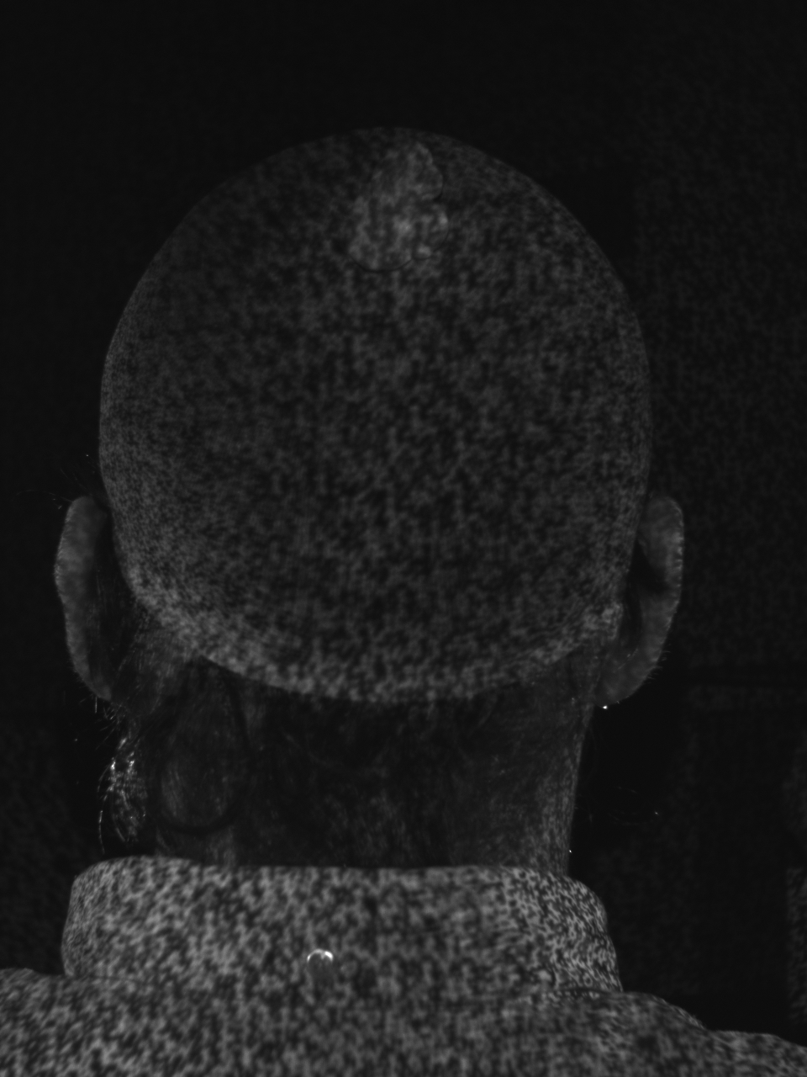
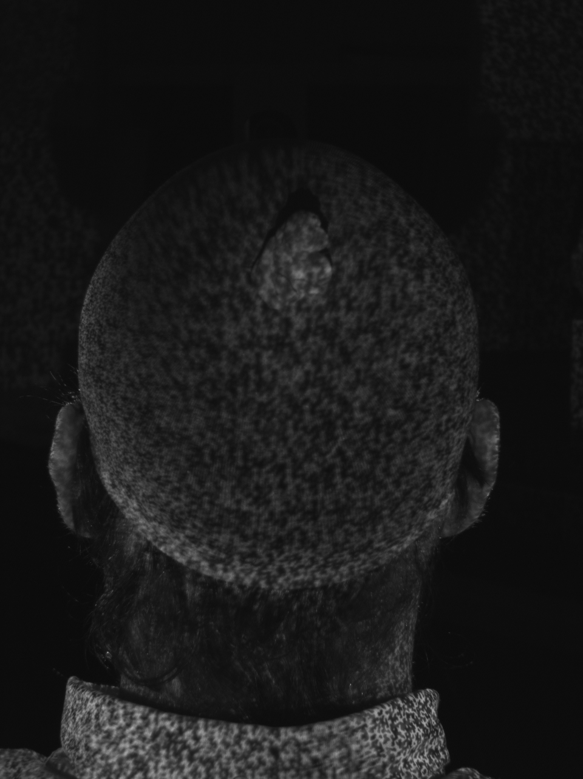
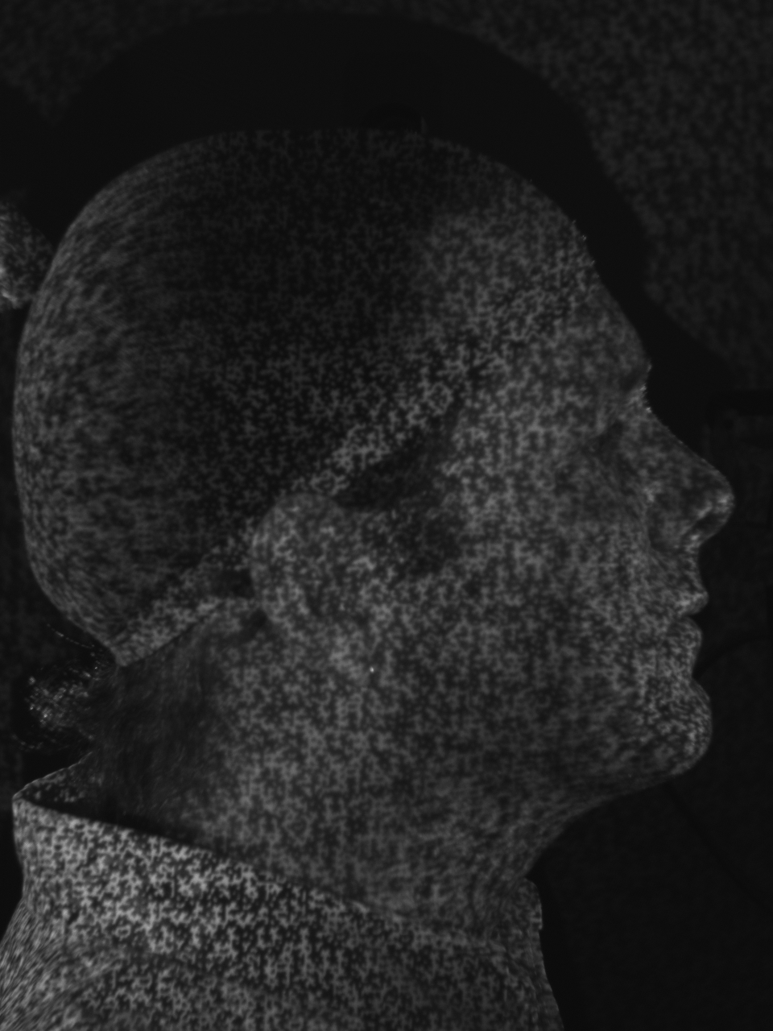
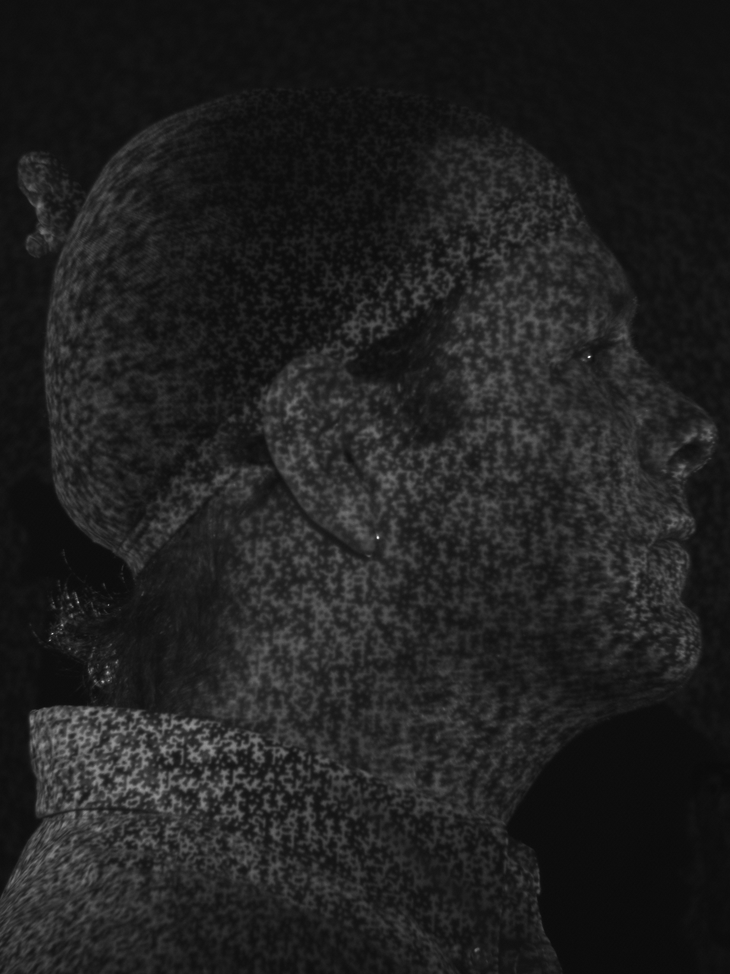
Active Stereo Light Pattern shown on Eric

Slide 49
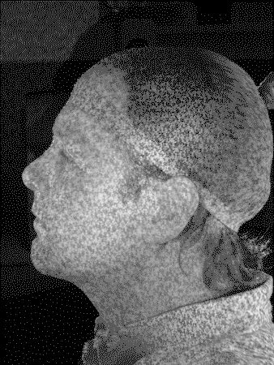
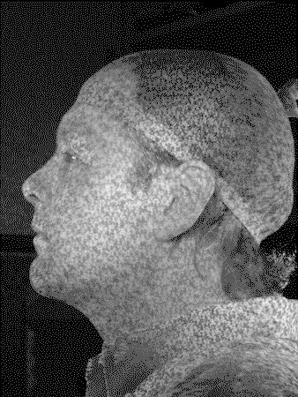
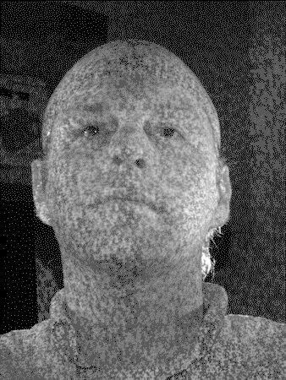
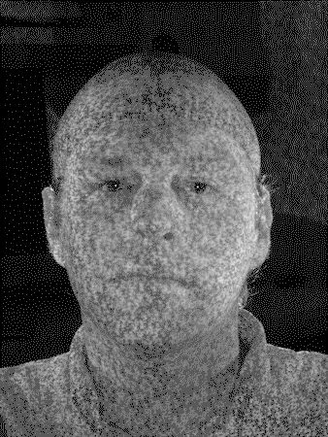
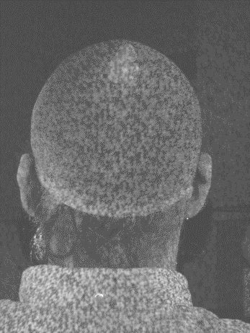
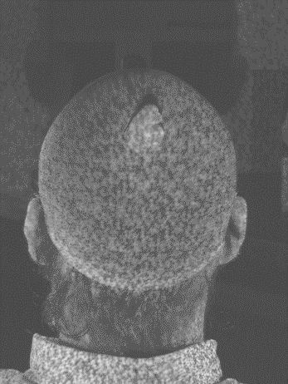
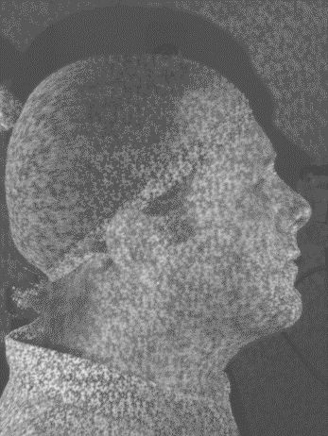
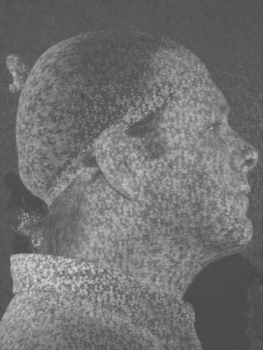
Active Stereo Light Pattern shown on Eric

Slide 50
The “us” Database
Dingding Indri Kasia Sara Steve Eric Jia Linda Shulin Xiang

Slide 51
Seth’s Database
The 3D Facial Norms Database: Part 1. A Web-Based Craniofacial Anthropometric and Image Repository for the Clinical and Research Community
Cleft Palate-Craniofacial Journal, Vol. 53, No. 6, November 2016

Slide 52
3dMD Face Dataset
3dMD face scans of our group

Slide 53
3dMD Face Dataset
mean shape

Slide 54
3dMD Face Dataset
mean shape
+ 1st PC
- 1st PC

Slide 55
3dMD Face Dataset
mean shape
+ 2nd PC
- 1nd PC

Slide 56
3dMD Face Dataset
mean shape
+ 3rd PC
- 3rd PC

Slide 57
3dMD Face Dataset
mean shape
+ 4th PC
- 4th PC

Slide 58
3dMD Face Dataset
mean shape
+ 5th PC
- 5th PC

Slide 59
3D Morphable Model
Any person’s face can be expressed as the linear combination of the PCs
$$+\sum_{i=1}^{200}{α_{i}{PC}_{i}}$$
=

Slide 60
Projects
We still have two 3D head/face data sets (and are applying for renewal from FaceBase)
The 3D Facial Norms Data Set that was provided to NIDCR by Seth Weinberg at Pitt
The African Children Data Set that was provided to NICDR by Richard Spritz at U of Colorado
These are 3D meshes in OBJ format and can be operated on by most packages for working with mesh data. We used VTK, which was C++ but now has Python wrappers.

Slide 61
Ideas
Features of the mouth, eyes, nose
Comparison of features of the two data sets
You name it.
NOTE: these are normal people

Slide 62
Shape-based Quantification of 3D Face Data for Craniofacial Research
Katarzyna Wilamowska
General Exam
Department of Computer Science & Engineering
University of Washington
2008
62
Notes:
Hello, and thank you for coming.
Today I’m going to tell you about some of the preliminary work I’ve done in ...
and propose some future directions for my work.

Slide 63
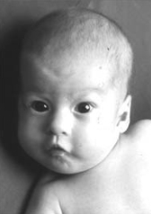
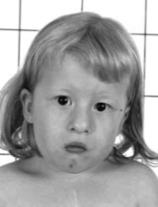
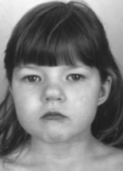
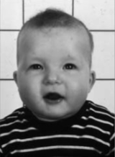
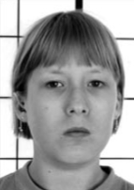
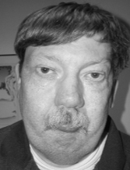
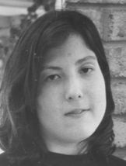
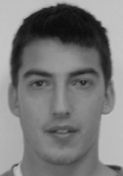
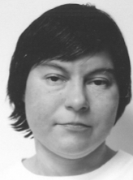
22q11.2 Deletion Syndrome
63
Notes:
Hello, and thank you for coming.
Today I’m going to tell you about some of the preliminary work I’ve done in ...
and propose some future directions for my work.

Slide 64
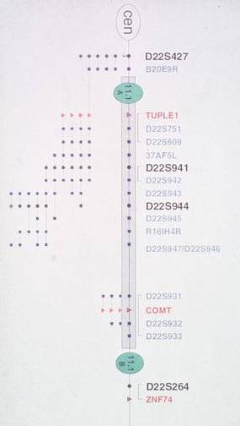
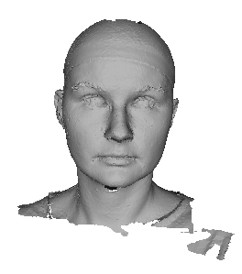
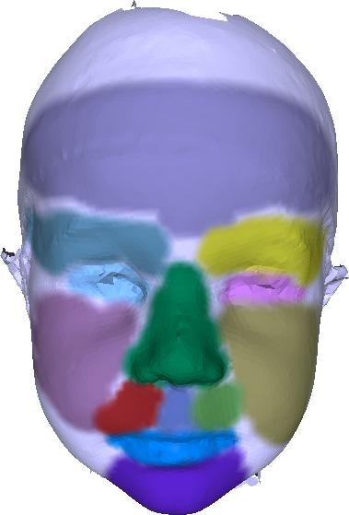
Motivation
Help detect disease more accurately
Describe useful features
64
Notes:
There is a disease that’s hard to classify (unless you’re an expert)
Final Goal: Want to connect visible features to genetic code (phenotype-genotype)
Have to start somewhere: help detect disease more accurately
In this process, find and describe useful features ...
leading to solving the overall goal

Slide 65
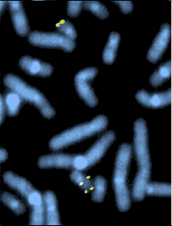
22q11.2 Deletion Syndrome (22q11.2DS)
aka Velo-cardio-facial syndrome (VCFS)
affects approximately 1 in 4000 individuals in the US
early detection is important
cardiac anomalies
mild to moderate immune deficiencies
learning disabilities
genetic test for 22q11.2DS
65
Notes:
one of the most common genetic deletions today
physician diagnosis based on
visual and non-visual cues
+ confirmation with genetic test
impact development and survival
FISH - fluorescence in situ hybridization

Slide 66
22q11.2 Deletion Syndrome has Subtle Facial Features
66
Notes:
One of the things we know about the disease is that it has subtle facial features
variable penetrance of any specific feature,
ex. SMALL MOUTH some have very small mouth, while others are less noticible

Slide 67
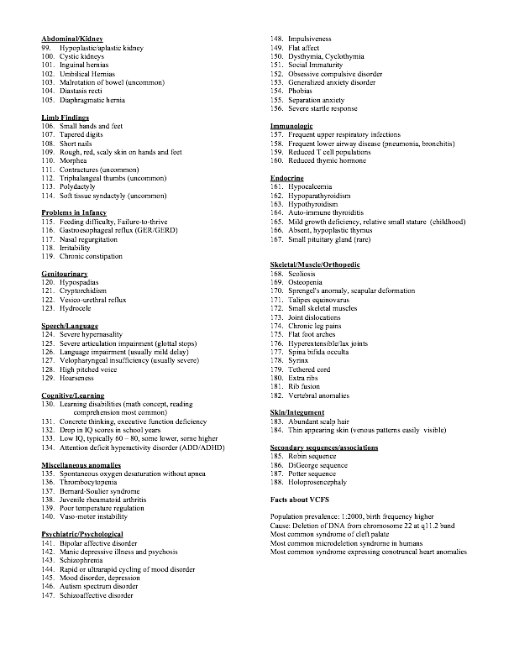
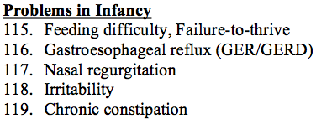
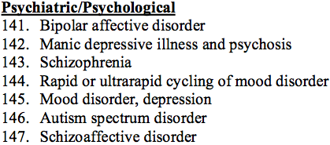
67
Notes:
In fact there are over 180 features tied to 22q11.2DS.
no one individual is affected by all features
no features are present in all affected individuals

Slide 68
Experts Looking at Photos
Becker et al. 2004
14 affected, 10 control
one photo at infancy & one beyond 2 years old
Improve accuracy of genetic testing referrals
Profession
#
Sensitivity
Specificity
Geneticist
9
0.72
0.51
Speech Pathologist
13
0.72
0.52
Surgeon
10
0.64
0.50
68
Notes:
Becker and colleagues
published a study of how accurately Likely Care Providers identify affected individuals from facial photographs.
Call to arms: identify features that will yield optimal referrals
Sn = recall = proportion of actual affected correctly labeled as affected
Sp = proportions of actual control correctly labeled as control
geneticist sn 0.72 65.8-77.2 sp 0.51 43.0-58.0 accuracy 0.63
speech path sn 0.72 67.3-76.7 sp 0.52 45.3-57.7 accuracy 0.64
surgeon sn 0.64 58.3-69.8 sp 0.50 42.9-57.1 accuracy 0.58

Slide 69
Research Objective
Develop a successful methodology to
classify 22q11.2 deletion syndrome affected individuals
quantify the degree of dysmorphology in facial features
Design consideration
Minimal human involvement
69
Notes:
#2 can be used for phenotype- genotype studies leading to
- understanding etiology of cranial malformations
- pathogenesis of VCFS
- informative on the genetic control necessary for normal craniofacial development
dysmorphology == malformation (actually study of malformations)

Slide 70
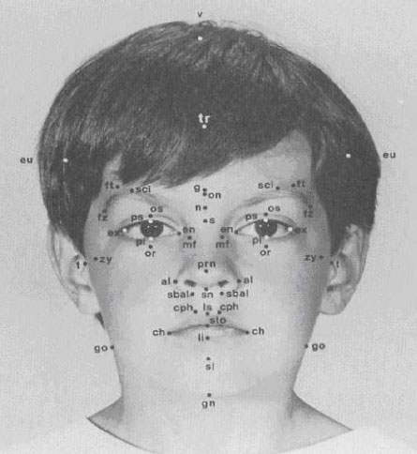
Related Literature
Medical Craniofacial Assessment
calipers, manual landmarks
CT, MRI, Ultra Sound, Stereoscopic imaging
Time consuming human involvement
70
Notes:
original measurements of calipers are intrusive, so movement to imaging systems
normative data is mostly caucasian
features were looking for are less than variance between different ethnicities

Slide 71
Related Literature
Computer Vision Craniofacial Analysis
1D waveforms
2D images, landmarks
3D morphable models, new representations, landmarks
hybrid 2D/3D systems
Focus: biometric authentication and recognition
71
Notes:
1D - Fourier, Cosine, Wavelets
2D - eigenfaces, lots of similar to 1D, and landmark models/placement
3D - morphable models (Hutton), Sal’s work on cheeks, landmark models/placement
hybrid - geodesic faces (make 2D texture from 3D data), use different modalities (photo, range image and infrared image and combine results)
CV work doesn’t directly apply to MD stuff so had to build infrastructure from scratch
bio authentication -- that’s interesting work, and techniques can be leveraged
trying to get exact measurements, while we want to categorize degrees of dysmorphology (so two different tasks) - devil’s in the details

Slide 72
Data Representation
3D snapshot
2.5D depth image
Curved lines
72
Notes:
Data representation

Slide 73
Results: 3D snapshot vs. 2.5D
73
Notes:
the next experiment we wanted to run to see how does 3Dsnp compares to 2.5D
human point of view
they all do about the same in Fmeasure, but 3dsnp and 2.5D represent different points on the precision recall curve
3dSnp is more precision, but gets fewer of the affected individuals
2.5D gets more of the affected individuals, but it’s precision goes down
different applications might prefer one or the other, we want 2.5D since it misses fewer of the affected individuals
(ALSO more similar to expert results)

Slide 74
Results: Curved Lines
74
Notes:
Seven lines - less info in side of face
Few lines better than whole image - noise
might be really good at picking out some global features like bump in forehead or low tone cheeks

