Slide 1


Brief Introduction to
CT and PET Imaging
Hesam Jahanian, PhD
Oct 6, 2021
Advanced Functional Neuroimaing (AdFun) Lab
hesamj@uw.edu
Special Thanks to Paul Kinahan and Adam Alessio for sharing slides
Notes:
The most common cause of dementia Begins with subtle memory loss and Causes progressive loss of cognitive ability that ultimately impairs independent function. AD has characteristic brain pathology

Slide 2
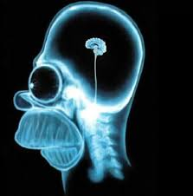
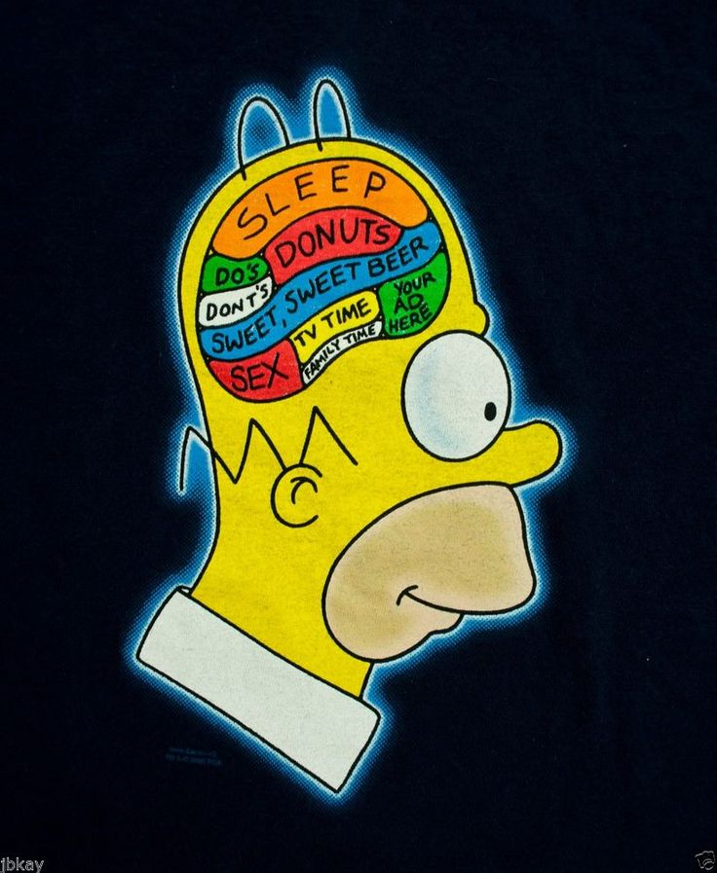
Anatomical Imaging vs Functional Imaging
Anatomical Imaging
Functional Imaging
Computed
Tomography
(CT)
Positron Emission
Tomography
(PET)
Physiological Information
is Interpreted
Functional Information
is Measured
Notes:
Traditionally we image the anatomy and physiological information is interpreted from the data.
For example if we see significant atrophy in one area of the brain we can assume that the functional related to that area is also affected.
Alternatively, in modern medical imaging we try to directly measure the physiological information that we are interested in. for example these days we can directly measure
e.g. Blood flow, blood volume, metabolism, neuronal activity
ok lets talk about some examples of each of these categories

Slide 3
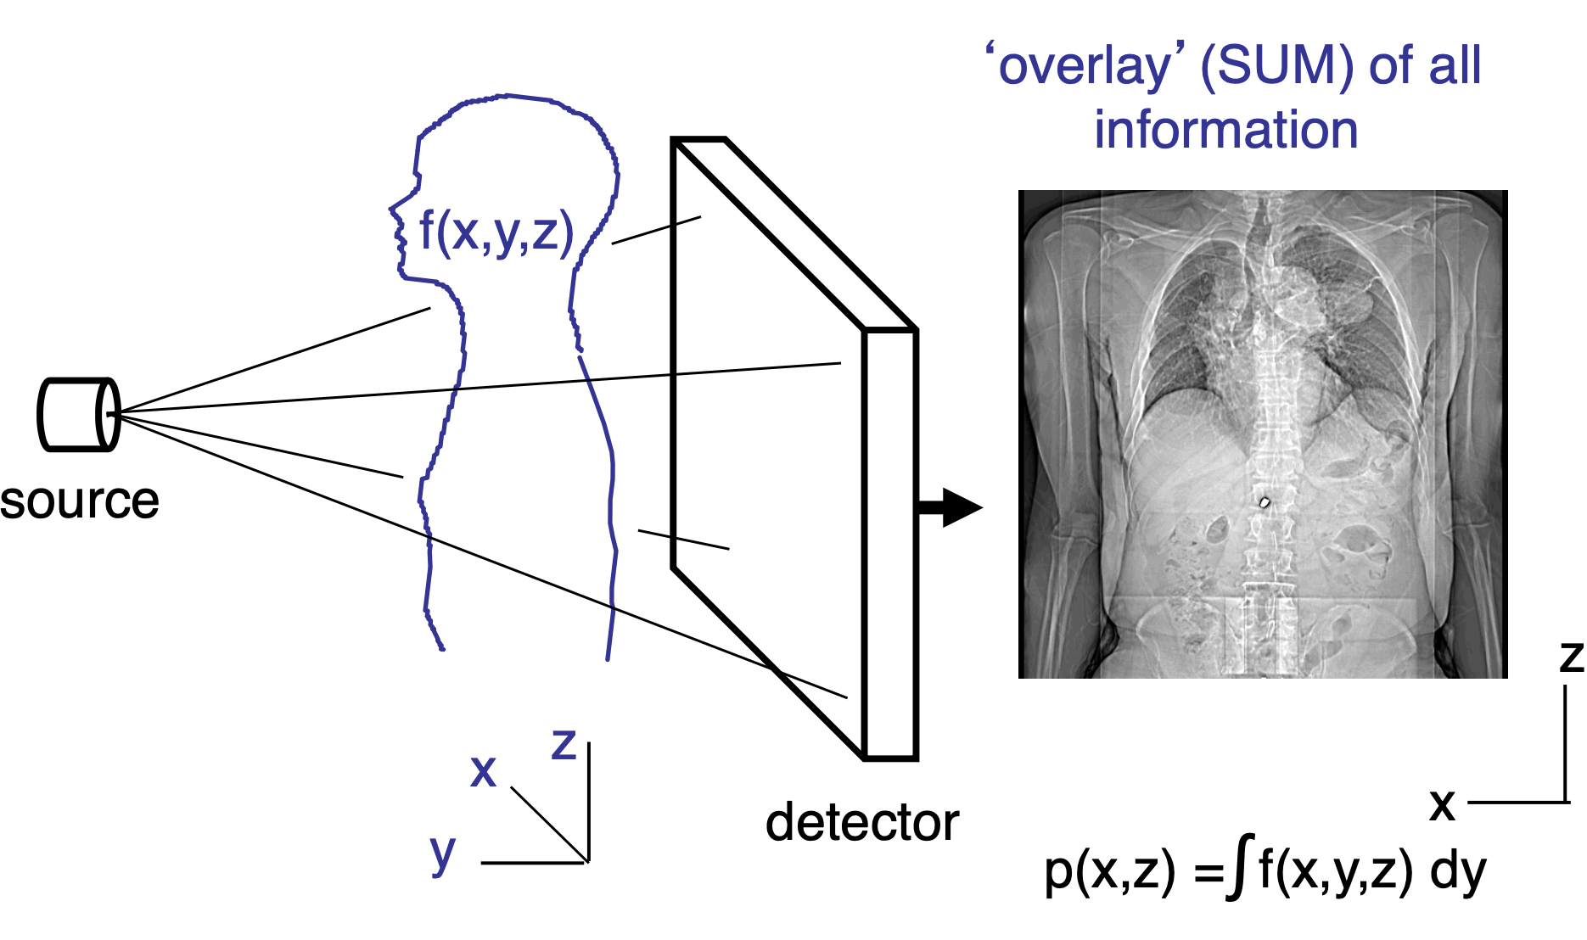
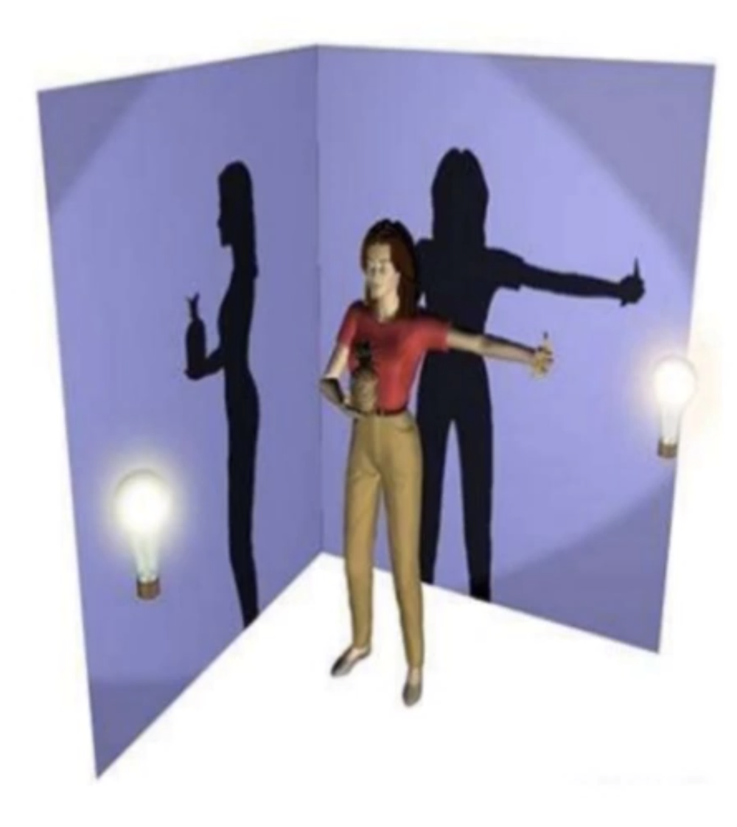
Projection Imaging
Single 2D image is created from 3D body; “Shadow” of the body in one direction

Slide 4
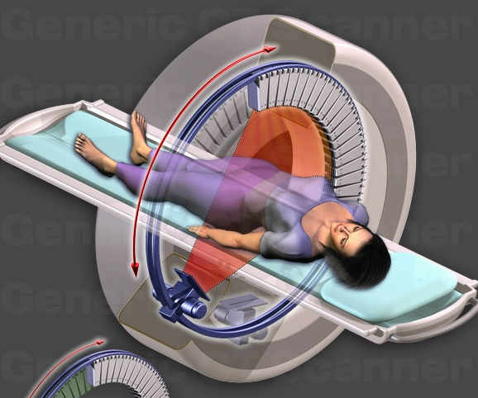
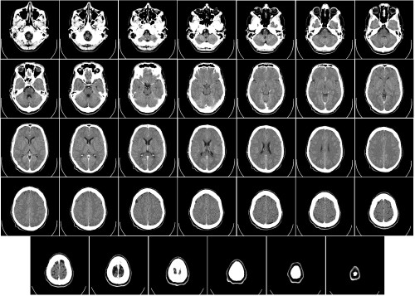
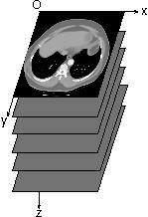
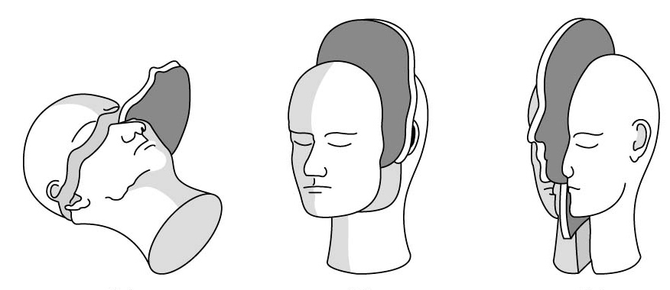
Tomographic Imaging
form image volume
tomographic acquisition
reconstruction of multiple images
Tomo + Graphy
=
Slice + Picture
True Cross-sectional
Image
3D image from
3D body
transaxial or axial view
coronal view
sagittal view

Slide 5
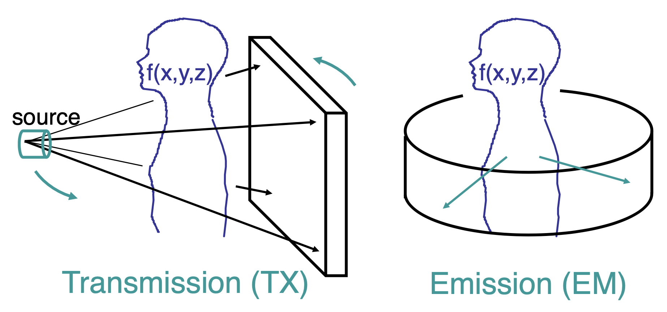
Types of Tomographic imaging systems
CT
PET
Same mathematics of tomography

Slide 6
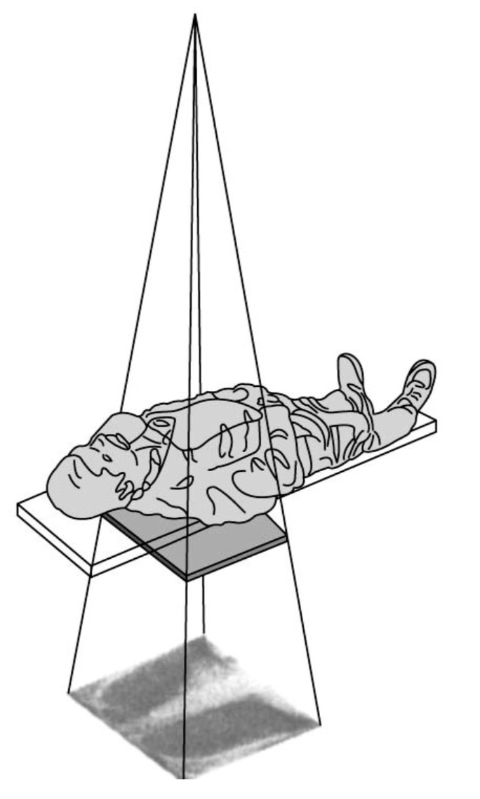
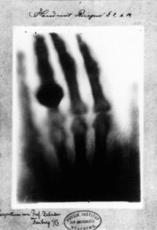
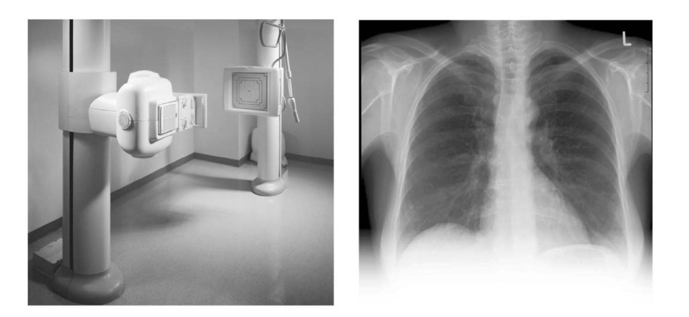
In the beginning, there was x-ray …
Contrast: density of X-ray absorption
First x-ray image was captured in 1895 by Rontgen
Notes:
The oldest imaging modality is x-ray
first x-ray image was captured at 1895 by Rontgen
The physical parameter that we are measuring is density of X-ray absorption.
in X-ray we have a source that generate and emits the X-ray and a detector that records the intensity of X-rays. X-rays gets absorbed or attenuated as they travel through the body and different tissue types have different attenuation coefficient. So the signal intensity on the detector, corresponds to the line integration of X-ray attenuation coefficient of the material that x-ray passes when traveling from source to detector.

Slide 7
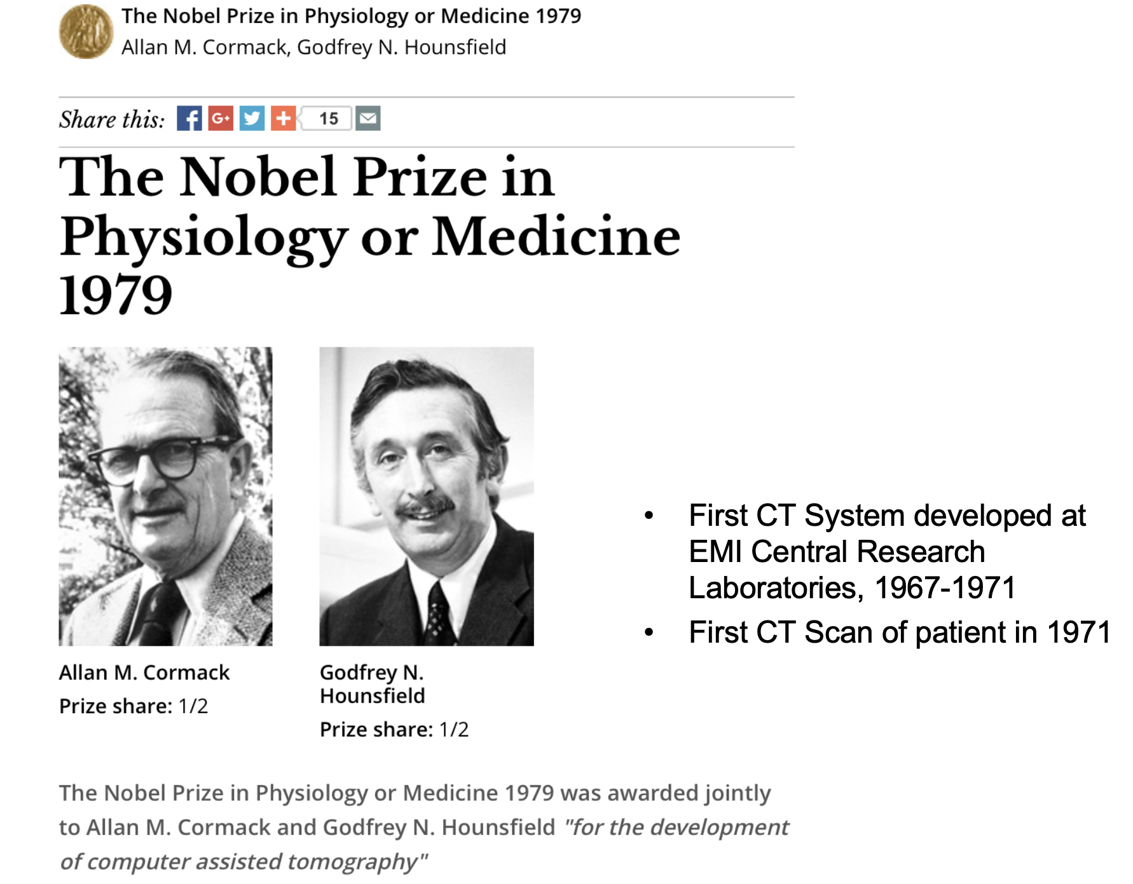

Slide 8
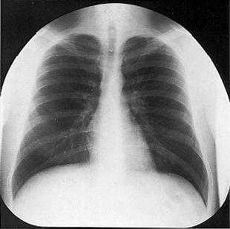
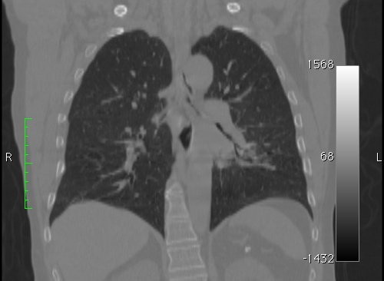
X-ray vs Computed Tomography (CT) Imaging
Hounsfield's insight was that by imaging all the way around a patient we should have enough information to form a cross-sectional image
Radiographs typically have higher resolution but much lower contrast and no depth information (i.e. in CT section below we can see lung structure)
Chest radiograph
Coronal section of a 3D CT image volume
Notes:
the revenues from the selling of the Beatles' records by Electric and Musical Industries (EMI) allowed the company to develop the computed tomography (CT) scanner.
Without salary expenses to Godfrey Hounsfield and his team, the development of the CT scanner cost EMI approximately £100,000. The British DHSS's expenses were £606,000. Hence, the financial contribution of DHSS into the development of the CT scanner was significantly bigger than that of EMI.

Slide 9
CT Scanner Components
x-ray tube
x-ray fan beam
patient
rotating gantry with tube and detectors attached
couch
detector array
Data acquisition in CT involves making transmission measurements through the object at angles around the object.
A typical scanner acquires 1,000 projections with a fan-beam angle of 30 to 60 degrees incident upon 500 to 1000 detectors and does this in <1 second.

Slide 10
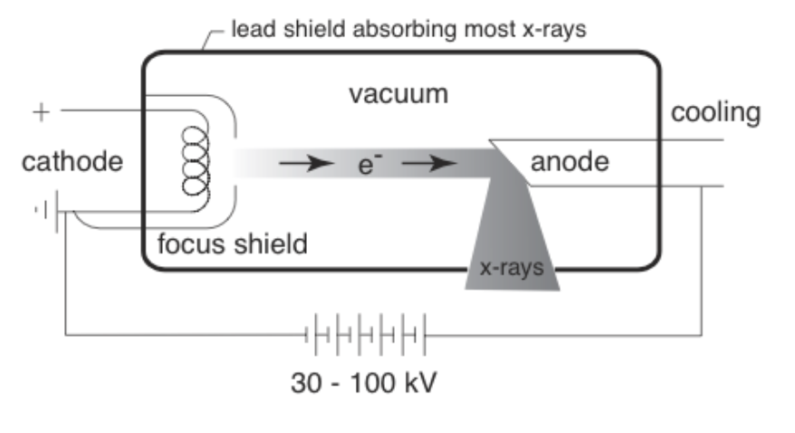
CT components: X-ray Tube
In evacuated tube, heated cathode current releases electrons
Electrons are accelerated to anode by voltage
Amount of x-ray photons = Cathode current × time [mAs]
Energy of the x-rays controlled by voltage between anode and cathode [kV]

Slide 11
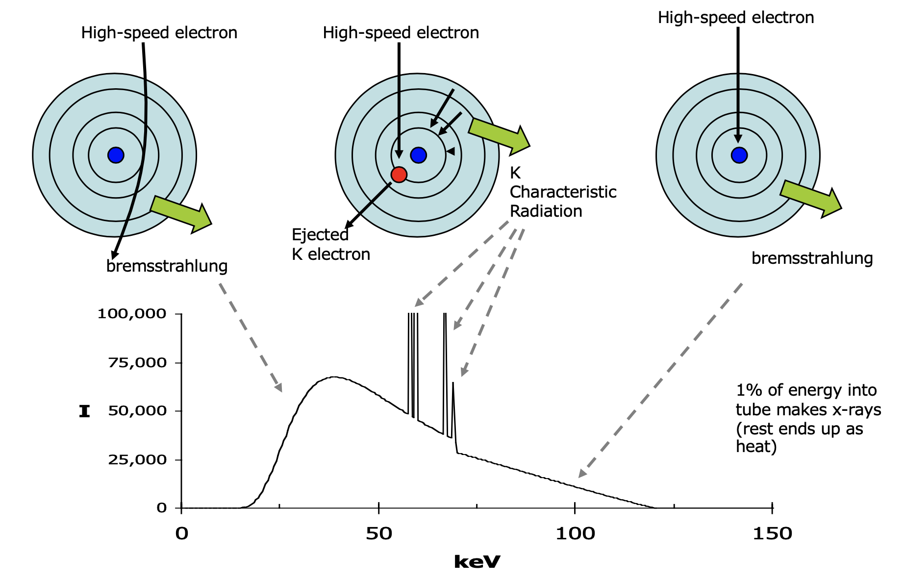
CT components: X-ray Production
Accelerated electron interacts with nuclei in anode
Electrons release their energy as bremsstrahlung and characteristic radiation
bremsstrahlung (braking radiation) is radiation produced due to the deceleration of electrons

Slide 12
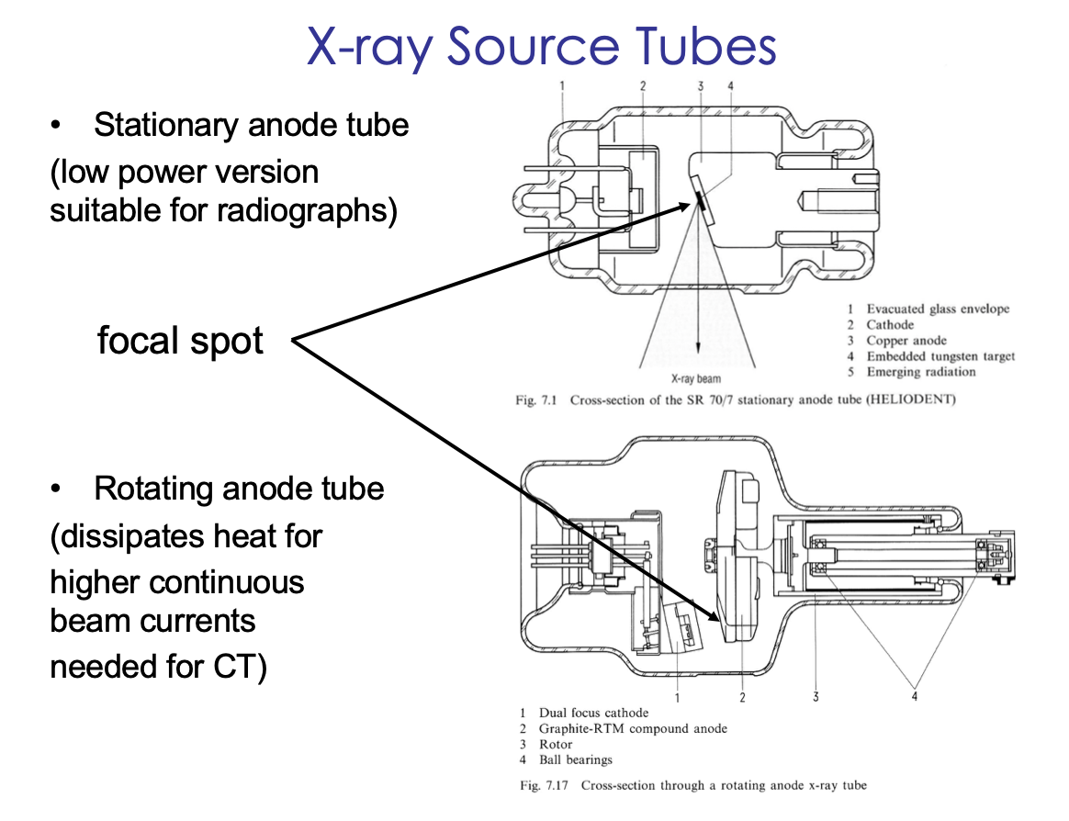
CT components: X-ray Source Tubes

Slide 13
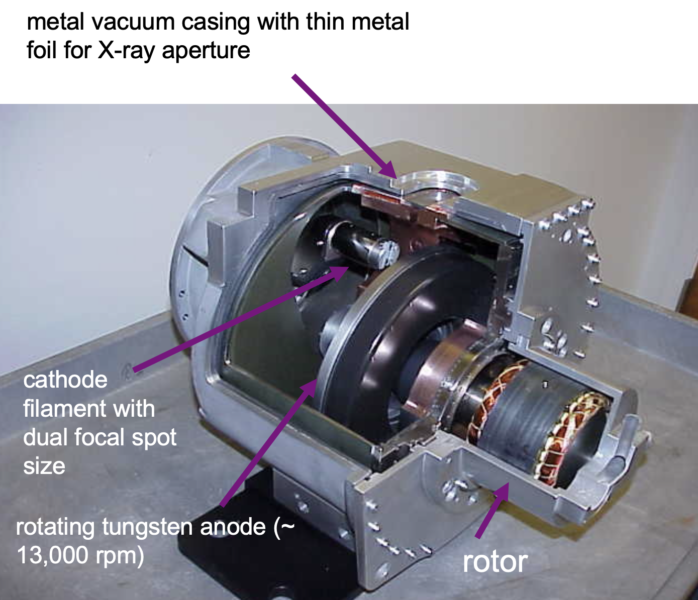
Modern X-ray Tube (GE Performix)

Slide 14
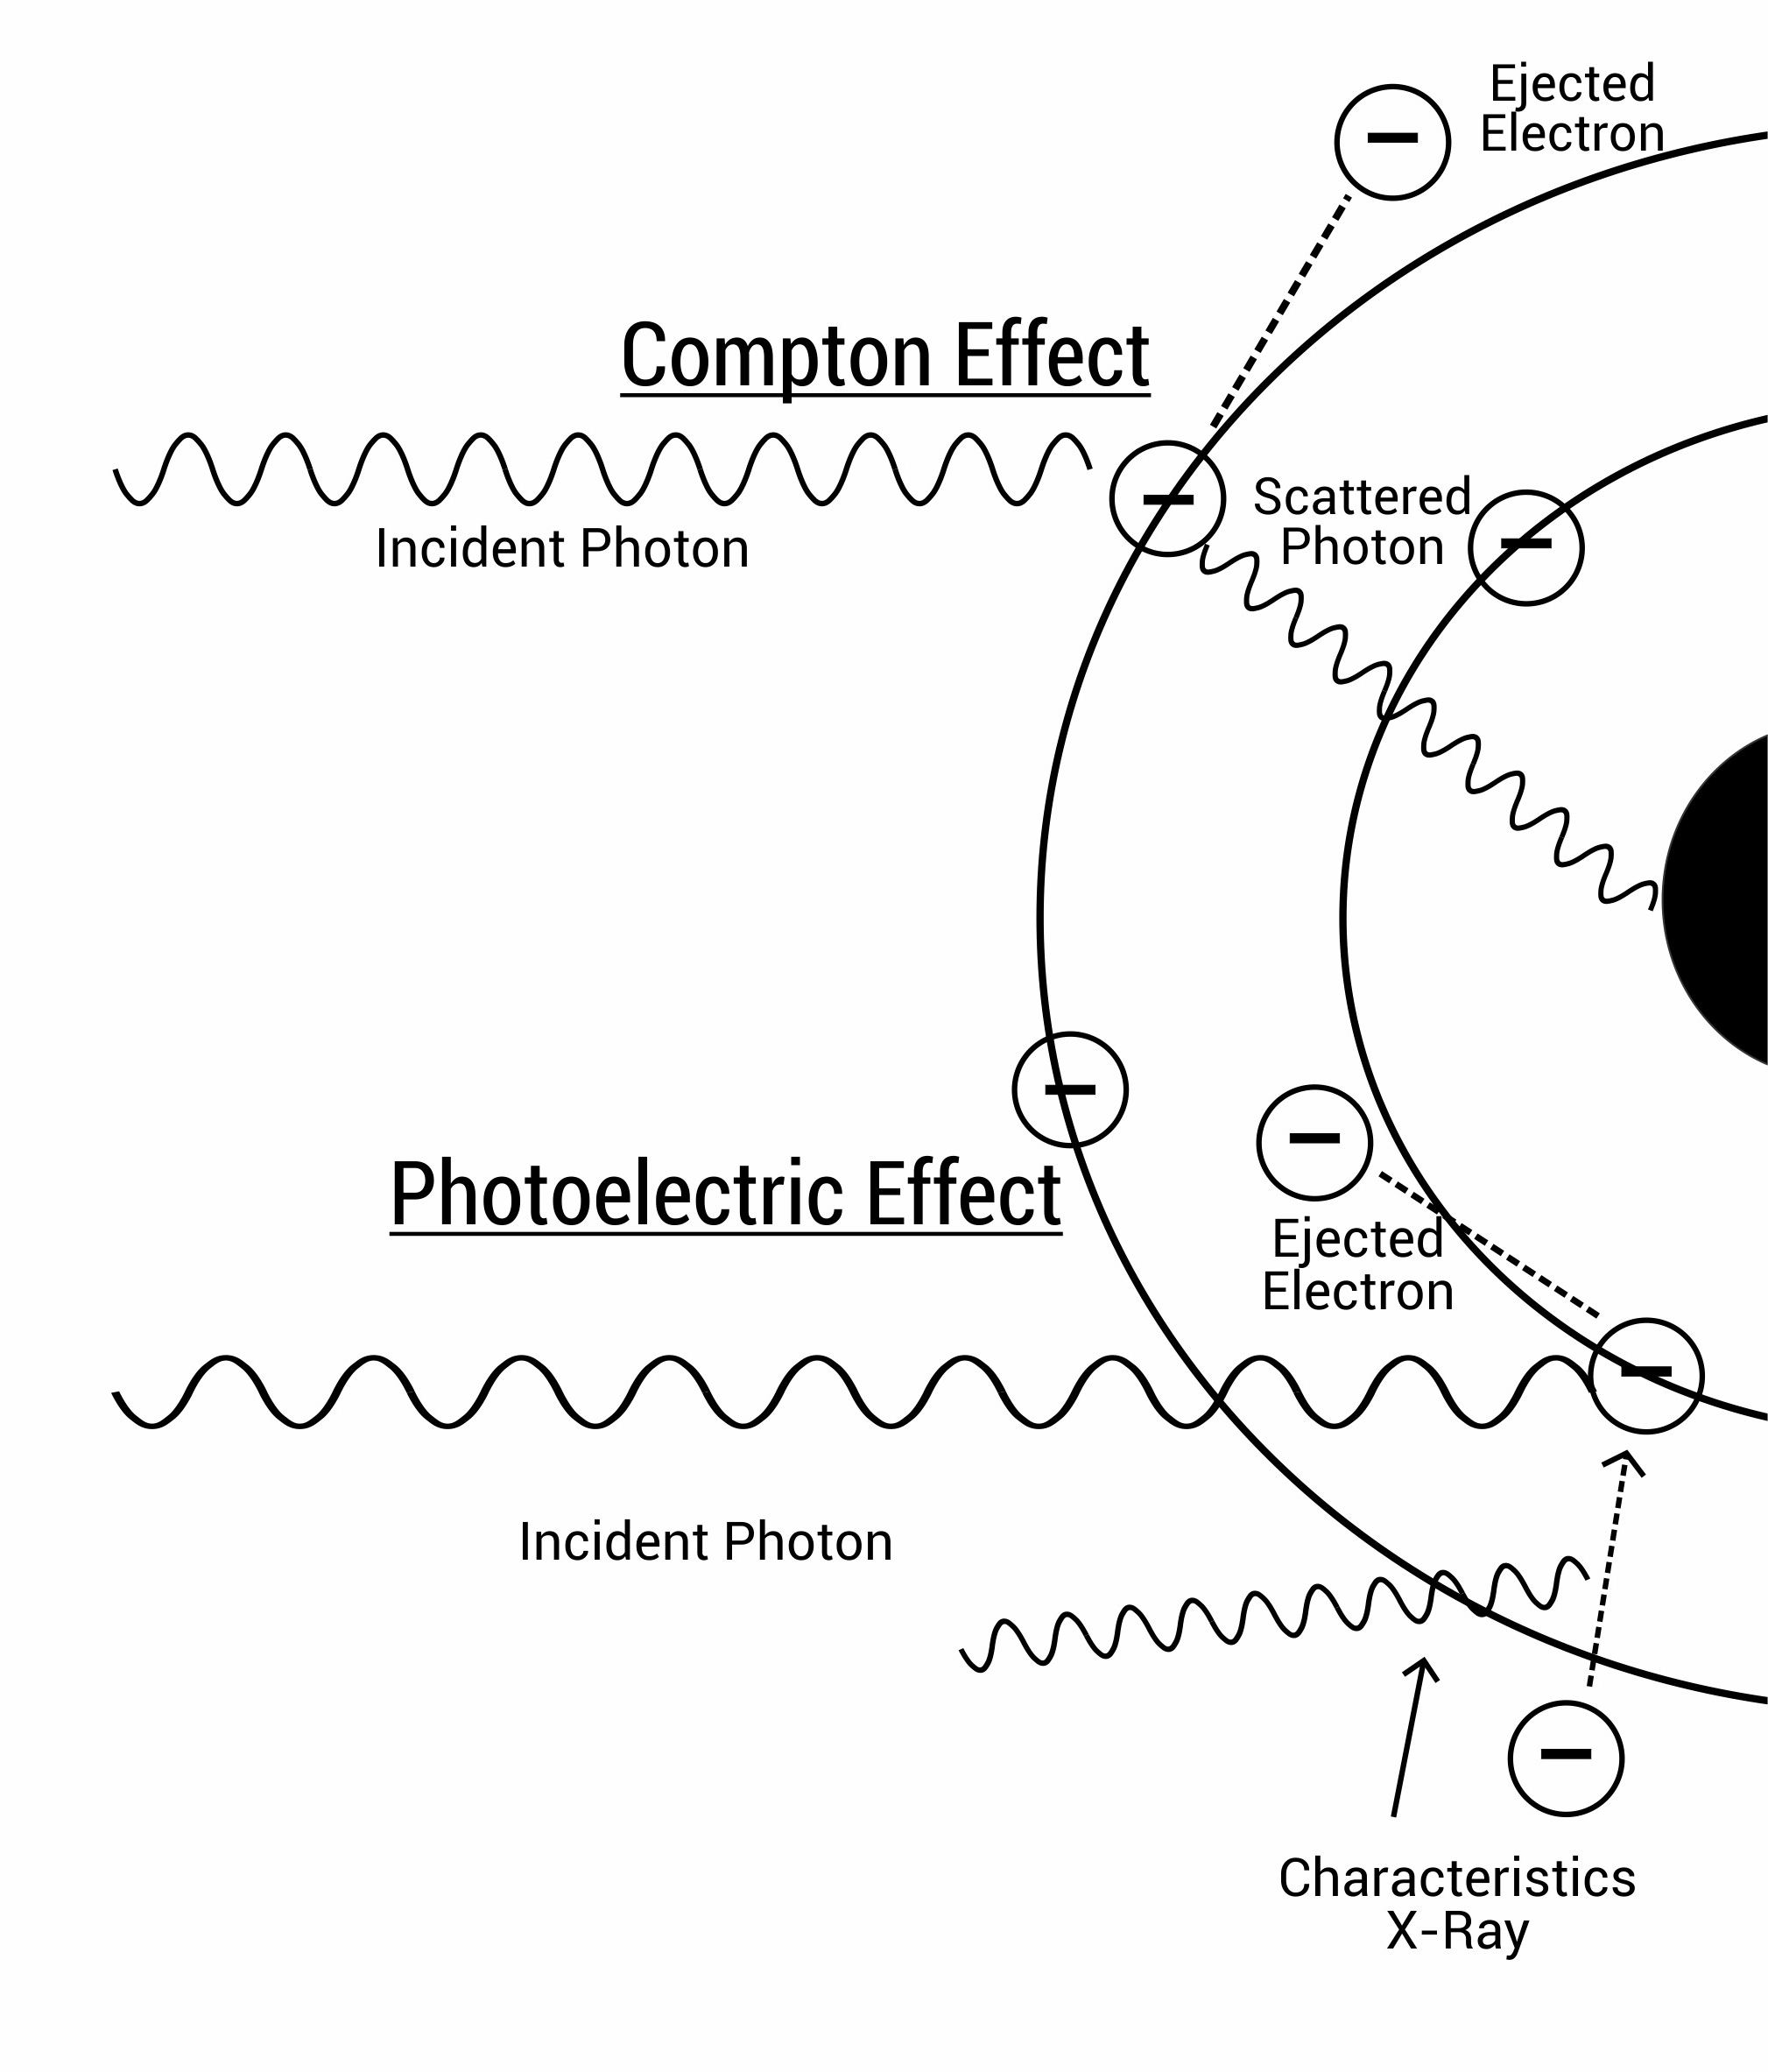
CT components: X-ray interaction with matter
Photon interacts with an
outer orbital electron
Photon collides with
an inner-shell electron

Slide 15
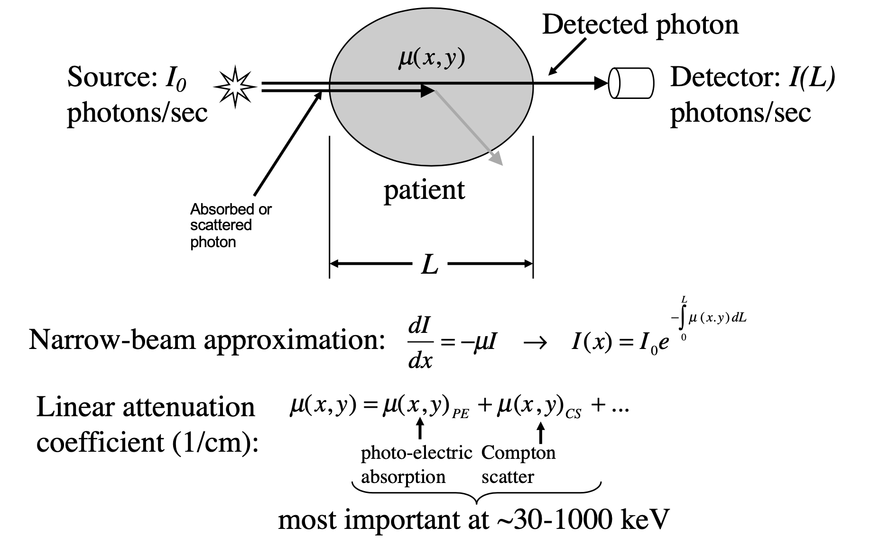
CT components: contrast

Slide 16
CT components: contrast
Attenuation of photons is a function of
Energy of the photons
Medium (density & atomic number)

Slide 17
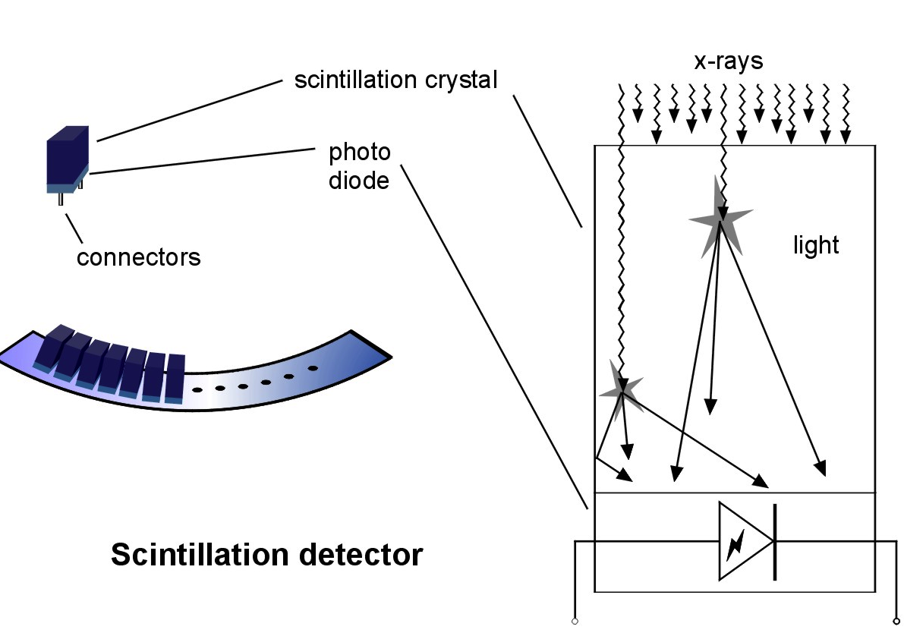
CT components: Detectors
The detectors are similar to those used in digital flat-panel X-ray imaging systems: scintillation followed by light collection
The scintillator (e.g. CsI) converts the high-energy photon to a light pulse, which is detected by photo diodes

Slide 18
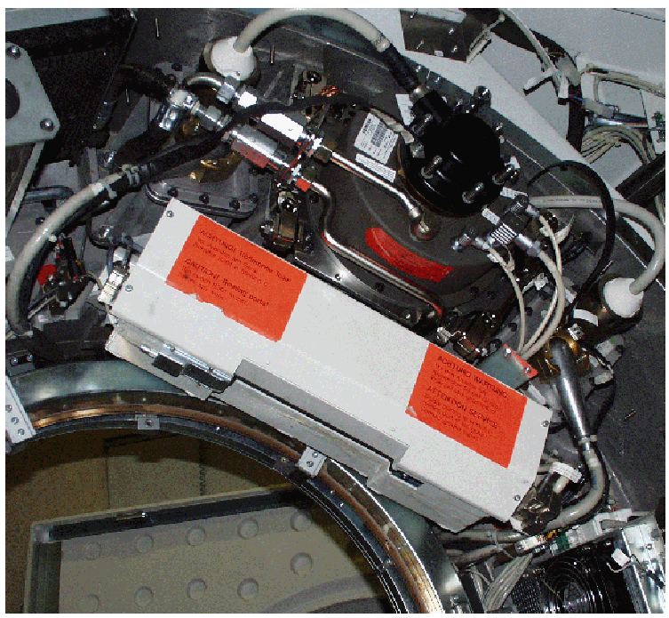
Pre-patient Collimation
Controls patient radiation exposure
X-ray tube
collimator
and filtration
assembly
X-ray slit

Slide 19
Pre-patient Collimation
Controls patient radiation exposure
X-ray tube
'fan' of X-rays

Slide 20
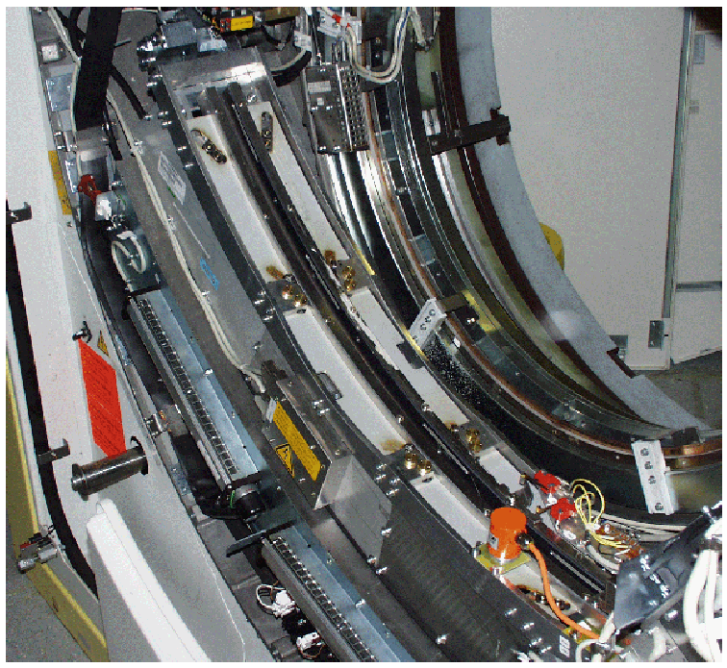
X-ray Detector Assembly
collimators
detectors

Slide 21
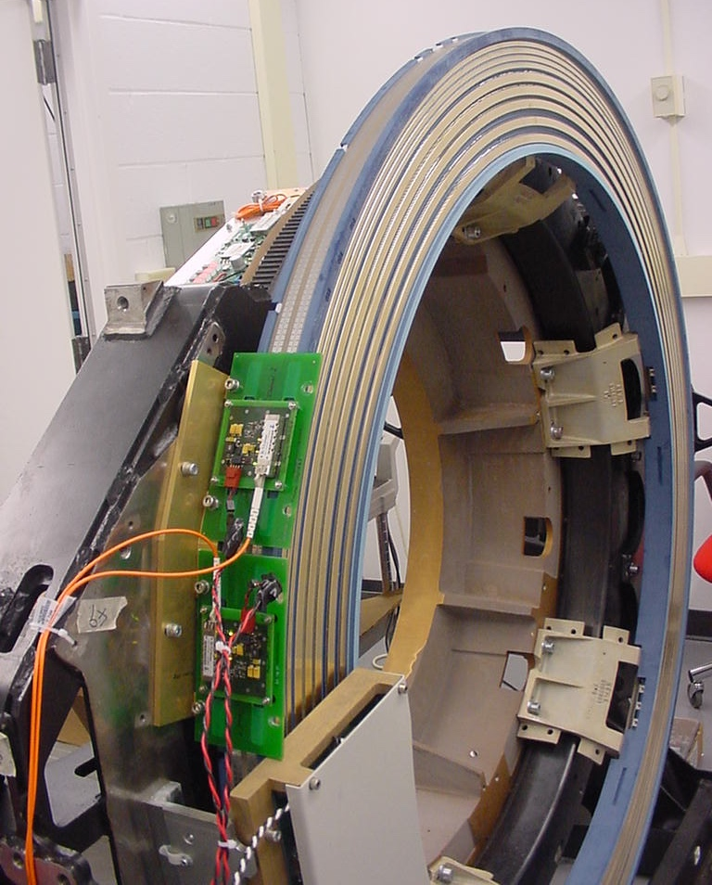
Gantry Slip Rings
Allows for continuous rotation
Notes:
A slip ring is electromechanical technology that enables the transmission of power and electrical signals from a stationary to a rotating structure. This transmission of power/data is made possible through electrical connections made by stationary brushes pressing against rotating circular conductors.
This technology is also called "rotary electrical joint" and "electric swivel" technology. A slip ring can be used in any electromechanical system that requires unrestrained, intermittent or continuous rotation while transmitting power and / or data. In Radiology, Slip Ring technology is found in CT, MRI, high-resolution ultrasound and digital mammography systems. In additional to medical systems, Slip Rings are also found in Electro-Optic Systems, Helicopters, Propellers, Wind Turbines and some Vehicles.
CT Slip ring technology was introduced to enable helical (continuous rotating) scanning. Prior to the introduction of Slip Rings, only Axial scanning was possible (which had the need to stop / reverse direction of rotation, after no more than 700 degrees rotation due to the finite length of the attached cables.) Slip ring technology eliminated the need for cables and enabled the continuous rotation of the gantry components.

Slide 22
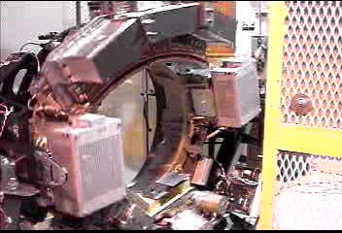
CT Scanner in operation
64-slice CT, weight ~ 1 ton, speed 0.33 sec (180 rpm)

Slide 23
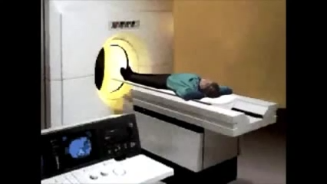

CT imaging - Summary
Notes:
3D images are generated from a large series of 2D X-ray images taken around a single axis of rotation

Slide 24
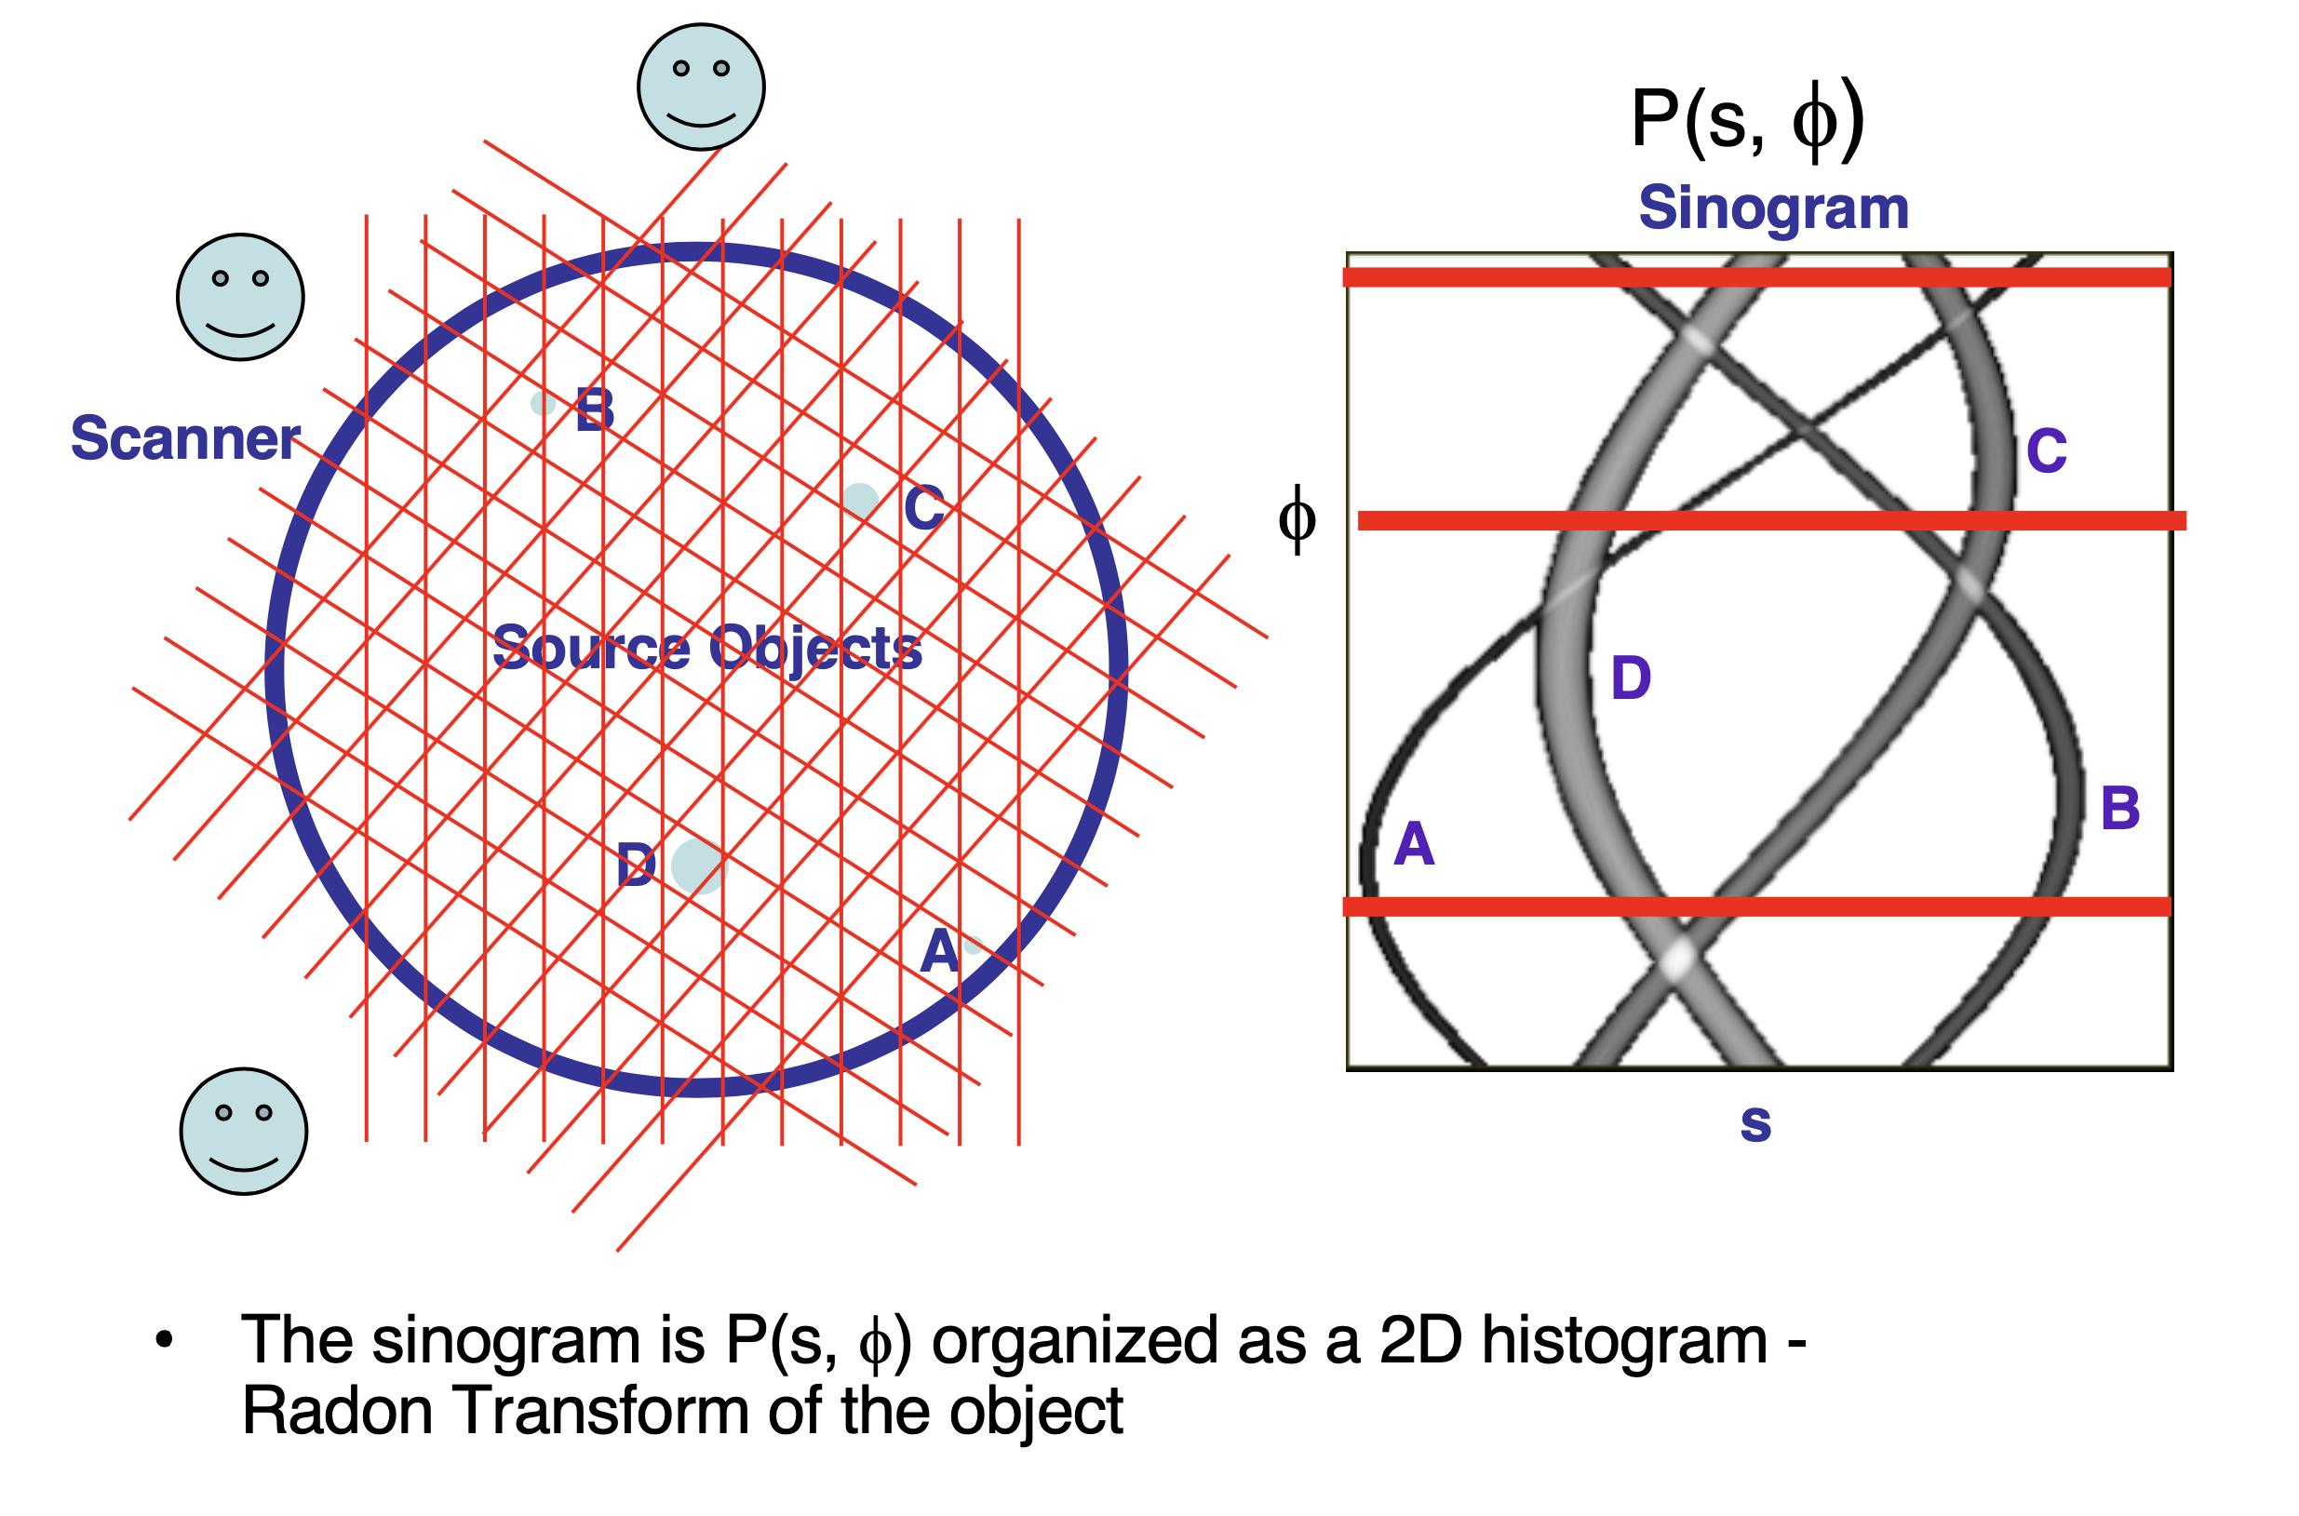
CT scan: Raw data

Slide 25
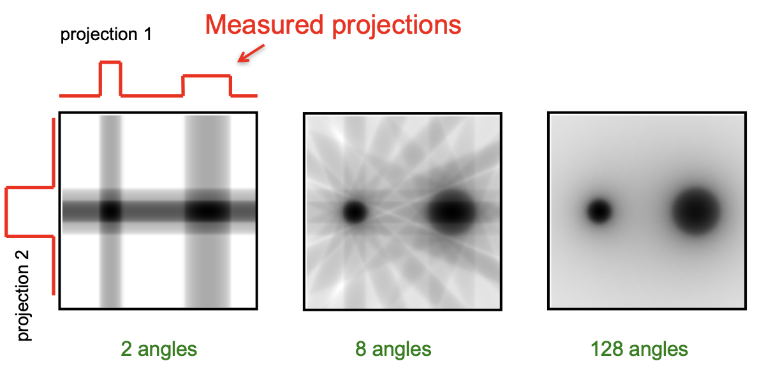
Image reconstruction – Simple Back Projection
Object
Back Projection = "smearing back" the projection across the image at the angle it was acquired

Slide 26
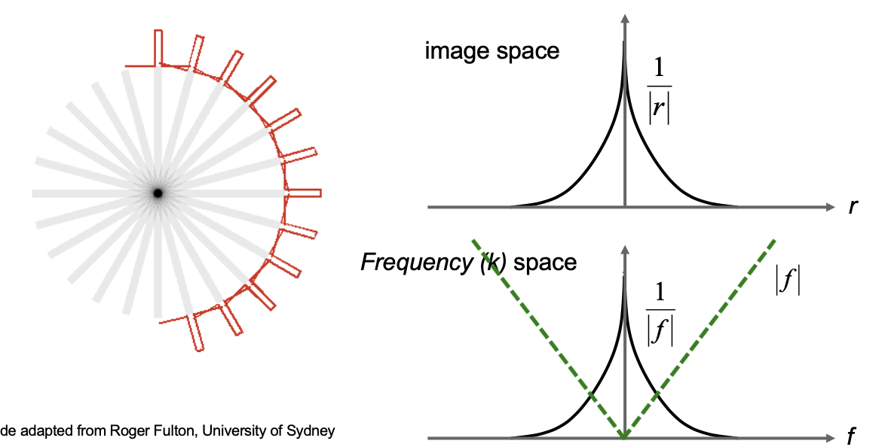
Image reconstruction – Simple Back Projection
Leads to radial (1/r) blurring in the spatial domain
Equivalent to a 1/f function in the frequency domain
We need to multiply 1/f by |f| to result in a perfect point source reconstruction

Slide 27
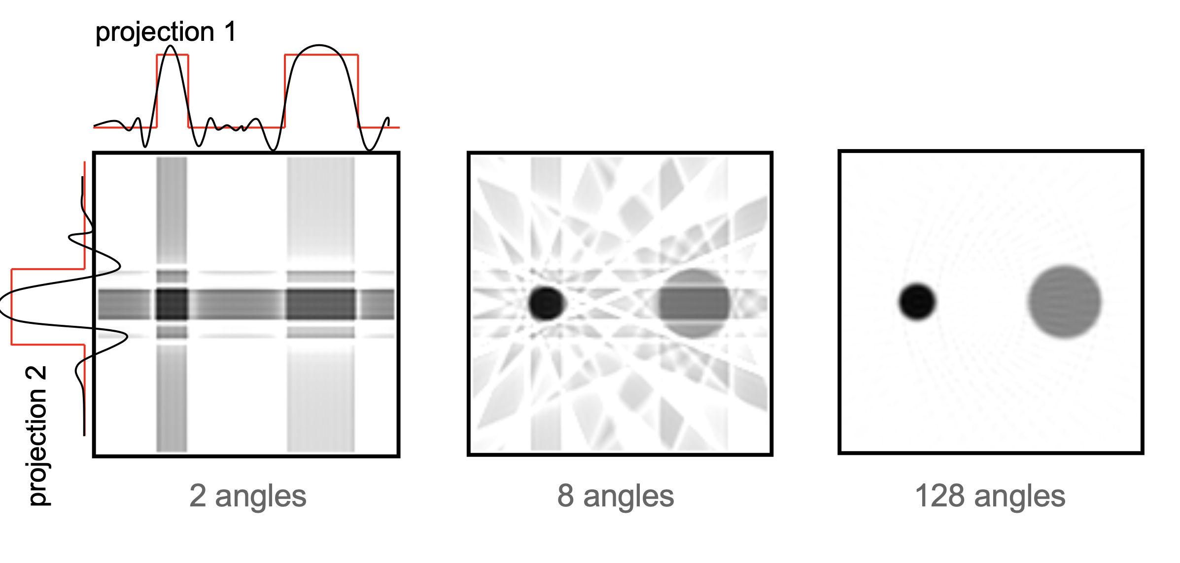
Image reconstruction – Filtered Back Projection
Object
Filtered Back Projection = "smearing back" the filtered projection across the image at the angle it was acquired

Slide 28
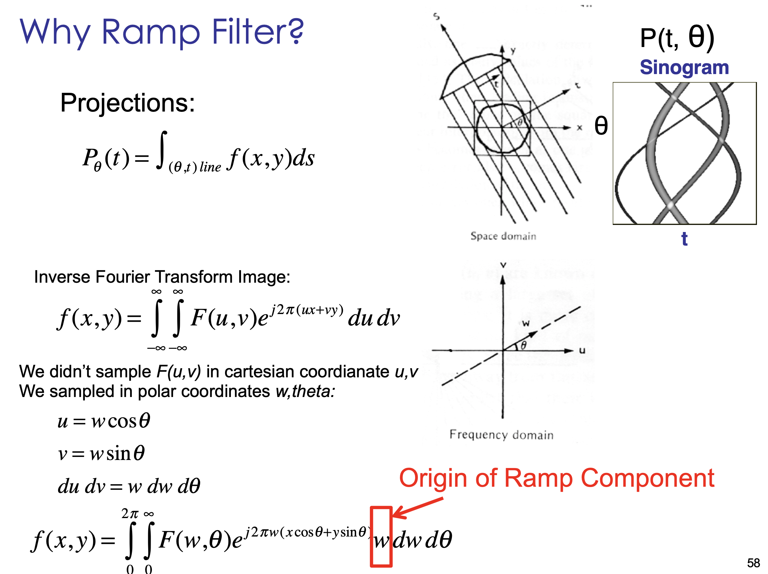
Filtered Back Projection
Projection Slice Theorem: Fourier transform of a projection at angle θ gives us a line in the polar Fourier space at the same angle θ
Notes:
Central Section Or Projection Slice Theorem

Slide 29
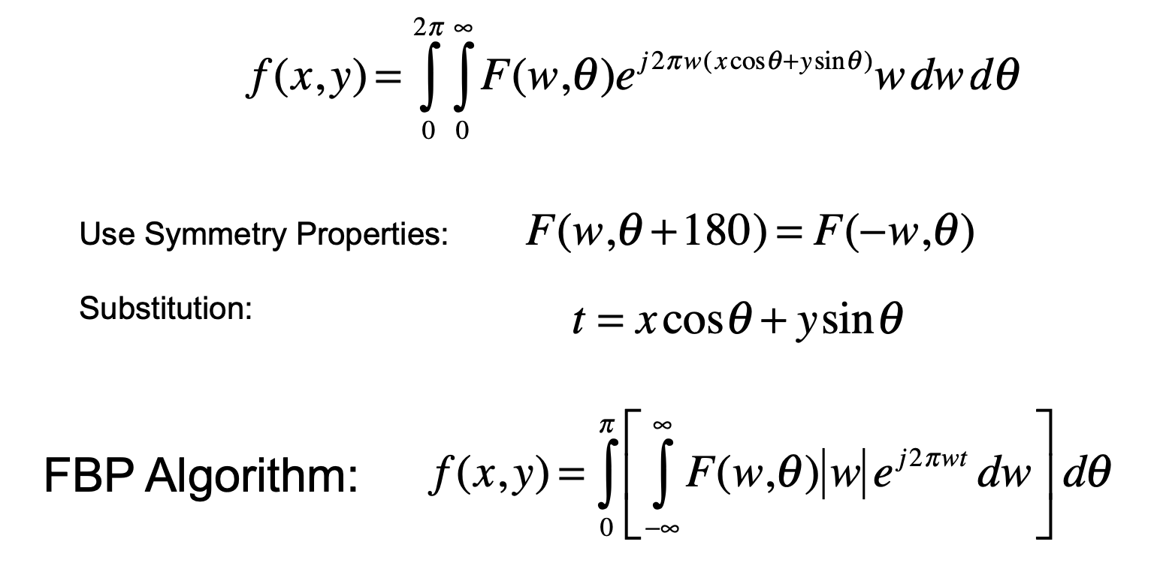
Filtered Back Projection
Take Fourier Transform of a projection at θ
Weight with “ramp” w
Take Inverse Fourier Transform at θ
Integrate over all θ to get f(x,y)

Slide 30
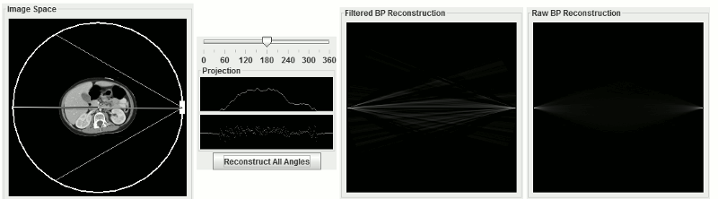
Image reconstruction – Filtered Back Projection
Notes:
http://xrayphysics.com/ctsim.html
Why? The remaining 180 degrees are simply a mirror image of the first.
because it does not matter which way a photon travels through tissue, it will be attenuated the same amount
you need to measure an extra amount - equal to the fan angle - to actually get all of the data you need, but the concept is the same.)

Slide 31
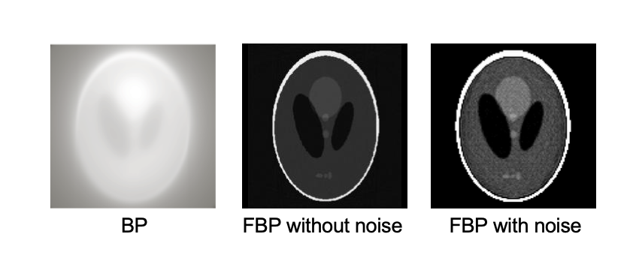
Filtered Back Projection
Works well when there is no noise, but real projections contain noise...

Slide 32
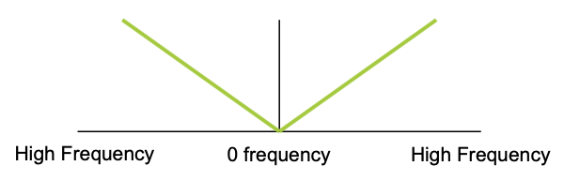
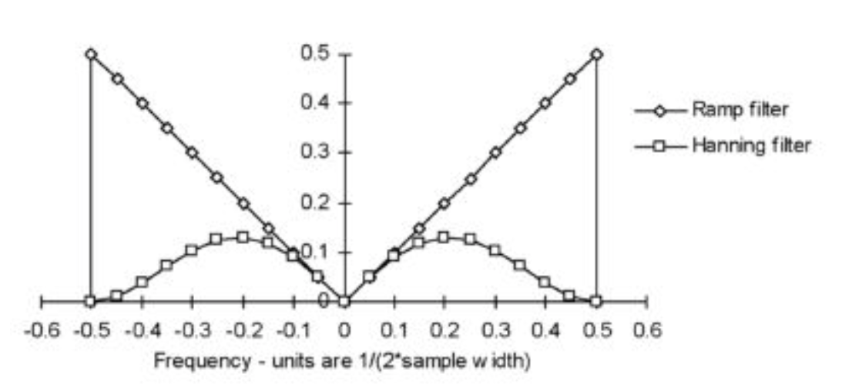
Filtered Back Projection – Effects of Filter
Ramp filter accentuates high frequency - Not good for noise
Additional filters are used to roll-off ramp to reduce noise: ex: Hanning filter

Slide 33
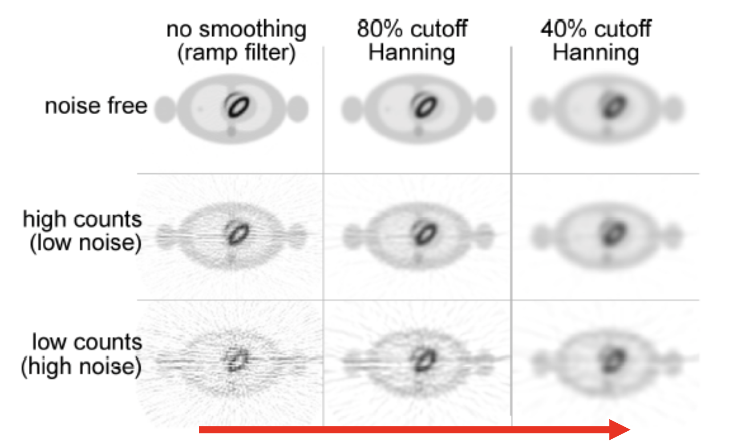
Filtered Back Projection – Effects of Filter
Reduce noise & Increase blurring

Slide 34
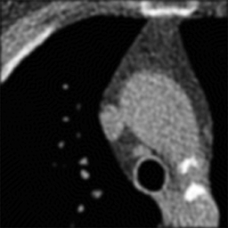
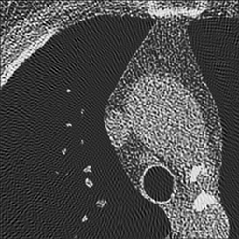
Filtered Back Projection – Effects of Filter
Soft Kernel
Sharp Kernel
We choose different kernels based on what type of image we are trying to create.

Slide 35
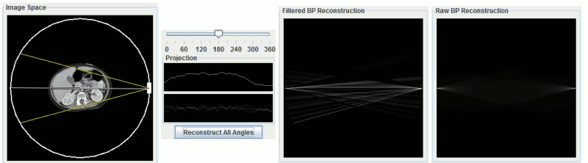
Filtered Back Projection – Effect of fan-beam angle
In a fan-beam geometry, the angle of the fan determines how much of the object is included in the reconstructible field of view.
A point must be included in all 180 degrees of projections in order to be reconstructed correctly.

Slide 36
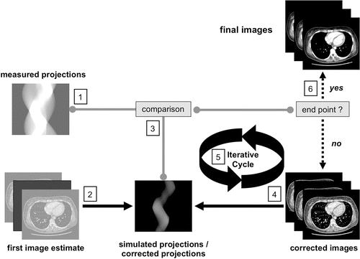
Image reconstruction – Iterative Methods

Slide 37
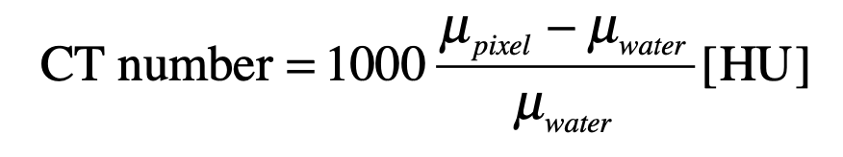
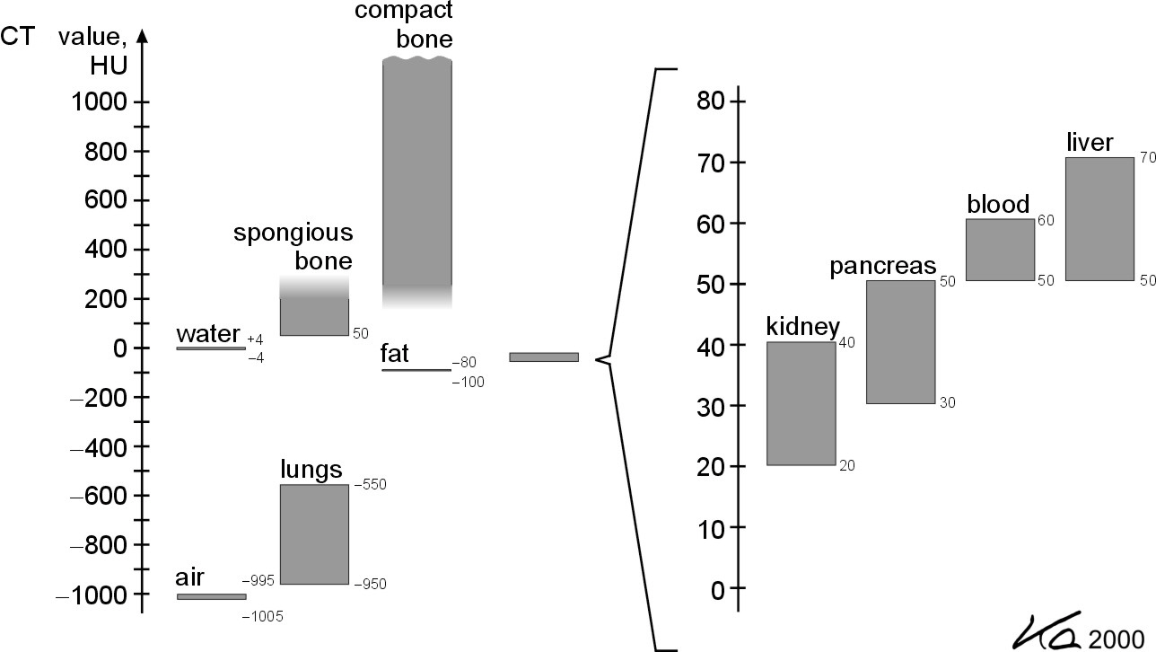
CT Number
To provide a uniform scale, do a scale conversion where all scanners set air = -1000 and water to 0. Units are called Hounsfield units [HU] after Godfrey N. Hounsfield.
Some typical values
other tissues
Notes:
We can't solve the real inverse problem since we have a mix of materials and densities, each with different Compton and photoelectric attenuation factors at different energies, and a weighted energy spectrum

Slide 38
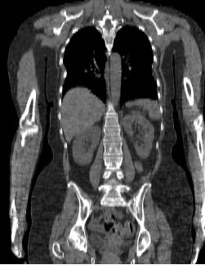
CT Number
To provide a uniform scale, do a scale conversion where all scanners set air = -1000 and water to 0. Units are called Hounsfield units [HU] after Godfrey N. Hounsfield.
Some typical values
other tissues

Slide 39
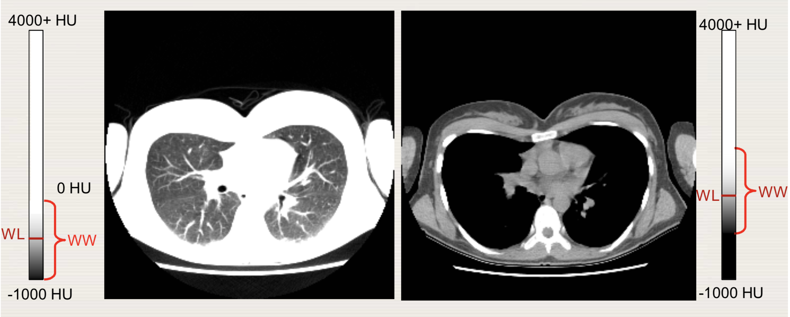
CT Number – Displaying CT Images
WL -593, WW 529
WL -12, WW 400
Same image data at different WL and WW
Notes:
The choice of WW and WL is dictated by clinical need
Optimal visualization of the tissues of interest in the CT image can only be achieved by selecting the most appropriate window width and window level.
Different settings of the WW and WL are used to visualize for example soft tissue, lung tissue or bone.

Slide 40
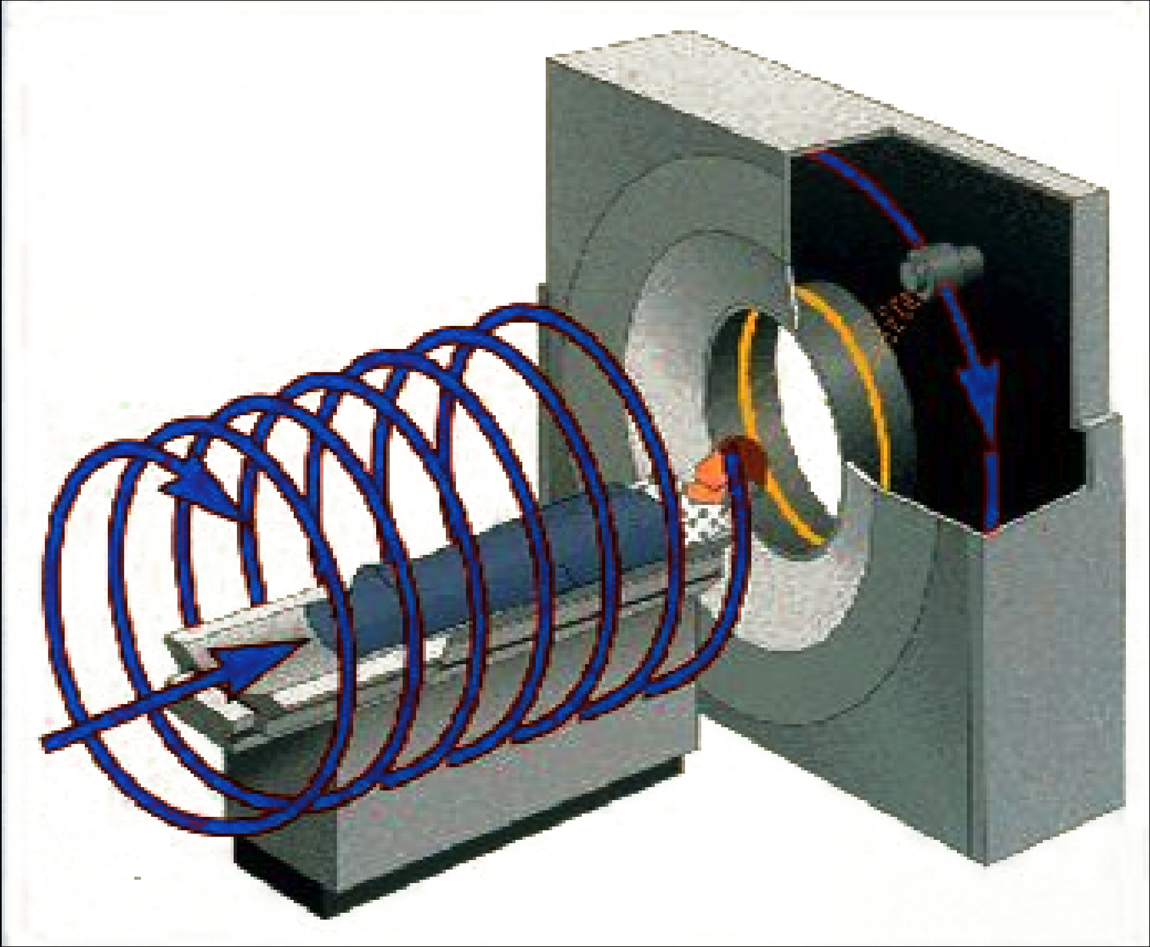
Helical CT scanning
The patient is transported continuously through gantry while data are acquired continuously during several 360-deg rotations
The ability to rapidly cover a large volume in a single-breath hold eliminates respiratory misregistration

Slide 41
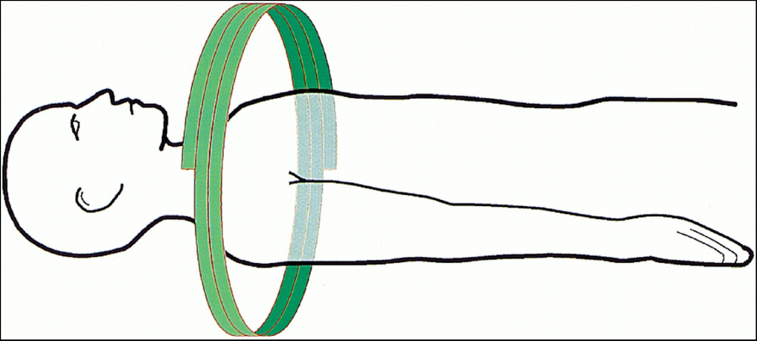
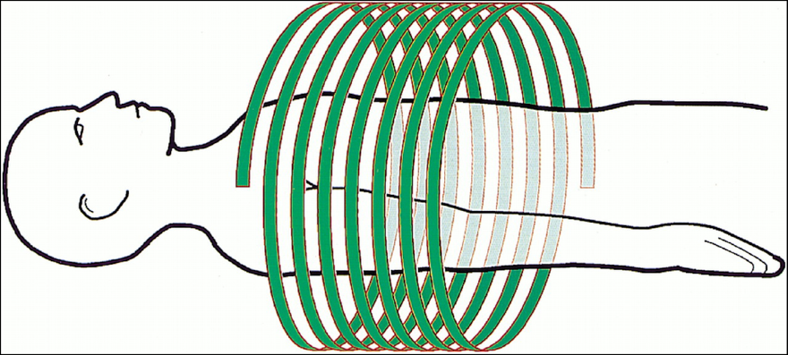
Helical CT scanning
slingle slice example
Pitch = 1
Pitch = 2
A pitch of 1.0 is roughly equivalent to axial (i.e. one slice at a time) scanning
  best image quality in helical CT scanning
A pitch of less than 1.0 involves overscanning
  some slight improvement in image quality, but higher radiation dose to the patient
A pitch greater than 1.0 is not sampling enough, relative to detector axial extent, to avoid artifacts
  Faster scan time, however, often more than compensates for undersampling artifacts (i.e. patient can hold breath so no breathing artifacts).
Notes:
This is for one detector array.
Pitch influences radiation dose to patient, image quality and scan time.

Slide 42
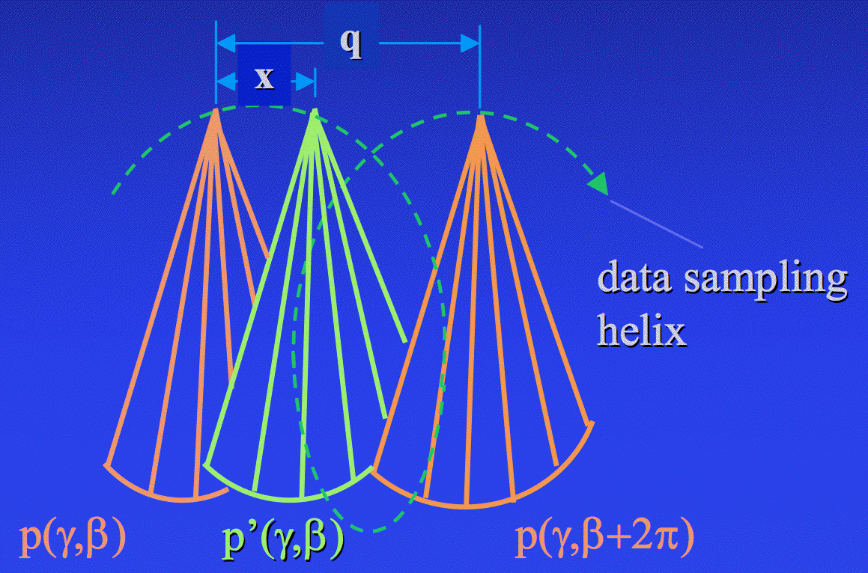
Helical CT scanning – Image reconstruction
Samples for the plane-of-reconstruction are estimated using two projections that are 2π apart
where

Slide 43


Single vs Multi-row detectors
Can image multiple planes at once
1 detector row
4 detector rows
Notes:
Additional rows curved towards the source?

Slide 44

Helical-multidetector CT
Fastest possible acquisition mode -- same region of body scanned in fewer rotations, even less motion effects
Single row scanners have to either scan longer, or have bigger gaps in coverage, or accept less patient coverage
The real advantage is reduction in scan time
1 detector row: pitch 1 and 2
4 detector rows: pitch 1

Slide 45
Emission Tomography
CT
PET
We want photons with differential absorption in tissue and complete absorption in the detectors
We want photons with no absorption in tissue and complete absorption in the detectors
Higher photons energies and thicker detectors for PET

Slide 46




Positron Emission Tomography
Radioactive
tracer
Detectors
1
2
3
4
Radionuclide Production
Radiochemistry (Label a tracer)
Imaging
Data analysis
Notes:
The choice of WW and WL is dictated by clinical need
Optimal visualization of the tissues of interest in the CT image can only be achieved by selecting the most appropriate window width and window level.
Different settings of the WW and WL are used to visualize for example soft tissue, lung tissue or bone.

Slide 47

Radionuclide Production
Stable nuclei bombarded with high energy particles
e.g. In production of F-18, O-18 is the target material bombarded with a proton causing a neutron to be emitted in the production of F-18
Requires on-site cyclotron or quick access to isotopes
Notes:
The choice of WW and WL is dictated by clinical need
Optimal visualization of the tissues of interest in the CT image can only be achieved by selecting the most appropriate window width and window level.
Different settings of the WW and WL are used to visualize for example soft tissue, lung tissue or bone.

Slide 48

2. Radiochemistry
Radioactive isotopes are synthesized with biologically meaningful material to form a radiotracer (radiopharmaceutical) - “label” a substance used in the body
Notes:
Unit are curies, (Ci), where 1 Ci = 3.7 x 10^10 disintegrations per second (dps), which is a lot
The SI units are becquerels, (Bq), where 1 Bq = 1 dps

Slide 49

3. Imaging
Notes:
The choice of WW and WL is dictated by clinical need
Optimal visualization of the tissues of interest in the CT image can only be achieved by selecting the most appropriate window width and window level.
Different settings of the WW and WL are used to visualize for example soft tissue, lung tissue or bone.

Slide 50

3. Imaging
Proton decays to neutron in nucleus
Unstable parent nucleus
Positron
combines with electron and annihilates
Two anti-parallel
511 keV photons
produced
Notes:
The choice of WW and WL is dictated by clinical need
Optimal visualization of the tissues of interest in the CT image can only be achieved by selecting the most appropriate window width and window level.
Different settings of the WW and WL are used to visualize for example soft tissue, lung tissue or bone.

Slide 51

3. Imaging
Photon travels through subject and interact with matter:
  Photoelectric Absorption
  Compton Scatter
The probability that the photons will continue on a straight line (will not be attenuated) is stated as:
Notes:
The choice of WW and WL is dictated by clinical need
Optimal visualization of the tissues of interest in the CT image can only be achieved by selecting the most appropriate window width and window level.
Different settings of the WW and WL are used to visualize for example soft tissue, lung tissue or bone.

Slide 52


3. Imaging
Photons Enter Detectors:
Photons enter scintillator-(One high energy photon makes many low energy photons)
Photo multipliers increase light to measurable signal
Detection system “counts” photon

Slide 53

3. Imaging
Photons pairs into coincident events
Notes:
The choice of WW and WL is dictated by clinical need
Optimal visualization of the tissues of interest in the CT image can only be achieved by selecting the most appropriate window width and window level.
Different settings of the WW and WL are used to visualize for example soft tissue, lung tissue or bone.

Slide 54

3. Imaging – Challenges
Errors in line of response (LOR) measurements
True Event
Both annihilation photons escape without scatter and interact in detector
Notes:
The choice of WW and WL is dictated by clinical need
Optimal visualization of the tissues of interest in the CT image can only be achieved by selecting the most appropriate window width and window level.
Different settings of the WW and WL are used to visualize for example soft tissue, lung tissue or bone.

Slide 55


4. Data analysis
Data organized into sinograms
LORs => Sinogram
Sinograms reconstructed into image
(Methods: FBP, Iterative,…)
Notes:
The choice of WW and WL is dictated by clinical need
Optimal visualization of the tissues of interest in the CT image can only be achieved by selecting the most appropriate window width and window level.
Different settings of the WW and WL are used to visualize for example soft tissue, lung tissue or bone.

Slide 56

Positron Emission Tomography - Summary
Notes:
PET tracer is : Chemical modelcule of interest attached to positron emitting isotop
Radioactive tracer is injected into the blood stream. Then we wait for the radio tracer to accumulates in the body tissue of interest for example in case of metabolism tracer they accumulate in tumors.
As the tracer decays they emit positron that in reaction with electrons generate pair of gamma rays in opposite directions.
Pairs of gamma are detected by gamma detectors in PET scanner and
An image is formed after many minutes of scanning (~1 hour) and tumors can be detected
Whole body , Medium – Low (mm - cm) resolution
Functional imaging (cancer detection, metabolic processes)

Slide 57


4. Data analysis – correcting for errors
Attenuation is mainly due to Compton scatter
It is by far the most important effect for both noise (due to reduced counts) and qualitative image appearance
Notes:
Depends on the size of the object
Coindicent events can be detected less

Slide 58

Effects of attenuation
Attenuation can be estimated given:
  Total distance traveled in object
  Attenuation coefficient
Can be performed with a CT image
Notes:
The mediastinum is the area that separates the lungs.

Slide 59

Flowchart of typical PET/CT operation
Attenuation correction factors can be obtained from a CT image
Notes:
The choice of WW and WL is dictated by clinical need
Optimal visualization of the tissues of interest in the CT image can only be achieved by selecting the most appropriate window width and window level.
Different settings of the WW and WL are used to visualize for example soft tissue, lung tissue or bone.

Slide 60

Commercial/Clinical PET/CT Scanner

Slide 61

Typical PET/CT Scan Protocol

Slide 62

Imaging physiology (FDG-PET) & Anatomy (CT)
Notes:
CT image has higher resolution (looks better) while the PET image is blurry and noisy
You might think CT images look better but at the cross hair is centered around the thyroid cancer which is clearly visible on the PET image but on the CT image you cant see it (Anatomical vs Physiological imaging)
By combining these two we have the both molecular imaging from PET and anatomical position from CT
Now almost exclusively all manufacturers produce PET/CT scanners

Slide 63

Image Quality Assessment
Question: Which one is a better image?

Slide 64

Trade-offs in selecting imaging parameters
High Sensitivity
Low Sensitivity
Long Scan
Short Scan
High dose
Low dose

Slide 65
Trade-offs in selecting imaging parameters
Parameter | 80 kVp | 120 kVp | 140 kVp
Image Contrast | Best | Intermediate | Poor
Noise | Most | Average | Least
Penetration | Least | Average | Most
kVp not only controls the dose but also controls other factors such as image contrast, noise and x-ray beam penetration through patient

Slide 66

Questions?
Special Thanks to Paul Kinahan and Adam Alessio for sharing their slides

Slide 67



Beam Hardening
Energy spectrum of an x-ray beam as it passes through water (rescaled)
Mean energy increases with depth
More photons get through, so measured attenuation is less than we would expect
CT image profiles across the centre of a uniform water phantom without beam hardening correction
Notes:
As the beam passes through an object, it becomes “harder,” that is to say its mean energy increases, because the lower- energy photons are absorbed more rapidly than the higher-energy photons (Fig 1)
Two types of artifact can result from this effect: so-called cup- ping artifacts and the appearance of dark bands or streaks between dense objects in the image.
As the beam becomes harder, the rate at which it is attenuated decreases, so the beam is more intense when it reaches the detectors than would be expected if it had not been hardened. Therefore, the resultant attenuation profile differs from the ideal profile that would be obtained without beam hardening (Fig 2). A profile of the CT numbers across the phantom displays a char- acteristic cupped shape (Fig 3a).

Slide 68
Beam Hardening Correction
Filtration: A flat piece of attenuating, usually metallic material is used to “pre-harden” the beam by filtering out the lower-energy components before it passes through the patient. An additional “bowtie” filter further hardens the edges of the beam, which will pass through the thinner parts of the patient.
Calibration correction: Manufacturers calibrate their scanners using phantoms in a range of sizes. This allows the detectors to be calibrated with compensation tailored for the beam hardening effects of different parts of the patient.
Beam hardening correction software
Notes:
Figure 3b demonstrates the elimination of cupping arti- facts by this means in a phantom. Since patient anatomy never exactly matches a cylindrical calibration phantom, in clinical practice there may be either a slight residual cupping artifact or a slight “capping” artifact, with a higher central CT value due to overcorrection.

Slide 69

Attenuation versus body location and direction
Notes:
Variation in tube current as a function of time and z-position for helical CT of a 6-year-old Reference effective tube current–time product of 165 mAs, effective value was 38 mAs

Slide 70
Effective Dose Comparison with Chest PA Exam
Procedures | Eff. Dose [mSv] | Equivalent no. of chest x-rays | Approx. period of background radiation
Chest PA | 0.02 | 1 | 3 days
Pelvis | 0.7 | 35 | 4 months
Abdomen | 1 | 50 | 6 months
CT Chest | 8 | 400 | 3.6 years
CT Abdomen or Pelvis | 10-20 | 500 | 4.5 years
Typical Background Radiation - 3 mSv per year
Notes:
The sievert is a unit of ionizing radiation dose in the International System of Units (SI) and is a measure of the health effect of low levels of ionizing radiation on the human body.
One sievert carries with it a 5.5% chance of eventually developing cancer based on the linear no-threshold model.
Background radiation is a measure of the level of ionizing radiation present in the environment at a particular location which is not due to deliberate introduction of radiation sources.
Posteroanterior PA
The majority of background radiation occurs naturally from minerals and a small fraction comes from man-made elements. Naturally occurring radioactive minerals in the ground, soil, and water produce background radiation. The human body even contains some of these naturally-occurring radioactive minerals. Cosmic radiation from space also contributes to the background radiation around us. There can be large variances in natural background radiation levels from place to place, as well as changes in the same location over time.
Cosmic radiation comes from extremely energetic particles from the sun and stars that enter Earth’s atmosphere. Some particles make it to the ground, while others interact with the atmosphere to create different types of radiation. Radiation levels increase as you get closer to the source, so the amount of cosmic radiation generally increases with elevation. The higher the altitude, the higher the dose. That is why those living in Denver, Colorado (altitude of 5,280 feet) receive a higher annual radiation dose from cosmic radiation than someone living at sea level (altitude of 0 feet). Learn more about cosmic radiation in RadTown, EPA's radiation education web area for students and teachers.

