Slide 1
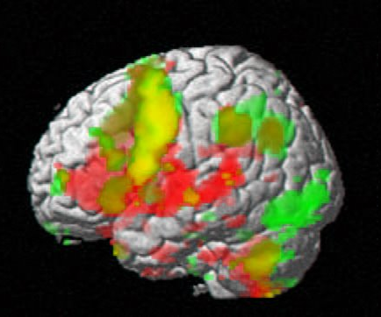
A Similarity Retrieval System for Multimodal Functional Brain Images
Rosalia F. Tungaraza
Advisor: Prof. Linda G. Shapiro
Ph.D. Defense
Computer Science & Engineering
University of Washington

Slide 2

Functional Brain Imaging
Study how the brain works
Imaging while subject performs a task
Image represents some aspect of the brain e.g.
  fMRI: brain blood oxygen level
  ERP: scalp electric activity

Slide 3
Motivation
Given a database of functional brain images from various subjects, cognitive tasks, and image modality.
Database users need to retrieve similar images
A system that can automatically perform this retrieval will reduce amount of time and effort users spend during this task
3

Slide 4
Contributions
Created a similarity retrieval system for multimodal brain images
    fMRI, ERP, and combined fMRI-ERP
    User interface
Developed feature extraction methods for fMRI and ERP data
Developed pair-wise similarity metrics
Simulated human expert similarity scores

Slide 5
Outline
Background
    fMRI
    ERP
    Existing Similarity Retrieval Systems for these modalities
Feature Extraction Process
Similarity Metric
User Interface
Retrieval Performance
Simulate Human Expert
5

Slide 6
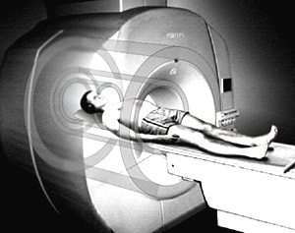
Functional Magnetic Resonance Imaging (fMRI)
A non-invasive brain imaging technique
Records blood oxygen level in brain
While imaging, subject performs a task
6
Notes:
6

Slide 7
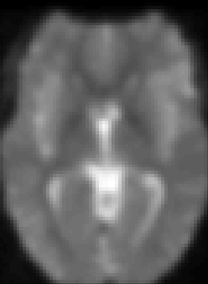
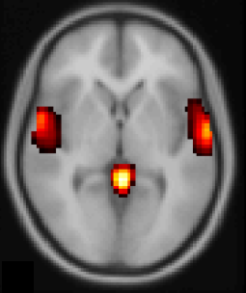
fMRI Statistical Images
Statistical Analysis
Voxel Thresholding

Slide 8
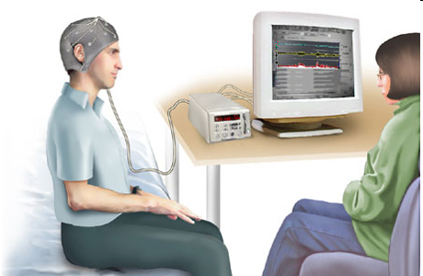
Event-Related Potentials (ERP)
@ 2004 by Nucleus Communications, Inc.
A non-invasive brain imaging technique
Records electric activity along scalp
While imaging, subject performs a task
8
Notes:
8

Slide 9
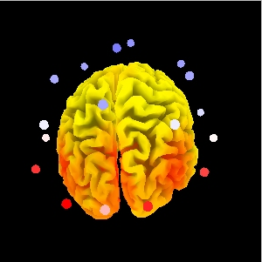
ERP Source Localization
Researchers want to identify the electric activity and its source for each electrode
But, multiple sources for each electrode
LORETA approximates anatomic locations of sources
9
Notes:
9

Slide 10
Comparison of fMRI and ERP Data
 | fMRI | ERP
Spatial resolution | Good (in mm) | undefined/poor
Temporal resolution | Poor (in sec) | Excellent (in msec)
10
Notes:
10

Slide 11
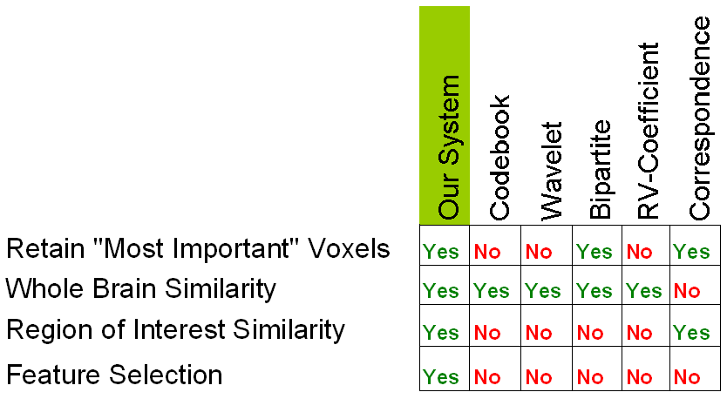
Similarity Retrieval Systems for fMRI Images
11
Notes:
11

Slide 12
Similarity Retrieval Systems for ERP Images
No relevant literature found
12
Notes:
12

Slide 13
Similarity Retrieval Systems for Combined fMRI-ERP Images
No relevant literature found
13
Notes:
13

Slide 14
Outline
Background
Feature Extraction Process
  fMRI features
  ERP features
Similarity Metric
User Interface
Retrieval Performance
Simulate Human Expert
14

Slide 15
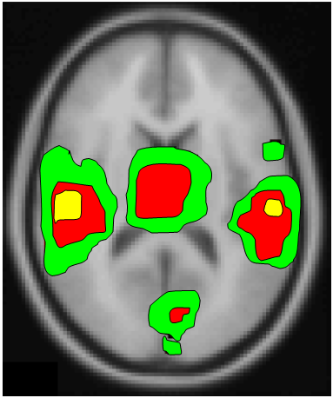
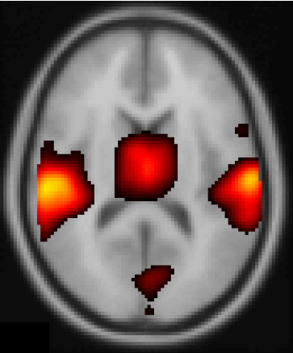
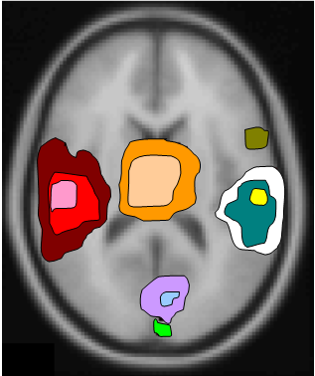
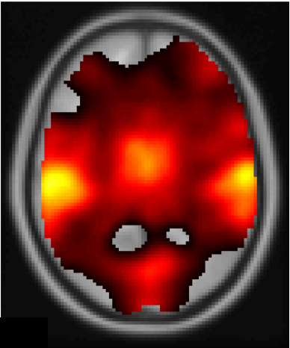
fMRI Feature Extraction
k=1
Approximate cluster centroids
Threshold
k=2
k=3
Perform clustering
Original database
Centroid
Avg Activation Value
Var Activation Value
Volume
Avg Distance to Centroid
Var of those Distances
Compute region vectors
Perform connected component analysis

Slide 16
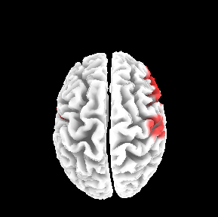
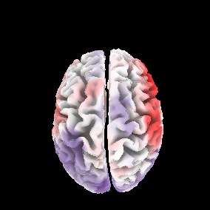
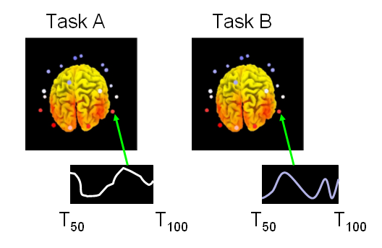
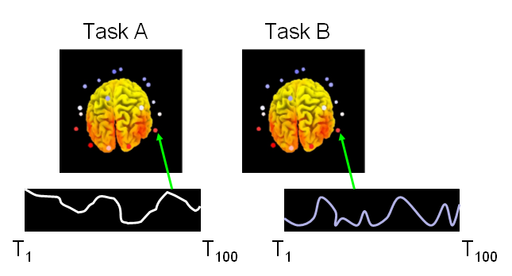
ERP Feature Extraction
Select time-segment
Compute voxel-wise statistically significant difference between means
Compute feature
(X,Y,Z) positions of retained voxels
Threshold

Slide 17
Outline
Background
Feature Extraction Process
Similarity Metric
  Summed Minimum Distance
  Similarity Score for Combined fMRI-ERP Images
User Interface
Retrieval Performance
Simulate Human Expert
17

Slide 18

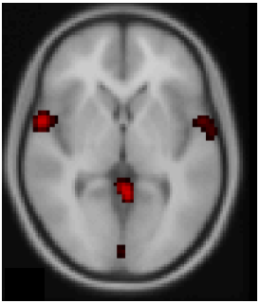
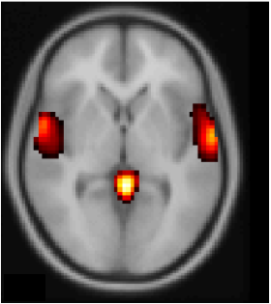
Summed Minimum Distance (SMD) for fMRI and ERP Images
Subject Q
Subject T
Q2T =
SMD = (Q2T+T2Q) / 2
18

Slide 19
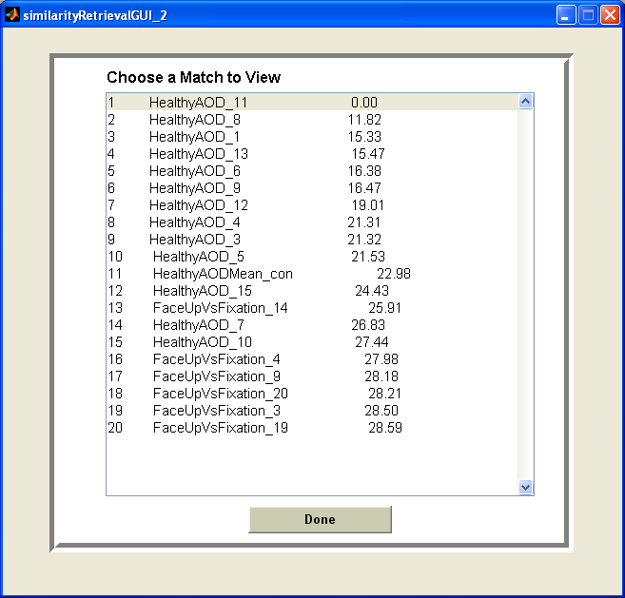
Sample SMD Scores
SMD
19

Slide 20
Similarity Score for Combined fMRI-ERP Images
SIM(i,j) = αSMD_{fMRI}(i,j) + (1-α)SMD_{ERP}(i,j)

Slide 21
Outline
Background
Feature Extraction Process
Similarity Metric
User Interface
Retrieval Performance
Simulate Human Expert
21

Slide 22
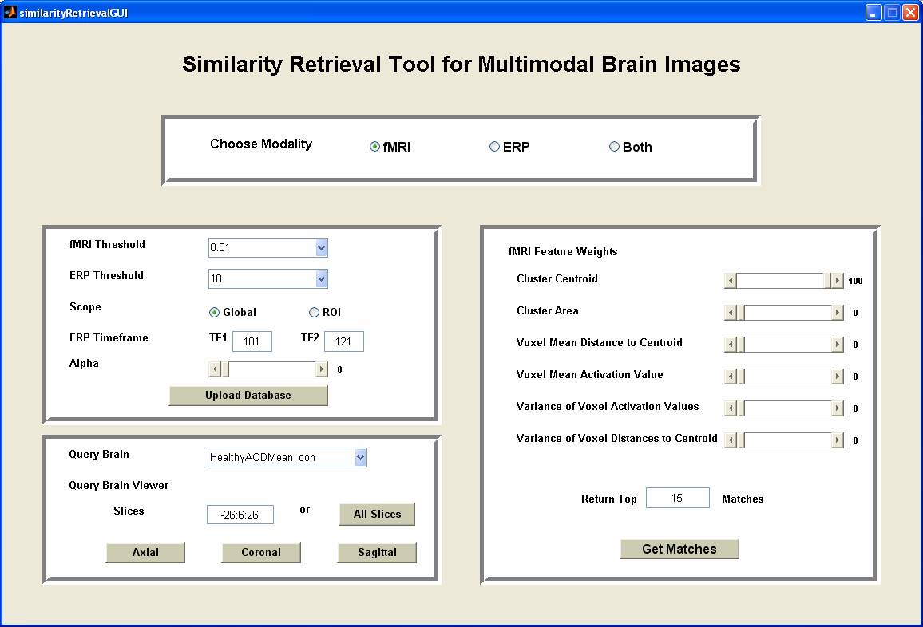
GUI: Front Page

Slide 23
GUI: Retrievals with SMD Scores
SMD
23

Slide 24
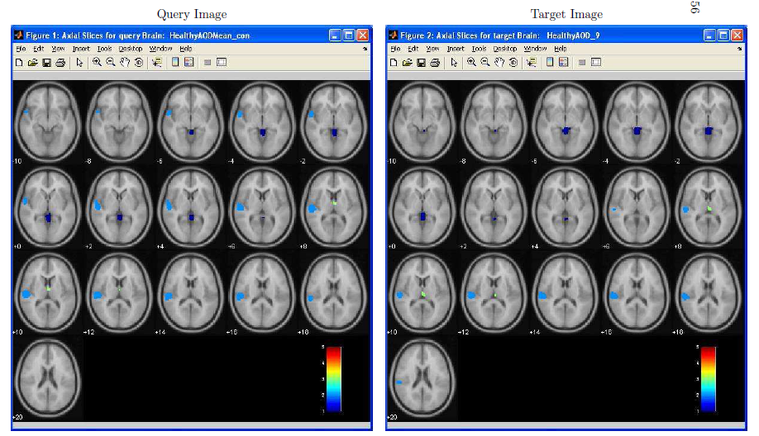
GUI: Query-Target Activations (fMRI)

Slide 25
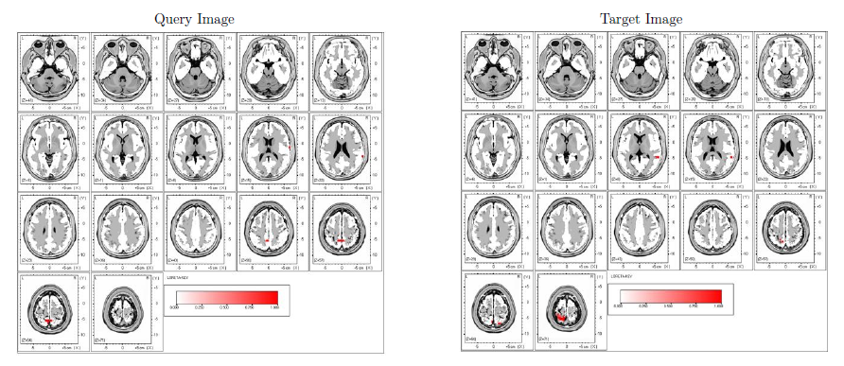
GUI: Query-Target Activations (ERP)

Slide 26
Outline
Background
Feature Extraction Process
Similarity Metric
User Interface
Retrieval Performance
  Data Sets
  fMRI Retrieval Performance
  ERP Retrieval Performance
  Combined fMRI-ERP Retrieval Performance
Simulate Human Expert
26

Slide 27
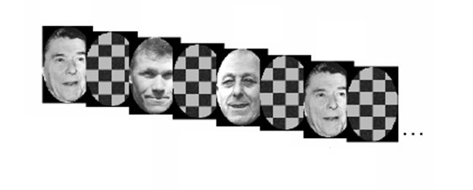
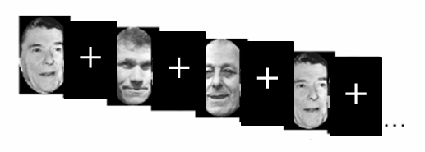
Data Sets for fMRI Retrievals
Checkerboard -- 12 subjects (Face Recognition)
Central-Cross -- 24 subjects (Face Recognition)
d
g
f
p
g
n
SB -- 15 subjects (Memorization)
AOD -- 15 subjects (Sound Recognition)
27

Slide 28

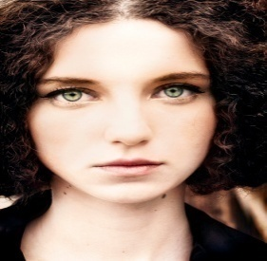
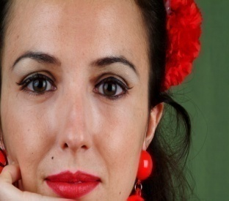

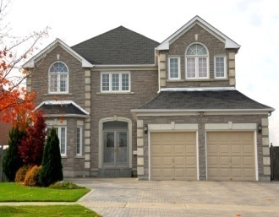
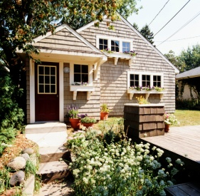
Data Set for ERP Retrievals
…
…
View Human Faces
(Face Up)
-- 15 subjects
View Houses
(House Up)
-- 15 subjects
28

Slide 29
Data Set for Combined fMRI-ERP Retrievals
ERP: same data set as used in ERP retrieval
fMRI:
  Task: Face recognition using a house up background
  Same subjects and images as data set for ERP retrieval
29

Slide 30
fMRI Retrieval Performance
RFX Retrievals
Individual Brain Retrieval
Testing Group Homogeneity
Feature Selection
30

Slide 31
fMRI Retrieval Score
Perfect score : Retrieval Score = 0
Random score: Retrieval Score ~ 0.5
Worst score: Retrieval Score = 1
31

Slide 32
fMRI Individual Brain Retrievals
Use individual brain as query
 | Mean Retrieval Scores (Top 6% activated voxels)
Checkerboard | 0.09
SB | 0.16
Central-Cross | 0.21
AOD | 0.26
32

Slide 33
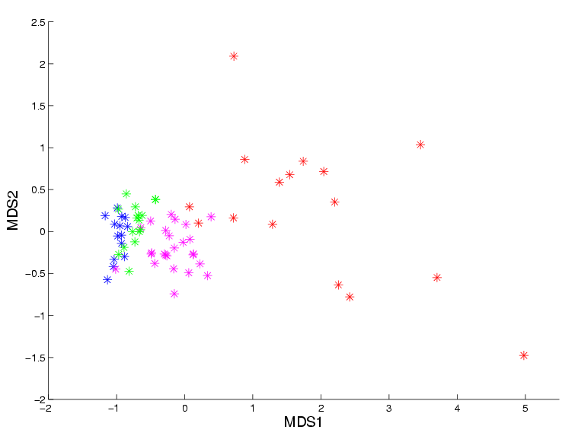
Testing Group Homogeneity for fMRI
SB
CB
AOD
Central-Cross
33

Slide 34
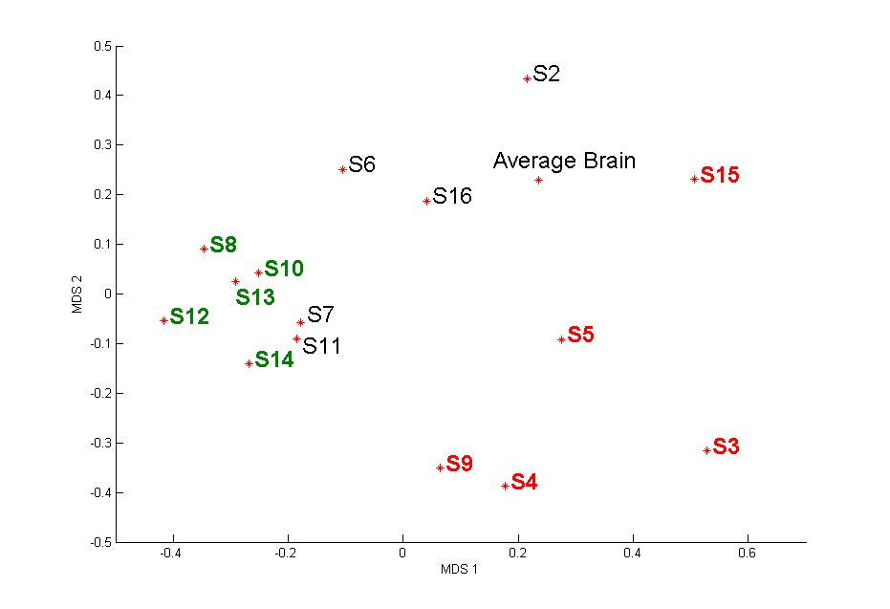
ERP Retrieval Performance
34

Slide 35
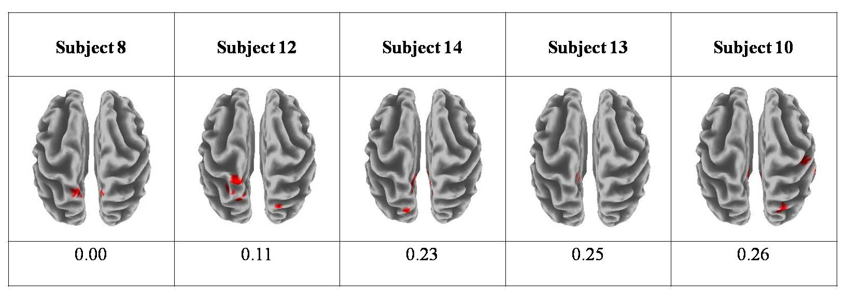
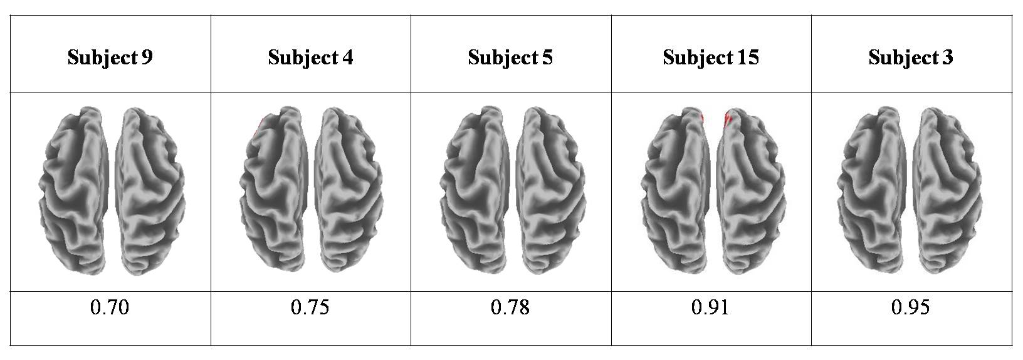
Subject #8 Retrievals
Top Retrievals
Bottom Retrievals

Slide 36
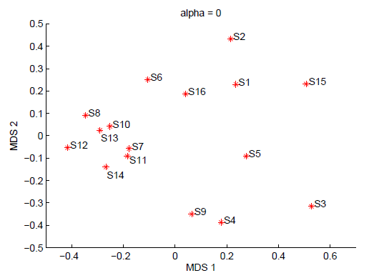
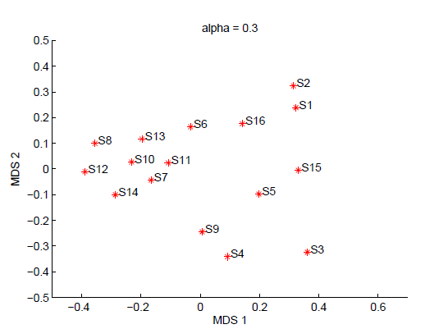
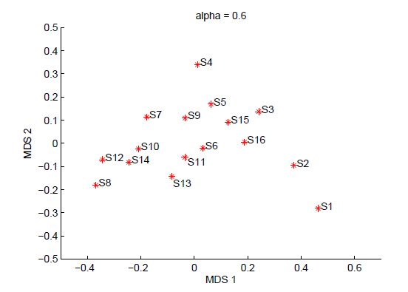
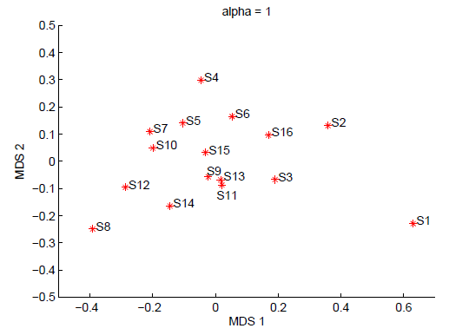
Combined fMRI-ERP Retrieval
α = 0.0, ERP only
α = 0.3
α = 0.6
α = 1.0, fMRI only
SIM(i,j) = αSMD_{fMRI}(i,j) + (1-α)SMD_{ERP}(i,j)

Slide 37
Outline
Background
Feature Extraction Process
Similarity Metric
User Interface
Retrieval Performance
Simulate Human Expert
  Simulation Method
  Data Set
  Testing Function Performance
37

Slide 38
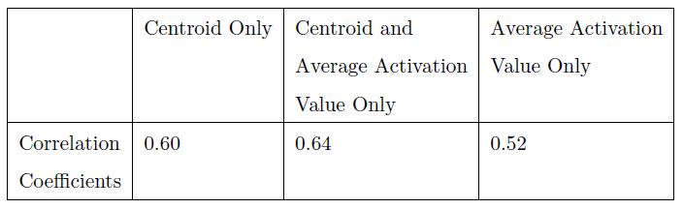
Simulate Human Expert
Current retrieval system requires some expert knowledge
Estimate a function to generate similarity scores with high correlation to expert scores

Slide 39
Simulation Method
Uniform feature representation: create codebook and encode each subject
Concatenate the codebook features for each pair of subjects
Create eigenfeatures
Estimate a function
Test function performance

Slide 40
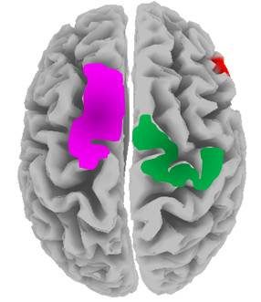
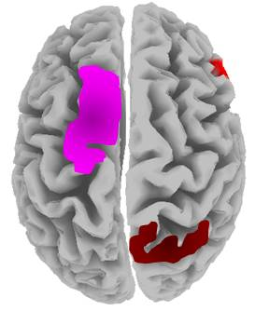
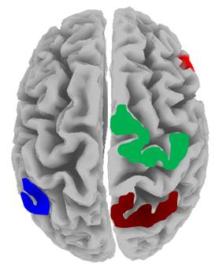
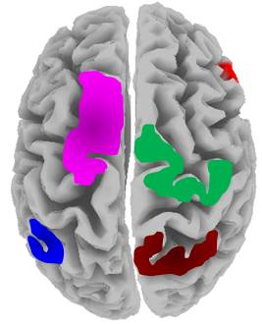
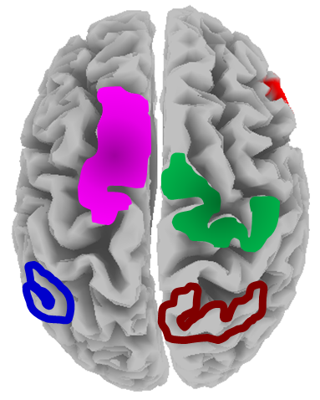
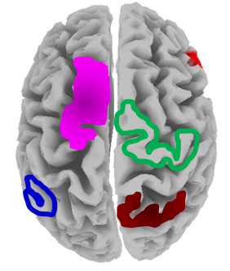
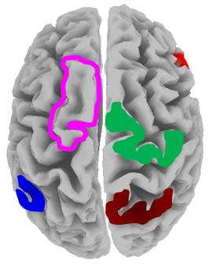
1. Uniform Feature Representation
Create the reference brain (codebook)
S1
S2
S3
Encode Images
S1
S2
S3

Slide 41
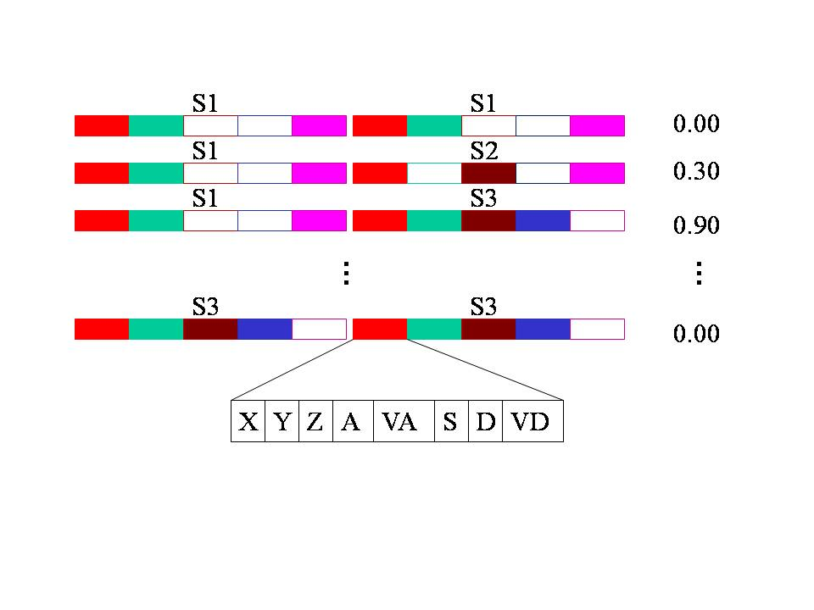
2. Concatenate Codebook Features
XYZ → Centroid
A → Avg Activation Value
VA → Var Activation Value
S → Size (Volume)
D → Avg Distance to Centroid
VD → Var of those Distances

Slide 42
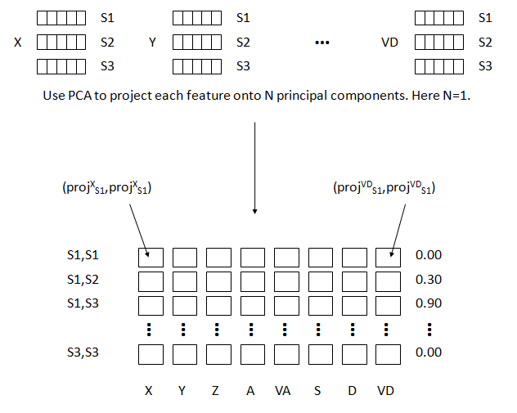
3. Create Eigenfeatures

Slide 43
4. Estimate a Function
S1,S1
0.00
S1,S2
0.30
S1,S3
0.90
…
…
…
…
…
…
…
…
…
S3,S3
0.00
Linear function using linear regression
Non-linear function using generalized regression neural networks (GRNN)

Slide 44


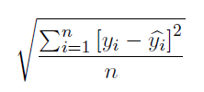
5. Test Function Performance
The Pearson Correlation Coefficient (CC)
The Average Absolute Error (A-ABSE)
The Root Mean Square Error (RMSE)

Slide 45
Data Set
Human Expert Generated Pair-wise Similarity Matrix
+
fMRI data (Central-Cross)
-- 23 subjects
-- Face Recognition task

Slide 46
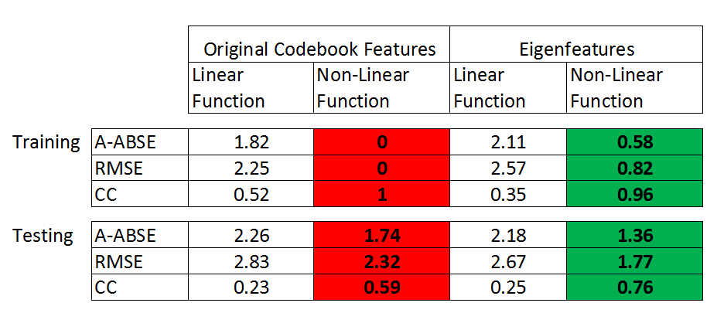
Overall Function Performance

Slide 47
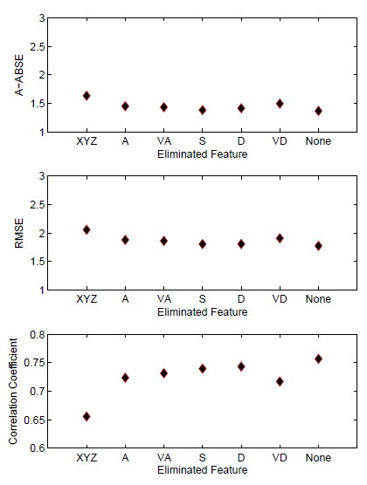
Feature Selection
XYZ → Centroid
A → Avg Activation Value
VA → Var Activation Value
S → Size (Volume)
D → Avg Distance to Centroid
VD → Var of those Distances
Bad
Good
Bad
Good
Good
Bad

Slide 48
Contributions
Created a similarity retrieval system for multimodal brain images
    fMRI, ERP, and combined fMRI-ERP
    User interface
Developed feature extraction methods for fMRI and ERP data
Developed pair-wise similarity metrics
Simulated human expert similarity scores

Slide 49
Future Direction
Add more modalities to the system
Obtain more expert scores for function estimation
Obtain more data
Develop similarity metrics other than SMD

Slide 50
Acknowledgements
Prof. Linda Shapiro
Prof. James Brinkley
Prof. Jeffrey Ojemann
Prof. John Kramlich
NSF grant number DBI-0543631
Computer Vision Lab
Collaborators in Radiology department
Practice-talk participants
50
Notes:
50

