Slide 1
Model-Based Organ Segmentation: Recent Methods
Jiun-Hung Chen
General Exam Paper
2009

Slide 2
Problem Statement
Learn how to segment new, unseen CT images from a set of training CT images with ground truth organs marked.
Goal: Minimize the training errors while generalizing to the new CT images

Slide 3
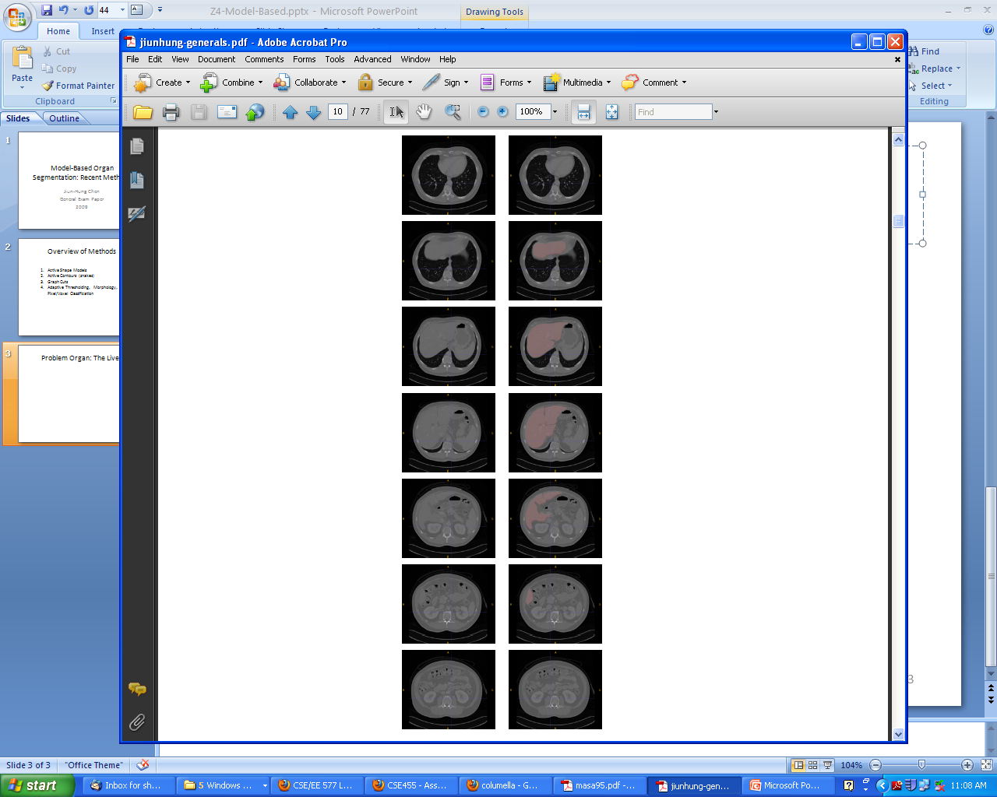
Problem Organ: The Liver

Slide 4
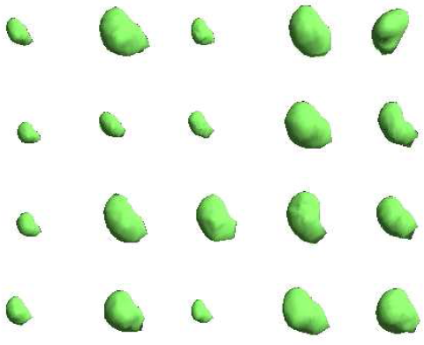
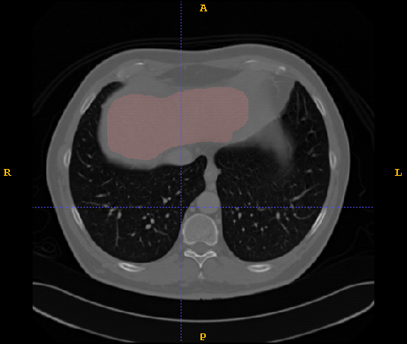
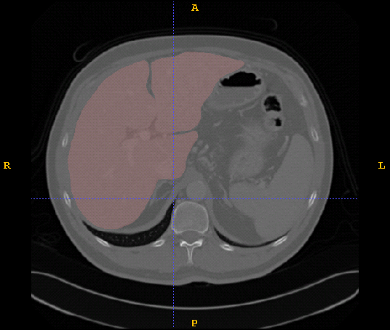
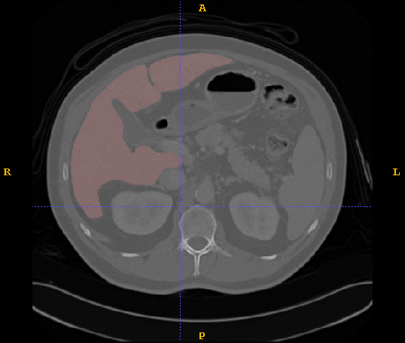
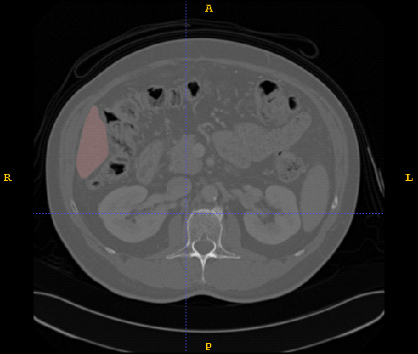
Why Difficult? (Shape Variations)

Slide 5
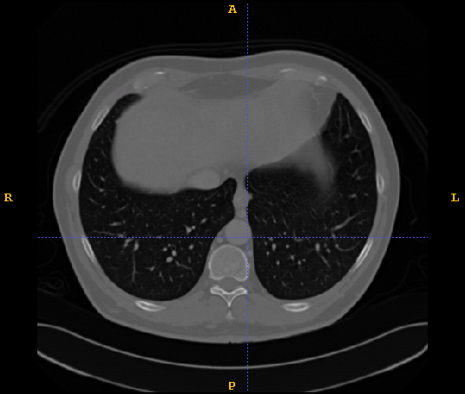
Why Difficult? (Similar Appearances)

Slide 6
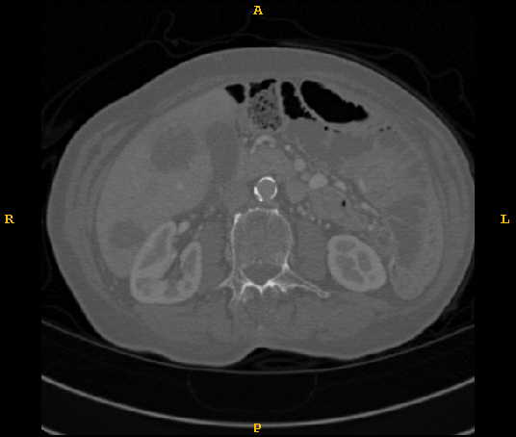
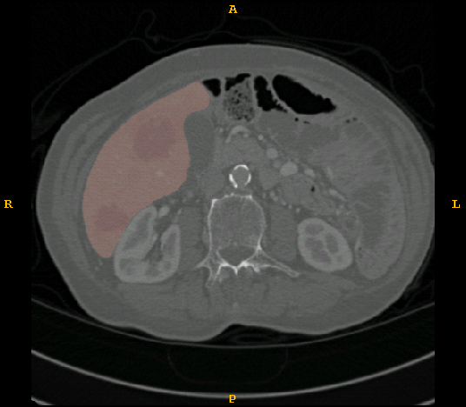
Why Difficult? (Appearance Changes)

Slide 7
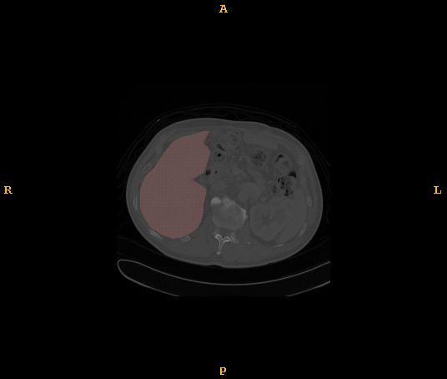
Why Difficult? (Position Changes)

Slide 8







Active Shape Model Based Framework
Input
…
3D point correspondence
Training CT Volumes
Known point correspondences
Training phase
Learning Statistical Shape Models
Learning Boundary Intensity Model
Learning Organ Detection
Learned Statistical Shape Model
Learned Boundary Intensity Model
Organ Detector
Organ Detection
Detected Bounding Box
A Testing CT Volume
Shape Model Initialization
Testing phase
…
Initial Shape
Boundary Refinement
Final Shape
…

Slide 9
Active Shape Models: Training
Shapes are modeled in a training phase using a
set of CT volumes whose ground truth segmentations
are given.
There are 4 steps to the training phase.
  1. Find 3D point correspondences on training meshes.
  2. Learn a statistical 3D shape model of the shapes.
  3. Learn a boundary intensity model for each vertex.
  4. Learn an organ detector that finds bounding boxes.

Slide 10
First find 3D point correspondences
Among all the training models of
The organ being modeled.
P₁
P₁
P₁
Input
P₂
P₂
P₂
P₃
P₃
P₃
P₁
P₁
P₁
P₂
Output
P₂
P₂
P₃
P₃
P₃

Slide 11
Next learn a statistical shape model
of that organ.
z
P₂
P₁
P₁
P₁
Input
y
P₂
P₂
P₃
P₃
P₃
x
simplified
linear model
Output

Slide 12
Next learn a model of the boundary intensities.
P₂
P₁
P₁
P₁
P₂
P₃
P₂
P₃
P₃
Intensity profiles
Input
Output
Learned Boundary Intensity Model
Prob.
simplified
Intensity profiles

Slide 13
Finally train a classifier to find the organ
inside a bounding box.
Given a bounding box and the
CT slices inside it, a classifier
learns to decide if everything
inside the box is liver or not.
r_{z}
s_{z}
r_{z}
r_{y}
s_{z}
r_{z}
r_{y}
s_{z}
r_{y}
…
Input
x,y,z
r_{x}
x,y,z
r_{x}
x,y,z
r_{x}
s_{y}
s_{y}
s_{x}
s_{y}
s_{x}
s_{x}
liver
Where do you
get the bounding
box?
Output
not liver

Slide 14
Active Shape Models: Testing
There are 3 steps to the testing phase
  organ detection: use the learned organ
  detector to detect the organ in the testing
  volume and return a bounding box
  2. shape model initialization: initialize the
  learned statistical model based on the
  detected bounding box
  boundary refinement: use the learned
  boundary intensity model to estimate the
  refinement to the model for this shape

Slide 15
Learned Statistical
Shape Model
Organ Detector
r_{z}
r_{y}
s_{z}
x,y,z
r_{x}
s_{x}
s_{y}
Test Organ
Find Bounding Box
Initialize Shape Model
Boundary Refinement

Slide 16
Methods for Point Correspondences
Principal Component Analysis (PCA)
PCA takes in the points of each shape in the training set.
It produces a set of basis vectors (the components).
Each shape can then be represented as a linear combination
of these components.
The optimal K projection axes b_{k}, k = 1 to K are the
eigenvectors of the covariance matrix of the training set of
points corresponding to the K largest eigenvalues.
~
K
x = x + ∑ c_{k}b_{k} where x is the mean shape
k=1

Slide 17
Intuitive Meaning of Principal Components
eigenvector corresponding to highest
eigenvalue
eigenvector corresponding to second
eigenvalue

Slide 18
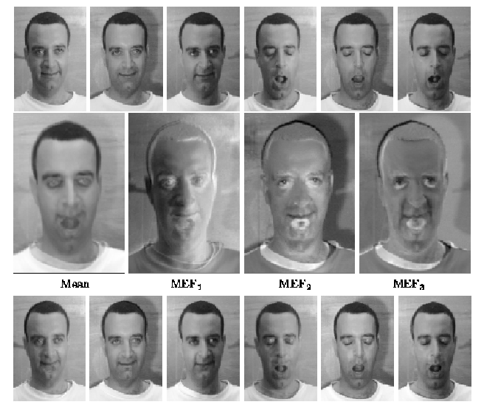
Eigenimages for Face Recognition
training
images
3 eigen-
images
mean
image
linear
approxi-
mations

Slide 19
3D Point Correspondence
(MDL)
Goal: Find 3D Point Correspondence
Idea: Minimize MDL-based objective function
  Evaluate the quality of the correspondence
The λ_{k}s are the eigenvalues from PCA.
How: Gradient descent
  Manipulate correspondences by parameterization and re-parameterization.
Davies et al. [IEEE TMI’02]

Slide 20
Statistical Shape Models
  Principal Component Analysis (PCA)
  Kernel PCA
  In either case the shape model consists of the PCA
  mean and basis. Any shape can be represented.
- Boundary Intensity Models
  Gaussian distribution
  AdaBoosted histogram classifiers
  Heuristics
Cootes et al. [IEEE PAMI 01], Twining et al. [BMVC’01]
Cootes et al. [IEEE PAMI 01], Li [ICCV’05], Kainmuller et al. [MICCAI’07]

Slide 21
Organ Detection
(MSL)
Goal: Find the bounding box
  The parameter space is 9D.
  3D positions, 3D scales and 3D orientations.
Idea
  Uniform and exhaustive search is unnecessary
How: decompose the problem into three steps
  position estimation, position-scale estimation and finally position-scale-orientation estimation.
Zheng et al. [ICCV’07]

Slide 22
Two ASM-based Systems
Kainmuller et al. [MICCAI’07]
Ling et al. [CVPR’08]
Statistical Shape Models
Statistical shape models
  PCA
  43 CT volumes
Boundary intensity model
  Heuristics
Liver detection
  Lungs detection and DICOM info
Performance
  Ranked first in a recent liver segmentation competition.
  10 testing volumes
  1.1mm (the average symmetric surface distance)
  15 minutes.
Statistical Shape models
  PCA, hierarchical shape pyramids
  75 volumes
Boundary intensity model
  A boundary classifier
Liver detection
  MSL (marginal space learning)
Performance
  5 fold cross validation
  1.59 mm (the average symmetric surface distance)
  1.38 mm (the median)
  12 seconds.
Boundary Intensity Model
Liver Detection
Performance

Slide 23
Experimental Setting
Datasets:
  4 types of organs (livers, left kidneys, right kidneys, spleens)
  15-20 subjects
Leave-one-out cross validation
Measure the reconstruction error
Metrics: Euclidean and Hausdorff distance

Slide 24
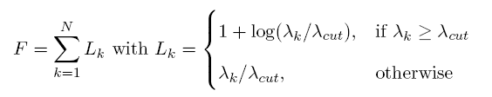
MDL-2DPCA
MDL-based objective function
Idea: Generalize the objective function to 2DPCA space
  Replace eigenvalues from PCA with those from 2DPCA
  How: Gradient descent
Comparisons: original MDL vs. MDL-2DPCA
* Chen and Shapiro [EMBC’09]

Slide 25
2DPCA
When we use normal PCA, our representation of a shape is a vector
(x₁,y₁,z₁, x₂,y₂,z₂, ..., x_{K}, y_{K}, z_{K})^{T}
When we use 2DPCA, our representation of a shape is a 2D matrix (or tensor)
x₁ y₁ z₁
x₂ y₂ z₂
x_{K} y_{K} z_{K}
And so are the components.

Slide 26
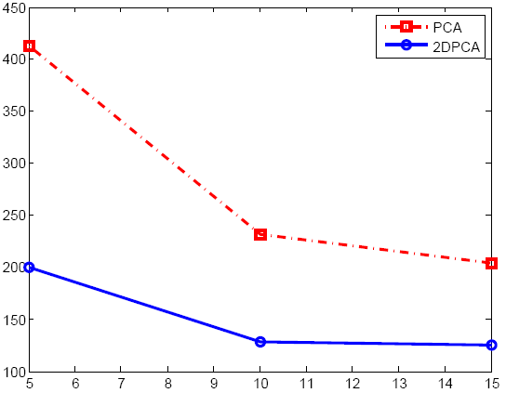
Results (3D Point Correspondences)
Livers
Left Kidneys
Reconstruction error
Original MDL
MDL-2DPCA
# eigenvectors
Right Kidneys
Spleens

Slide 27
Tensor-based SSM
Idea: Tensor-based dimension reduction methods
  2DPCA
  Parafac model
  Tucker decomposition
Comparisons: PCA vs. Tensor-based dimension reduction
* Chen and Shapiro [EMBC’09]

Slide 28
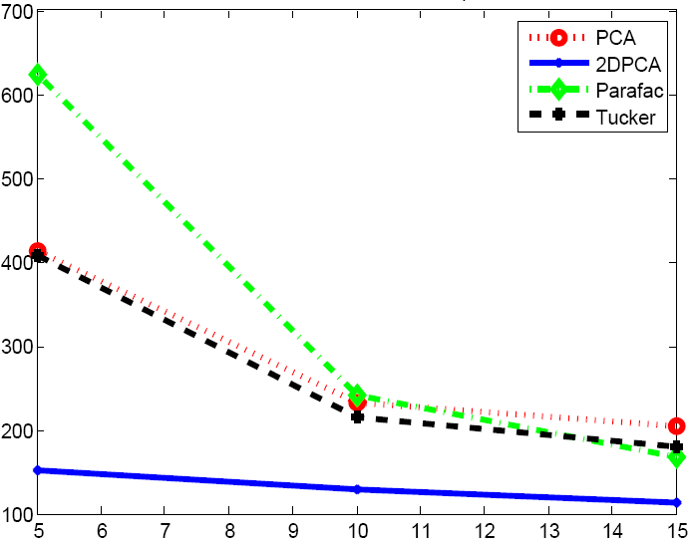
Results (Statistical Shape Models)
Livers
Left Kidneys
Reconstruction error
Parafac
PCA
Tucker
2DPCA
# eigenvectors
Right Kidneys
Spleens

Slide 29
Organ Detection
(Boosting Approach)
Idea: Classify whether an image block contains an organ of interest
How:
  Partition slices into non-overlapping 32x32 blocks
  Global features: gray-tone histogram of the image slice and its slice index
  Local features: the position of a block, the mean and variance of its intensity values, and its intensity histogram.
  20,000 SVM linear classifiers + Adaboosting
Comparisons: Manual vs. Adaboosting

Slide 30
Results (Organ Detection)
 | Positive (predicted) | Negative (predicted)
Positive (actual) | 96.23% | 3.77%
Negative (actual) | 4.57% | 95.43%
Livers (Training)
 | Positive (predicted) | Negative (predicted)
Positive (actual) | 91.23% | 8.77%
Negative (actual) | 6.57% | 93.43%
Livers (Testing)

Slide 31
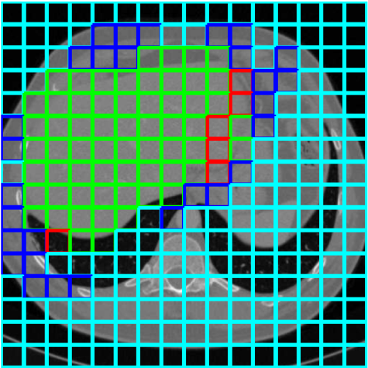
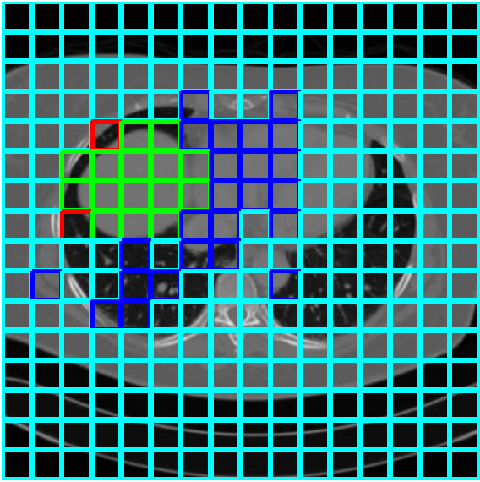
True Positive : Green, False Positive: Blue
False Negative: Red, True Negative: Cyan
Sub. 1
Sub. 2

Slide 32
Graph Cuts Based
Boundary Refinement
The goal of the s-t cuts paper is to incorporate additional shape information (e.g., size) to find the boundary/shape of an organ of interest (e.g., kidney) in an image.
Idea: Adding hard constraints to min s-t cuts
Min s-t cuts with side constraints
  NP-hard in general cases
  Approximation algorithm: standard rounding algorithm
Comparisons: with constraints vs. without constraints
Chen and Shapiro [ICPR’08]

Slide 33
Results (Boundary Refinement)
Initial Contour
Slice 1
Slice 2
without
with

Slide 34
What have we got?
A great design.
Several conference papers.
No complete system, just pieces, some pieces never really done.
Would be a space for a course or longer project.
Livers came from here: http://sliver07.org/
Here is a newer one: https://www.virtualskeleton.ch/ShapeChallenge/Start2014
LOTS of data challenges here: https://grand-challenge.org/all_challenges/

