Slide 1
Knowledge-Based Organ Identification from CT Images
Masahara Kobashi and Linda Shapiro
Best-Paper Prize in
Pattern Recognition
Vol. 28, No. 4
1995

Slide 2
Motivation
The extraction of structure from CT volumes of cancer
patients is an important first step in the creation of
patient-specific models that can be used by treatment
planning software to deliver maximal dosage to the
tumor and minimal dosage to critical anatomical structures.
Even today, no automatic techniques have been successful
enough to replace the standard manual methods of
outlining the organs.
The goal of this work was to develop a knowledge-based
recognition system that utilizes knowledge of anatomy and
image processing to extract the organs from CT volumes.

Slide 3
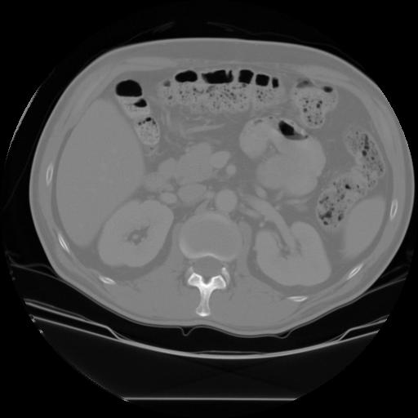
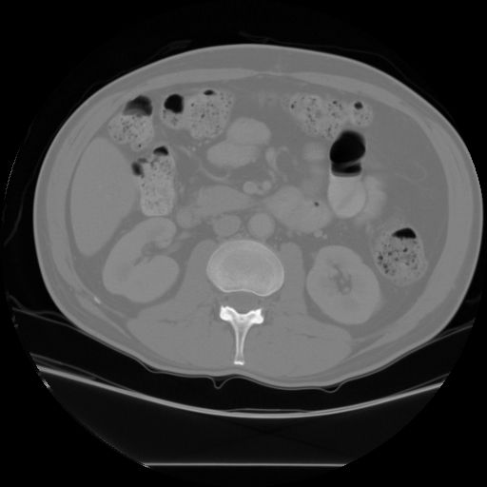
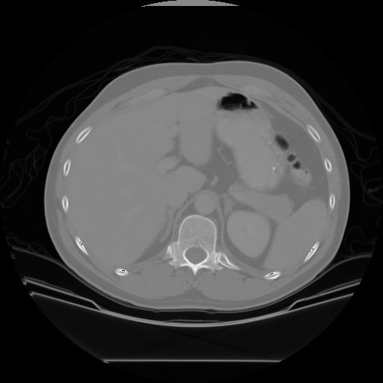
3 CT Slices of the Abdomen
kidney.jpg g006.jpg e030.jpg
Where are the kidneys, liver, spleen, aorta, spine?

Slide 4
Major Features of the System
dynamic thresholding controlled by feedback
the use of negative shape constraints that
3. progressive landmarking that extracts organs
in order of predicted success and uses
already-extracted organs to help locate others

Slide 5
Difficulties in Segmenting CT Images
Regions produced by gray-tone-based
segmentation procedures do not correspond
to organs.
There are very few shape invariants for organs.
The absolute gray tones for each organ vary
widely over difference instances.
There is no precise, objective ground truth for
performance evaluation (in our study).

Slide 6
Observations
Two different organs can have the same or very close
gray tones in CT images
Most human organs have few computable and stable
shape invariants.
Shapes of a kidney in different CT slices.

Slide 7
More Observations
Each organ has a fairly stable vertical and horizontal location.
The ordering of organs by their gray tones is fairly stable,
even though their absolute gray tones vary widely.
Each biological substance has a relatively narrow range of
gray tones.
But CT image analysis is simpler than many outside-world
computer vision domains.
And there are relatively small numbers of objects in each
image.
There are some very stable landmarks: spine and aorta.

Slide 8
Specific Organ Properties to Use
position in the ordering of gray tones among organs
relevant gray-tone range
height of gray-tone cliff (related to range of thresholds)
location in terms of stable landmarks: aorta and spine
adjacency with other organs
size in terms of expected area in a slice
overlap ratio with other slices
positive and negative shape constraints

Slide 9
Idea of the Dynamic Thresholding
too high
results of thresholding
at the initial (highest)
threshold for kidneys
at 3 steps, the kidneys
become detectible
at 11 steps, both kidneys
connect with other organs
3 steps down
too far

Slide 10
Steps of the Procedure
Set the initial threshold to the high end of the
relevant gray tone range for the organ of interest.
From the second iteration on, this threshold will
be reduced by a constant value (10 was used) in
each iteration.
If the threshold reaches the low end of the range
with no candidates, other methods are invoked.

Slide 11
Steps
Threshold the image with the current threshold.
Perform connected components to produce a
set of regions.
AREA CHECK: Check if there is a region of acceptable
size in the search area for the organ of interest. If
not, go back to step 1.
LOCATION CHECK: Check if any candidate regions
satisfy the location condition for the organ of interest.
If so, record them, else go back to step 1.

Slide 12
Steps
SHAPE CHECK: Check if there is among the candidates
one that satisfies the positive shape constraints (for
the aorta and spine) or the negative shape constraints
(for the rest).
Negative shape constraints include
- abnormal size
- abnormal extension
- vertical and horizontal lengths
- vertical/horizontal ratio

Slide 13
Concept of a Negative Shape Constraint: Shapes that are NOT Kidney

Slide 14
Steps
OVERLAP CHECK: check if there is a candidate
region that satisfies the overlap condition with
an already-segmented adjacent slice. Else go to step 1.
The minimum required overlap is 50% of the
smaller region.
COLLISION CHECK: Check if there is a candidate
region that does not collide with other recognized
organs. Else go to step 1.
9. CHOOSE BEST: Choose the best candidate region.

Slide 15
Steps
SLOPE CHECK: Check the change in area with
change in threshold. Look for the flattest part of the
curve that has acceptable area. Choose the midpoint
as the threshold.

Slide 16
Steps
MORPHOLOGICAL OPERATIONS:
Close with a disk of 3
Open with a disk of 5
Extract the regions that satisfies the conditions
Close the extracted region with a disk of 3
The result is output as the organ of interest.

Slide 17
Some Results: Labeled as Grade A, B, or C
Grade A: Comparable to human dosimetry within a 5 pixel mismatch.

Slide 18
Some Results: Labeled as Grade A, B, or C
Grade B: Worse than A, but at least 70% correct.

Slide 19
Some Results: Labeled as Grade A, B, or C
Grade B Spleen

Slide 20
Some Results: Labeled as Grade A, B, or C
Grade C: Less than 70% correct.

Slide 21
Extraction from 3 Slices
low-level slice mid-level slice higher-level slice

Slide 22
Comparison
 | Grade A | Grade B | Grade C
Kidneys | 85% | 0% | 15%
Spleen | 70% | 6% | 23%
Liver | 52% | 31% | 17%

Slide 23
Possible Course Project
Design and implement a semi-automatic system
that finds and segments organs from CT or other
images and produces 3D meshes from the slices
of each organ.
There are other methods in the literature now.
We have a set of CT images with kidneys in them
from the web.

