Slide 1


Medical Image Analysis:
Introduction
Course: CSE/EE 577
Instructor: Prof. Linda Shapiro
TA: Shu Liang
Web Page: http://www.cs.washington.edu/577

Slide 2
Related Texts
Shapiro and Stockman, Computer Vision, Prentice-Hall, 2001.
Original chapters available at
http://www.cs.washington.edu/education/courses/cse576/99sp/book.html
Dhawan, Medical Image Analysis, Second Edition, IEEE Press, 2011.
You can access this book through UW Libraries on a UW computer
or using your UW Netid.

Slide 3
List of Topics
Introduction to Medical Imaging Modalities and Applications
Low-level Operations for Processing and Enhancement
CT Imaging
PET/CT Registration
Brain Imaging
  MRI
  fMRI
  DTI
Ultrasound Imaging
3D from Multi-Camera Stereo for Craniofacial Application
Cancer Biopsy Processing

Slide 4
Evaluation
Several Matlab programming assignments
Course project of your choice

Slide 5
Medical Image Analysis
Some Lecture Slides will
Come From
Atam P. Dhawan, Ph.D.
Dept. of Electrical & Computer Engineering
Dept. of Biomedical Engineering
New Jersey Institute of Technology
Newark, NJ, 07102
Dhawan@adm.njit.edu

Slide 6
Introduction
Imaging is an essential aspect of medical sciences for
  visualization of anatomical structures
  functional or metabolic information of the human body
Structural and functional imaging of human body is important for understanding
  human body anatomy
  physiological processes
  function of organs
  behavior of whole or a part of organ under the influence of abnormal physiological conditions or a disease

Slide 7
A Multidisciplinary Paradigm

Slide 8
Medical Imaging Information
Anatomical
  X-Ray Radiography
  X-Ray CT
  MRI
  Ultrasound
  Optical
  3D Mesh from Stereo
Functional/Metabolic
  SPECT
  PET
  fMRI, pMRI
  Ultrasound
  Optical Fluorescence
  Electrical Impedance

Slide 9
X-rays
X-rays were invented by Conrad Rontgen in 1895 describing it as new kind of rays which can penetrate almost anything. He described the diagnostic capabilities of X-rays for imaging the human body and received the Noble Prize in 1901.
X-ray radiographs are the simplest form of medical imaging through the transmission of X-rays through the body which are then collected on a film. The attenuation or absorption of X-rays is described by the photoelectric and Compton effects providing more attenuation through bones than soft tissues or air.
Notes:
9

Slide 10
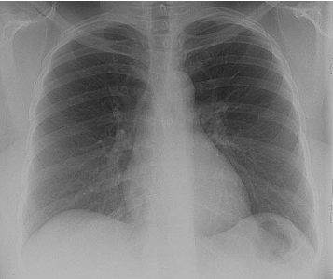
Chest Radiograph
Notes:
10

Slide 11
Computed Tomography
radiography in which a three-dimensional image of a body structure is constructed by computer from a series of plane cross-sectional images made along an axis
also called computed axial tomography, computerized axial tomography, computerized tomography

Slide 12
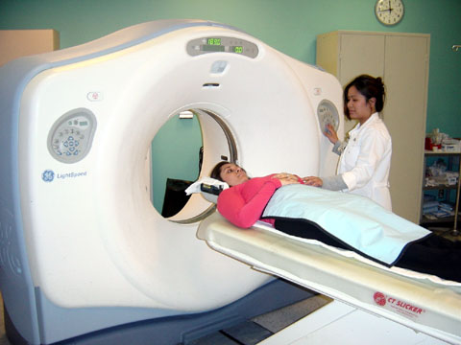
CT Scanner
Notes:
12

Slide 13
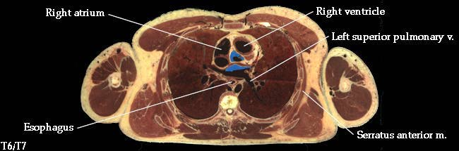
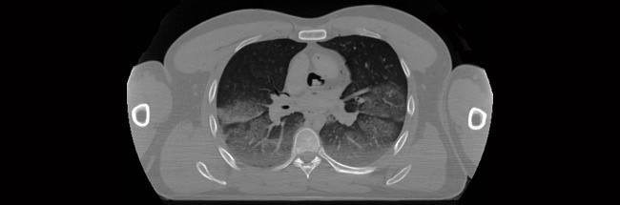
CT Chest Images
pathological
image of a slice
of the cardiac
cavity of a
cadaver.
X-ray CT image
of the same
slice
Notes:
13

Slide 14
Magnetic Resonance Imaging
Basic Principle: The electromagnetic induction based rf signals are collected
through nuclear magnetic resonance from the excited nuclei with magnetic
moment and angular momentum present in the body. Most common is proton
density imaging.

Slide 15
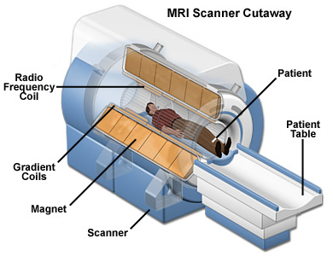
MRI Scanner

Slide 16
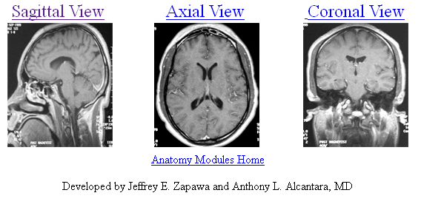
3-D Brain Imaging
left-right
top-bottom
front-back
http://www.med.wayne.edu/diagradiology/anatomy_modules/brain/brain.html

Slide 17
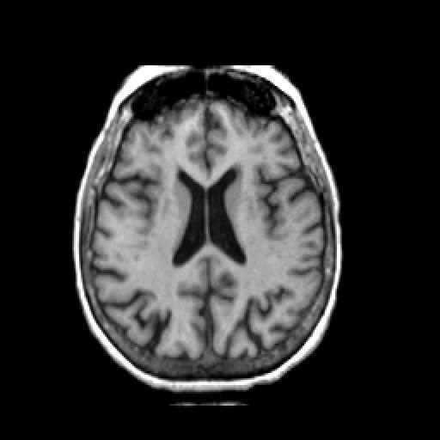
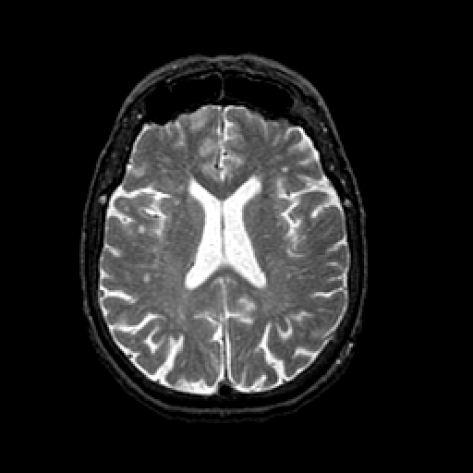
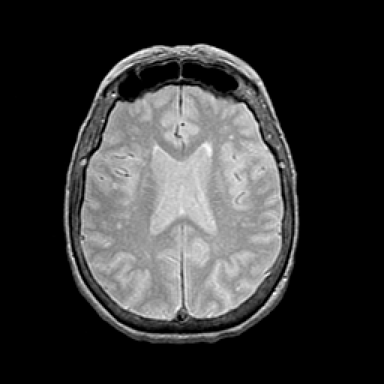
Kinds of MR Images
T1 Weighted
T2 Weighted
Spin Density Image

Slide 18
MRI Advantage
The most important advantage of the MRI is its ability to provide unprecedented contrasts between various organs and tissues and the three-dimensional nature of imaging methods.
Selective 3-D imaging is provided by appropriate selection of gradient fields and phase encoding methods.
A variety of contrast images can be created by different combinations of weighting of T1, T2 and echo images
MR spectroscopy provides a great potential for meaningful tissue characterization.
Functional MRI holds great promise for the future.

Slide 19
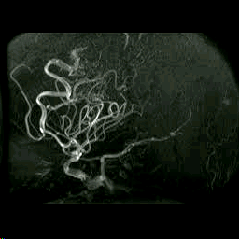
MR Angiography
Used to visualize the inside, or lumen, of blood vessels and organs of the body,
with particular interest in the arteries, veins and the heart chambers.

Slide 20
SPECT
Radioactive materials are administered into the body and are selectively taken up in a manner designed to indicate a specific metabolism or disease.
In SPECT imaging, gamma rays are emitted from these materials absorbed by the tissue or body, which then becomes a radioactive source. External detectors are used to reconstruct images of the radioactive source.

Slide 21
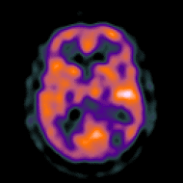
^{99m}T_{c} (140 keV) SPECT Image

Slide 22
PET
In PET imaging, the radioactive pharmaceuticals which decay by emitting positrons are administered in the body.
When these radioactive materials are taken up by the body, positrons are emitted which, after losing some energy through kinetic motion, annihilates with the free electrons of the biomaterial within the body.
The annihilation results in the emission of two photons, which travel in almost opposite directions and escape from the body to be detected by external detectors. This is called the coincidence detection.

Slide 23
PET
In PET, images are reconstructed from the coincidence detection to represent the distribution of the emission of photons within the body.
Since the emission of photons is very close to the emission of positron, the reconstructed images are considered the representation of the radioactivity source or tracer.

Slide 24
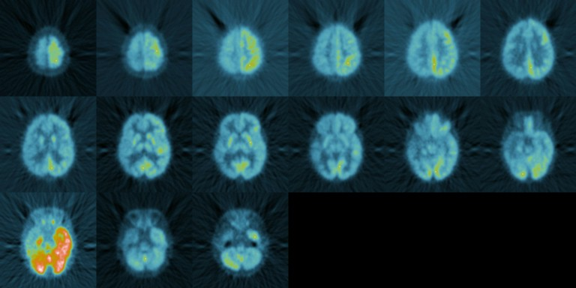
FDG PET Imaging

Slide 25
Ultrasound Imaging
Basic Principle: Backscattered echo and Doppler shift principles are more commonly used with the interaction of sound waves with human tissue. Sometimes the scattering information is complemented with transmission or attenuation related information such as velocity in the tissue.

Slide 26
Ultrasound Imaging
For thicker parts of the body such as abdominal imaging, frequencies of about 1.0 to 3.0 MHz are used to provide reasonable attenuation.
Unlike X-rays, in ultrasound imaging, the images are produced through the reflection or echo using the known velocity of propagation to calculate the depth.
In ultrasound imaging, air causes excessive attenuation and therefore cannot be used to study some anatomical structures, such as lungs.
Ultrasound imaging operates close to the diffraction limit because of its larger wavelength compared to X-rays.

Slide 27
Ultrasound Imaging
Pulse
Generation and Timing
Transmitter/
Receiver
Circuit
Control
Circuit
Acoustic absorbers
Blockers
Piezoelectric crystal
Data-Acquisition
Analog to Digital Converter
Computer
Imaging Storage and Processing
Display
Imaging
Object

Slide 28
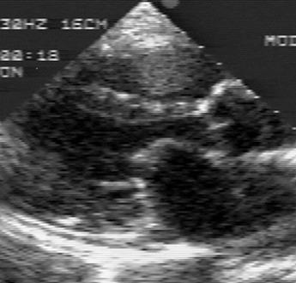
B-Mode Imaging of Heart

Slide 29
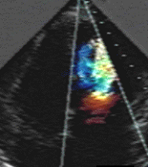
Doppler Imaging of Beating Heart

Slide 30
Ultrasound Advantage
The main advantage of ultrasound imaging is its non-invasive nature and capability of providing excellent information for imaging objects immersed in fluids.
Another advantage of using ultrasound is its low velocity of propagation as compared to the free-space velocity of X-rays which is 3X10⁸ m/sec. This makes the time of flight measurements possible using ultrasound with pulse echo techniques.
Unlike X-rays, the velocity of propagation of ultrasound is dependent on the material. Ultrasound provides a variety of refractive indices of materials. Thus, selective imaging of specific planes is feasible with ultrasound through the construction of so-called lens systems to provide images of focused structures.

Slide 31
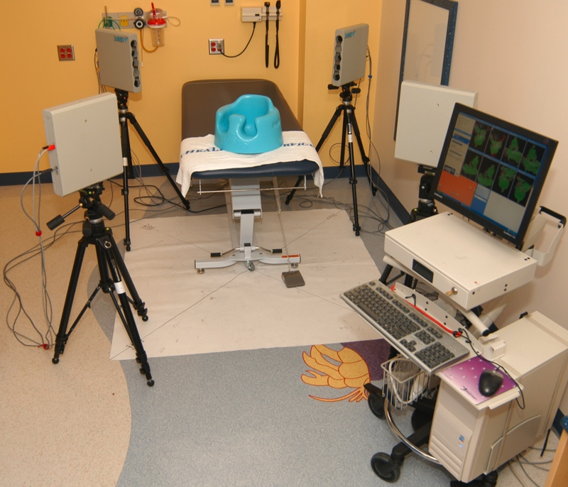
3D from Stereo
3dMD 12-Camera Stereo System at Children’s Hospital

Slide 32
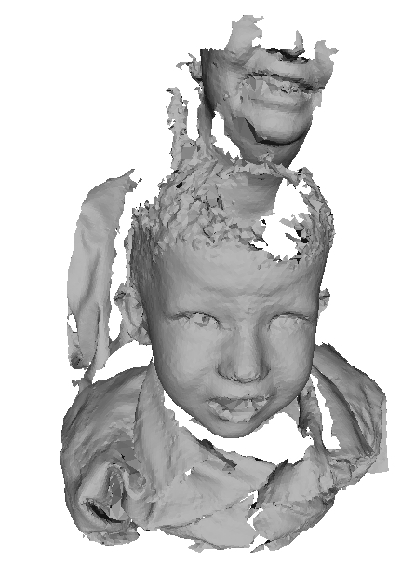
3D Mesh from 3dMD

Slide 33
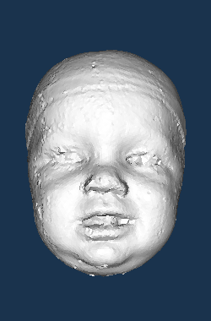
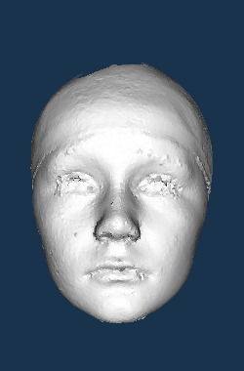
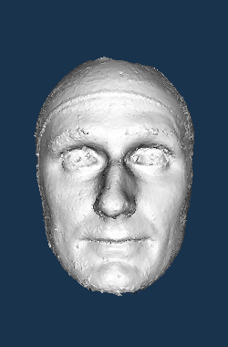
Some Sample Head Meshes
10 months 10 years 30 years

Slide 34
Advantages
Allows for 3D head images of young children
since the image acquisition is very fast
3D mesh format is common in computer vision
so there are many known algorithms
Can be analyzed in mesh format or converted
to other forms such as a 3D depth image

Slide 35
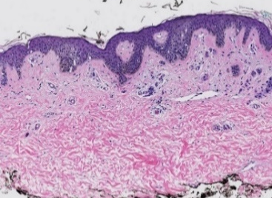
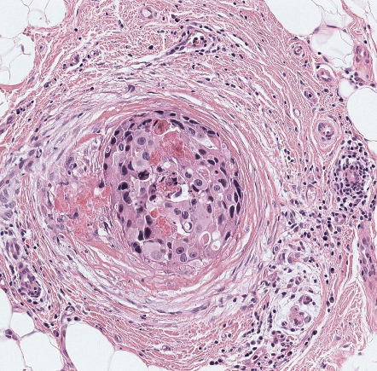
Digital Pathology
After an image from a machine shows possible cancer, physicians perform a biopsy.
Pathologists look at the biopsy, traditionally on a slide under a microscope.
Now, the FDA has approved digital pathology, and our group is working on both breast and melanoma cancer biopsy analysis.

Slide 36
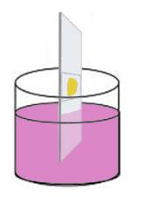

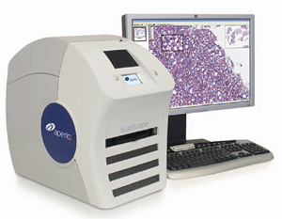
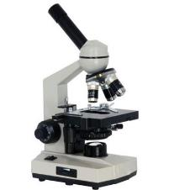
Medical Diagnosis of Cancer
1. Introduction 2. ROI Localization 3. Tissue Segmentation 4. Automated Diagnosis 5.Viewing Behavior Analysis 6. Conclusions
tissue specimen
H&E staining
glass slide
light microscope
whole slide imaging

Slide 37
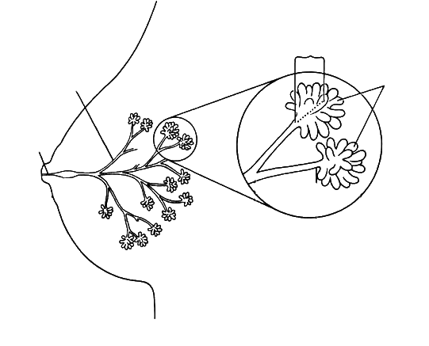
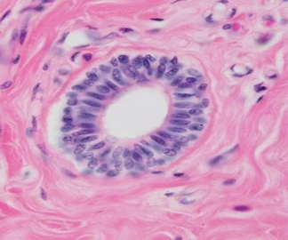
Breast Histopathology
1. Introduction 2. ROI Localization 3. Tissue Segmentation 4. Automated Diagnosis 5.Viewing Behavior Analysis 6. Conclusions
terminal ducts
segmental ducts
ductules
duct
(epithelium)
stroma
(connective tissue)
female breast
a duct
lumen

Slide 38
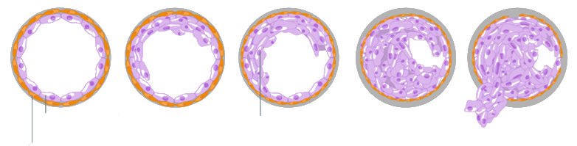
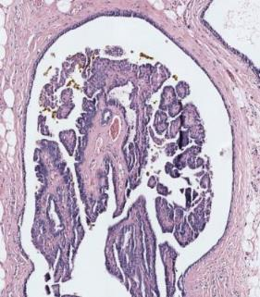
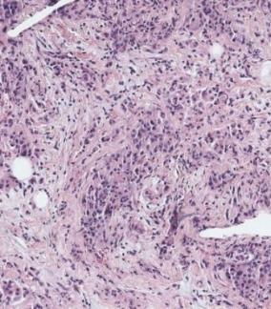
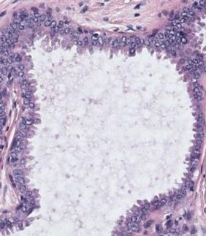
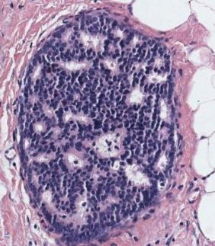
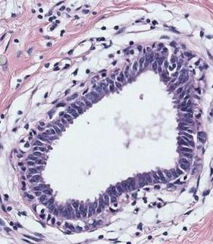
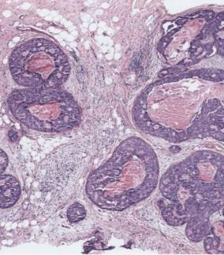
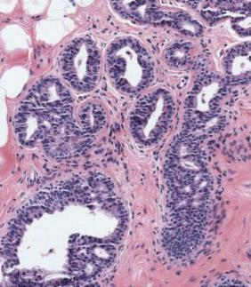
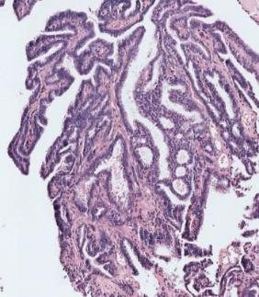
Diagnostic Categories
1. Introduction 2. ROI Localization 3. Tissue Segmentation 4. Automated Diagnosis 5.Viewing Behavior Analysis 6. Conclusions
normal duct
benign
atypia
ductal carcinoma in situ (DCIS)
invasive
normal epithelial cells
cancer cells
atypical ductal hyperplasia
flat epithelial atypia
papilloma w/atypia
invasive carcinoma
columnar cell change
usual ductal hyperplasia
intraductal papilloma
ductal carcinoma in situ (DCIS)

Slide 39
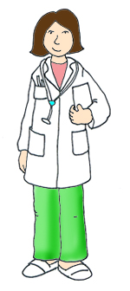

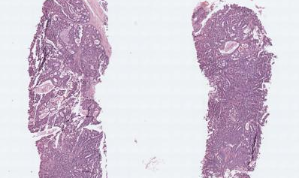
digiPATH Dataset
1. Introduction 2. ROI Localization 3. Tissue Segmentation 4. Automated Diagnosis 5.Viewing Behavior Analysis 6. Conclusions
pathologist
(n=87)
assessment
(n=5,220)
case
(n=240)
age
years in practice
# cases per week
affiliation
lab size
education
pathology perception
participant ROI*
participant diagnosis
viewport log
digital WSI
consensus ROI
consensus diagnosis
confidence score
difficulty score
borderline diagnoses
biopsy type
breast density
patient age
diagnostic outcome
ROI identification*
diagnostic agreement
efficiency

Slide 40

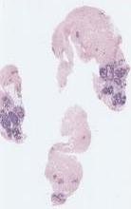
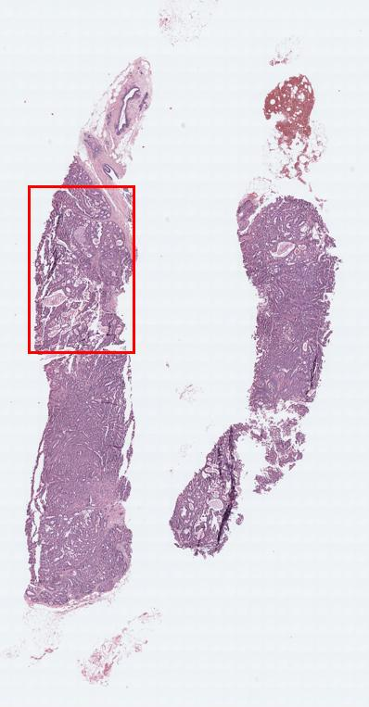
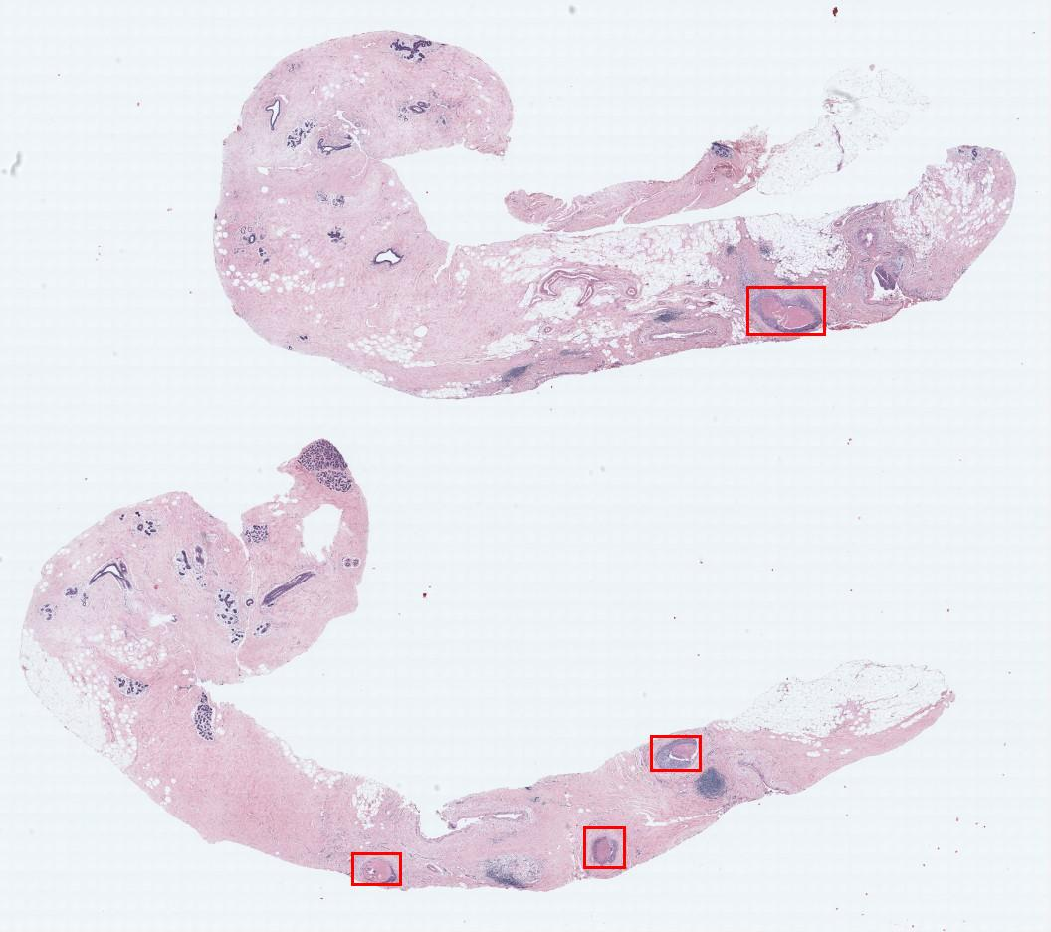
1. Introduction 2. ROI Localization 3. Tissue Segmentation 4. Automated Diagnosis 5.Viewing Behavior Analysis 6. Conclusions
Expert Consensus Data Collection
digital
WSI
Consensus
Diagnosis
benign
atypia
(DCIS)
invasive
# Cases
60
80
78
22
Consensus
ROIs
102
128
162
36
3 world experts

Slide 41
Epilogue
There are multiple imaging modalities, each with its own characteristics.
When I started to work here, a radiologist told me they would never use digital images.
Now they only use digital images and automation is an important topic.
In April 2017 Philips obtained FDA approval for use of whole slide digital images, beginning a new era for pathologists.

