Slide 1
Learning to Segment Breast Biopsy Whole Slide Images
Sachin Mehta, Ezgi Mercan, Jamen Bartlett, Donald Weaver, Joann Elmore, and Linda Shapiro

Slide 2
Outline
Introduction
Our encoder-decoder architecture
  Input-aware residual convolutional units
  Densely connected decoding units
  Multi-resolution input
Results

Slide 3
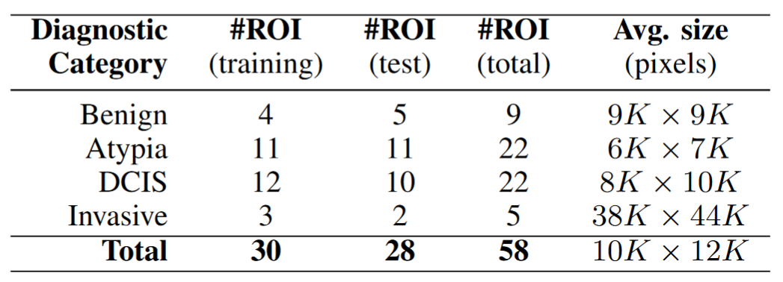
Introduction
CNNs are the state-of-the-art architectures for segmenting natural and medical images.
However, CNNs can’t be directly applied to breast biopsy WSI images due to their size.

Slide 4
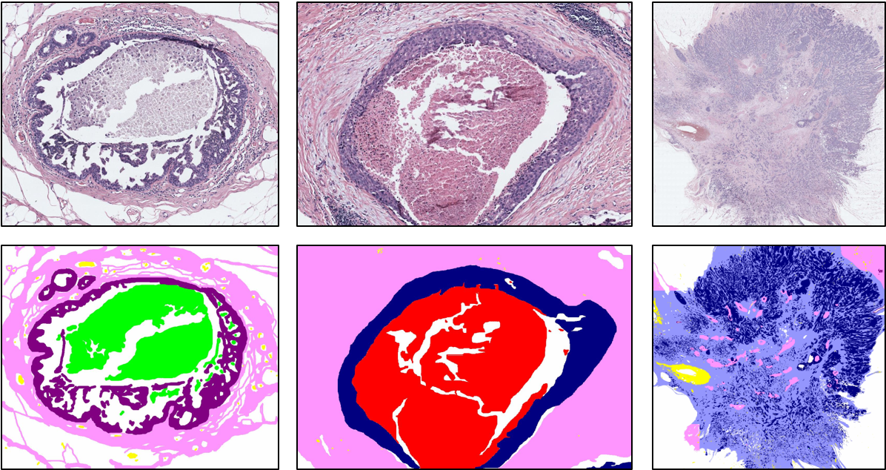
Introduction
To segment these images, a simple strategy is to use a sliding window-based approach
Diving these large tissue structures limits the context available to CNNs and may affect the segmentation performance.
We introduced a new multi-resolution encoder-decoder architecture that was specifically designed to handle the challenges of the breast biopsy semantic segmentation problem.
Figure: The set of tissue labels used in semantic segmentation. Note that the objects of interest (or tissues) are variable in size.

Slide 5
Encoder-decoder Network for Segmenting WSIs

Slide 6
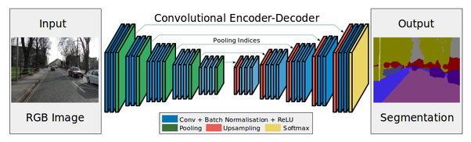
Overview of encoder-decoder network
Encoder-decoder network comprises of two networks:
  Encoder
  Decoder
Encoder aggregate features at multiple spatial resolutions by performing different operations such as convolution and down-sampling operations.
Decoder tries to invert the loss of spatial resolution due to down-sampling operations in the encoder.
Figure: Convolutional Encoder-Decoder Network*
* Image Source: Badrinarayanan, V., Kendall, A. and Cipolla, R., 2017. Segnet: A deep convolutional encoder-decoder architecture for image segmentation. TPAMI

Slide 7
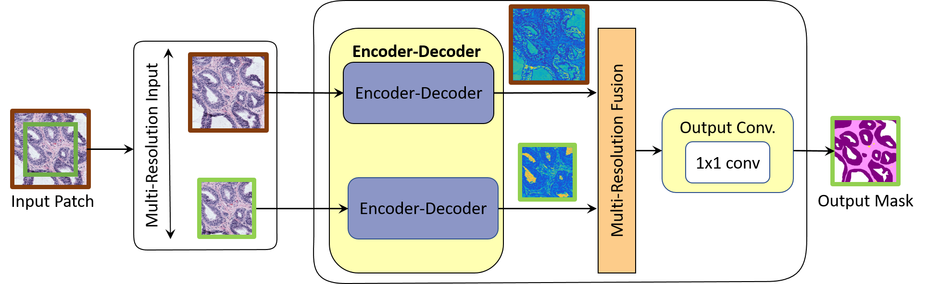
Single vs Multi-resolution Network
Patch-based approach divides large tissue structures into smaller structures and limits the context (surrounding tissue information) available to CNNs.
Patch-based approach may affect the segmentation performance.
To make the CNN model aware of the surrounding information, we introduce a multi-resolution network

Slide 8
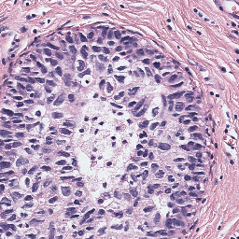
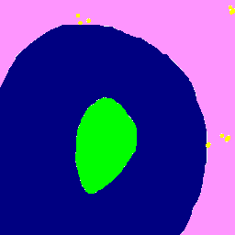
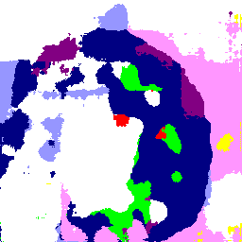
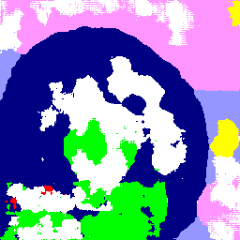
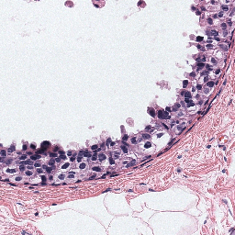
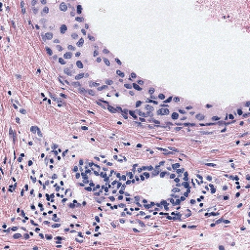

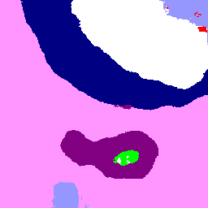
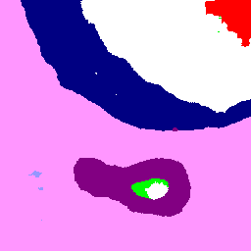
Patch-wise Predictions: Single vs Multi-resolution Network
RGB Image
Ground Truth
Single Resolution
Multi Resolution
Figure: Patch-wise predictions of Plain Encoder-Decoder network with single and multiple resolution input. Multi-resolution input helps in improving the predictions, especially at the patch borders.

Slide 9
Overview of Convolutional Units
Convolutional unit is a composite function comprising of convolutional layers, non-linearity operations (such as ReLU) and batch normalization.
Two popular convolutional units are:
ResNet adds a bypass connection between input and output of the convolutional block to improve the information flow inside the network and avoid the vanishing gradient problem.
Input
Input
Conv 3x3
Conv 3x3
Conv 3x3
Conv 3x3
Sum
Output
Output
VGG
ResNet
Source:
VGG: Simonyan, Karen, and Andrew Zisserman. "Very deep convolutional networks for large-scale image recognition." ICLR, 2015
ResNet: He, Kaiming, Xiangyu Zhang, Shaoqing Ren, and Jian Sun. "Deep residual learning for image recognition." In Proceedings of the IEEE conference on computer vision and pattern recognition, pp. 770-778. 2016.

Slide 10
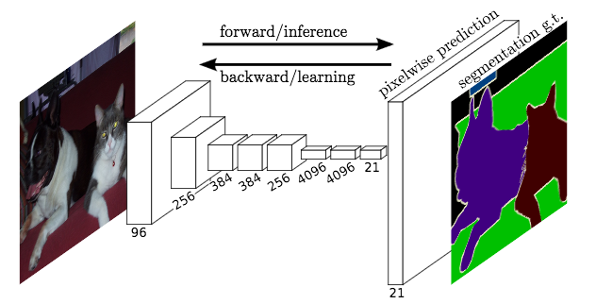
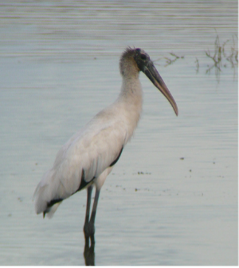

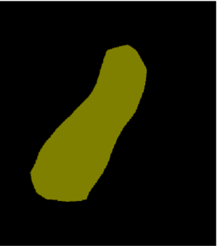
Input-aware Residual Convolution Units
As we increase the depth of the network, we learn coarse features about the objects. These coarse features are useful for object classification, but not for segmentation.
Figure: FCN-32s architecture that upsamples the last CNN layer (VGG) output by 32x, so that input image and segmentation output are of the same resolution
Input Image
Ground Truth
Output of FCN-32s
Figure: Output of FCN-32s
Source: Long, Jonathan, Evan Shelhamer, and Trevor Darrell. "Fully convolutional networks for semantic segmentation." In Proceedings of the IEEE Conference on Computer Vision and Pattern Recognition, pp. 3431-3440. 2015.

Slide 11
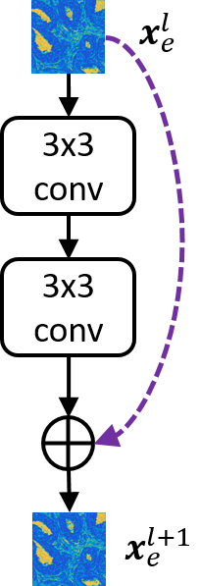
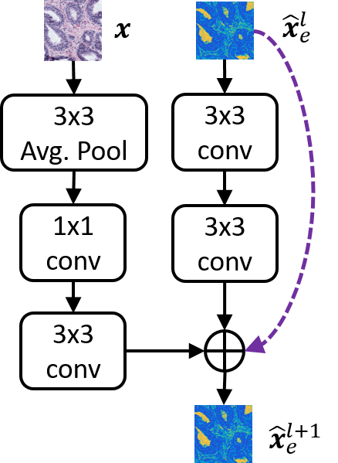
Input-aware Residual Convolution Units
We introduce an input-aware residual convolutional unit that reinforces the input at different spatial levels of CNNs to learn input-specific features
RCU
IA-RCU

Slide 12
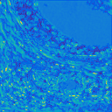
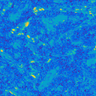


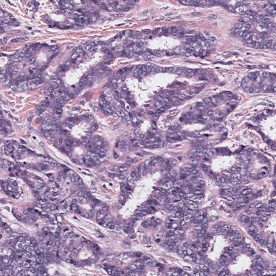
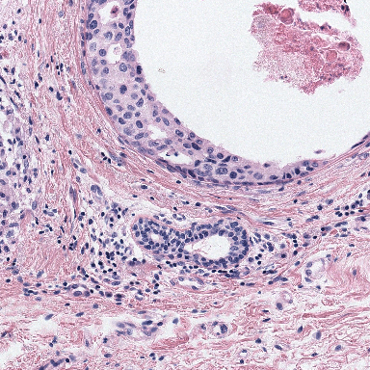
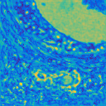
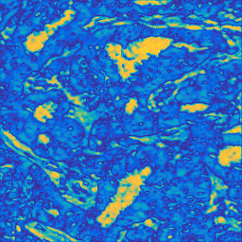

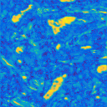
Activation Map Visualization
Residual Convolutional Unit (RCU) vs Input Aware Residual Convolutional Unit (IA-RCU)
RCU
RCU
High
Low
IA-RCU
IA-RCU
Figure: Two examples visualizing the activation maps at different spatial resolutions. IA-RCU compensates the loss of
spatial information due to down-sampling operations and helps in learning features that are relevant with respect to input.

Slide 13
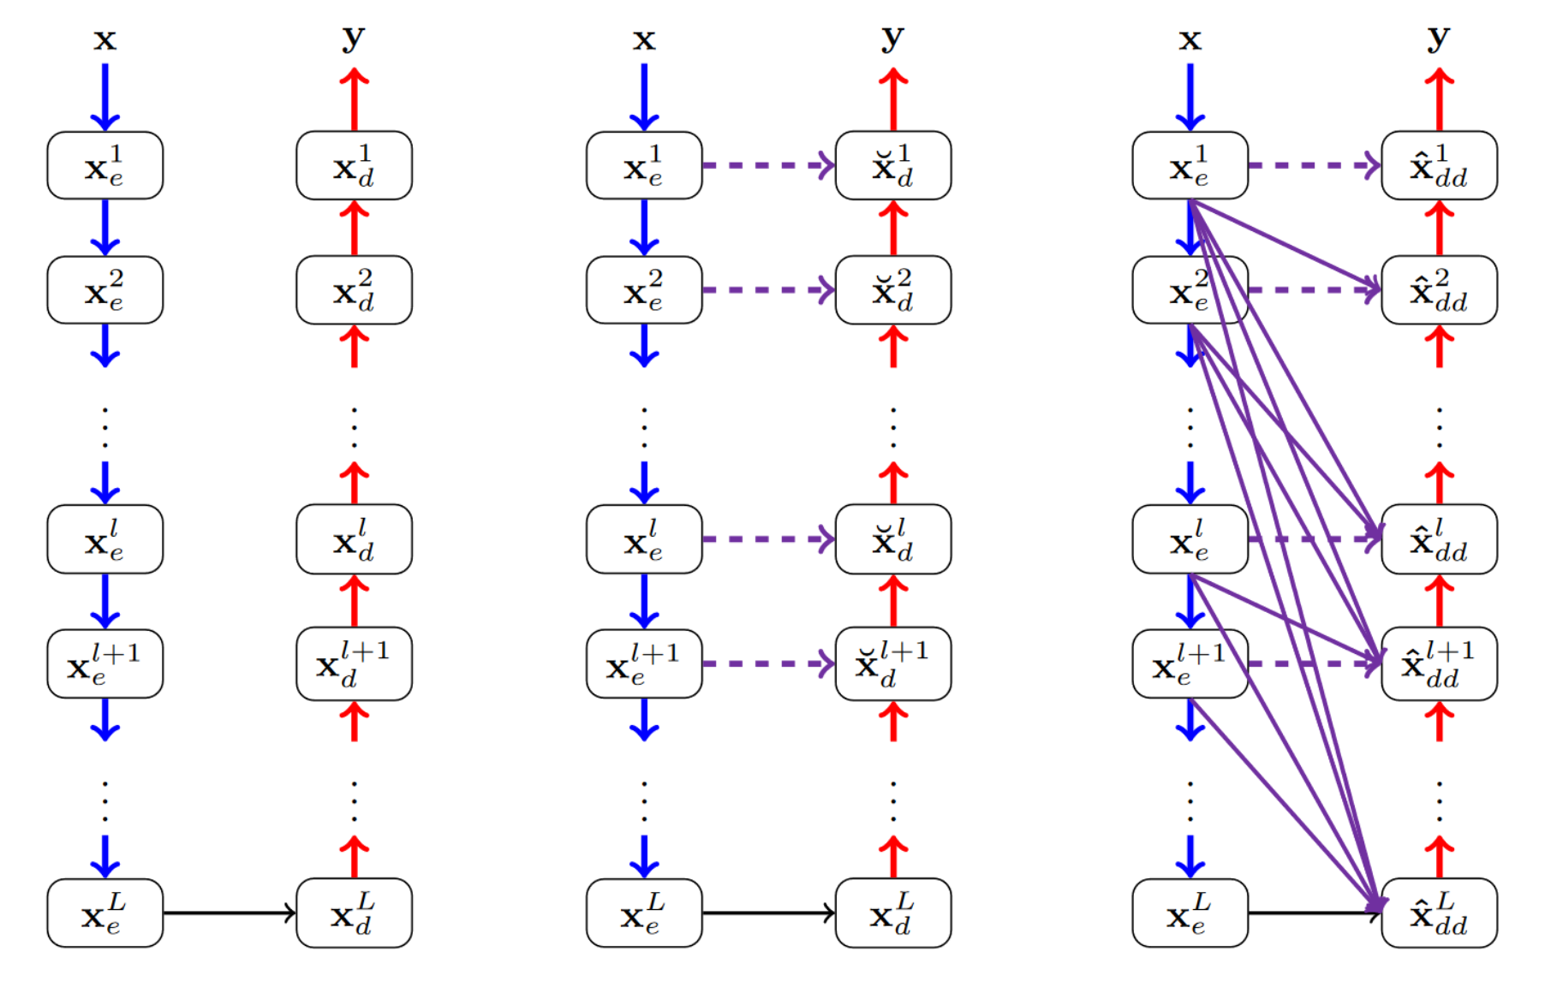
Densely Connected Decoding Paths
Similar to convolutional units, we can have skip connections between encoding and its corresponding decoding block.
These skip-connections establishes a direct connection between encoder and decoder and improves the information flow.
To further improve the information flow, we introduce direct connections between a decoding block and all encoding blocks that are at the same-level or lower-level.
These connections establishes long-range connections and promote feature reuse.
Plain
Residual
Densely-Connected
Figure: Different encoder-decoder architectures

Slide 14
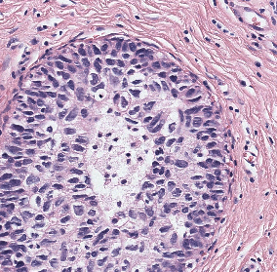
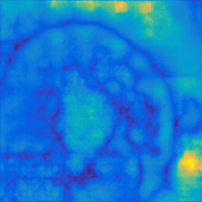
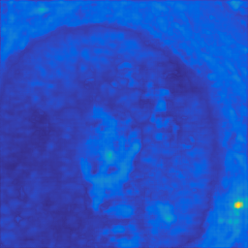
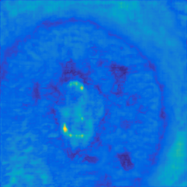
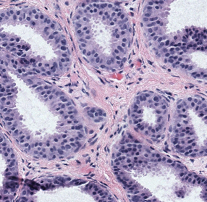
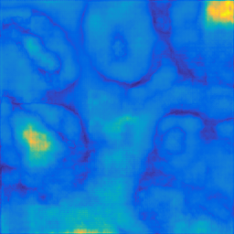
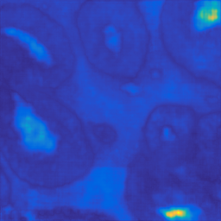
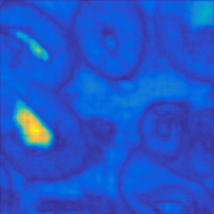
Visualization of Activation Maps of different networks
RGB Image
Plain
Residual
Densely Connected
Features learned by the plain network are noisy.
Residual network helps in refining the feature maps by combining the low-level and high-level information.
Dense connections promote the feature reuse and helps in efficiently combining the low-level and high-level information.
High
Low

Slide 15
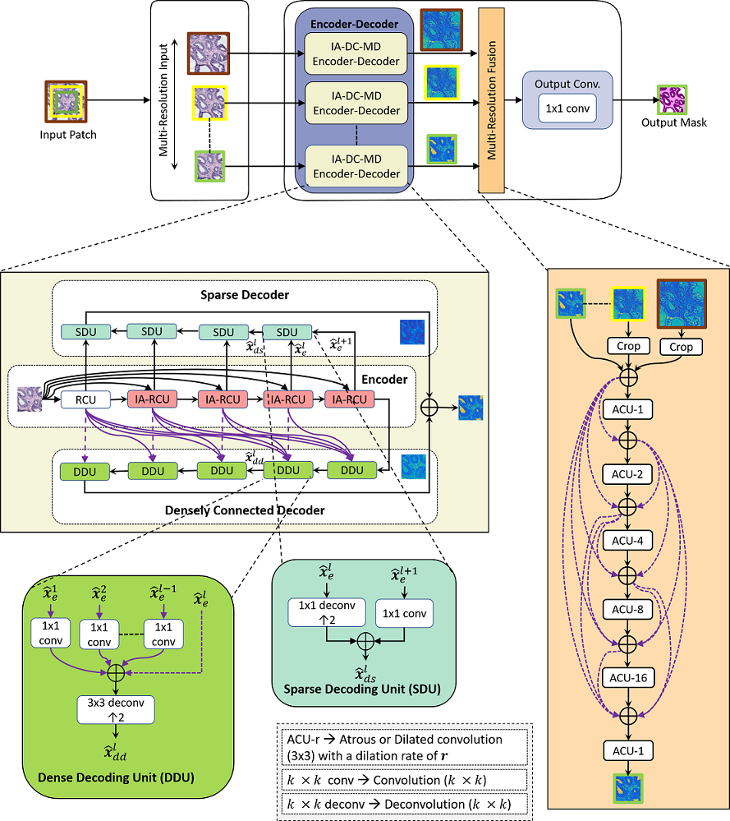
Our Encoder-Decoder Architecture for WSI Segmentation
Our encoder-decoder network for segmenting WSIs that incorporates:
Multi-resolution input
Input-aware residual convolutional units
Densely connected decoding paths
Sparse decoder
More details about the network architecture, see our paper: Learning to Segment Breast Biopsy Whole Slide Images, to appear in IEEE Winter Conference in Computer Vision (WACV-18)
Web Link: https://arxiv.org/abs/1709.02554

Slide 16
Results

Slide 17
Training details
Training Set: 30 ROIs
  25,992 patches of size 256x256 with augmentation
  Split into training and validation set using 90:10 ratio
Test Set: 28 ROIs
Evaluation metric:
  Pixel accuracy
  Mean Region Intersection over Union
  F1-score
Stochastic Gradient Descent for optimization
Implemented in Torch
  http://torch.ch/

Slide 18
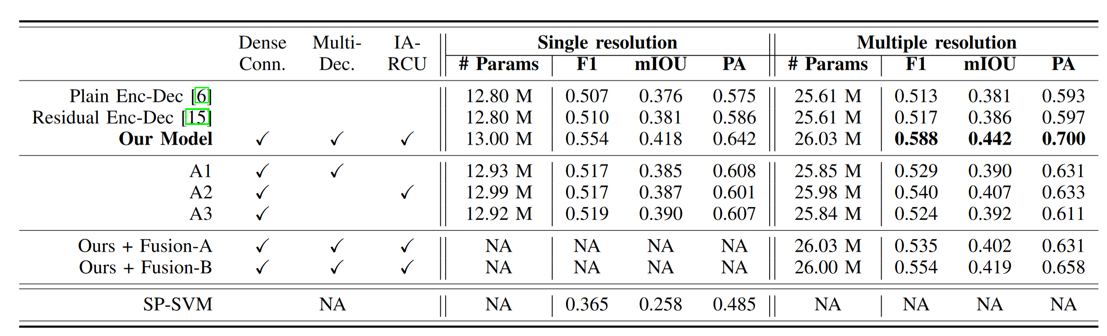
Results
Key findings:
Singe-vs-multi-resolution: For all models, multi-resolution improves the pixel accuracy by about 6%.
RCU-vs-IARCU: IARCU improves the pixel accuracy by about 4% and 7% over RCUs (A1).
Residual vs Dense Connections: The residual encoder-decoder has a 0.5% higher pixel accuracy (PA) than the plain
encoder-decoder, and our model with dense connections (A3) has a 2% higher PA than plain encoder-decoder under both
single and multiple resolution settings.

Slide 19
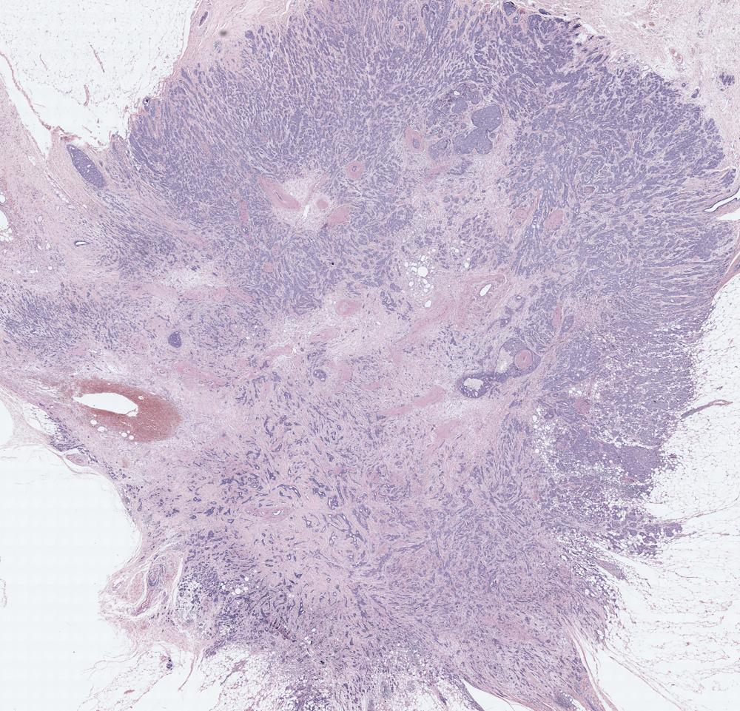
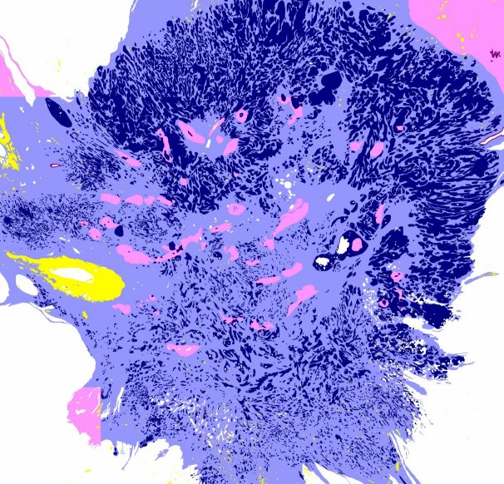
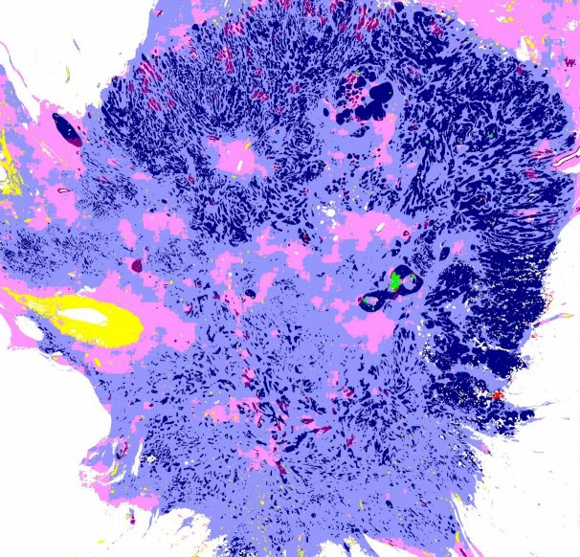
WSI Segmentation Results
RGB Image
Ground Truth
Predicted Semantic Mask

Slide 20
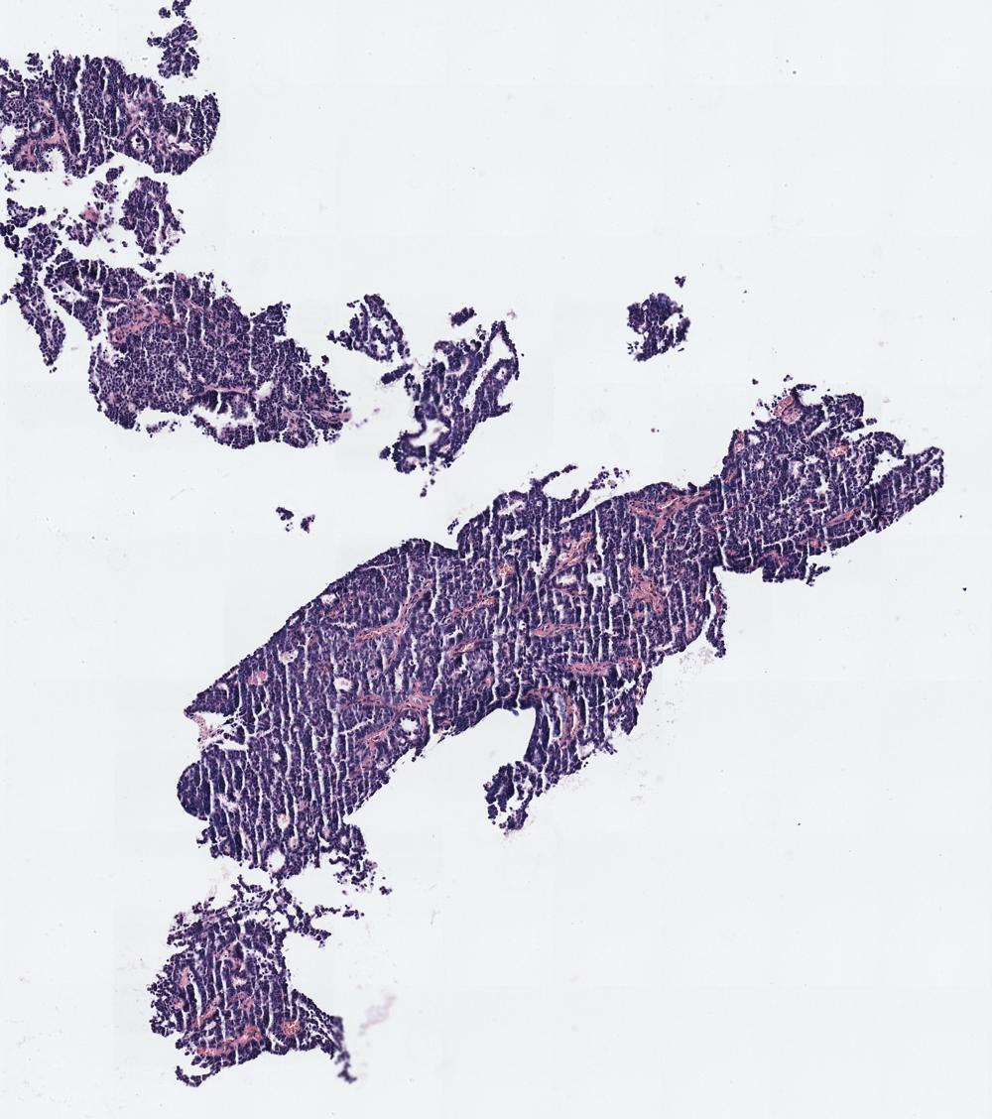
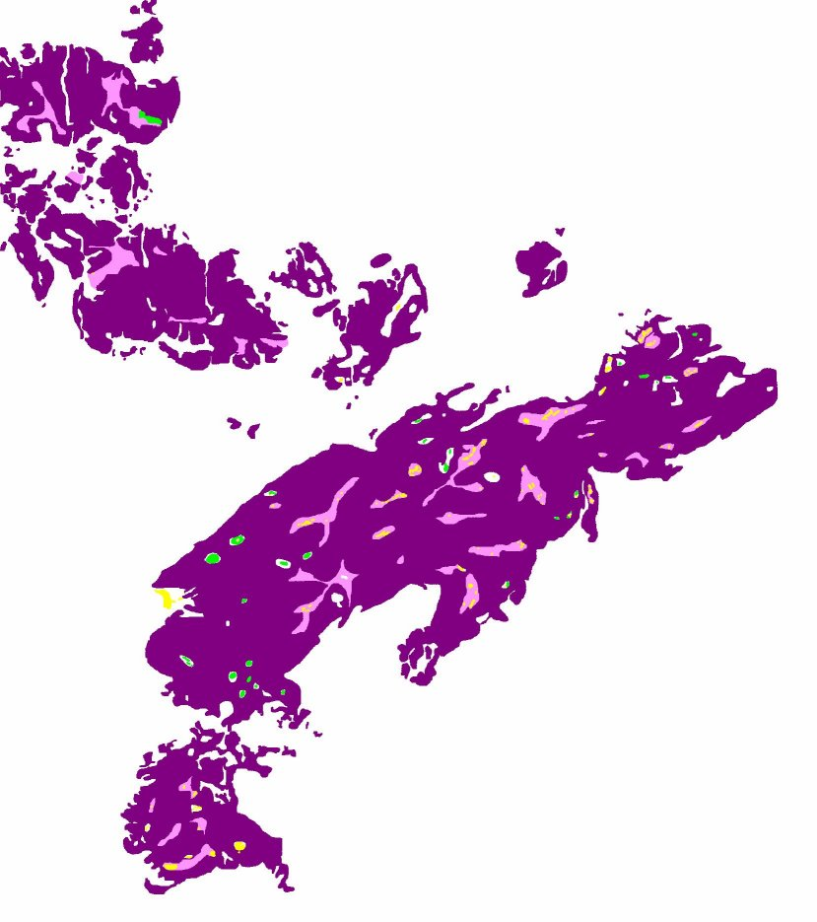
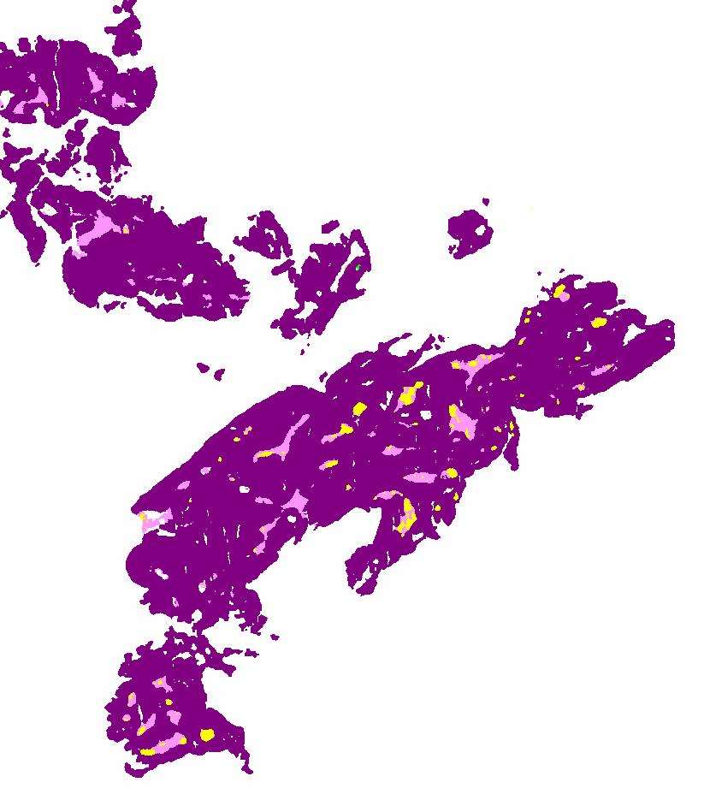
WSI Segmentation Results
RGB Image
Ground Truth
Predicted Semantic Mask

Slide 21
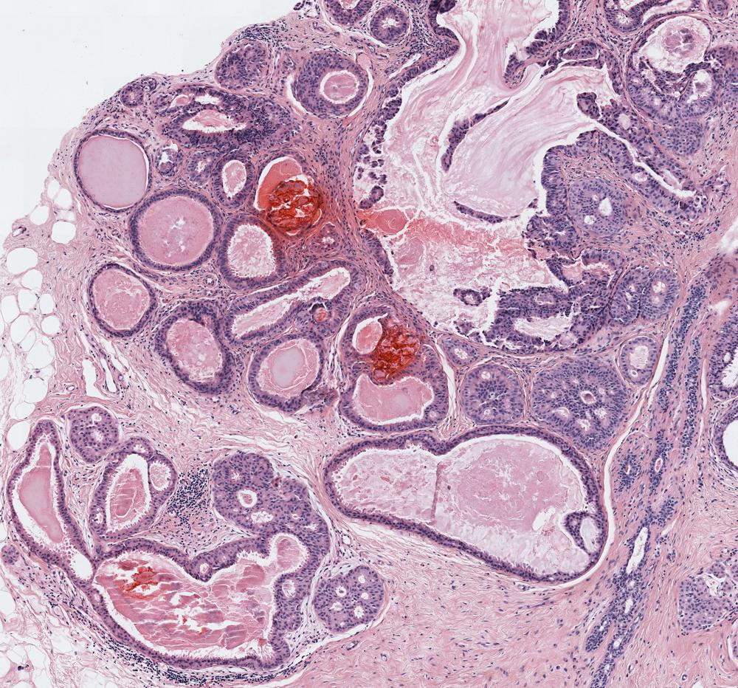
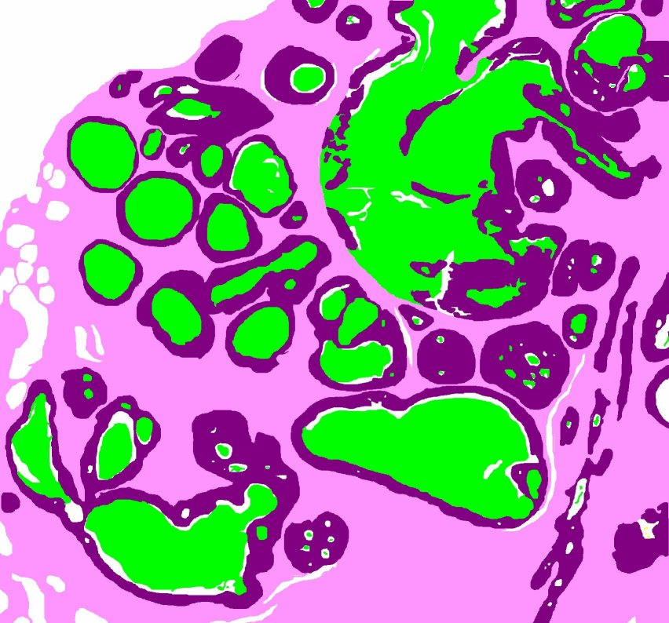
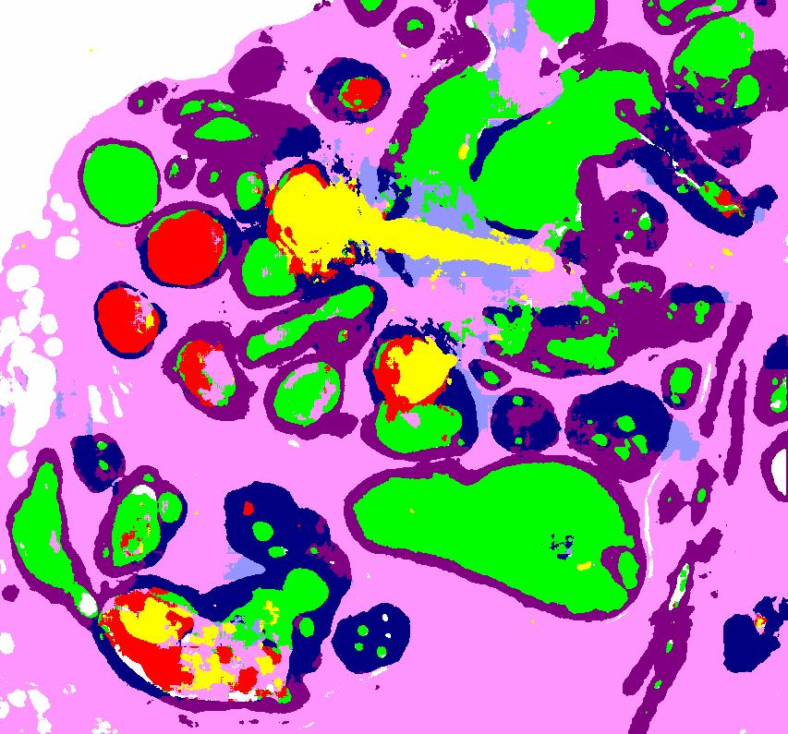
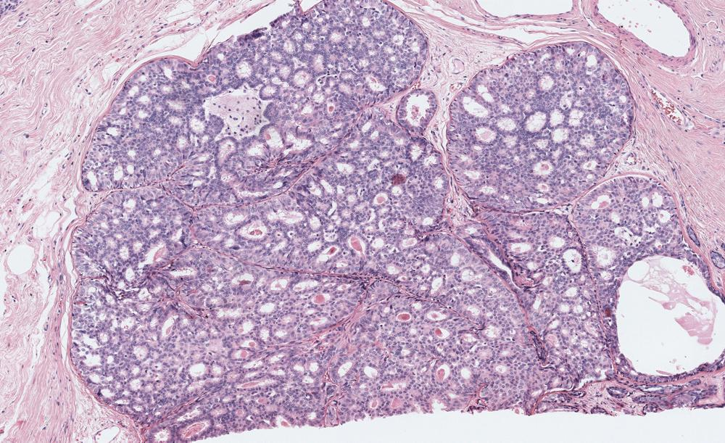
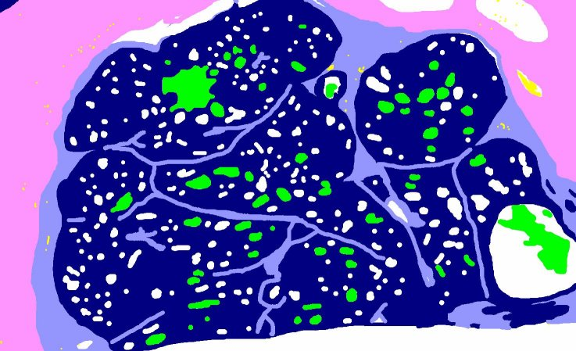
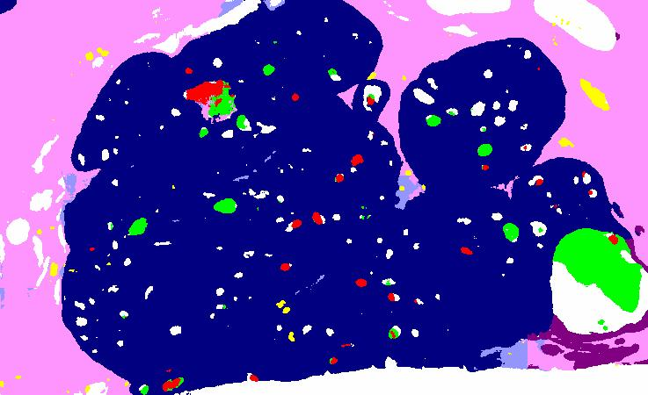
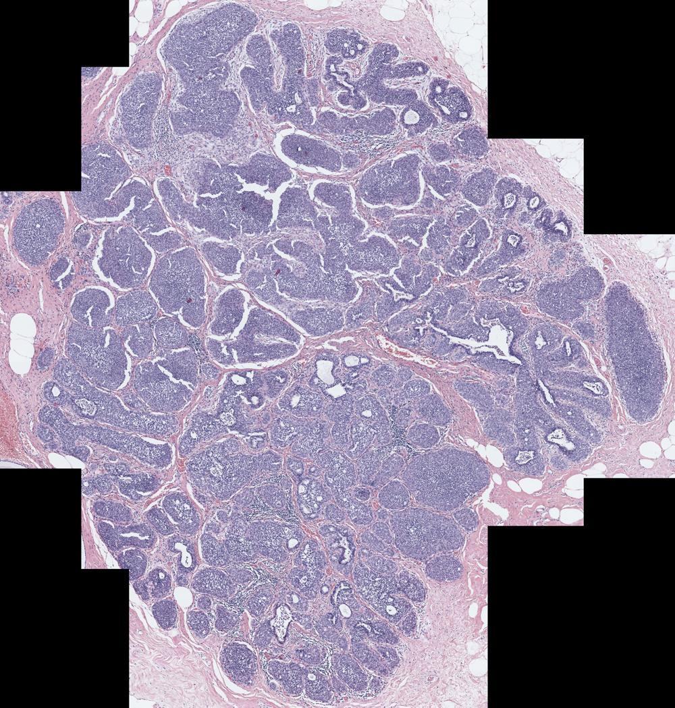
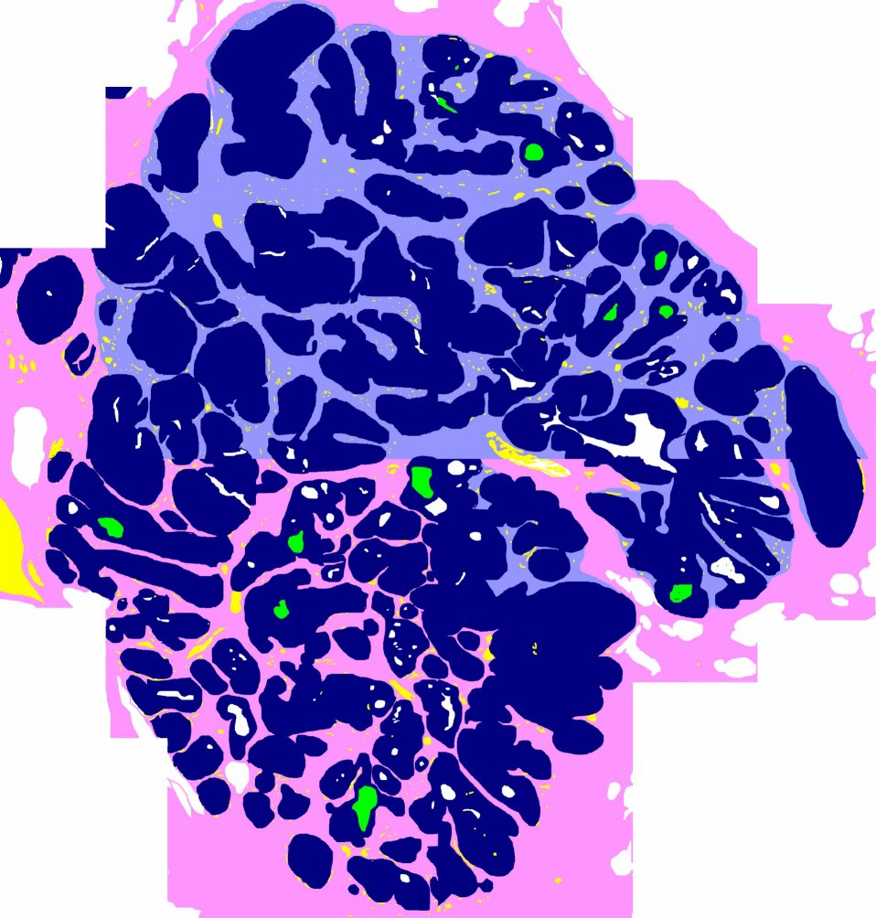
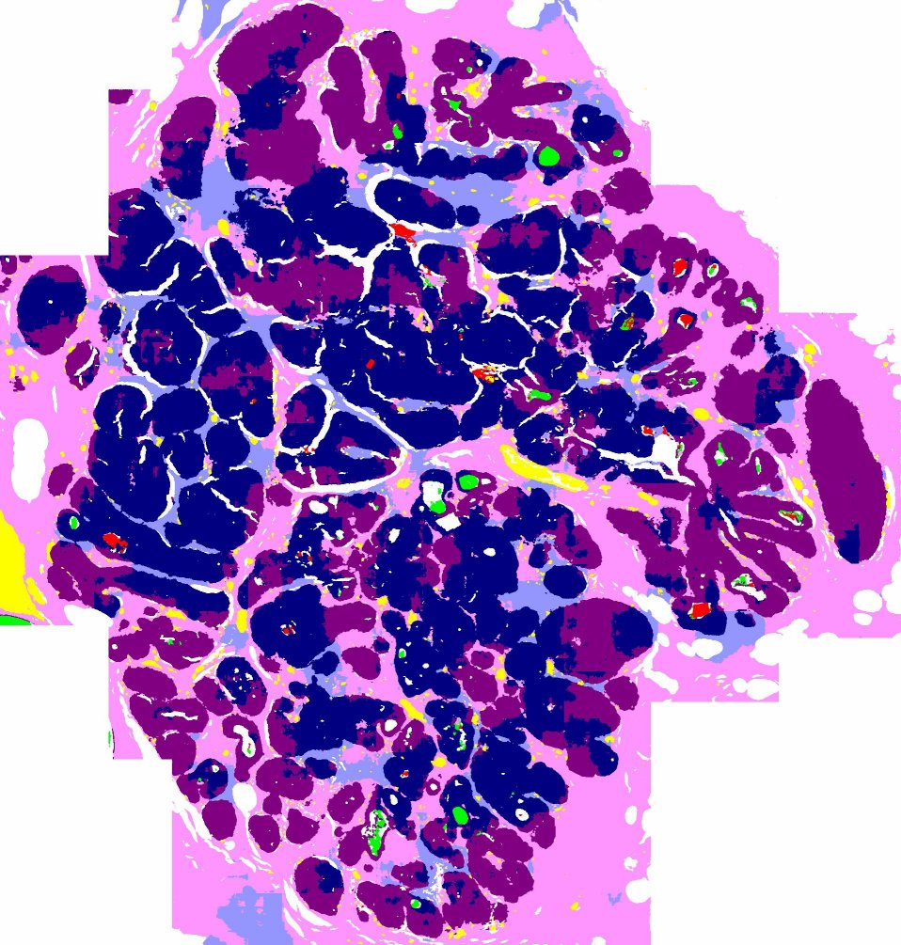



WSI Segmentation Results
Predicted Semantic Mask
RGB Image
Ground Truth
Predicted Semantic Mask
RGB Image
Ground Truth

Slide 22


Application to Cancer Diagnosis
Segmentation labels have high descriptive power and therefore, leads to good classification accuracy even with simple classifiers such as SVM and Multi-layer perceptron (MLP)
Multi-resolution network improves the pixel-wise classification accuracy of stroma tissue; which is an important tissue type for identifying invasive cancer.

Slide 23
Thank You!!
For more details about this work, please check DIGITAL PATHOLOGY project here: https://homes.cs.washington.edu/~shapiro/digipath.html

