Slide 1
Connectivity-based Parcellation of
Human Inferior Parietal Lobule using
Diffusion MRI and Probabilistic Tractography
Joe Xie
May 26, 2011

Slide 2
Outline
Background
  Diffusion MRI
  Human inferior parietal lobule
Materials & Methods
  Data Collection
  Connectivity Map Preparation via preprocessing
  Unsupervised Classification Approaches (Spectral clustering)
Results
  Pseudo truth from Jülich Atlas
  K means, Mixture Gaussian, and Spectral Clustering
  Correspondence accuracy metric for parcellation evaluation

Slide 3
Background

Slide 4
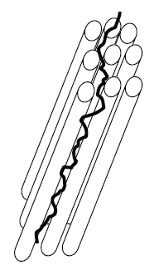
Diffusion in White Matter
X
Z
Y
Water in an Oriented Tissue
Diffusion ‘Ellipse’
Water Motion
MII08Wk6Wang

Slide 5
Inferior Parietal Lobule
Brain region with marked functional heterogeneity involved in visuospatial attention, memory, and mathematical cognition
Availability of ECoG electrodes to verify and make testable predications in our study
Consisted of seven cytoarchitectonic regions (PGp, PGa, PF, PFcm, PFm, PFt, Pfop)

Slide 6
Prior Knowledge of IPL Connectivity
Rostral IPL areas: targets in
the prefrontal, motor,
somatosensory, and anterior
superior parietal cortex
Caudal IPL areas: targets in
the posterior superior
parietal and temporal areas
Caspers, 2009

Slide 7
Materials & Methods

Slide 8
Data
One subject
  Diffusion weighted data (128x128x70)
    B value – 1000
    Acquired in 63 gradient directions
  T1 coronal data (256x256x208)
    Manually extracted brain data
T1 MNI 152 1mm standard data (182x218x182)
  Juelich atlas

Slide 9
Tools for Brain Analysis
FreeSurfer: automated tools for reconstruction of
the brain’s cortical surface from structural MRI data,
and overlay of functional MRI data onto the
reconstructed surface.
FSL: a comprehensive library of analysis tools
for FMRI, MRI and DTI brain imaging data.
FSL runs on Apples, Linux, and Windows. Most
of the tools can be run both from the command
line and as GUIs.
SPM: a statistical package for processing brain data
including fMRI, SPECT, PET, EEG, MEG.

Slide 10
Juelich Atlas
Juelich histological (cyto- and myelo-architectonic) atlas
A probabilistic atlas created by averaging multi-subject
post-mortem cyto- and myelo-architectonic segmentations.
The atlas contains 52 grey matter structures and 10 white
matter structures. This is an update to the data used in
Eickhoff's Anatomy Toolbox v1.5.
The atlas is based on the miscroscopic and quantitative histological
examination of ten human post-mortem brains. The histological
volumes of these brains were 3D reconstructed and spatially
normalized into the space of the MNI single subject template
to create a probabilistic map of each area. For the FSL version
of this atlas, these probabilistic maps were then linearly
transformed into MNI152 space.

Slide 11
Flowchart
Diffusion-weighted Imaging
High resolution
T1 weighted imaging
Using FSL - bedpostX
Using Freesurfer
ROIs (including the region to be parcellated, and regions to be targeted for connectivity analysis) extraction
Diffusion Propagator Estimation
Using FSL - Probtrackx
Generate the connectivity map for each seed point using Probabilistic Tractography
Using K-Means, Mixture-Gaussian, Spectral Clustering, etc
Labeling the voxels from the ROI region into functional fields based on connectivity pattern
Verification with Jülich atlas

Slide 12
Estimation of Distribution of Diffusion using FSL BEDPOSTX
Bayesian Estimation of Diffusion Parameters Obtained using Sampling Techniques (BEDPOSTX) to build up distribution of diffusion parameters at each voxel
  Partial model allowing for fiber direction mixed with an isotropic ally diffusion model
  A parameterized model of the transfer function between a distribution of fiber orientations in a voxel and the measured diffusion weighted signal
  Use of Markov Chain Monte Carlo (MCMC) sampling to estimate the posterior distribution on parameters of interest
Behrens 2003

Slide 13
WGMI Partition using Freesurfer
White gray matter interface (WGMI) Partition
  Gray matter does not have enough connectivity information for parcellation
  Atlas based cortical registration (a2009 atlas)
  Seed regions: inferior parietal lobule (IPC) including angus and super marginal
  Target regions: all cortical regions except IPC

Slide 14
Connectivity Matrix Calculation using Probabilistic Tractography (FSL PROBTRACKX)
Each value in the connectivity matrix indicates the probability that the seed particle can reach the target region through probabilistic tractography
ID # of target regions
connectivity probability =
(number of particles that reached the target region) /
(total number of particles issued from the seed voxel)
ID # of seed voxels
Connectivity matrix

Slide 15
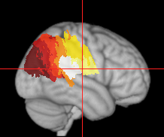
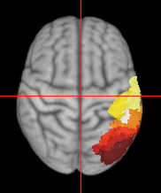
Juelich Atlas for Verification
lh-IPC, Sagittal View
lh-IPC,Transverse View
3
2
4
5
1
7
6
6
5
4
7
3
2
1
Post-process group averaged probability map
to obtain the function field labels with highest probability

Slide 16
Labeling Approaches
K–Means Clustering
Mixture of Gaussians (EM Clustering)
Spectral Clustering (Graph – cut)

Slide 17
Spectral Clustering
Spectral Clustering
  Build the similarity graph through pair-voxel correlation of connectivity similarity and spatial affinity
  Solve the normalized graph-cut problem through Eigen decomposition of similarity matrix

Slide 18
Build the Similarity Graph
W_conn=
exp(-alpha*connectivity distance/delta^2)
# of seed voxels
W_conn
# of seed voxels
# of the target regions
# of seed voxels
W_compo=
W_conn.*W_spatial
Connectivity Pattern #i
Connectivity similarity matrix
# of seed voxels
# of seed voxels
# of seed voxels
W_spatial
Composite similarity graph
Connectivity matrix
# of seed voxels
W_conn=
exp(-(1-alpha)*spatial distance/delta^2)
Spatial affinity matrix
Notes:
----- Meeting Notes (5/24/11 10:48) -----
connectivity distance
spatial distance
regularization

Slide 19
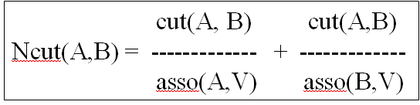
Normalized cut of the Similarity Graph
Normalized cut
Example
A
B
2
2
2
2
2
2
2
2
1
4
3
1
2
2
2
3
3 3
Ncut(A,B) = ------- + ------
21 16
Shi & Malik, 2000
Notes:
Algorithm steps
Decide the cluster number N
Solve the eigen vectors for the smallest eigen values
Form the new matrix with the eigen vectors corresponding to the k smallest eigen values as columns
K-means clustering of the new formed matrix into N clusters

Slide 20
results

Slide 21
Data Summary
Left Hemisphere IPL Parcellation (LH-IPL)
  667 voxels selected as seed for probabilistic tractography
  148 targets are selected for probabilistic tractography, 3 targets are discarded due to lack of enough connectivity
Right hemisphere IPL Parcellation (RH-IPL)
  617 voxels selected as seed for probabilistic tractography
  148 targets are selected for probabilistic tractography, 2 targets are discarded due to lack of enough connectivity

Slide 22




Lh-IPL: 3D Sagittal View
Kmeans (N=5)
EM (N=5)
Spectral clustering (N=5)
Notes:
----- Meeting Notes (5/24/11 10:48) -----
hancd curve and copy it from altas to other

Slide 23
Lh-IPL – 2D Views (Kmeans, N=5)
Grey clusters are the atlas, while the colored ones are clustered by kmeans
Notes:
----- Meeting Notes (5/24/11 10:48) -----
Boundary 2D

Slide 24
Lh-IPL – 2D Views (EM, N=5)
Grey clusters are the atlas, while the colored ones are clustered by EM

Slide 25
Lh-IPL – 2D Views (SC, N=5)
Grey clusters are the atlas, while the colored ones are clustered by Spectral Clustering

Slide 26
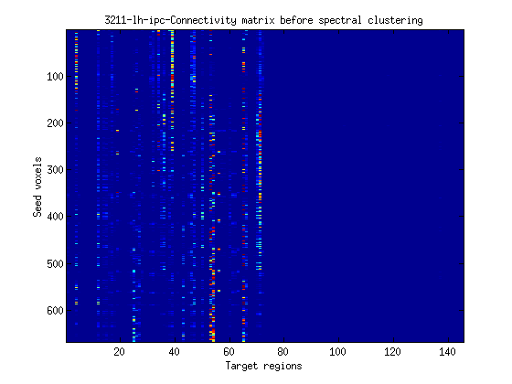
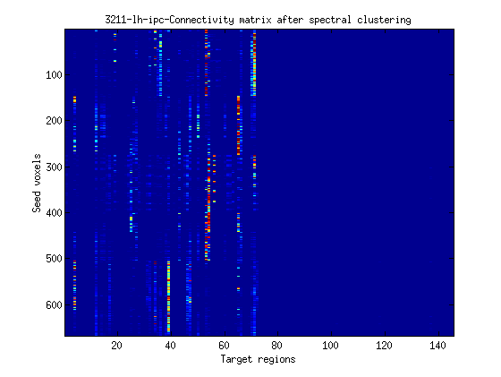
Normalized Connectivity Matrix
Before spectral clustering
After spectral clustering
Notes:
----- Meeting Notes (5/24/11 10:48) -----
big thing below before and after

Slide 27
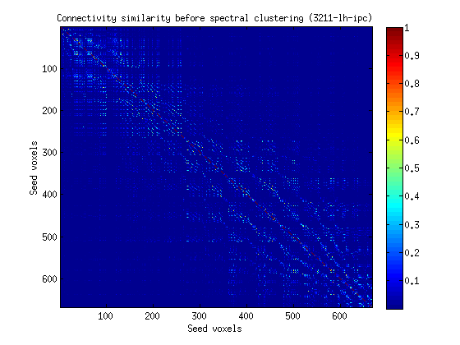
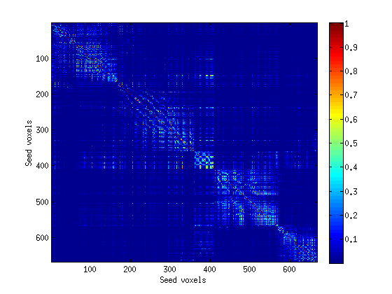
Connectivity Similarity Matrix of Spectral Clustering
Before spectral clustering
After spectral clustering

Slide 28
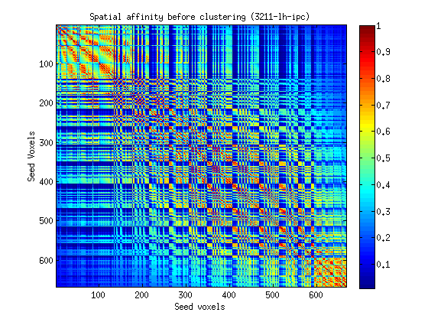
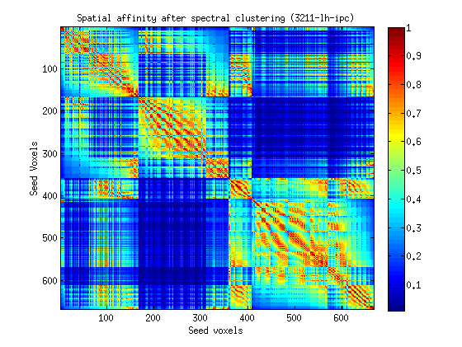
Affinity Matrix of Spectral Clustering
Before spectral clustering
After spectral clustering
Notes:
----- Meeting Notes (5/24/11 10:48) -----
before vs after

Slide 29
Interpretation of the Clusters (LH-IPL)
 | PGp | PGa | PFm | PF | PFt | PFop | PFcm | Total | Top 3 connected targets
Cluster#1 | 88 (96.7%) | 2 | 0 | 1 | 0 | 0 | 0 | 91 | wm_lh_S_temporal_sup wm_lh_S_oc_sup_and_transversal wm_lh_S_intrapariet_and_P_trans
Cluster #2 | 0 | 0 | 4 | 69 (53.1%) | 26 | 29 | 0 | 135 | wm_lh_S_postcentral wm_lh_G_and_S_subcentral wm_lh_G_front_inf-Opercular
Cluster #3 | 48 (40.1%) | 25 | 31 | 14 | 0 | 0 | 0 | 119 | wm_lh_S_intrapariet_and_P_trans wm_lh_S_interm_prim-Jensen wm_lh_G_parietal_sup
Cluster #4 | 0 | 0 | 0 | 33 | 0 | 66 (46.5%) | 43 | 163 | wm_lh_Lat_Fis-post wm_lh_G_and_S_subcentral wm_lh_S_circular_insula_sup
Cluster #5 | 4 | 34 | 53 | 67 (42.1%) | 0 | 0 | 1 | 159 | wm_lh_S_interm_prim-Jensen wm_lh_S_temporal_sup wm_lh_G_temporal_middle
Notes:
C2a=
88 2 0 1 0 0 0
0 0 4 69 26 29 0
48 25 31 14 0 0 0
0 0 0 33 0 66 43
4 34 53 67 0 0 1
c2a_ratio =
0.9670 0.0220 0 0.0110 0 0 0
0 0 0.0312 0.5391 0.2031 0.2266 0
0.4068 0.2119 0.2627 0.1186 0 0 0
0 0 0 0.2324 0 0.4648 0.3028
0.0252 0.2138 0.3333 0.4214 0 0 0.0063
nSize_SC =
91 135 119 163 159
Target_list=
target_reorder(:,1:5)
ans =
13174 13159 13157 13119 13149
13168 13104 13112 13153 13150
13157 13156 13127 13168 13146
13141 13104 13150 13136 13174
13156 13174 13138 13173 13157
----- Meeting Notes (5/24/11 10:48) -----
spectral clustering

Slide 30
Additional Study
Bilge Soran
Quals Project
November 2011

Slide 31
Outline of Work
Tried several variants of normalized graph cuts
Used both connectivity and spatial distance information
Tried several different connectivity similarity functions
Tried several different spatial distance functions
Developed a spatial affinity function
Tried out a feature selection approach
Developed a new metric for evaluation

Slide 32
Similarity matrix computation
Build a normalized connectivity matrix using probabilistic tractography. The values are normalized by dividing by the largest value of the matrix.
Build a symmetric spatial distance matrix

Slide 33

Connectivity Similarity Function
(where σ is a weighting factor and set to 2.)
Distance Functions:
Euclidean
Standardized Euclidean
Mahalanobis
City Block
Minkowski
Cheybchev
Jaccard
Cosine
Correlation
Hamming

Slide 34
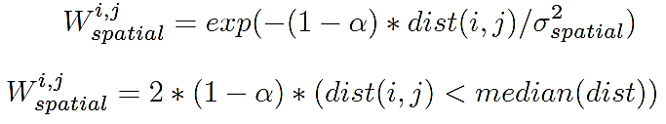
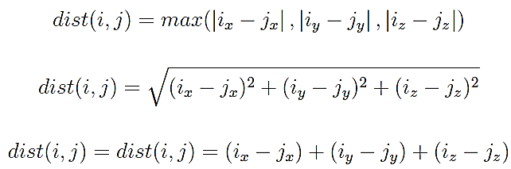
Spatial Affinity Functions
(where σ is a weighting factor and set to 0.5.)

Slide 35
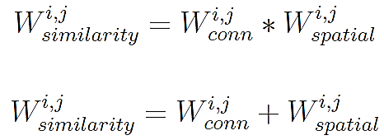
Similarity matrix computation
Compute the composite similarity matrix with one of the equations below:

Slide 36
Graph-Cuts Variants
Standard Normalized Graph Cuts
Normalized Graph Cuts with Feature Selection
Normalized Graph Cuts with K-means

Slide 37
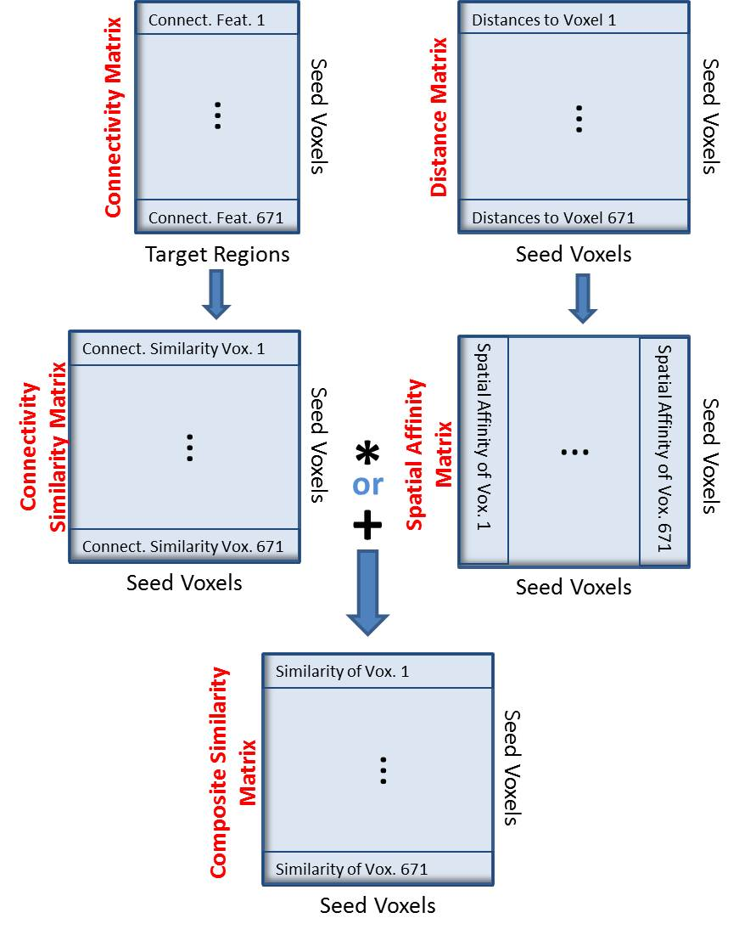
Similarity matrix computation

Slide 38
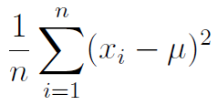
Feature Selection by Target Elimination
Not all voxels have connections to all target regions.
The variance of a target region is computed by using the connectivity values in its column of the connectivity matrix with the standard formula:
After computing the variance for each target region, a threshold is applied to select targets with high variances since they are expected to carry discriminative information.

Slide 39
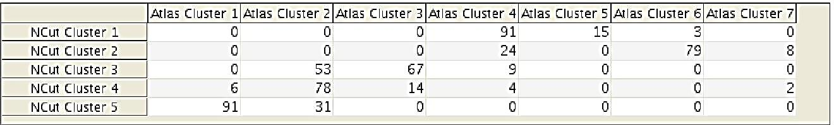
Evaluation
An example table used in evaluation:

Slide 40
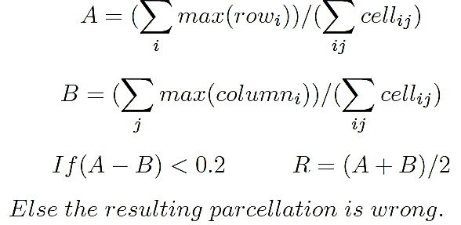
Evaluation Metric

Slide 41
RESULTS

Slide 42
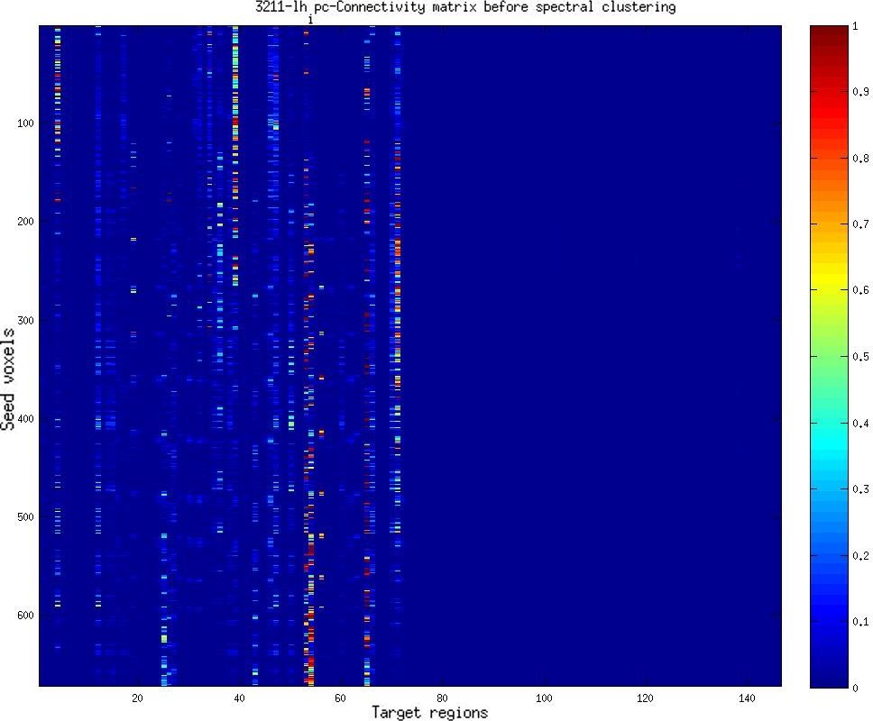
Parcellation of Subject 3211: Connectivity Matrix Before Parcellation

Slide 43
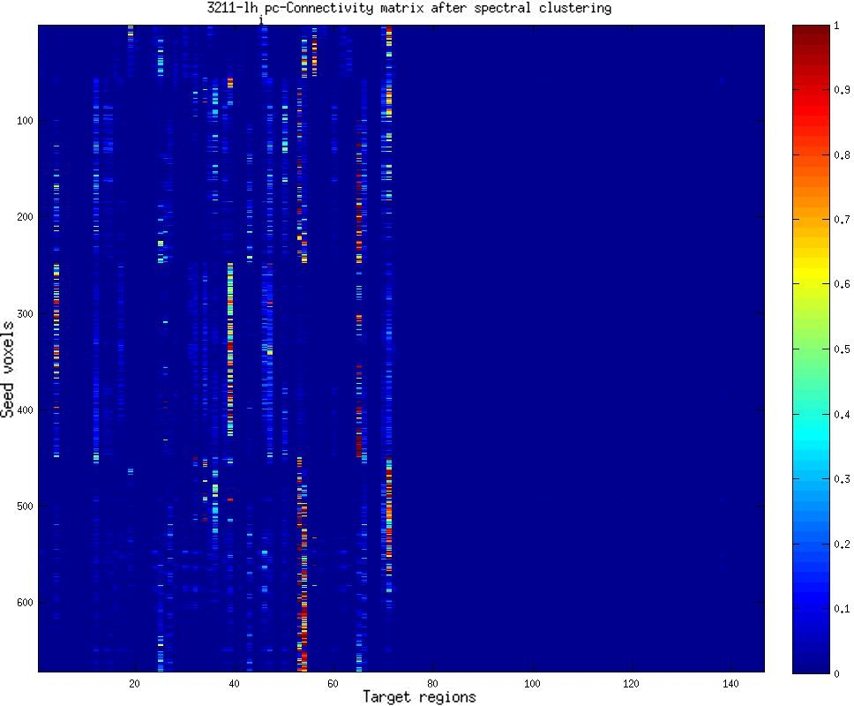
Parcellation of Subject 3211: Connectivity Matrix After Parcellation

Slide 44
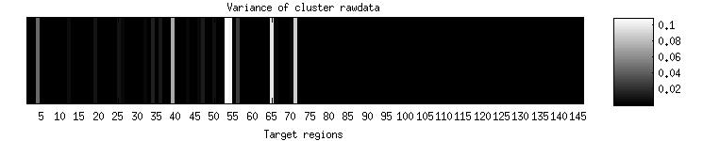
Parcellation of Subject 3211: Connectivity Variances Before Parcellation

Slide 45
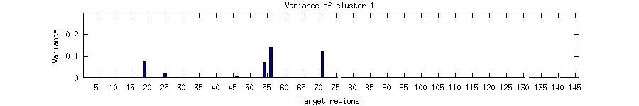
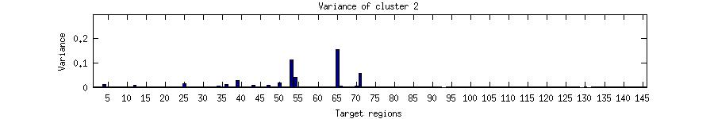
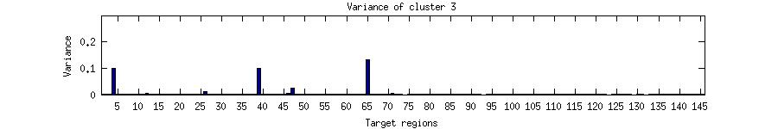
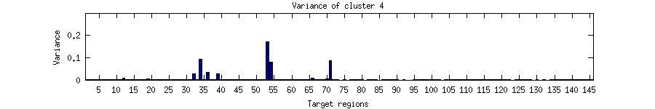
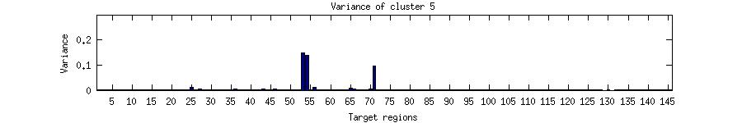
Parcellation of Subject 3211:
Variance of Each Cluster After Parcellation

Slide 46
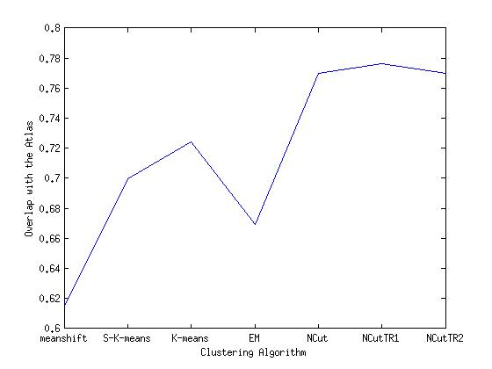
Parcellation of Subject 3211:
Performances of Different Clustering Methods

Slide 47
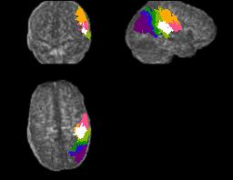
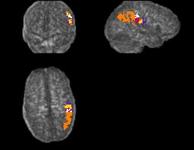
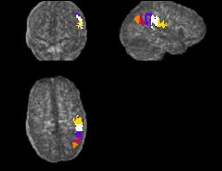
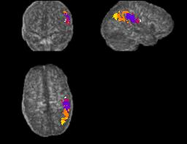
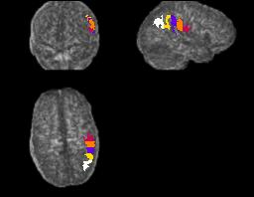
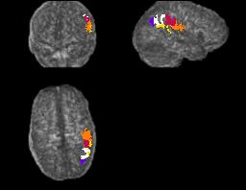
Parcellation of Subject 3211:
Performances of Different Clustering Methods
Atlas
EM
K-means
Mean-Shift
Sparse K-means
Normalized Graph Cuts

Slide 48
Work in Progress

Slide 49
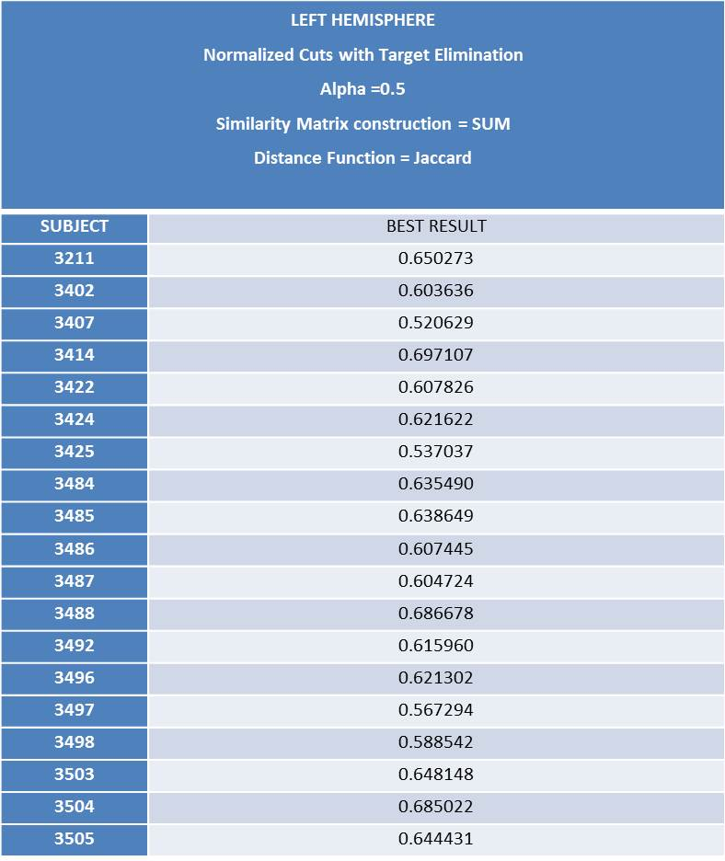
Parcellation of 19 Subjects:
Based on the selected parameters from the parcellation of Subject 3211

Slide 50
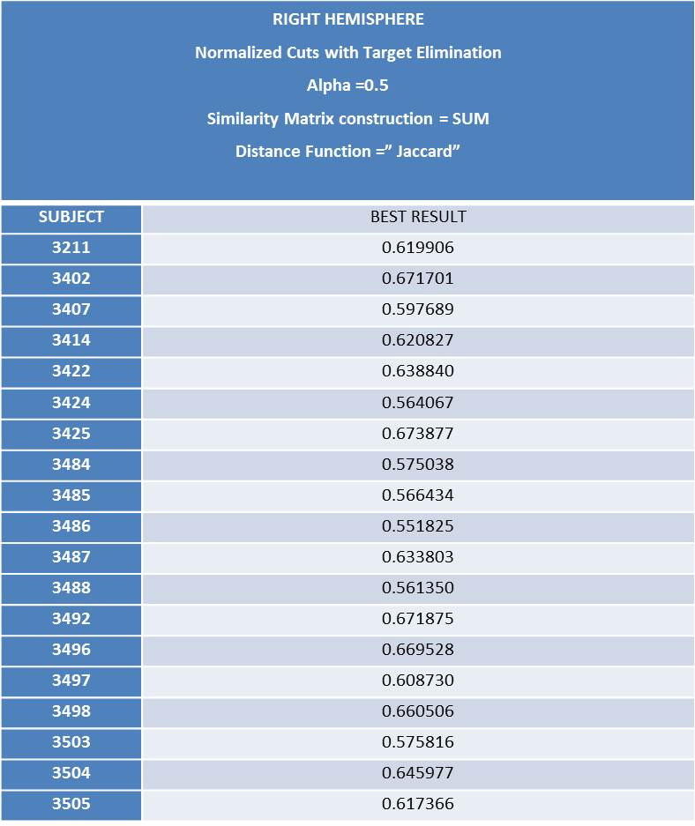
Parcellation of 19 Subjects:
Based on the selected parameters from the parcellation of Subject 3211

Slide 51
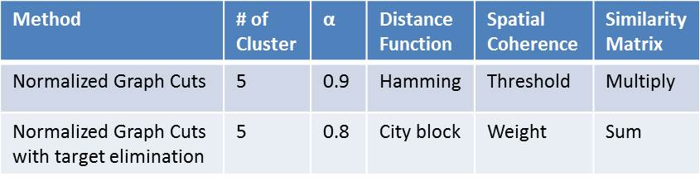
Parcellation of 19 Subjects:
Best Parameters (Left Hemisphere)

Slide 52
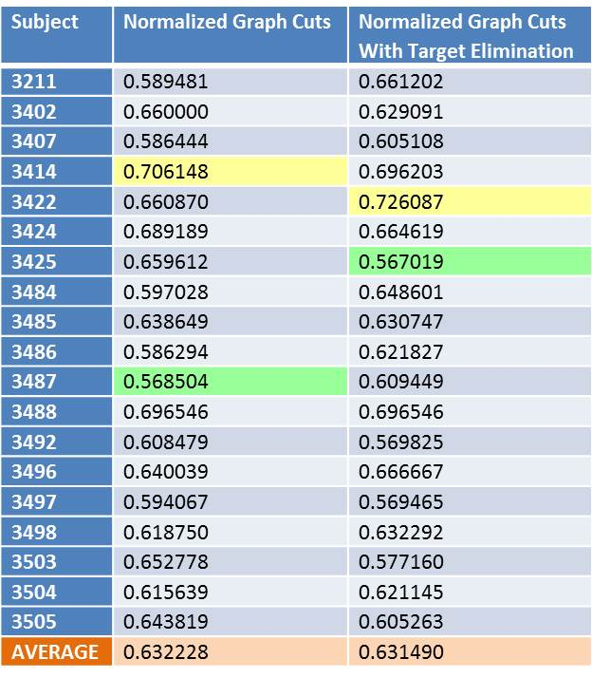
Parcellation of 19 Subjects:
Parcellation Evaluation based on the training parameters (Left Hemisphere)

Slide 53
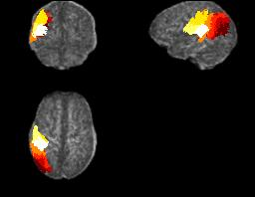
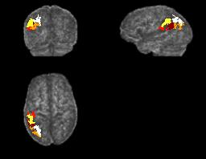
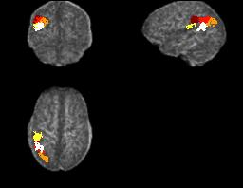
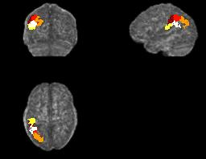
Parcellation with Target Elimination Results:
Subjects 3414, 3422, 3488 (Left Hemisphere)
Atlas in 3422’s FA space
3414
3422
3488

Slide 54
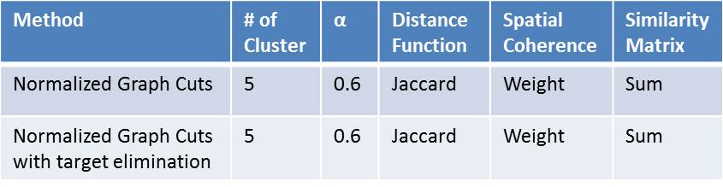
Parcellation of 19 Subjects:
Best Parameters (Right Hemisphere)

Slide 55
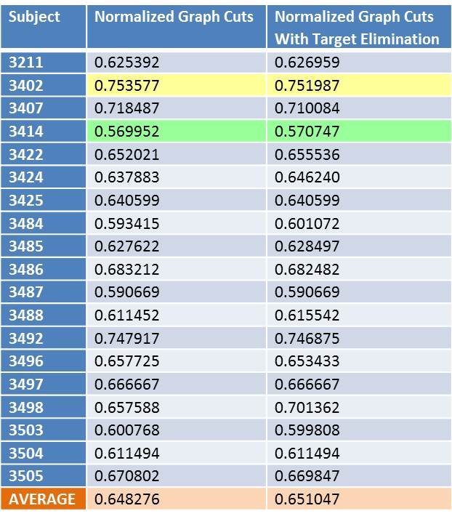
Parcellation of 19 Subjects:
Parcellation Evaluation based on the training parameters (Right Hemisphere)

Slide 56
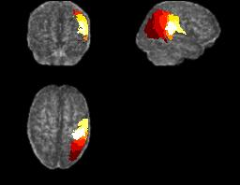
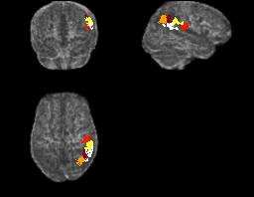
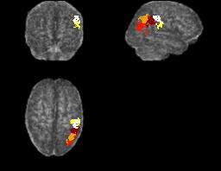
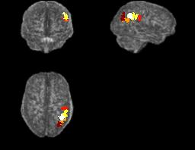
Parcellation with Target Elimination Results:
Subjects 3402, 3407, 3492 (Right Hemisphere)
Atlas in 3402’s FA space
3407
3402
3492

Slide 57
Comparison of Normalized Graph Cuts
Standard NGC with feature selection produced best results in most of the tests.
Standard NGC without feature selection produced results very close to those with feature selection.
NGC with k-means produced incorrect parcellations according to the metric.

Slide 58
Conclusion
Different clustering methods were applied to an anatomical connectivity map, which is obtained by DTI-based tractography of the IPL of a living subject to parcellate it into component regions with different connectivity patterns.
Among the different methods investigated, normalized graph cuts showed the best performance.

Slide 59
Conclusion
The main difficulty of the evaluation was having no ground truth data by which to measure the quality of our parcellation.
How many different regions exist in the IPL of a human being is still an unknown. Therefore in this work, different numbers of clusters were tried and the evaluation metric was designed to measure the quality of the overlap with different numbers of clusters.
Notes:
The only data we have for ground truth is the Juelich atlas,
which is an average brain map of 10 post-mortem subjects. Since it is only an avarage
and not ground truth, perfect overlap is not possible. Individual subjects' brains might
have very different sizes for regions with different functionalities. Even if the 3D volume
of the subject and the atlas perfectly overlaps,
the size of the regions might be very different.

