Slide 1
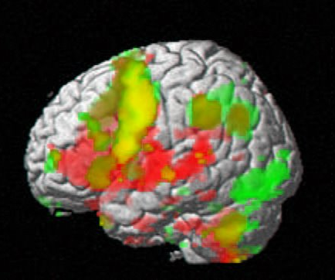
A Similarity Retrieval System for Multimodal Functional Brain Images
Rosalia F. Tungaraza
Advisor: Prof. Linda G. Shapiro
Ph.D. Defense
Computer Science & Engineering
University of Washington

Slide 2

Functional Brain Imaging
Study how the brain works
Imaging while subject performs a task
Image represents some aspect of the brain e.g.
  fMRI: brain blood oxygen level
  ERP: scalp electric activity

Slide 3
Motivation
Given a database of functional brain images from various subjects, cognitive tasks, and image modality.
Database users need to retrieve similar images
A system that can automatically perform this retrieval will reduce amount of time and effort users spend during this task
3

Slide 4
Content-Based Image Retrieval
Given a query image and an image database,
retrieve the images that are most similar to the
query in order of similarity.
Example system for photographic images:
Andy Berman’s FIDS system; Yi Li’s Demo
http://www.cs.washington.edu/research/imagedatabase/demo

Slide 5


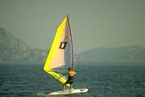
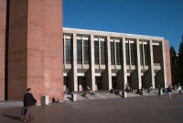

Image Features / Distance Measures
Query Image
Retrieved Images
User
Image Database
Distance Measure
Images
Image Feature
Extraction
Feature Space

Slide 6
Contributions
Created a similarity retrieval system for multimodal brain images
    fMRI, ERP, and combined fMRI-ERP
    User interface
Developed feature extraction methods for fMRI and ERP data
Developed pair-wise similarity metrics
Simulated human expert similarity scores

Slide 7
Outline
Background
    fMRI
    ERP
    Existing Similarity Retrieval Systems for these modalities
Feature Extraction Process
Similarity Metric
User Interface
Retrieval Performance
Simulate Human Expert
7

Slide 8
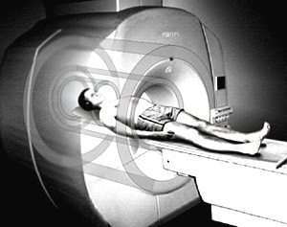
Functional Magnetic Resonance Imaging (fMRI)
A non-invasive brain imaging technique
Records blood oxygen level in brain
While imaging, subject performs a task
8
Notes:
8

Slide 9
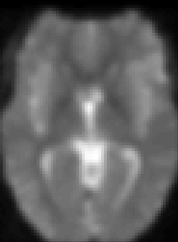
fMRI Statistical Images
Statistical Analysis
Voxel Thresholding

Slide 10
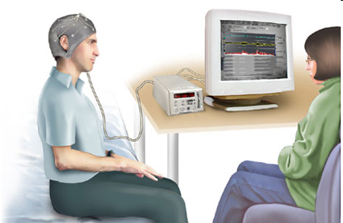
Event-Related Potentials (ERP)
@ 2004 by Nucleus Communications, Inc.
A non-invasive brain imaging technique
Records electric activity along scalp
While imaging, subject performs a task
10
Notes:
10

Slide 11
ERP Source Localization
Researchers want to identify the electric activity and its source for each electrode
But, multiple sources for each electrode
LORETA approximates anatomic locations of sources
11
Notes:
11

Slide 12
Comparison of fMRI and ERP Data
 | fMRI | ERP
Spatial resolution | Good (in mm) | undefined/poor
Temporal resolution | Poor (in sec) | Excellent (in msec)
12
Notes:
12

Slide 13
Similarity Retrieval Systems for fMRI Images
13
Notes:
13

Slide 14
Similarity Retrieval Systems for ERP Images
No relevant literature found
14
Notes:
14

Slide 15
Similarity Retrieval Systems for Combined fMRI-ERP Images
No relevant literature found
15
Notes:
15

Slide 16
Outline
Background
Feature Extraction Process
  fMRI features
  ERP features
Similarity Metric
User Interface
Retrieval Performance
Simulate Human Expert
16

Slide 17
fMRI Feature Extraction
k=1
Approximate cluster centroids
Threshold
k=2
k=3
Perform clustering
Original database
Centroid
Avg Activation Value
Var Activation Value
Volume
Avg Distance to Centroid
Var of those Distances
Compute region vectors
Perform connected component analysis

Slide 18
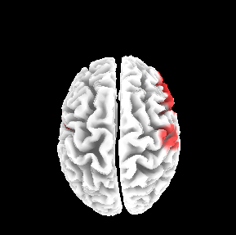
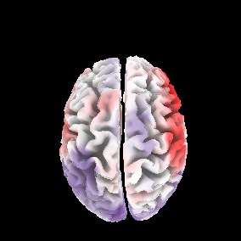
ERP Feature Extraction
Select time-segment
Signals at each point incorporate
information from that voxel and neighbors.
Compute voxel-wise statistically significant difference between means
The retained voxels have significant activation
meaning activities A and B are very different.
Compute feature
(X,Y,Z) positions of retained voxels
Threshold

Slide 19
Outline
Background
Feature Extraction Process
Similarity Metric
  Summed Minimum Distance
  Similarity Score for Combined fMRI-ERP Images
User Interface
Retrieval Performance
Simulate Human Expert
19

Slide 20

Summed Minimum Distance (SMD) for fMRI and ERP Images
Subject Q
Subject T
Euclidean
distance
between
feature
vectors*
Q2T =
SMD = (Q2T+T2Q) / 2
*We also used normalized Euclidean distance.
20

Slide 21
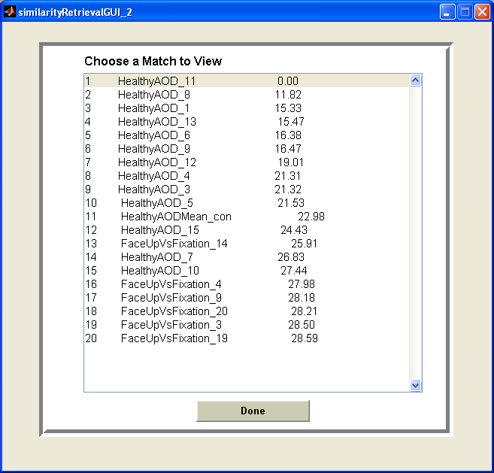
Sample SMD Scores
SMD
21

Slide 22
Similarity Score for Combined fMRI-ERP Images
SIM(i,j) = αSMD_{fMRI}(i,j) + (1-α)SMD_{ERP}(i,j)

Slide 23
Outline
Background
Feature Extraction Process
Similarity Metric
User Interface
Retrieval Performance
Simulate Human Expert
23

Slide 24
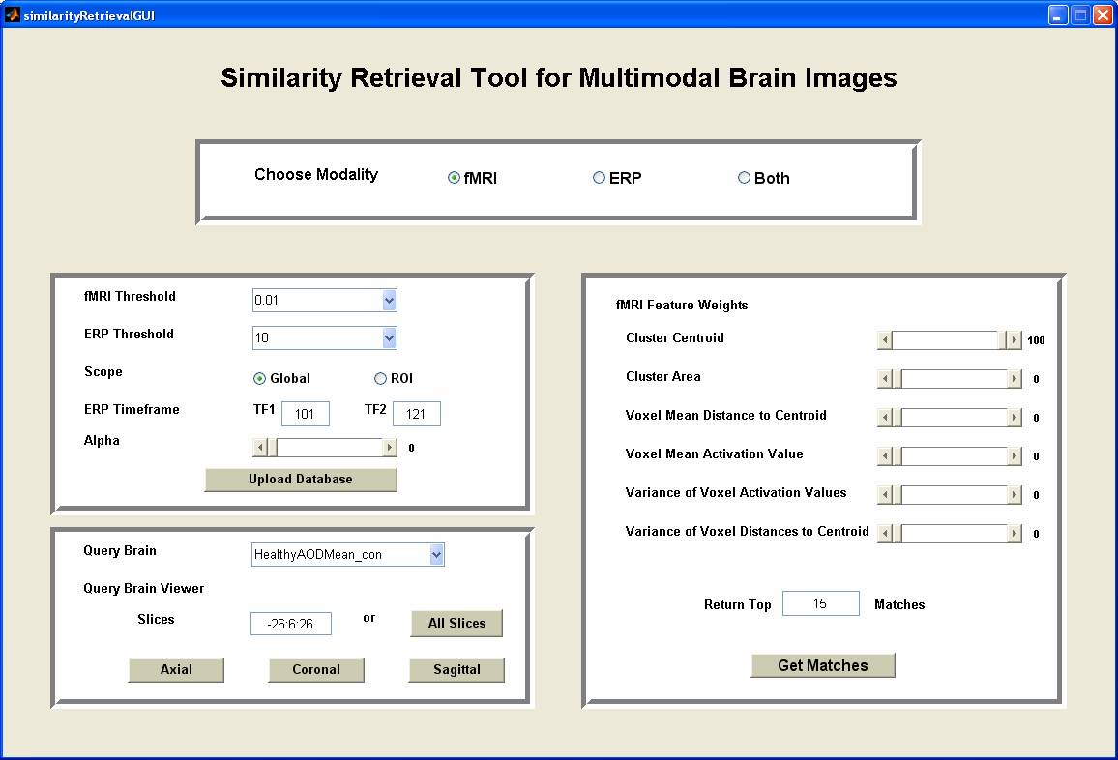
GUI: Front Page

Slide 25
GUI: Retrievals with SMD Scores
SMD
25

Slide 26
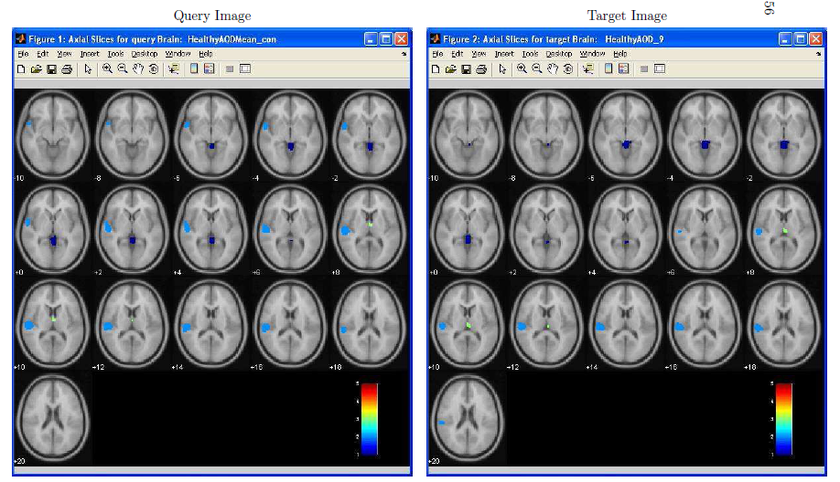
GUI: Query-Target Activations (fMRI)

Slide 27
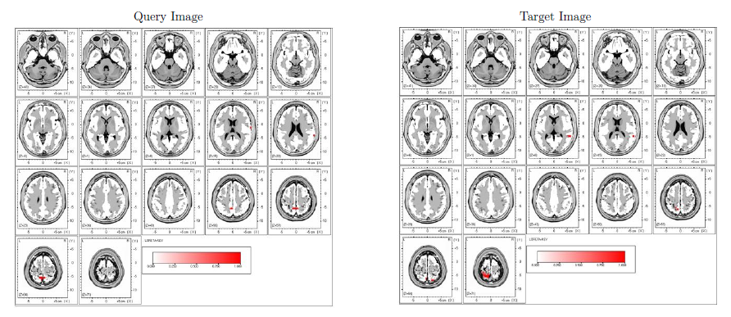
GUI: Query-Target Activations (ERP)

Slide 28
Outline
Background
Feature Extraction Process
Similarity Metric
User Interface
Retrieval Performance
  Data Sets
  fMRI Retrieval Performance
  ERP Retrieval Performance
  Combined fMRI-ERP Retrieval Performance
Simulate Human Expert
28

Slide 29
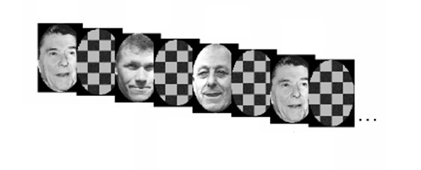
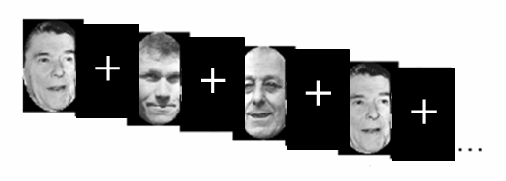
Data Sets for fMRI Retrievals
Checkerboard -- 12 subjects (Face Recognition)
Central-Cross -- 24 subjects (Face Recognition)
d
g
f
p
g
n
SB -- 15 subjects (Memorization)
AOD -- 15 subjects (Sound Recognition)
29

Slide 30

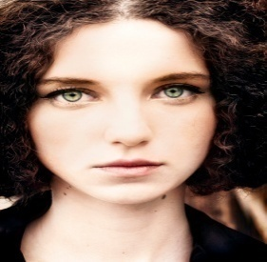
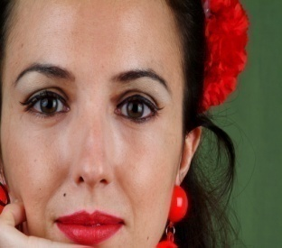

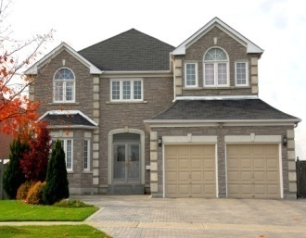
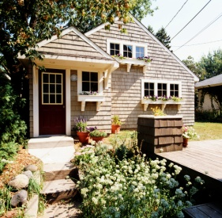
Data Set for ERP Retrievals
…
…
View Human Faces
(Face Up)
-- 15 subjects
View Houses
(House Up)
-- 15 subjects
30

Slide 31
Data Set for Combined fMRI-ERP Retrievals
ERP: same data set as used in ERP retrieval
fMRI:
  Task: Face recognition using a house up background
  Same subjects and images as data set for ERP retrieval
31

Slide 32
fMRI Retrieval Performance
RFX Retrievals
Individual Brain Retrieval
Testing Group Homogeneity
Feature Selection
Random effects models are very conservative
average activation models from a group, which
contain only activated voxels present in all members.
32

Slide 33
fMRI Retrieval Score
Perfect score : Retrieval Score = 0
Random score: Retrieval Score ~ 0.5
Worst score: Retrieval Score = 1
33

Slide 34
Example Scores
Let N = 100 and N_{rel} = 3
Sample Case1 R_{i} = i, i = 1 to 3
1 + 2 + 3 – 6 = 0/300
Sample Case 2 R₁ = 3, R₂ = 2, R₃ = 1
3 + 2 + 1 – 6 = 0/300
Sample Case 3: R₁ = 10, R₂ = 20, R₃ = 30
10 + 20 + 30 – 6 = 54/300

Slide 35
fMRI Individual Brain Retrievals
Use individual brain as query
 | Mean Retrieval Scores (Top 6% activated voxels)
Checkerboard | 0.09
SB | 0.16
Central-Cross | 0.21
AOD | 0.26
35

Slide 36
Testing Group Homogeneity for fMRI
All groups except AOD had tight clusters.
SB
CB
AOD
Central-Cross
MDS1 and MDS2 are 2 projections of the
multidimensional feature data.
36

Slide 37
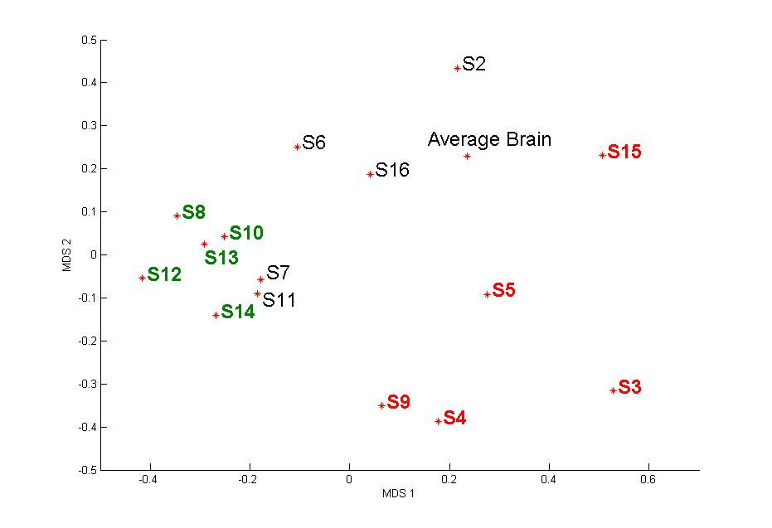
ERP Retrieval Performance
37

Slide 38
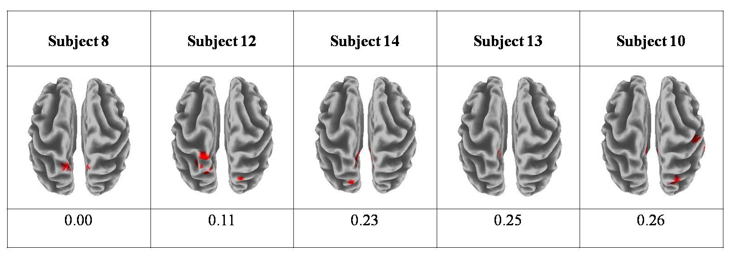
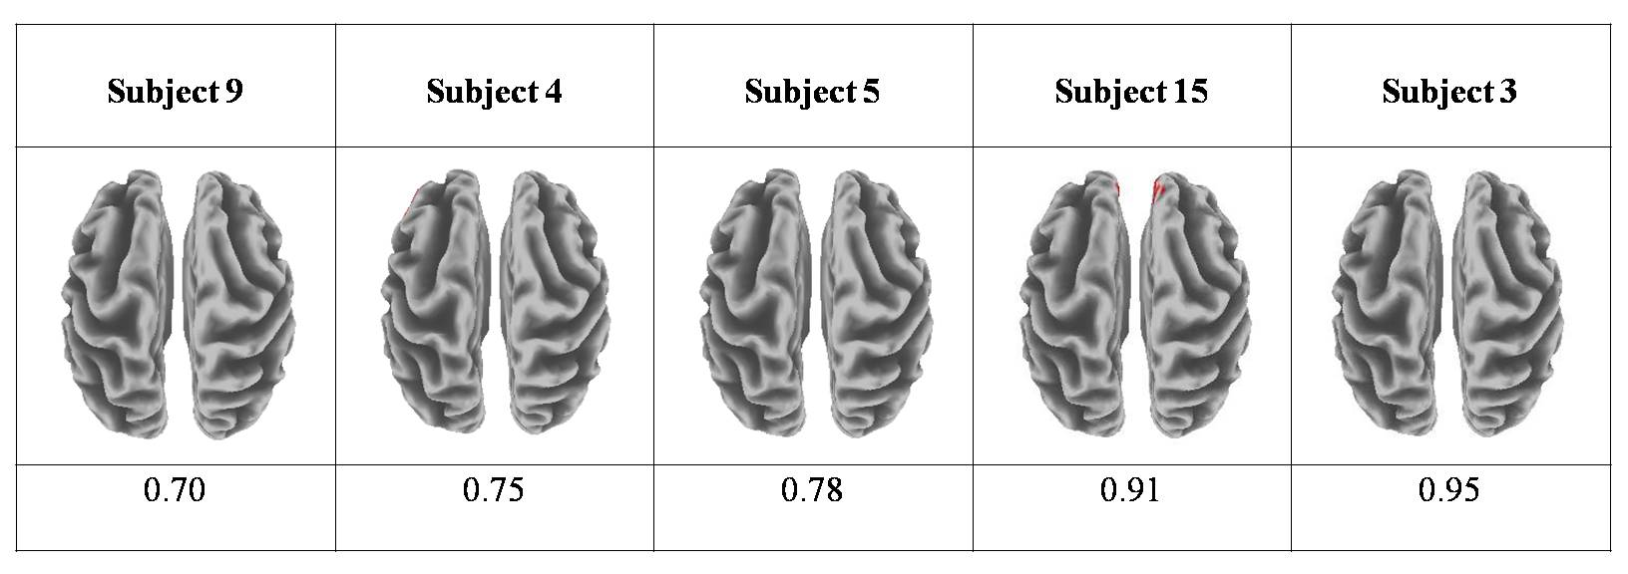
Subject #8 Retrievals
Top Retrievals
Bottom Retrievals

Slide 39
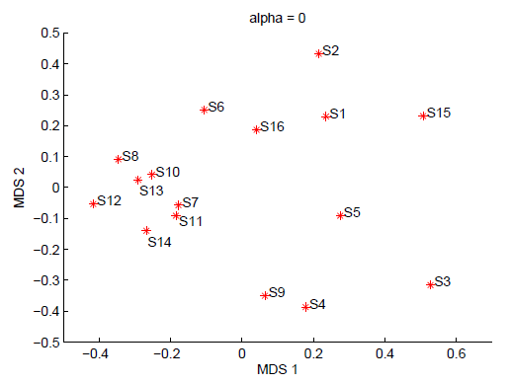
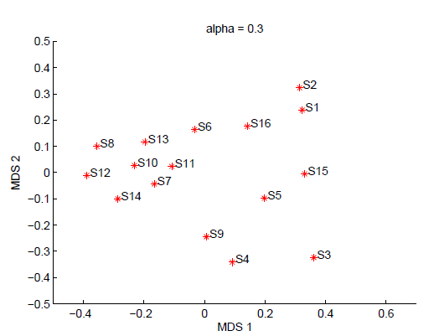
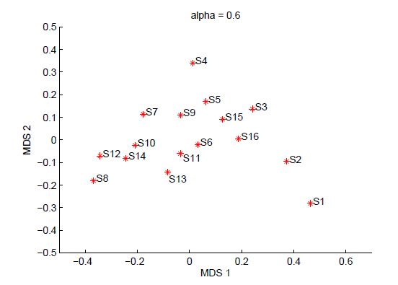
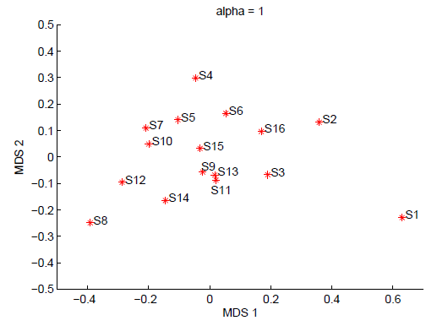
Combined fMRI-ERP Retrieval
α = 0.0, ERP only
α = 0.3
α = 0.6
α = 1.0, fMRI only
SIM(i,j) = αSMD_{fMRI}(i,j) + (1-α)SMD_{ERP}(i,j)

Slide 40
Outline
Background
Feature Extraction Process
Similarity Metric
User Interface
Retrieval Performance
Simulate Human Expert
  Simulation Method
  Data Set
  Testing Function Performance
40

Slide 41
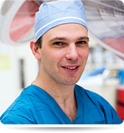
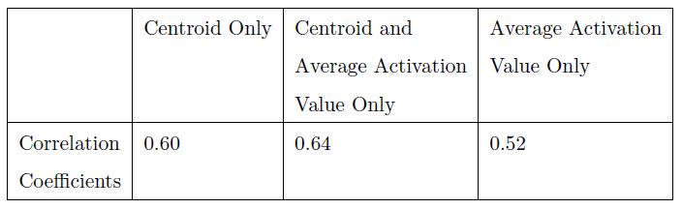
Simulate Human Expert
Dr. Jeff
Ojemann
Current retrieval system requires some expert knowledge
Estimate a function to generate similarity scores with high correlation to expert scores

Slide 42
Simulation Method
Uniform feature representation: create codebook and encode each subject
Concatenate the codebook features for each pair of subjects
Create eigenfeatures
Estimate a function
Test function performance

Slide 43
The Codebook
Out of all the clusters found in all N brains, create a single brain that has
a representation of each unique cluster. This is the codebook.
Then for each of the N brains use the codebook to create a
subject-specific vector representing each of those clusters.
In the case where the codebook has a given cluster, but that particular
subject misses it, that whole portion of this subject's codebook will be empty.
Otherwise, the other parts of this subject's codebook will be filled with the
properties of this subject's clusters.

Slide 44
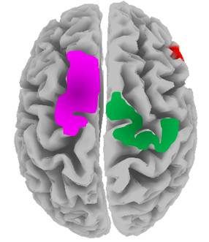
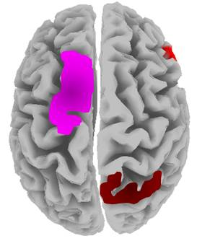
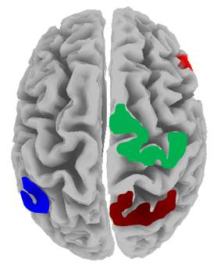
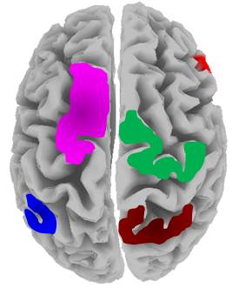
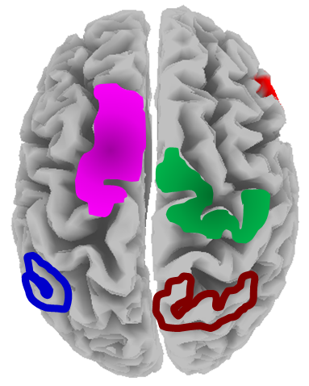
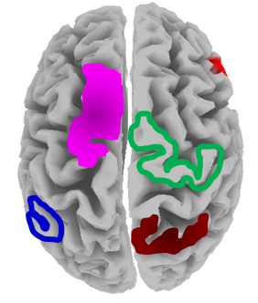
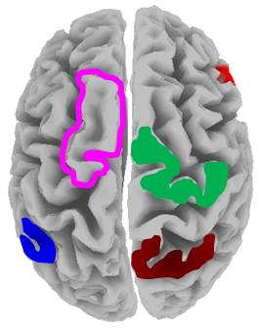
1. Uniform Feature Representation
Create the reference brain (codebook)
S1
S2
S3
Encode Images
S1
S2
S3

Slide 45
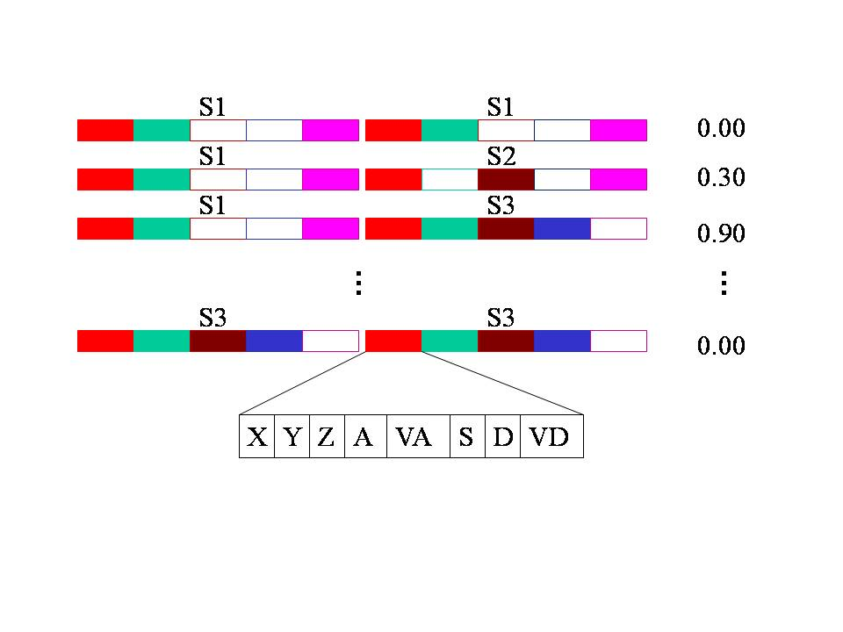
2. Concatenate Codebook Features
Pairs of Subjects Expert
Score
XYZ → Centroid
A → Avg Activation Value
VA → Var Activation Value
S → Size (Volume)
D → Avg Distance to Centroid
VD → Var of those Distances

Slide 46
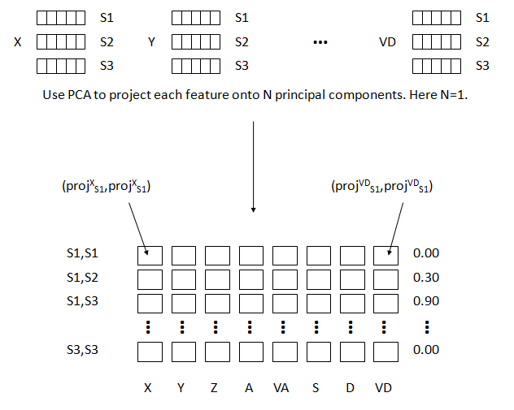
3. Create Eigenfeatures
original
feature
space
eigenfeature
space

Slide 47
4. Estimate a Function
We want to estimate a function that takes a pair of region vectors
from two subjects and computes their similarity score.
S1,S1
0.00
S1,S2
0.30
S1,S3
0.90
…
…
…
…
…
…
…
…
…
S3,S3
0.00
Linear function using linear regression
Non-linear function using generalized regression neural networks (GRNN)

Slide 48


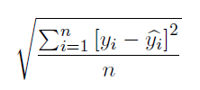
5. Test Function Performance
The Pearson Correlation Coefficient (CC)
The Average Absolute Error (A-ABSE)
The Root Mean Square Error (RMSE)

Slide 49
Data Set
Human Expert Generated Pair-wise Similarity Matrix
+
fMRI data (Central-Cross)
-- 23 subjects
-- Face Recognition task

Slide 50
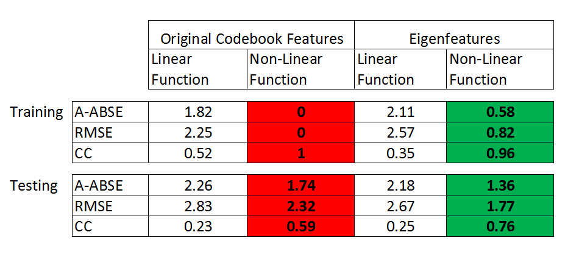
Overall Function Performance
overfitting!

Slide 51
Contributions
Created a similarity retrieval system for multimodal brain images
    fMRI, ERP, and combined fMRI-ERP
    User interface
Developed feature extraction methods for fMRI and ERP data
Developed pair-wise similarity metrics
Simulated human expert similarity scores

