Slide 1
Mesh Alignment Algorithms
General and the Craniofacial Standard

Slide 2
Outline
The Problem
Iterative Closest Point Algorithm
Deformable Mesh Alignment
The Procrustes Methodology
Examples

Slide 3
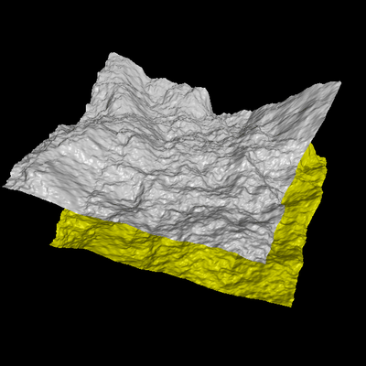
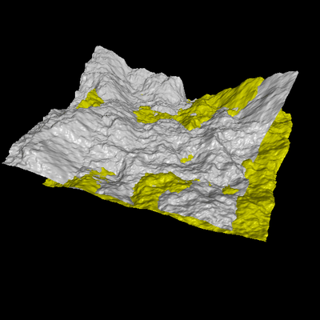
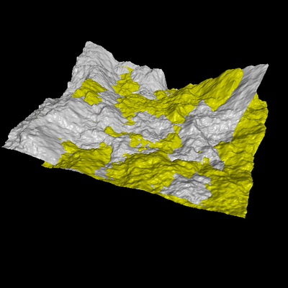
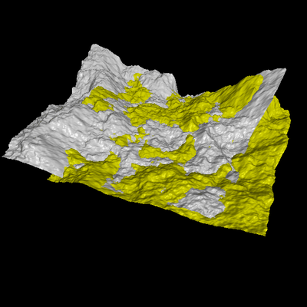
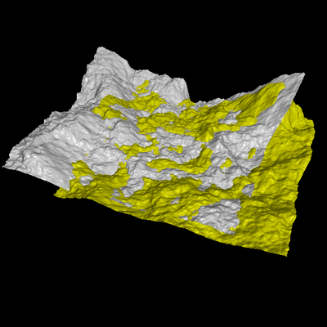
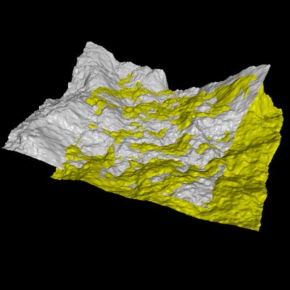
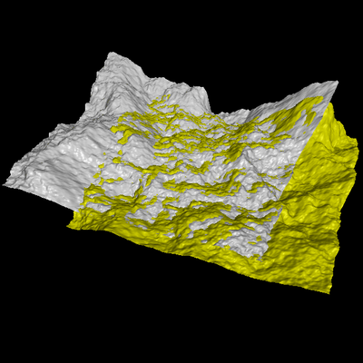
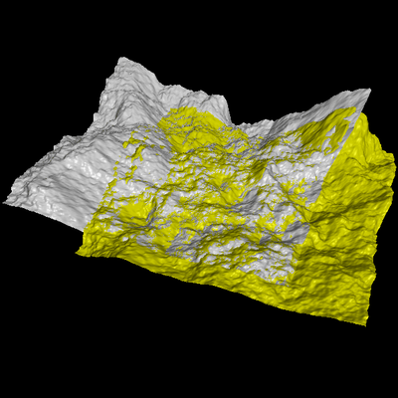
The Problem
Align two partially- overlapping meshes given initial guess for relative transform

Slide 4
Motivation
Shape inspection
Motion estimation
Appearance analysis (what we are doing)
Texture mapping
Tracking

Slide 5
Aligning 3D Data: Iterative Closest Point Algorithm

Slide 6
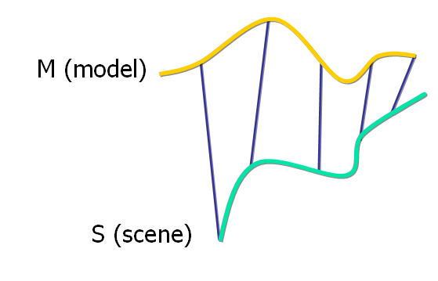
Corresponding Point Set Alignment
Let M be a model point set.
Let S be a scene point set.
We assume :
N_{M} = N_{S}.
Each point S_{i} correspond to M_{i} .

Slide 7
Aligning 3D Data
If correct correspondences are known, can find correct relative rotation/translation

Slide 8
Aligning 3D Data
How to find correspondences: User input? Feature detection? Signatures?
Alternative: assume closest points correspond

Slide 9
Aligning 3D Data
How to find correspondences: User input? Feature detection? Signatures?
Alternative: assume closest points correspond

Slide 10
Aligning 3D Data
Converges if starting position “close enough“

Slide 11
Closest Point
Given 2 points r₁ and r₂ , the Euclidean distance is:
Given a point r₁ and set of points A , the Euclidean distance is:

Slide 12
Finding Matches
The scene shape S is aligned to be in the best alignment with the model shape M.
The distance of each point s of the scene from the model is :

Slide 13
Finding Matches
C – the closest point operator
Y – the set of closest points to S

Slide 14
Finding Matches
Finding each match is performed in O(N_{M}) worst case.
Given Y we can calculate alignment
S is updated to be :

Slide 15
The Algorithm
Init the error to ∞
Y = CP(M,S),e
Calculate correspondence
(rot,trans,d)
Calculate alignment
S`= rot(S)+trans
Apply alignment
d` = d
Update error
If error > threshold

Slide 16
The Algorithm
function ICP(Scene,Model)
begin
E` ← + ∞;
(Rot,Trans) ← In Initialize-Alignment(Scene,Model);
repeat
E ← E`;
Aligned-Scene ← Apply-Alignment(Scene,Rot,Trans);
Pairs ← Return-Closest-Pairs(Aligned-Scene,Model);
(Rot,Trans,E`) ← Update-Alignment(Scene,Model,Pairs,Rot,Trans);
Until |E`- E| < Threshold
return (Rot,Trans);
end

Slide 17
Convergence Theorem
The ICP algorithm always converges monotonically to a local minimum with respect to the MSE distance objective function.

Slide 18
Convergence Theorem
Correspondence error :
Alignment error:

Slide 19
Time analysis
Each iteration includes 3 main steps
A. Finding the closest points :
O(N_{M}) per each point
O(N_{M}*N_{S}) total.
B. Calculating the alignment: O(N_{S})
C. Updating the scene: O(N_{S})

Slide 20
Optimizing the Algorithm
The best match/nearest neighbor problem :
Given N records each described by K real values (attributes) , and a dissimilarity measure D , find the m records closest to a query record.

Slide 21
Optimizing the Algorithm
K-D Tree :
Construction time: O(knlogn)
Space: O(n)
Region Query : O(n^{1-1/k}+k )

Slide 22
ICP Variants
Variants on the following stages of ICP have been proposed:
Selecting sample points (from one or both meshes)
Matching to points in the other mesh
Weighting the correspondences
Rejecting certain (outlier) point pairs
Assigning an error metric to the current transform
Minimizing the error metric w.r.t. transformation

Slide 23
Robust Simultaneous Alignment of Multiple Range Images

Slide 24
Motivation

Slide 25
Motivation

Slide 26
Why not just use ICP?
It looks for a 3D rigid body transformation
involving only rotation and translation.
Not good enough for heads and human bodies.

Slide 27
Three-Dimensional Correspondence
Christian R. Shelton
M.S. Thesis
M.I.T.
1998
(mentioned in Chia-Chi Teng’s Work)

Slide 28
Problem Statement
An object X is a mesh of triangles (X_{K}, X_{V}) where X_{V} is
an ordered set of vertices and X_{K} is the mesh connectivity.
A correspondence algorithm will take two meshes A and B
and produce a displacement set D of vectors that warp
object A by adding each member of D to the corresponding
vertex of A. The warped object is called D(A).
A B

Slide 29
Energy Minimization
The problem is to find the best D to warp A into
correspondence with B.
The method is to minimize an energy function E(D).
E(D) will have two terms
The similarity term will measure the similarity
of D(A) to B.
The structure term will measure the changes in
in structure to A.

Slide 30
Similarity Term
distance from point p
to manifold X
sum over sampled points
of D(A) of distance² to
closest point of B
other way
(B to D(A))
add in the vertices
to the sampled points
this new part of the distance
penalizes matching 2 points whose
orientations do not match well
e.g. what if they differ
by 90 degrees?

Slide 31
Structure Term
Uses the model of directional springs.
Place a directional spring from each vertex in A
to all adjacent vertices in A and every other
vertex closer than the most distant adjacent one.
Let C_{A} be the set of all pairs of vertices of A
connected by directional springs
Let C_{A}ª be that intersected just with vertex a
How much did the spring from a to b stretch?

Slide 32
Energy Function
E(D) = E_{sim}(D) + αE_{str}(D)
Method uses gradient descent to minimize E(D.)
Algorithm uses a pyramid to speed it up.

Slide 33
A
B

Slide 35
Deformable Mesh Alignment: Brett Allen’s 2003 SIGGRAPH Paper

Slide 36
Overview
Goal: to fit a template surface T to a scanned example
surface D.
Each surface is represented as a triangular mesh
The matching is accomplished by an optimization framework
Each vertex v_{i} is influenced by a 4 x 4 affine transformation
matrix T_{i}.
The algorithm must find a set of transformations that move
all of the points in T to a deformed surface T’ such that T’
matches well with D.

Slide 37
Match in Progress
hole
destination
transformations
template

Slide 38
Energy Function: E = αE_{d} + βE_{s} +γE_{m}
data error
smoothness
error
marker error
(if markers)
where dist() computes the distances from T_{i}v_{i} to the closest compatible point on D,
where compatible means the surface normals are no more than 90 degrees apart,
and the distance is less than a threshold.
where || ||_{F} is the Frobenius norm and measures the distance between transformations.

Slide 39
Procedure
At low resolution
Fit the markers first: α=0, β=1, γ=10
Allow the data term to contribute: α=1, β=1, γ=10
At high resolution
Continue the optimization: α=1, β=1, γ=10
Allow the data term to dominate: α=10, β=1, γ=1
There is also a hole-filling procedure.

Slide 40
Example
two data heads
template with
zero data-fitting
term in green
with markers
template mapped to data heads
with holes filled and ear fixed

Slide 41
Video
SIGGRAPH 2003 Video

Slide 42
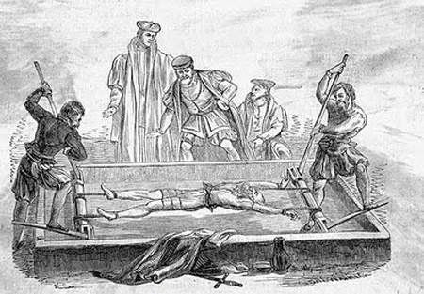
The Procrustes Approach
In Greek mythology Procrustes or "the stretcher
[who hammers out the metal]" was a rogue smith
and bandit from Attica who physically attacked
people by stretching them or cutting off their legs,
so as to force them to fit the size of an iron bed.
In general, when something is Procrustean, different
lengths or sizes or properties are fitted to an arbitrary
standard.

Slide 43
Procrustes Superimposition in Geometric Morphometrics
Given a group of similar objects (ie. heads, feet, livers)
each represented by a set of landmark points.
1. Translate the landmark configuration of each
object so that they have the same centroid (0,0,0)
Scale each landmark configuration so they have the
same centroid size (square root of summed squared
distances of the landmarks to the centroid).
3. When superimposing two objects, one of the two
centered, scaled configurations is rotated around
its centroid until the sum of squared Euclidean
distances between the corresponding landmarks
is minimized.

Slide 44
Example with 2 Shapes
residual error
Note that the scaling process has removed the size
difference between the 2 shapes, which is some
applications may be important.
The resultant coordinates are called the Procrustes
shape coordinates. The shapes are aligned as they
best can be under these transformations.
This is like least squares, but not identical.

Slide 45
Extension to N Shapes: Generalized Procrustes Analysis
Perform the translation and scaling steps.
convergence is set to false.
Choose one sample object arbitrarily from the set
and call it the consensus.
while not convergence
- rotate each object to best fit the consensus
- if total Procrustes distance* from objects to consensus
is small enough, convergence becomes true
- set consensus to the average of the newly
rotated objects
* Procrustes distance between 2 shapes is the Euclidian distance between the
two sets of Procrustes shape coordinates.

Slide 46
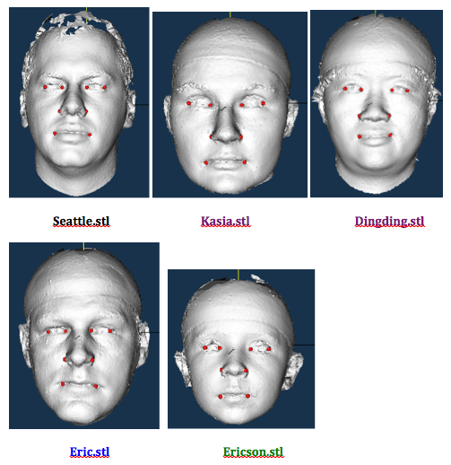
Demo – using our subset

Slide 47
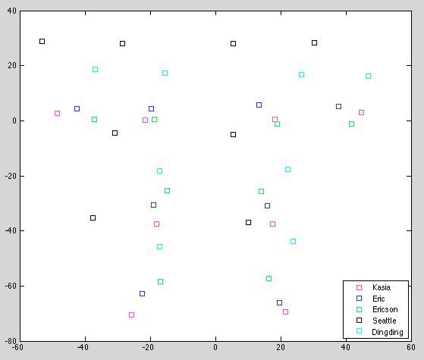
8 landmarks each
Eyes
Nose
mouth

Slide 48
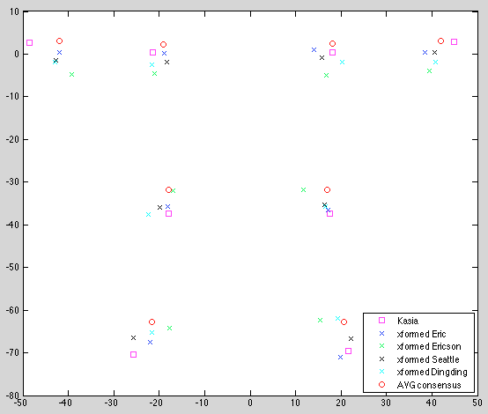
Avg consensus Procrustes shape
 | d (to Kasia)
Eric | 0.0119
Ericson | 0.0414
Seattle | 0.0122
Dingding | 0.0307

Slide 49
Shape vs. Form
Mitteroecker makes a strong point of differentiating
between shape and form.
Shape refers to the geometric properties of an object
that are invariant to scale, rotation. and translation.
Form refers to the geometric properties of an object that
are invariant to rotation and translation, but not scale.
same
shape
not the
same form

Slide 50
Can we adapt Procrustes to form?
Yes, there are several possibilities.
Mitteroecker says to augment the Procrustes
shape coordinates by the natural logarithm of
centroid size to construct a Procrustes form space.
Hammond and Hutton use Procrustes as the first
step in a different approach they call a dense surface
model.

Slide 51
Dense Surface Approach
Start with a set of already landmarked head meshes.
Apply the generalized Procrustes algorithm to obtain
a mean landmark set.
Warp each full surface mesh to the mean using the
landmarks and Bookstein’s thin-plate spline technique.
NOW THEY ARE ALL ALIGNED IN ONE SPACE.

Slide 52
Continued
Choose one mesh to be the base mesh, and for each head
mesh, find a dense correspondence between the vertices
of the base mesh and its vertices using closest point.
NOW THEY ARE ALL IN FULL, DENSE CORRESPONDENCE
Transfer the mesh connectivity of the base mesh to each
of the others, throwing out original meshes.
Apply the inverse of the warp to send each mesh back to
its original space,
THUS REGAINING THE ORIGINAL FORM.

Slide 53
Conceptually
original
shapes
Procrustes
superimposition
Dense superimposition
Dense
correspondence

Slide 54
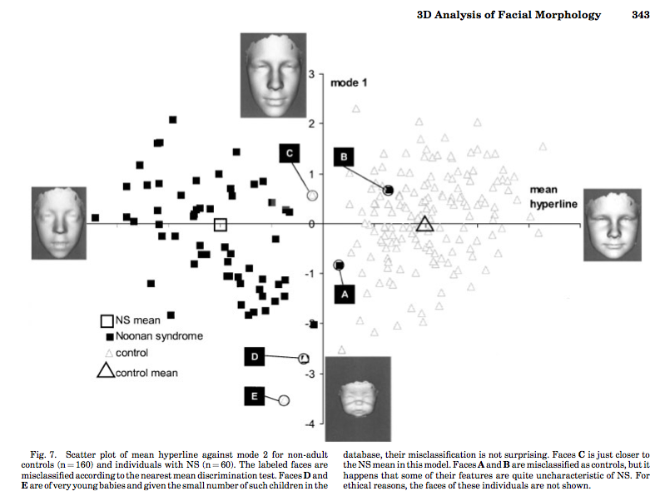
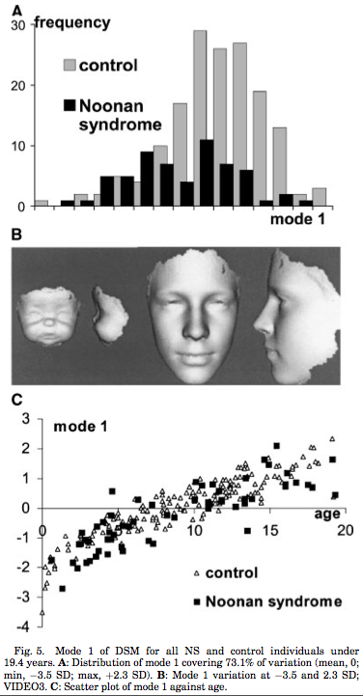
Procrustes in Classification Vector of PCA Mode Values, Nearest Mean Classifier
Peter Hammond et al., “3D Analysis of Facial Morphology”, American Joural of Medical Genetics 126A:33-348, 2004

