Slide 1
Medical Image Analysis:
Introduction
Course: CSE/EE 577
Instructor: Prof. Linda Shapiro
TA: Shulin (Lynn) Yang
Web Page: http://www.cs.washington.edu/577

Slide 2
Related Texts
Shapiro and Stockman, Computer Vision, Prentice-Hall, 2001.
Original chapters available at
http://www.cs.washington.edu/education/courses/cse576/99sp/book.html
Dhawan, Medical Image Analysis, Second Edition, IEEE Press, 2009.
To access this book online through UW Libraries
(on a UW computer or logged in with your UW Netid) go to
http://uwashington.worldcat.org/title/medical-image-analysis/oclc/1970701471025&referer=brief_results
and click on the link that says Connect to this title online.

Slide 3
List of Topics
Introduction to Medical Imaging Modalities and Applications
Low-level Operations for Processing and Enhancement
CT Imaging
PET/CT Registration
Brain Imaging
  MRI
  fMRI
  DTI
Ultrasound Imaging
3D from Multi-Camera Stereo for Craniofacial Application

Slide 4
Evaluation
specific assignments, such as exercises, reports
course projects, including both programming
and research possibilities

Slide 5
Medical Image Analysis
Some Lecture Slides will
Come From
Atam P. Dhawan, Ph.D.
Dept. of Electrical & Computer Engineering
Dept. of Biomedical Engineering
New Jersey Institute of Technology
Newark, NJ, 07102
Dhawan@adm.njit.edu

Slide 6
Introduction
Imaging is an essential aspect of medical sciences for
  visualization of anatomical structures
  functional or metabolic information of the human body
Structural and functional imaging of human body is important for understanding
  human body anatomy
  physiological processes
  function of organs
  behavior of whole or a part of organ under the influence of abnormal physiological conditions or a disease

Slide 7
A Multidisciplinary Paradigm

Slide 8
Medical Imaging Information
Anatomical
  X-Ray Radiography
  X-Ray CT
  MRI
  Ultrasound
  Optical
  3D Mesh from Stereo
Functional/Metabolic
  SPECT
  PET
  fMRI, pMRI
  Ultrasound
  Optical Fluorescence
  Electrical Impedance

Slide 9
X-rays
X-rays were invented by Conrad Rontgen in 1895 describing it as new kind of rays which can penetrate almost anything. He described the diagnostic capabilities of X-rays for imaging the human body and received the Noble Prize in 1901.
X-ray radiographs are the simplest form of medical imaging through the transmission of X-rays through the body which are then collected on a film. The attenuation or absorption of X-rays is described by the photoelectric and Compton effects providing more attenuation through bones than soft tissues or air.
Notes:
9

Slide 10
Chest Radiograph
Notes:
10

Slide 11
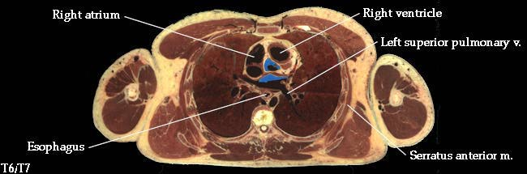
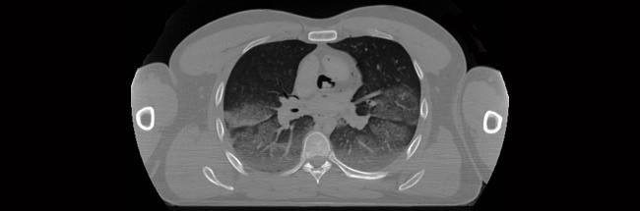
CT Chest Images
pathological
image of a slice
of the cardiac
cavity of a
cadaver.
X-ray CT image
of the same
slice
Notes:
11

Slide 12
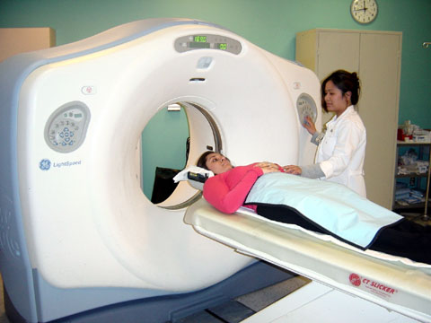
CT Scanner
Notes:
12

Slide 13
Magnetic Resonance Imaging
Basic Principle: The electromagnetic induction based rf signals are collected
through nuclear magnetic resonance from the excited nuclei with magnetic
moment and angular momentum present in the body. Most common is proton
density imaging.

Slide 14
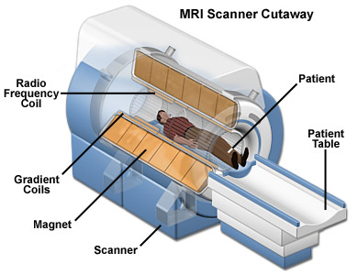
MRI Scanner

Slide 15
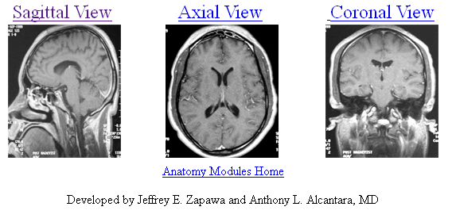
3-D Brain Imaging
http://www.med.wayne.edu/diagradiology/anatomy_modules/brain/brain.html

Slide 16
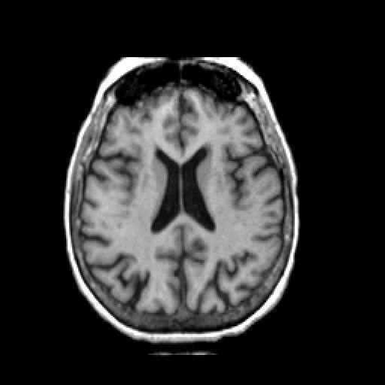
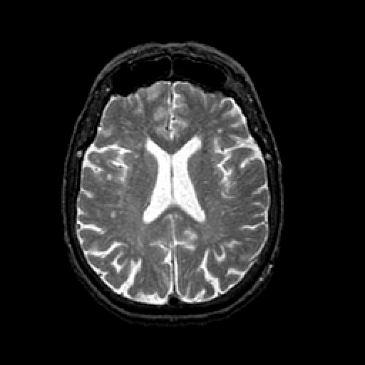
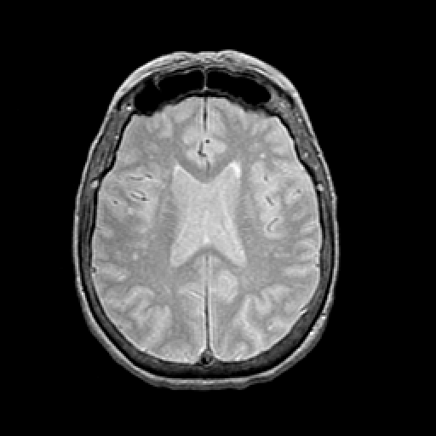
Kinds of MR Images
T1 Weighted
T2 Weighted
Spin Density Image

Slide 17
MRI Advantage
The most important advantage of the MRI is its ability to provide unprecedented contrasts between various organs and tissues and the three-dimensional nature of imaging methods.
Selective 3-D imaging is provided by appropriate selection of gradient fields and phase encoding methods.
A variety of contrast images can be created by different combinations of weighting of T1, T2 and echo images
MR spectroscopy provides a great potential for meaningful tissue characterization.
Functional MRI holds great promise for the future.

Slide 18
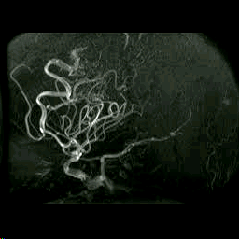
MR Angiography
Used to visualize the inside, or lumen, of blood vessels and organs of the body,
with particular interest in the arteries, veins and the heart chambers.

Slide 19
SPECT
Radioactive materials are administered into the body and are selectively taken up in a manner designed to indicate a specific metabolism or disease.
In SPECT imaging, gamma rays are emitted from these materials absorbed by the tissue or body, which then becomes a radioactive source. External detectors are used to reconstruct images of the radioactive source.

Slide 20
^{99m}T_{c} (140 keV) SPECT Image

Slide 21
PET
In PET imaging, the radioactive pharmaceuticals which decay by emitting positrons are administered in the body. When these radioactive materials are taken up by the body, positrons are emitted which, after losing some energy through kinetic motion, annihilates with the free electrons of the biomaterial within the body. The annihilation results in the emission of two photons, which travel in almost opposite directions and escape from the body to be detected by external detectors. This is called the coincidence detection.
In PET, images are reconstructed from the coincidence detection to represent the distribution of the emission of photons within the body. Since the emission of photons is very close to the emission of positron, the reconstructed images are considered the representation of the radioactivity source or tracer.

Slide 22
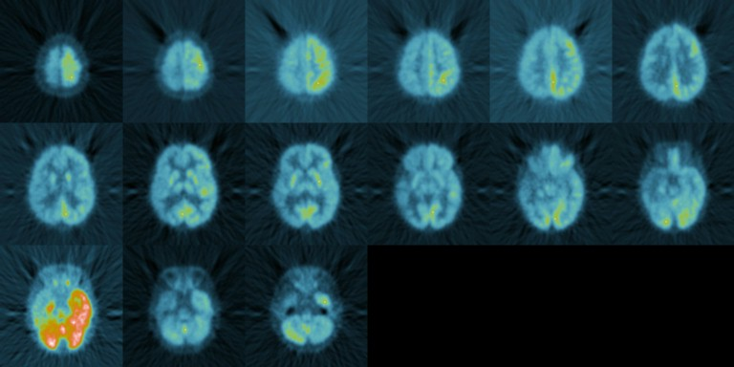
FDG PET Imaging

Slide 23
Ultrasound Imaging
Basic Principle: Backscattered echo and Doppler shift principles are more commonly used with the interaction of sound waves with human tissue. Sometimes the scattering information is complemented with transmission or attenuation related information such as velocity in the tissue.

Slide 24
Ultrasound Imaging
For thicker parts of the body such as abdominal imaging, frequencies of about 1.0 to 3.0 MHz are used to provide reasonable attenuation.
Unlike X-rays, in ultrasound imaging, the images are produced through the reflection or echo using the known velocity of propagation to calculate the depth.
In ultrasound imaging, air causes excessive attenuation and therefore cannot be used to study some anatomical structures, such as lungs.
Ultrasound imaging operates close to the diffraction limit because of its larger wavelength compared to X-rays.

Slide 25
Ultrasound Imaging
Pulse
Generation and Timing
Transmitter/
Receiver
Circuit
Control
Circuit
Acoustic absorbers
Blockers
Piezoelectric crystal
Data-Acquisition
Analog to Digital Converter
Computer
Imaging Storage and Processing
Display
Imaging
Object

Slide 26
B-Mode Imaging of Heart

Slide 27
Doppler Imaging of Beating Heart

Slide 28
Ultrasound Advantage
The main advantage of ultrasound imaging is its non-invasive nature and capability of providing excellent information for imaging objects immersed in fluids.
Another advantage of using ultrasound is its low velocity of propagation as compared to the free-space velocity of X-rays which is 3X10⁸ m/sec. This makes the time of flight measurements possible using ultrasound with pulse echo techniques.
Unlike X-rays, the velocity of propagation of ultrasound is dependent on the material. Ultrasound provides a variety of refractive indices of materials. Thus, selective imaging of specific planes is feasible with ultrasound through the construction of so-called lens systems to provide images of focused structures.

Slide 29
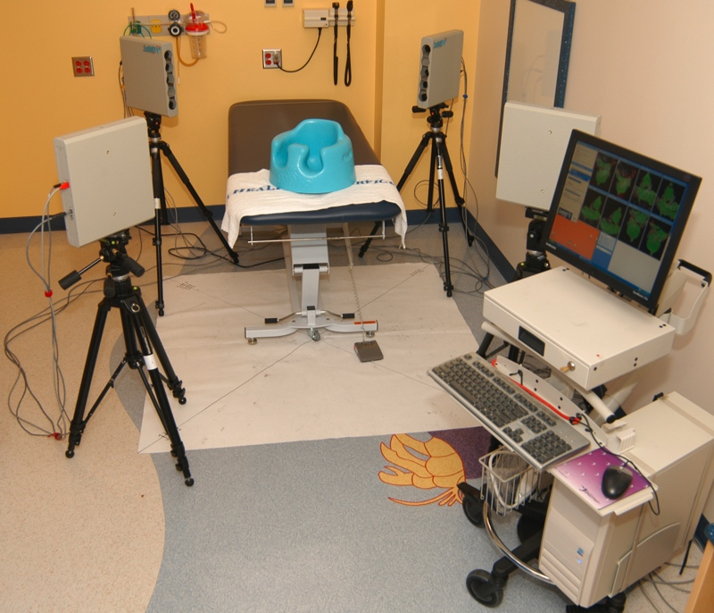
3D from Stereo
3dMD 12-Camera Stereo System at Children’s Hospital

Slide 30
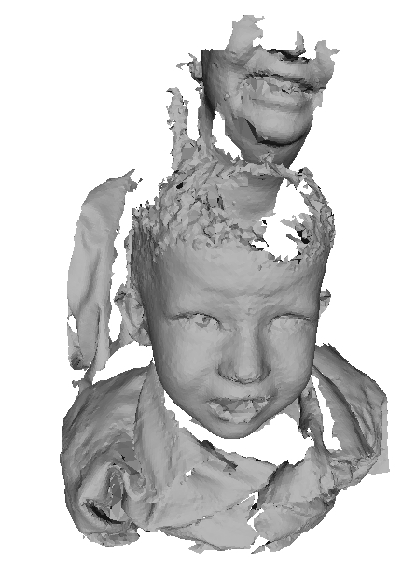
3D Mesh from 3dMD

Slide 31
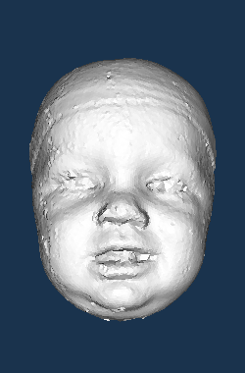
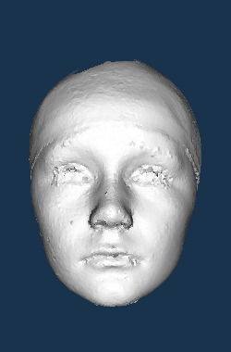
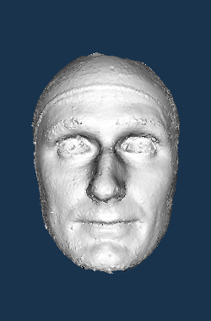
Some Sample Head Meshes
10 months 10 years 30 years

Slide 32
Advantages
Allows for 3D head images of young children
since the image acquisition is very fast
3D mesh format is common in computer vision
so there are many known algorithms
Can be analyzed in mesh format or converted
to other forms such as a 3D depth image

