Slide 1
Classification and Feature Selection for Craniosynostosis
Shulin Yang, Linda G. Shapiro, Michael L. Cunningham, Matthew Speltz, Su-In Lee
University of Washington

Slide 2
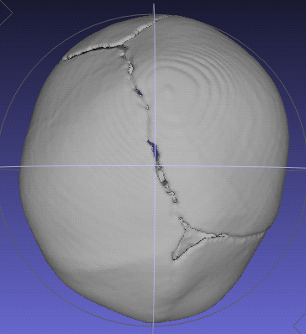
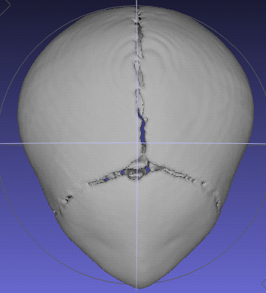
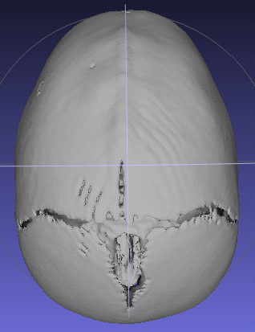
Craniosynostosis
Craniosynostosis is a common congenital condition in which one or more of the fibrous sutures in an infant’s calvaria fuse prematurely.
Coronal
Metopic
Sagittal

Slide 3
Goal of our Work
To analyze 3D skull shapes for the purpose of medical research
Classification: which type of craniosynostosis
Region selection: which regions contribute most toward classification
Quantification: what is the degree of severity of the deformity

Slide 4
Related Work
Previous work
Craniofacial descriptors that analyzed the shape of the mid-face and back of the head [ICIAP09]
Classification of two synostoses vs. normal using symbolic shape descriptors [ICCV05, CPCJournal06]
Difference from ours
not fully automatic
doctors may not understand the methodology
focus on the whole skull

Slide 5
Overview of our Approach
Two step approach to shape analysis
Cranial image (CI) generation
A shape representation for 3D images
Shape analysis using CI
Classification
Localization of interest areas on skulls
Quantification of craniofacial abnormalities

Slide 6
Cranial Image (CI) Generation
Automatic system: process 3D CT images
Input: CT skull images
Output: a distance matrix – Cranial Image
1 2 3 j N
1
2
i d(i,j)
N

Slide 7
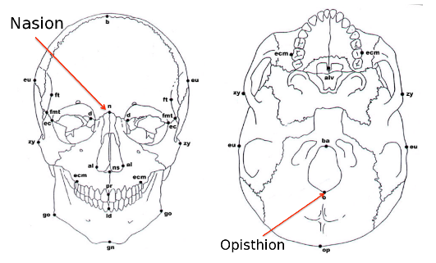
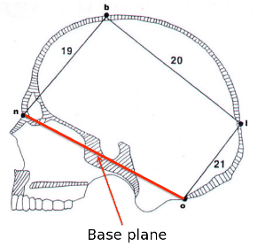
Landmarks

Slide 8
Visualization of Cranial Image
Yellow represents 0 in the matrix;
Blue represents 1 in the matrix
1 plane
3 planes
10 planes

Slide 9
Shape Analysis using CI
Goal: classification and feature selection on CI
Methodology: logistic regression model
x: features in a Cranial Image
y: classification result for a Cranial Image
w: weight assigned to each feature in a Cranial Image

Slide 10
Logistic Regression
Find the “w” that minimize the loss function

Slide 11
Regularized Logistic Regression Models
L₁ regularized logistic regression
Fused lasso
suppress the number
of selected features
suppress the number
of selected features
suppress weight differences
for pairs of neighboring features

Slide 12
A New Form of Regularized Logistic Regression Models: cLasso
cLasso – forming feature clusters
w^{c}: weights of the cluster centers of CI features
w: residual weights of the features
suppress the number
of selected features
suppress the number
of feature clusters

Slide 13
Experiments
Medical data: 3D CT images of children’s heads from hospitals in four different cities in the US; 70 images in total; 3 types of craniosynostosis
Parameter selection: the regularization parameters were found using 10-fold cross validation on the training set

Slide 14
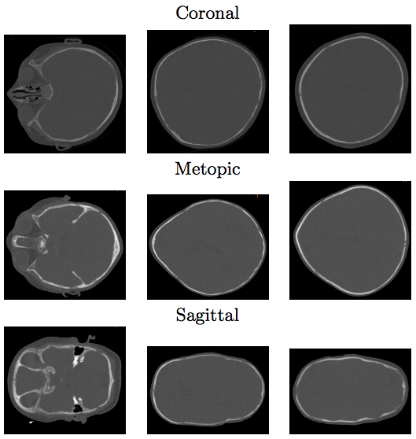
CT data

Slide 15
Classification Results: Error Rates
Results using logistic regression only
Results using four regression models

Slide 16
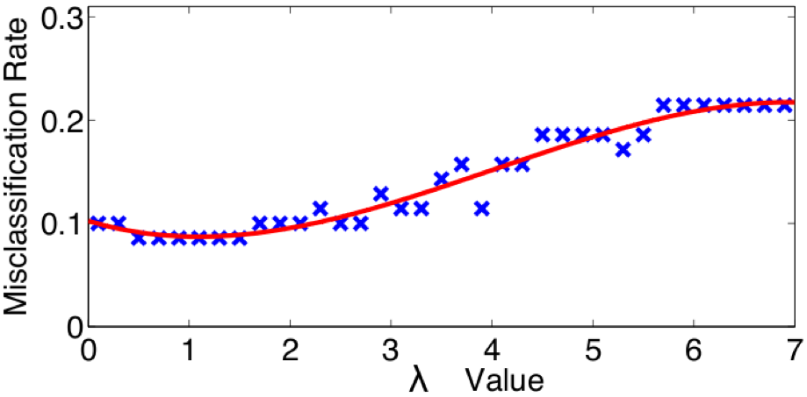
Parameter selection
Misclassification rate v.s. lamda value

Slide 17
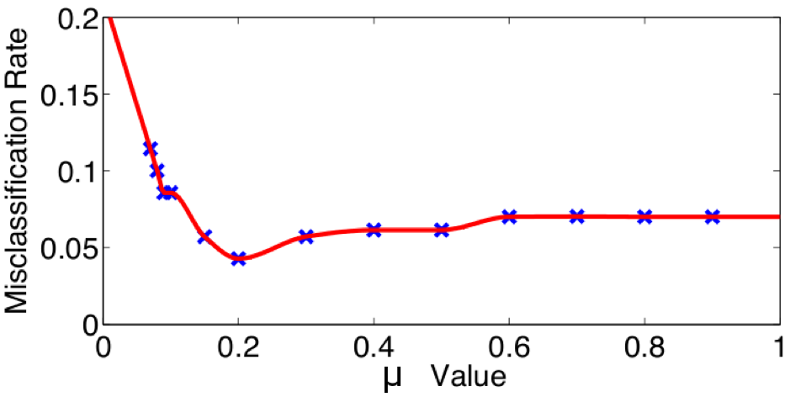
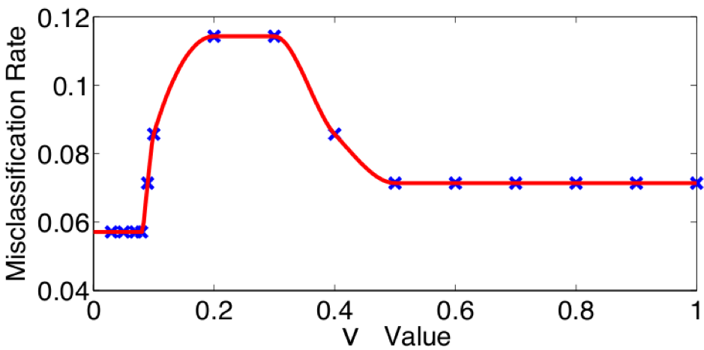

Slide 18
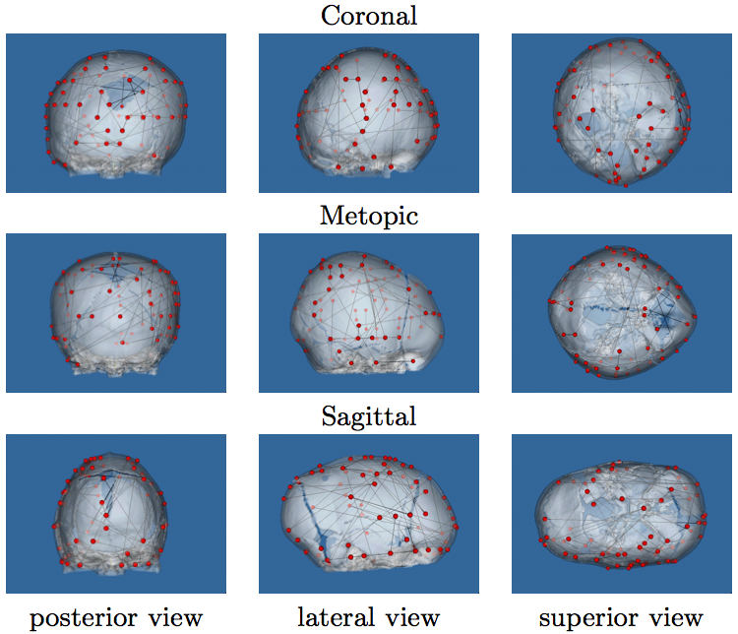
Visualization of Feature Selection using L₁ Regression

Slide 19
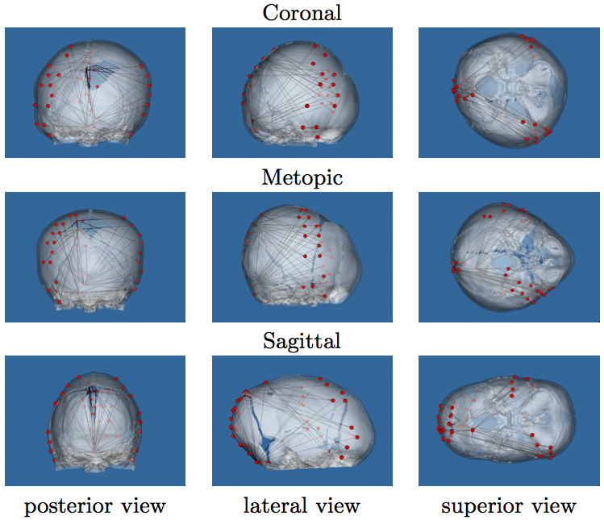
Visualization of Feature Selection using Fused Lasso

Slide 20
Quantification
Use the same methodology as classification
Use the same training process
Replace the decision function: from sigmoid function to the linear combination before taking sigmoid
Function response: the severity of craniosynostosis
Use different training data for each of the three craniosynostosis (coronal, metopic, sagittal)

Slide 21
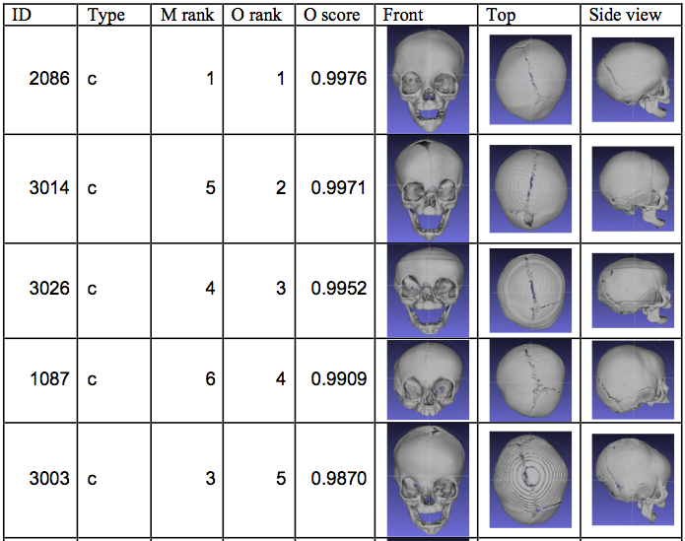

Slide 22
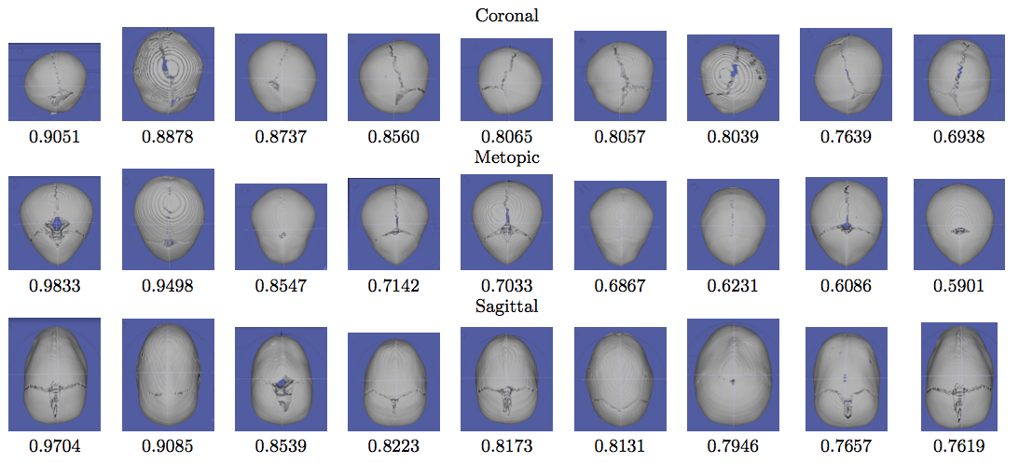

Slide 23
Summary and Future Work
Contributions
A fully automatic system for skull shape analysis
New form of logistic regression for feature selection and interest region localization
Future work
Extension to other 3D shapes, such as facial surfaces
Landmark detection on 3D surfaces
Run studies of controls vs abnormal for each class and use results to quantify the degree of abnormality

