Slide 1
Learning to Compute the Symmetry Plane for Human Faces
Jia Wu (jiawu@uw.edu)
ACM-BCB '11, August 2011

Slide 2
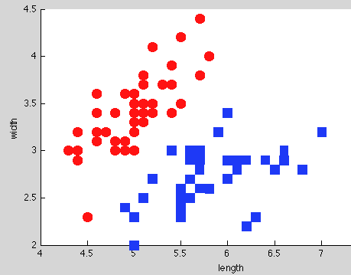
A simple introduction for classification
Training
Positive /negative samples
testing
Classifier
Notes:
Classification is the problem of identifying the sub-population to which new observations belong.
Training set: positive and negative samples
Feature: quantitative information on one or more measurements
where the identify of the sub-population is unknown, on the basis of a training set of data containing observations whose sub-population is known. Thus the requirement is that new individual items are placed into groups based on quantitative information on one or more measurements, traits or characteristics, etc) and based on the training set in which previously decided groupings are already established.

Slide 3
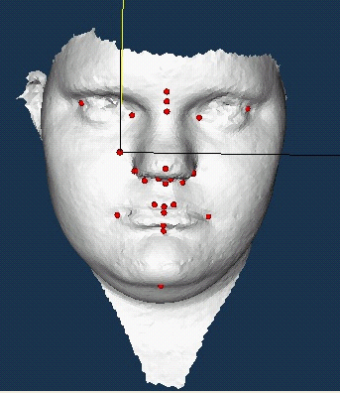
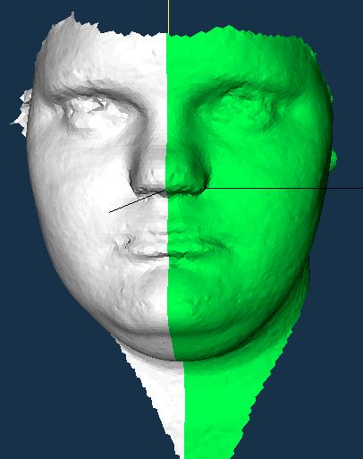
Landmark by medical experts
Landmarks labeled by experts
Standard symmetry plane
Notes:
Discuss whether this is a good way to estimate symmetry plane

Slide 4
Flow chart for training
Landmarks from medical experts
Standard symmetry plane
Landmark model training
Symmetry model training
Points predicted as interesting regions
Connected regions

Slide 5
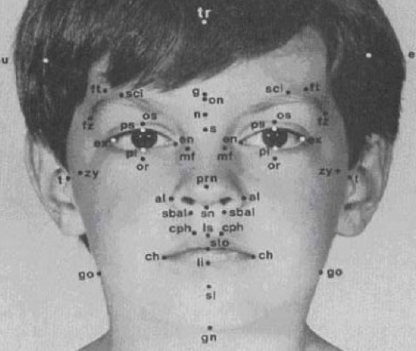
10 kinds of landmarks.
Nose: ac (nose side), prn, sn,se
Eyes: en, ex
Mouth: (li,ls), ch, sto
Chin: slab
Notes:
Most robust and reliable points ( missing data, or missing points)

Slide 6
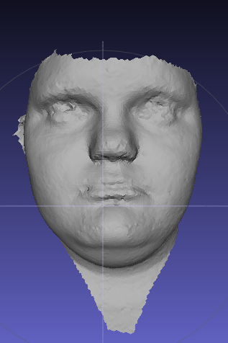
Positive/negative samples
Training for en: the inner corners of the eyes
Training for prn: most protruded point of nasal tip

Slide 7
Features: mean and Gaussian curvatures for original head and smoothed head

Slide 8
Flow chart
Landmarks from medical experts
Standard symmetry plane
Landmark model training
Symmetry model training
Points predicted as interesting
Connected regions

Slide 9
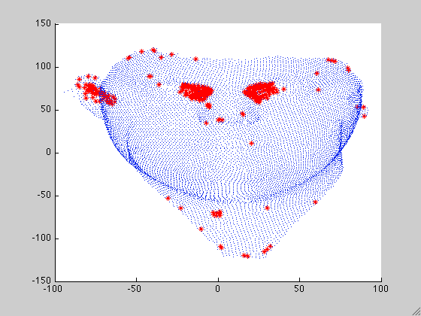
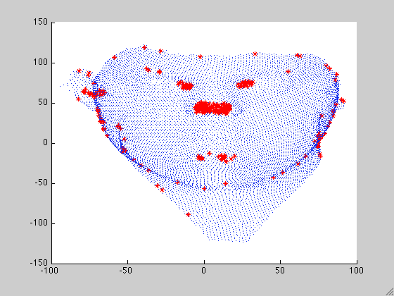
Interesting points prediction
Prediction of en: the inner corners of the eyes
Prediction of prn: most protruded point of nasal tip
Notes:
Area show up because they have similar properties

Slide 10
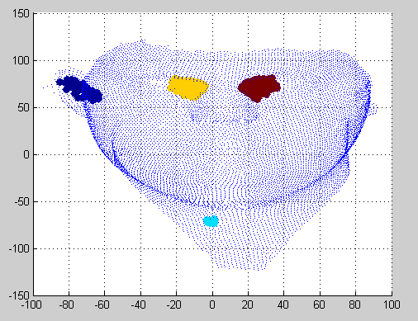
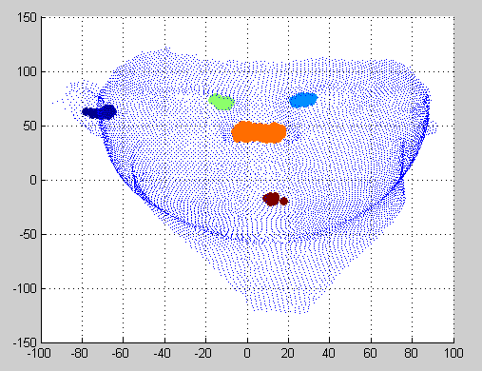
Connected regions
Connected regions for en: each color means one region
Connected regions for prn: each color means one region
Notes:
Connected to each other on the mesh

Slide 11
Flow chart
Landmarks from medical experts
Standard symmetry plane
Landmark model training
Symmetry model training
Points predicted as interesting regions
Connected regions

Slide 12
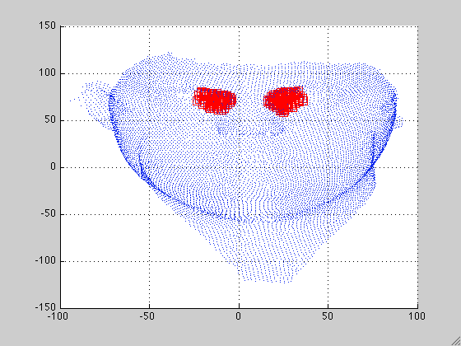
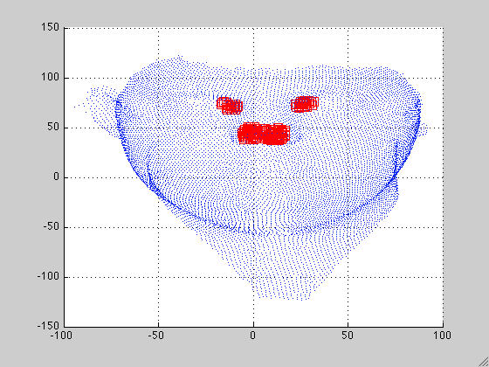
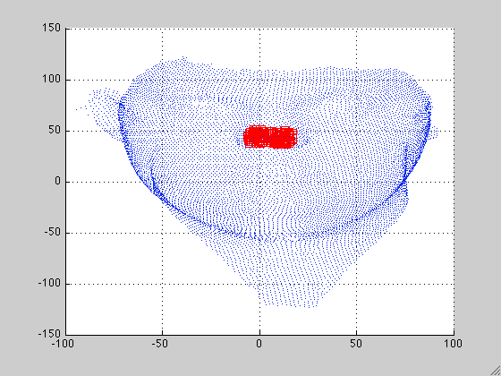
How to define “good” symmetric regions
A “good” pair of regions should be symmetric to the standard symmetry plane
A “good” single region should have the center on the standard symmetry plane
“good” regions for en
“good” regions for prn

Slide 13
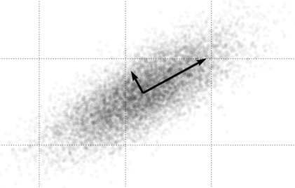
Feature for regions
Principal component analysis and eigenvalues

Slide 14
Flow chart for training
Landmarks from medical experts
Standard symmetry plane
Landmark model training
Symmetry model training
Points predicted as interesting regions
Connected regions

Slide 15
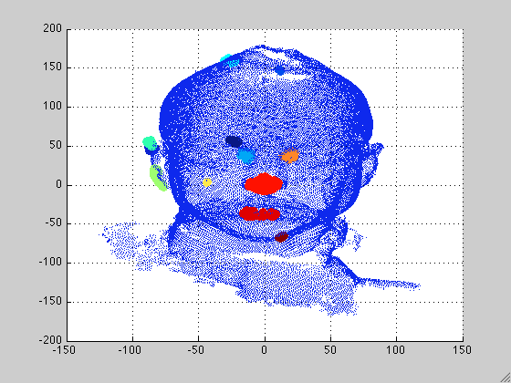
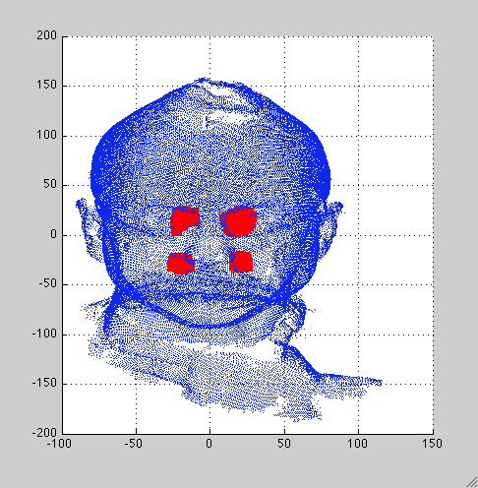
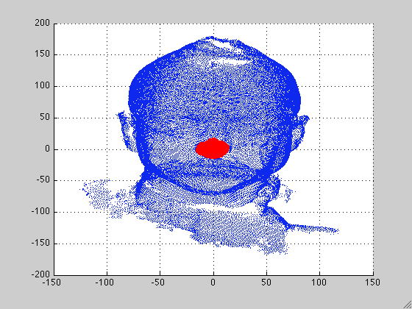
Procedure for New data
Select possible landmark areas( from Landmark model)
Find and pair connected regions
interesting regions for prn
Determine good singles and good pairs ( from Symmetry model)
Get center and draw a plane using learned centers
Predicted as good single
Predicted as good pair

Slide 16
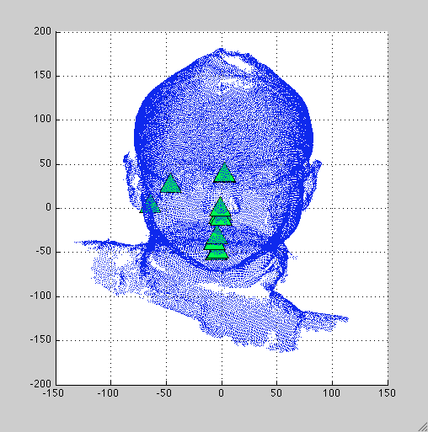
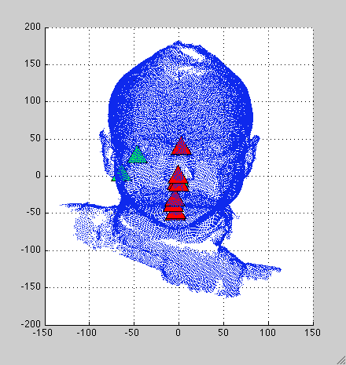
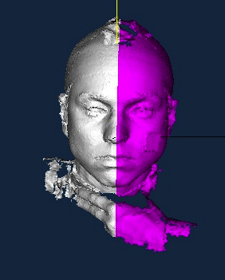
Procedure for New Images
Centers of good regions
Centers for constructing plane of symmetry
Result: Plane of symmetry

Slide 17
Experiments
Compare the plane of symmetry to
Ground truth (plane determined by expert labeled landmarks)
Mirror method in literature
Ground truth dataset 1
Ground truth dataset 2
Cleft dataset

Slide 18
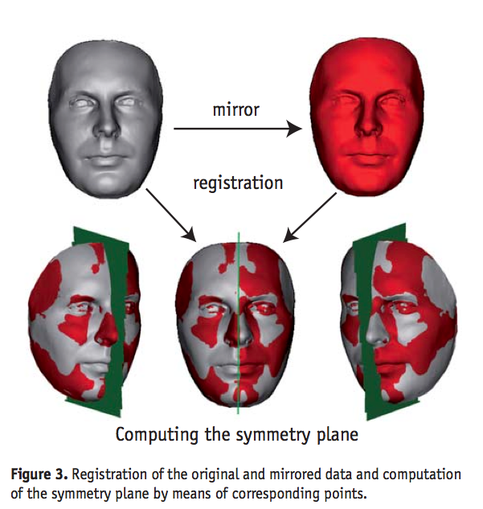
Mirror method in literature

Slide 19
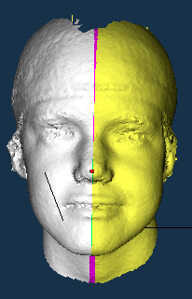
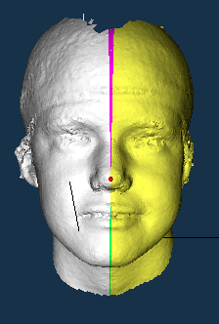
Results compare to ground truth
our method
Angle:4.03˚
mirror method
Angle:2.15˚
Yellow: overlapping with ground truth
Green: ground truth
Purple: extra from each method

Slide 20
Results compare to ground truth
our method
mirror method
Yellow: overlapping with ground truth -> true positive
Green: ground truth -> false negative
Purple: extra from each method -> false positive

Slide 21
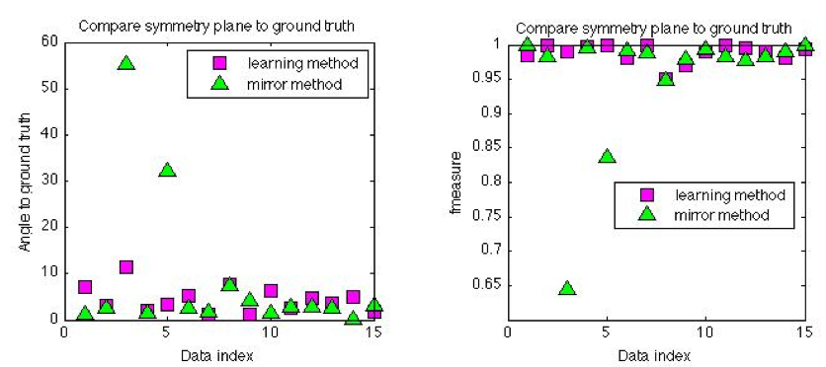
worst
best
best
worst

Slide 22
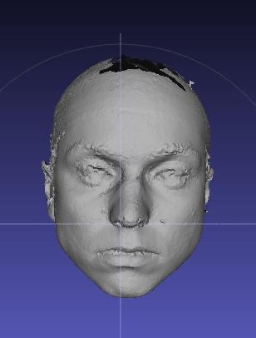
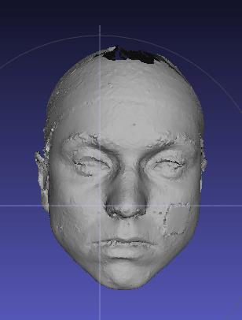
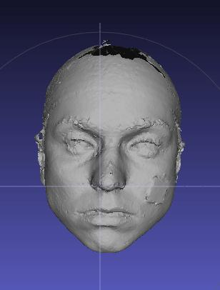
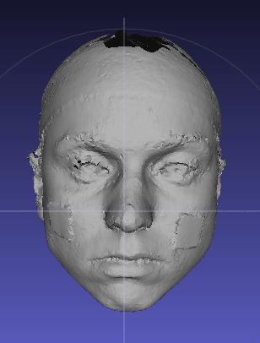
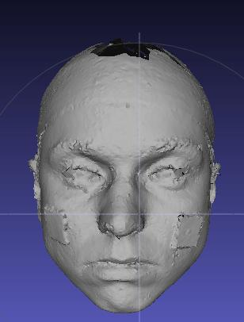
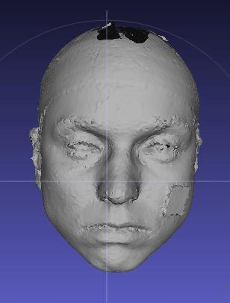
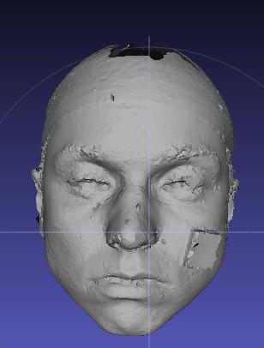
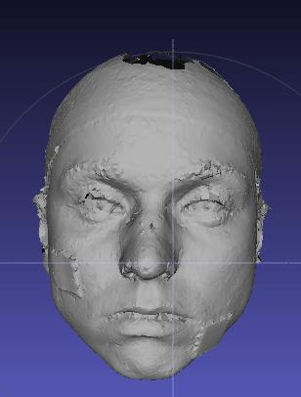
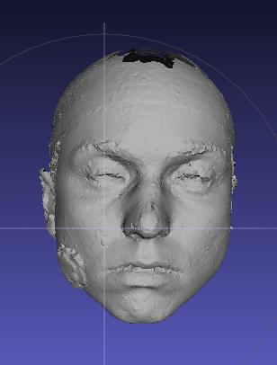
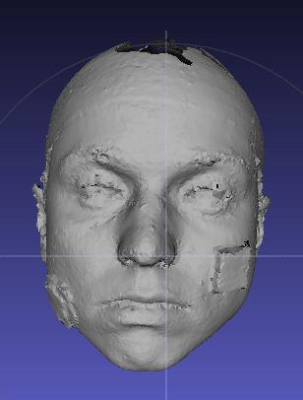
Ground truth dataset 2
1 | 2 | 3 | 4 | 5
6 | 7 | 8 | 9 | 10

Slide 23
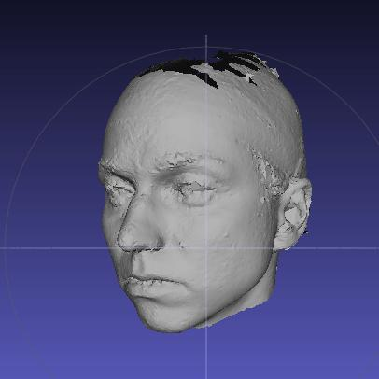
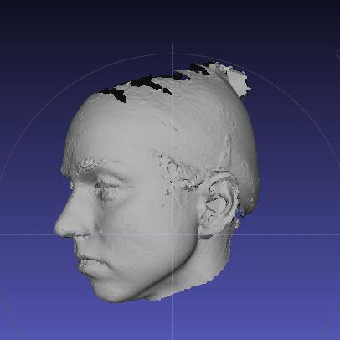
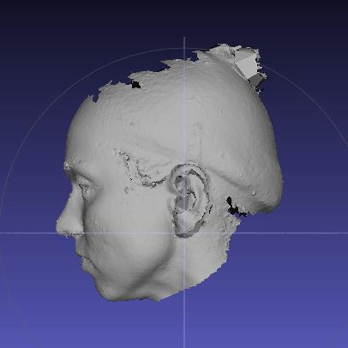
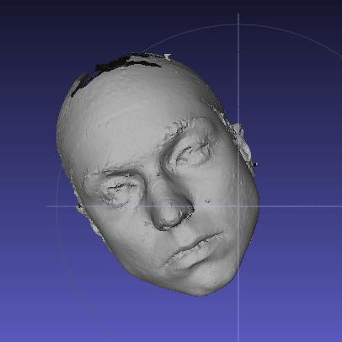
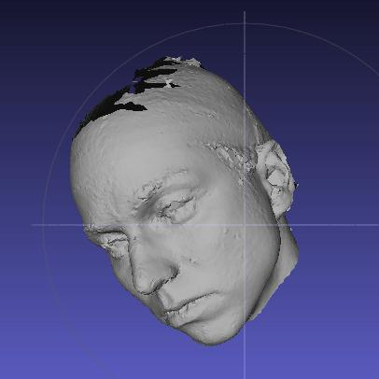
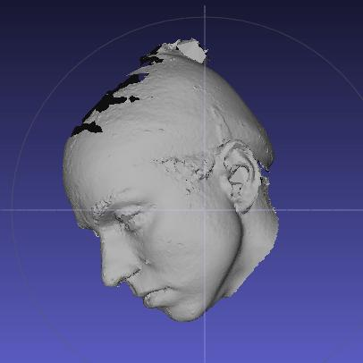
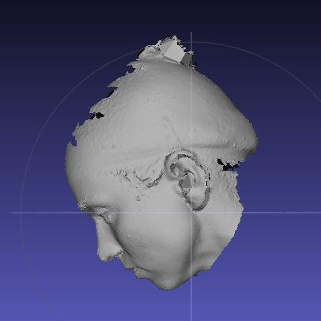
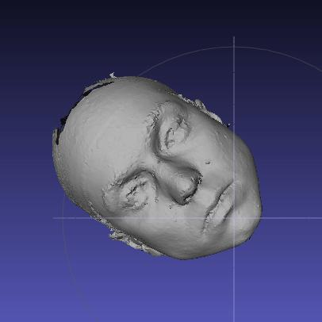
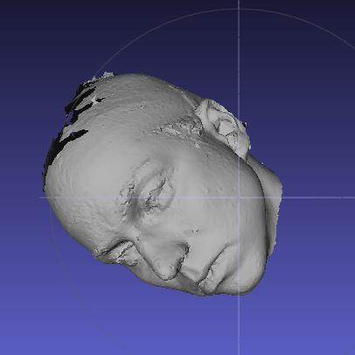
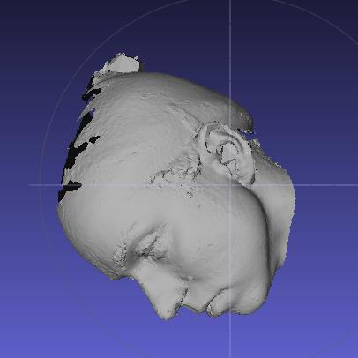
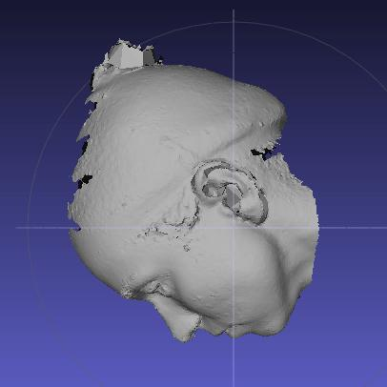
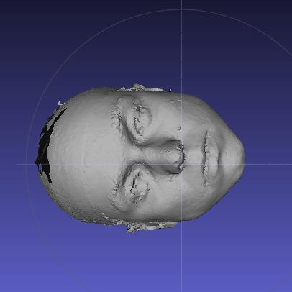
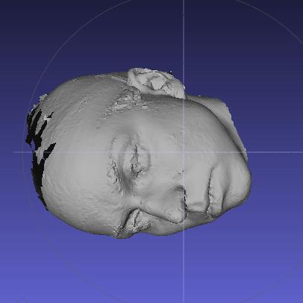
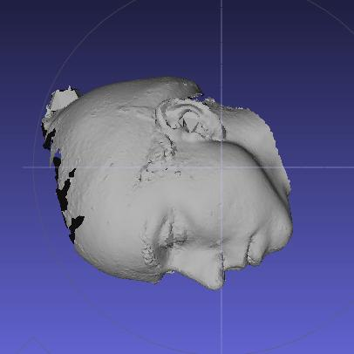
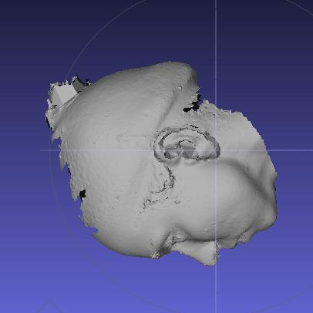
 | 0 | 30 | 60 | 90
0 | 1 | 2 | 4 | 7
30 | 3 | 5 | 8 | 11
60 | 6 | 9 | 12 | 14
90 | 10 | 13 | 15 | 16

Slide 24
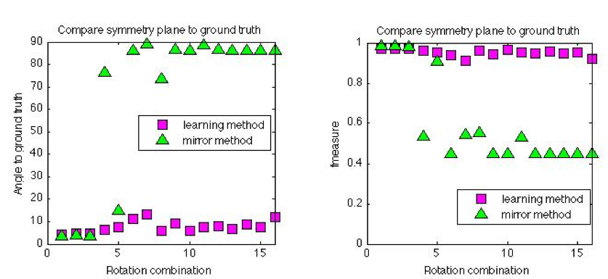
worst
best
best
worst

Slide 25
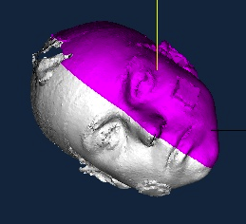

Slide 26
Cleft dataset
Learning method
Mirror method

Slide 27
Questions?

