Slide 1
Computer Vision CSE/EE 576 Interest Regions, Recognition, and Matching Linda Shapiro Professor of Computer Science & Engineering Professor of Electrical & Computer Engineering

Slide 2
The Kadir Operator Saliency, Scale and Image Description Timor Kadir and Michael Brady University of Oxford

Slide 3
The issues…
salient – standing out from the rest, noticeable, conspicous, prominent
scale – find the best scale for a feature
image description – create a descriptor for use in object recognition

Slide 4
Early Vision Motivation
pre-attentive stage: features pop out
attentive stage: relationships between features and grouping

Slide 5
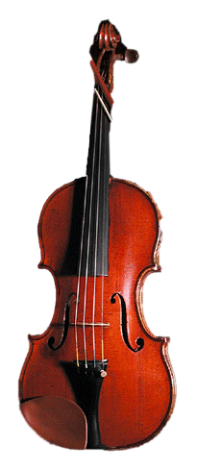
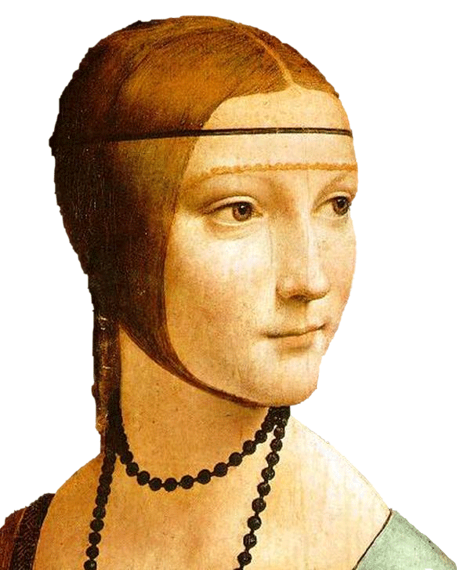
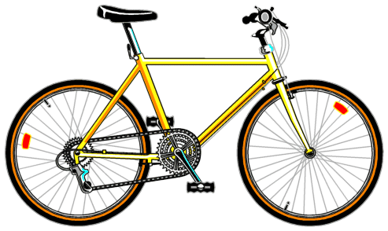
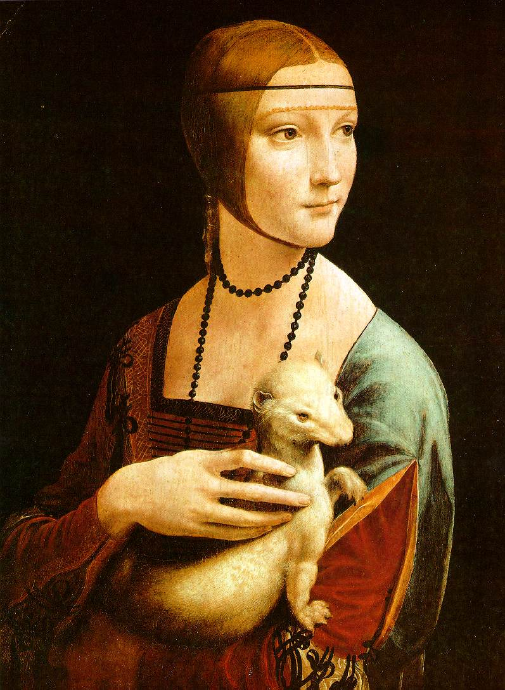
Bags of Words

Slide 6
Detection of Salient Features for an Object Class

Slide 7
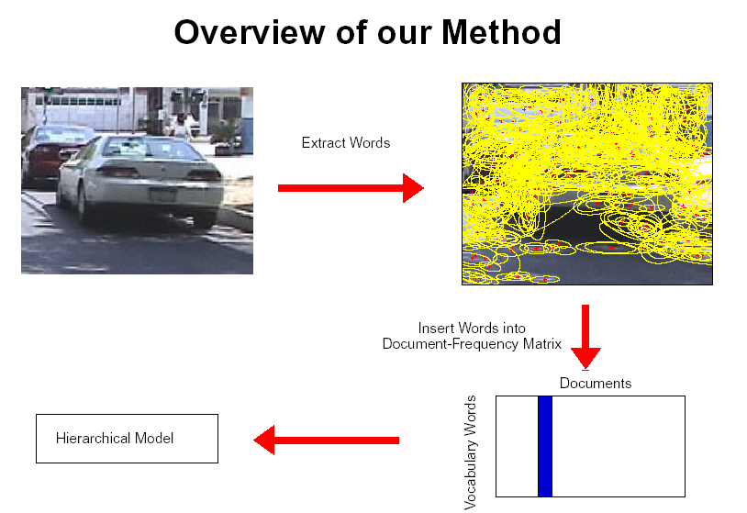
How do we do this?
fixed size windows (simple approach)
Harris detector, Lowe detector, etc.
Kadir’s approach

Slide 8
Kadir’s Approach
Scale is intimately related to the problem of determining saliency and extracting relevant descriptions.
Saliency is related to the local image complexity, ie. Shannon entropy.
entropy definition H = -∑ P_{i} log₂ P_{i}
i in set
of interest

Slide 9
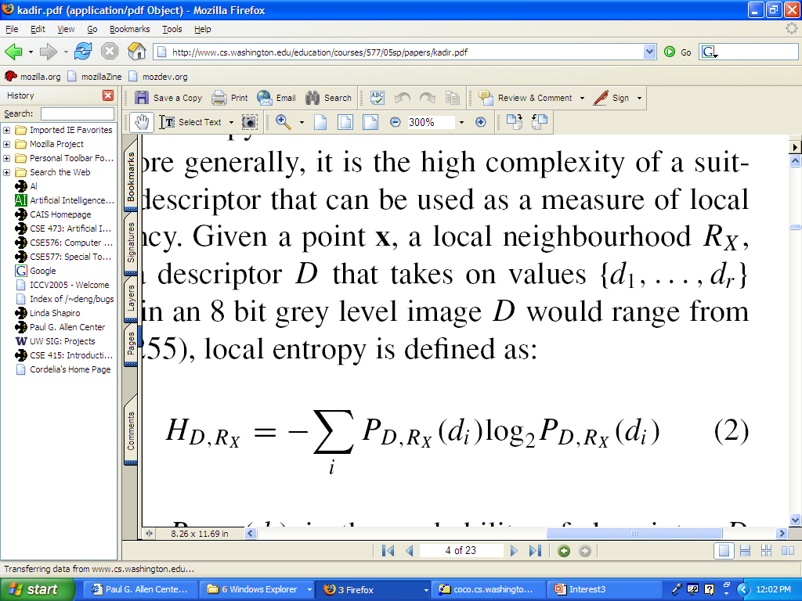
Specifically
x is a point on the image
R_{x} is its local neighborhood
D is a descriptor and has values {d₁, ... d_{r}}.
P_{D,Rx}(d_{i}) is the probability of descriptor D taking the value d_{i} in the local region R_{x}. (The normalized histogram of the gray tones in a region estimates this probability distribution.)

Slide 10
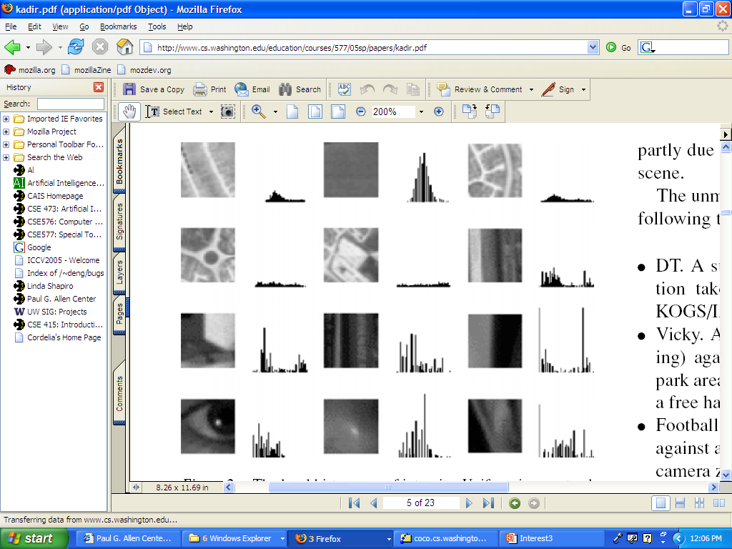
Local Histograms of Intensity
Neighborhoods with structure have flatter distributions
which converts to higher entropy.

Slide 11
Problems Kadir wanted to solve
Scale should not be a global, preselected parameter
Highly textured regions can score high on entropy, but not be useful
The algorithm should not be sensitive to small changes in the image or noise.

Slide 12
Kadir’s Methodology
use a scale-space approach
features will exist over multiple scales
Berghoml (1986) regarded features (edges) that existed over multiple scales as best.
Kadir took the opposite approach.
He considers these too self-similar.
Instead he looks for peaks in (weighted) entropy over the scales.

Slide 13
The Algorithm
For each pixel location x
For each scale s between smin and smax
Measure the local descriptor values within a window of scale s
Estimate the local PDF (use a histogram)
Select scales (set S) for which the entropy is peaked (S may be empty)
Weight the entropy values in S by the sum of absolute difference of the PDFs of the local descriptor around S.

Slide 14
Finding salient points
the math for saliency discretized
saliency
entropy
weight
based on
difference
between
scales
s
(gray tones)
X
probability of descriptor D taking value d in
the region centered at x with scale s
= normalized histogram count for the bin representing gray tone d.

Slide 15
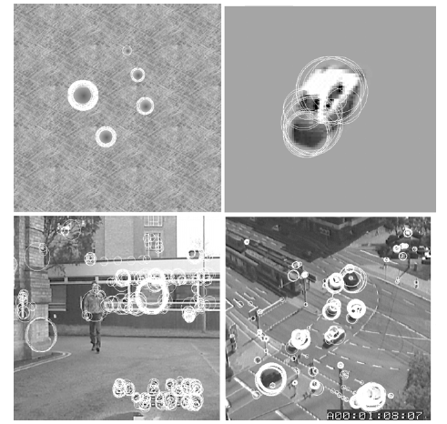
Picking salient points and their scales

Slide 16
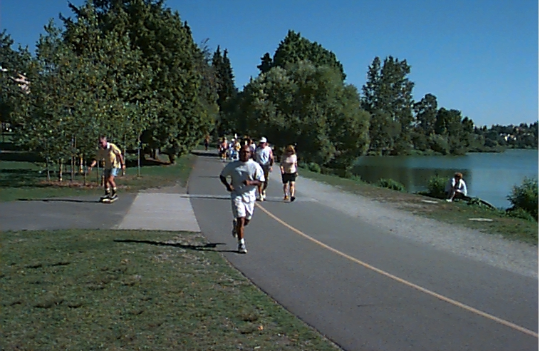
Getting rid of texture
One goal was to not select highly textured regions such as grass or bushes, which are not the type of objects the Oxford group wanted to recognize
Such regions are highly salient with just entropy, because they contain a lot of gray tones in roughly equal proportions
But they are similar at different scales and thus the weights make them go away

Slide 17
Salient Regions
Instead of just selecting the most salient points (based on weighted entropy), select salient regions (more robust).
Regions are like volumes in scale space.
Kadir used clustering to group selected points into regions.
We found the clustering was a critical step.

Slide 18
Kadir’s clustering (VERY ad hoc)
Apply a global threshold on saliency.
Choose the highest salient points (50% works well).
Find the K nearest neighbors (K=8 preset)
Check variance at center points with these neighbors.
Accept if far enough away from existant clusters and variance small enough.
Represent with mean scale and spatial location of the K points
Repeat with next highest salient point

Slide 19
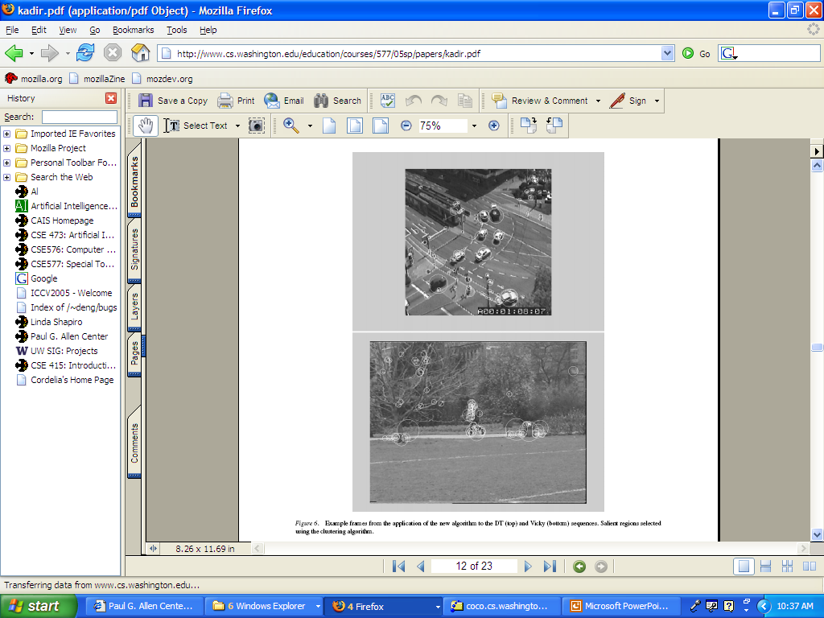
More examples

Slide 20
Robustness Claims
scale invariant (chooses its scale)
rotation invariant (uses circular regions and histograms)
somewhat illumination invariant (why?)
not affine invariant (able to handle small changes in viewpoint)

Slide 21
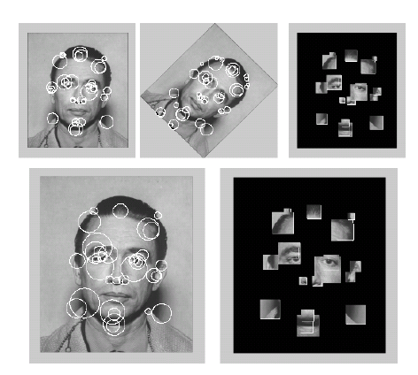
More Examples

Slide 22
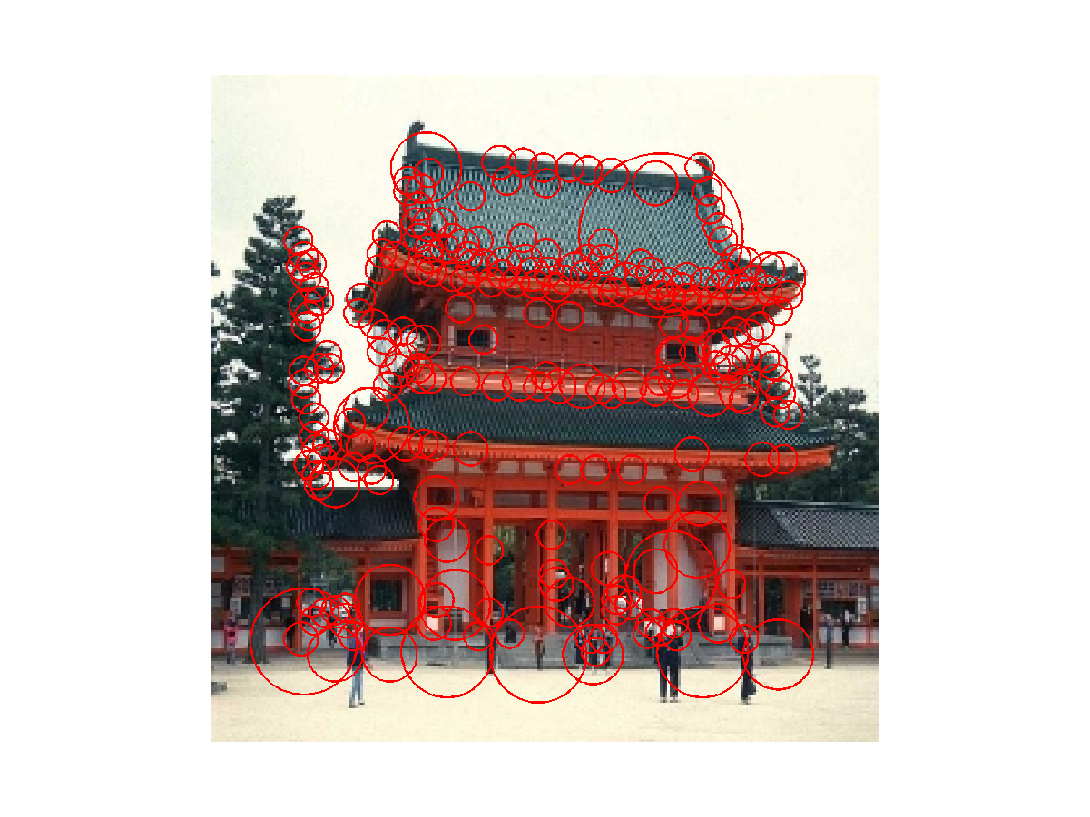
Temple

Slide 23
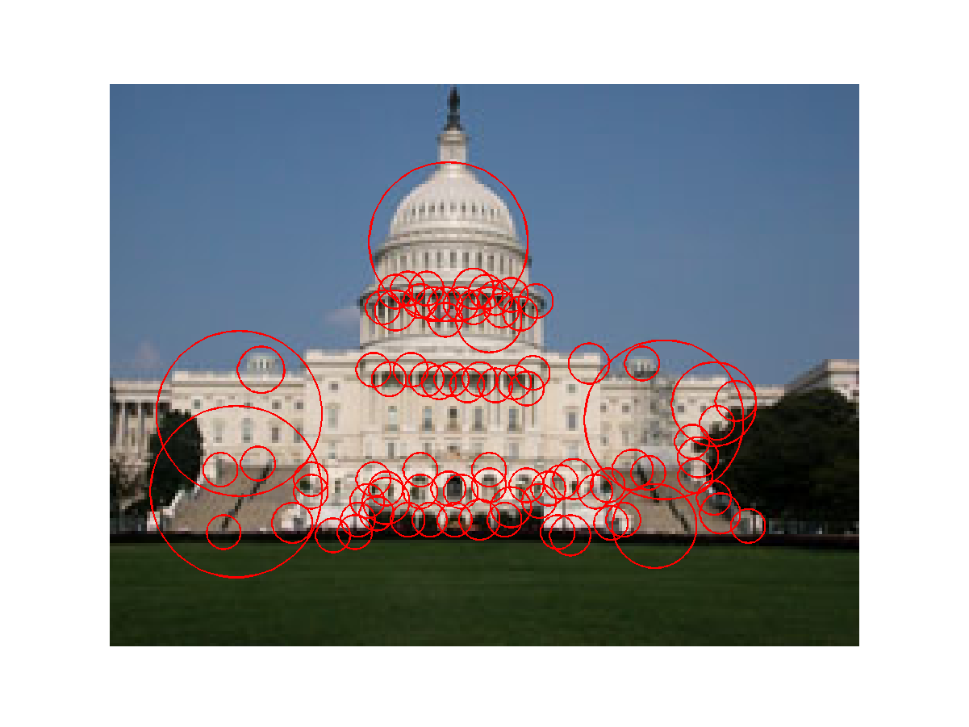
Capitol

Slide 24
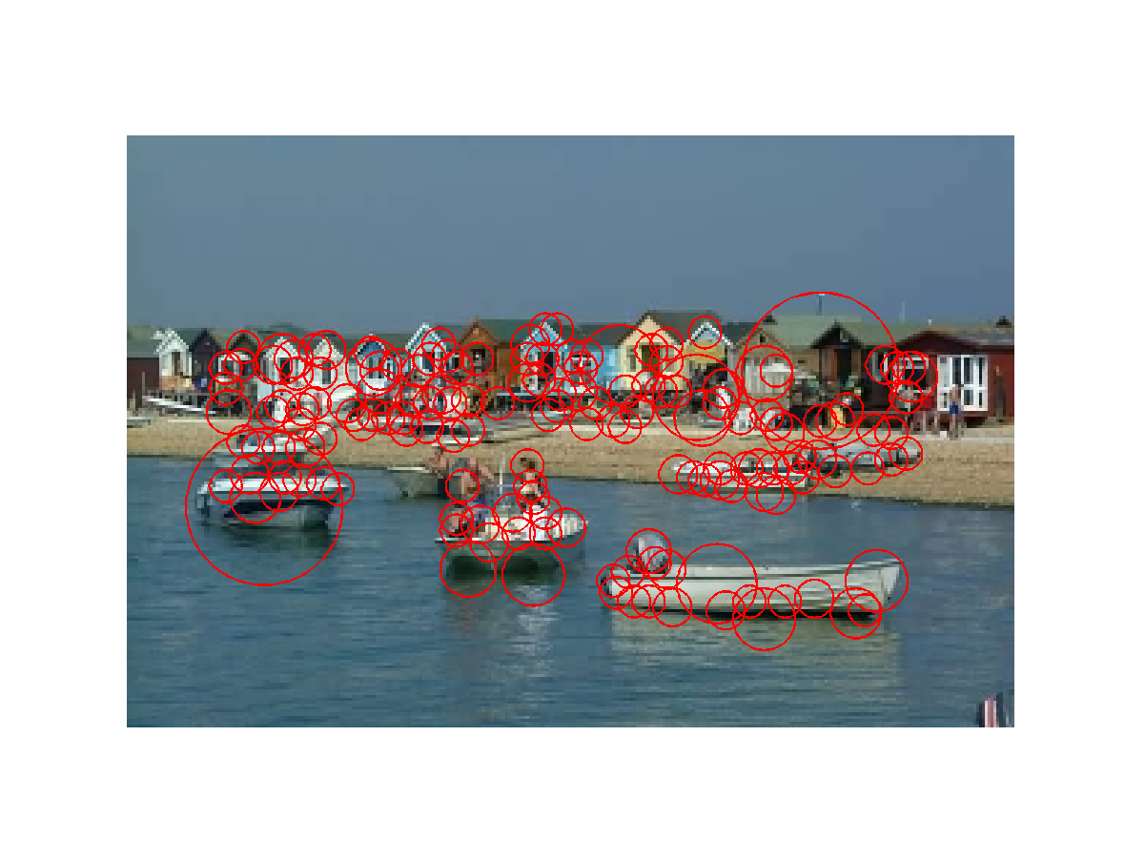
Houses and Boats

Slide 25
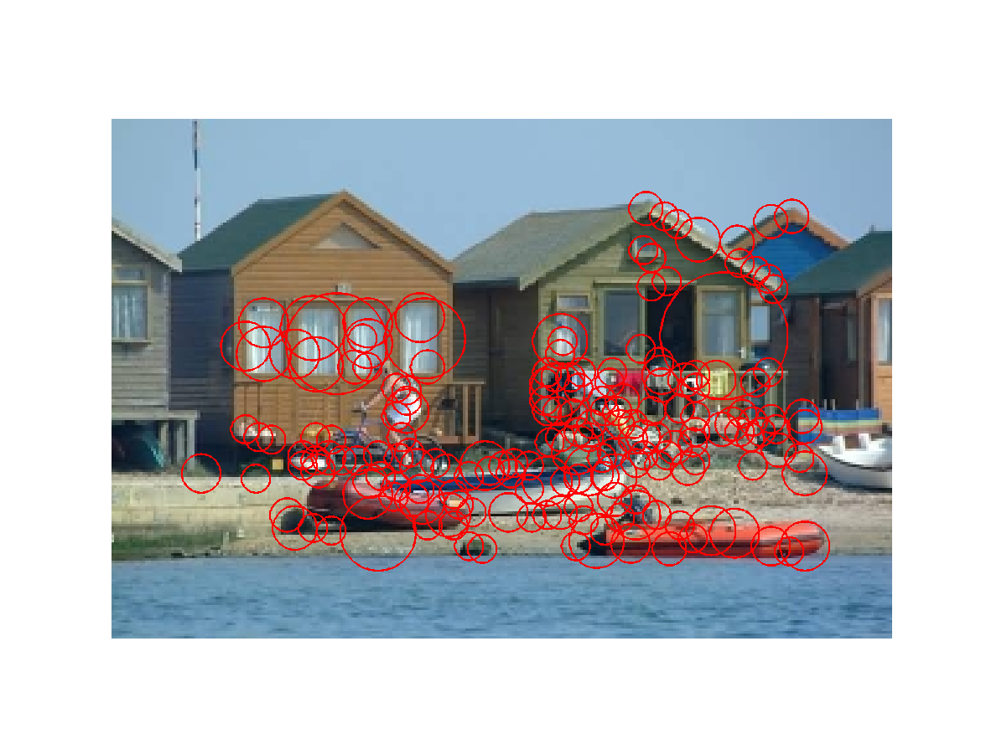
Houses and Boats

Slide 26
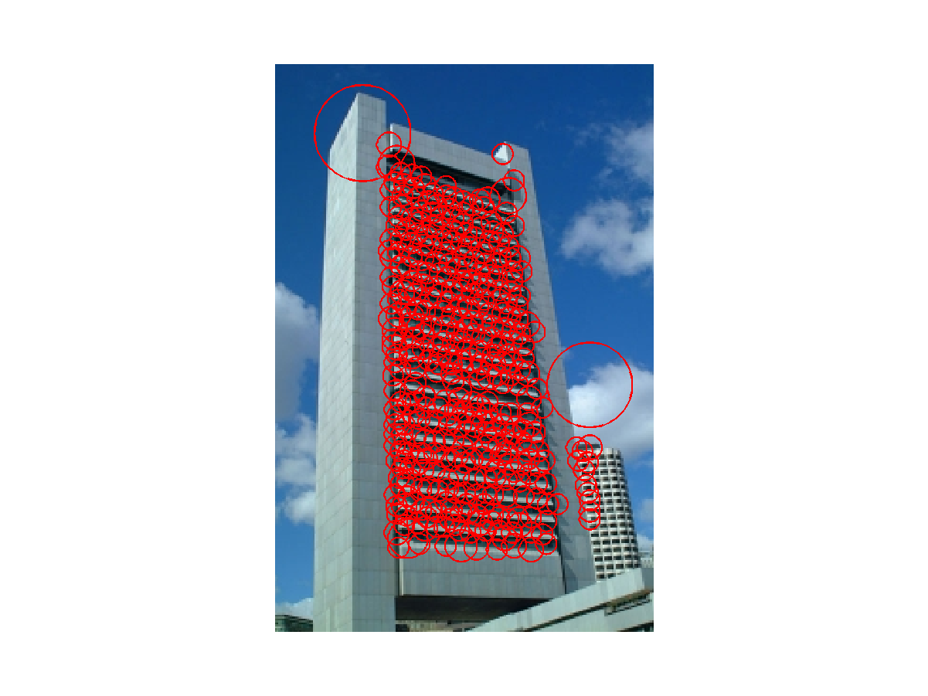
Sky Scraper

Slide 27
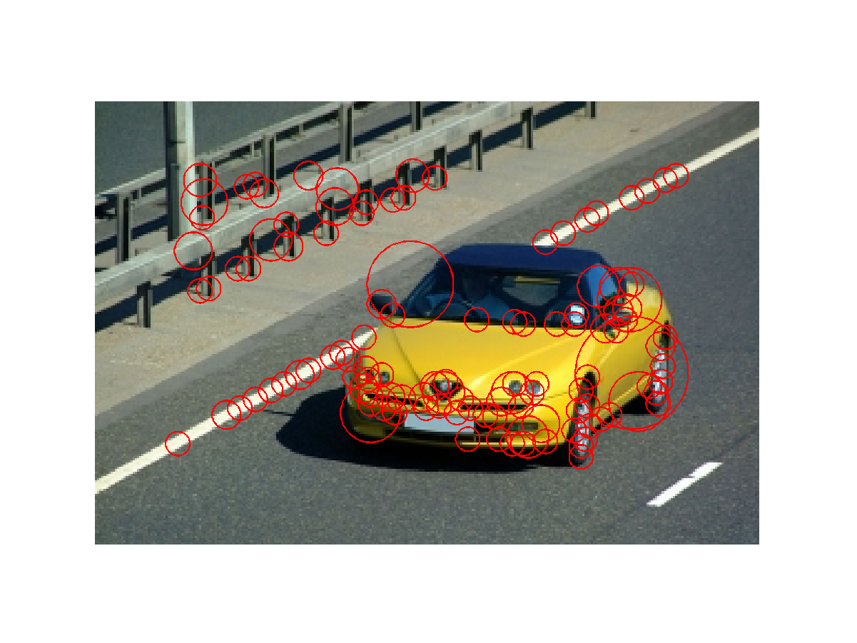
Car

Slide 28
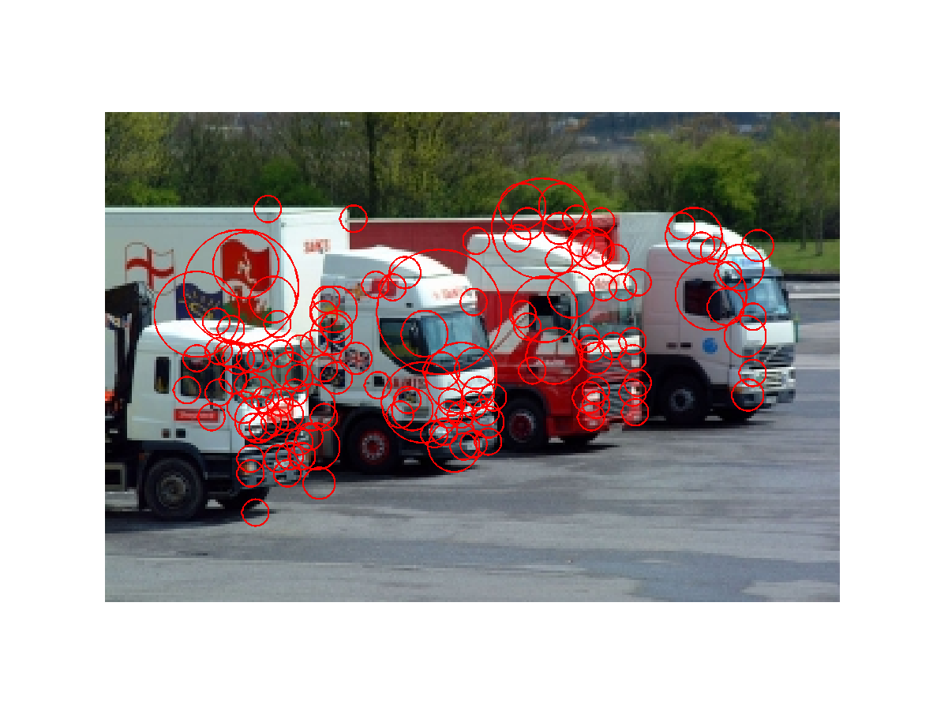
Trucks

Slide 29
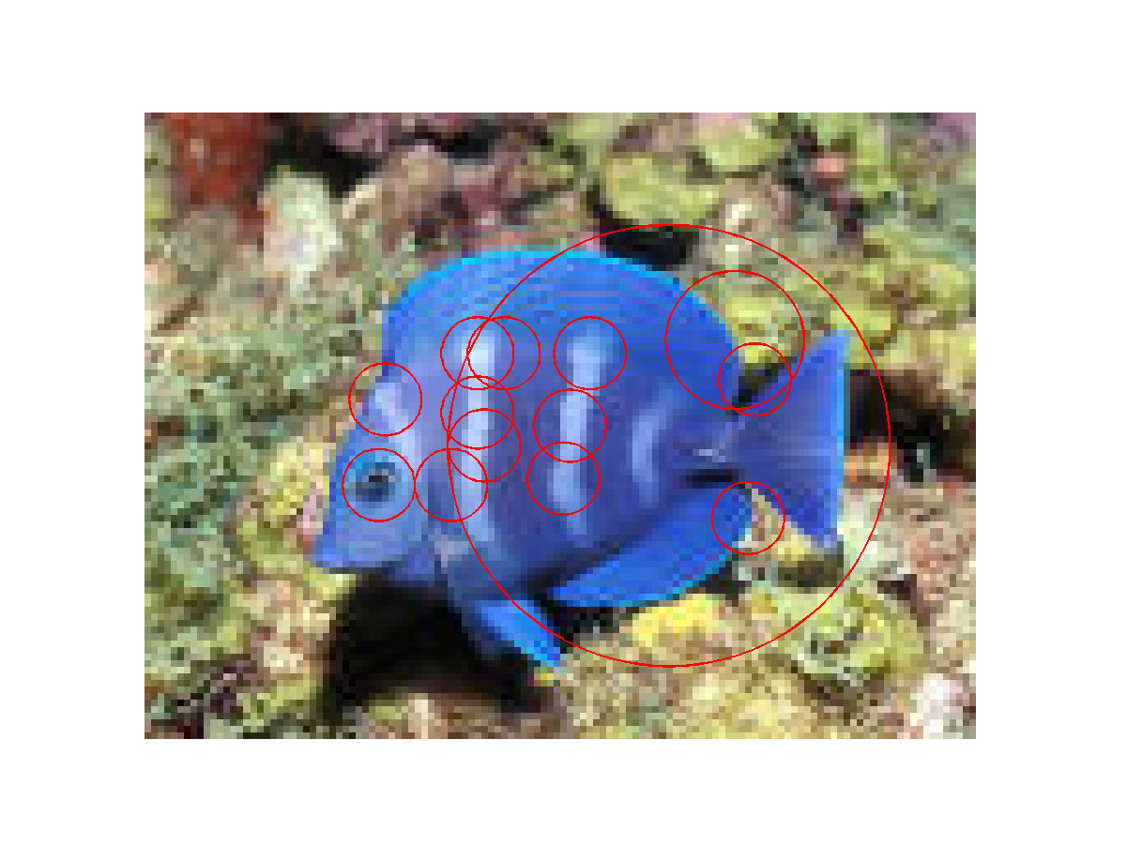
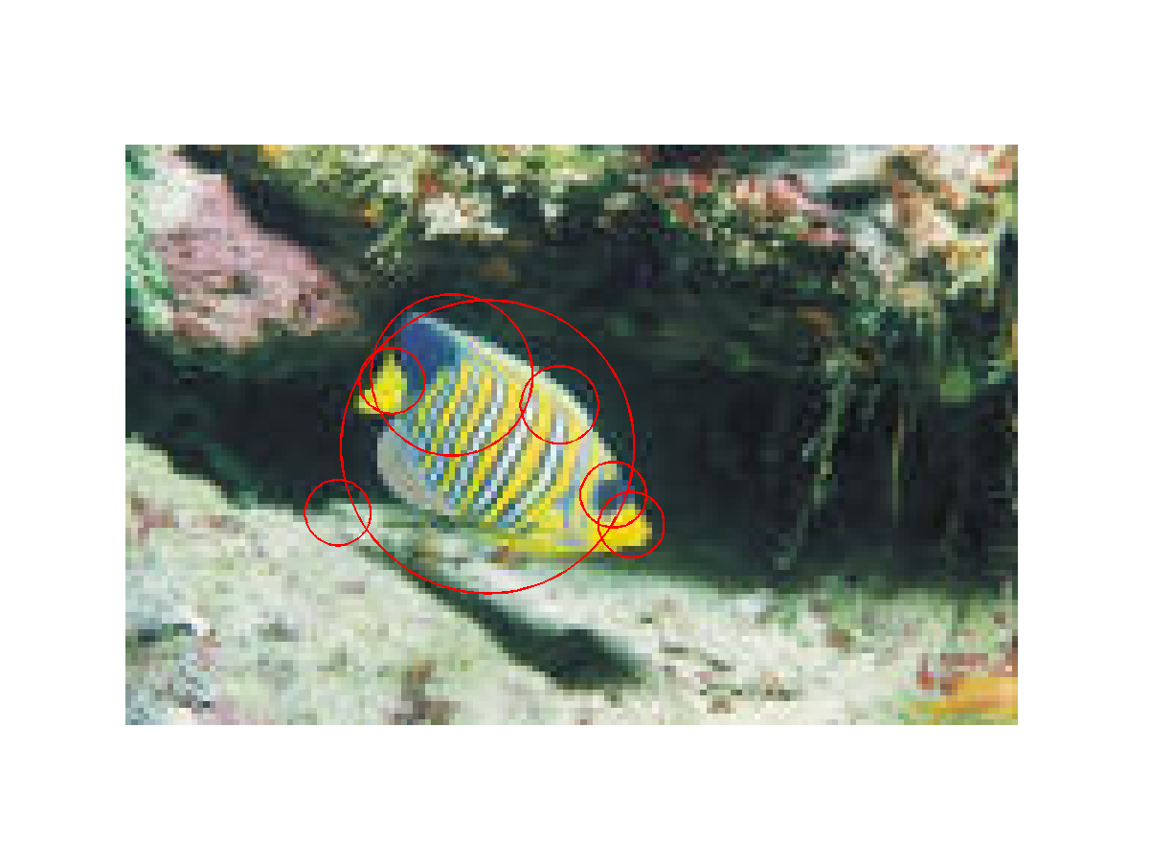
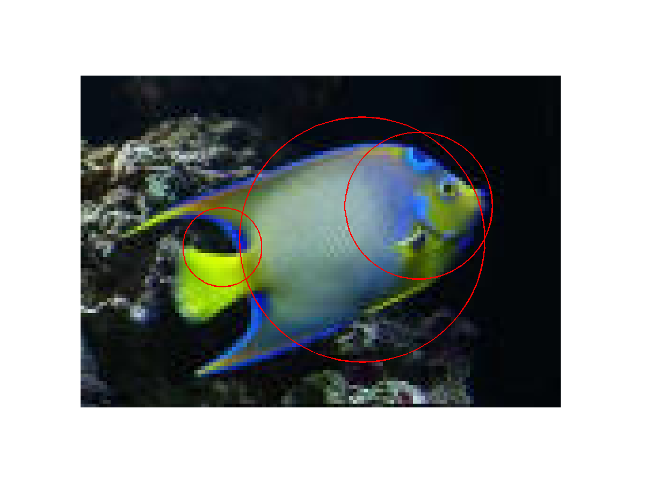
Fish

Slide 30
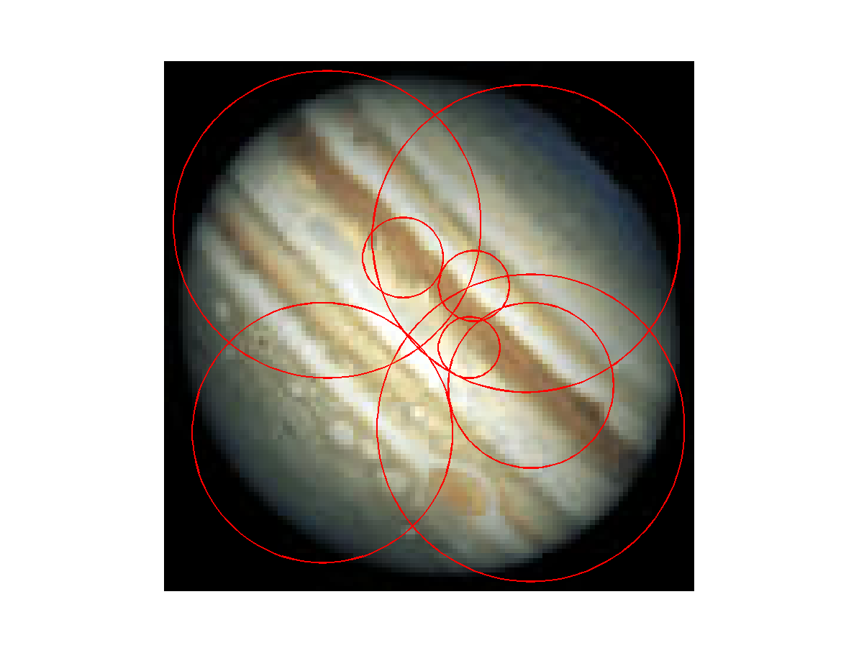
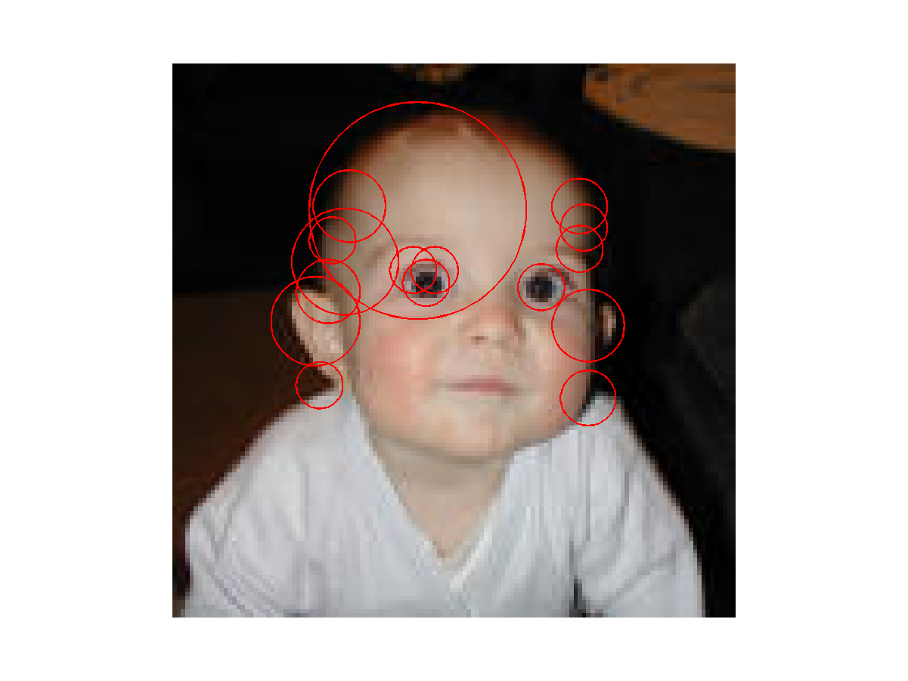
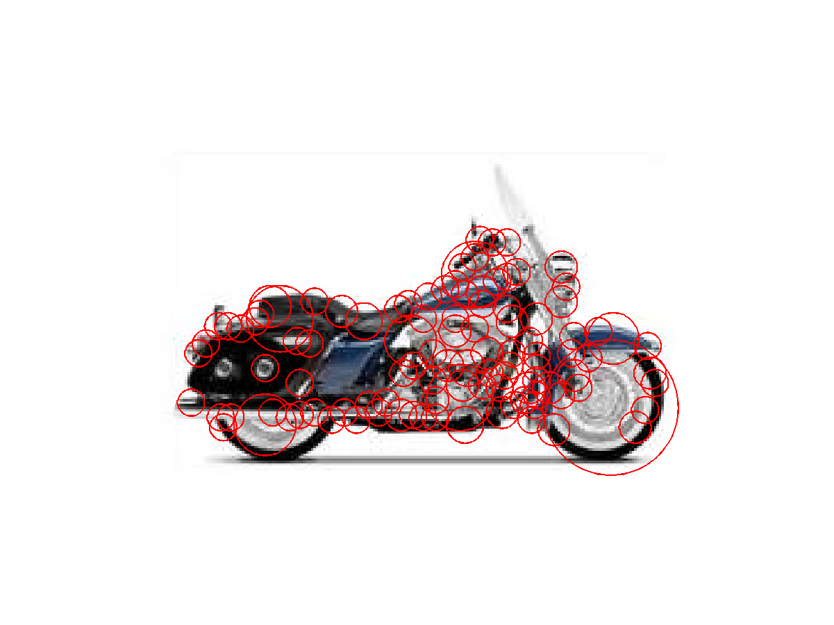
Other …

Slide 31
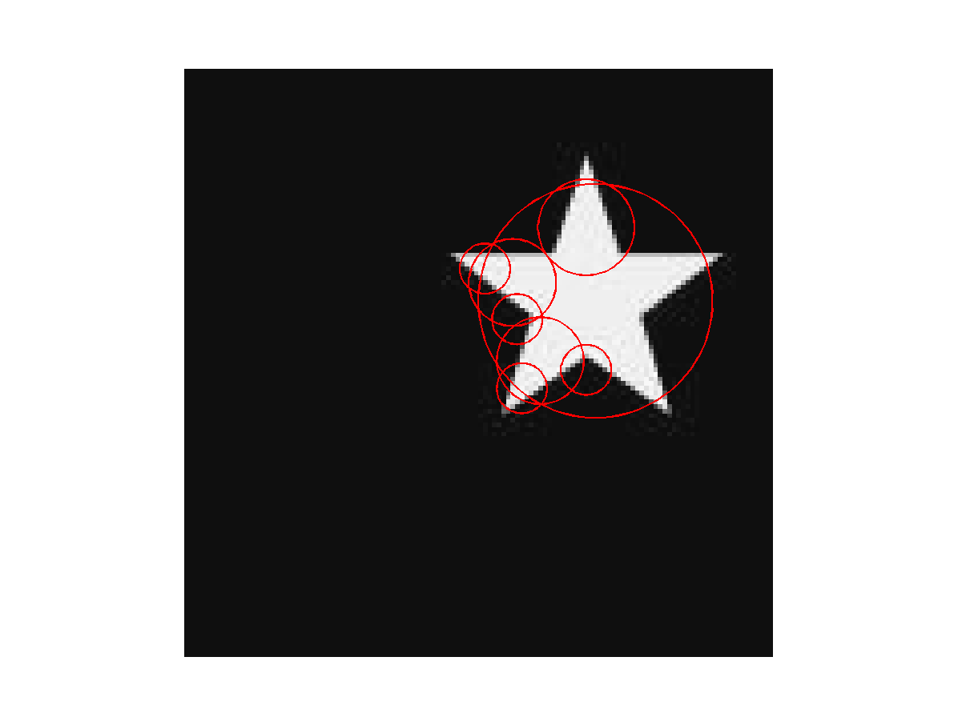
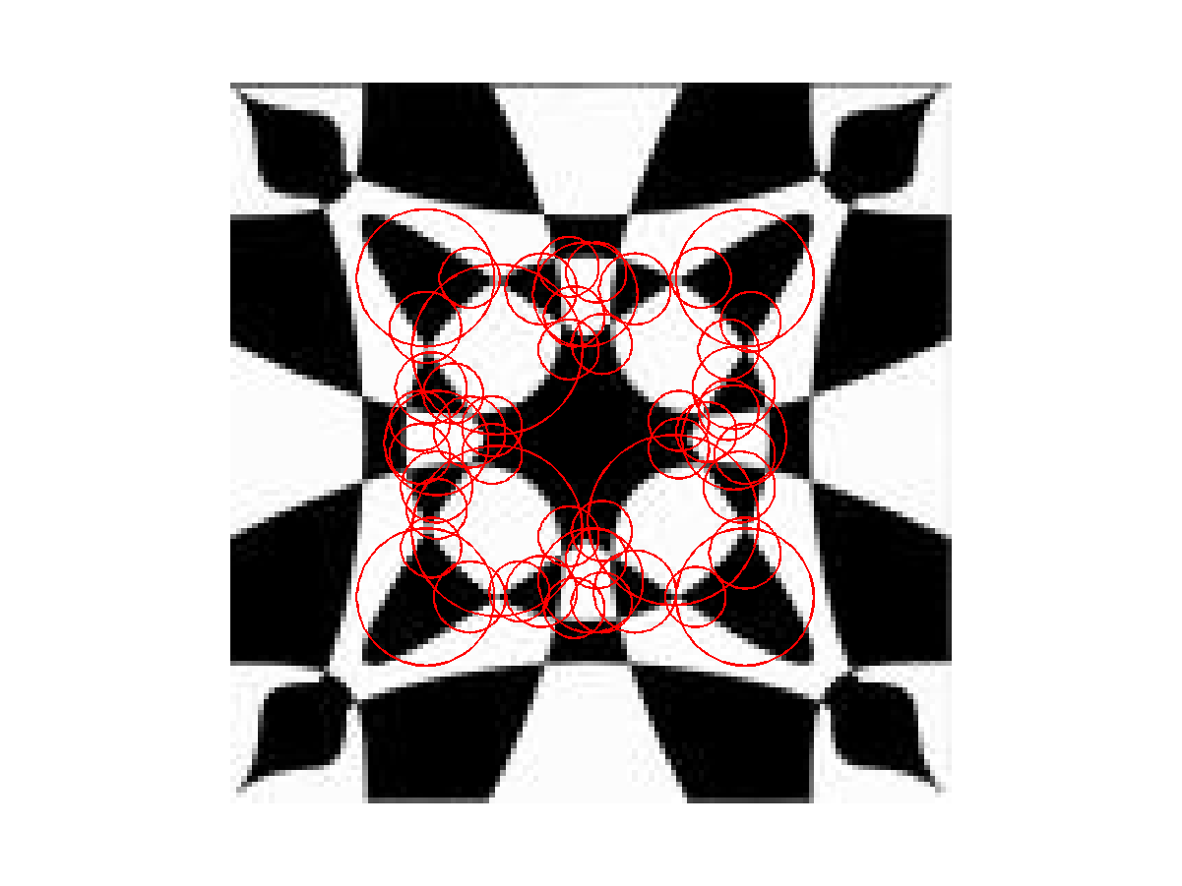
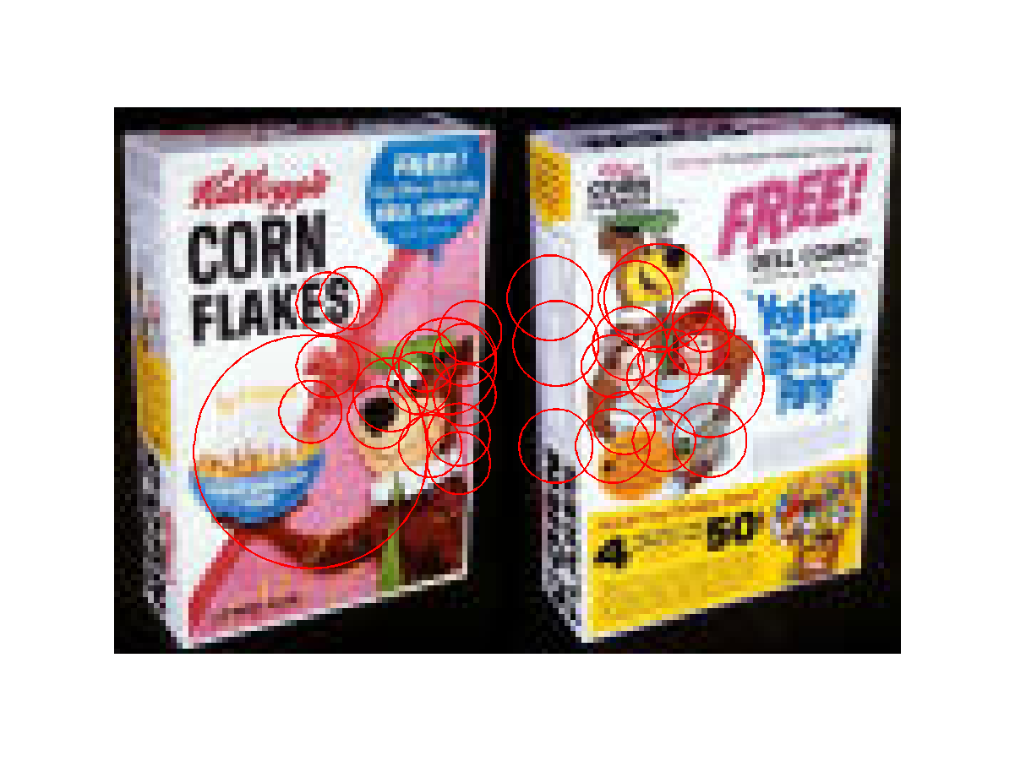
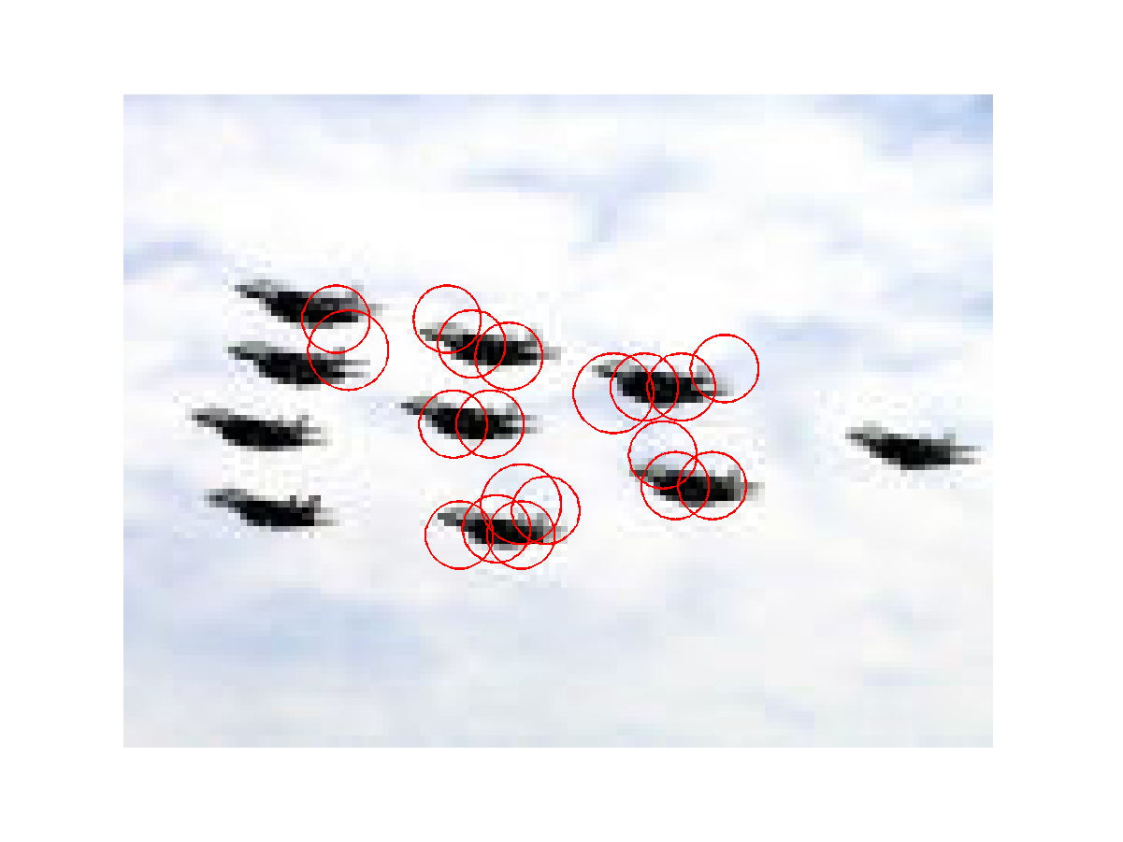
Symmetry and More

Slide 32
Benefits
General feature: not tied to any specific object
Can be used to detect rather complex objects that are not all one color
Location invariant, rotation invariant
Selects relevant scale, so scale invariant
What else is good?
Anything bad?

Slide 33
Object Recognition with Interest Operators
Object recognition started with line segments.
- Roberts recognized objects from line segments
and junctions.
- This led to systems that extracted linear features.
- CAD-model-based vision works well for industrial.
An “appearance-based approach” was first developed
for face recognition and later generalized up to a point.
The interest operators have led to a new kind of
recognition by “parts” that can handle a variety of
objects that were previously difficult or impossible.

Slide 34
Object Class Recognition by Unsupervised Scale-Invariant Learning
R. Fergus, P. Perona, and A. Zisserman
Oxford University and Caltech
CVPR 2003
won the best student paper award
CVPR 2013
won the best 10-year award

Slide 35
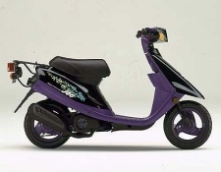
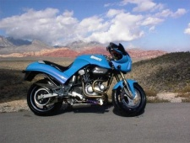

Goal:
Enable Computers to Recognize Different Categories of Objects in Images.

Slide 36
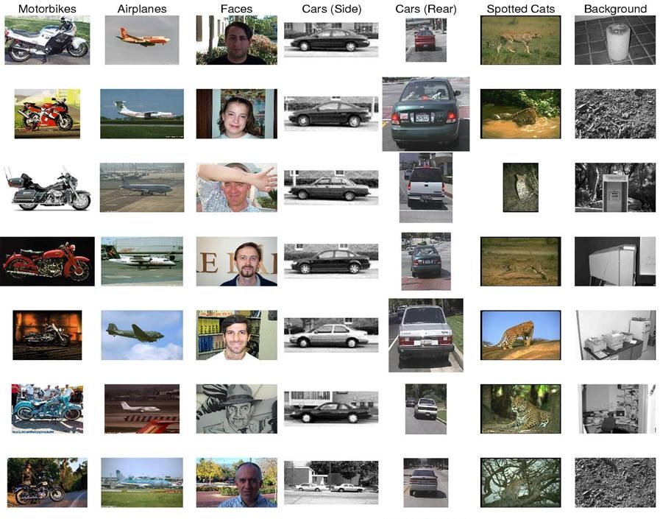
Notes:
Difficulties: Size Variation,

Slide 37
Approach
An object is a constellation of parts (from Burl, Weber and Perona, 1998).
The parts are detected by an interest operator (Kadir’s).
The parts can be recognized by appearance.
Objects may vary greatly in scale.
The constellation of parts for a given object is learned from training images

Slide 38
Components
Model
Generative Probabilistic Model including
Location, Scale, and Appearance of Parts
Learning
Estimate Parameters Via EM Algorithm
Recognition
Evaluate Image Using Model and Threshold

Slide 39
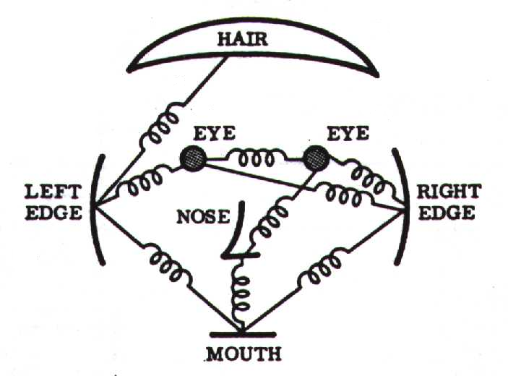
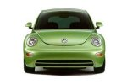
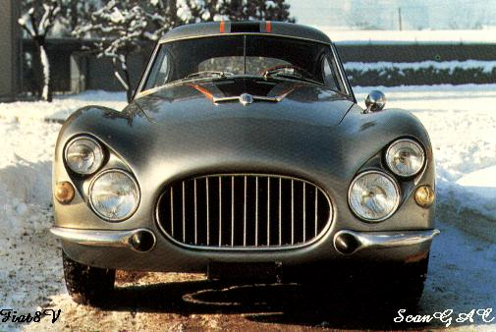
Model: Constellation Of Parts
Fischler & Elschlager, 1973
Yuille, 91
Brunelli & Poggio, 93
Lades, v.d. Malsburg et al. 93
Cootes, Lanitis, Taylor et al. 95
Amit & Geman, 95, 99
Perona et al. 95, 96, 98, 00

Slide 40
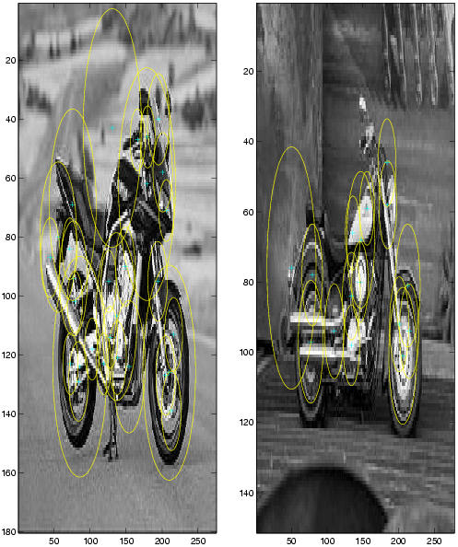
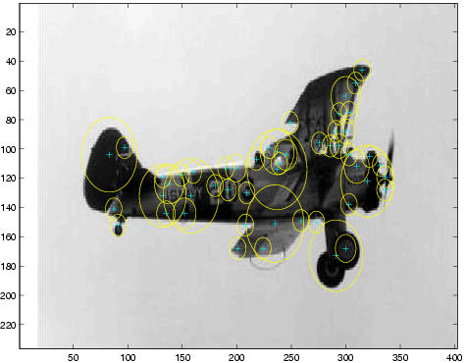
Parts Selected by
Interest Operator
Kadir and Brady's Interest Operator.
Finds Maxima in Entropy Over Scale and Location

Slide 41
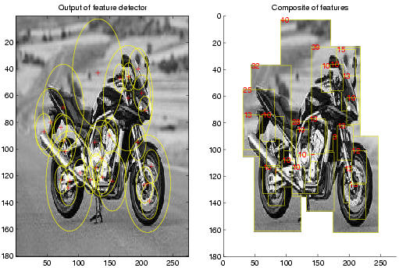

Representation of Appearance
c₁
Projection onto
PCA basis
c₂
11x11 patch
Normalize
121 dimensions was too big, so they used PCA to reduce to 10-15.
c₁₅

Slide 42
Learning a Model
An object class is represented by a generative model with P parts and a set of parameters θ.
Once the model has been learned, a decision procedure must determine if a new image contains an instance of the object class or not.
Suppose the new image has N interesting features with locations X, scales S and appearances A.

Slide 43
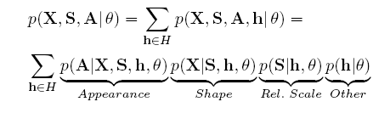
Probabilistic Model
X is a description of the shape of the object (in terms of locations of parts)
S is a description of the scale of the object
A is a description of the appearance of the object
θ is the (maximum likelihood value of) the parameters of the object
h is a hypothesis: a set of parts in the image that might be the parts of the object
H is the set of all possible hypotheses for that object in that image.
For N features in the image and P parts in the object, its size is O(N^{P})

Slide 44







Appearance
The appearance (A) of each part p
has a Gaussian density with
mean c_{p} and covariance V_{P}.
Background model has mean c_{bg}
and covariance V_{bg}.
Gaussian Part Appearance PDF
Gausian Appearance PDF
Object Background

Slide 45
Shape as Location
Object shape is represented by a joint Gaussian density of the locations (X)
of features within a hypothesis transformed into a scale-invariant space.
Gaussian Shape PDF
Uniform Shape PDF
Object Background

Slide 46
Scale
The relative scale of each part is modeled by a Gaussian density with
mean t_{p} and covariance U_{p}.
Prob. of detection
Gaussian
Relative Scale PDF
0.8
0.75
0.9
Log(scale)

Slide 47
Occlusion and Part Statistics
This was very complicated and turned out to not work
well and not be necessary, in both Fergus’s work and
other subsequent works.

Slide 48

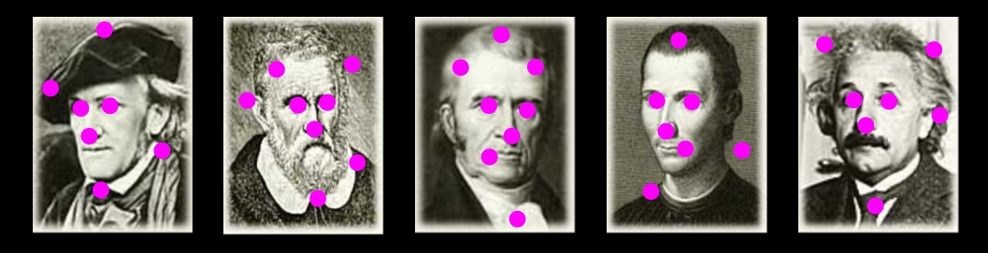
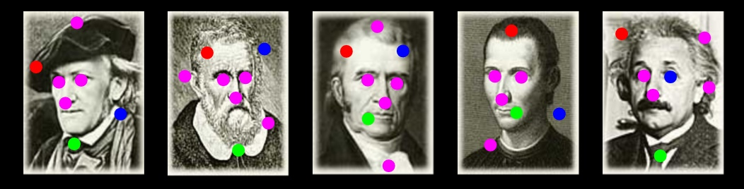
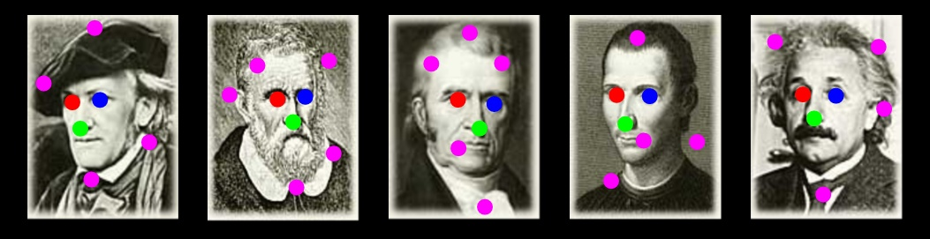
Learning
Train Model Parameters Using EM:
Optimize Parameters
Optimize Assignments
Repeat Until Convergence
location
occlusion
appearance
scale

Slide 49
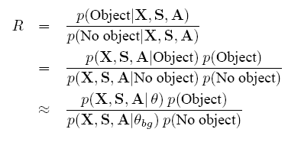
Recognition
Make this likelihood ratio:
greater than a threshold.

Slide 50
RESULTS
Initially tested on the Caltech-4 data set
motorbikes
faces
airplanes
cars
Now there is a much bigger data set: the Caltech-101 http://www.vision.caltech.edu/archive.html

Slide 51
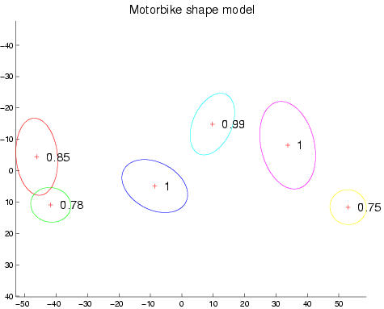
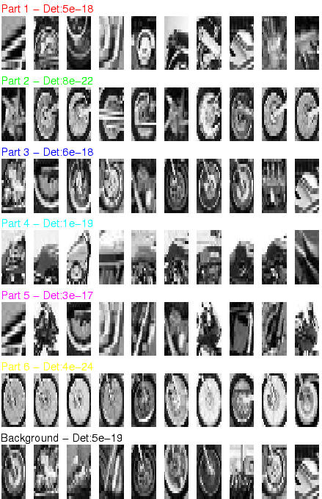
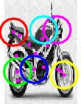
Motorbikes
Equal error rate: 7.5%

Slide 52
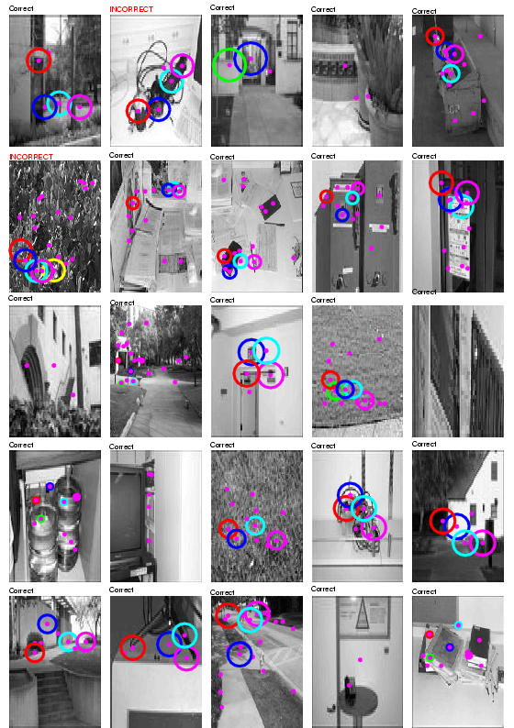
Background Images
It learns that these are NOT motorbikes.

Slide 53
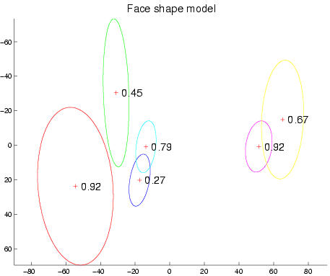
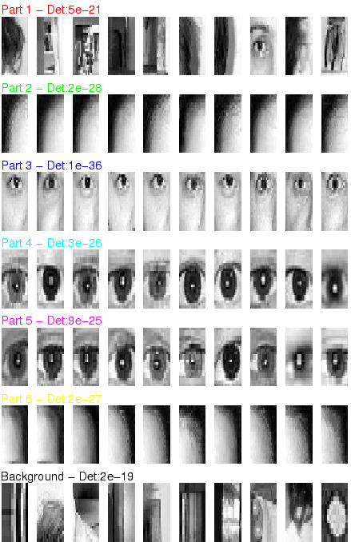
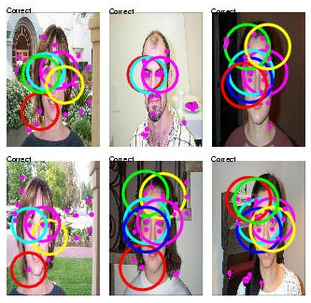
Frontal faces
Equal error rate: 4.6%

Slide 54
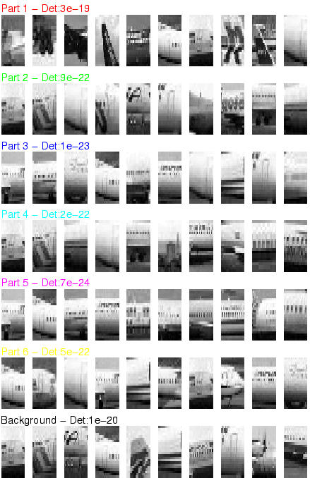


Airplanes
Equal error rate: 9.8%

Slide 55



Scale-Invariant Cars
Equal error rate: 9.7%

Slide 56

Accuracy
Initial Pre-Scaled Experiments
Early Data Set: The CalTech 4

Slide 57
Available Today
CalTech 101 and Caltech 256
ImageNet
Pascal VOC dataset
CIFAR-10
MS Coco
Cityscapes
https://analyticsindiamag.com/10-open-datasets-you-can-use-for-computer-vision-projects/

