Slide 1
Self Supervised Learning
Mehmet Saygin Seyfioglu
11/13/23

Slide 2
What fuels the recent AI boom?

Slide 3
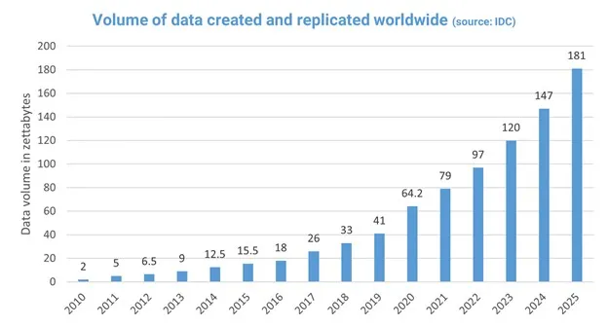
What fuels the recent AI boom?
DATA
Taken from https://medium.com/@mwaliph/exponential-growth-of-data-2f53df89124

Slide 4
What is the largest human-labeled dataset to date?
Ideas?

Slide 5
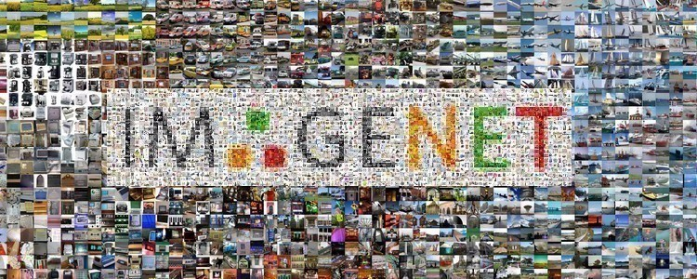
What is the largest human-made dataset to date?
How Large?
Russakovsky, Olga, et al. "Imagenet large scale visual recognition challenge." International journal of computer vision 115 (2015): 211-252.

Slide 6
What is the largest human-made dataset to date?
14M images and labels

Slide 7
How Large are the Datasets for training Foundational Models (Like CLIP, Stable Diffusion, GPT etc.)
Any ideas?

Slide 8
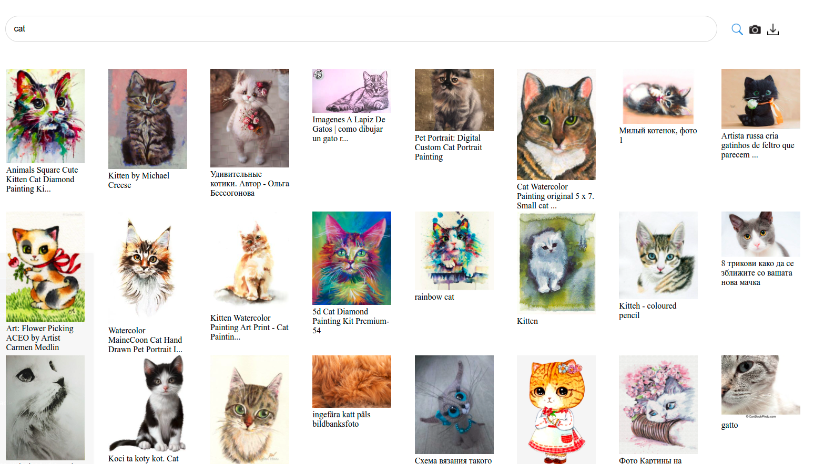
How Large are the Datasets for training Foundational Models (Like CLIP, Stable Diffusion, GPT etc.)
LAION 5B
Impossible to rely on Human labels at this scale.
Schuhmann, Christoph, et al. "Laion-5b: An open large-scale dataset for training next generation image-text models." Advances in Neural Information Processing Systems 35 (2022): 25278-25294.

Slide 9
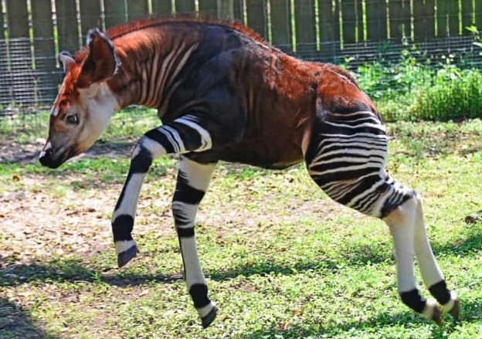
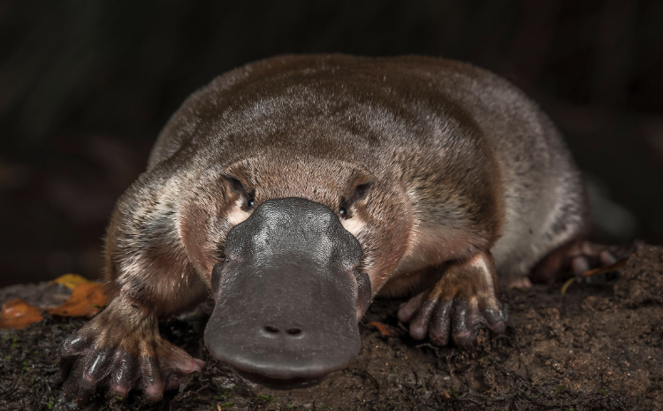
Self Supervised Learning
What are these animals? Can you name them?
Notes:
The important thing is, our brains know that they are different without knowing what they are called.
So we can differentiate between different “looking” animals or more generally objects even without seeing them before, or knowing what they are specifically
Animals are Okapi and platypus

Slide 10
Self Supervised Learning
So SSL methods are generally encoding the similarity, or the difference of entities without specifically knowing what those entities are.

Slide 11
Self Supervised Learning
So SSL methods are generally encoding the similarity, or the difference of entities without specifically knowing what those entities are.
Recent trend is to train a “Foundational Model” with a huge dataset in a self-supervised manner, which aims to learn some underlying generalizable facts then fine-tune this model for certain “downstream tasks”.

Slide 12
Self Supervised Learning
So SSL methods are generally encoding the similarity, or the difference of entities without specifically knowing what those entities are.
Recent trend is to train a “Foundational Model” with a huge dataset in a self-supervised manner, which aims to learn some underlying generalizable facts then fine-tune this model for certain “downstream tasks”.
The trick is to create some pretext task, which generates some pseudo labels from unlabeled data. How?

Slide 13
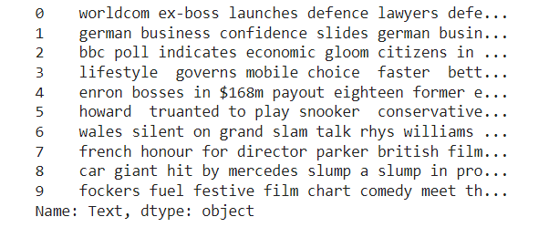
SSL for Natural Language Processing (NLP)
How can we implement SSL techniques in Natural Language Processing?
Notes:
IN NLP WORLD, the SSL works in multitude of ways. How can we encode the

Slide 14
SSL for Natural Language Processing (NLP)
How can we implement SSL techniques in Natural Language Processing?
  Context (align words that appear in similar context)
    Any issues with this?
Notes:
IN NLP WORLD, the SSL works in multitude of ways. How can we encode the
Context issue: heteronym words THE WORDS that spelled the same but have different meaning

Slide 15
SSL for Natural Language Processing (NLP)
How can we implement SSL techniques in Natural Language Processing?
  Context (align words that appear in similar context)
    Any issues with this?
  Masked Language Modeling (Predict the masked word using its context)
    Predict Next word
Notes:
IN NLP WORLD, the SSL works in multitude of ways. How can we encode the
Context issue: heteronym words THE WORDS that spelled the same but have different meaning

Slide 16
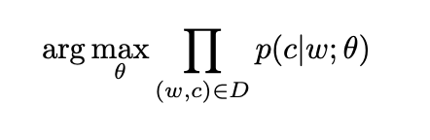
Word2Vec
Use a shallow neural network to learn word embeddings
Let w denote the corpus of words and let c be the context of words for a given data set D. The word2vec model is trying to maximize the conditional probability p(c|w) by optimizing its parameters θ.
How do we solve this objective?
Mikolov, Tomas, et al. "Distributed representations of words and phrases and their compositionality." Advances in neural information processing systems 26 (2013).

Slide 17
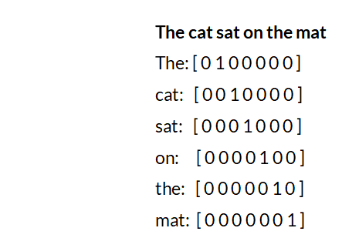
Word2Vec Skip-Gram
Assume we encoded each word in the corpus into a one hot vector.
Notes:
Orthogonal

Slide 18
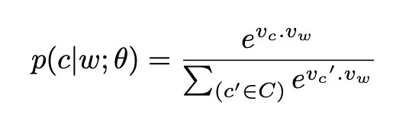
Word2Vec Skip-Gram
Given one hot embedded word vectors, we can then try to do negative sampling to train a shallow network using softmax function:
The nominator here is a word w and its context c. On the denominator though, we randomly sample context from the dataset. This is called Negative Sampling.
So we didn’t label the dataset at all, but utilizing the context (word proximity)

Slide 19
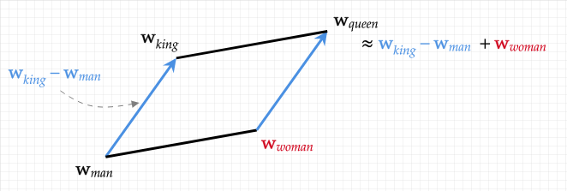
Word2Vec
Turns out, if you do this with a large enough dataset, you can learn vector representation of words which can be used in vector algebra!
This was a wake up call for the field. Tom Mikolov came up with the word2vec algorithm at Google during 2013. What happened after then?

Slide 20
What happened between 2013-2019?
If word2vec is great, why the research on SSL got stalled (!) in NLP?

Slide 21
What happened between 2013-2019?
If word2vec is great, why the research on SSL got stalled (!) in NLP?
Folks mainly relied on LSTMs (recurrent nets) to learn from large datasets, and LSTMs does not have a capacity to encode long range dependencies.
We lacked data.

Slide 22
What happened 2013-2019?
If word2vec is great, why the research on SSL got stalled (!) in NLP?
Folks mainly relied on LSTMs (recurrent nets) to learn from large datasets, and LSTMs does not have a capacity to encode long range dependencies.
We lacked data.
What architecture changed it?

Slide 23
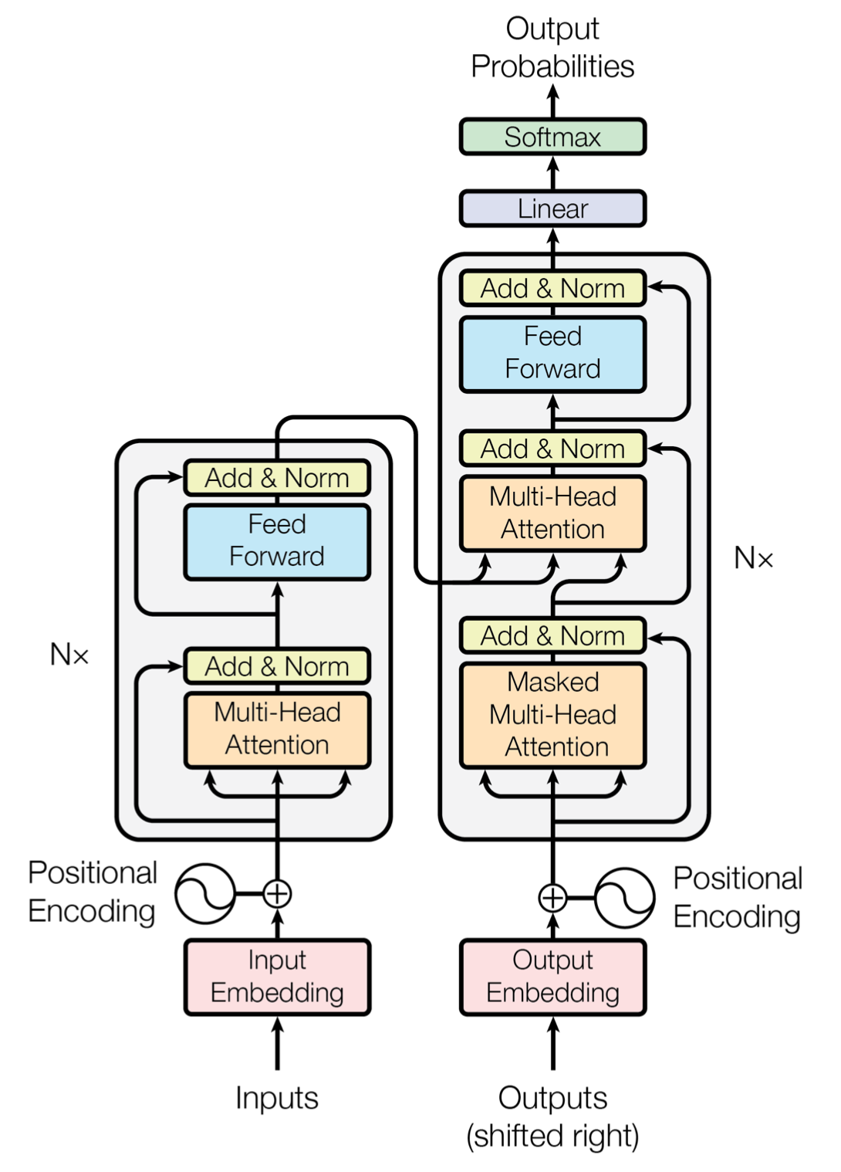
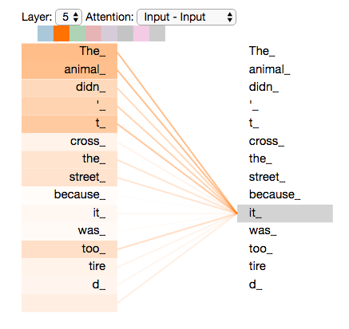
Transformer
Decoder
Encoder
Vaswani, Ashish, et al. "Attention is all you need." Advances in neural information processing systems 30 (2017).

Slide 24
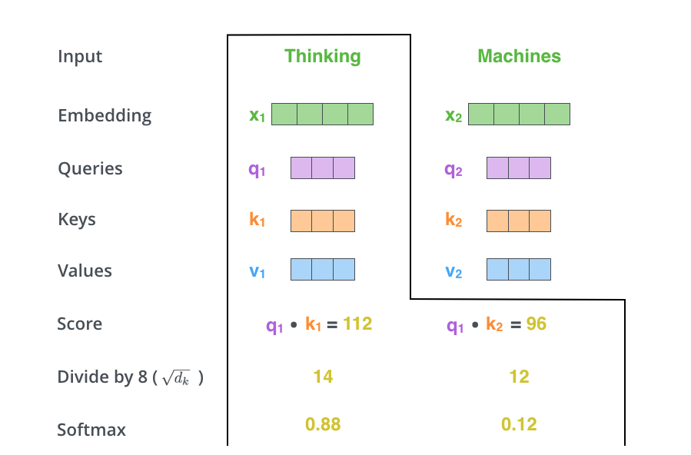
Transformer
Taken from https://jalammar.github.io/illustrated-transformer/

Slide 25
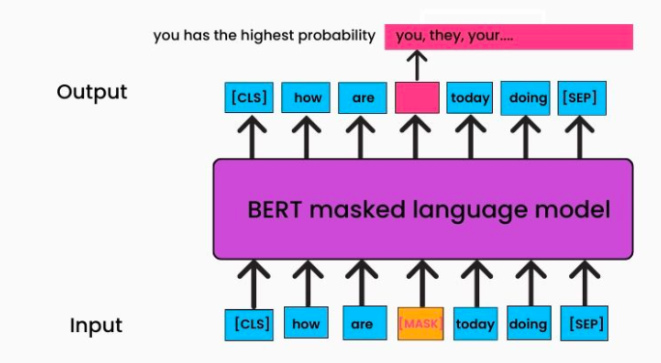
BERT
Encoder-only architecture. 340 million parameters.
Devlin, Jacob, et al. "Bert: Pre-training of deep bidirectional transformers for language understanding." arXiv preprint arXiv:1810.04805 (2018)
Taken from https://www.turing.com/kb/how-bert-nlp-optimization-model-works
Notes:
Unlike traditional encoder-decoder models that engage in both understanding and generation, encoder-only models specialize in contextual encoding, which can be immensely beneficial in tasks such as sentiment analysis, named entity recognition, and more.
So Encoder-Decoder models are good for translation etc.
Encoder only is good for getting the context from the content
https://medium.com/@amirhossein.abaskohi/navigating-transformers-a-comprehensive-exploration-of-encoder-only-and-decoder-only-models-right-a0b46bdf6abe

Slide 26
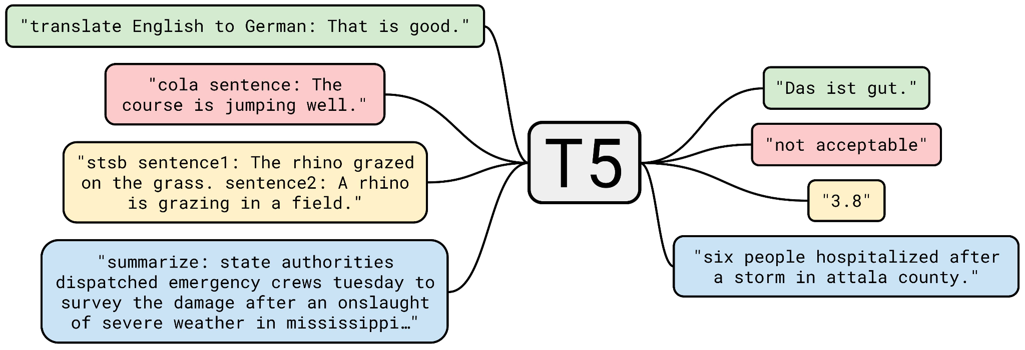
T5
Encoder-Decoder model
Shuffling, Masked Language Modeling. 3b parameters
Raffel, Colin, et al. "Exploring the limits of transfer learning with a unified text-to-text transformer." The Journal of Machine Learning Research 21.1 (2020): 5485-5551.
Notes:
Encoder Decoder model

Slide 27
GPT
Decoder only architecture
Trained for the next word prediction (Turns out, this scales well with more data and model size, thus we have the modern GPTs now)
GPT2 - 1.75b parameters
…
GPT4 - 275b parameters (estimation)
Brown, Tom, et al. "Language models are few-shot learners." Advances in neural information processing systems 33 (2020): 1877-1901.
Notes:
Decoder-only models represent a distinct breed of transformers that excel in generating coherent sequences based on contextual information. Unlike their encoder-only counterparts that specialize in understanding context, decoder-only models delve into the art of creative generation. These models are designed to take a sequence of tokens and predict the next token in the sequence, step by step, crafting coherent and contextually sound outputs.

Slide 28
SSL for Vision
How can we implement SSL techniques in Vision?

Slide 29
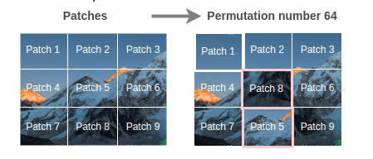
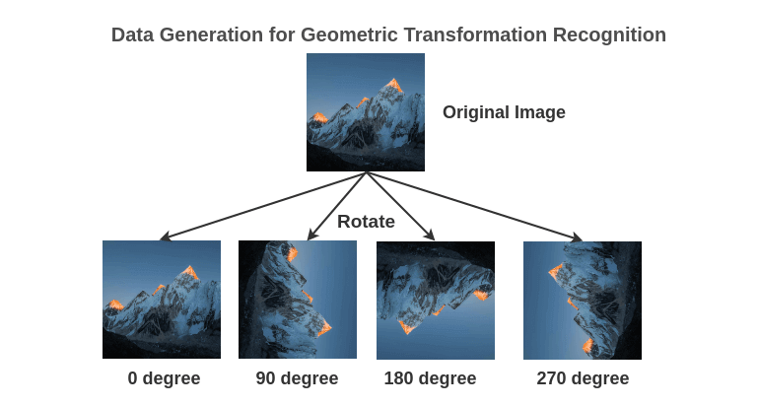
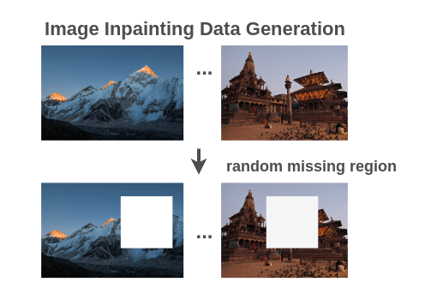
SSL for Vision

Slide 30
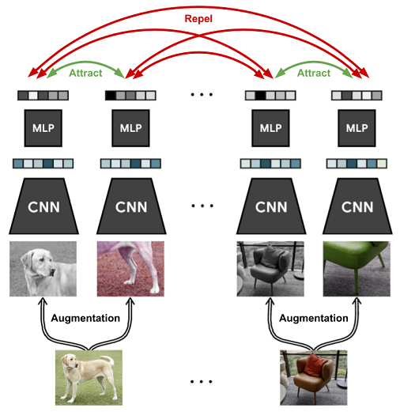
SimCLR
Figure taken from https://sh-tsang.medium.com/review-simclr-a-simple-framework-for-contrastive-learning-of-visual-representations-5de42ba0bc66
Chen, Ting, et al. "A simple framework for contrastive learning of visual representations." International conference on machine learning. PMLR, 2020.

Slide 31
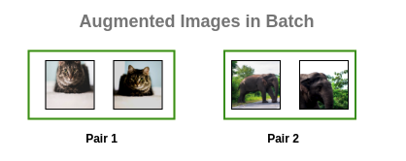
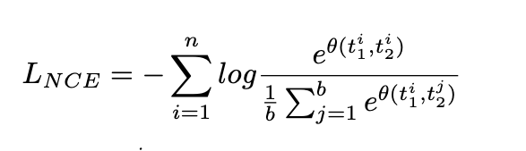
SimCLR (cont’d)
Notes:
noise contrastive estimation
What is this very similar with? (Word2vec)
why noise (because negative samples are somewhat of a noise)

Slide 32
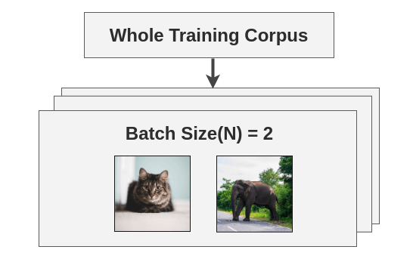
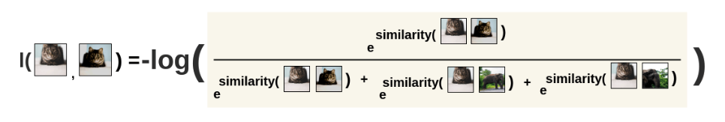
SimCLR (cont’d)

Slide 33
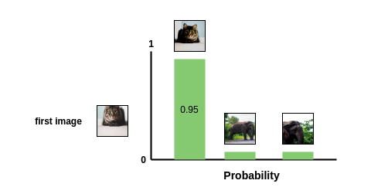
SimCLR (cont’d)
Figures taken from https://amitness.com/2020/03/illustrated-simclr/

Slide 34
The importance of Augmentations in SimCLR
What augmentations to use depends on the downstream task, and the dataset itself.
Let’s say you want to classify a data of apples of different colors.
Would you use color augmentation in this task?
Notes:
Augmentations are a way to inject inductive bias into the task.
Think of inductive bias as some domain knowledge

Slide 35
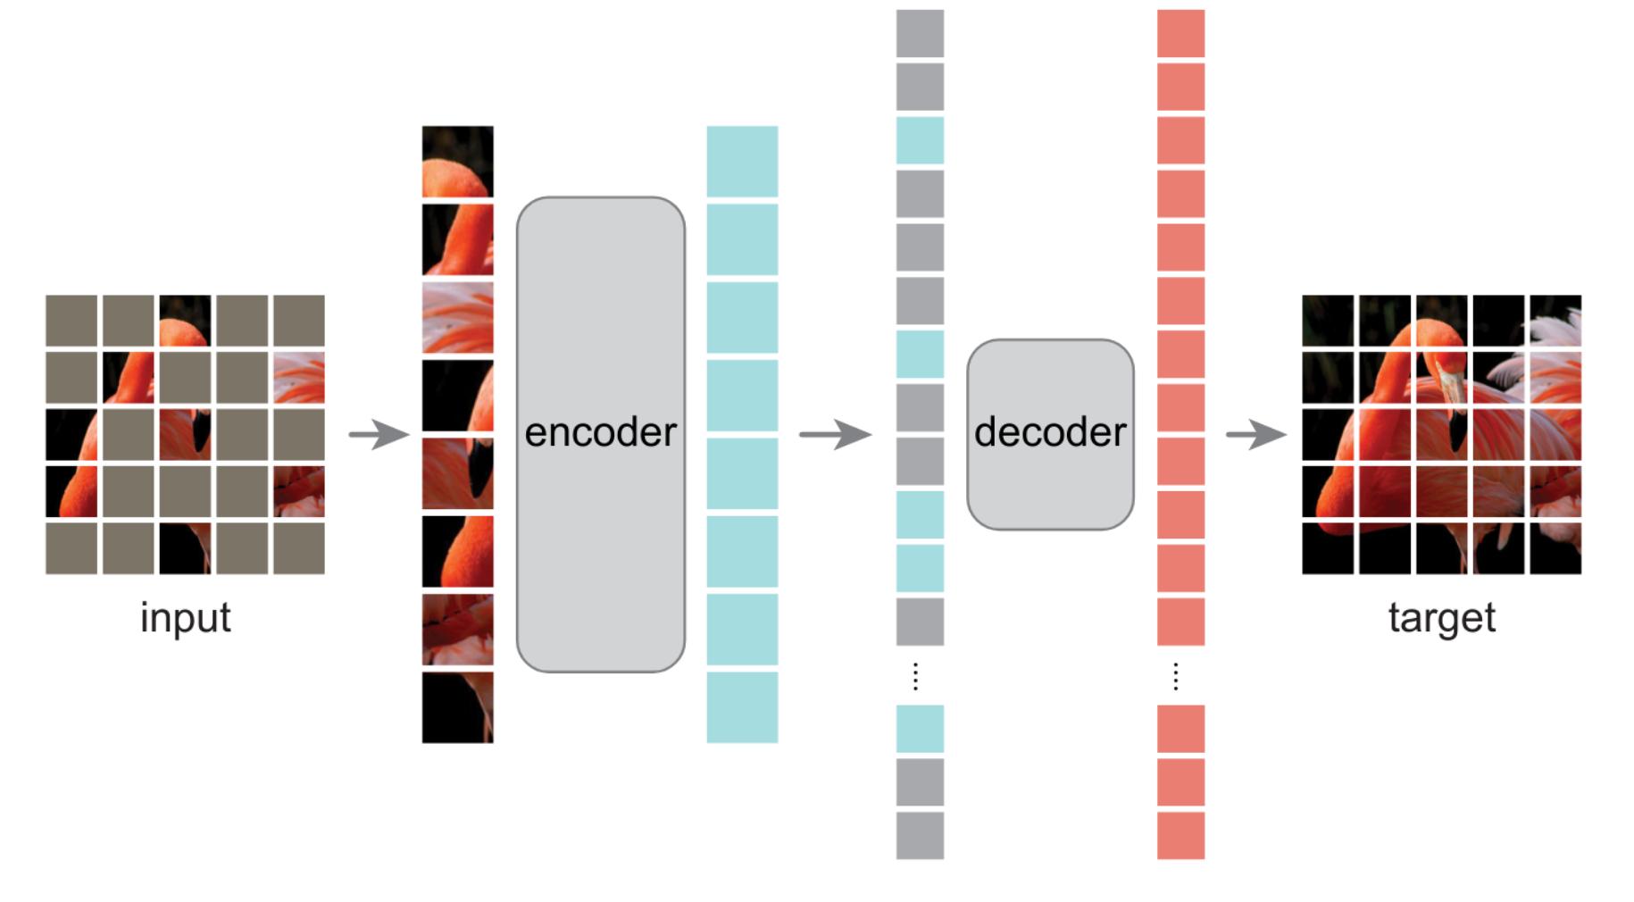
Masked Autoencoders
He, Kaiming, et al. "Masked autoencoders are scalable vision learners." Proceedings of the IEEE/CVF conference on computer vision and pattern recognition. 2022.

Slide 36
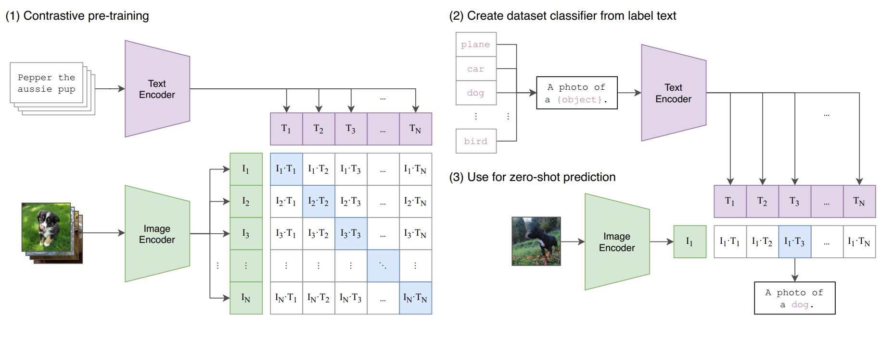
CLIP
Radford, Alec, et al. "Learning transferable visual models from natural language supervision." International conference on machine learning. PMLR, 2021.

