Slide 1
Computer Vision ECE/CSE 576 Filters Linda Shapiro Professor of Computer Science & Engineering Professor of Electrical & Computer Engineering

Slide 2
Let’s do something interesting already!!

Slide 3
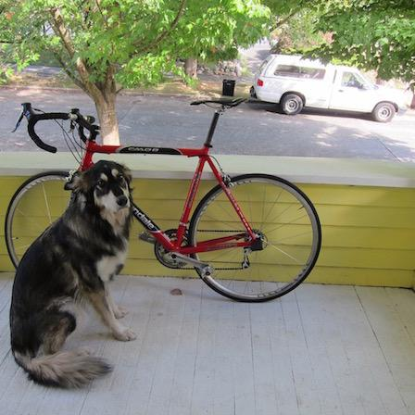
Want to make image smaller

Slide 4

448x448 -> 64x64

Slide 5
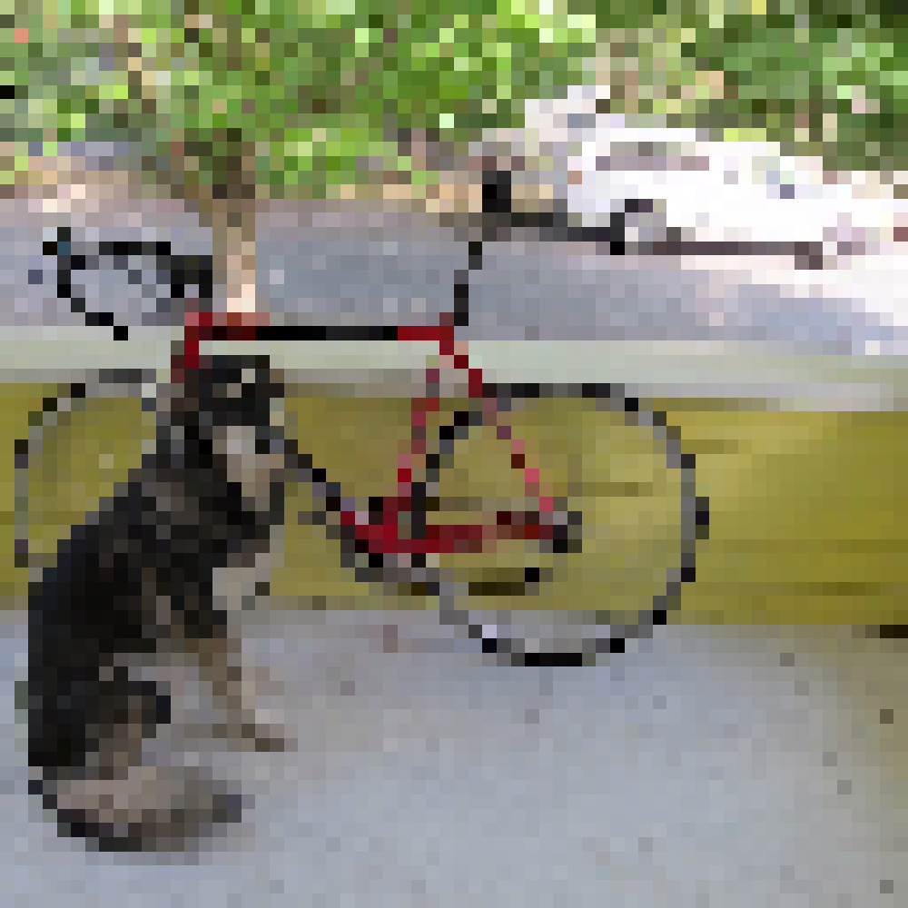
448x448 -> 64x64

Slide 6
448x448 -> 64x64

Slide 7

448x448 -> 64x64

Slide 8
448x448 -> 64x64

Slide 9
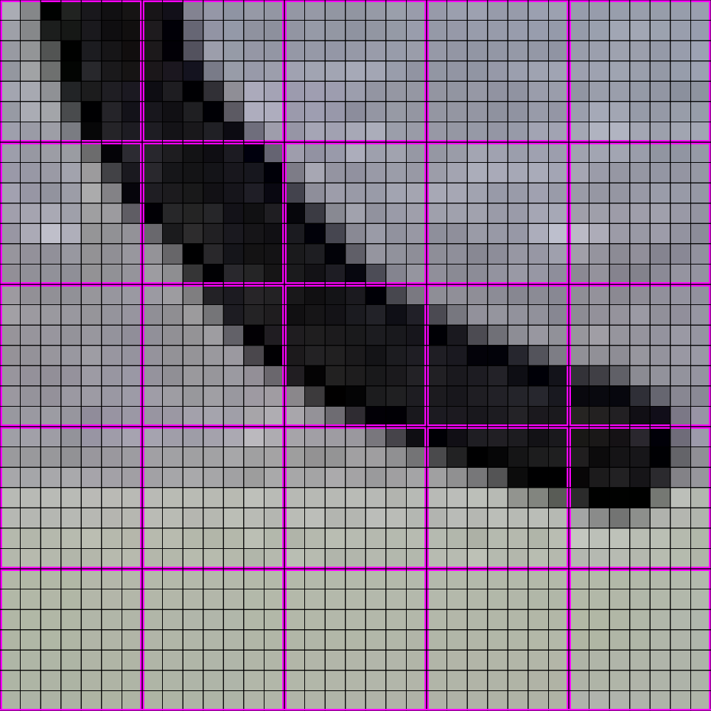
448x448 -> 64x64

Slide 10

448x448 -> 64x64

Slide 11
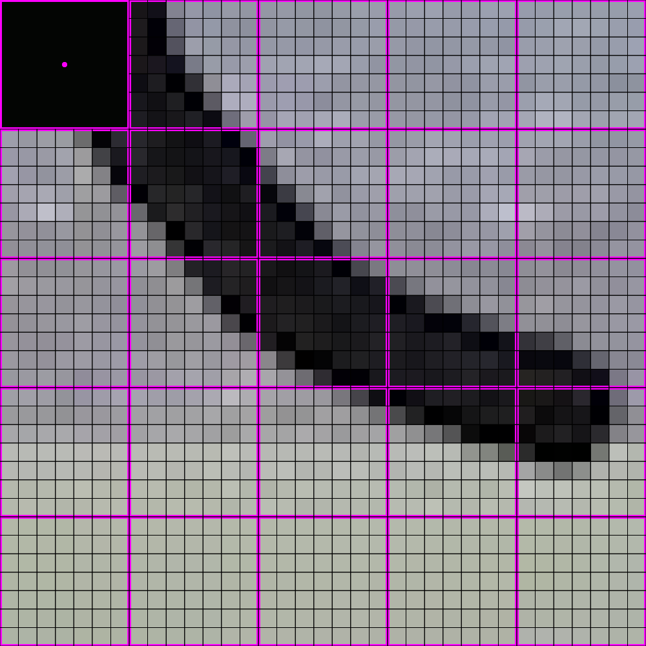
448x448 -> 64x64

Slide 12

448x448 -> 64x64

Slide 13
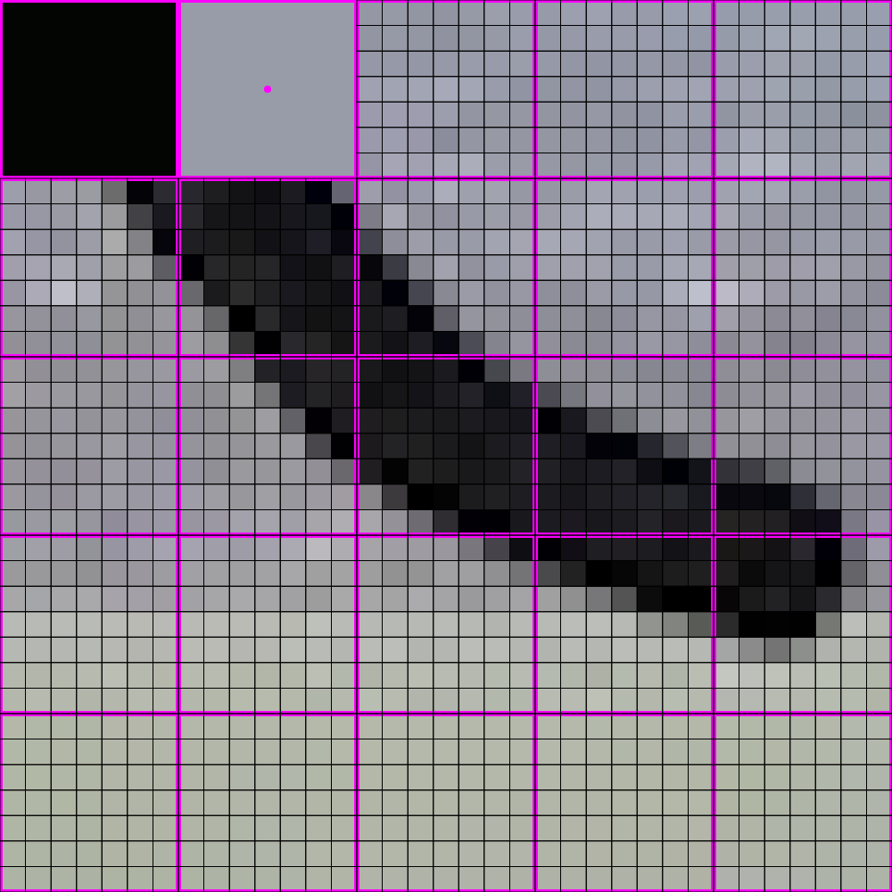
448x448 -> 64x64

Slide 14

448x448 -> 64x64

Slide 15
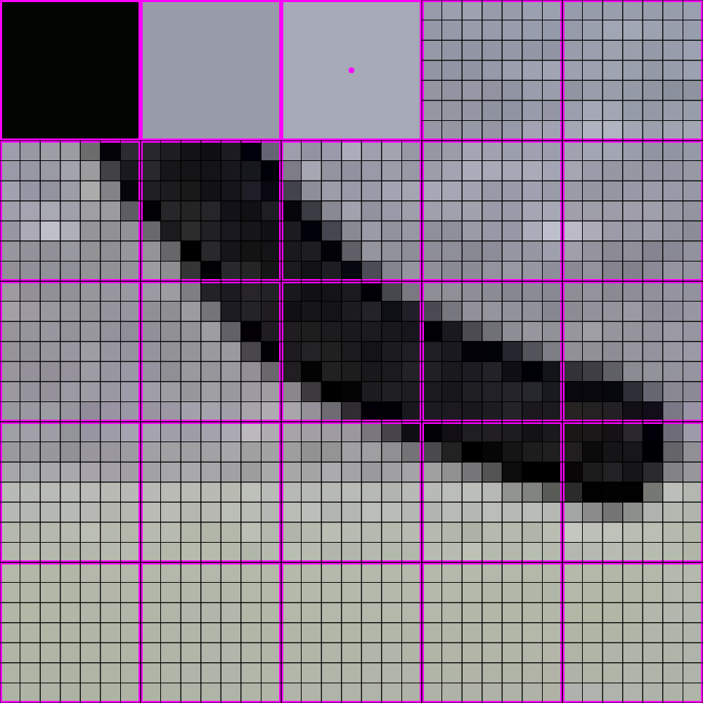
448x448 -> 64x64

Slide 16

448x448 -> 64x64

Slide 17
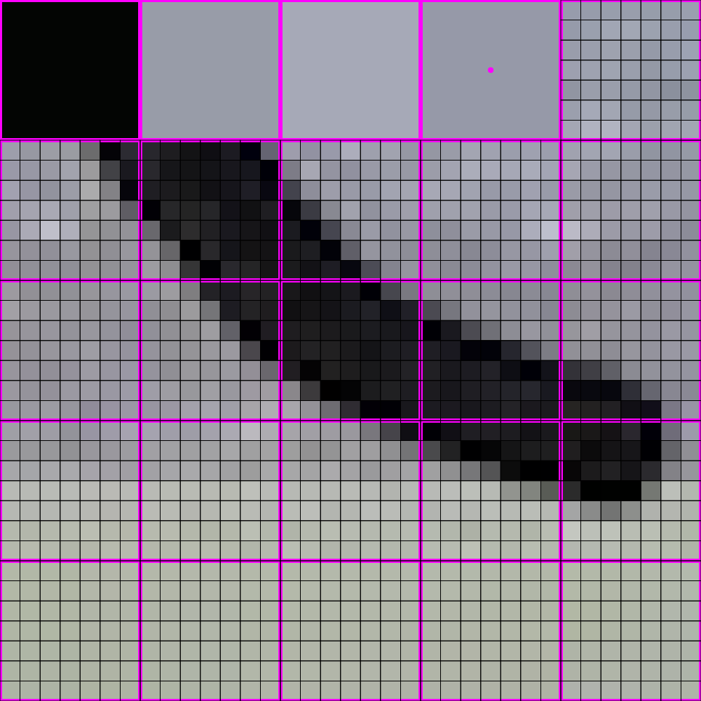
448x448 -> 64x64

Slide 18

448x448 -> 64x64

Slide 19
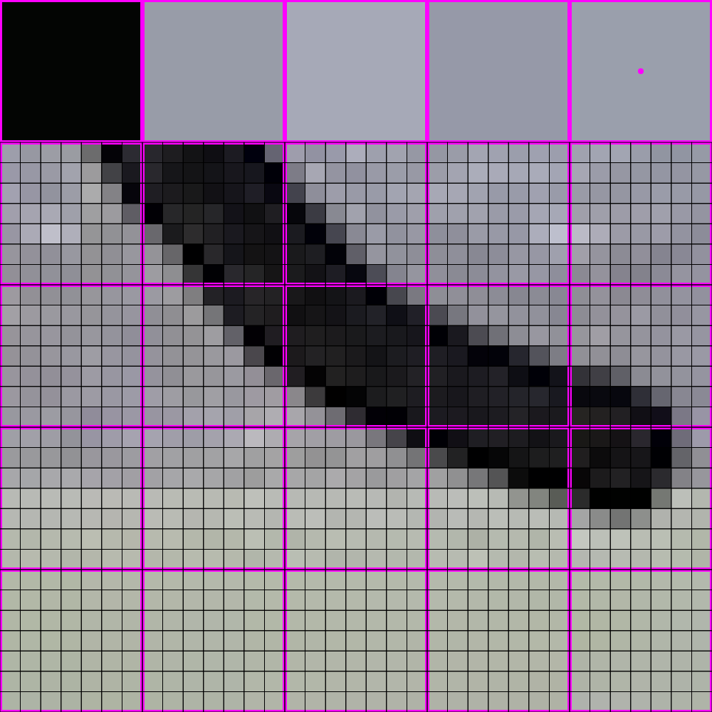
448x448 -> 64x64

Slide 20

448x448 -> 64x64

Slide 21
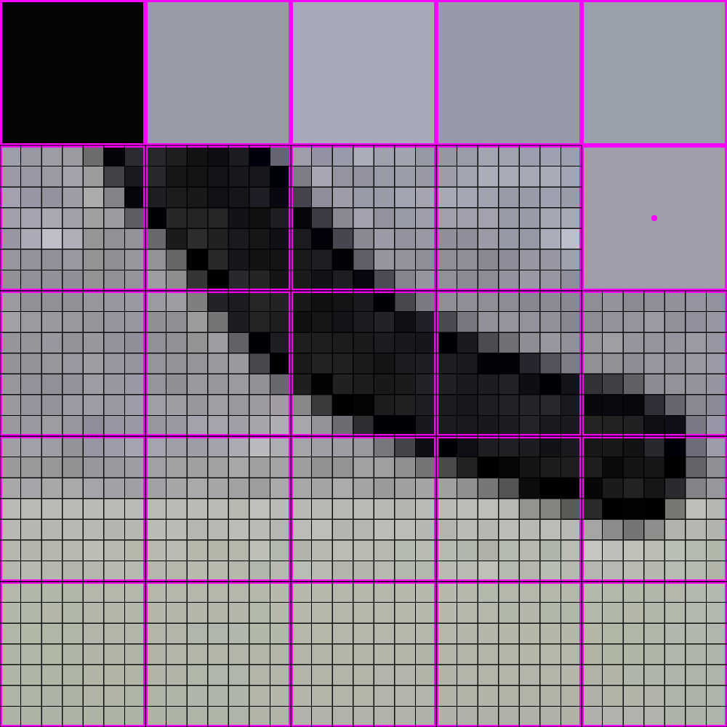
448x448 -> 64x64

Slide 22
448x448 -> 64x64

Slide 23

448x448 -> 64x64

Slide 24
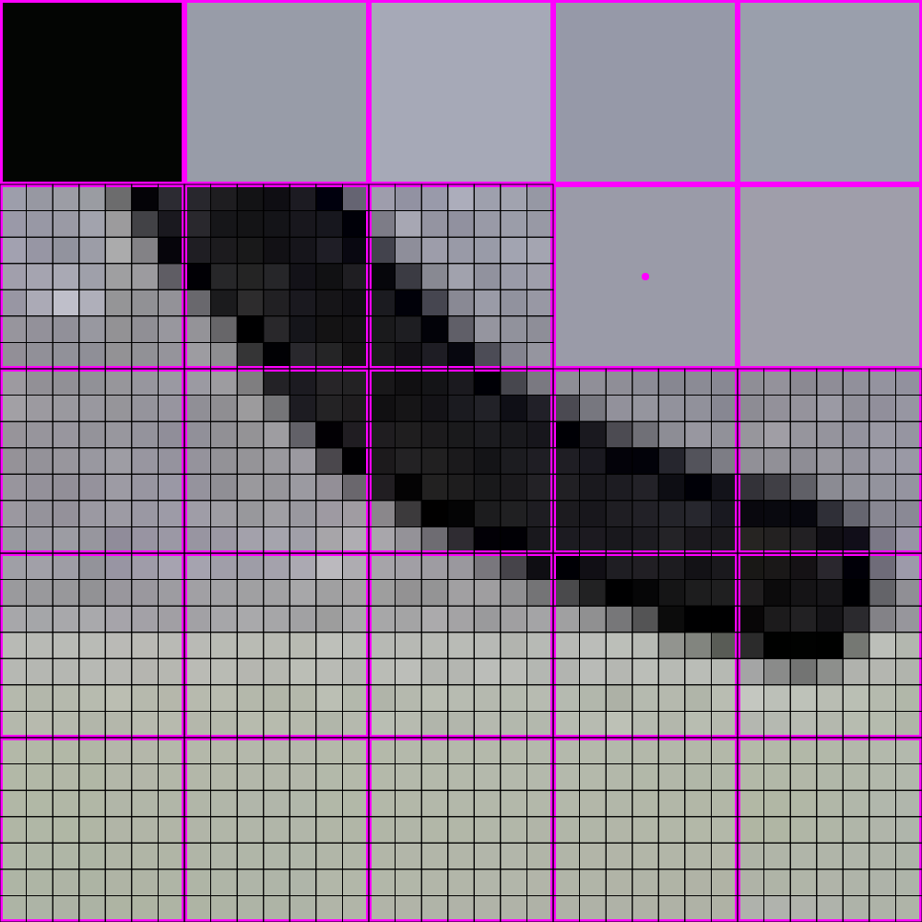
448x448 -> 64x64

Slide 25

448x448 -> 64x64

Slide 26
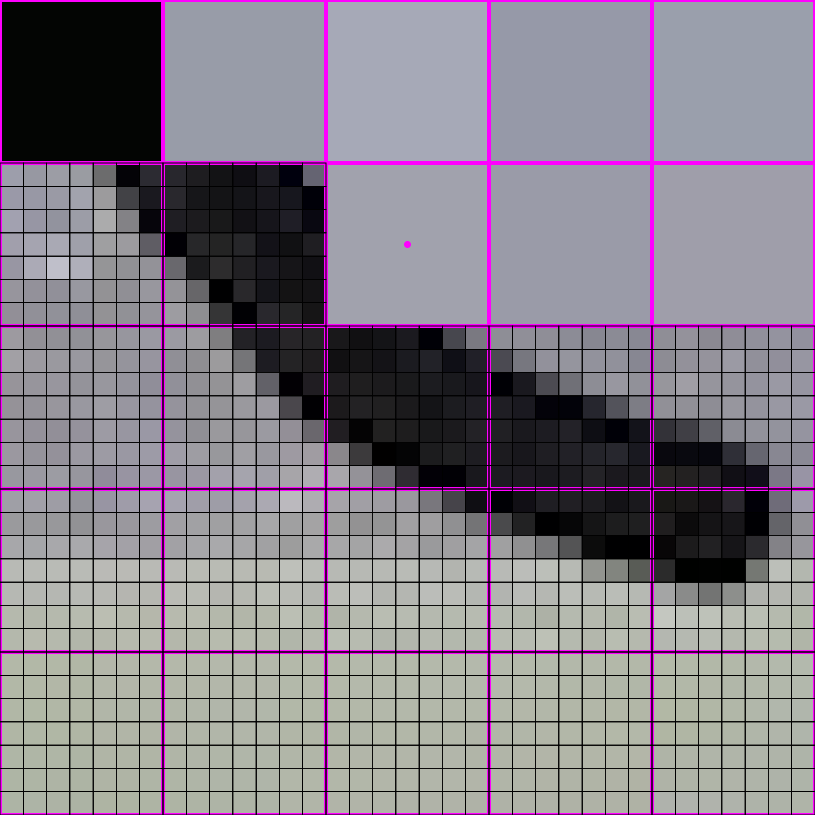
448x448 -> 64x64

Slide 27
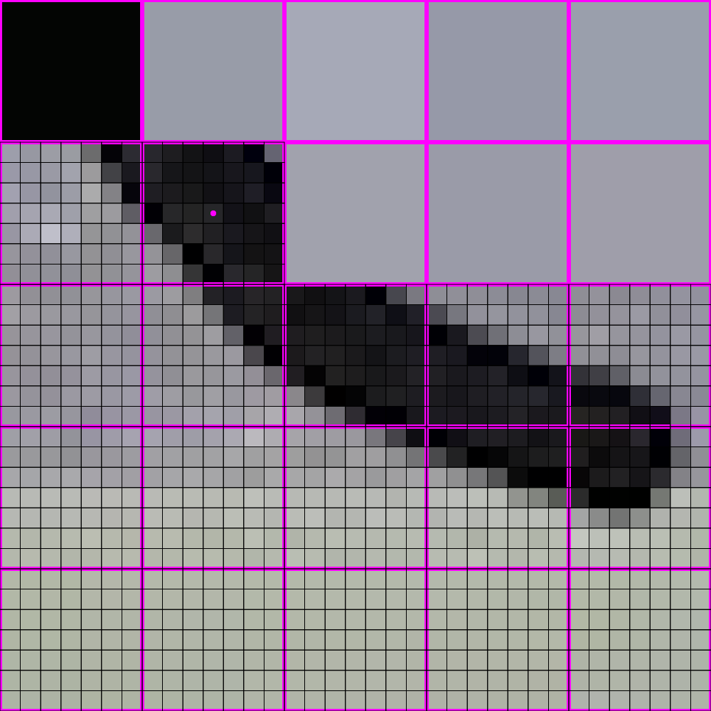
448x448 -> 64x64

Slide 28
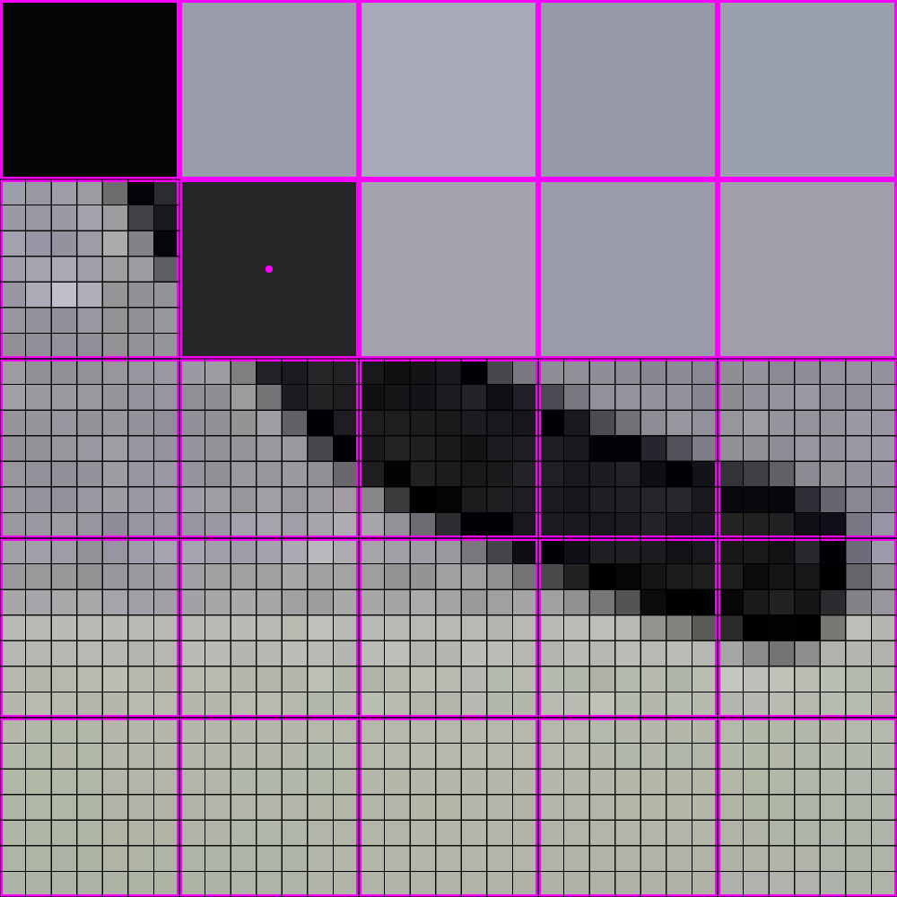
448x448 -> 64x64

Slide 29
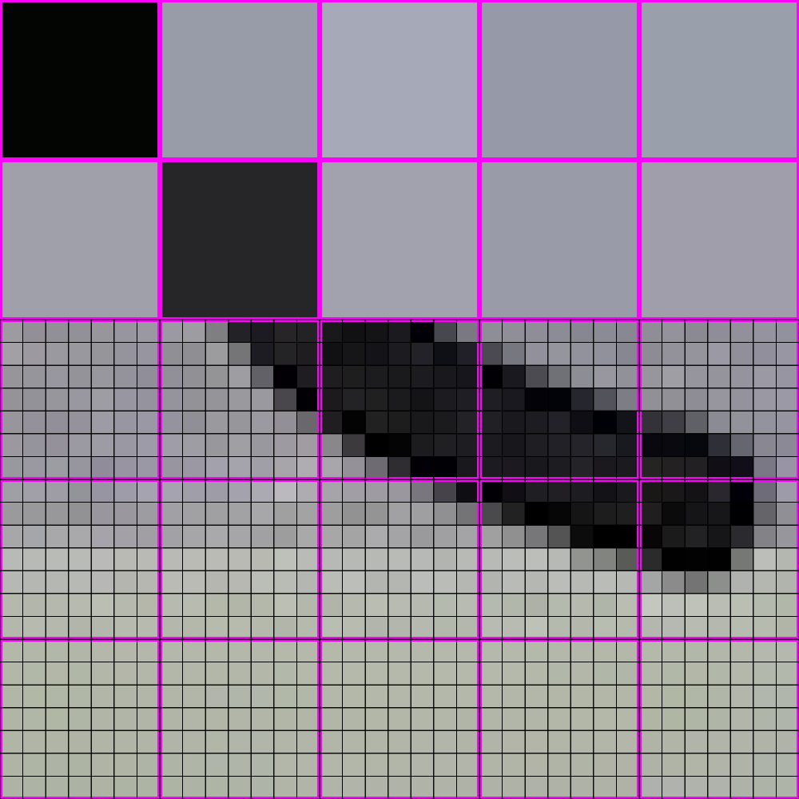
448x448 -> 64x64

Slide 30
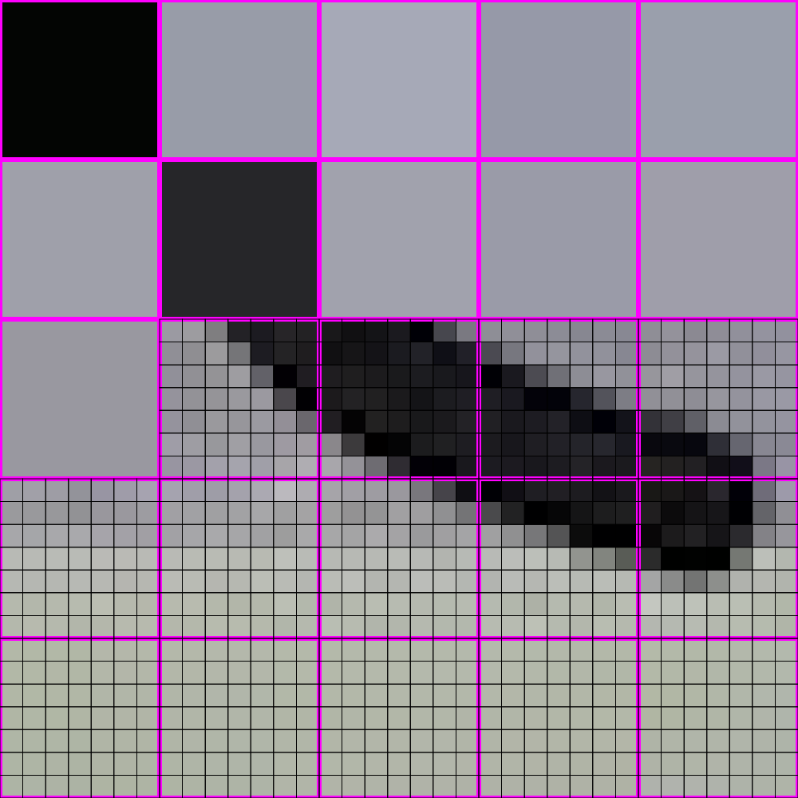
448x448 -> 64x64

Slide 31
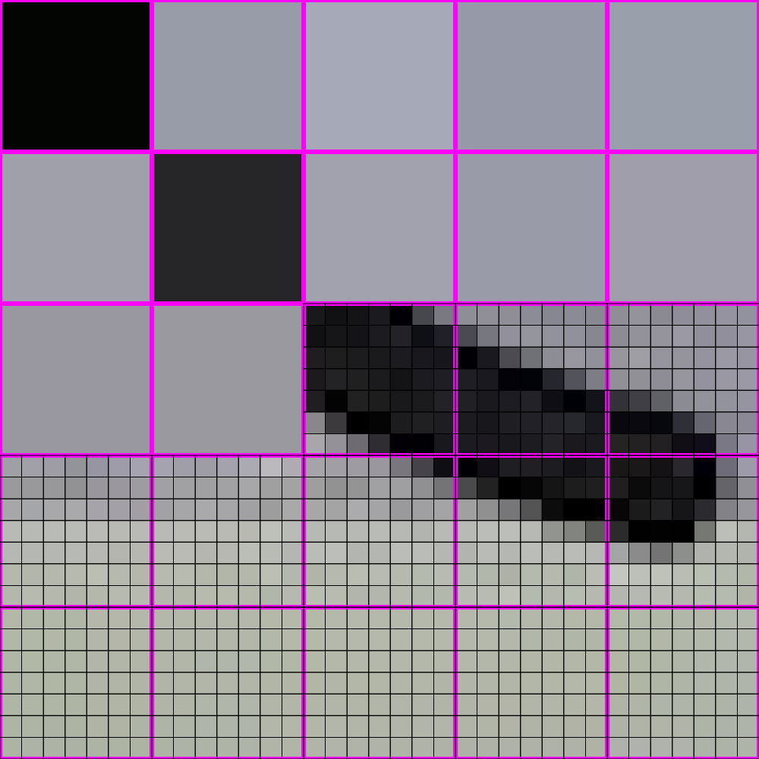
448x448 -> 64x64

Slide 32
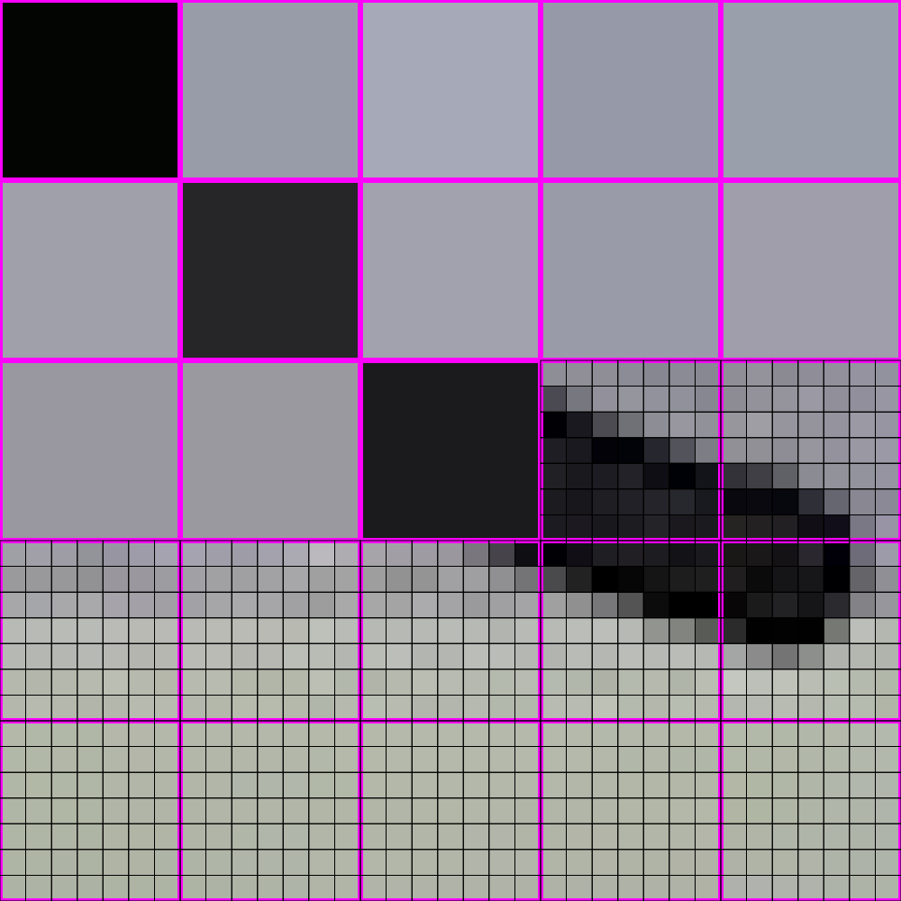
448x448 -> 64x64

Slide 33
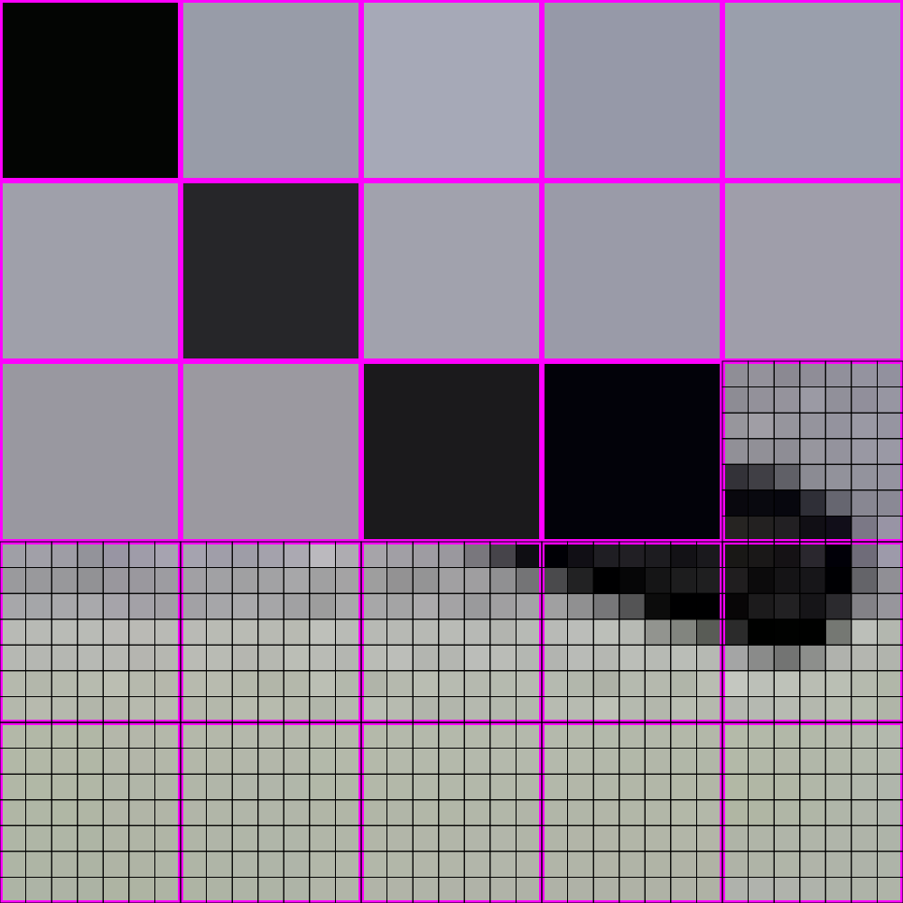
448x448 -> 64x64

Slide 34
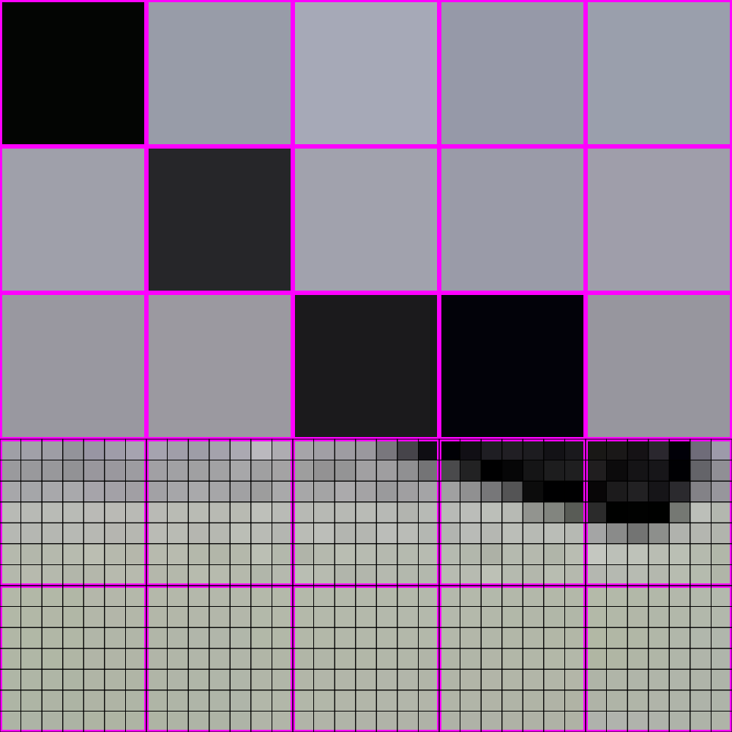
448x448 -> 64x64

Slide 35
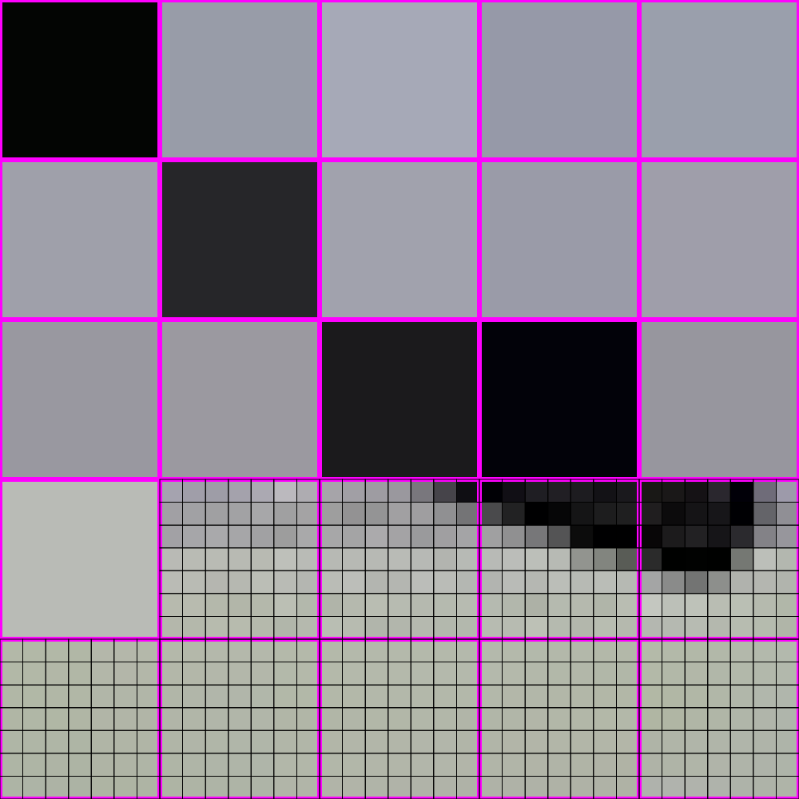
448x448 -> 64x64

Slide 36
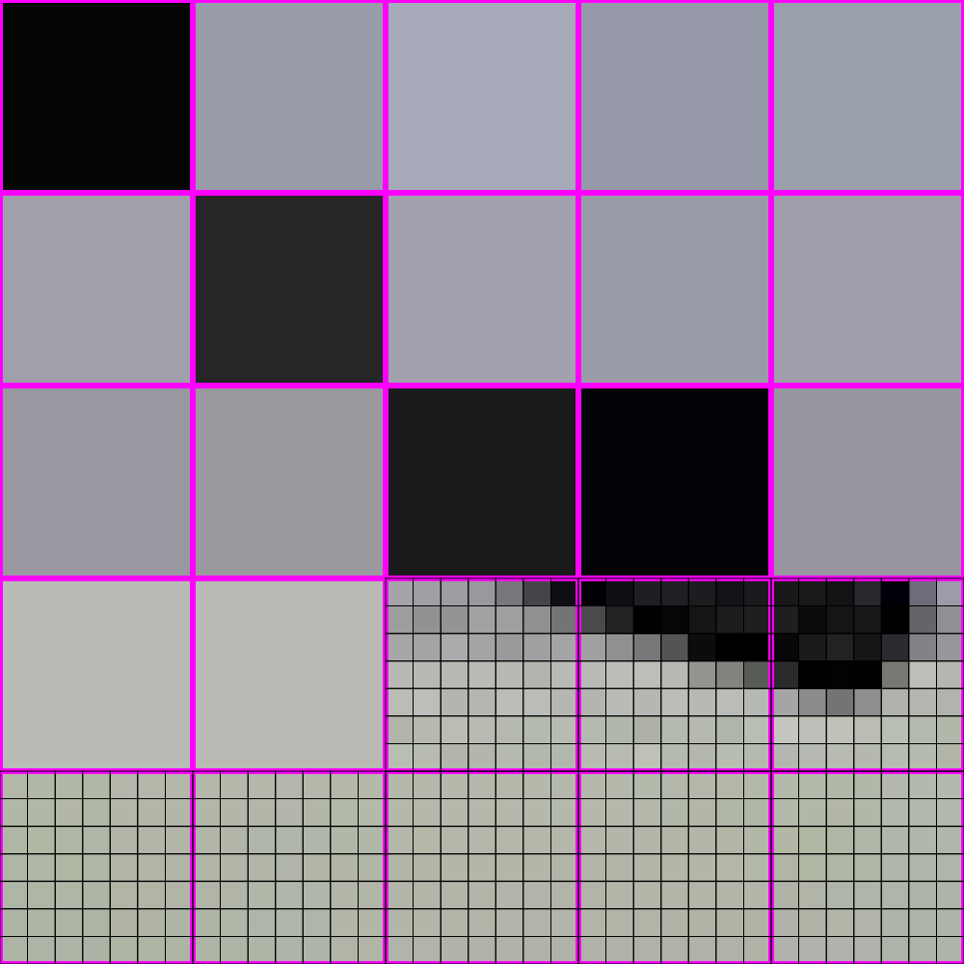
448x448 -> 64x64

Slide 37
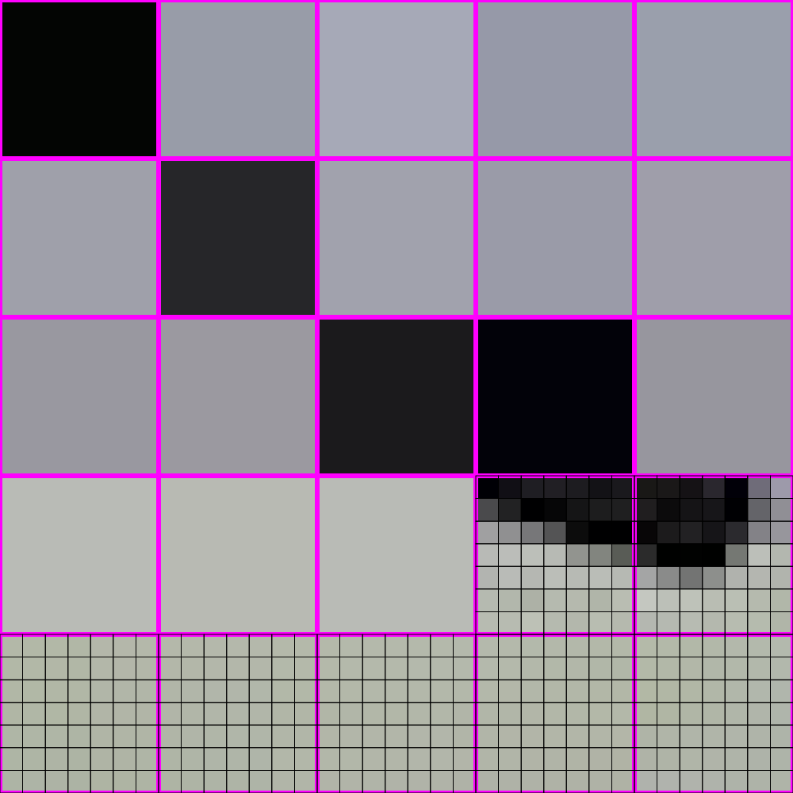
448x448 -> 64x64

Slide 38
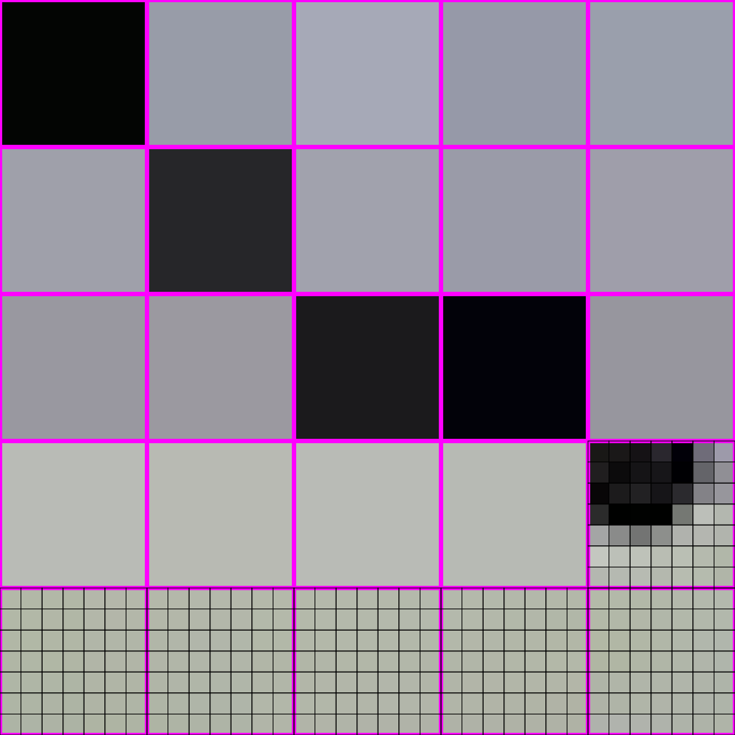
448x448 -> 64x64

Slide 39
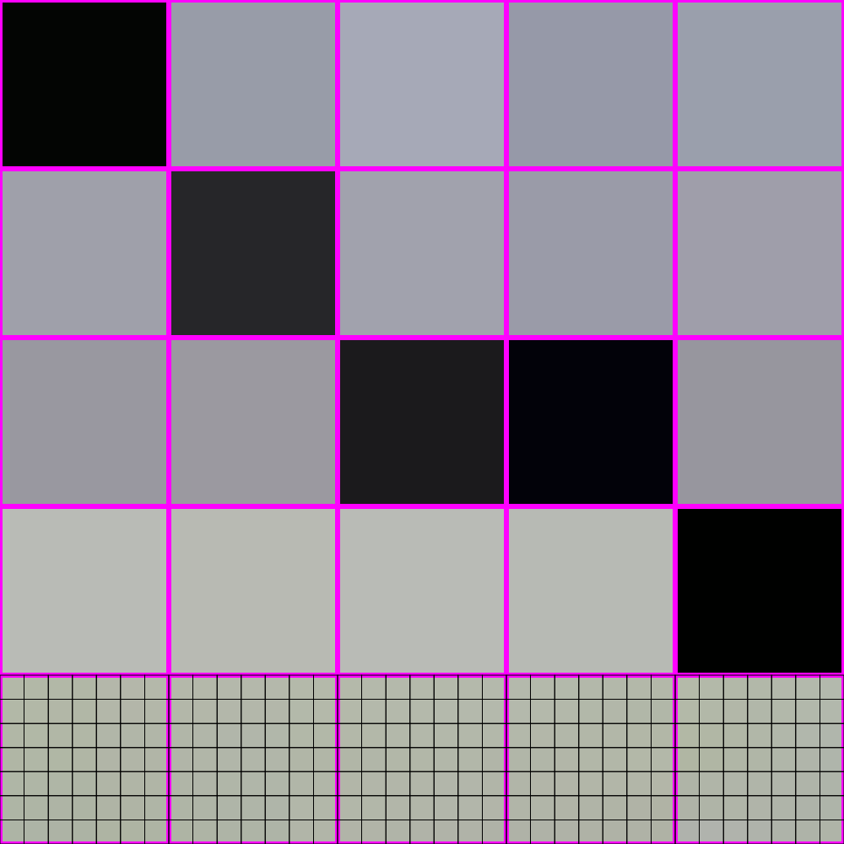
448x448 -> 64x64

Slide 40
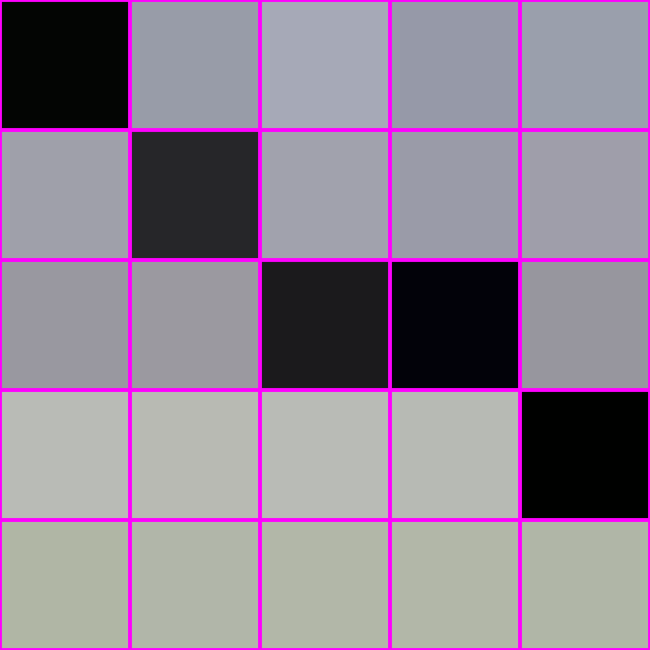
448x448 -> 64x64

Slide 41
448x448 -> 64x64

Slide 42
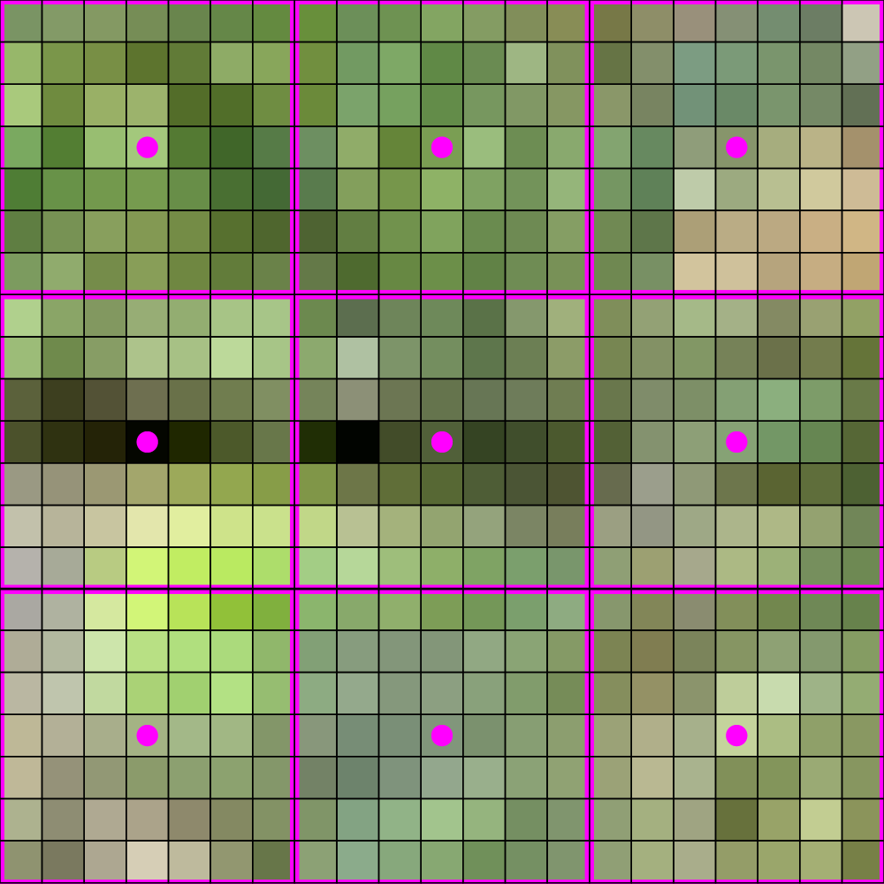
448x448 -> 64x64

Slide 43
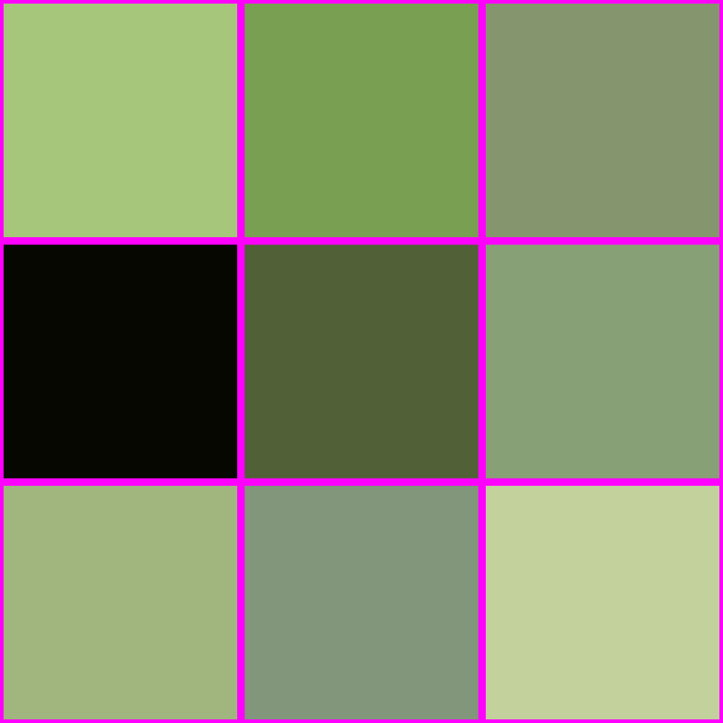
448x448 -> 64x64

Slide 44
IS THIS ALL THERE IS??

Slide 45

THERE IS A BETTER WAY!

Slide 46

LOOK AT HOW MUCH BETTER

Slide 47
How do?

Slide 48
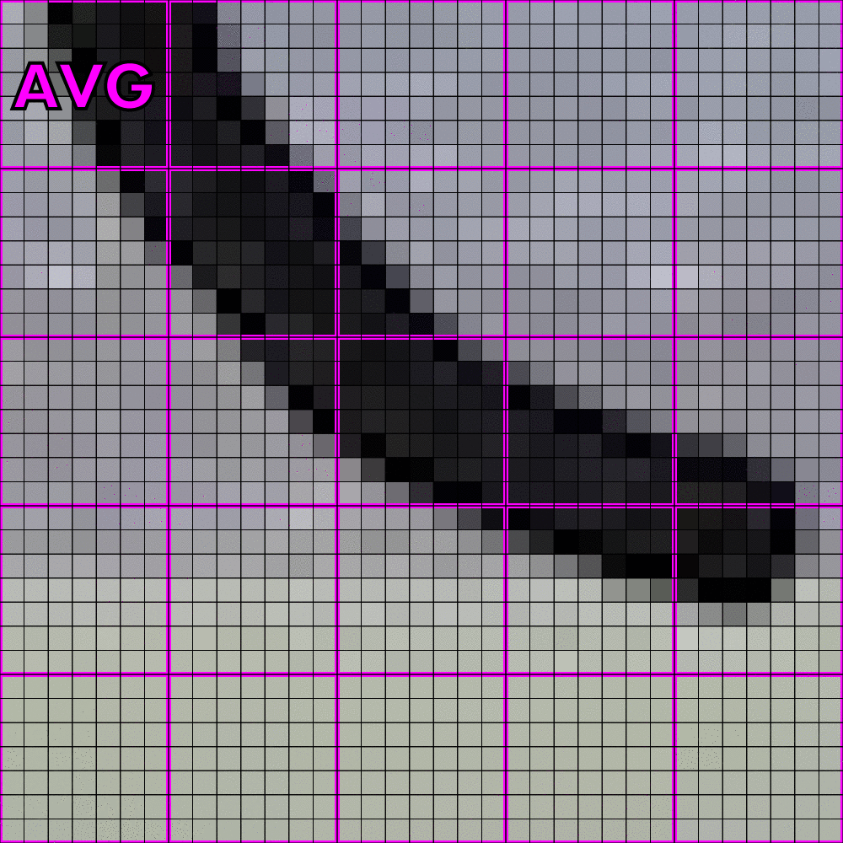
How do? Averaging!

Slide 49

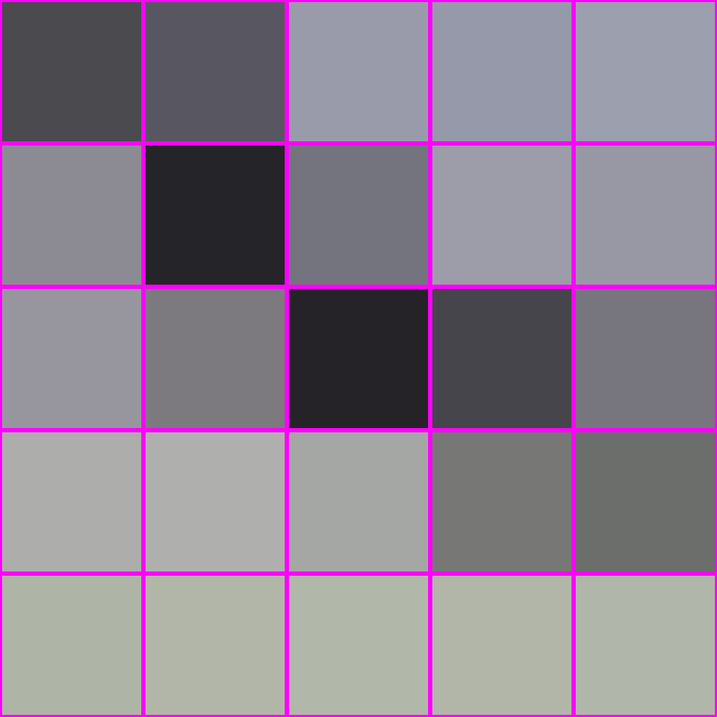
How do? Averaging!
“interpolation”
averaging
X

Slide 50

What is averaging?

Slide 51

What is averaging? A weighted sum

Slide 52
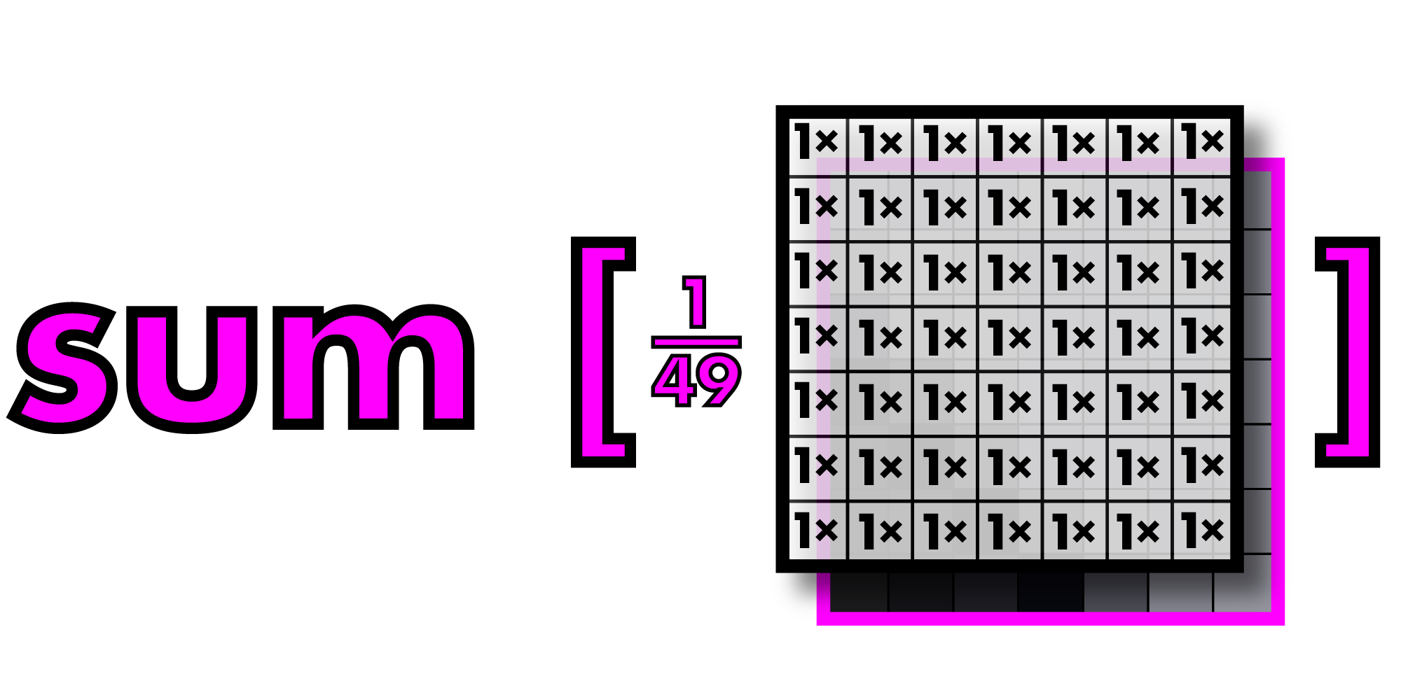
What is averaging? A weighted sum

Slide 53
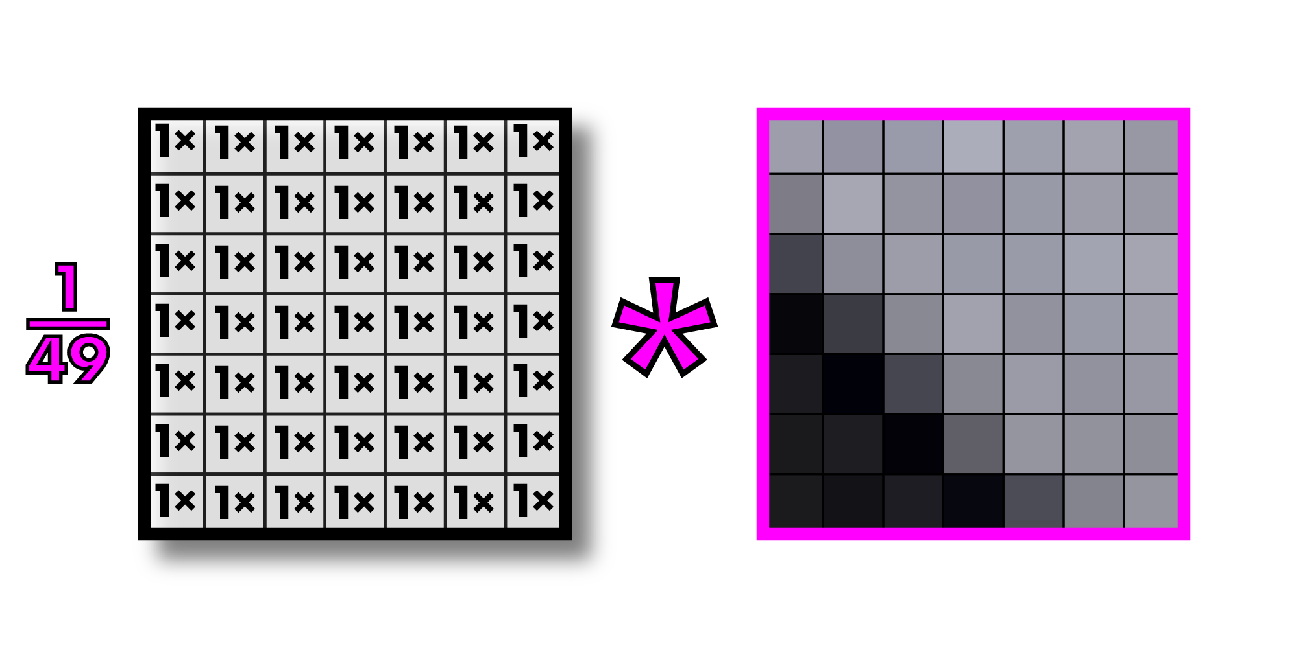
Call this operation “convolution”
Filter or kernel
Note: multiplying an image section by a filter is actually called “correlation” and convolution
Involves inverting the filter first, but since our filters are generally symmetric, we call
Everything convolution. This is what all computer vision people do.

Slide 54
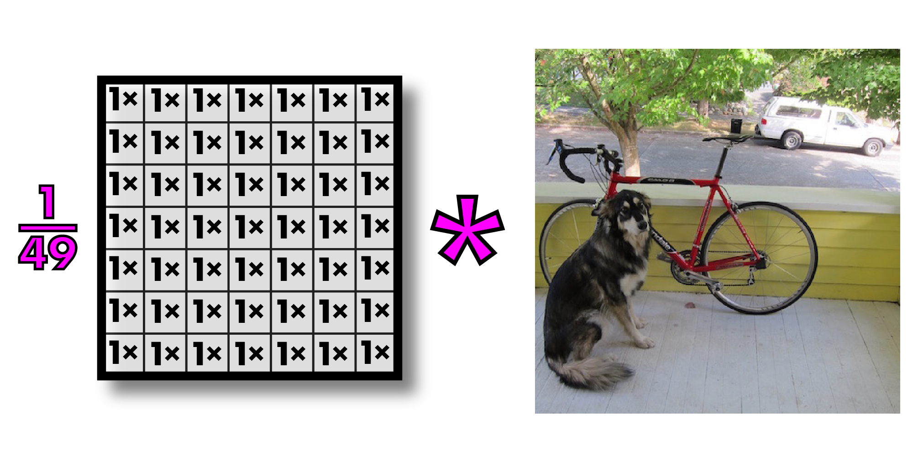
Convolutions on larger images

Slide 55
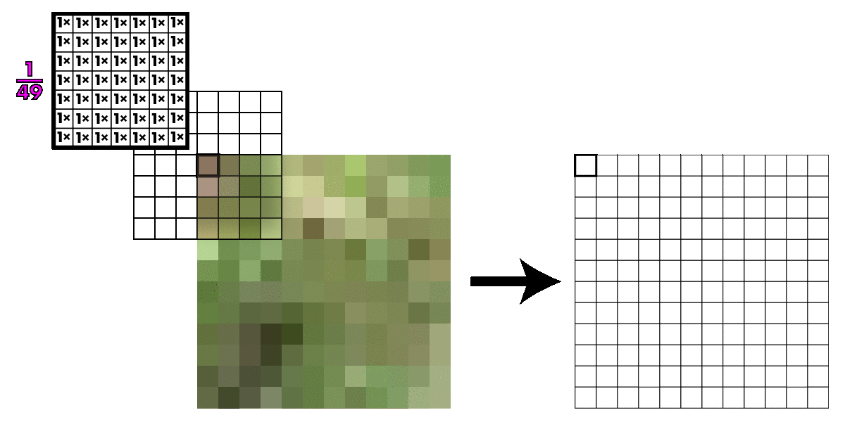
Kernel slides across image

Slide 56
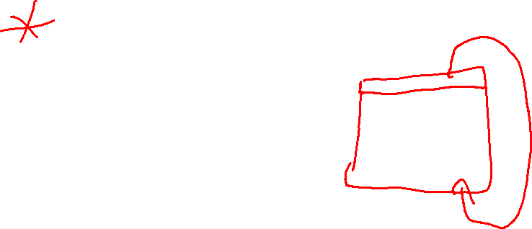
Kernel slides across image
What happens at the edges of the images?
Zero padding: easiest but can give bad results
Duplicate the outermost row or column
Use wraparound

Slide 57

Convolutions on larger images

Slide 58
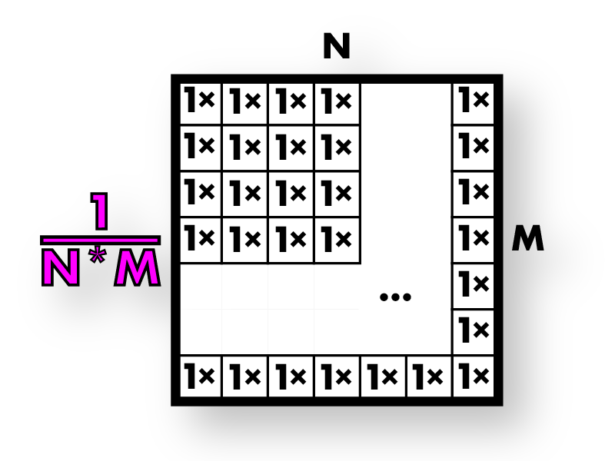
This is called box filter
Box filters

Slide 59
Box filters smooth image
Box filters

Slide 60
Box filters smooth image
Box filters

Slide 61
Now we resize our smoothed image

Slide 62
So much better!

Slide 63
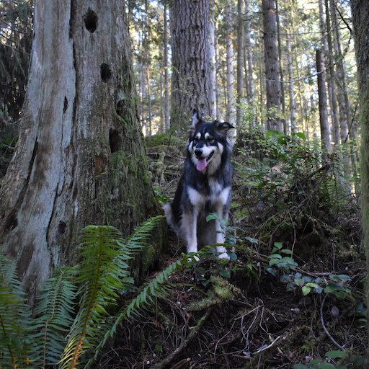

Box filters have artifacts

Slide 64

Box filters have artifacts

Slide 65
Box filters: vertical + horizontal streaking

Slide 66
Box filters: vertical + horizontal streaking

Slide 67
Box filters: vertical + horizontal streaking

Slide 68
Box filters: vertical + horizontal streaking

Slide 69
We want a smoothly weighted kernel

Slide 70
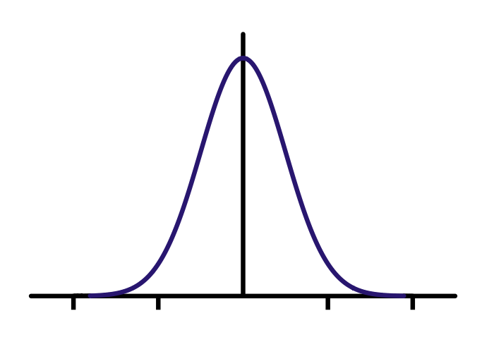

Gaussians

Slide 71

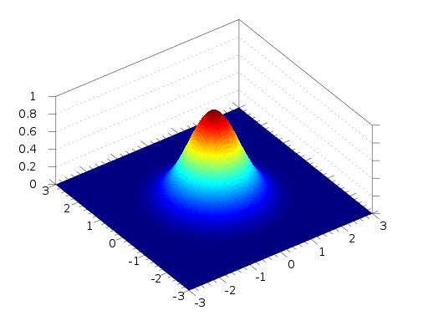
2d Gaussian

Slide 72

Better smoothing with Gaussians
=
*

Slide 73
Better smoothing with Gaussians

Slide 74

Better smoothing with Gaussians
Box Filtered Gaussian Filtered

Slide 75
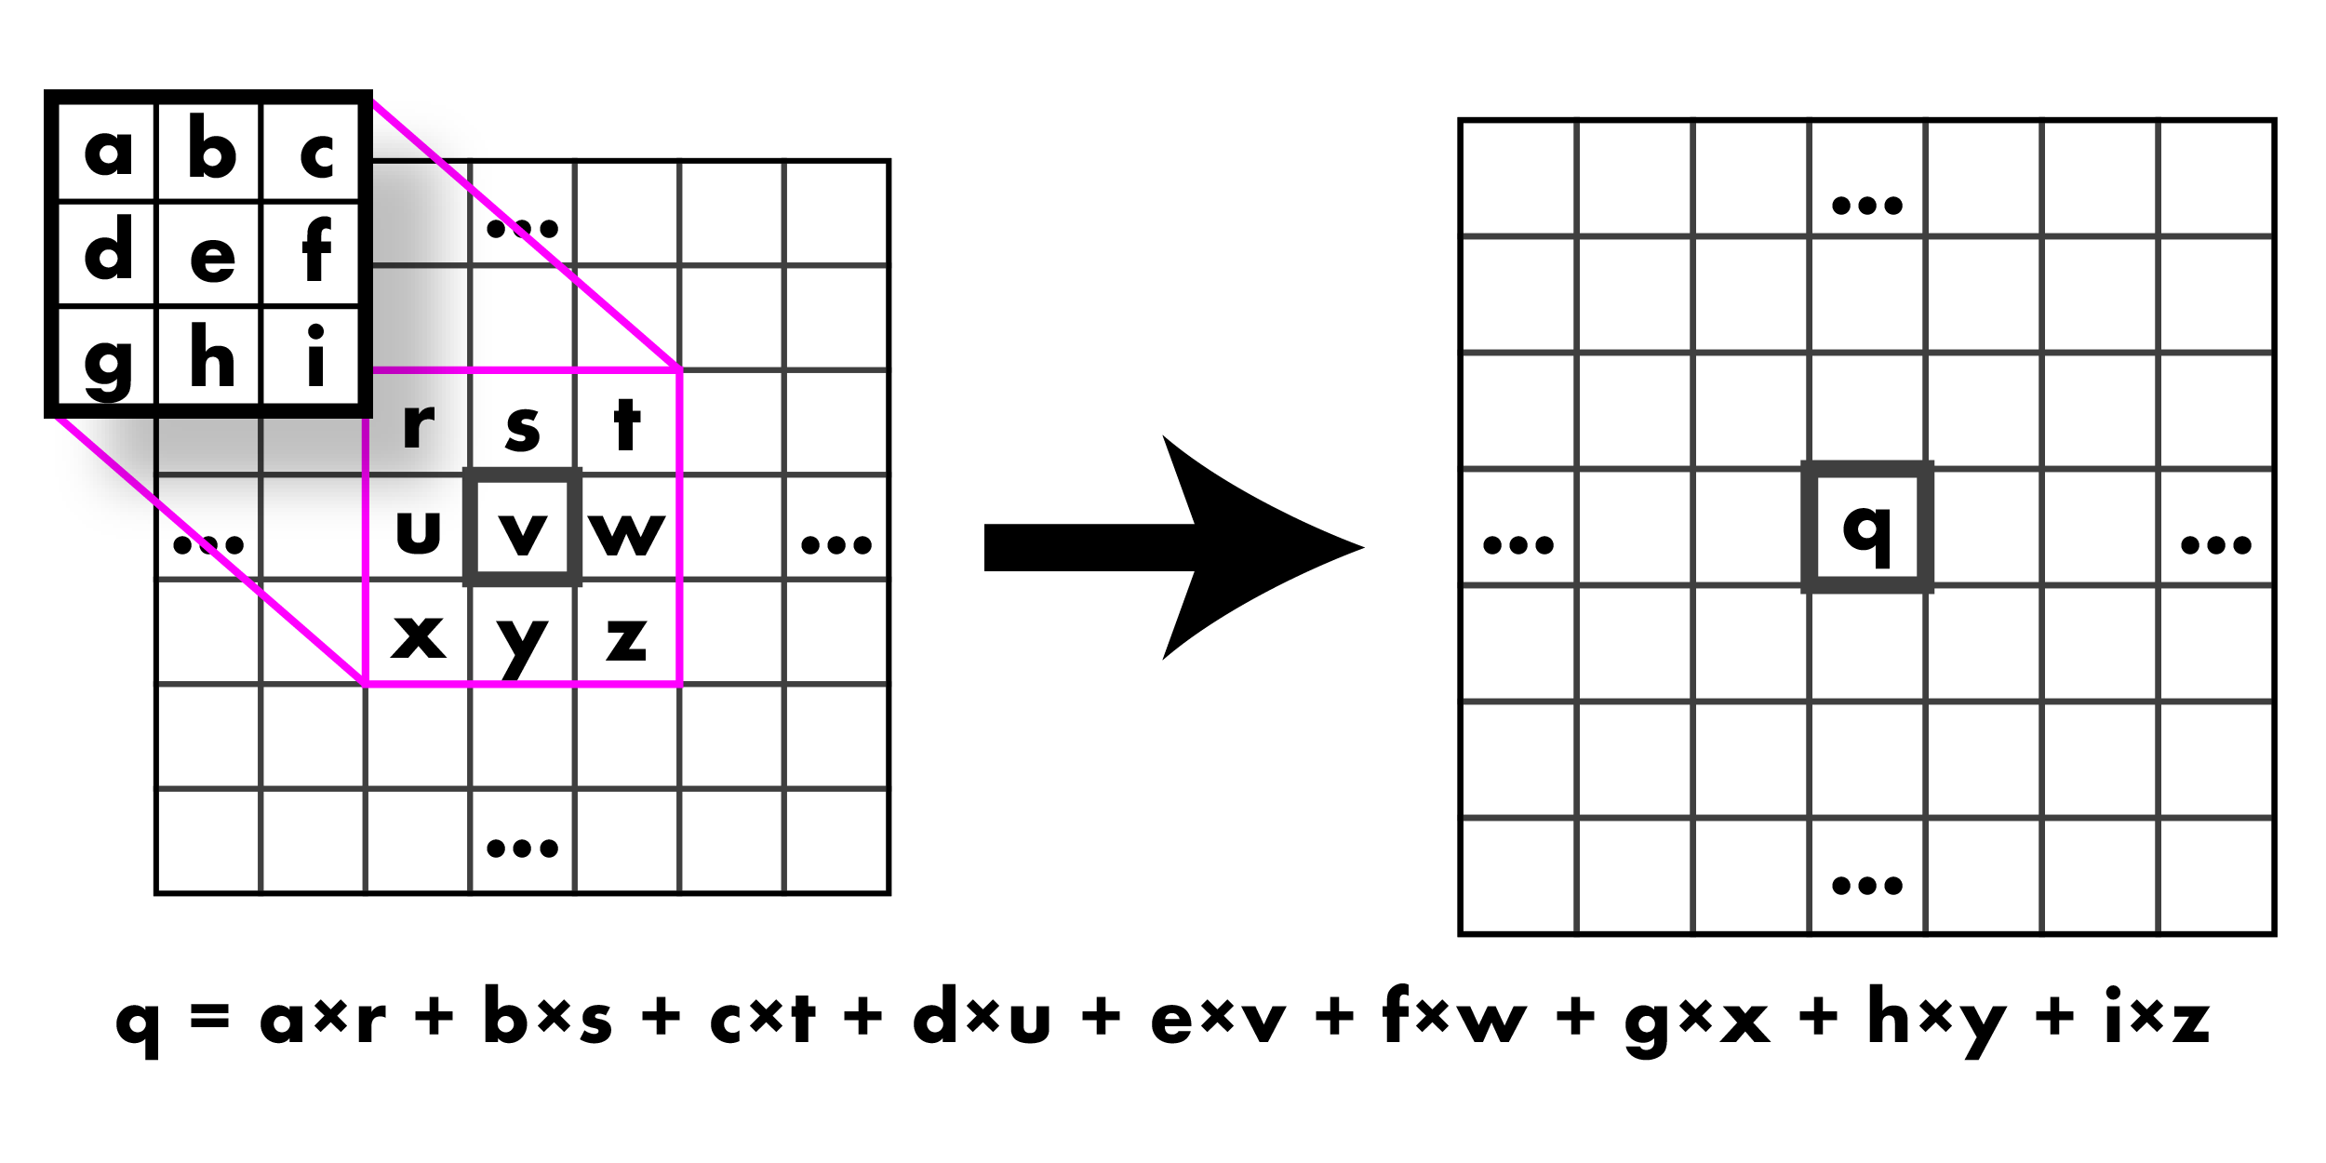
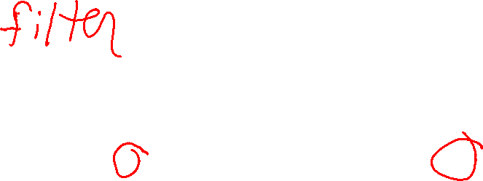
Wow, so what was that convolution thing??

Slide 76
Wow, so what was that convolution thing??

Slide 77
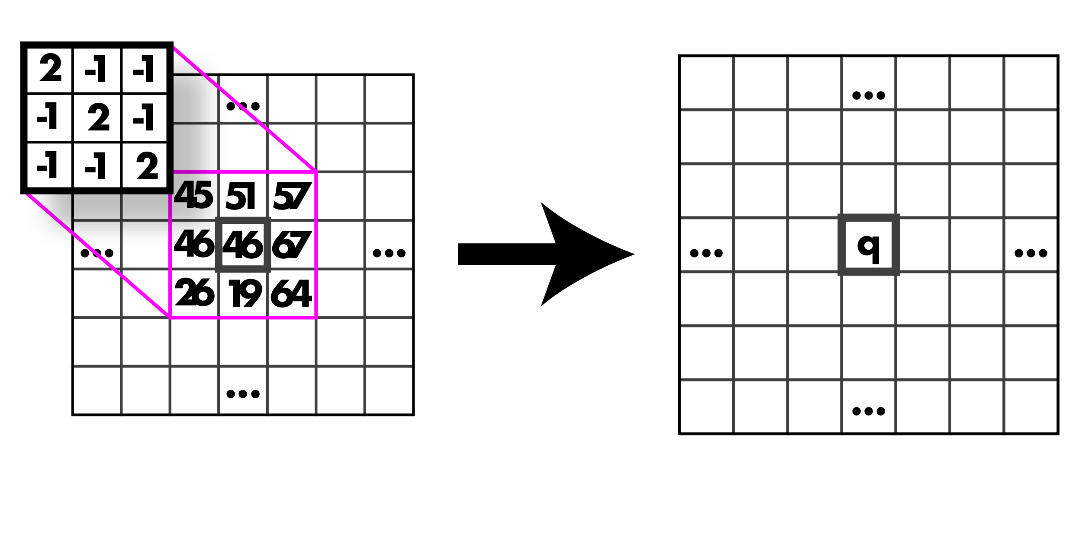
Calculate it, go!

Slide 78
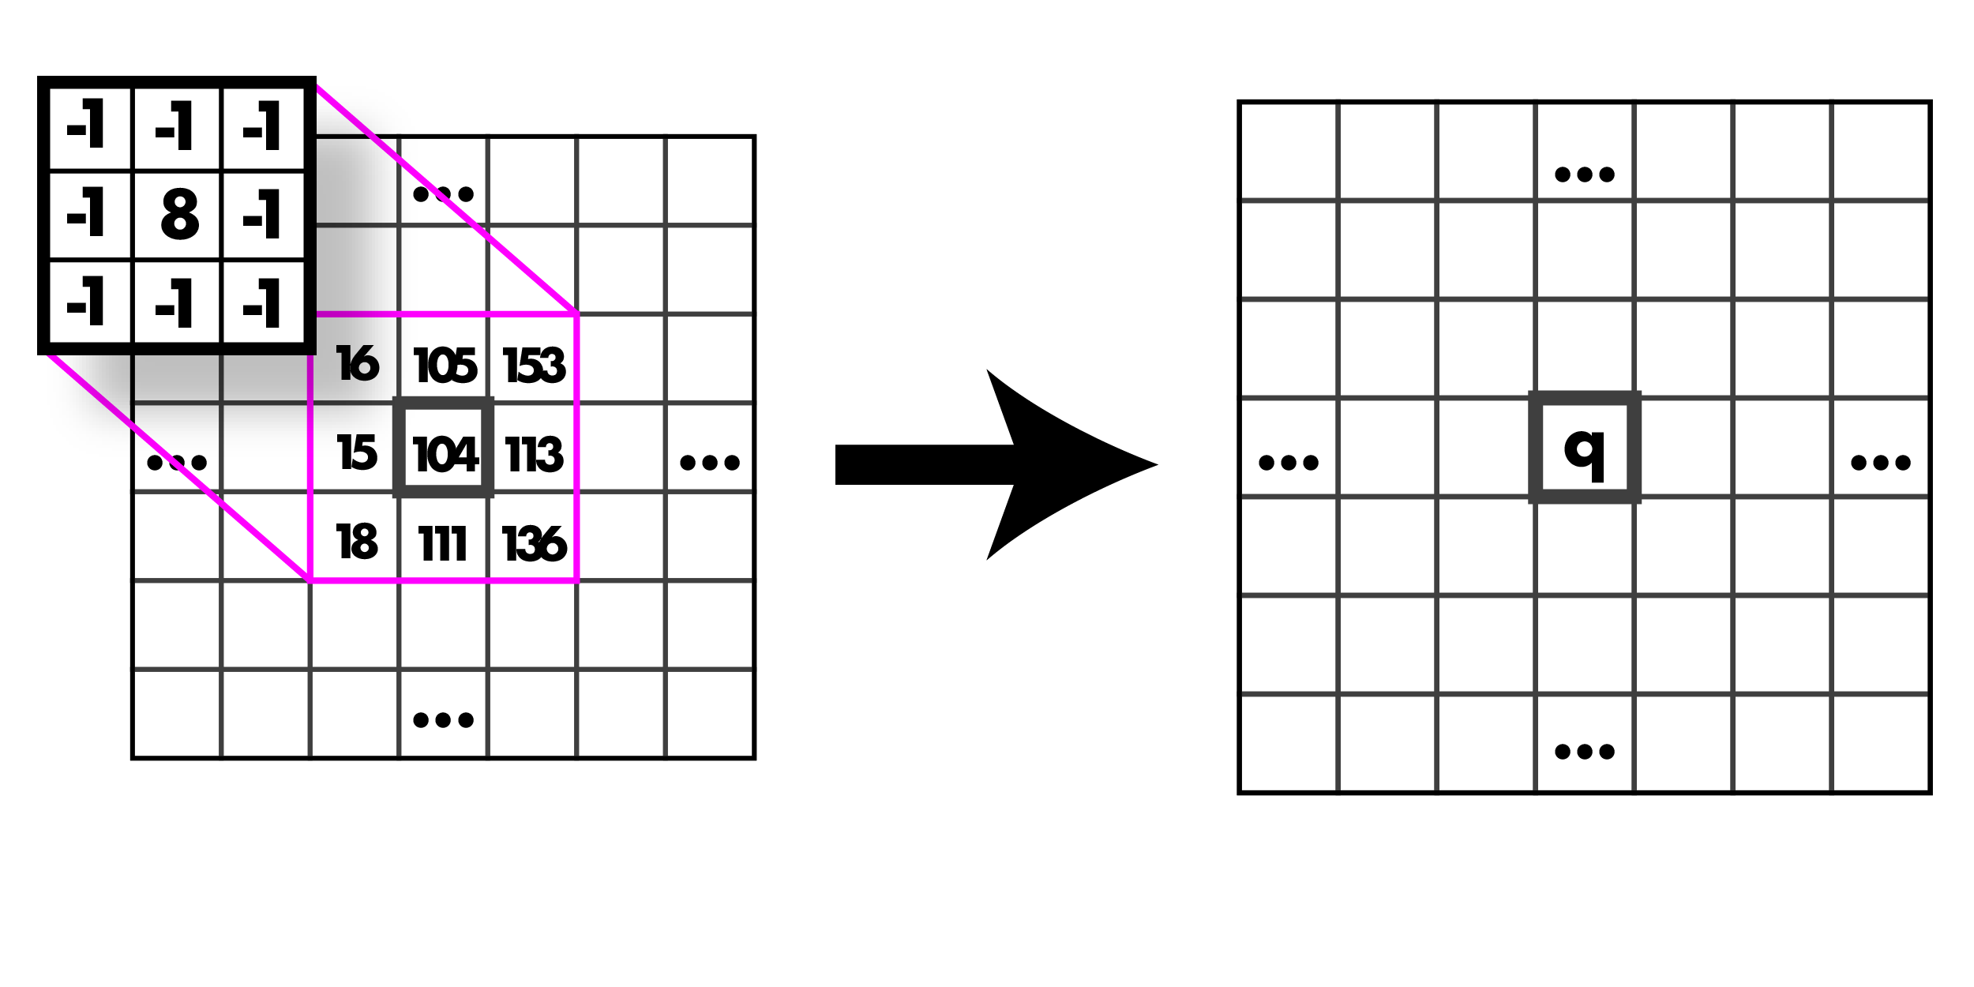
Calculate it, go!

Slide 79
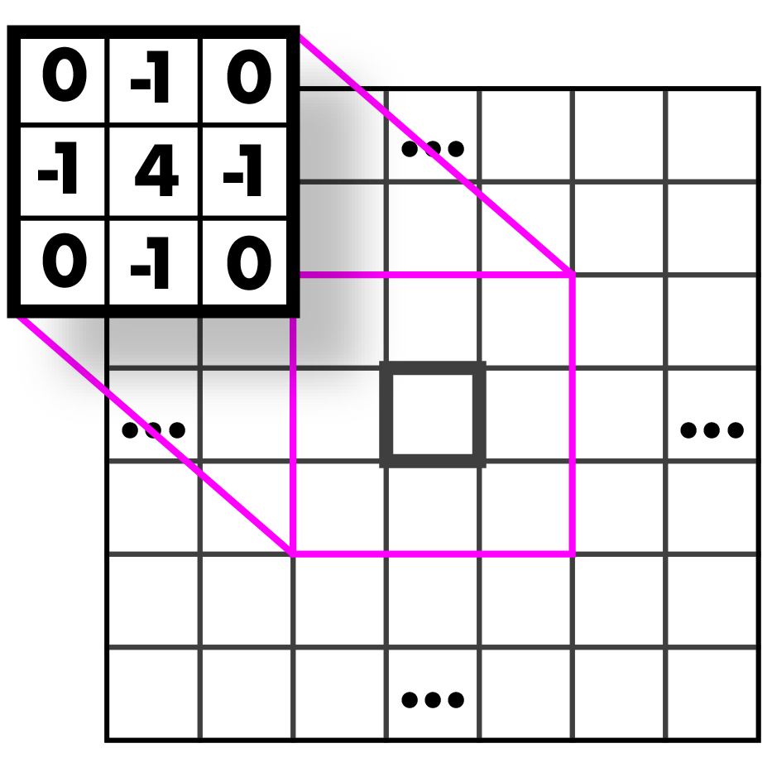
Guess that kernel!

Slide 80
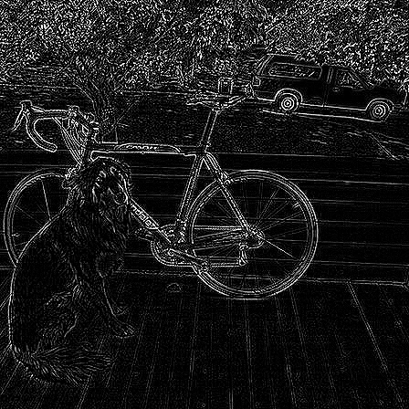
Highpass Kernel: finds edges (applied to the graytone image!)

Slide 81
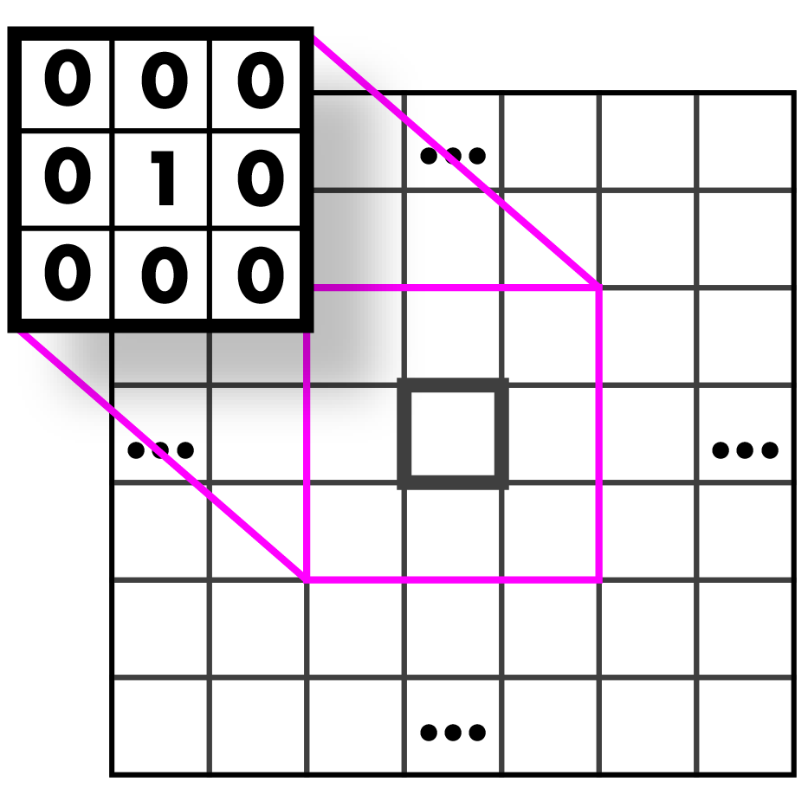
Guess that kernel!

Slide 82
Identity Kernel: Does nothing!

Slide 83

Guess that kernel!

Slide 84
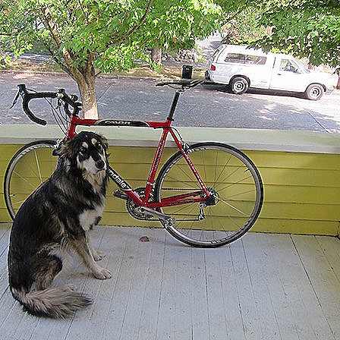
Sharpen Kernel: sharpens! (applied to all three bands)
Note: sharpen = highpass + identity!

Slide 85

Guess that kernel!

Slide 86
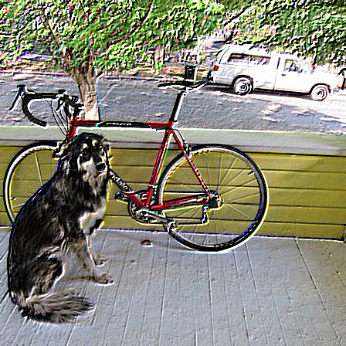
Emboss Kernel: stylin’ (applied to all three bands)

Slide 87
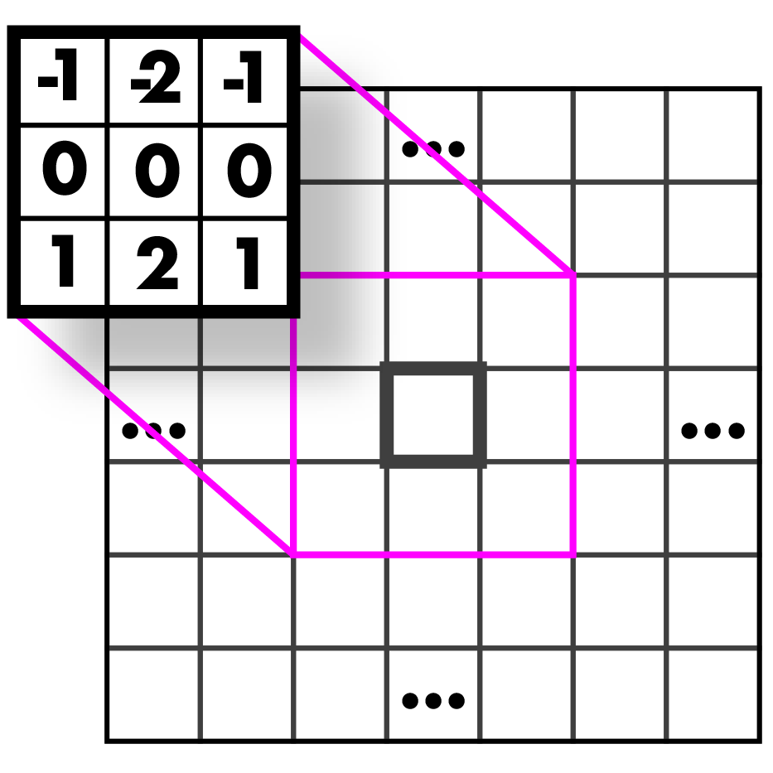

Guess those kernels!

Slide 88
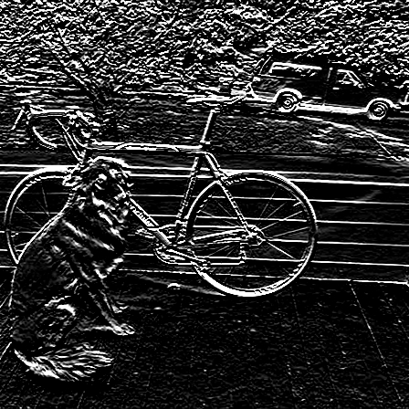
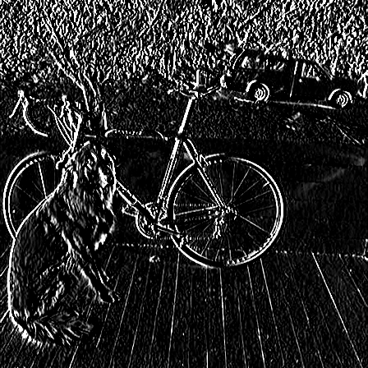
Sobel Kernels: edges (applied to a graytone image and thresholded)

Slide 89

Sobel Kernels: edges and gradient!

Slide 90
Sobel Kernels: edges and gradient!
This visualization is showing the magnitude and direction of the gradient. We will talk further about this when we discuss edges.

Slide 91
And so much more!!

Slide 92
Assignment 2
Image resizing and filtering

Slide 93
First things first!
First, you need to run git pull from inside your homeworks folder to get the latest changes from GitHub.
Remember that you might need some of your code from the previous hw (e.g. set_pixel) for this hw as well. Have your code from hw1 in your src folder.
Then run:
make clean
make

Slide 94
Assignment 2
Nearest Neighbor Interpolation and Resizing
float nn_interpolate(image im, float x, float y, int c); in src/modify_image.c
image nn_resize(image im, int w, int h);
Bilinear Interpolation and Resizing
float bilinear_interpolate(image im, float x, float y, int c);
image bilinear_resize(image im, int w, int h);

Slide 95
Assignment 2
Box Filter
void l1_normalize(image im)
image make_box_filter(int w)
Convolution
image convolve_image(image im, image filter, int preserve)
image make_highpass_filter()
image make_sharpen_filter()
image make_emboss_filter()

Slide 96
Assignment 2
Gaussian
image make_gaussian_filter(float sigma)
Hybrid Images
image add_image(image a, image b)
image sub_image(image a, image b)

Slide 97
Assignment 2
Sobel Operator (next lecture)
image make_gx_filter()
image make_gy_filter()
void feature_normalize(image im)
image *sobel_image(image im)
image colorize_sobel(image im)

