Slide 1
Computer Vision ECE/CSE 576 Color and Texture Linda Shapiro Professor of Computer Science & Engineering Professor of Electrical & Computer Engineering

Slide 2
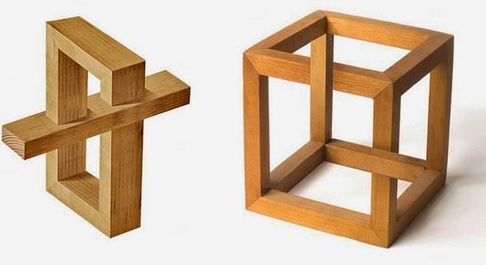
We don’t really understand vision
Visual cortex - highly studied part of the brain
Only rough idea of what different components do
New discoveries in vision all the time
Eye uses blinking to reset its rotational orientation
Visual cortex can make some “high-level” decisions

Slide 3
Is vision easy or hard for humans?
What do you think?

Slide 4
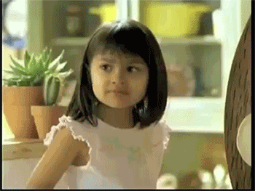


Is vision easy or hard for humans?
What do you think now?

Slide 5
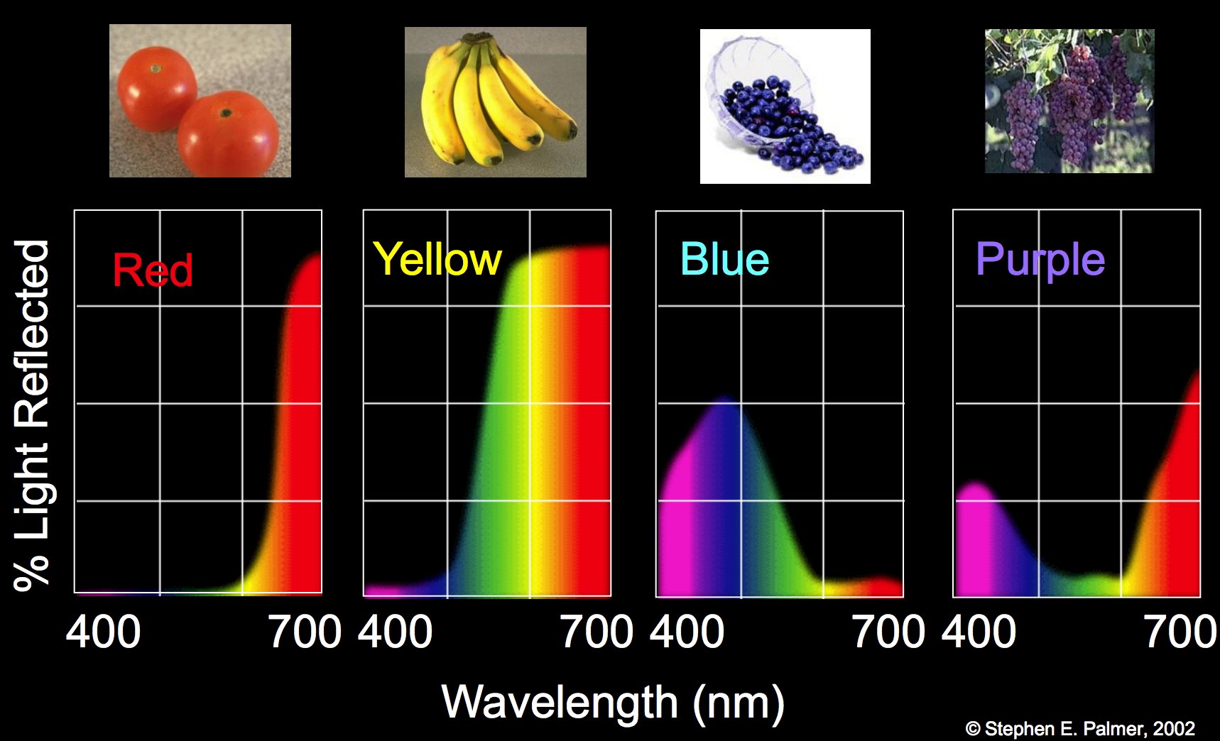
Objects reflect only some light

Slide 6
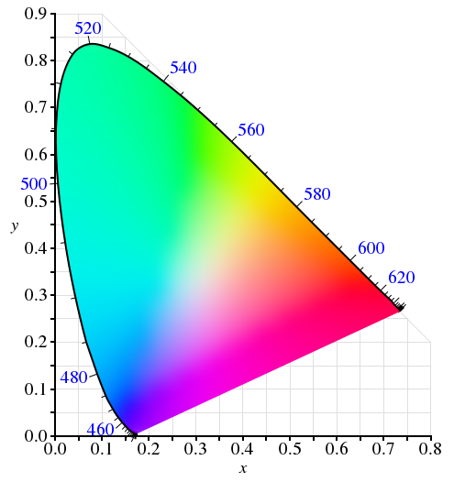
We can make a map of color

Slide 7
Linear colorspace
Pick some primaries
Can mix those primaries to match any color inside the triangle
There is a commision that studies color!
Commission internationale de l’éclairage (CIE) is a 100 year old organization that creates international standards related to light and color.

Slide 8
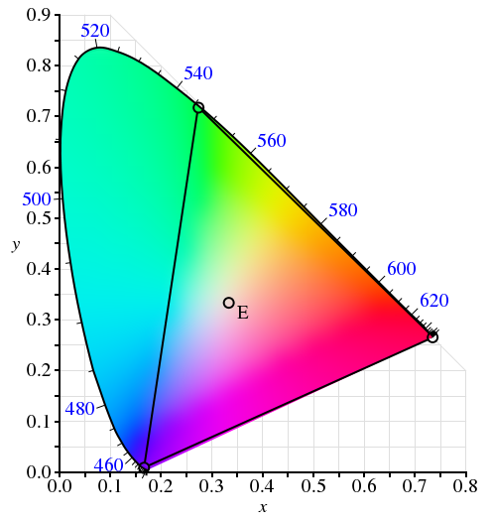

“Theoretical” CIE RGB primaries

Slide 9
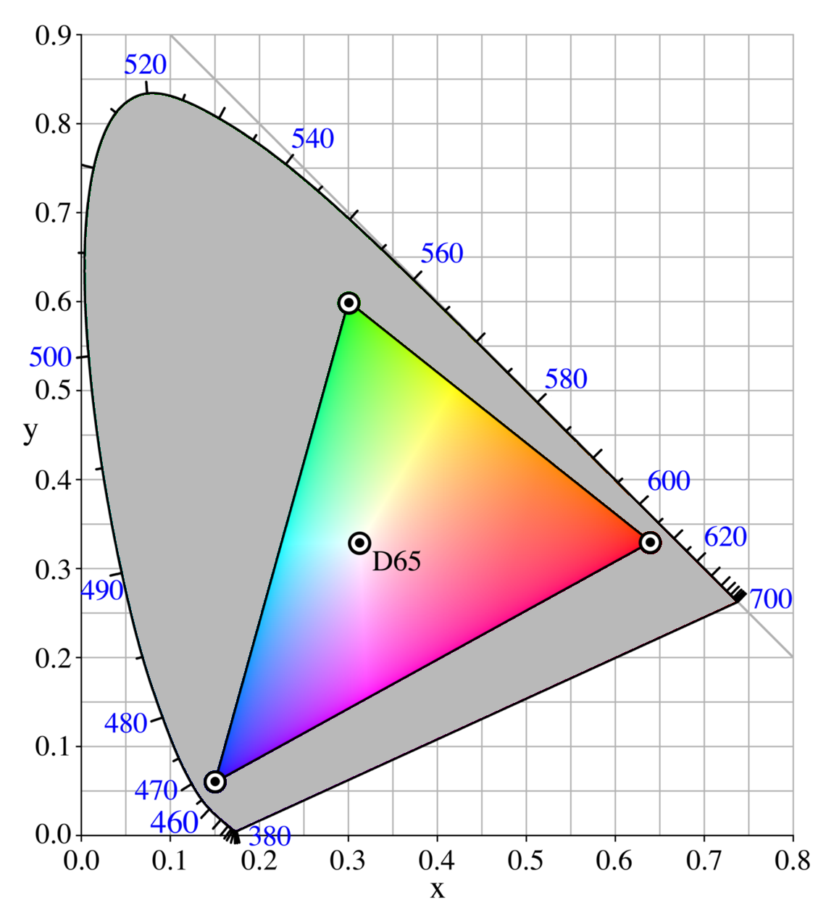
Practical sRGB primaries, MSFT 1996
sRGB (standard Red Green Blue) is an RGB color space that HP and Microsoft created
cooperatively in 1996 to use on monitors, printers, and the Internet. It was subsequently
standardized by the IEC (International Electrotechnical Commission) as IEC 61966-2-1:1999.

Slide 10
What does this mean for computers?
We represent images as grids of pixels
Each pixel has a color, 3 components: RGB
Not every color can be represented in RGB!
Have to go out in the real world sometimes
RGB is not fully accurate
We can represent a color with 3 numbers
#ff00ff; (1.0, 0.0, 1.0); 255,0,255
WHAT COLOR IS THAT?

Slide 11
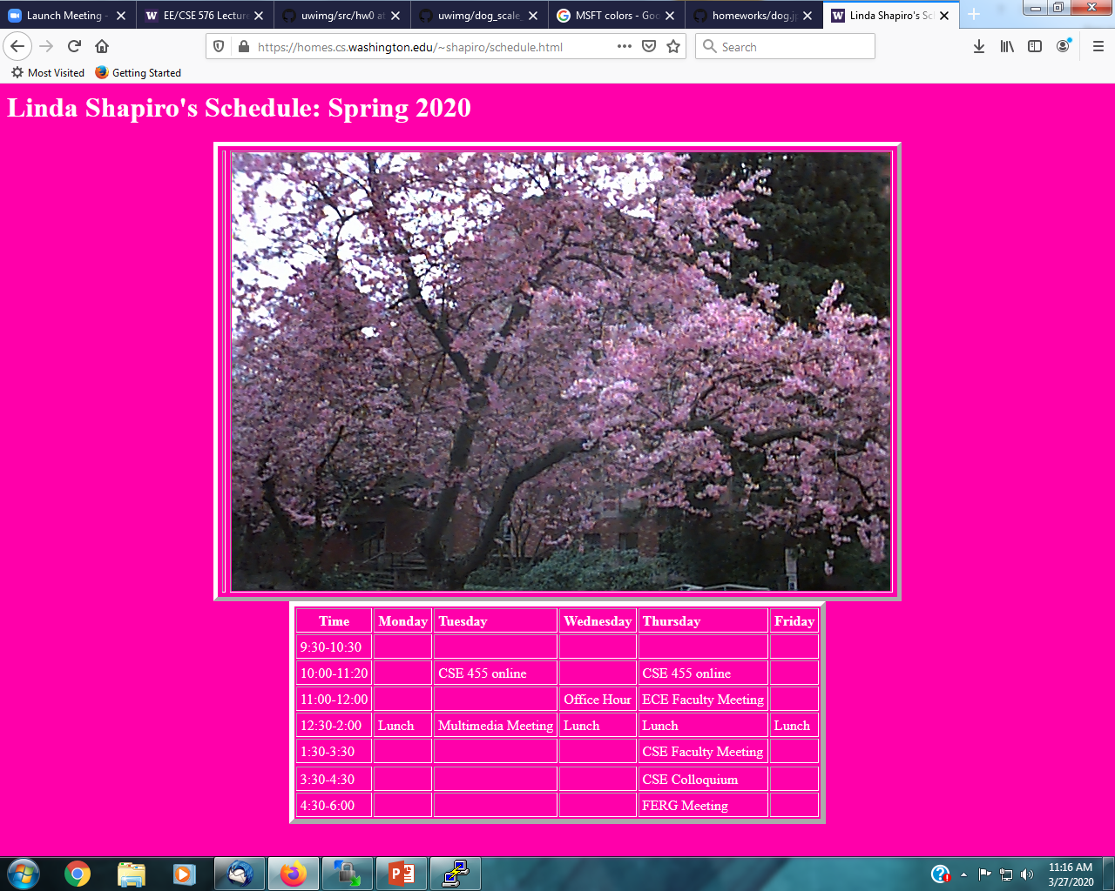
FF00AA

Slide 12
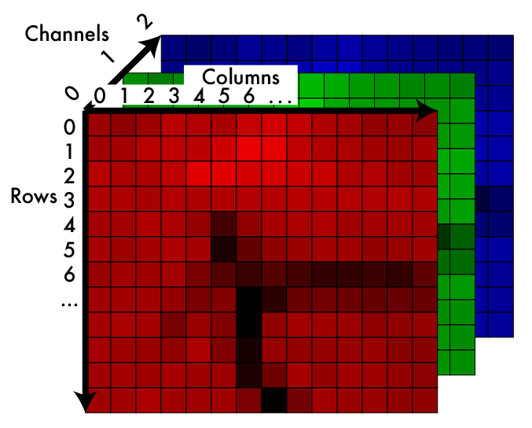
Image: 2d array of color
Some range
[0,255]
0.0 - 1.0
We’ll talk more about this later.

Slide 13
Grayscale - making color images not
We can simulate monochromatic images from RGB
Want a good approximation of how “bright” the image is without color information
(R+B+G/3) - looks weird
We should
Gamma decompress
Calculatight lightness
Gamma compress
We can just operate on sRGB
Typically ~ .30R + .59G + .11B

Slide 14
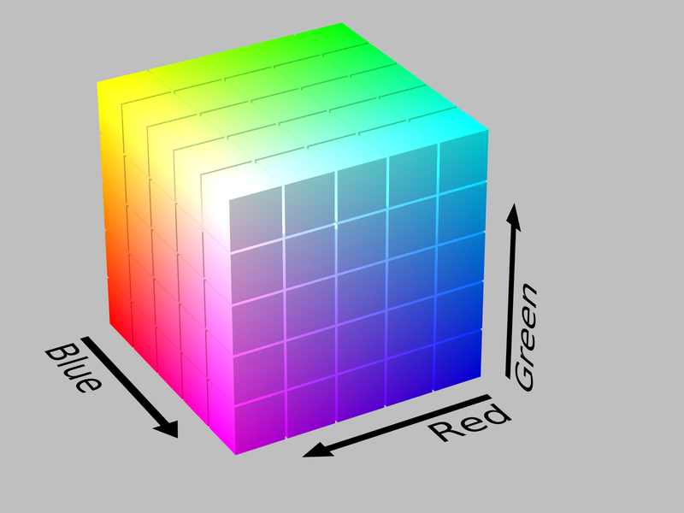
RGB is a cube...

Slide 15
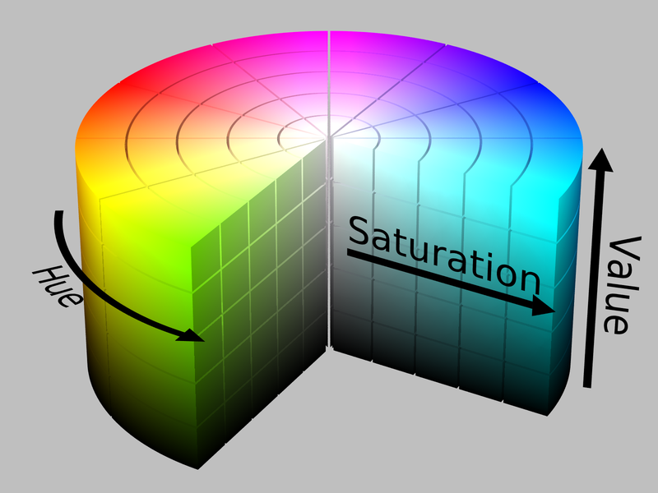
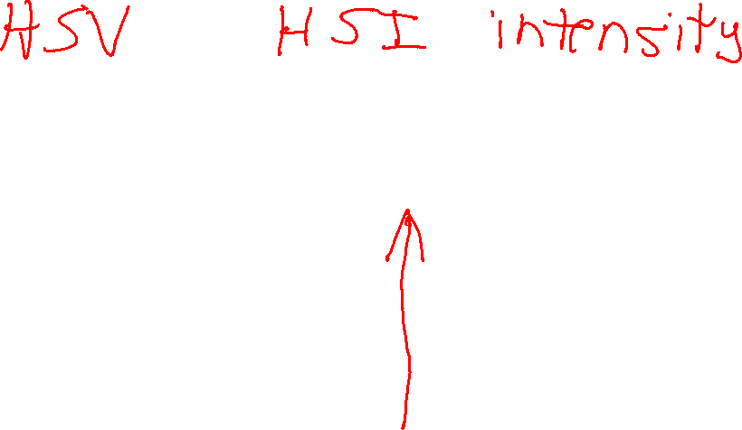
Hue, Saturation, Value: cylinder!

Slide 16
Hue, Saturation, Value
Different model based on perception of light
Hue: what color
Saturation: how much color
Value: how bright
Allows easy image transforms
Shift the hue
Increase saturation

Slide 17
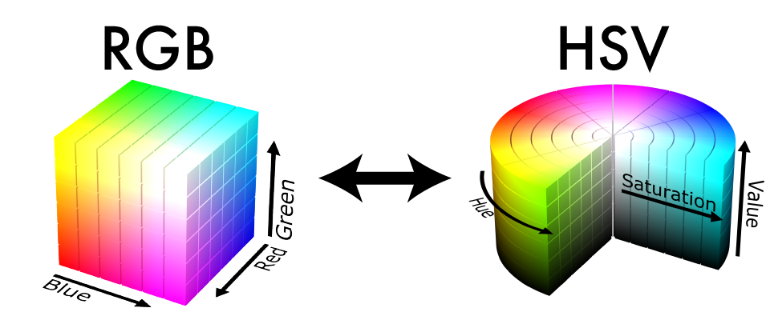
Other colorspaces are fun!

Slide 18
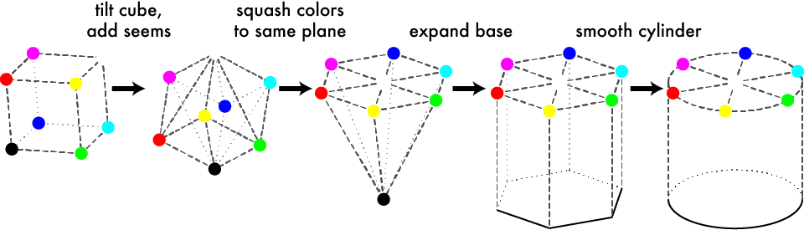
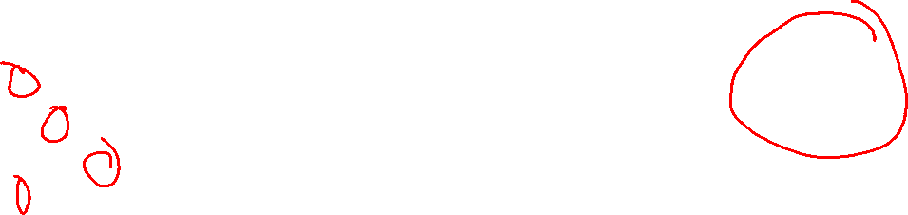
Geometric HSV to RGB:

Slide 19
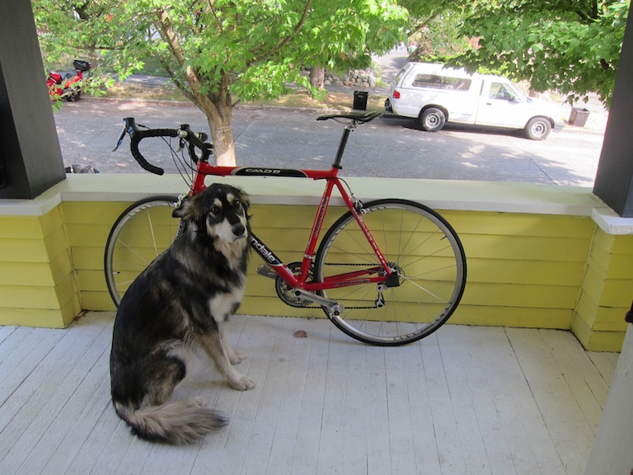
An RGB Image

Slide 20
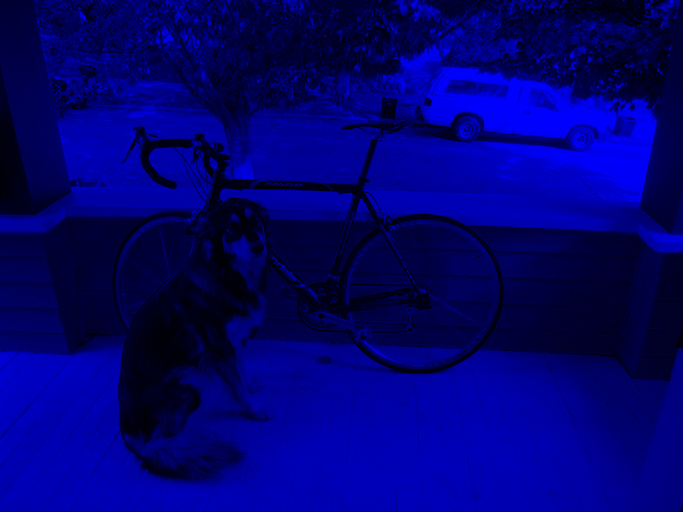
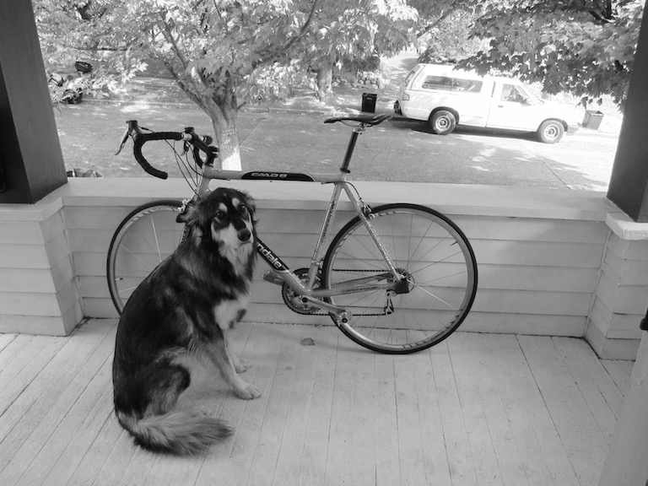
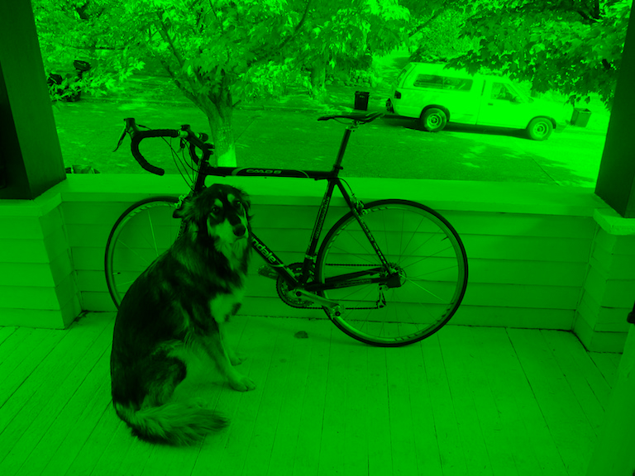
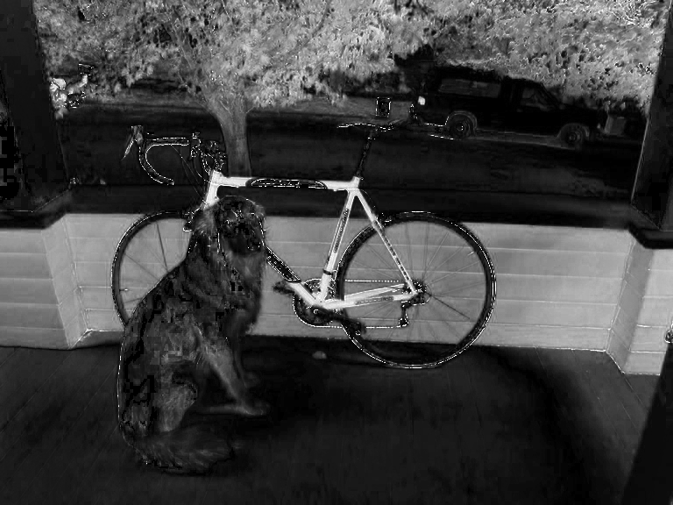
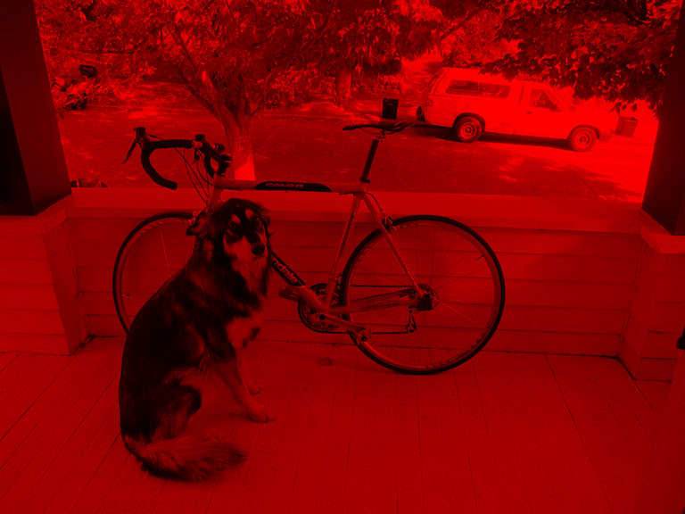
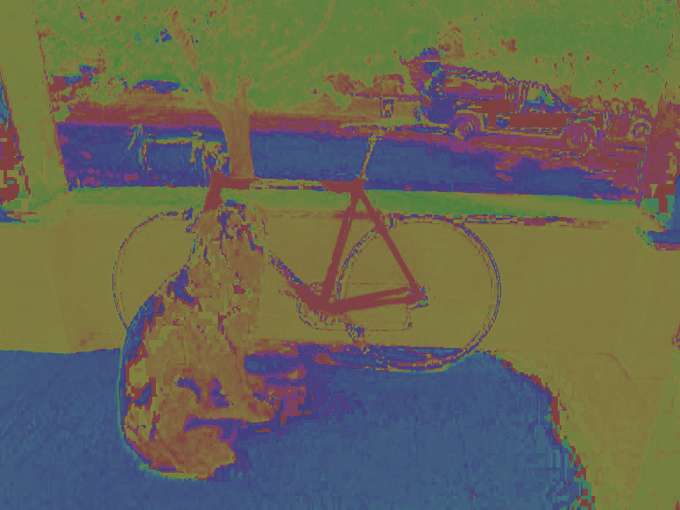
Still 3d tensor, different info

Slide 21
Hue Saturation Value

Slide 22
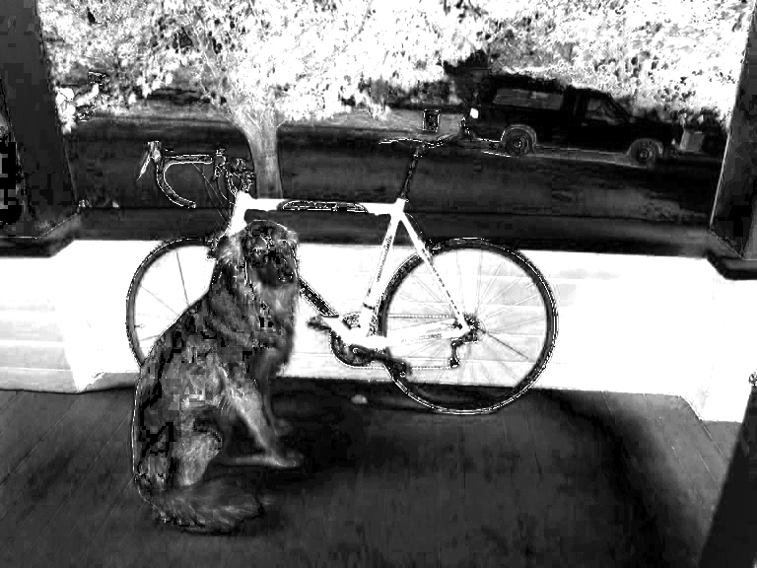
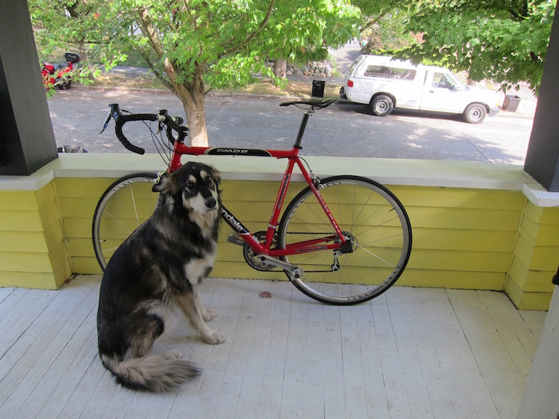
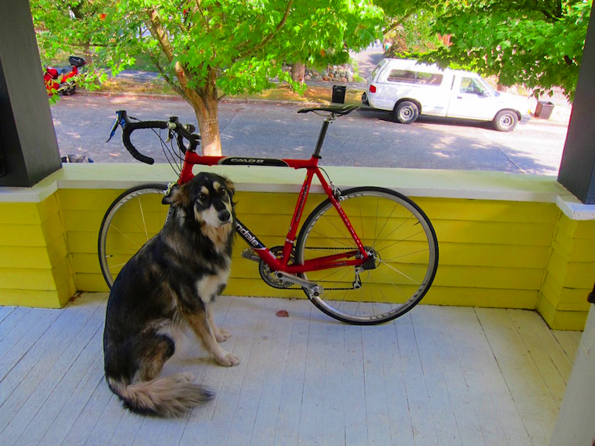
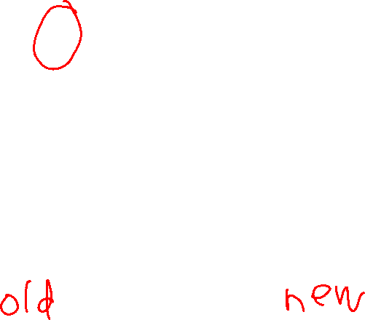
More saturation = intense colors
H Channel S Channel V Channel
2x

Slide 23
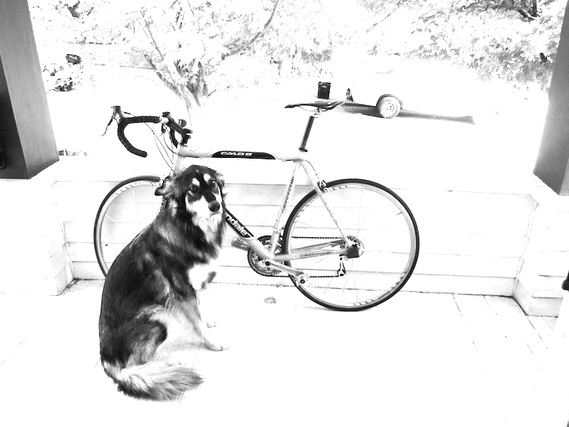
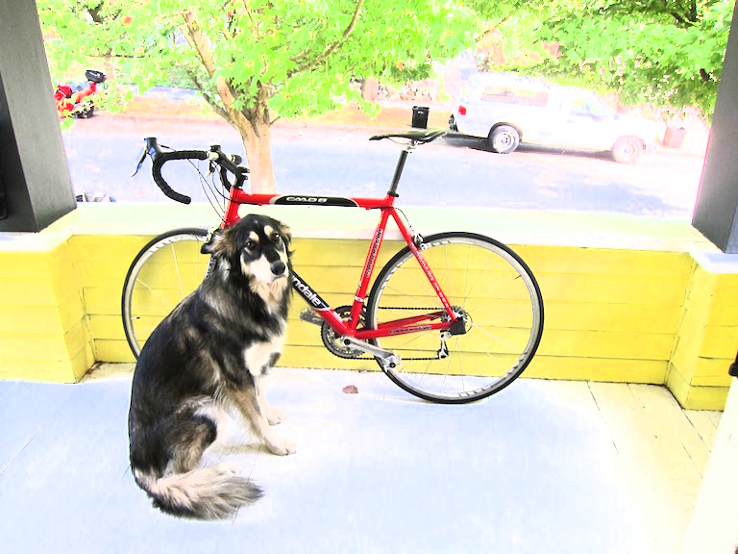

More value = lighter image
H Channel S Channel V Channel
2x

Slide 24
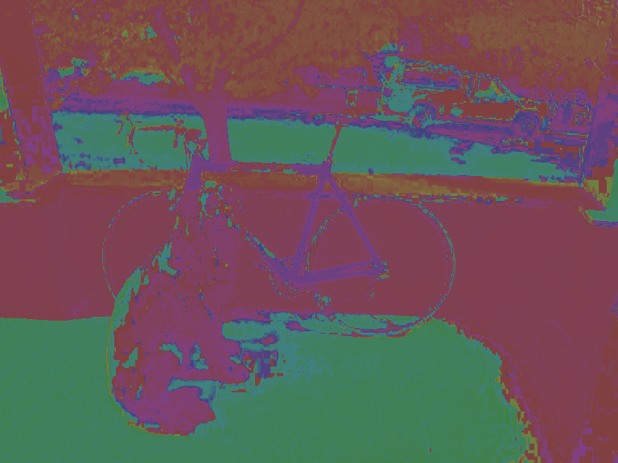
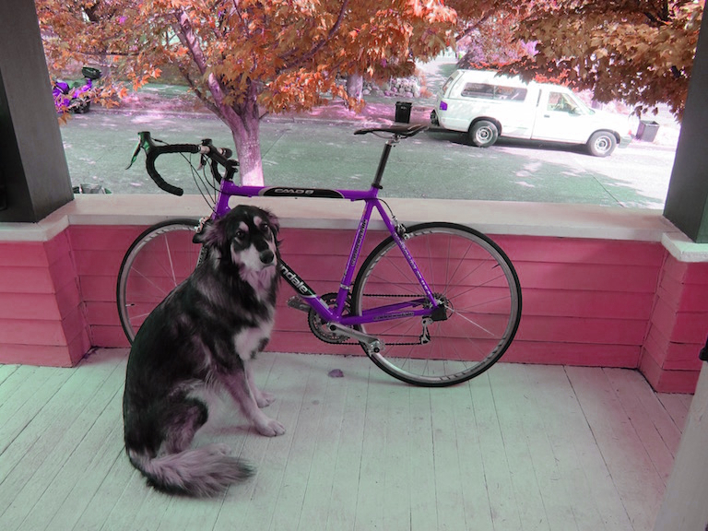
Shift hue = shift colors
H Channel S Channel V Channel
-.2

Slide 25

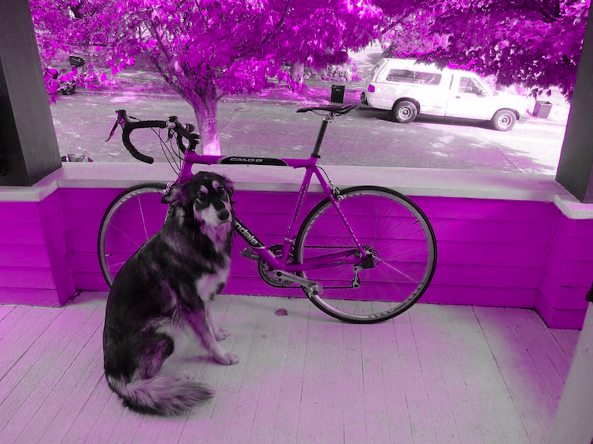
Set hue to your favorite color!
H Channel S Channel V Channel

Slide 26

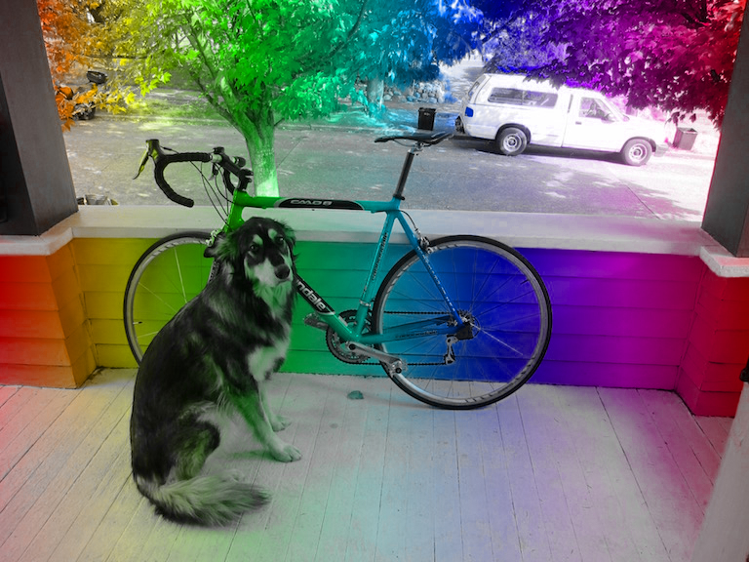
Or pattern...
H Channel S Channel V Channel

Slide 27
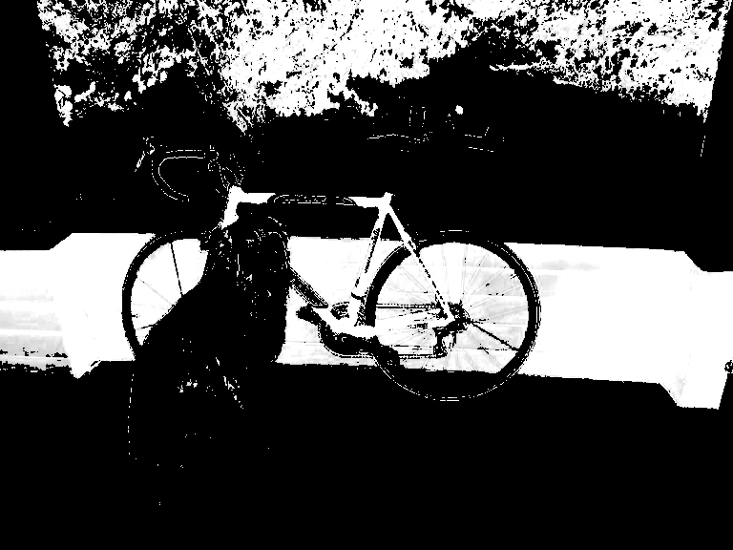
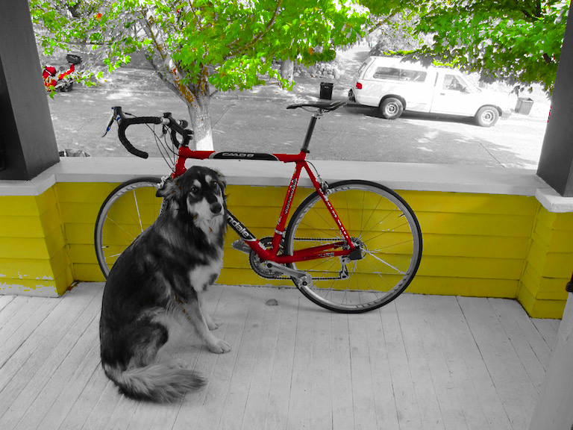
Increase and threshold saturation
H Channel S Channel V Channel

Slide 29
More Details on Color Spaces
RGB
HSI/HSV
CIE L*a*b
YIQ
Opponent
standard for cameras
allows us to separate
intensity plus 2 color channels
color TVs, Y is intensity
used in Swain & Ballard work

Slide 30

RGB Color Space
Absolute Normalized
Normalized red r = R/(R+G+B)
Normalized green g = G/(R+G+B)
Normalized blue b = B/(R+G+B)
(0,0,255)
blue
R,G,B)
(0,0,0)
(0,255,0)
red
green
(255,0,0)

Slide 31
Color hexagon for HSI (HSV)
Hue is encoded as an angle (0 to 2π).
Saturation is the distance to the vertical axis (0 to 1).
Intensity is the height along the vertical axis (0 to 1).
H=120 is green
saturation
intensity
hue
H=180 is cyan
I=1
H=0 is red
H=240 is blue
I=0

Slide 32
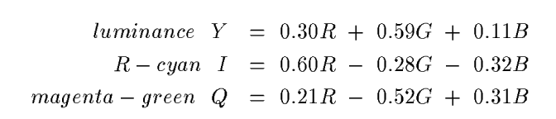

Conversion from RGB to YIQ
An approximate linear transformation from RGB to YIQ:
We often use this for color to gray-tone conversion.

Slide 33
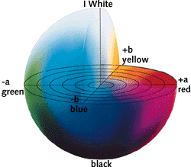
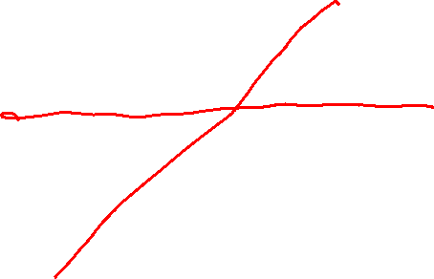
CIELAB, Lab, L*a*b
One luminance channel (L)
and two color channels (a and b).
In this model, the color differences which you perceive correspond to Euclidian distances in CIELab.
The a axis extends from green (-a) to red (+a) and the b axis from blue (-b) to yellow (+b). The brightness (L) increases from the bottom to the top of the three-dimensional model.
CIE L*a*b* (CIELAB) is a color space specified by the International Commission on
Illumination (French Commission internationale de l'éclairage, hence its CIE initialism).

Slide 34
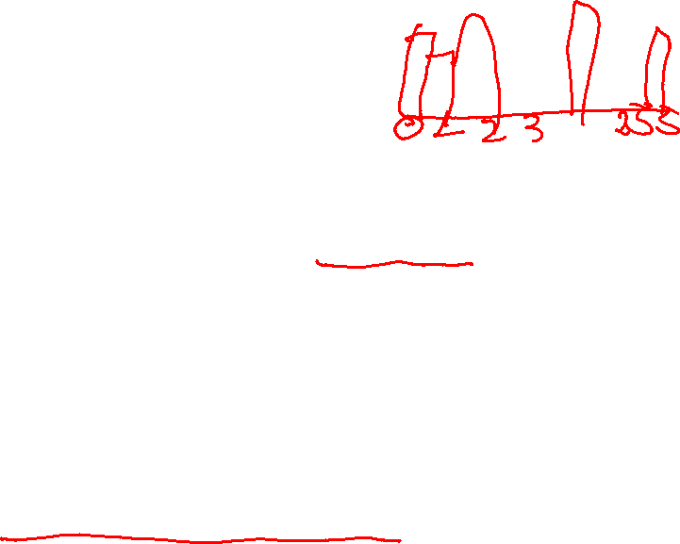
Histograms
A histogram of a gray-tone image is an array H[*] of bins, one for each gray tone.
H[i] gives the count of how many pixels of an image have gray tone i.
P[i] (the normalized histogram) gives the percentage of pixels that have gray tone i.

Slide 35
Color histograms can represent an image
Histogram is fast and easy to compute.
Size can easily be normalized so that different image histograms can be compared.
Can match color histograms for database query or classification.

Slide 36
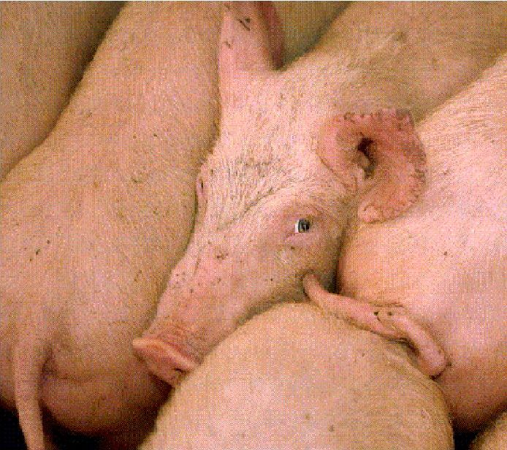
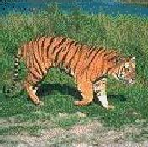
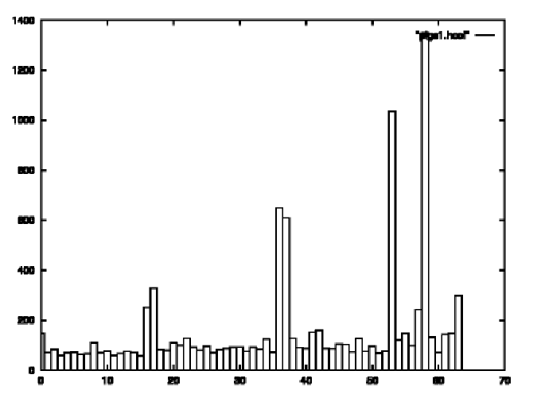
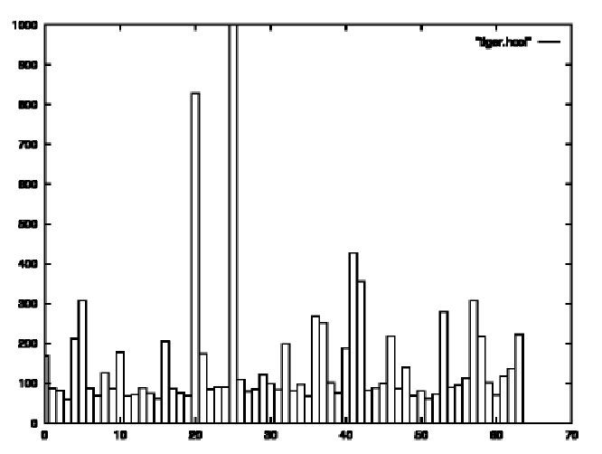
Histograms of two color images

Slide 37
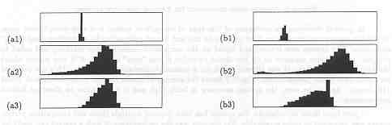
Apples versus Oranges
H
S
I
Separate HSI histograms for apples (left) and oranges (right) used by IBM’s VeggieVision for recognizing produce at the grocery store checkout station (see Ch 16).

Slide 38
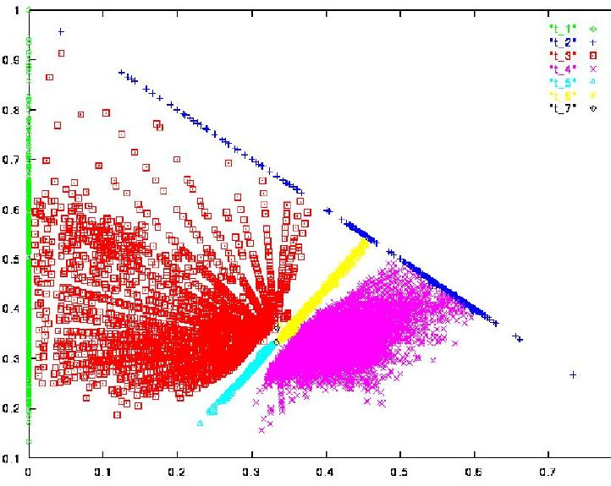
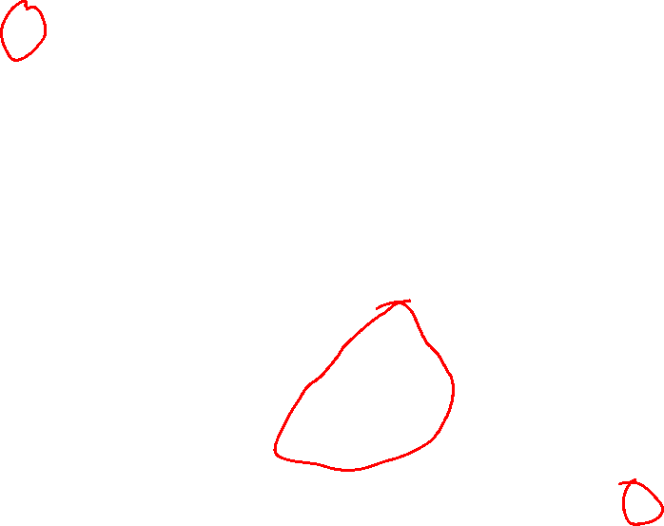
Skin color in Normalized R-G Space
G normalized
Purple region shows skin color samples from several people. Blue and yellow regions show skin in shadow or behind a beard.
R normalized

Slide 39
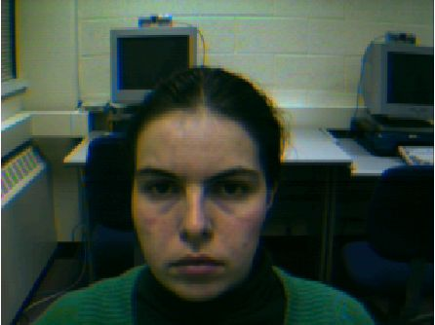
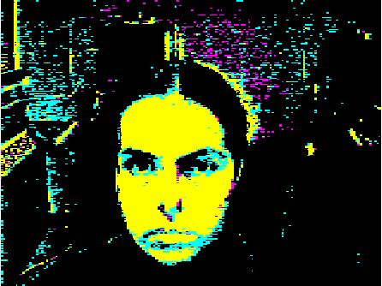
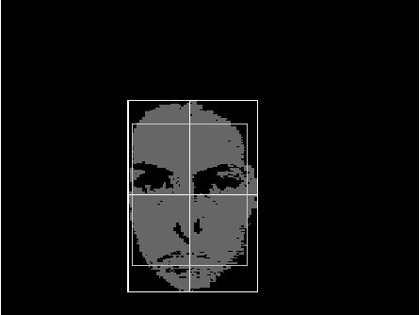
Finding a face in video frame
(left) input video frame
(center) pixels classified according to RGB space
(right) largest connected component with aspect similar to a face (all work contributed by Vera Bakic)

Slide 40
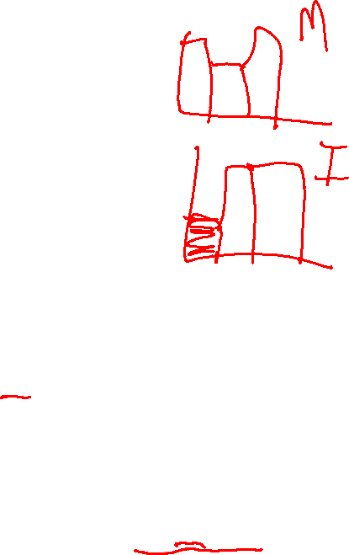
Swain and Ballard’s Histogram Matching for Color Object Recognition (IJCV Vol 7, No. 1, 1991)
Opponent Encoding:
Histograms: 8 x 16 x 16 = 2048 bins
Intersection of image histogram and model histogram:
Match score is the normalized intersection:
wb = R + G + B
rg = R - G
by = 2B - R - G
numbins
intersection(h(I),h(M)) = ∑ min{h(I)[j],h(M)[j]}
j=1
numbins
match(h(I),h(M)) = intersection(h(I),h(M)) / ∑ h(M)[j]
j=1

Slide 41
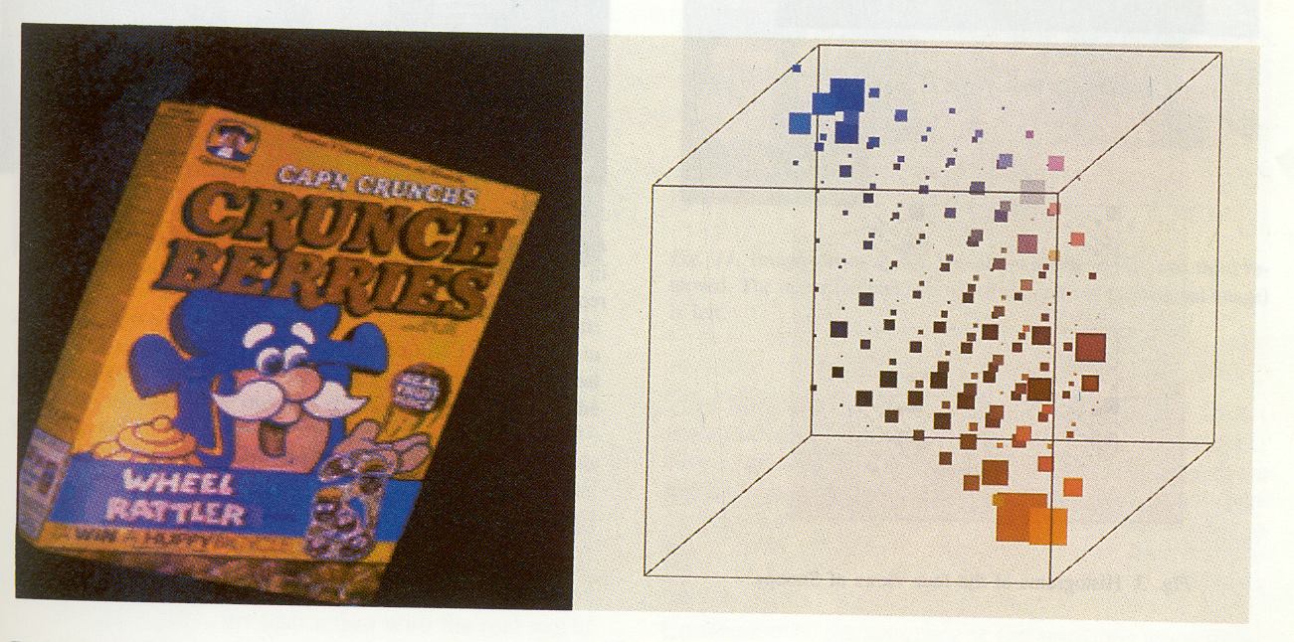
(from Swain and Ballard)
cereal box image
3D color histogram

Slide 42
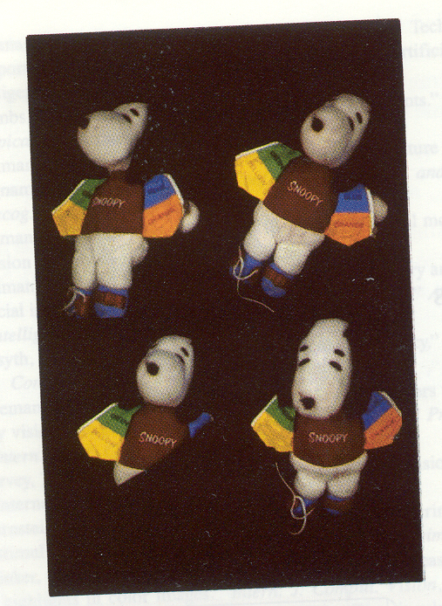

Four views of Snoopy Histograms

Slide 43

Texture
Color is well defined.
But what is texture?

Slide 44

Structural Texture
Texture is a description of the spatial arrangement of color or
intensities in an image or a selected region of an image.
Structural approach: a set of texels in some regular or repeated pattern

Slide 45


Natural Textures from VisTex
grass
leaves
What/Where are the texels?

Slide 46
The Case for Statistical Texture
Segmenting out texels is difficult or impossible in real images.
Numeric quantities or statistics that describe a texture can be
computed from the gray tones (or colors) alone.
This approach is less intuitive, but is computationally efficient.
It can be used for both classification and segmentation.

Slide 47

Local Binary Pattern Measure
For each pixel p, create an 8-bit number b1 b2 b3 b4 b5 b6 b7 b8,
where bi = 0 if neighbor i has value less than or equal to p’s
value and 1 otherwise.
Represent the texture in the image (or a region) by the
histogram of these numbers.
1 2 3
100 101 103
40 50 80
50 60 90
4
5
8
1 1 1 1 1 1 0 0
7 6

Slide 48


Example
Fids (Flexible Image Database
System) is retrieving images
similar to the query image
using LBP texture as the
texture measure and comparing
their LBP histograms

Slide 49

Example
Low-level
measures don’t
always find
semantically
similar images.

Slide 50
What else is LBP good for?
We found it in a paper for classifying deciduous trees.
We used it in a real system for finding cancer in Pap smears.
We are using it to look for regions of interest in breast and melanoma biopsy slides.

Slide 51
Co-occurrence Matrix Features
A co-occurrence matrix is a 2D array C in which
Both the rows and columns represent a set of possible
image values.
C (i,j) indicates how many times value i co-occurs with
value j in a particular spatial relationship d.
The spatial relationship is specified by a vector d = (dr,dc).
d

Slide 52

Co-occurrence Example
1
0 1 2
1 1 0 0
1 1 0 0
0 0 2 2
0 0 2 2
0 0 2 2
0 0 2 2
i
j
0
1
2
1 0 3
2 0 2
0 0 1
3
C_{d}
d = (3,1)
co-occurrence
matrix
gray-tone
image
From C_{d} we can compute N_{d}, the normalized co-occurrence matrix,
where each value is divided by the sum of all the values.

Slide 53

Co-occurrence Features
What do these measure?
sums.
Energy measures uniformity of the normalized matrix.

Slide 54
What are Co-occurrence Features used for?
They were designed for recognizing different kinds of land uses in satellite images.
They are still used heavily in geospatial domains, but they can be added on to any other calculated features.

Slide 55

Example

Slide 56

Satellite Image of Monterey Bay

Slide 57
Assignment 0
FUN WITH COLOR!

Slide 58
Image basics
Data structure for an image
typedef struct{
int h, w, c;
float *data;
} image;

Slide 59

Image basics
Data structure for an image
typedef struct{
int h, w, c;
float *data;
} image;
h = height
w = width
c = number of channels
c = 3 for RGB image; c = 1 for grayscale image

Slide 60

Image basics
Data structure for an image
typedef struct{
int h, w, c;
float *data;
} image;
data = array of floats
floats in the range [0,1]
3D image matrix linearized into 1D array

Slide 61

To Do #1
Fill in:
float get_pixel(image im, int x, int y, int c)
void set_pixel(image im, int x, int y, int c, float v)
assign value v to im.data[coord(x,y,c)]

Slide 62
To Do #2
Fill in:
image copy_image(image im)
create a separate image that is a copy of the input image im and return the copy
Useful functions:
make_image() in load_image.c
memcpy()
You can use get_pixel() and set_pixel() functions you implemented from now on

Slide 63
To Do #3
Fill in:
image rgb_to_grayscale(image im)
create a new image with 1 channel
Get R,G,B values from input image im
Compute Y = 0.299 R + 0.587 G + .114 B
Assign Y to new image and return that image

Slide 64
To Do #4
Fill in:
void shift_image(image im, int c, float v)
add value v to each pixel of im in channel c
change the input image in-place (do not create a separate image) wherever the return type of the function is void

Slide 65
To Do #5
Fill in:
void clamp_image(image im)
clamp the pixel values of input image im to be in the range [0,1]

Slide 66
To Do #6
Fill in:
void rgb_to_hsv(image im)
Convert R,G,B values of image im pixelwise into H,S,V values using the given formulas
You can use the three_way_max() and three_way_min() functions provided

Slide 67
To Do #7
Fill in:
void hsv_to_rgb(image im)
Convert H,S,V values of image im pixelwise into R,G,B values using the given table

Slide 68
To Do #8 (extra credit)
Fill in:
void scale_image(image im, int c, float v)
multiply each pixel of im in channel c with value v
add to the lines in image.h and other files as necessary to test the function. No need to submit the other edited files; write a comment in CAPS at the top of process_image.c if you attempt any extra credit

Slide 69
To Do #9 (super extra credit)
Fill in:
void rgb_to_lch(image im)
Convert R,G,B values of image im pixelwise into L,C,H values using the formulas in the given link

Slide 70
Have Fun

