Slide 1
Scale-Aware Transformers for
Diagnosing Melanocytic Lesions
Wenjun Wu , Sachin Mehta , Shima Nofallah , Stevan Knezevich , Caitlin J. May , Oliver H. Chang , Joann G. Elmore and Linda G. Shapiro

Slide 2
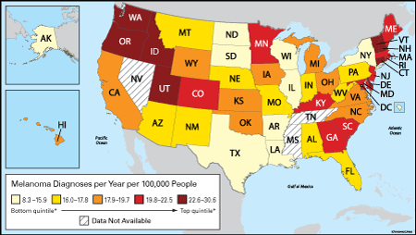
Melanoma
Melanoma is the most aggressive type of skin cancer
One of the most diagnosed cancers in the US
Gold standard for diagnosis → visual assessment of skin biopsy by pathologists

Slide 3
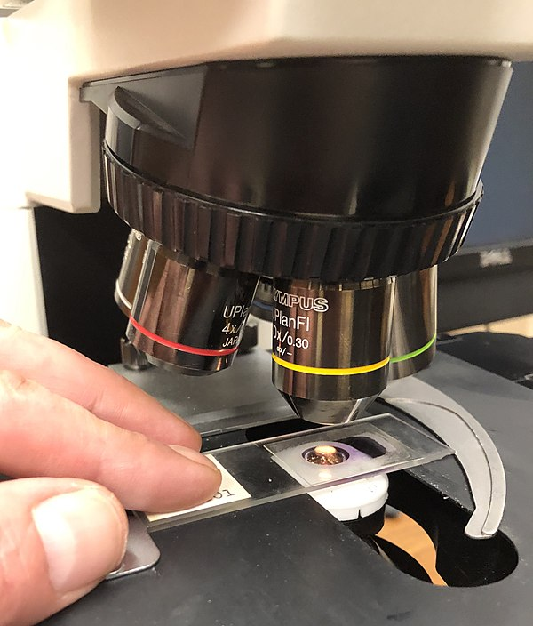
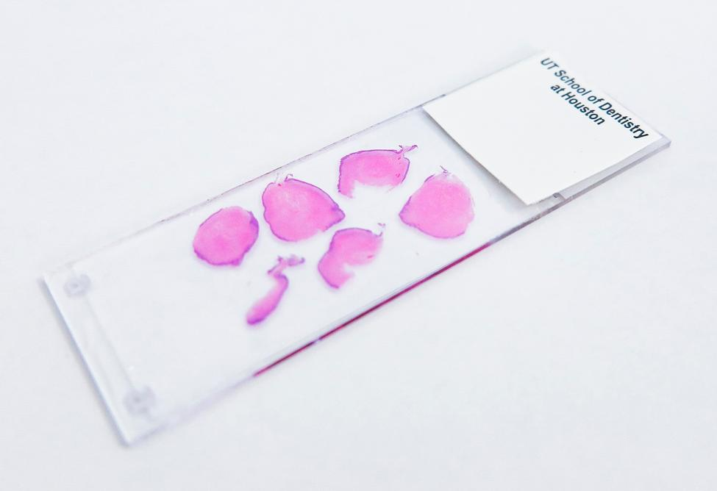
Histology Examination

Slide 4
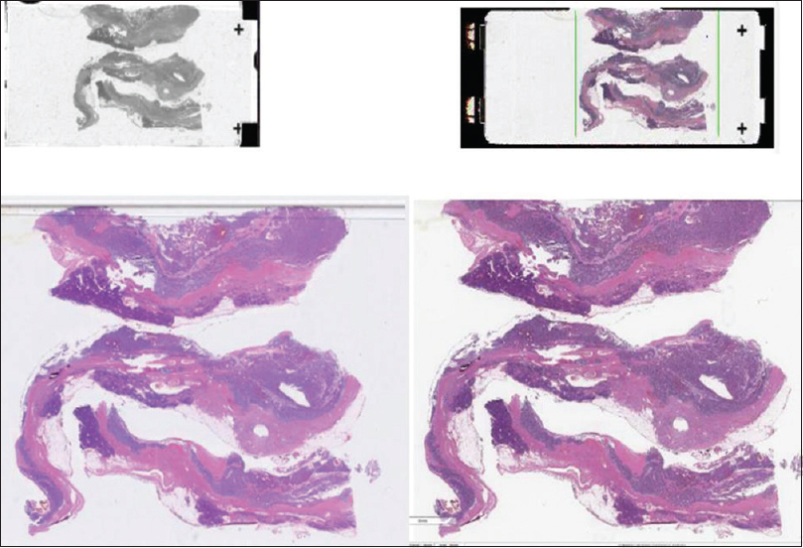
Digitized Whole slide Images (WSI)
Multiple tissues

Slide 5
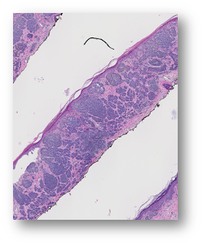
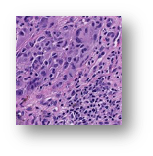
Difficulties in diagnosis
Mixed normal and cancerous tissue
?
Notes:
The first difficulty is that cancerous and non-cancerous regions are mixed in a WSI. Therefore, when pathologists actually conduct subtype classification, it is necessary to find out which part of the slide contains the relevant “interesting” regions, and perform subtype classification based on the features of the region of interest (ROI).

Slide 6
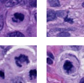
Difficulties in learning to diagnose
Mixed normal and cancerous tissue
Feature is dependent on resolution
Notes:
The second difficulty is that different features of tissues are observed when the magnification of the pathological image is changed. Pathologists conduct diagnosis by changing the magnification of a microscope repeatedly to find out various features of the tissues.

Slide 7
Difficulties in learning to diagnose
Mixed normal and cancerous tissue
Feature is dependent on resolution
Dataset
Notes:
The third difficulty is the nature of the dataset, like the size of the dataset, class distribution and what the images look like.

Slide 8
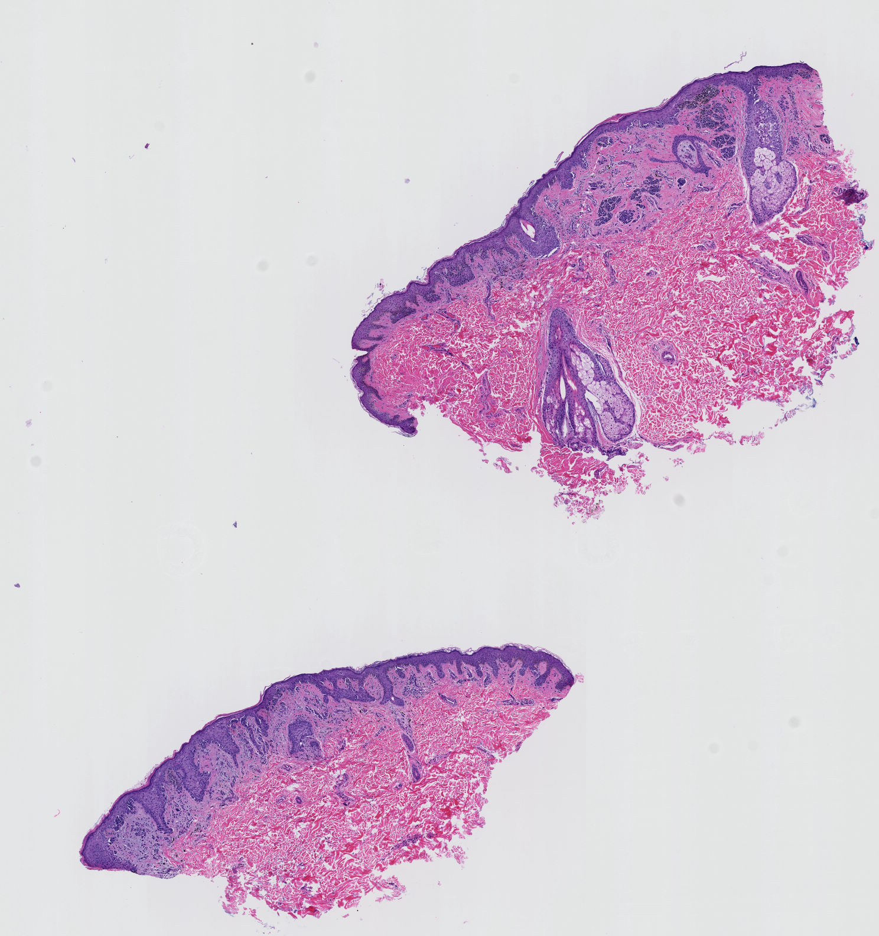
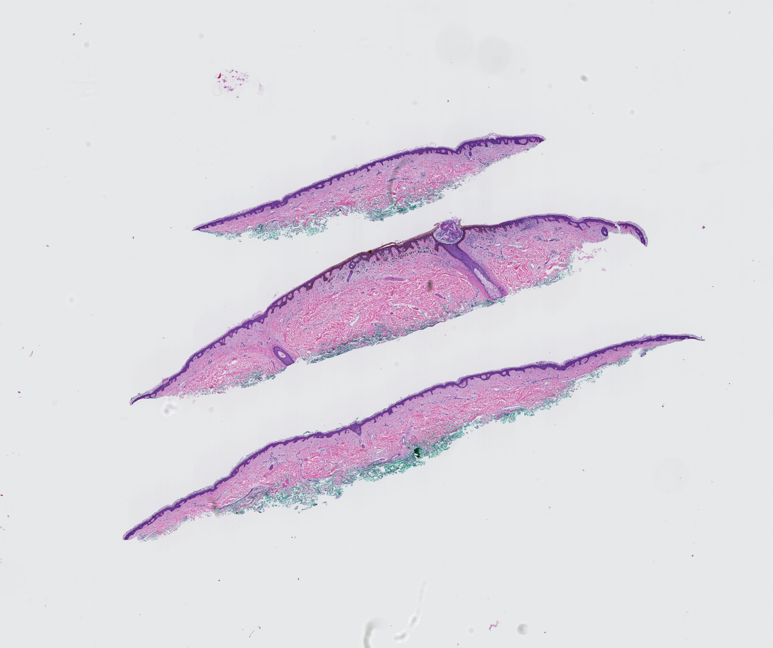
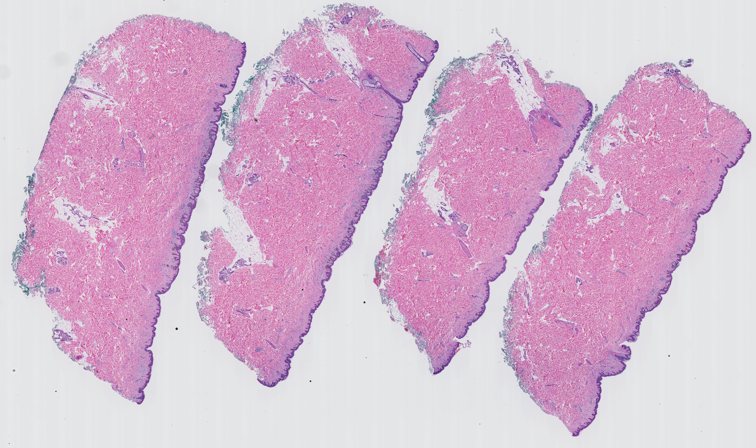
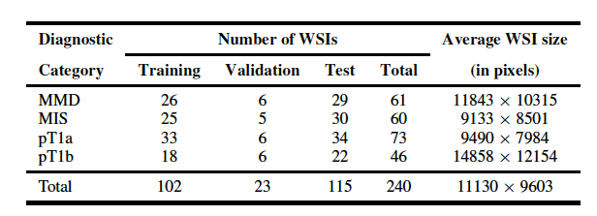
Dataset
Multiple tissues
TABLE 1: Statistics of skin biopsy whole slide image (WSI) dataset. The average WSI size is computed at a magnification factor of x10. Diagnostic terms for the dataset used in this
study are as follows: mild and moderate dysplastic nevi (MMD), melanoma in situ (MIS), invasive melanoma stage pT1a (pT1a), invasive melanoma stage ≥ pT1b (pT1b).

Slide 9
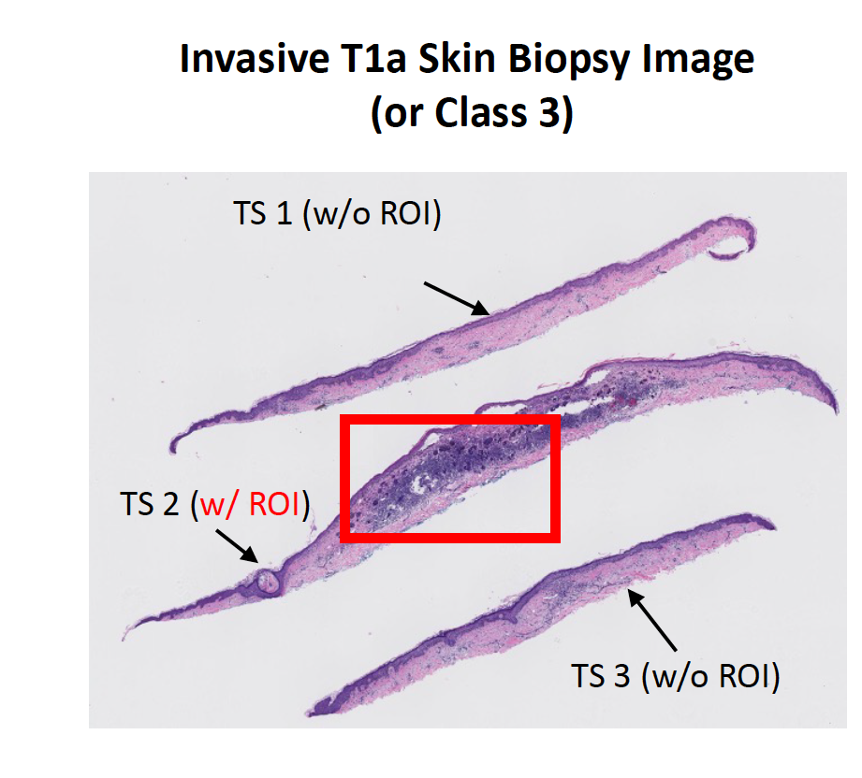
Dataset
Notes:
Skin biopsy images often contain multiple tissue slices on a single WSI, as shown in Figure 4a. In general, the representative regions-of-interest (ROIs; shown in red in Figure) that helped pathologists in diagnosis belong to one or two tissue slices, while the other tissue slices may correspond to other diagnosis categories. Assigning the same diagnostic label to all tissue slices (similar to MIL-based approaches) results in more false tissue-label pairs and hinders learning representations.

Slide 10
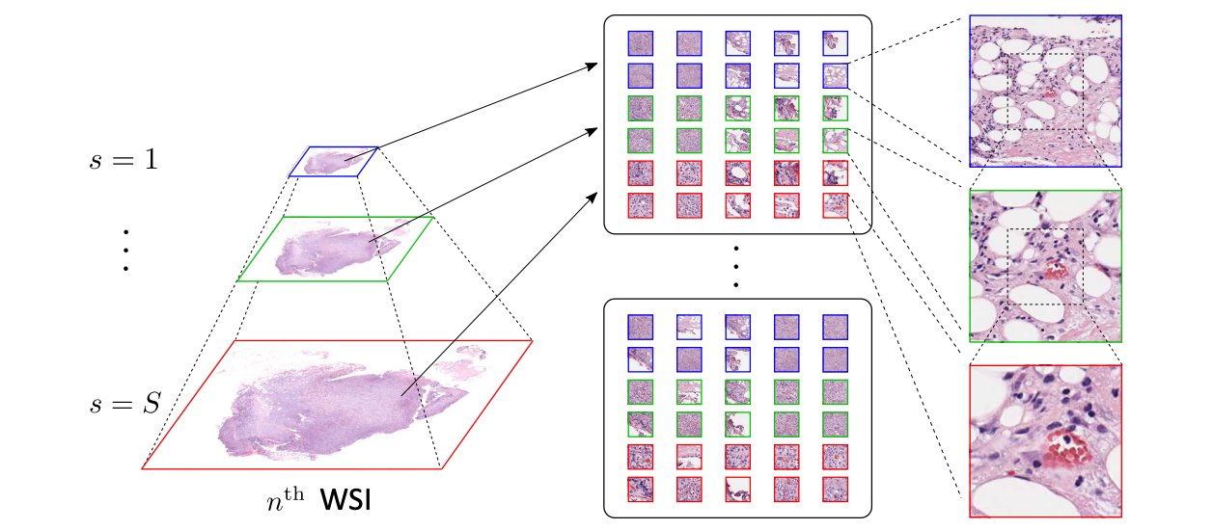
Key Idea
A framework for classifying WSIs at multiple input resolutions
A soft label assignment method to reduce ambiguities

Slide 11
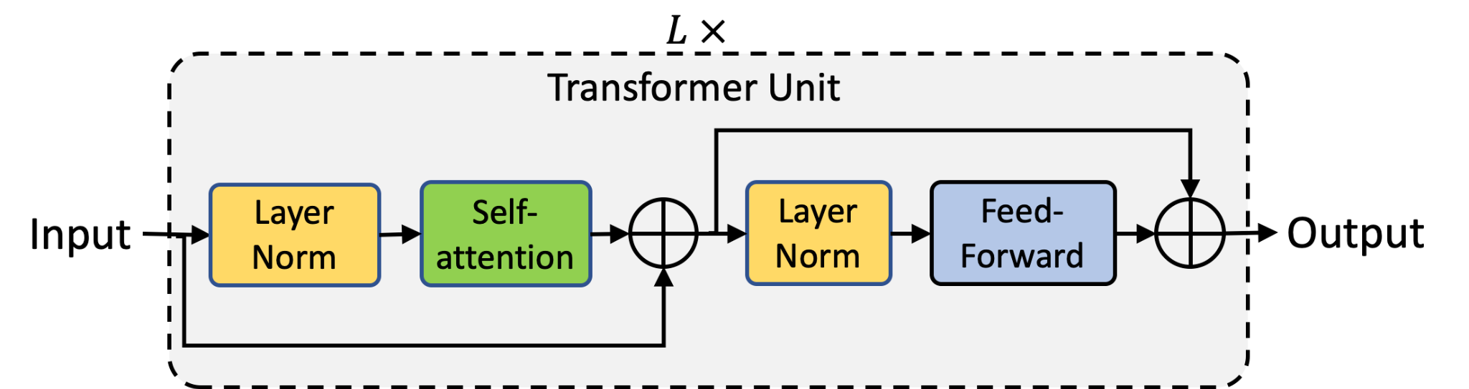
Transformer Unit
Notes:
The transformer unit, shown here, is comprised of two modules: (1) self-attention and (2) feed-forward. The self-attention module allows the inputs to interact with each other and learn contextual relationships.

Slide 12
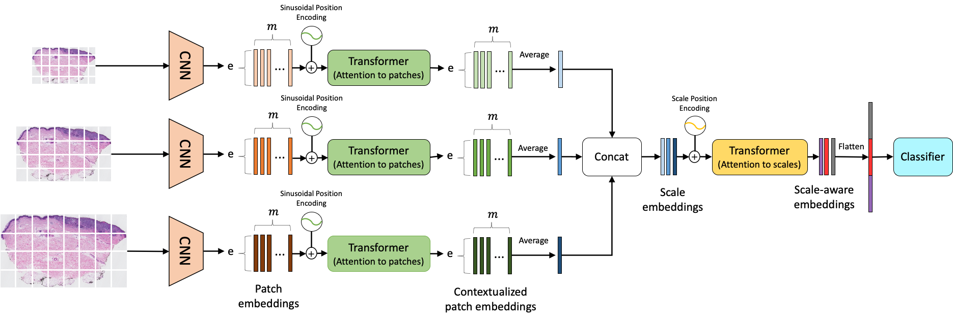
Scale-Aware Transformers for Diagnosing Melanocytic Lesions
Notes:
In this work, we divided the classification pipeline into three steps.
The first step involves learning local patch-wise embeddings using an off-the-shelf CNN for each input scale independently.
Then, for each scale, a transformer (in green) learns inter-patch representations and produces contextualized patch embeddings.
Concatenated contextualized patch embeddings from each input scale produces multi-scale embeddings.
Finally, the last transformer (in yellow) learns inter-scale representations from the concatenated multi-scale embeddings and produces scale-aware embeddings, which are then classified linearly into diagnostic categories.

Slide 13
ScAtNet: Soft Label
Wu et al. Scale-aware transformers for diagnosing melanocytic lesions. IEEE Access, 9:163526–163541, 2021.
Notes:
To solve the multiple tissue slice ambiguity problem, we also proposed a way to compute soft labels for tissue slices without labeled regions of interest.
The motivation is that skin biopsy images often contain multiple tissue slices on a single WSI. In general, the representative regions-of-interest usually belong to one or two tissue slices, while the other tissue slices may correspond to other diagnostic categories. Assigning the same diagnostic label to all tissue slices will result in more false tissue-label pairs and make learning meaningful representations more difficult.

Slide 14
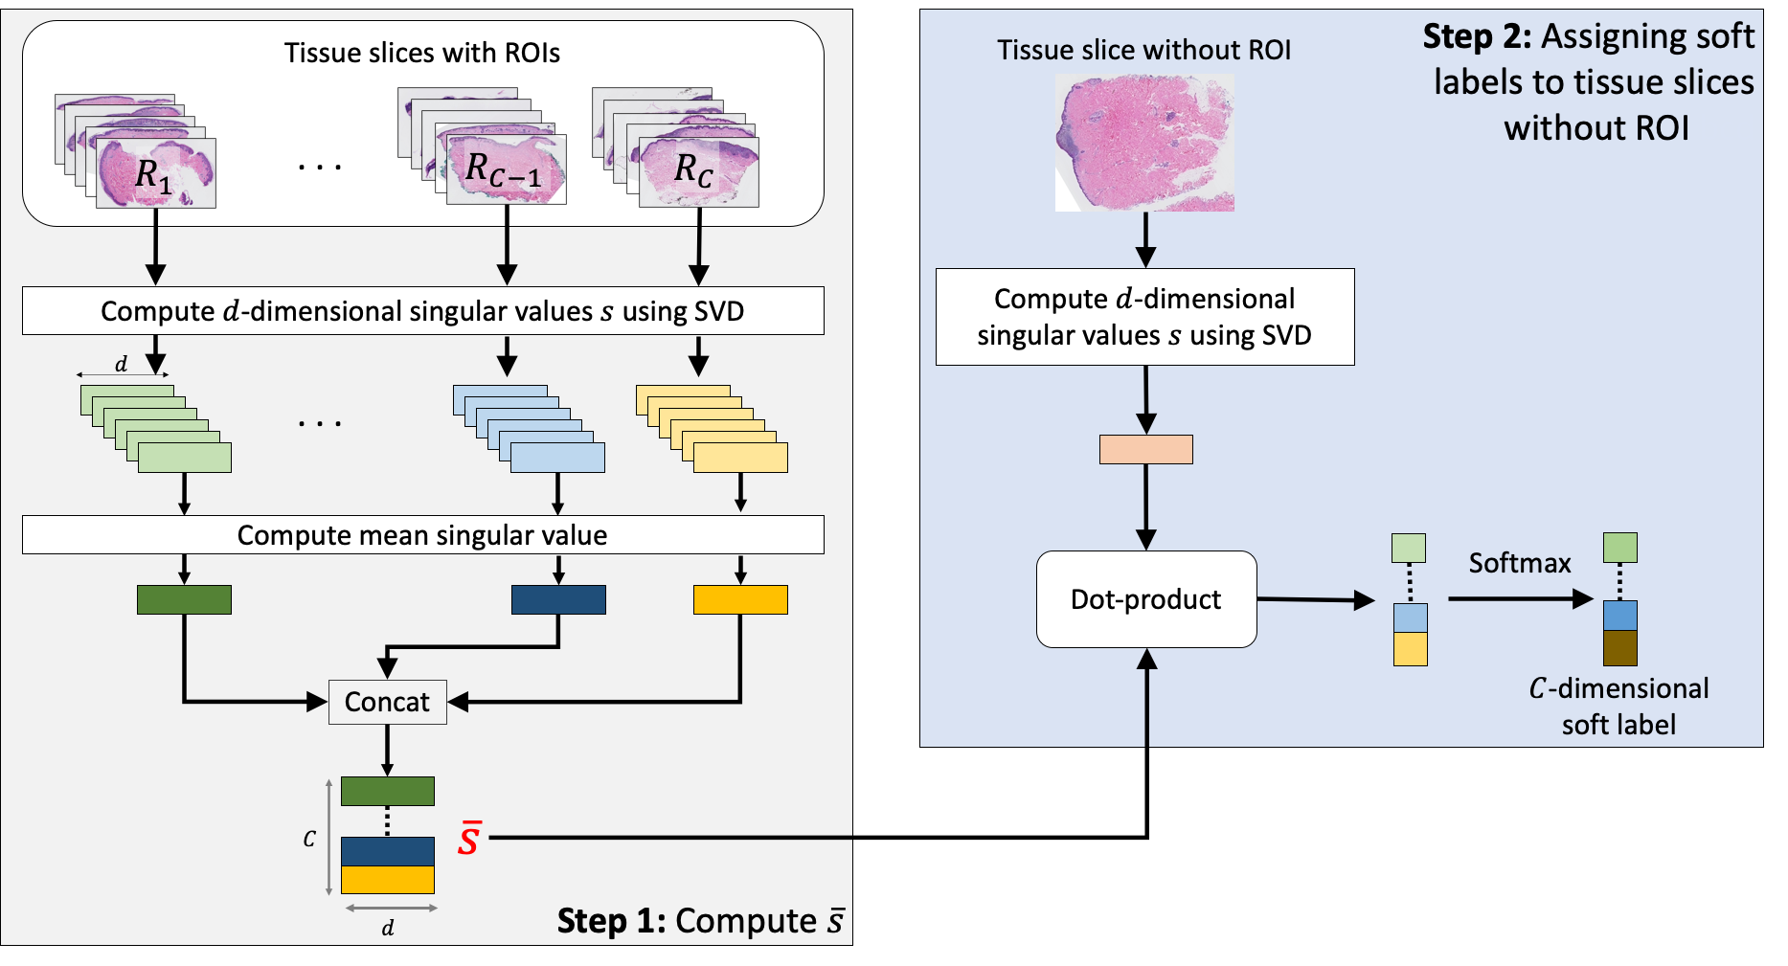
Soft labels
Notes:
So, the goal is to assign soft labels for tissue slices without ROIs.
First we categorize WSI into two categorie: with ROI and without ROI.
Then, we further split the slides with ROI into R1, R2, R3 and R4 since we have 4 classes.
Next, we compute the mean singular value vector from all the images with ROI for each category. The idea is to use these vectors to represent the appearance of the diagnostic categories.
Now we have everything we need. We can start computing the soft labels for tissues we are uncertain about.
Given a tissue slice without ROI, we compute the singular value vector representing a particular slice. Then, we calculate the dot product between that and the mean singular value that represents what each class look like. Applying softmax to the dot product, we get a score representing how likely this particular tissue slice belong to each of the 4 classes.

Slide 15
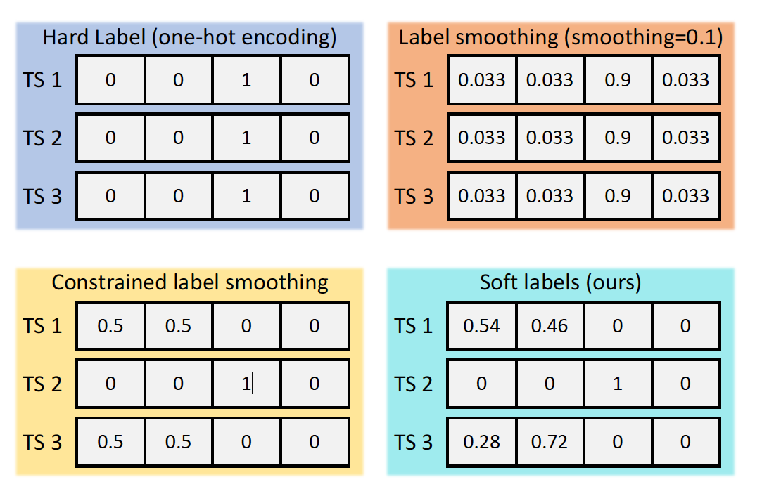
Soft labels

Slide 16
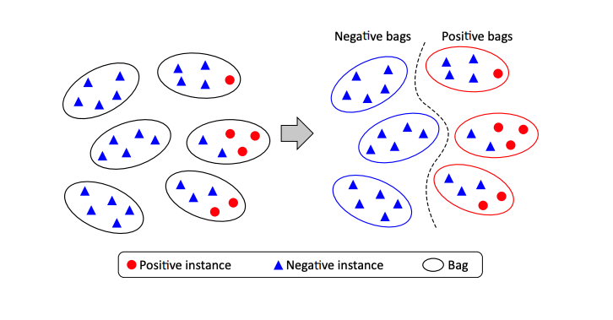
Baseline Methods
Patch-based classification
Weighted feature aggregation
ChikonMIL
MS-DA-MIL
Streaming CNN
Notes:
ScAtNet’s performance is compared with five recent whole slide image classification methods.
The first method we compare to is a standard patch-based CNN classification framework that was built following saliency-based methods. This method treats each patch independently and assigns the same diagnostic label to all patches in the WSI during training. During evaluation, majority-voting is used for predicting the slide-level diagnostic label. Similar to the use of ScAtNet, Mobilenetv2, pretrained on the ImageNet dataset was used as the CNN model.
Second method is a CNN-based deep feature extraction framework that builds slide-level feature representations by aggregating patch representations.
ChikonMIL is a multiple instance learning based method which first selects the top-k patches and then uses these patches for instance and bag-representation learning. It also uses a loss that reduces intra-class variability and allow for soft assignment.
The fourth one, multi-scale Domain adversarial Multiple Instance Learning CNN is a framework that learns from a group of patches extracted at different scales with attention mechanism. In contrast to our method which is end-to-end, this particular framework first trains a single-scale network to classify patches for each scale. Then a multi-scale network is trained using the features extracted from single-scale network.
Finally, streaming CNN uses a patch-based approach with gradient checkpointing, which allows it to classify whole slide images in an end-to-end fashion.

Slide 17
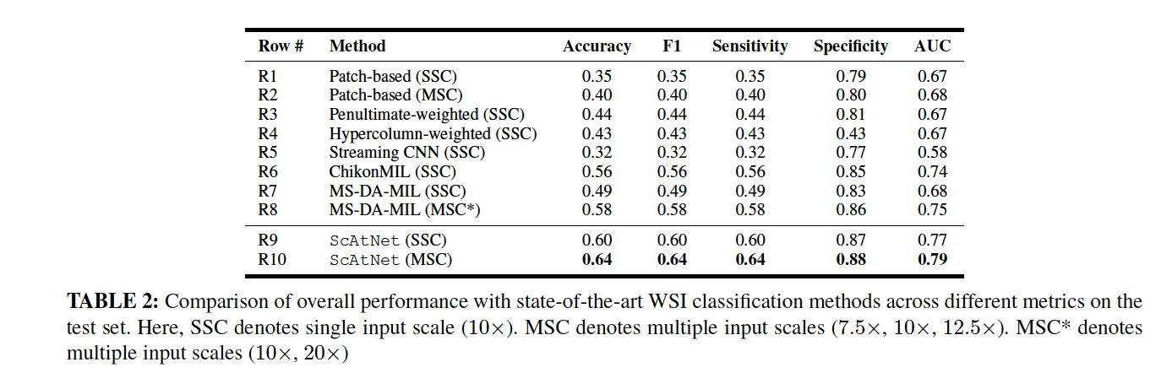
Experimental Result: baseline methods

Slide 18
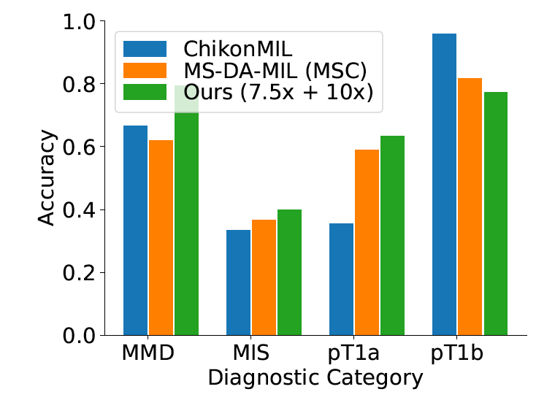
Experimental Result: baseline methods
Notes:
Comparison of class-wise accuracy with stateof- the-art WSI classification methods on the test set. Overall, ScAtNet delivered better performance across all diagnostic categories except the pT1b category.

Slide 19
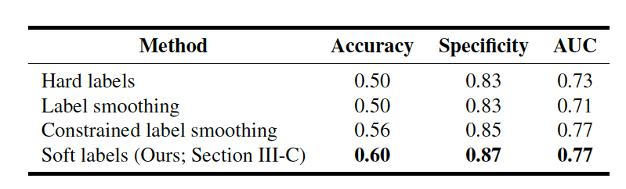
Experimental Result: soft label
Comparison of the performance of different labeling methods.
Notes:
Our soft labeling method is simple and effective; it reduces the ambiguity that arises during training because of multiple tissue slices in a WSI that do not have a ROI and helps improve the performance.

Slide 20
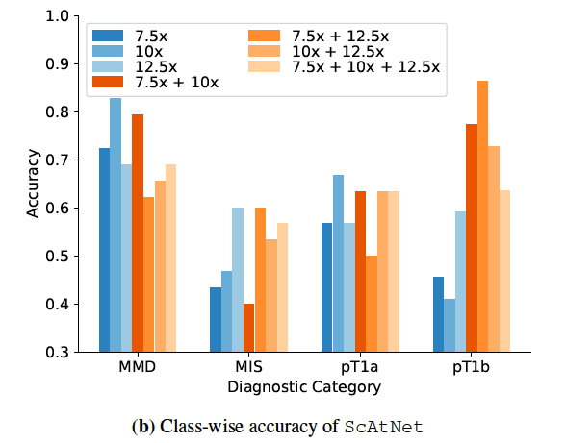
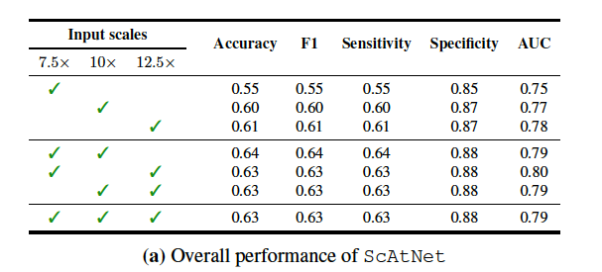
Experimental Result: single vs. multiple input scales

Slide 21
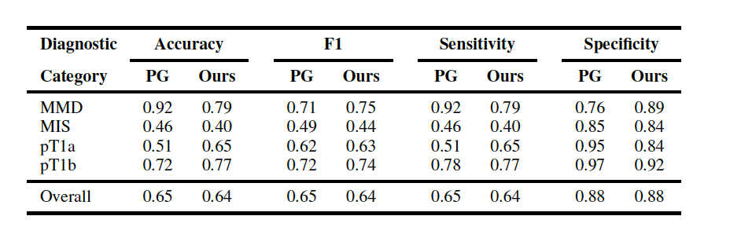
Experimental Result: pathologists performance
Comparison of ScAtNet with pathologists’ (PG) performance.
Notes:
Comparison of ScAtNet with pathologists’ (PG) performance. Pathologists’ performance data is from a prior independent clinical study of 187 pathologists [6] who interpreted these same 115 cases in our test set

Slide 22
Discussion
Limited study on whole slide skin biopsy images (lack of public datasets)
Limited in-house dataset size
Mostly binary classification
  This study covers the full spectrum of melanocytic skin biopsy
Small test set
  We have independent test set of 115 WSIs (50%)
Saliency analysis shows that different input results in different attentions

Slide 23
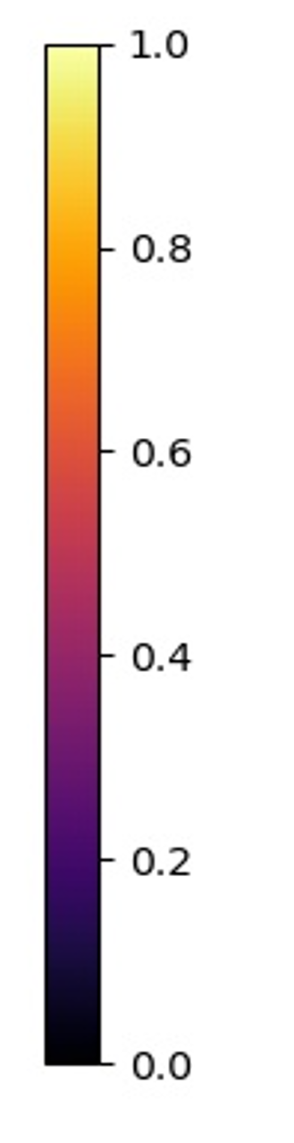
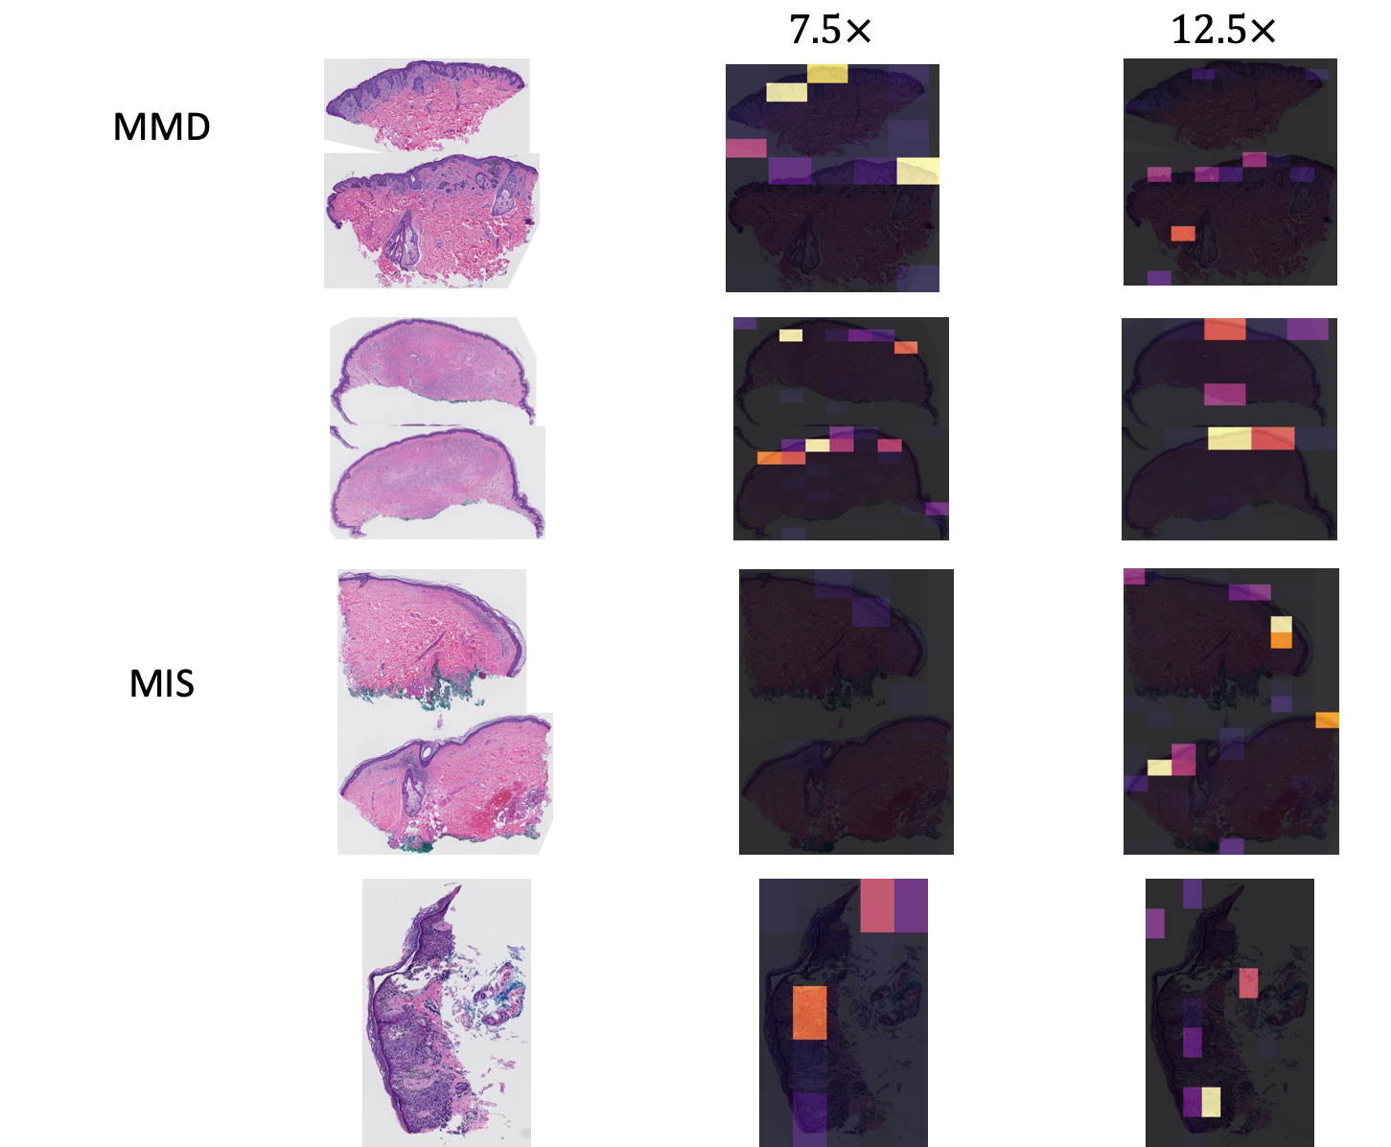

Slide 24
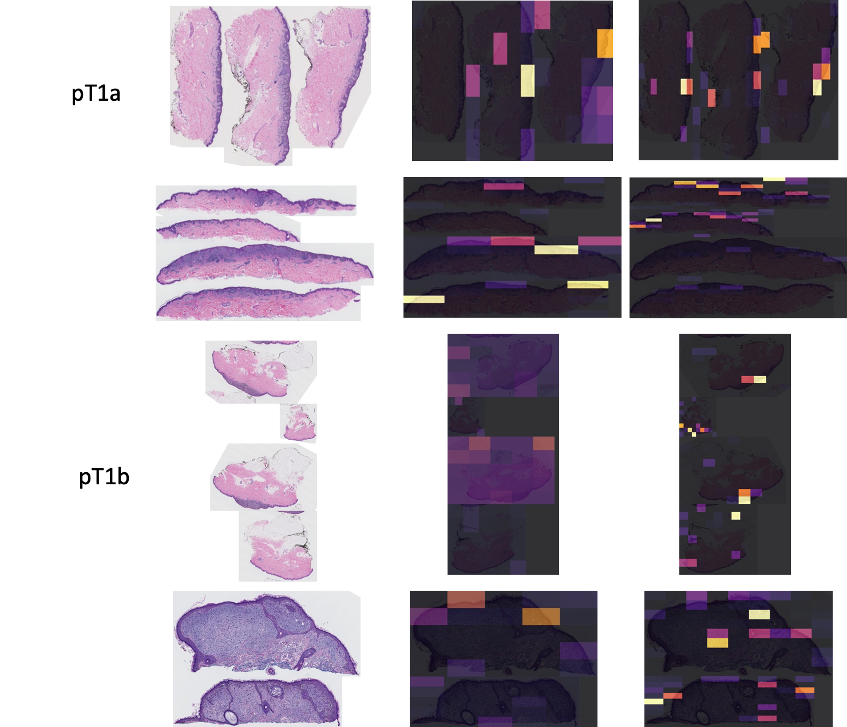

Slide 25
Future Work
Other types of image and cancer
Learnable scale
Wider range of scales
Interpreting choice of scale, class and diagnosis accuracy
Comparing viewing behavior with pathologists

Slide 26

Acknowledgement
Research reported in this study was supported by grants R01CA200690 and U01CA231782 from the National Cancer Institute of the National Institutes of Health, 622600 from Melanoma Research Alliance, and W81XWH-20-1-0798 from the United States Department of Defense.
Advisor:
Dr. Linda Shapiro
PI:
Dr. Joann Elmore
Pathologists:
Dr. Stevan Knezevich
Dr. Caitlin May
Dr. Oliver Chang
Dr. Mojgan Mokhtari
Collaborators:
Shima Nofallah
Dr. Sachin Mehta

Slide 27
References
[1] P. Chikontwe, M. Kim, S. J. Nam, H. Go, and S. H. Park, “Multiple instance learning with center embeddings for histopathology classification,” in International Conference on Medical Image Computing and Computer- Assisted Intervention. Springer, 2020, pp. 519–528.
[2] C. Mercan, B. Aygunes, S. Aksoy, E. Mercan, L. G. Shapiro, D. L.Weaver, and J. G. Elmore, “Deep feature representations for variable-sized regions of interest in breast histopathology,” IEEE Journal of Biomedical and Health Informatics, 2020.
[3] E. Mercan, L. G. Shapiro, T. T. Brunyé, D. L. Weaver, and J. G. Elmore, “Characterizing diagnostic search patterns in digital breast pathology: scanners and drillers,” Journal of digital imaging, vol. 31, no. 1, pp. 32–41, 2018.
[4] H. Pinckaers, W. Bulten, J. Van der Laak, and G. Litjens, “Detection of prostate cancer in whole-slide images through end-to-end training with image-level labels,” IEEE transactions on medical imaging, vol. PP, March 2021.
[5] N. Hashimoto, D. Fukushima, R. Koga, Y. Takagi, K. Ko, K. Kohno, M. Nakaguro, S. Nakamura, H. Hontani, and I. Takeuchi, “Multi-scale domain-adversarial multiple-instance cnn for cancer subtype classification with unannotated histopathological images,” in Proceedings of the IEEE/CVF conference on computer vision and pattern recognition, 2020, pp. 3852–3861.

Slide 28
References
[6] Elmore et al., “Diagnostic concordance among pathologists interpreting breast biopsy specimens,” JAMA, 2015.
[7] J. G. Elmore, R. L. Barnhill, D. E. Elder, G. M. Longton, M. S. Pepe, L. M. Reisch, P. A. Carney, L. J. Titus, H. D. Nelson, T. Onega et al., “Pathologists’ diagnosis of invasive melanoma and melanocytic proliferations: observer accuracy and reproducibility study,” Bmj, vol. 357, 2017.
[8] K. H. Allison, L. M. Reisch, P. A. Carney, D. L. Weaver, S. J. Schnitt, F. P. O’Malley, B. M. Geller, and J. G. Elmore, “Understanding diagnostic variability in breast pathology: lessons learned from an expert consensus review panel,” Histopathology, vol. 65, no. 2, pp. 240–251, 2014.

