Slide 1
Computer Vision ECE/CSE 576 Describing and Matching Linda Shapiro Professor of Computer Science & Engineering Professor of Electrical & Computer Engineering

Slide 2
Review
Harris Corner Dector
SIFT Key Point Detector
On to Descriptors

Slide 3
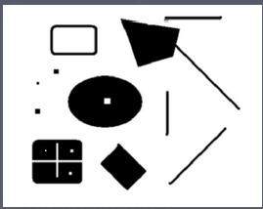
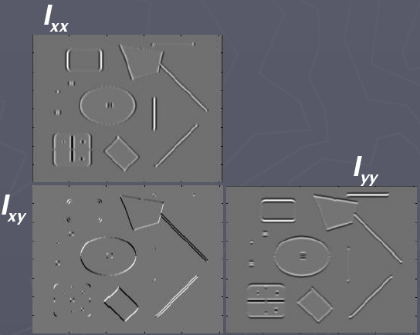
Second Moment Matrix or Harris Matrix
| Σ_{i}w_{i} I_{x} I_{x} Σ_{i}w_{i} I_{x} I_{y} |
| Σ_{i}w_{i} I_{x} I_{y} Σ_{i}w_{i} I_{y} I_{y} |
H =
2 x 2 matrix of image derivatives smoothed by Gaussian weights.
Notation:
First compute I_{x}, I_{y}, and I_{x} I_{x,} I_{y} I_{y,} I_{x}I_{y}; then apply Gaussian to each.
Notes:
3

Slide 4
From HW3: Structure matrix
Weighted sum of gradient information
| Σ_{i}w_{i}I_{x}(i)I_{x}(i) Σ_{i}w_{i}I_{x}(i)I_{y}(i) |
| Σ_{i}w_{i}I_{x}(i)I_{y}(i) Σ_{i}w_{i}I_{y}(i)I_{y}(i) |
Use Gaussian weighting
Eigen vectors/values of this matrix summarize the distribution of the gradients nearby
λ₁ and λ₂ are eigenvalues
λ₁ and λ₂ both small: no gradient
λ₁ >> λ₂: gradient in one direction
λ₁ and λ₂ similar: multiple gradient directions, corner
We’ll tell you how to store this!

Slide 5
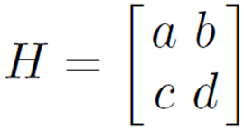
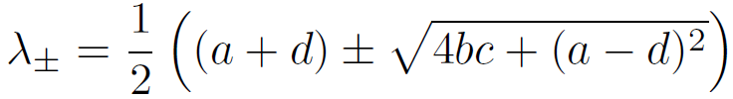

Estimating Response
A few methods we use to estimate:
Calculate these directly from the 2x2 matrix
det(S) = ad – bc = λ₁*λ₂
trace(S) = a + d = λ₁+λ₂
**Estimate formula 1: R = det(S) - α trace(S)² = λ₁λ₂ - α(λ₁+λ₂)²
---Estimate formula 2: R = det(S) / trace(S) = λ₁λ₂/(λ₁+λ₂)
If these estimates are large, λ₂ is large

Slide 6

Harris Corner Detector
Calculate derivatives I_{x} and I_{y}
Calculate 3 measures I_{x}I_{x}, I_{y}I_{y}, I_{x}I_{y}
Calculate weighted sums
Want a weighted sum of nearby pixels, guess what this is?
Gaussian!
Estimate response
Non-max suppression (just like Canny)

Slide 7
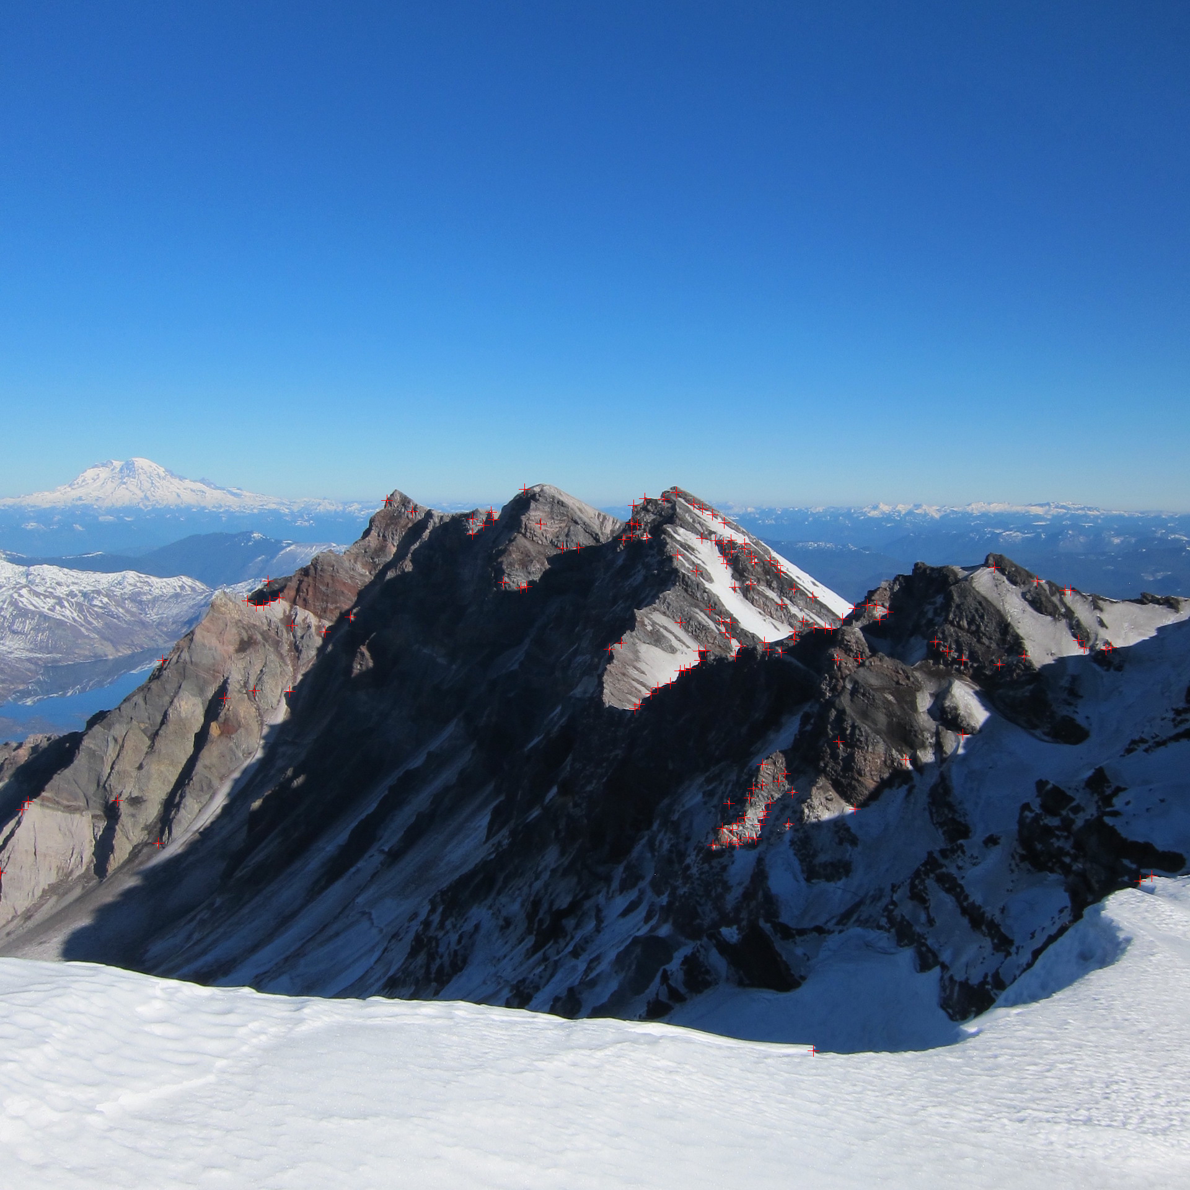

Slide 9
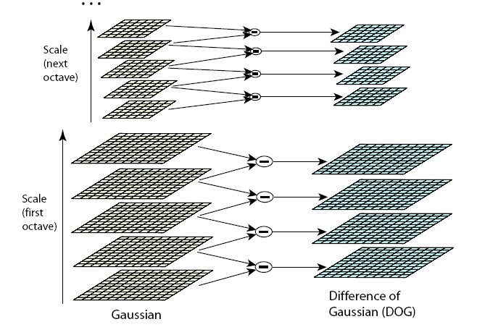
Lowe’s Pyramid Scheme
s+2 filters
σ_{s+1}=2^{(s+1)/s}σ₀
.
.
σ_{i}=2^{i/s}σ₀
.
.
σ₂=2^{2/s}σ₀
σ₁=2^{1/s}σ₀
σ₀
s+3
images
including
original
s+2
differ-
ence
images
The parameter s determines the number of images per octave.

Slide 10

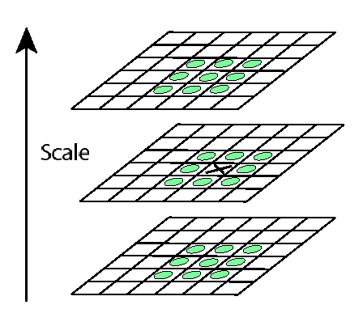
Key point localization
s+2 difference images.
top and bottom ignored.
s planes searched.
Detect maxima and minima of difference-of-Gaussian in scale space
Each point is compared to its 8 neighbors in the current image and 9 neighbors each in the scales above and below
For each max or min found,
output is the location and
the scale.

Slide 11
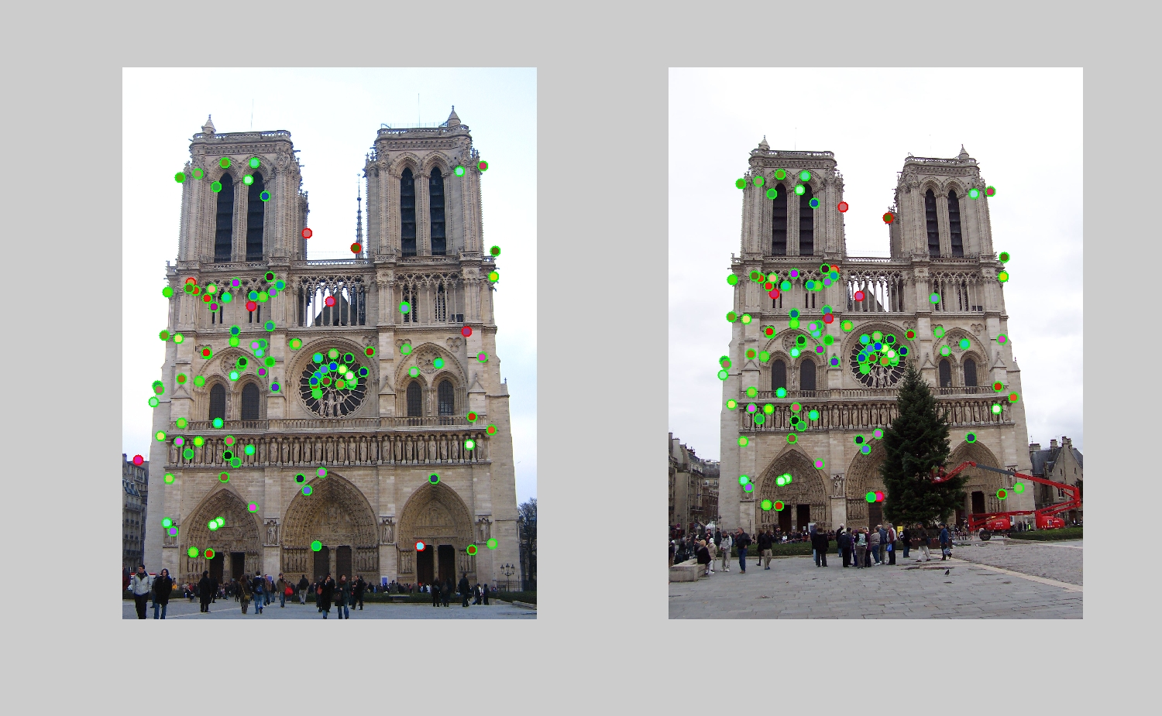

Slide 12
Important Point
People just say “SIFT”.
But there are TWO parts to SIFT.
an interest point detector
a region descriptor
They are independent. Many people use the region descriptor without looking for the points.

Slide 13
Descriptors
How are we going to describe the patch around each of the interest points we find in order to match them between images?
We will use a very simple descriptor.
Let’s look at that first.

Slide 14
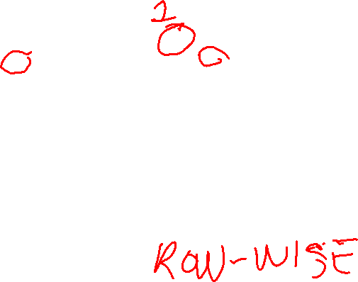
Simple Normalized Descriptor
interest point neighborhood around normalized neighborhood
interest point around interest point
56 200
201 200
85 101 105
145 1
0 1
116 100 96
201
The simple descriptor just subtracts each of the neighbors from the center value, including the center itself, to normalize for lighting and exposure.
We can store this as a 1D vector to be efficient:
156 145 1 155 0 1 116 100 96

Slide 15
Properties of our Descriptor
Translation Invariant
Not scale invariant
Not rotation invariant
Somewhat invariant to lighting changes
Let’s look at the SIFT descriptor, because it is heavily used, even without using the SIFT key point detector.
It already solves the scale problem by computing at multiple scales and keeping track.

Slide 16
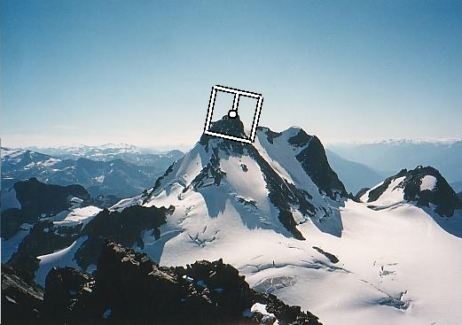
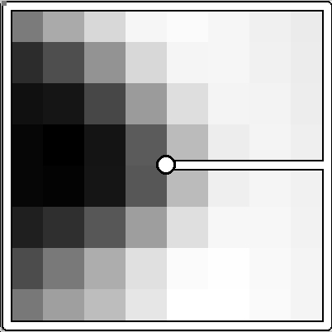
Rotation invariance
CSE 576: Computer Vision
Rotate patch according to its dominant gradient orientation
This puts the patches into a canonical orientation.
Image from Matthew Brown
Notes:
16

Slide 17
Orientation Normalization
Compute orientation histogram
Select dominant orientation
Normalize: rotate to fixed orientation
[Lowe, SIFT, 1999]
0
2
π
T. Tuytelaars, B. Leibe

Slide 18
Once we have found the key points and a dominant orientation for each,
we need to describe the (rotated and scaled) neighborhood about each.
128-dimensional vector

Slide 19
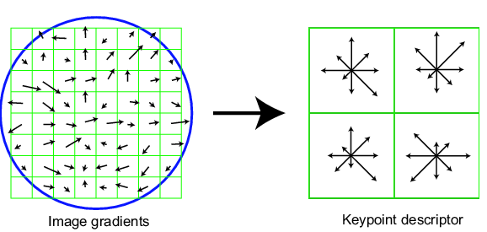
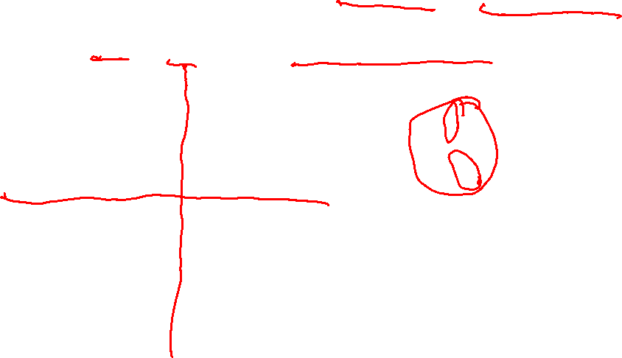
SIFT descriptor
Full version
Divide the 16x16 window into a 4x4 grid of cells (2x2 case shown below)
Compute an orientation histogram for each cell
16 cells * 8 orientations = 128 dimensional descriptor
Adapted from slide by David Lowe

Slide 20
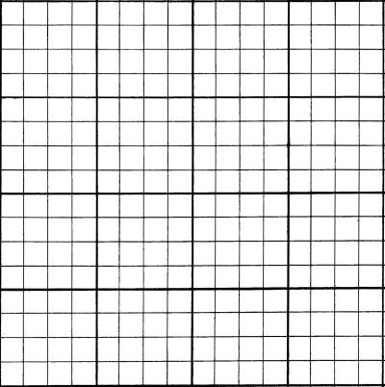

SIFT descriptor
Full version
Divide the 16x16 window into a 4x4 grid of cells
Compute an orientation histogram for each cell
16 cells * 8 orientations = 128 dimensional descriptor
8 8 . . . 8

Slide 21
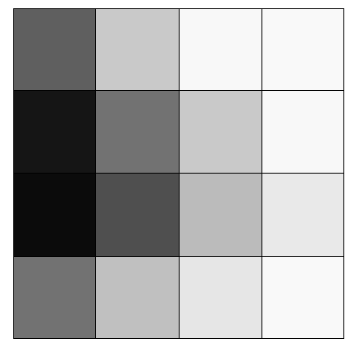
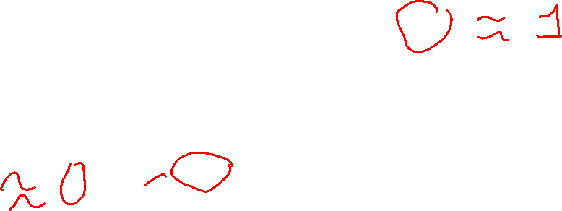
Numeric Example
0.37
0.79
0.97
0.98
0.08
0.45
0.79
0.97
0.04
0.31
0.73
0.91
0.45
0.75
0.90
0.98
by Yao Lu

Slide 22

The orientations all
ended up in two bins:
11 in one bin, 5 in the
other. (rough count)
Orientations in each of
the 16 pixels of the cell
5 11 0 0 0 0 0 0

Slide 23
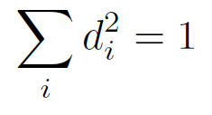

SIFT descriptor
Full version
Start with a 16x16 window (256 pixels)
Divide the 16x16 window into a 4x4 grid of cells (16 cells)
Compute an orientation histogram for each cell
16 cells * 8 orientations = 128 dimensional descriptor
Threshold normalize the descriptor:
such that:
0.2
Adapted from slide by David Lowe

Slide 24
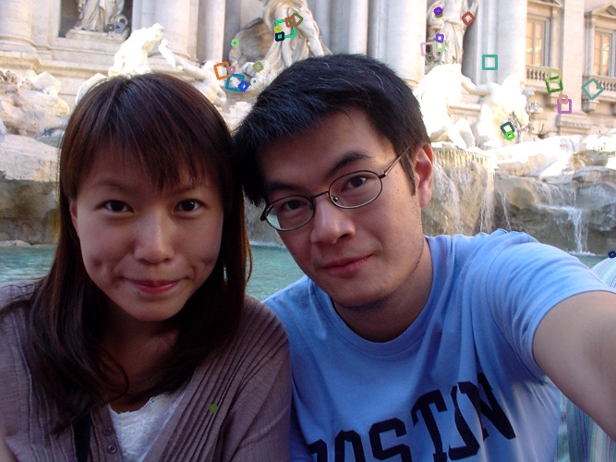
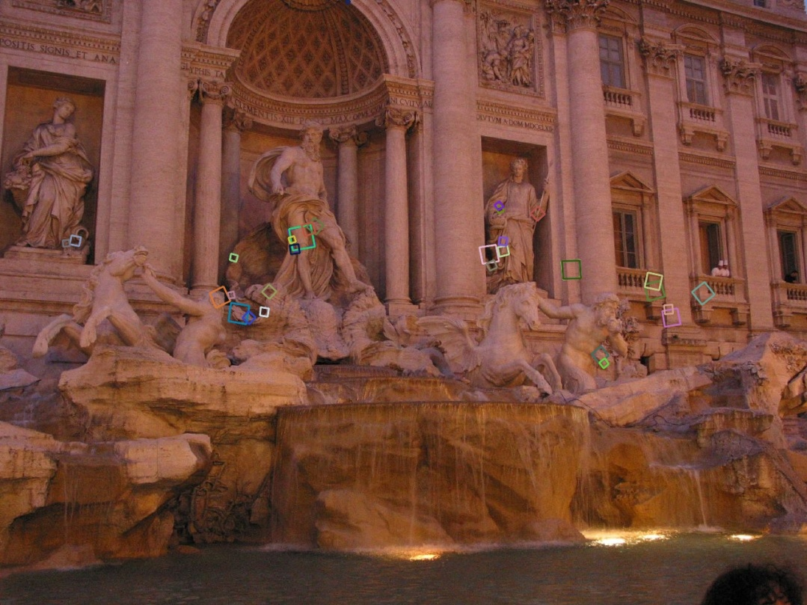

Properties of SIFT
Extraordinarily robust matching technique
Can handle changes in viewpoint
Up to about 30 degree out of plane rotation
Can handle significant changes in illumination
Sometimes even day vs. night (below)
Fast and efficient—can run in real time
Various code available
http://www.cs.ubc.ca/~lowe/keypoints/

Slide 25
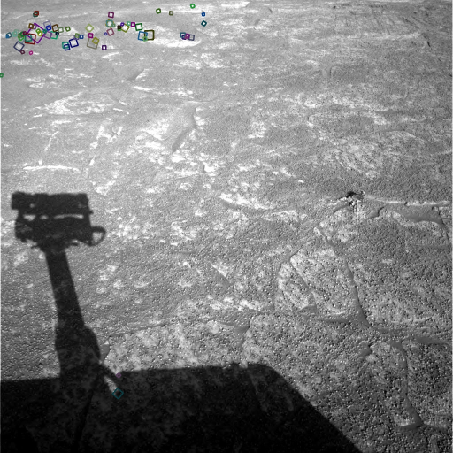
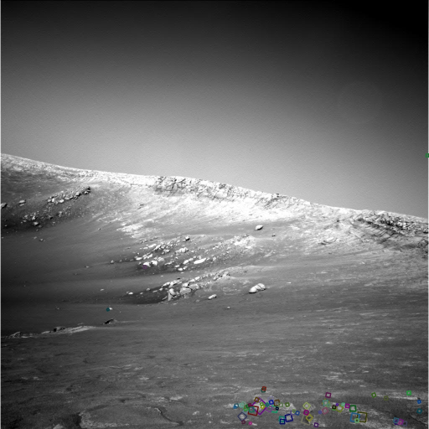
Example
NASA Mars Rover images
with SIFT feature matches Figure by Noah Snavely

Slide 26
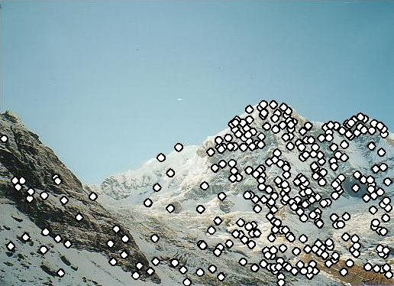
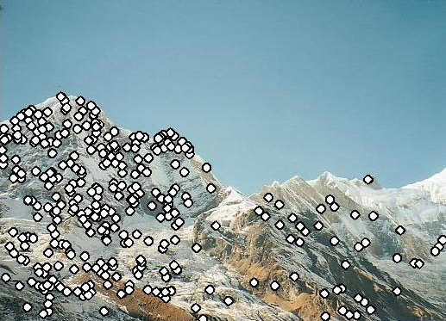
Matching with Features
Detect feature points in both images

Slide 27
Matching with Features
Detect feature points in both images
Find corresponding pairs

Slide 28

How do you find correspondences?
Put the descriptors from each image into vectors and match them
How do you compare two descriptors?
Vector distance
L1-Distance(A,B) = Σ_{i} |a_{i} - b_{i}|
L2-Distance(A,B) = Σ_{i} sqrt( a_{i}² –b_{i}²)
cosine distance (angle between 2 vectors)

Slide 29

Find the best matches
For each descriptor a in A, find its best match b in B
And store it in a vector of matches
Note: this is abstract; see code for details.
A B M
i j
i
j

Slide 30
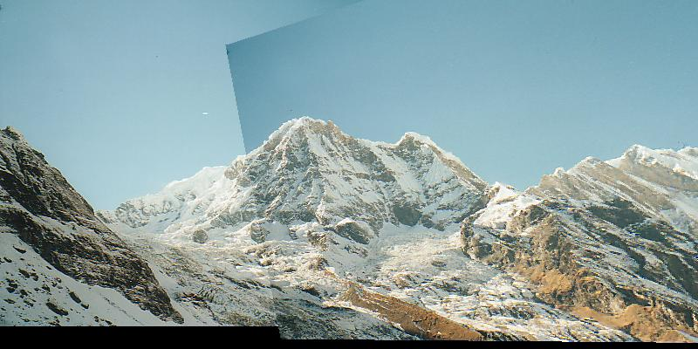
Matching with Features
Detect feature points in both images
Find corresponding pairs
Use these matching pairs to align images.

Slide 31
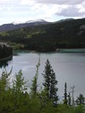
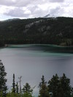
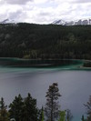
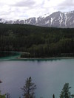
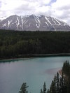
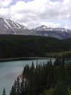
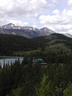
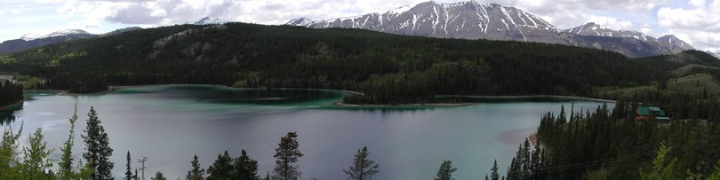
Larger Goal: Combine two or more overlapping images to make one larger image
Add example
Slide credit: Vaibhav Vaish

Slide 32
How to do it?
Basic Procedure
Take a sequence of images from the same position
(Rotate the camera about its optical center)
Compute transformation between second image and first
Shift the second image to overlap with the first
Blend the two together to create a mosaic
If there are more images, repeat

Slide 33
1. Take a sequence of images from the same position
Rotate the camera about its optical center

Slide 34
2. Compute transformation between images
Extract interest points
Find Matches
Compute transformation
?

Slide 35
3. Shift the images to overlap

Slide 36
4. Blend the two together to create a mosaic

Slide 37
5. Repeat for all images

Slide 38
How to do it?
Basic Procedure
Take a sequence of images from the same position
Rotate the camera about its optical center
Compute transformation between second image and first
Shift the second image to overlap with the first
Blend the two together to create a mosaic
If there are more images, repeat
✓

Slide 39

Compute Transformations
✓
Extract interest points
Find good matches
Compute transformation
✓
Let’s assume we are given a set of good matching interest points

Slide 40
Image reprojection
mosaic PP
The mosaic has a natural interpretation in 3D
The images are reprojected onto a common plane
The mosaic is formed on this plane

Slide 41
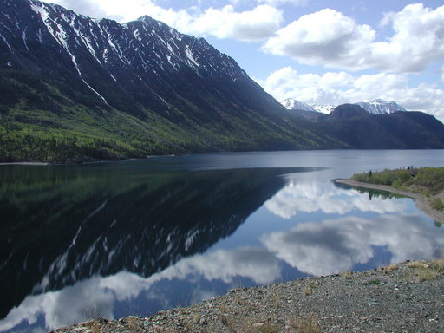
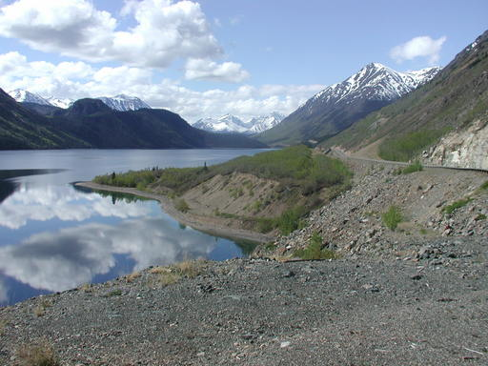
Example
Camera Center

Slide 42
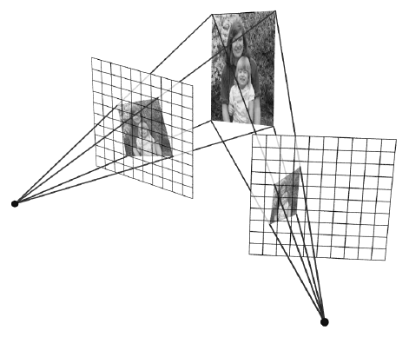
Image reprojection
Observation
Rather than thinking of this as a 3D reprojection, think of it as a 2D image warp from one image to another

Slide 43
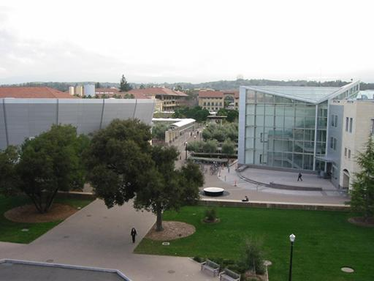
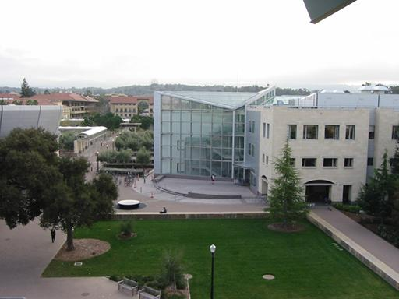
Motion models
What happens when we take two images with a camera and try to align them?
translation?
rotation?
scale?
affine?
Perspective?

Slide 44
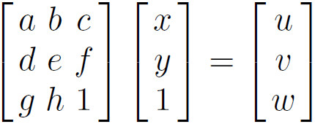


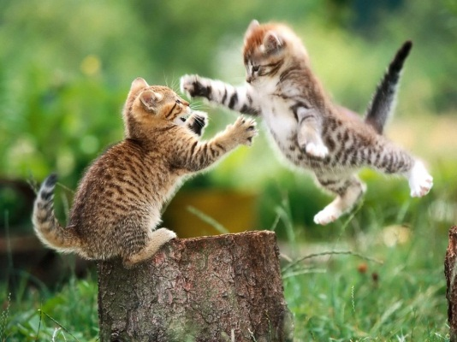



Projective transformations
(aka homographies)

Slide 45
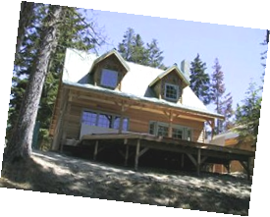
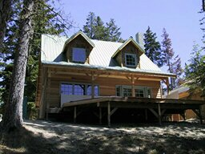
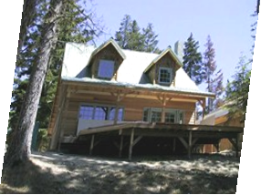
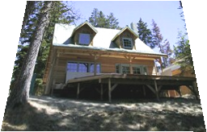
Parametric (global) warping
Examples of parametric warps:
translation
rotation
aspect
perspective
affine

Slide 46
2D coordinate transformations
translation: x’ = x + t x = (x,y)
rotation: x’ = R x + t
similarity: x’ = s R x + t
affine: x’ = A x + t
perspective: x’ ≅ H x x = (x,y,1) (x is a homogeneous coordinate)

Slide 47
Image Warping
Given a coordinate transform x’ = h(x) and a source image f(x), how do we compute a transformed image g(x’) = f(h(x))?
h(x)
x
x’
f(x)
g(x’)

Slide 48
Inverse Warping
Get each pixel g(x’) from its corresponding location x’ = h(x) in f(x)
What if pixel comes from “between” two pixels?
h⁻¹(x)
x
x’
f(x)
g(x’)

Slide 49
Inverse Warping
Get each pixel g(x’) from its corresponding location x’ = h(x) in f(x)
What if pixel comes from “between” two pixels?
Answer: We already know this: resample color value from interpolated source image
h⁻¹(x)
x
x’
f(x)
g(x’)

Slide 50
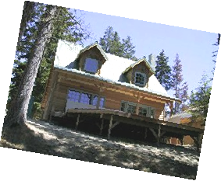
Interpolation
Possible interpolation filters:
nearest neighbor
bilinear
bicubic (interpolating)

Slide 51
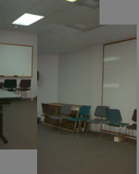
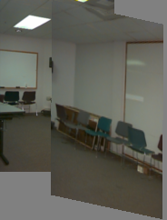
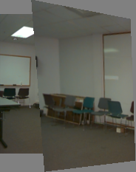
Motion models
Translation
Affine
Perspective
2 unknowns
6 unknowns
8 unknowns

Slide 52
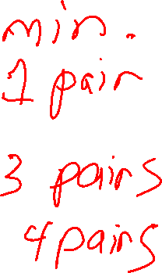
Finding the transformation
Translation = 2 degrees of freedom
Similarity = 4 degrees of freedom
Affine = 6 degrees of freedom
Homography = 8 degrees of freedom
How many corresponding points do we need to solve?

Slide 53
Plane perspective mosaics
8-parameter generalization of affine motion
works for pure rotation or planar surfaces
Limitations:
local minima
slow convergence
difficult to control interactively

Slide 54
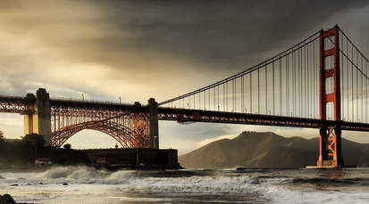


Simple case: translations
How do we solve for
?

Slide 55






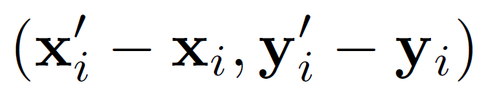


Simple case: translations
Displacement of match i =
Mean displacement =

Slide 56


Simple case: translations
System of linear equations
What are the knowns? Unknowns?
How many unknowns? How many equations (per match)?

Slide 57
Simple case: translations
Problem: more equations than unknowns
“Overdetermined” system of equations
We will find the least squares solution

Slide 58



Least squares formulation
For each point
we define the residuals as

Slide 59

Least squares formulation
Goal: minimize sum of squared residuals
“Least squares” solution
For translations, is equal to mean displacement

Slide 60






Solving for translations
Using least squares
2n x 2
2 x 1
2n x 1

Slide 61




Least squares
Find t that minimizes
To solve, form the normal equations

Slide 62


Affine transformations
How many unknowns?
How many equations per match?
x´ = ax + by + c; y´ = dx + ey +f
How many matches do we need?

Slide 63




Affine transformations
Residuals:
Cost function:

Slide 64

Affine transformations
Matrix form
2n x 6
6 x 1
2n x 1

Slide 65

Solving for homographies
Why is this now a variable and not just 1?
A homography is a projective object, in that it has no scale.
It is represented by the above matrix, up to scale.
One way of fixing the scale is to set one of the coordinates to 1,
though that choice is arbitrary.
But that’s what most people do and your assignment code does.

Slide 66



Solving for homographies
Why the division?

Slide 67


Solving for homographies
This is just for one pair of points.

Slide 68







Direct Linear Transforms (n points)
2n × 9
9
2n
Defines a least squares problem:
Since is only defined up to scale, solve for unit vector
Solution: = eigenvector of with smallest eigenvalue
Works with 4 or more points

Slide 69
Direct Linear Transforms
Why could we not solve for the homography in exactly the same way we did for the affine transform, ie.

Slide 70


Answer from Sameer Agarwal (Dr. Rome in a Day)
For an affine transform, we have equations of the form Ax_{i} + b = y_{i}, solvable by linear regression.
For the homography, the equation is of the form
Hx̃_{i} ̴ ỹ_{i} (homogeneous coordinates)
and the ̴ means it holds only up to scale. The affine solution does not hold.

Slide 71

Matching features
What do we do about the “bad” matches?

Slide 72
RAndom SAmple Consensus
Select one match, count inliers

Slide 73
RAndom SAmple Consensus
Select one match, count inliers

Slide 74
Least squares fit (from inliers)
Find “average” translation vector

Slide 75



Slide 76
RANSAC for estimating homography
RANSAC loop:
Select four feature pairs (at random)
Compute homography H (exact)
Compute inliers where ||p_{i}´, H p_{i}|| < ε
Keep largest set of inliers
Re-compute least-squares H estimate using all of the inliers

Slide 77
Simple example: fit a line
Rather than homography H (8 numbers) fit y=ax+b (2 numbers a, b) to 2D pairs
77

Slide 78
Simple example: fit a line
Pick 2 points
Fit line
Count inliers
3 inliers
78

Slide 79
Simple example: fit a line
Pick 2 points
Fit line
Count inliers
4 inliers
79

Slide 80
Simple example: fit a line
Pick 2 points
Fit line
Count inliers
9 inliers
80

Slide 81
Simple example: fit a line
Pick 2 points
Fit line
Count inliers
8 inliers
81

Slide 82
Simple example: fit a line
Use biggest set of inliers
Do least-square fit
82

Slide 83
What still needs to be fixed?
The planar projections may not work so well
Your homework uses cylindrical projections instead.

Slide 84
Panorama algorithm:
Find corners in both images Calculate descriptors Match descriptors RANSAC to find homography Stitch together images with homography
NEXT TIME.

