Slide 1
Depth Camera, 3D Reconstruction, and Applications
Jeong Joon Park

Slide 2
Overview
Range Imaging -- Why use it? How does it work?
a. Structured Light Sensor Mechanism
Depth Sensor-based 3D reconstruction
Explicit vs Implicit Representation
Signed Distance Function
SDF Fusion
Depth-based Tracking
Recent Developments
DynamicFusion
Appearance Reconstruction
Learning on SDF

Slide 3
Depth Camera: Core of AR Technology
Automonous Driving: https://www.youtube.com/watch?v=JC94Y063x58
Magic Leap Demo: https://www.youtube.com/watch?v=kPMHcanq0xM

Slide 4
Depth Sensor
Passive Depth -- Stereo
ToF Camera
Phase Modulated, Lidar, etc
Structured Light Sensor
Kinect

Slide 5
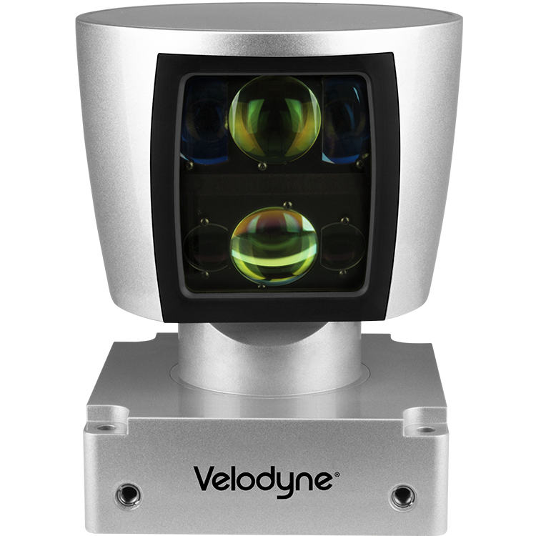
Depth Sensor
Passive Depth -- Stereo
ToF Camera
Phase Modulated, Lidar, etc
Structured Light Sensor
Kinect

Slide 6
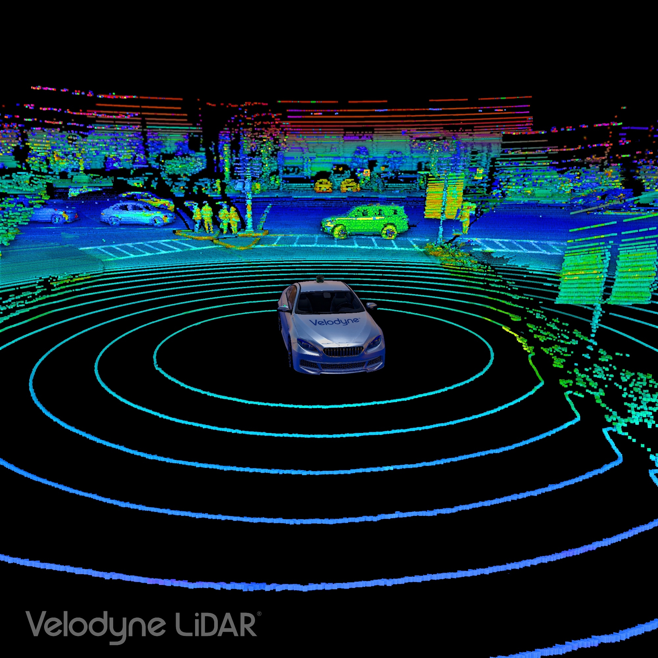
Depth Sensor
Passive Depth -- Stereo
ToF Camera
Phase Modulated, Lidar, etc
Structured Light Sensor
Kinect

Slide 7
Depth Sensor
Passive Depth -- Stereo
ToF Camera
Phase Modulated, Lidar, etc
Structured Light Sensor
Kinect, Hololens

Slide 8
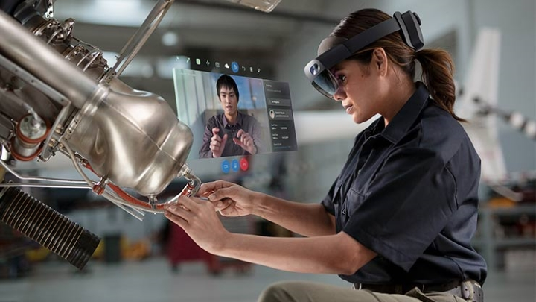
Depth Sensor
Passive Depth -- Stereo
ToF Camera
Phase Modulated, Lidar, etc
Structured Light Sensor
Kinect, Hololens

Slide 9
Depth Sensor
Passive Depth -- Stereo
ToF Camera
Phase Modulated, Lidar, etc
Structured Light Sensor
Kinect, Hololens

Slide 10
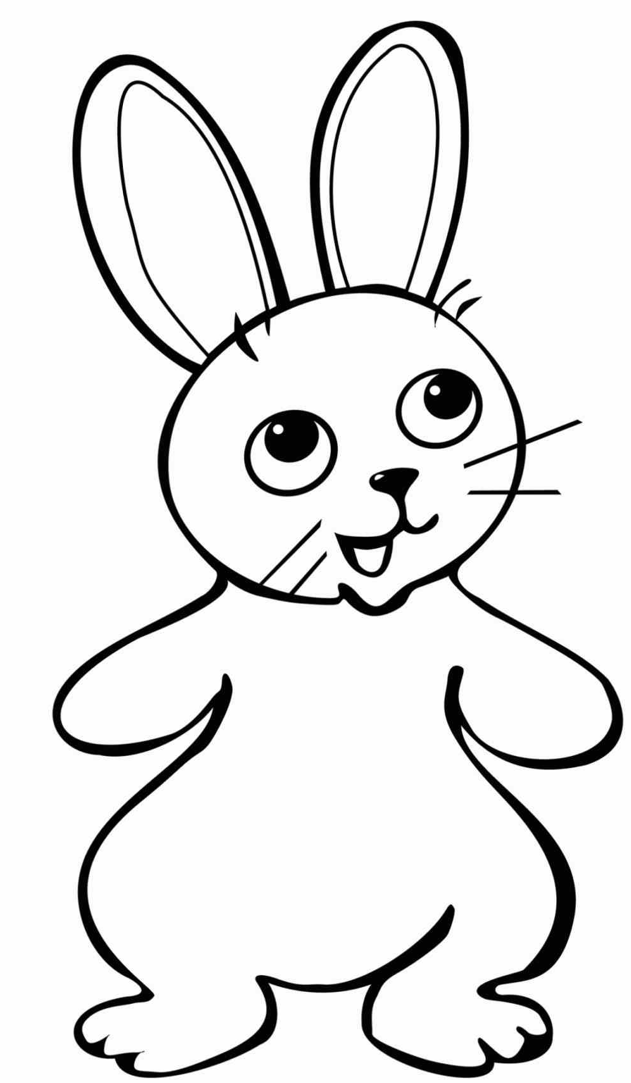
Stereo-Based Depth

Slide 11
Stereo-Based Depth

Slide 12
Stereo-Based Depth

Slide 13
Stereo-Based Depth

Slide 14
Stereo-Based Depth -- fails for textureless case

Slide 15
Stereo-Based Depth -- fails for textureless case

Slide 16
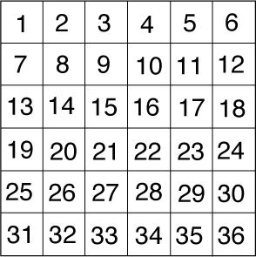
Active Depth Camera – IR Projector

Slide 17
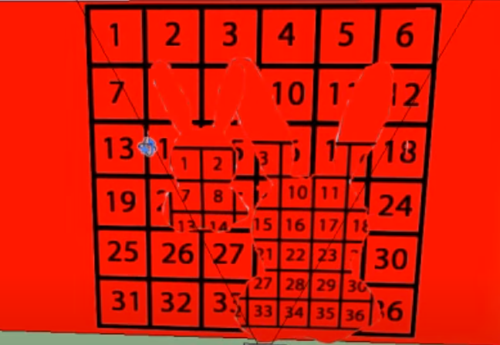
Active Depth Camera -- Projector

Slide 18
Active Depth Camera -- Projector

Slide 19
Active Depth Camera – Speckle Pattern

Slide 20
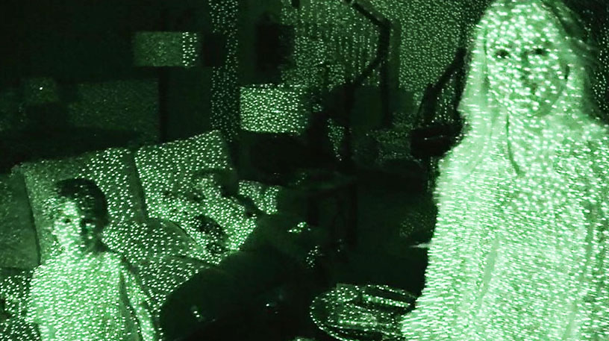

Slide 21
Active Depth Camera

Slide 22
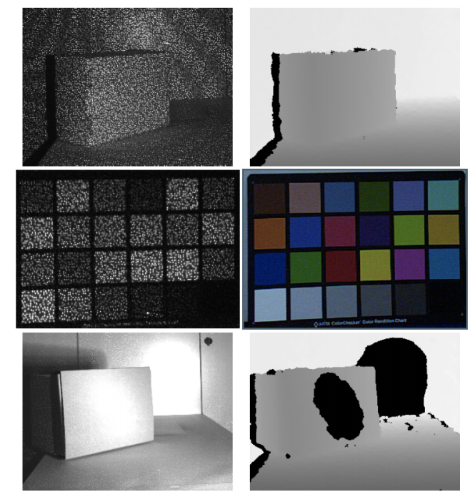
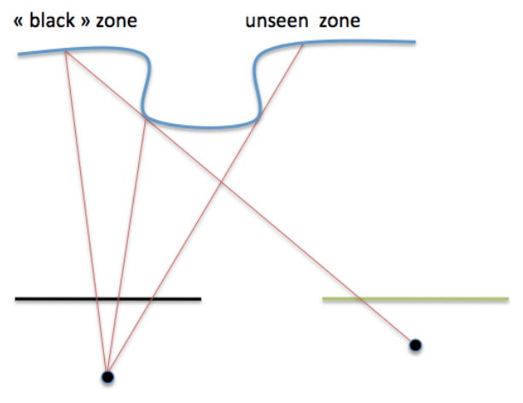
Failure Modes
Notes:
Fails when there is occlusion, too dark surfaces, specular highlights, outdoor where IR is abundant

Slide 23
KinectFusion Video
https://www.youtube.com/watch?v=quGhaggn3cQ
Newcombe, Richard A., et al. "KinectFusion: Real-time dense surface mapping and tracking." 2011 10th IEEE International Symposium on Mixed and Augmented Reality. IEEE, 2011.

Slide 24
Dense 3D Reconstruction (KinectFusion 2011)
Signed Distance Function (SDF)
Raycasting
SDF Fusion [Curless 1996]
Tracking (Iterative Closest Point) [Rusinkiewicz 2001]

Slide 25
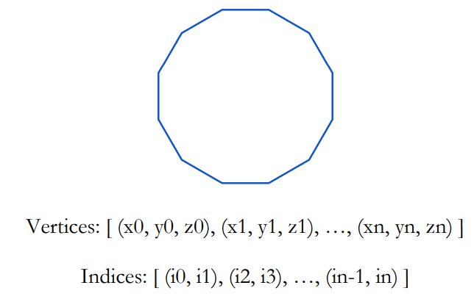
Explicit Surface Representation
Explicitly Carry List of Vertices and Lines
E.g. Triangle Mesh

Slide 26
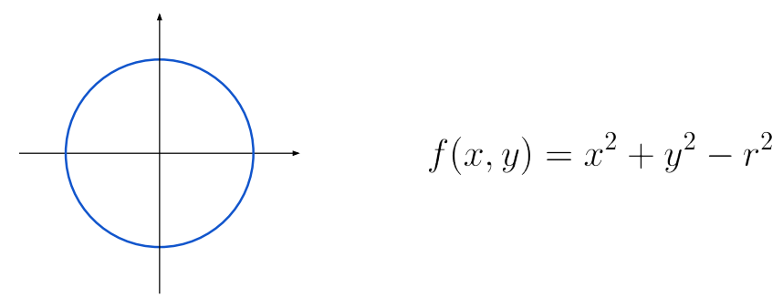
Implicit Surface Representation
Implicitly represent the surface through level set
E.g. parametric equation – zero level set!
F(x,y) = 0

Slide 27
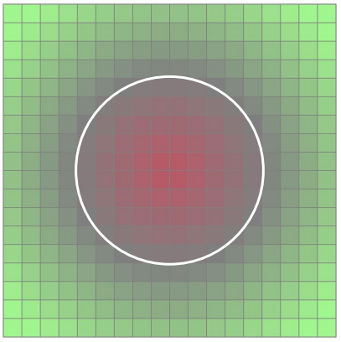
Implicit Surface Representation
Implicitly represent the surface through level set
E.g. Non-parametric – zero level set!

Slide 28
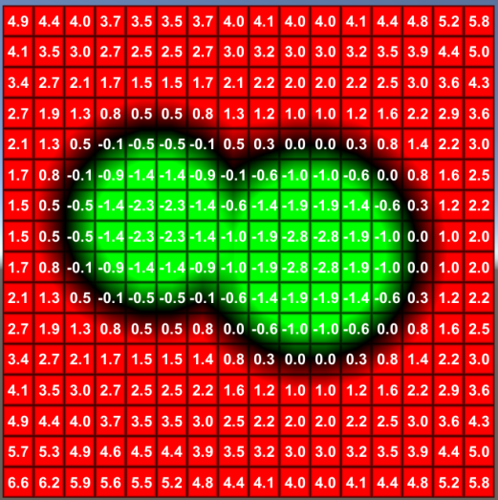
Signed Distance
Distance to Closest Surface

Slide 29
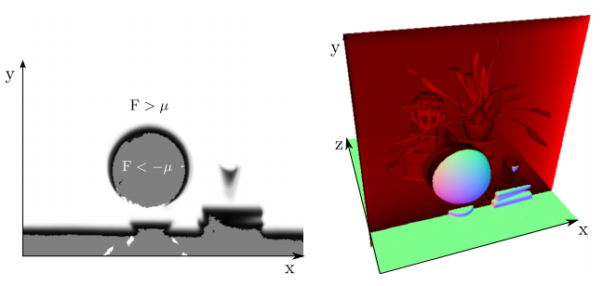
Implicit Surface Representation
Implicitly represent the surface through level set
Represent Arbitrary Topology!

Slide 30
Implicit -> Explicit Conversion
Marching Cubes / Squres
1. Thresholding

Slide 31
Implicit -> Explicit Conversion
Marching Cubes / Squres
1. Thresholding

Slide 32
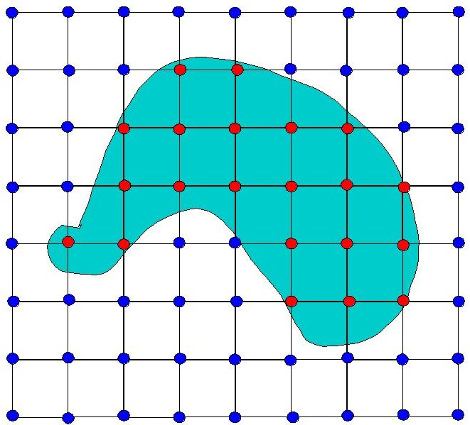
Implicit -> Explicit Conversion
Lookup Codebook for Marching Cubes / Squres

Slide 33
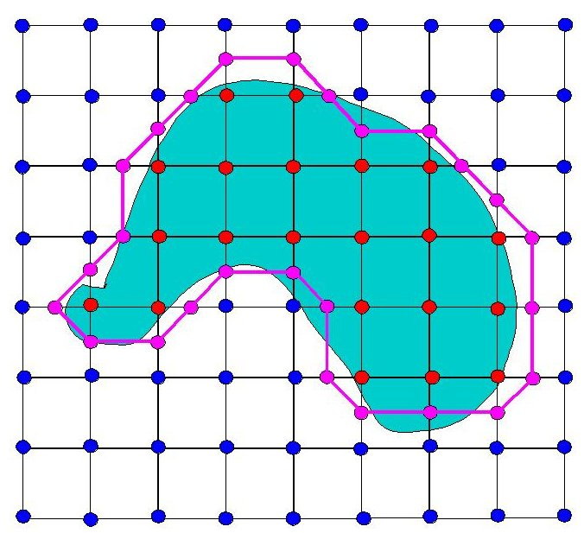
Implicit -> Explicit Conversion
Lookup Codebook for Marching Cubes / Squres

Slide 34
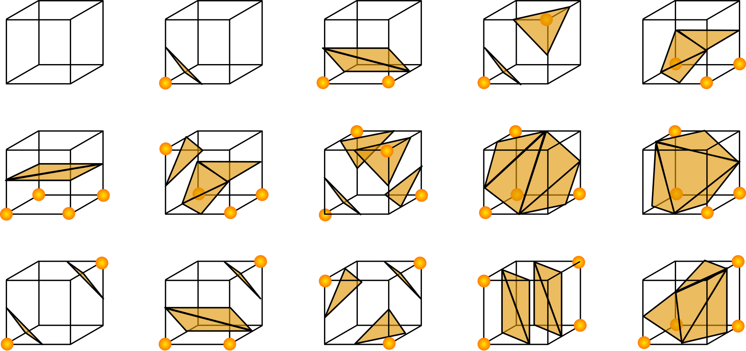
Implicit -> Explicit Conversion
3D Marching Cubes
Lorensen, William E., and Harvey E. Cline. "Marching cubes: A high resolution 3D surface construction algorithm." ACM siggraph computer graphics 21.4 (1987): 163-169.

Slide 35
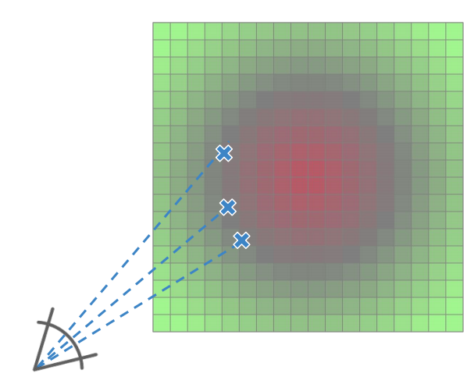
Implicit -> Explicit Conversion
RayCasting → produce depth map

Slide 36
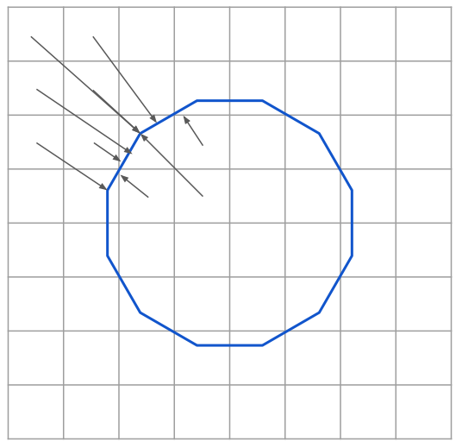
Implicit -> Explicit Conversion
Raycasting: Arbitrary Accuracy

Slide 37
Dense 3D Reconstruction (KinectFusion 2011)
Signed Distance Function (SDF)
Marching Cubes, Raycasting
SDF Fusion (Curless 1996)
Tracking (Iterative Closest Point)

Slide 38
SDF Fusion
Range Sensing to Volumetric SDFs
Projective SDF vs True SDF
SDF Averaging Fusion
Newcombe, Richard A., et al. "KinectFusion: Real-time dense surface mapping and tracking." 2011 10th IEEE International Symposium on Mixed and Augmented Reality. IEEE, 2011.
Curless, Brian, and Marc Levoy. "A volumetric method for building complex models from range images." Proceedings of the 23rd annual conference on Computer graphics and interactive techniques. 1996.

Slide 39
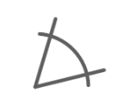
Fusing Multi-view Depth
Range Observations
Known Camera Poses

Slide 40
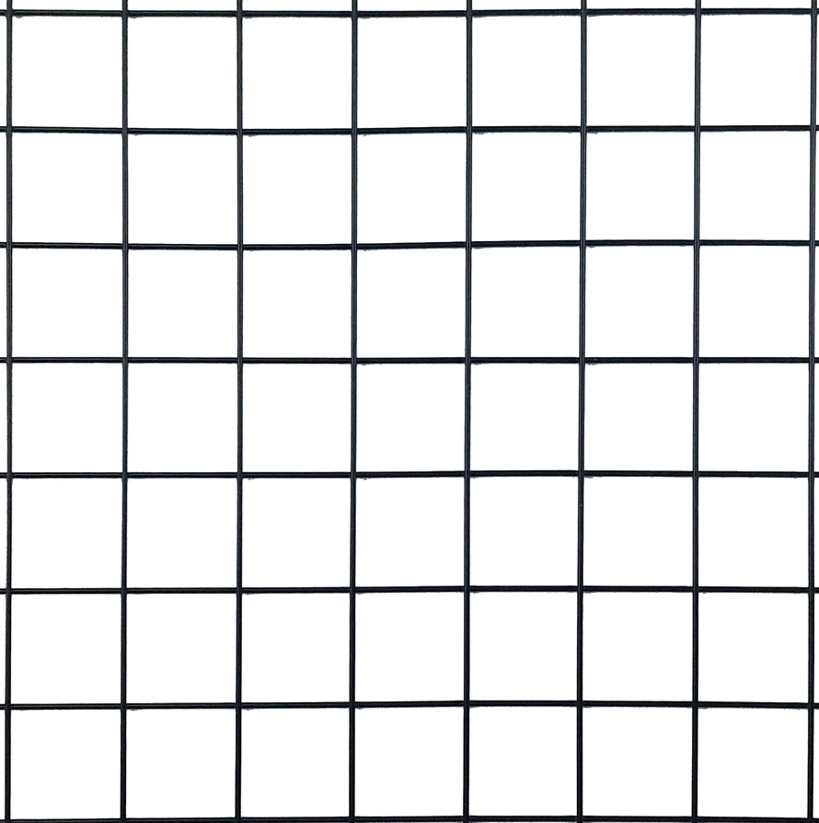
Fusing Multi-view Depth

Slide 41
Fusing Multi-view Depth
d

Slide 42
Fusing Multi-view Depth
-1.0
-0.5
-0.1
0.0
0.2
0.2
0.5
1.0

Slide 43
Projective vs True SDF
-1.0
-0.5
-0.1
0.0
0.2
0.2
0.5
1.0

Slide 44
Projective vs True SDF
Only precise at zero-crossing,
which is fine when interested in surface reconstruction.
-1.0
-0.5
-0.1
0.0
0.2
0.2
0.5
1.0

Slide 45
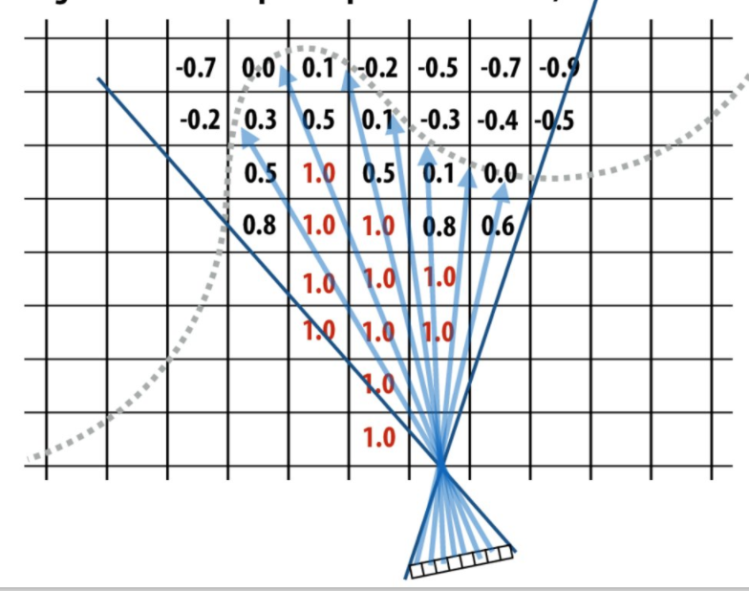
Projective vs True SDF

Slide 46
Projective vs True SDF -- Averaging!
-1.0
-0.5
-0.1
0.0
0.2
0.2
0.5
1.0

Slide 47
Projective SDF, Why Averaging?
Measurement: r_1, r_2, r_3, …
Averaging is optimal in least squares sense

Slide 48
Projective SDF, Why Averaging?
Measurement: r_1, r_2, r_3, …
Weighted Averaging: Weights based on view-angle, camera speed, etc

Slide 49
Projective SDF, Why Averaging?
Measurement: r_1, r_2, r_3, …
Weighted Averaging: Weights based on view-angle, camera speed, etc
Provably Optimal in Least Squares sense
Curless, Brian, and Marc Levoy. "A volumetric method for building complex models from range images." Proceedings of the 23rd annual conference on Computer graphics and interactive techniques. 1996.

Slide 50
Dense 3D Reconstruction (KinectFusion 2011)
Signed Distance Function (SDF)
Raycasting
SDF Fusion (Curless 1996)
Tracking (Iterative Closest Point)

Slide 51
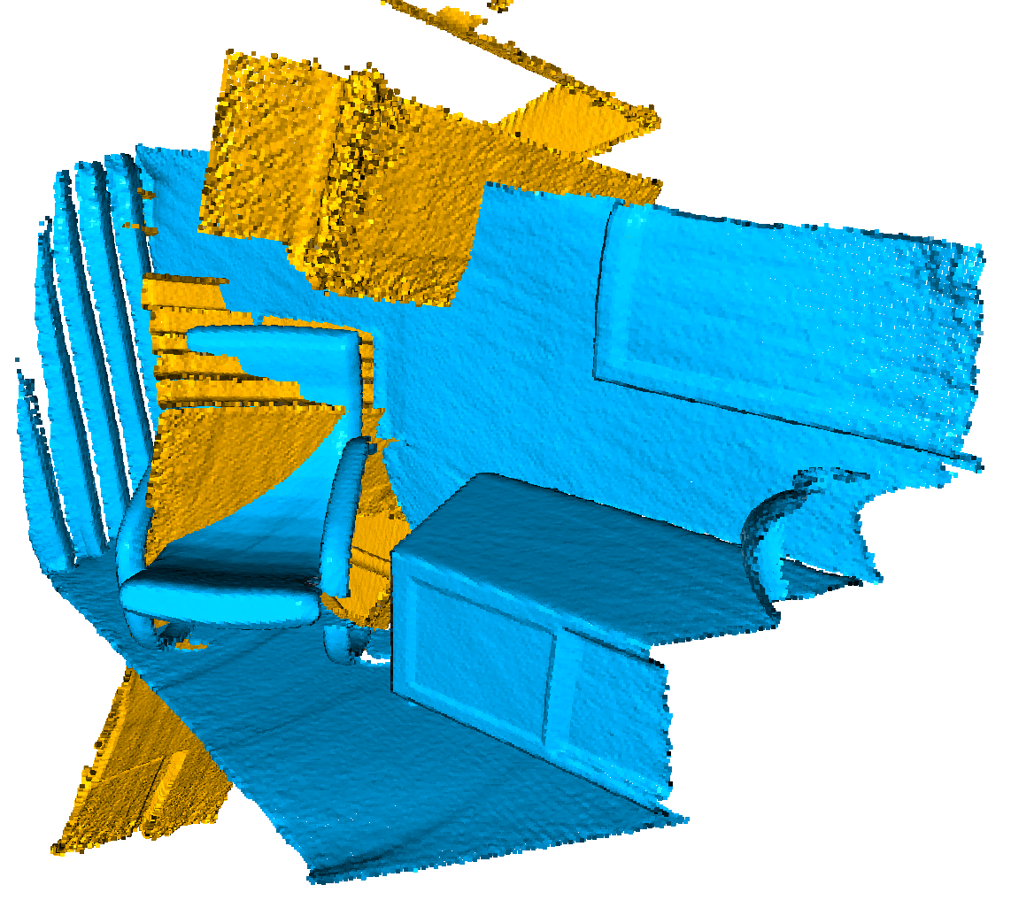
Camera Tracking
Registering two Point Clouds

Slide 52
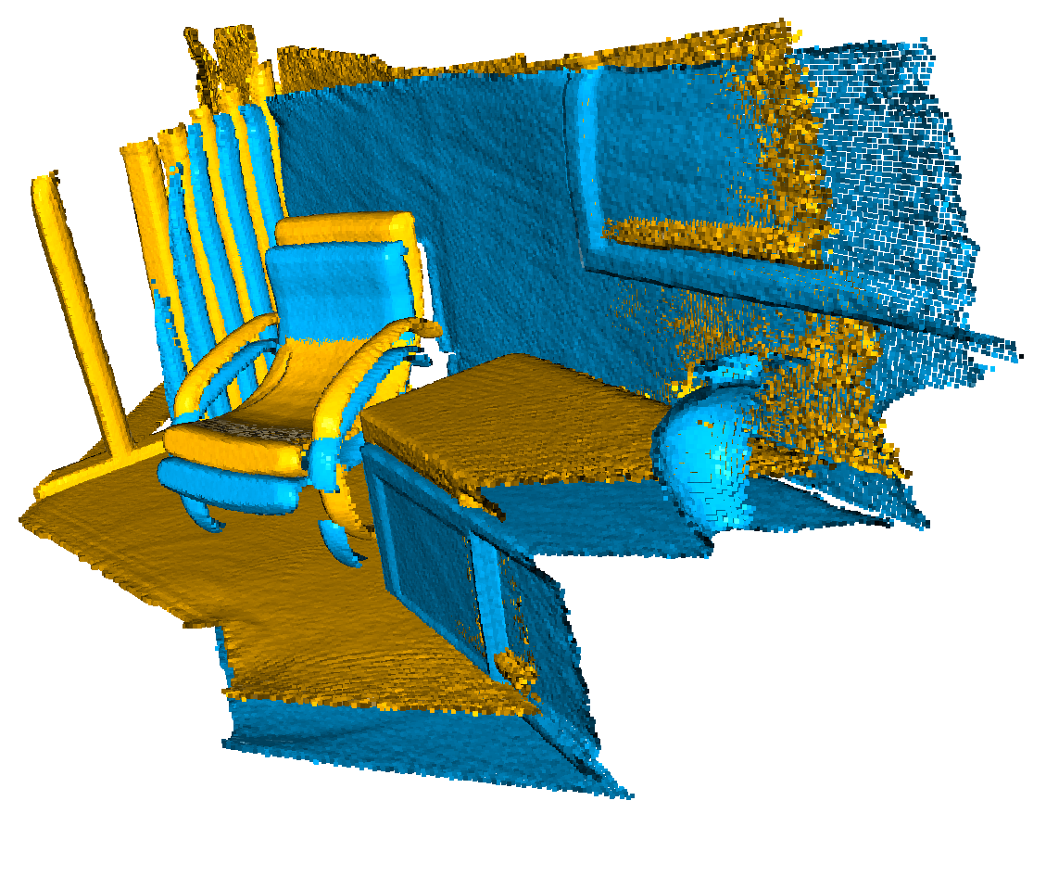
Camera Tracking
Registering two Point Clouds

Slide 53
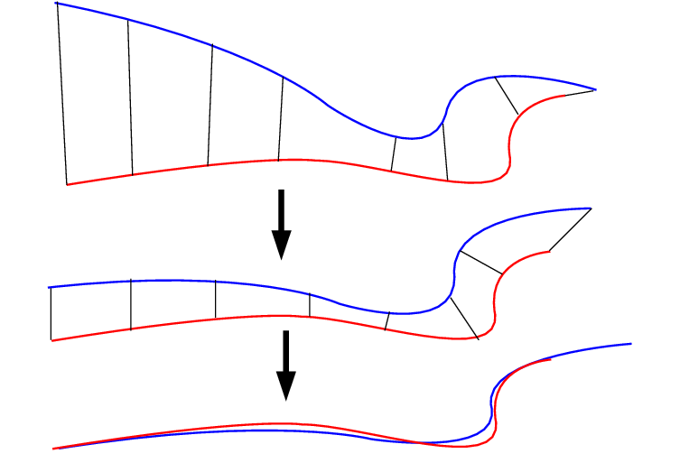
Camera Tracking
Registering two Point Clouds
Iterative Closest Point
[Besl and McKay 1992]
Besl, Paul J., and Neil D. McKay. "Method for registration of 3-D shapes." Sensor fusion IV: control paradigms and data structures. Vol. 1611. International Society for Optics and Photonics, 1992.

Slide 54
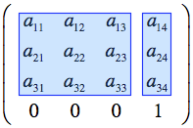
Camera Tracking
Step 1. Find Correspondence
Correspondence set
Transformation Matrix

Slide 55
Camera Tracking
Step 2: Minimize distance between correspondences

Slide 56
Camera Tracking
Step 2: Minimize distance between correspondences
by finding optimal Transformation using Small-angle approximation
https://www.comp.nus.edu.sg/~lowkl/publications/lowk_point-to-plane_icp_techrep.pdf

Slide 57
Camera Tracking
Iterate Step 1 & 2
Until the energy is low enough!

Slide 58
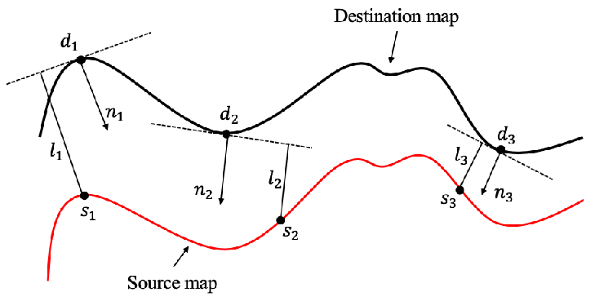
Camera Tracking
Often use Point-to-Plane loss [Rusinkiewicz 2001]
Converges Faster

Slide 59
Camera Tracking
Often use Point-to-Plane loss [Rusinkiewicz 2001]
Converges Faster
Rusinkiewicz, Szymon, and Marc Levoy. "Efficient variants of the ICP algorithm." Proceedings Third International Conference on 3-D Digital Imaging and Modeling. IEEE, 2001.

Slide 60
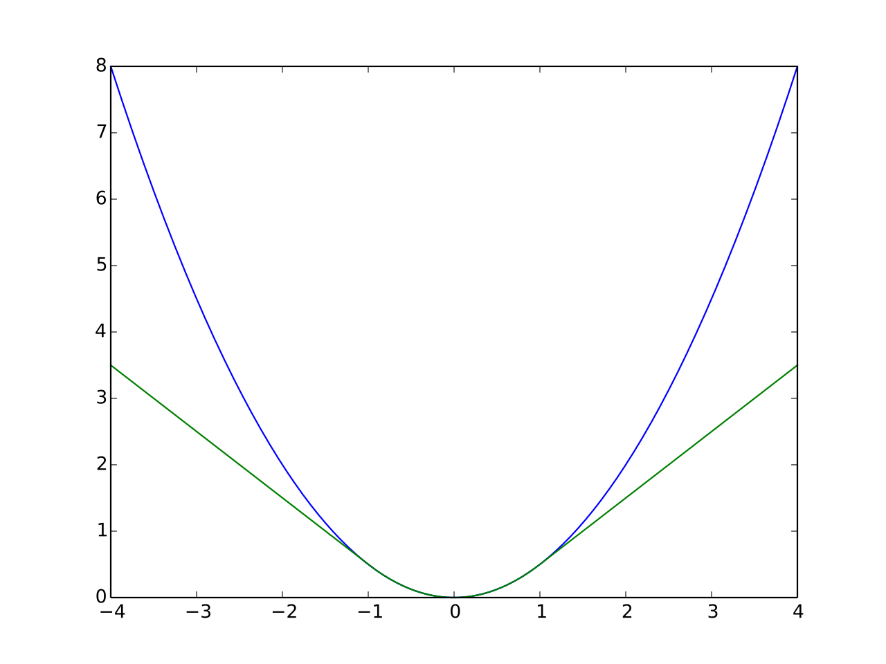
Camera Tracking
Robust Loss: [Huber 1964], reduce effects of outliers
Huber, Peter J. (1964). "Robust Estimation of a Location Parameter". Annals of Statistics. 53 (1): 73–101. doi:10.1214/aoms/1177703732. JSTOR 2238020.

Slide 61
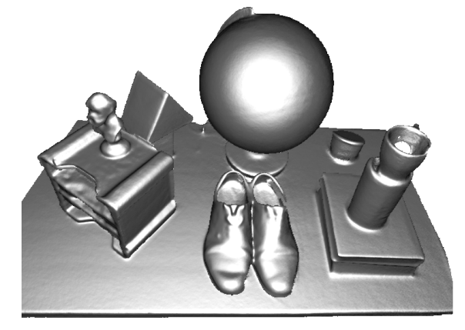
Dense 3D Reconstruction (KinectFusion 2011)
Signed Distance Function (SDF)
Raycasting
SDF Fusion (Curless 1996)
Tracking (Iterative Closest Point)

Slide 62
Applications
Appearance & Lighting Reconstruction
DeepSDF

Slide 63
Seeing the World in a Bag of Chips

Slide 64
Seeing the World in a Bag of Chips

Slide 65
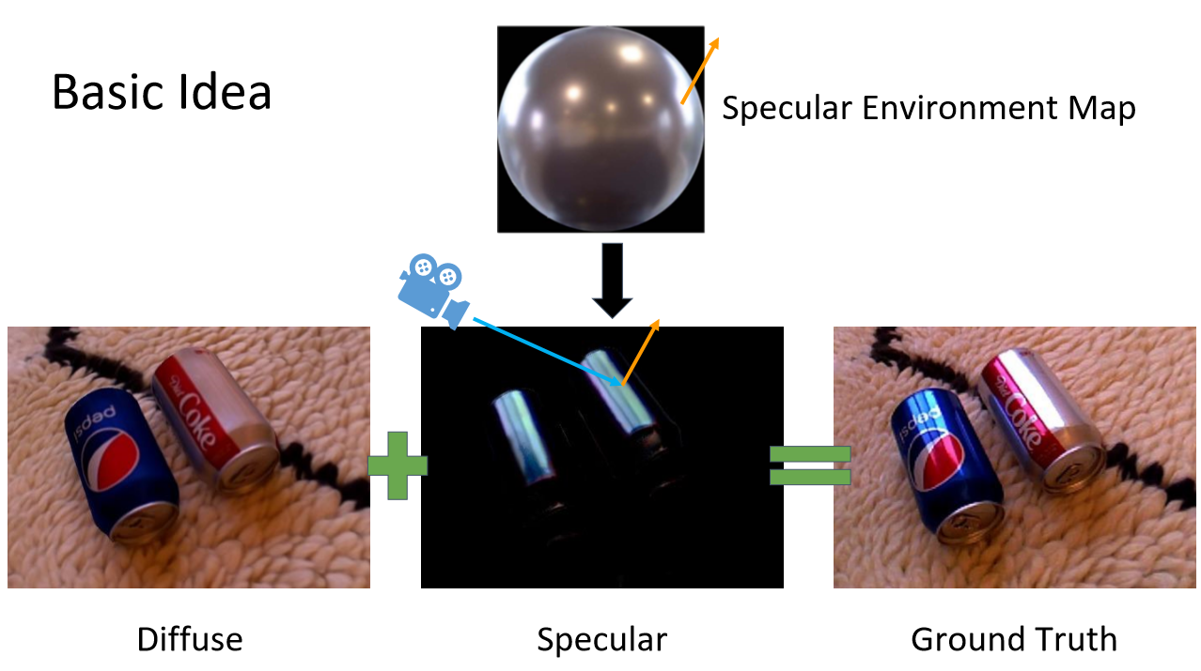
Seeing the World in a Bag of Chips

Slide 67
Notes:
This is a video showing the rendering of novel-viewpoints. Please note how accurately the neural rendering predicts specular highlights for novel-view synthesis.

Slide 69
DeepSDF: Learning Continuous SDFs for Shape Representation
Jeong Joon Park, Peter Florence, Julian Straub,
Richard Newcombe, Steven Lovegrove

Slide 70
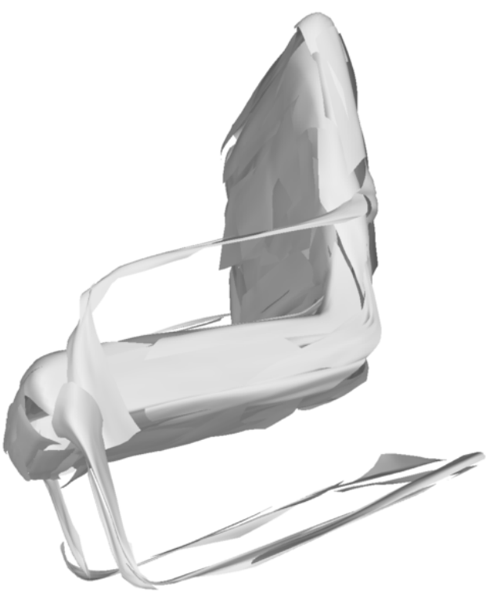
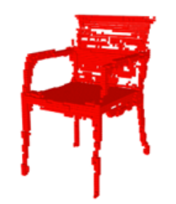
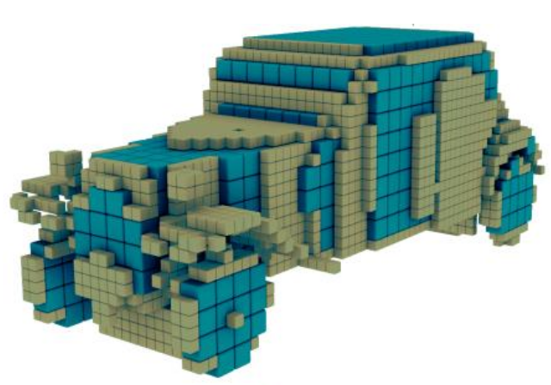
Representations for 3D Deep Learning
Wu et al. 2016
Tatarchenko et al. 2015
Groueix et al. 2018

Slide 71
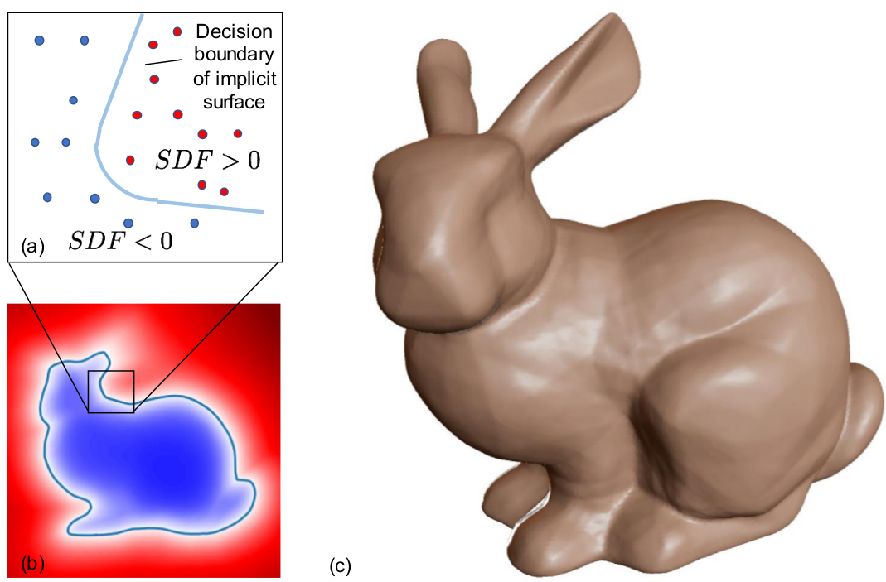
Key Idea: Directly regress SDF

Slide 72
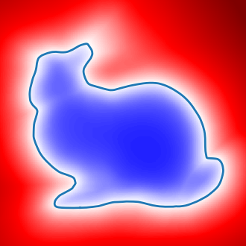
Signed Distance Function

Slide 73
Signed Distance Function

Slide 74
Signed Distance Function

Slide 75
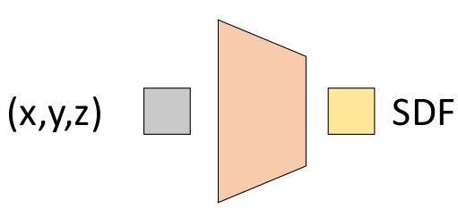
Direct Regression of SDF

Slide 76
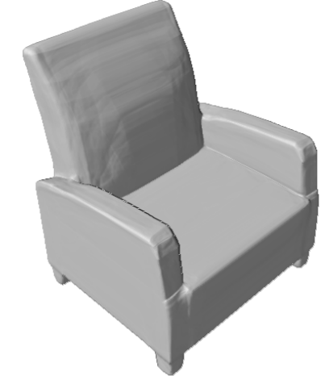
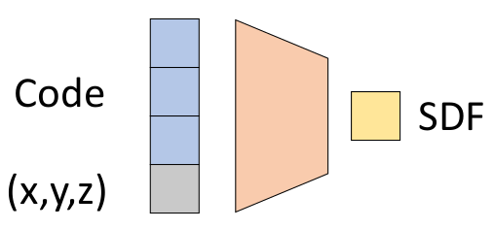
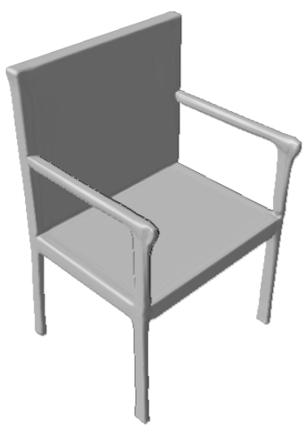
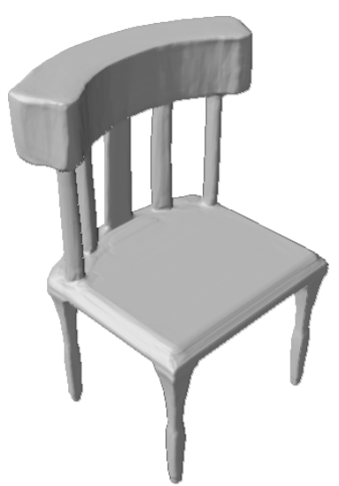
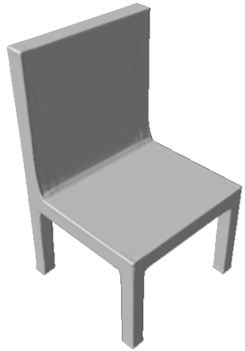
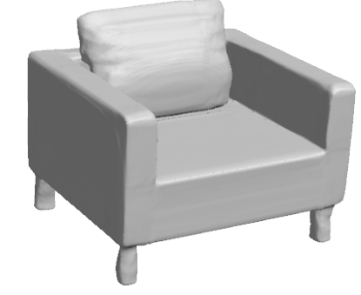
Coding Multiple Shapes

Slide 79
References
KinectFusion: https://www.microsoft.com/en-us/research/wp-content/uploads/2016/02/ismar2011.pdf
Curless 1996: https://graphics.stanford.edu/papers/volrange/volrange.pdf
Seeing the World in a Bag of Chips: https://youtu.be/9t_Rx6n1HGA
DeepSDF: https://arxiv.org/abs/1901.05103
Tanner Schmidt: https://courses.cs.washington.edu/courses/cse571/16au/slides/10-sdf.pdf
CuriousInventor: https://www.youtube.com/watch?v=uq9SEJxZiUg
Carleton lecture note: http://www.cs.carleton.edu/cs_comps/0405/shape/marching_cubes.html
ICP: https://www.comp.nus.edu.sg/~lowkl/publications/lowk_point-to-plane_icp_techrep.pdf

