Slide 1
Image Stitching II
Linda Shapiro
ECE/CSE 576

Slide 2
Review
So far
Find points (Harris or SIFT)
Describe points
Find a good set of consistent matches using RANSAC
Produce the final homography that can transform one image into the space of the other.

Slide 3
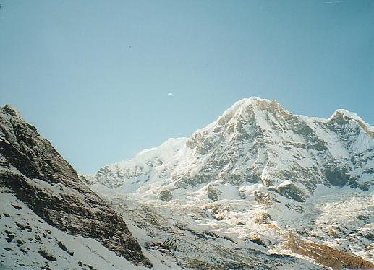
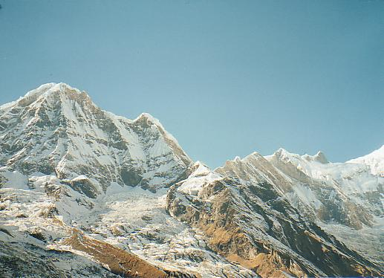
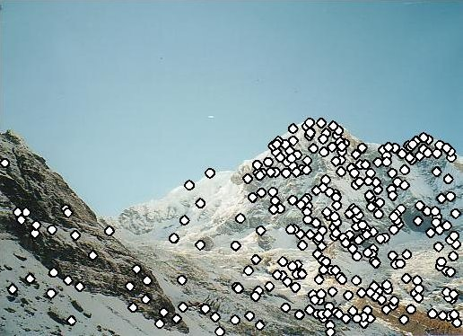
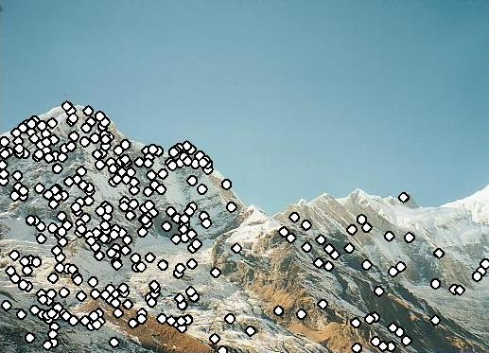
RANSAC for Homography
Initial Matched Points

Slide 4
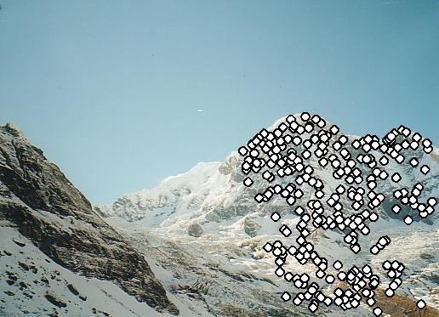
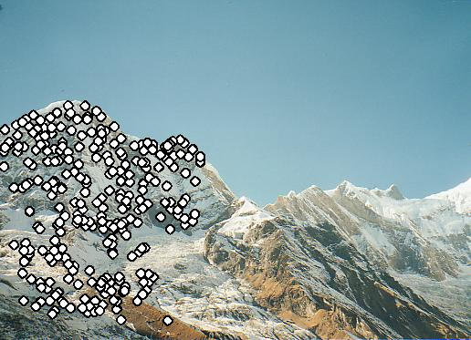
RANSAC for Homography
Final Matched Points

Slide 5
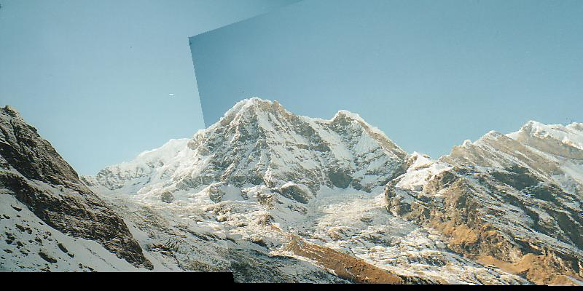
RANSAC for Homography

Slide 6
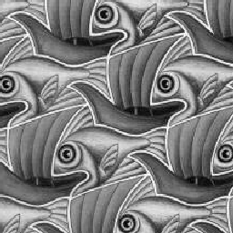
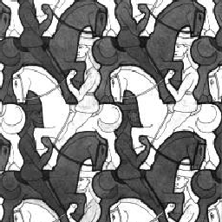
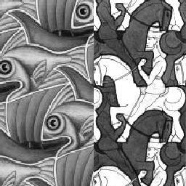
Image Blending
What’s wrong?

Slide 7
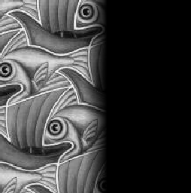
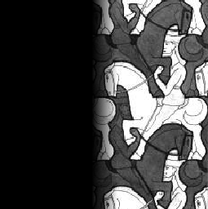
Feathering
+
1
1
0
ramp
0
=

Slide 8
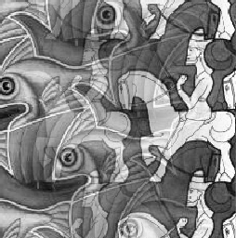
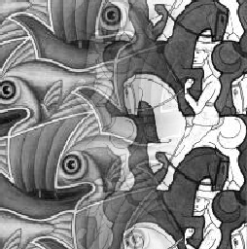
Effect of window (ramp-width) size
1
left
1
right
0
0

Slide 9
Effect of window size
1
1
0
0

Slide 10
Good window size
1
What can we do
instead?
0
“Optimal” window: smooth but not ghosted
Doesn’t always work...

Slide 11
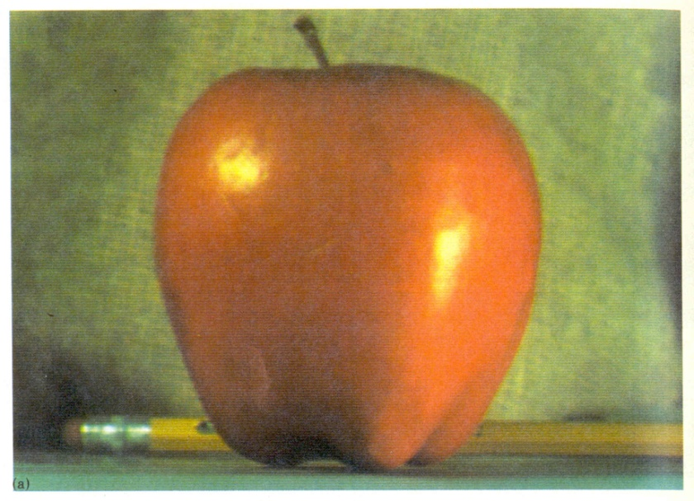
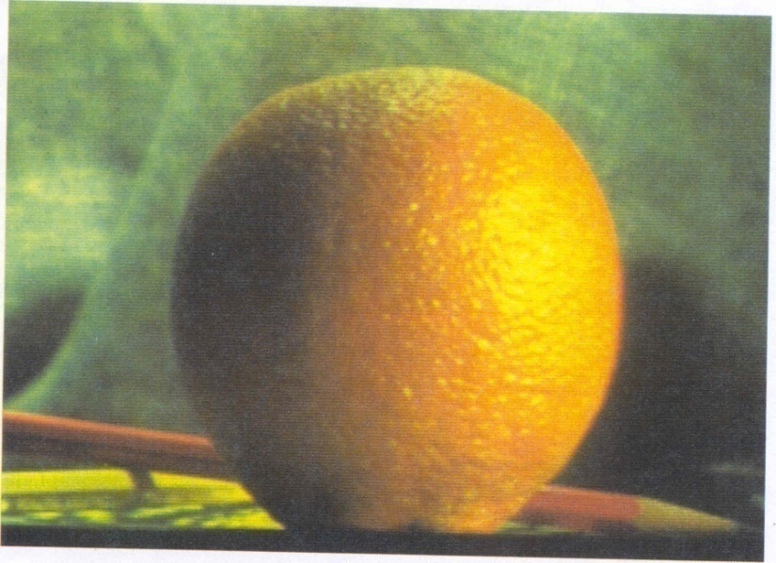
Pyramid blending
apple
orange
Create a Laplacian pyramid, blend each level
Burt, P. J. and Adelson, E. H., A Multiresolution Spline with Application to Image Mosaics, ACM Transactions on Graphics, 42(4), October 1983, 217-236. http://persci.mit.edu/pub_pdfs/spline83.pdf

Slide 12
Forming a Gaussian Pyramid
Start with the original image G₀
Perform a local Gaussian weighted averaging function in a neighborhood about each pixel, sampling so that the result is a reduced image of half the size in each dimension.
Do this all the way up the pyramid
G_{l} = REDUCE(G_{l-1})
Each level l node will represent a weighted average of a subarray of level l.

Slide 13
Making the Laplacians
We want to subtract each level of the pyramid from the next lower one.
But they are different sizes!
In order to do the subtraction, we perform an interpolation process.
We interpolate new samples between those of a given image to make it big enough to subtract.
The operation is called EXPAND.

Slide 14
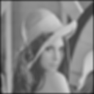
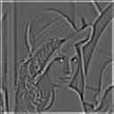
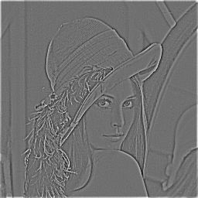
The Laplacian Pyramid
Gaussian Pyramid
Laplacian Pyramid
-
=
-
=
-
=

Slide 15
To blend two images, We’ll combine two Laplacian pyramids
Laplacian Pyramid LA Laplacian Pyramid LS Laplacian Pyramid LB
to be filled in

Slide 16
Forming the New Pyramid
Laplacian pyramids LB and LB are constructed for images A and B, respectively.
A third Laplacian pyramid LS is constructed by copying nodes from the left half of LA to the corresponding nodes of LS and nodes from the right half of LB to the right half of LS.
Nodes along the center line are set equal to the average of corresponding LA and LB nodes

Slide 17
Using the new Laplacian Pyramid
Use the new Laplacian pyramid with the reverse of how it was created to create a Gaussian pyramid.
The lowest level of the new Gaussian pyramid gives the final result.

Slide 18
Laplacian
level
4
Laplacian
level
2
Laplacian
level
0
left pyramid
right pyramid
blended pyramid
Notes:
with the ramp function

Slide 19
Pyramid blending
apple
orange
Create a Laplacian pyramid, blend each level
Burt, P. J. and Adelson, E. H., A Multiresolution Spline with Application to Image Mosaics, ACM Transactions on Graphics, 42(4), October 1983, 217-236. http://persci.mit.edu/pub_pdfs/spline83.pdf

Slide 20
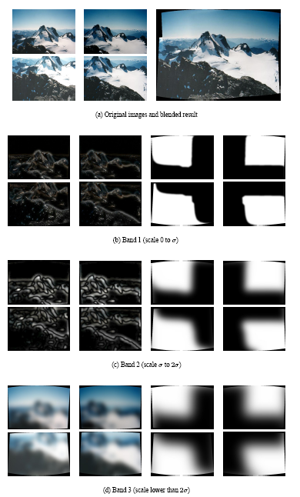
Multiband blending (IJCV 2007)
Laplacian pyramids
Compute Laplacian pyramid of images and mask
Create blended image at each level of pyramid
Reconstruct complete image
Notes:
3 different frequency levels of blending; mask is blurred in lower levels

Slide 21
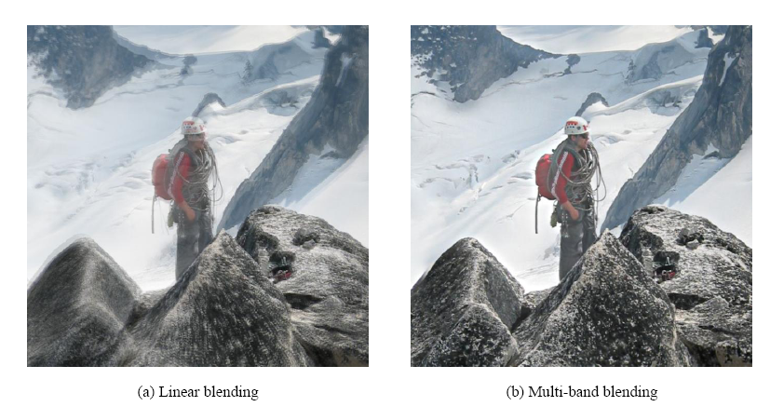
Blending comparison (IJCV 2007)

Slide 22
Alpha Blending
I₃
p
I₁
Optional: see Blinn (CGA, 1994) for details:
http://ieeexplore.ieee.org/iel1/38/7531/00310740.pdf?isNumber=7531&prod=JNL&arnumber=310740&arSt=83&ared=87&arAuthor=Blinn%2C+J.F.
I₂
Encoding blend weights: I(x,y) = (αR, αG, αB, α )
color at p =
Implement this in two steps:
1. accumulate: add up the (α premultiplied) RGB values at each pixel
2. normalize: divide each pixel’s accumulated RGB by its α value
Notes:
A: render as black

Slide 23
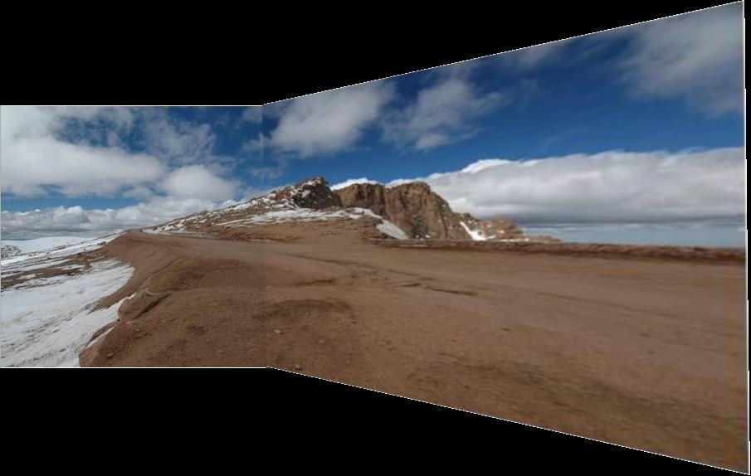
Gain Compensation: Getting rid of artifacts
Simple gain adjustment
Compute average RGB intensity of each image in overlapping region
Normalize intensities by ratio of averages

Slide 24
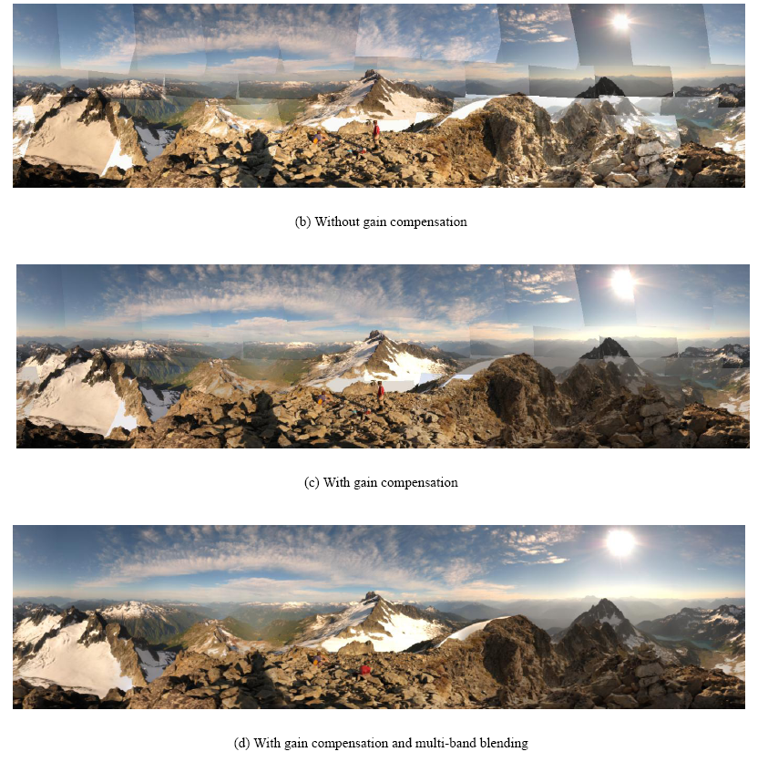
Blending Comparison

Slide 25
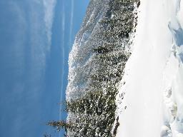
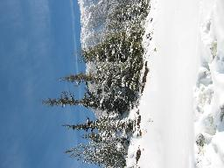
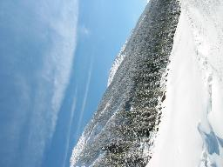
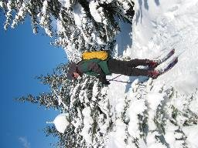
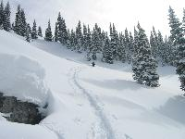
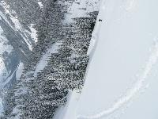
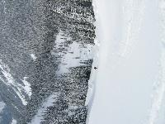
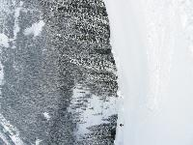
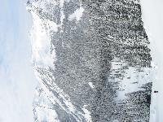
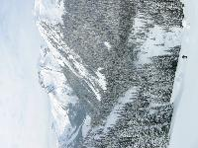
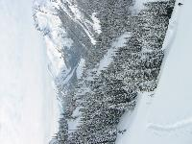
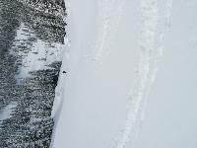
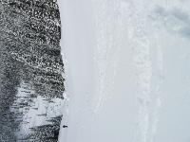
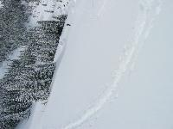
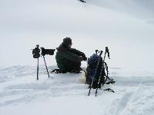
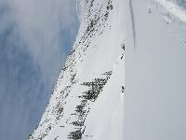
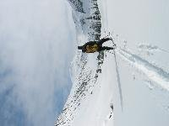
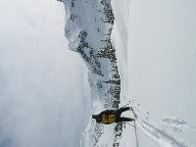
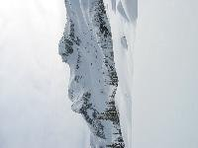
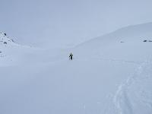
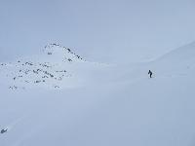
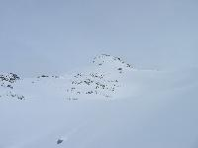
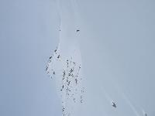
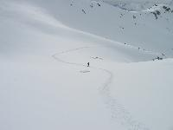
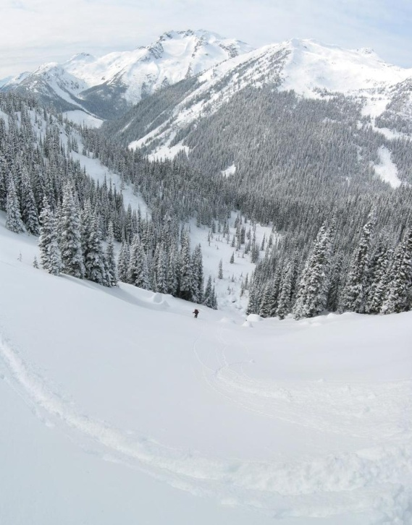
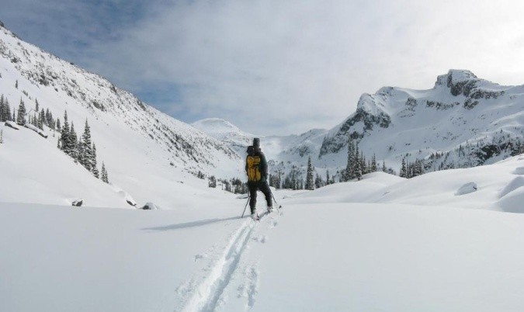
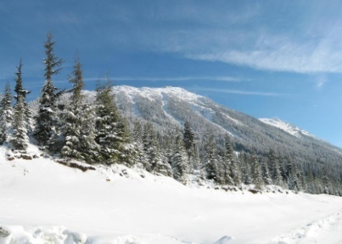
Recognizing Panoramas
Some of following material from Brown and Lowe 2003 talk
Brown and Lowe 2003, 2007

Slide 26
Recognizing Panoramas
Input: N images
Extract SIFT points, descriptors from all images
Find K-nearest neighbors for each point (K=4)
For each image
Select M candidate matching images by counting matched keypoints (m=6)
Solve homography H_{ij} for each matched image

Slide 28
Recognizing Panoramas
Input: N images
Extract SIFT points, descriptors from all images
Find K-nearest neighbors for each point (K=4)
For each image
Select M candidate matching images by counting matched keypoints (m=6)
Solve homography H_{ij} for each matched image
Decide if match is valid (n_{i} > 8 + 0.3 n_{f} )
# inliers
# keypoints in overlapping area

Slide 29
Recognizing Panoramas (cont.)
(now we have matched pairs of images)
Make a graph of matched pairs
Find connected components of the graph

Slide 30
Finding the panoramas

Slide 31
Finding the panoramas

Slide 32
Recognizing Panoramas (cont.)
(now we have matched pairs of images)
Find connected components
For each connected component
Solve for rotation and f
Project to a surface (plane, cylinder, or sphere)
Render with multiband blending

Slide 33
Finding the panoramas

