Slide 1
Color, Texture and
Segmentation
EE/CSE 576
Linda Shapiro

Slide 2
Color Spaces
RGB
HSI/HSV
CIE L*a*b
YIQ
and more
standard for cameras
hue, saturation, intensity
intensity plus 2 color channels
color TVs, Y is intensity

Slide 3
RGB Color Space
Absolute Normalized
Normalized red r = R/(R+G+B)
Normalized green g = G/(R+G+B)
Normalized blue b = B/(R+G+B)
(0,0,255)
blue
R,G,B)
(0,0,0)
(0,255,0)
red
green
(255,0,0)

Slide 4
Color hexagon for HSI (HSV)
Hue is encoded as an angle (0 to 2π).
Saturation is the distance to the vertical axis (0 to 1).
Intensity is the height along the vertical axis (0 to 1).
H=120 is green
saturation
intensity
hue
H=180 is cyan
I=1
H=0 is red
H=240 is blue
I=0

Slide 5
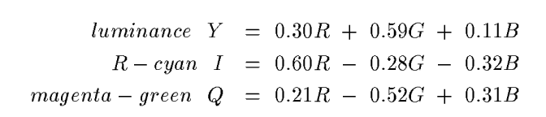
Conversion from RGB to YIQ
An approximate linear transformation from RGB to YIQ:
We often use this for color to gray-tone conversion.

Slide 6
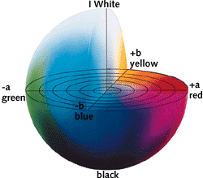
CIELAB, Lab, L*a*b
One luminance channel (L)
and two color channels (a and b).
In this model, the color differences which you perceive correspond to Euclidian distances in CIELab.
The a axis extends from green (-a) to red (+a) and the b axis from blue (-b) to yellow (+b). The brightness (L) increases from the bottom to the top of the three-dimensional model.

Slide 7
Histograms
A histogram of a gray-tone image is an array H[*] of bins, one for each gray tone.
H[i] gives the count of how many pixels of an image have gray tone i.
P[i] (the normalized histogram) gives the percentage of pixels that have gray tone i.

Slide 8
Color histograms can represent an image
Histogram is fast and easy to compute.
Size can easily be normalized so that different image histograms can be compared.
Can match color histograms for database query or classification.

Slide 9
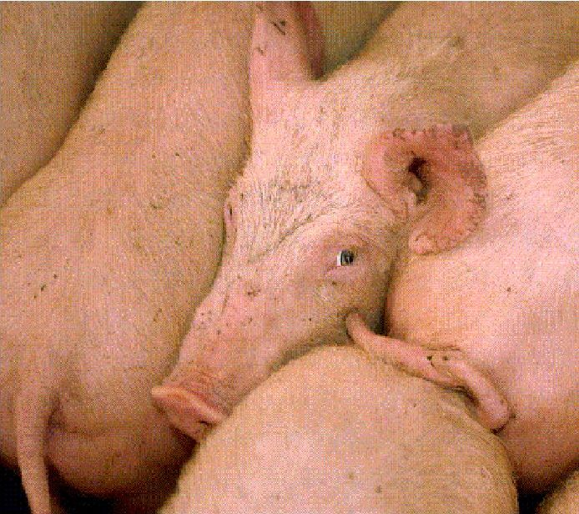
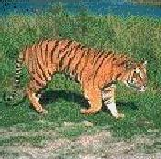
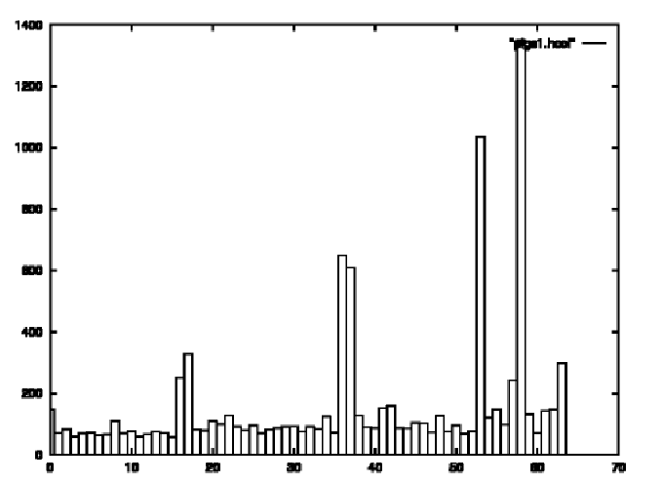
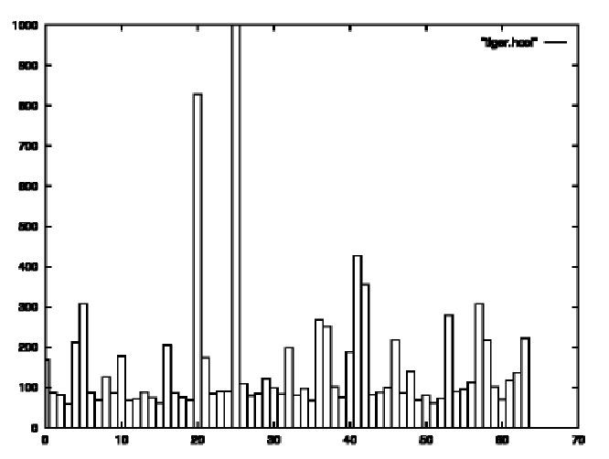
Histograms of two color images

Slide 10
How to make a color histogram
Make a single 3D histogram.
Make 3 histograms and concatenate them
Create a single pseudo color between 0 and 255 by using 3 bits of R, 3 bits of G and 2 bits of B (which bits?)
Use normalized color space and 2D histograms.

Slide 11
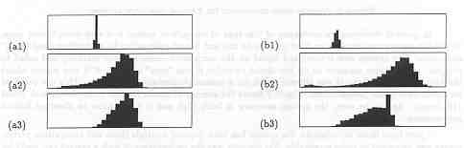
Apples versus Oranges
H
S
I
Separate HSI histograms for apples (left) and oranges (right) used by IBM’s VeggieVision for recognizing produce at the grocery store checkout station (see Ch 16).

Slide 12
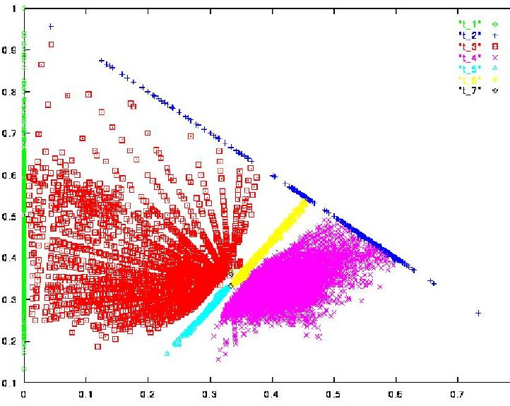
Skin color in RGB space (shown as normalized red vs normalized green)
Purple region shows skin color samples from several people. Blue and yellow regions show skin in shadow or behind a beard.

Slide 13
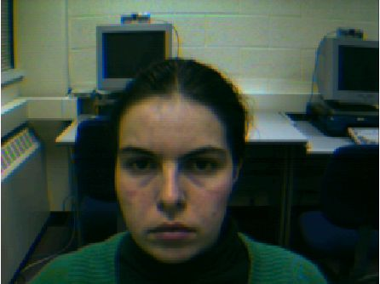
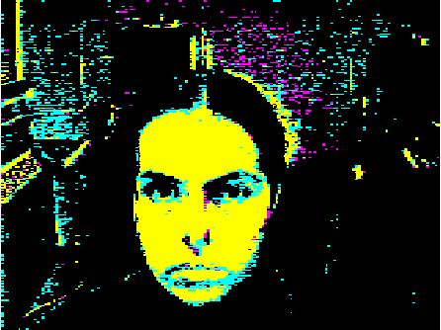
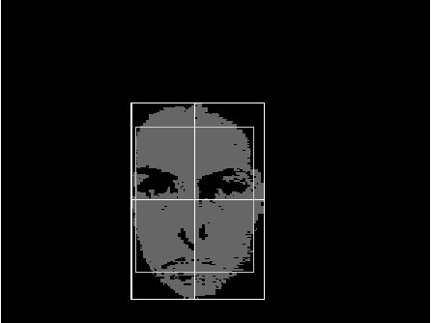
Finding a face in video frame
(left) input video frame
(center) pixels classified according to RGB space
(right) largest connected component with aspect similar to a face (all work contributed by Vera Bakic)

Slide 14
Swain and Ballard’s Histogram Matching for Color Object Recognition
(IJCV Vol 7, No. 1, 1991)
Opponent Encoding:
Histograms: 8 x 16 x 16 = 2048 bins
Intersection of image histogram and model histogram:
Match score is the normalized intersection:
wb = R + G + B
rg = R - G
by = 2B - R - G
numbins
intersection(h(I),h(M)) = ∑ min{h(I)[j],h(M)[j]}
j=1
numbins
match(h(I),h(M)) = intersection(h(I),h(M)) / ∑ h(M)[j]
j=1

Slide 15
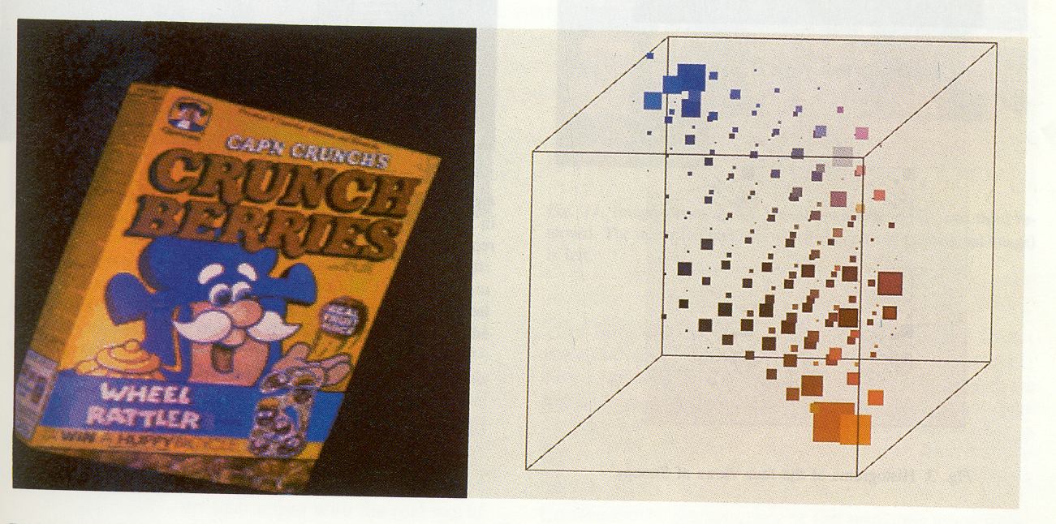
(from Swain and Ballard)
cereal box image
3D color histogram

Slide 16
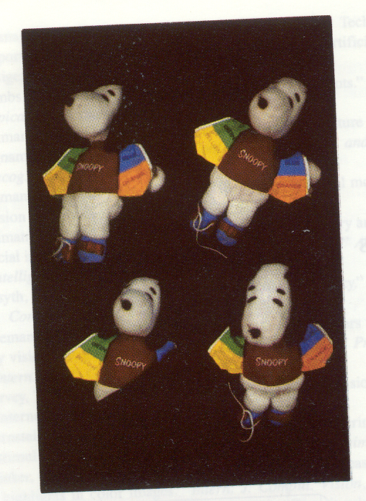
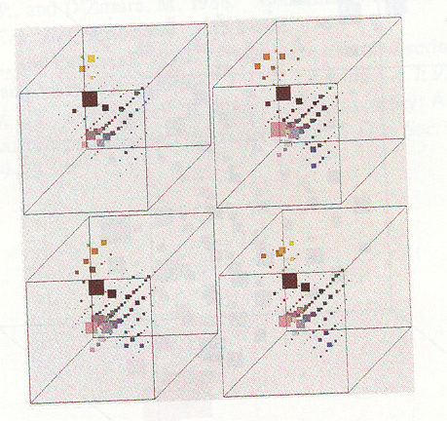
Four views of Snoopy Histograms

Slide 17
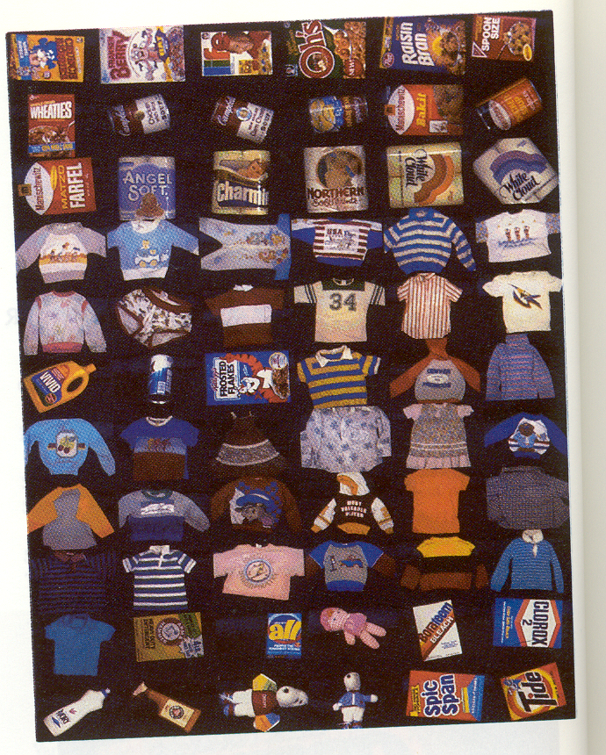
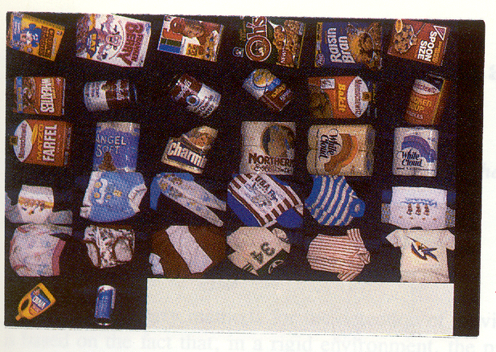
The 66 models objects Some test objects

Slide 18
Swain and Ballard Results
Results were surprisingly good.
At their highest resolution (128 x 90), average match
percentile (with and without occlusion) was 99.9.
This translates to 29 objects matching best with
their true models and 3 others matching second best
with their true models.
At resolution 16 X 11, they still got decent results
(15 6 4) in one experiment; (23 5 3) in another.

Slide 19
Uses
Although this is an extremely simple technique, it became the basis for many content-based image retrieval systems and works surprisingly well, both alone, and in conjunction with other techniques.

Slide 20
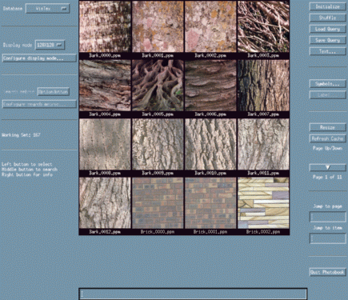
Texture
Color is well defined.
But what is texture?

Slide 21
Structural Texture
Texture is a description of the spatial arrangement of color or
intensities in an image or a selected region of an image.
Structural approach: a set of texels in some regular or repeated pattern

Slide 22
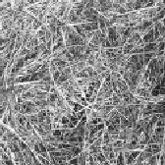
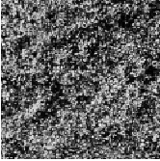
Natural Textures from VisTex
grass
leaves
What/Where are the texels?

Slide 23
The Case for Statistical Texture
Segmenting out texels is difficult or impossible in real images.
Numeric quantities or statistics that describe a texture can be
computed from the gray tones (or colors) alone.
This approach is less intuitive, but is computationally efficient.
It can be used for both classification and segmentation.

Slide 24
Some Simple Statistical Texture Measures
1. Edge Density and Direction
Use an edge detector as the first step in texture analysis.
The number of edge pixels in a fixed-size region tells us
how busy that region is.
The directions of the edges also help characterize the texture

Slide 25
Two Edge-based Texture Measures
1. edgeness per unit area
2. edge magnitude and direction histograms
Fedgeness = |{ p | gradient_magnitude(p) ≥ threshold}| / N
where N is the size of the unit area
Fmagdir = ( Hmagnitude, Hdirection )
where these are the normalized histograms of gradient
magnitudes and gradient directions, respectively.

Slide 26
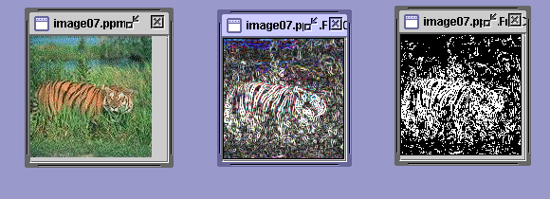
Example
Original Image Frei-Chen Thresholded
Edge Image Edge Image

Slide 27
Local Binary Pattern Measure
For each pixel p, create an 8-bit number b1 b2 b3 b4 b5 b6 b7 b8,
where bi = 0 if neighbor i has value less than or equal to p’s
value and 1 otherwise.
Represent the texture in the image (or a region) by the
histogram of these numbers.
1 2 3
100 101 103
40 50 80
50 60 90
4
5
8
1 1 1 1 1 1 0 0
7 6

Slide 28
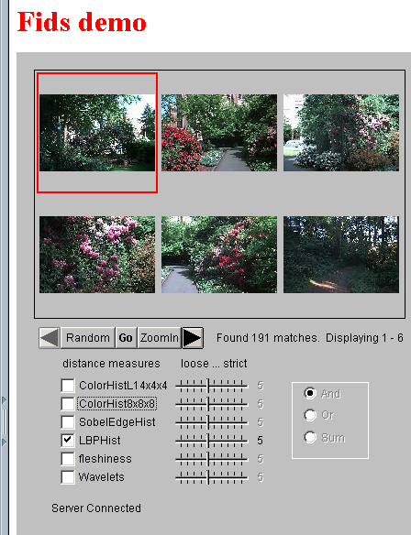
Example
Fids (Flexible Image Database
System) is retrieving images
similar to the query image
using LBP texture as the
texture measure and comparing
their LBP histograms

Slide 29
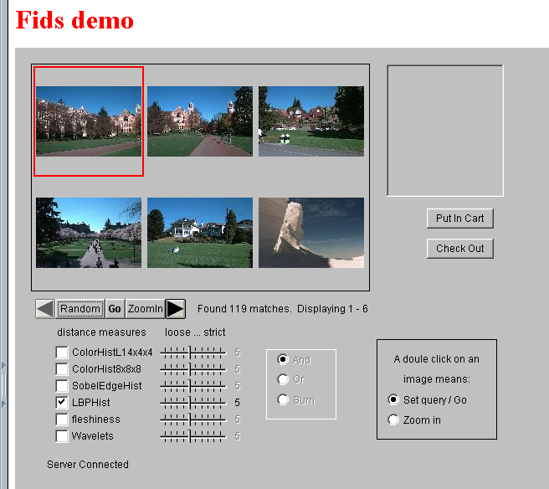
Example
Low-level
measures don’t
always find
semantically
similar images.

Slide 30
What else is LBP good for?
We found it in a paper for classifying deciduous trees.
We used it in a real system for finding cancer in Pap smears.
We are using it to look for regions of interest in breast and melanoma biopsy slides.

Slide 31
Co-occurrence Matrix Features
A co-occurrence matrix is a 2D array C in which
Both the rows and columns represent a set of possible
image values.
C (i,j) indicates how many times value i co-occurs with
value j in a particular spatial relationship d.
The spatial relationship is specified by a vector d = (dr,dc).
d

Slide 32
Co-occurrence Example
1
0 1 2
1 1 0 0
1 1 0 0
0 0 2 2
0 0 2 2
0 0 2 2
0 0 2 2
i
j
0
1
2
1 0 3
2 0 2
0 0 1
3
C_{d}
d = (3,1)
co-occurrence
matrix
gray-tone
image
From C_{d} we can compute N_{d}, the normalized co-occurrence matrix,
where each value is divided by the sum of all the values.

Slide 33
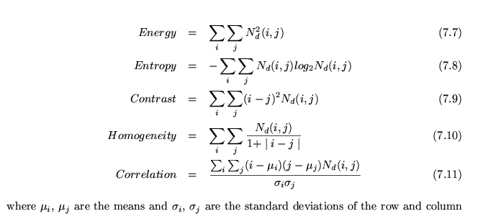
Co-occurrence Features
What do these measure?
sums.
Energy measures uniformity of the normalized matrix.

Slide 34
But how do you choose d?
This is actually a critical question with all the
statistical texture methods.
Are the “texels” tiny, medium, large, all three …?
Not really a solved problem.
Zucker and Terzopoulos suggested using a χ² statistical
test to select the value(s) of d that have the most structure
for a given class of images.

Slide 35
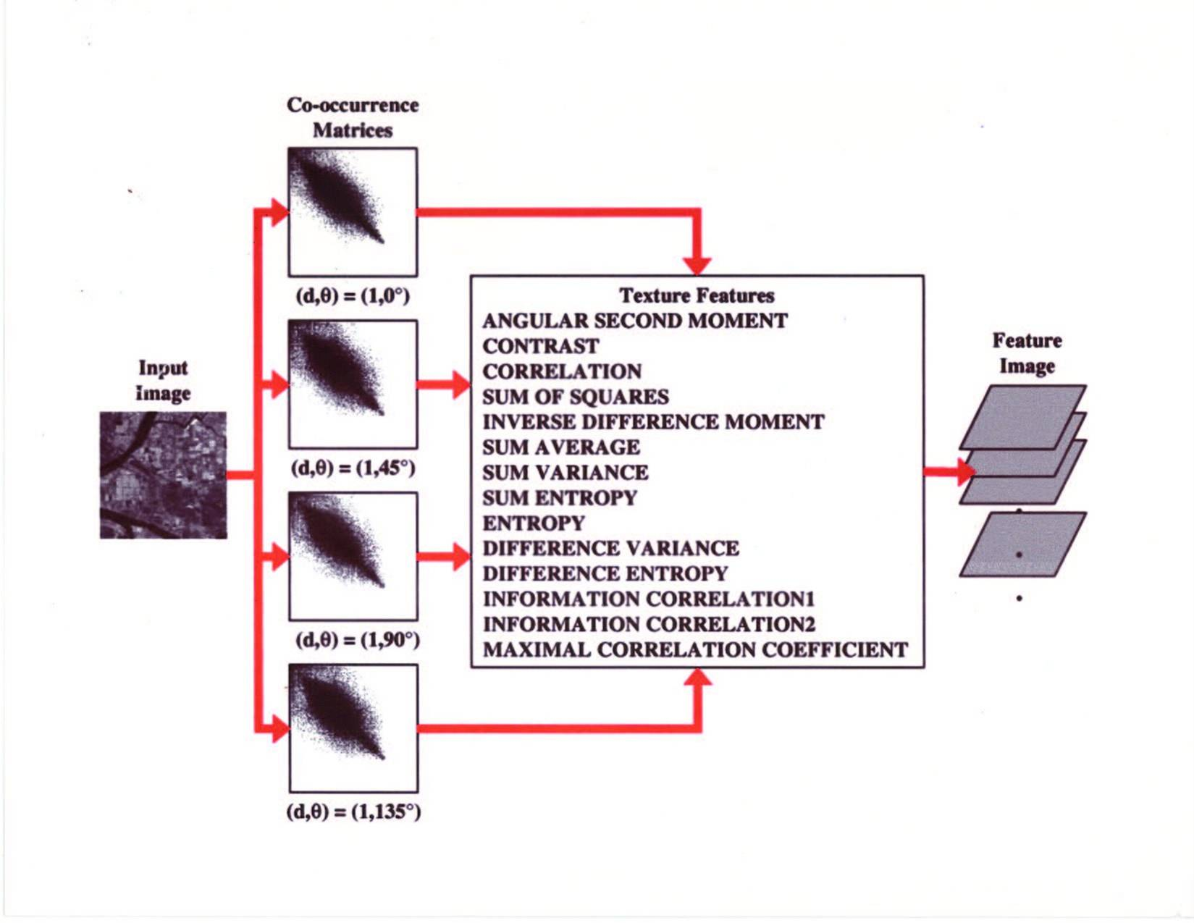
Example

Slide 36
What are Co-occurrence Features used for?
They were designed for recognizing different kinds of land uses in satellite images.
They are still used heavily in geospatial domains, but they can be added on to any other calculated features.

Slide 37
Laws’ Texture Energy Features
Signal-processing-based algorithms use texture filters
applied to the image to create filtered images from which
texture features are computed.
The Laws Algorithm
Filter the input image using texture filters.
Compute texture energy by summing the absolute
value of filtering results in local neighborhoods
around each pixel.
Combine features to achieve rotational invariance.

Slide 38
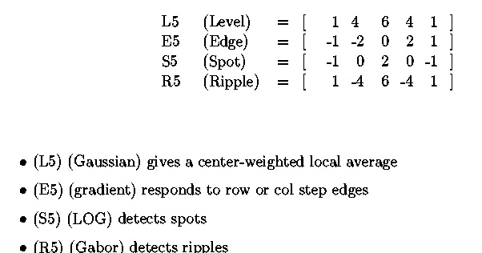
Law’s texture masks (1)

Slide 39
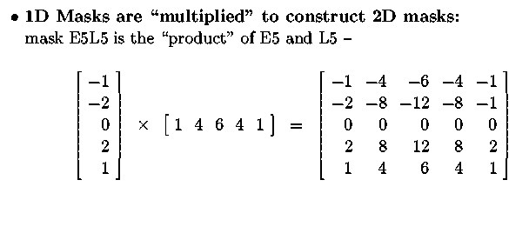
Law’s texture masks (2)
Creation of 2D Masks
E5
L5
E5L5

Slide 40
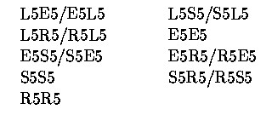
9D feature vector for pixel
Subtract mean neighborhood intensity from (center) pixel
Apply 16 5x5 masks to get 16 filtered images F_{k} , k=1 to 16
Produce 16 texture energy maps using 15x15 windows
E_{k}[r,c] = ∑ |F_{k}[i,j]|
Replace each distinct pair with its average map:
9 features (9 filtered images) defined as follows:

Slide 41
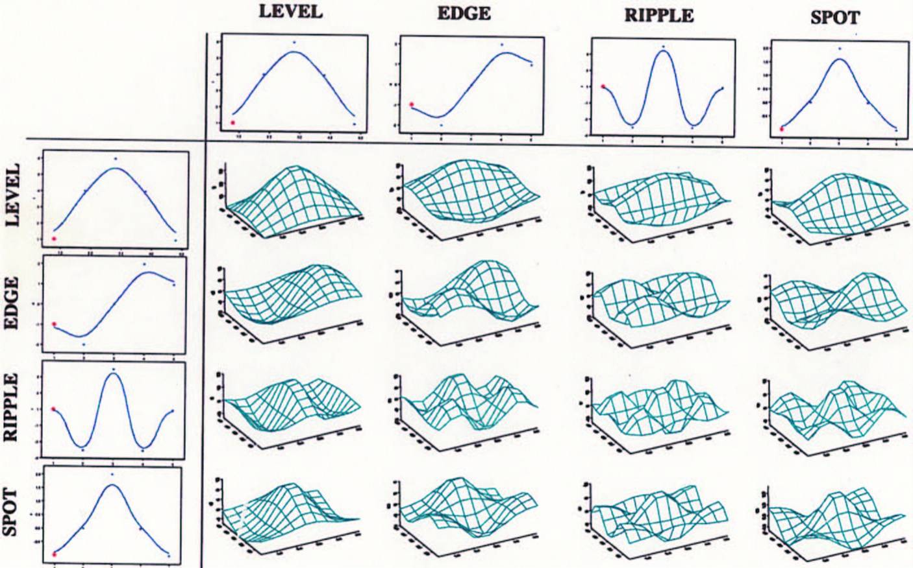
Laws Filters

Slide 42
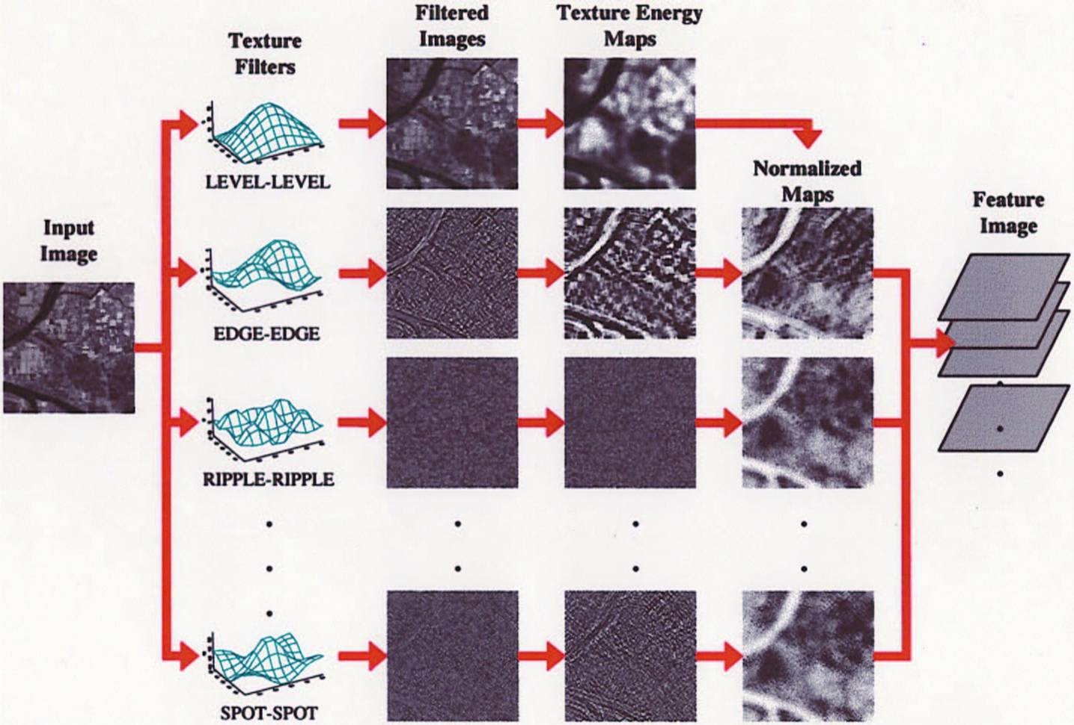
Laws Process

Slide 43
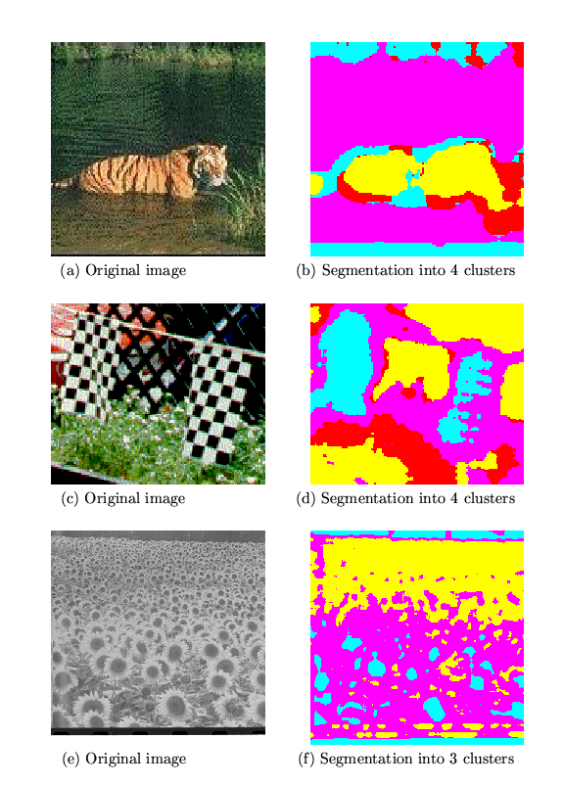
Example: Using Laws Features to Cluster
water
tiger
fence
flag
grass
Is there a
neighborhood
size problem
with Laws?
small flowers
big flowers

Slide 44
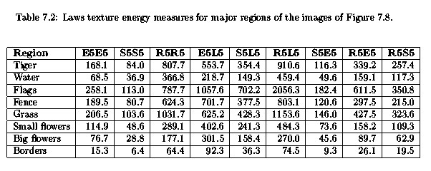
Features from sample images

Slide 45
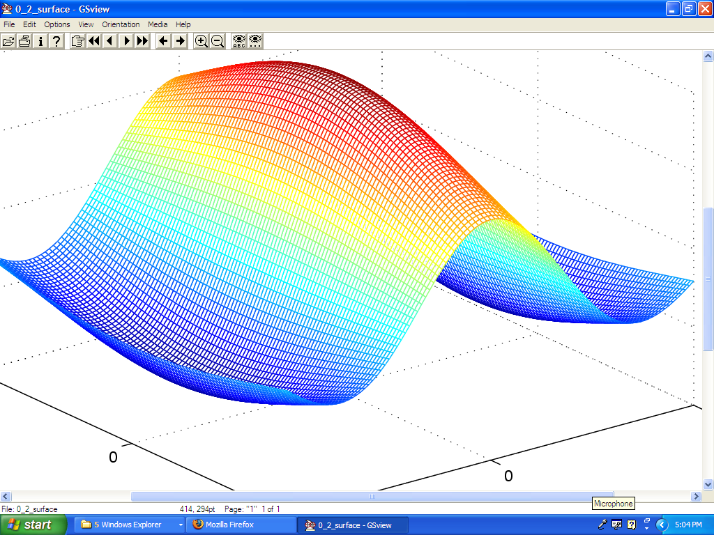
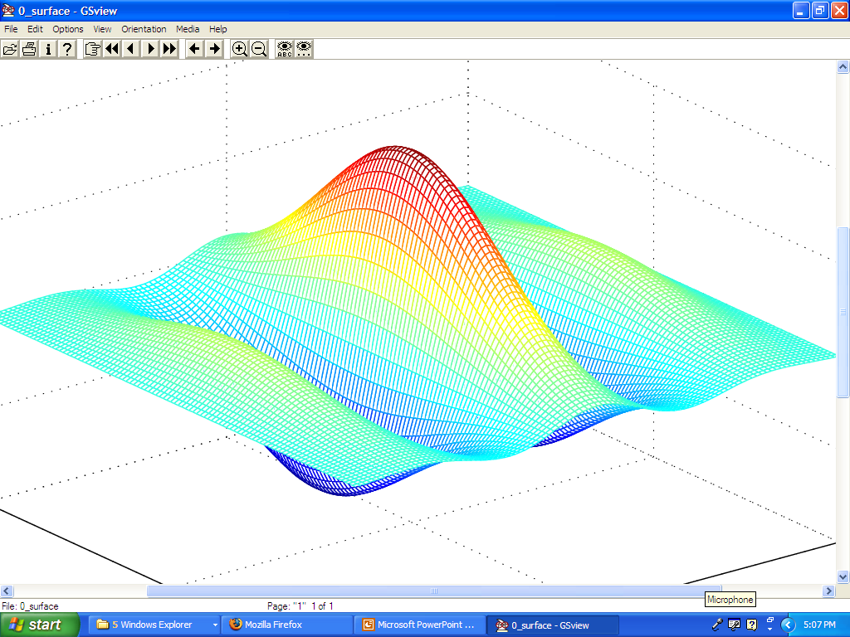
Gabor Filters
Similar approach to Laws
Wavelets at different frequencies and different orientations

Slide 46
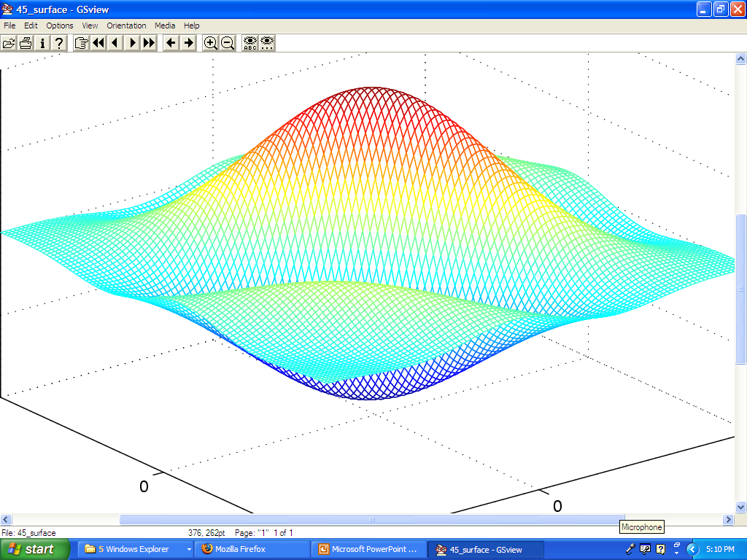
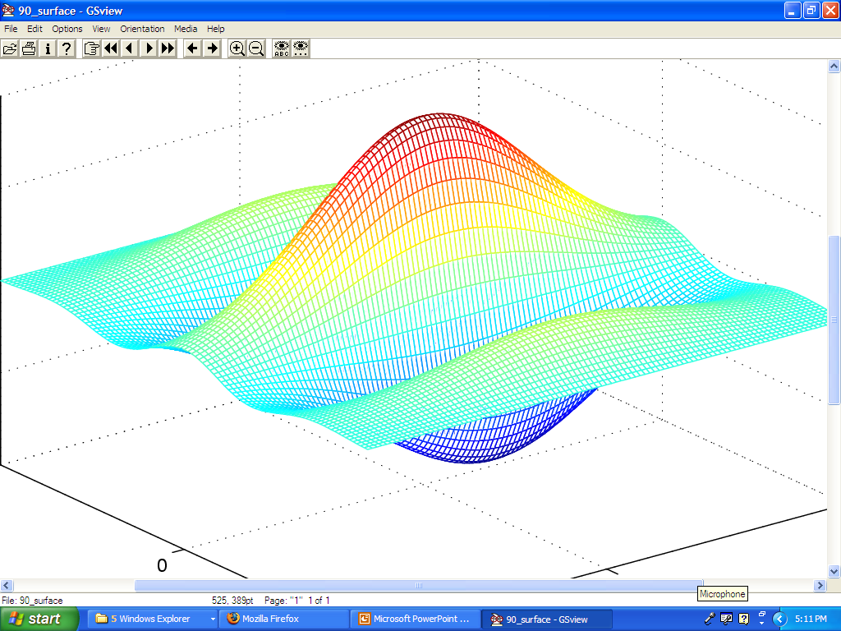
Gabor Filters

Slide 47
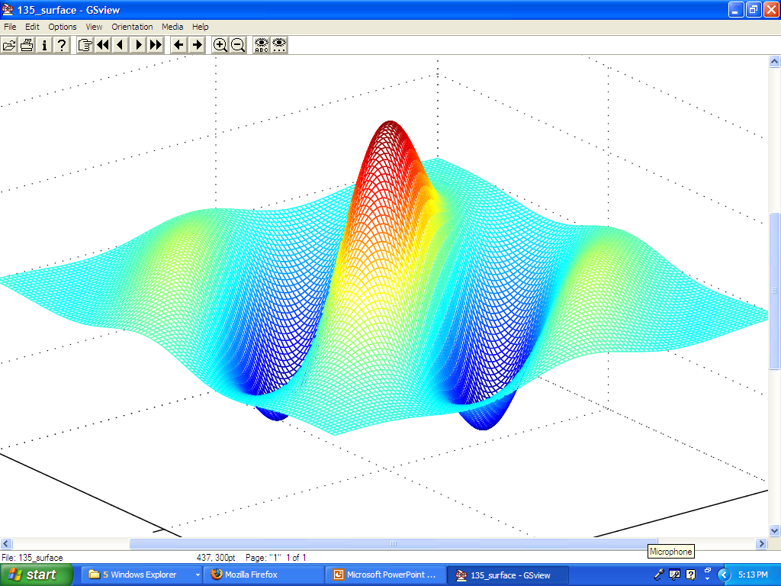
Gabor Filters

Slide 48
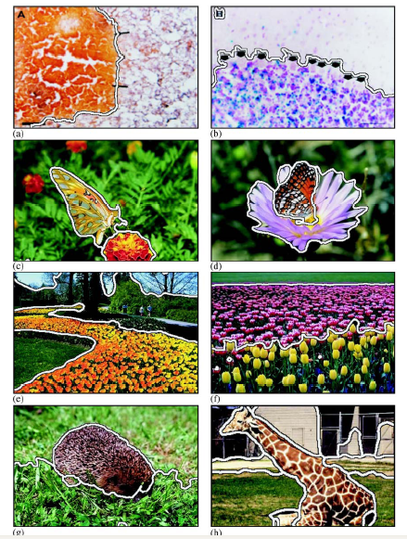
Segmentation with Color and Gabor-Filter Texture (Smeulders)

Slide 49
Use of Texture
Texture is important, but usually not as discriminative alone as color.
The use of color and texture together can work well for both recognition and segmentation.

Slide 50
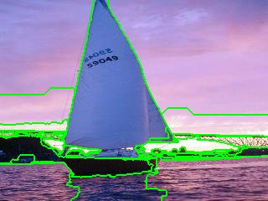
Region Segmentation by Color

Slide 51
Main Methods of Region Segmentation
1. Region Growing
2. Split and Merge
3. Clustering

Slide 52
Clustering
There are K clusters C₁,…, C_{K} with means m₁,…, m_{K}.
The least-squares error is defined as
Out of all possible partitions into K clusters,
choose the one that minimizes D.
K
2
D = ∑ ∑ || x_{i} - m_{k} || .
k=1 x_{i} ∈ C_{k}
Why don’t we just do this?
If we could, would we get meaningful objects?

Slide 53
K-Means Clustering
Form K-means clusters from a set of n-dimensional vectors
1. Set ic (iteration count) to 1
2. Choose randomly a set of K means m₁(1), …, m_{K}(1).
3. For each vector x_{i} compute D(x_{i} , m_{k}(ic)), k=1,…K
and assign x_{i} to the cluster C_{j} with nearest mean.
4. Increment ic by 1, update the means to get m₁(ic),…,m_{K}(ic).
5. Repeat steps 3 and 4 until C_{k}(ic) = C_{k}(ic+1) for all k.

Slide 54
Simple Example
10
10
9
9
8
8
7
7
6
6
5
5
4
Assign each object to most similar center
Update the cluster means
4
3
3
2
2
1
1
0
0
0
1
2
3
4
5
6
7
8
9
10
0
1
2
3
4
5
6
7
8
9
10
reassign
reassign
K=2
Arbitrarily choose K objects as initial cluster center
Update the cluster means

Slide 55
Space for K-Means
The example was in some arbitrary 2D space
We don’t want to cluster in that space.
We will be clustering in color space (ie. RGB)
K-means can be used to cluster in any n-dimensional space.

Slide 56
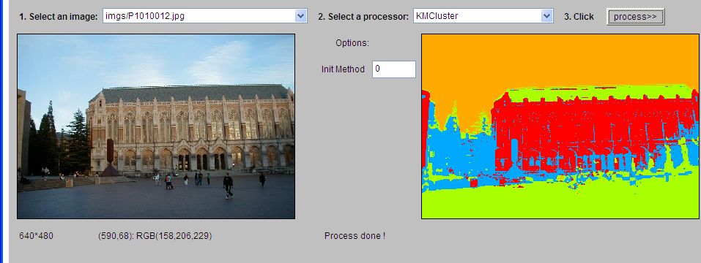
K-Means Example 1

Slide 57
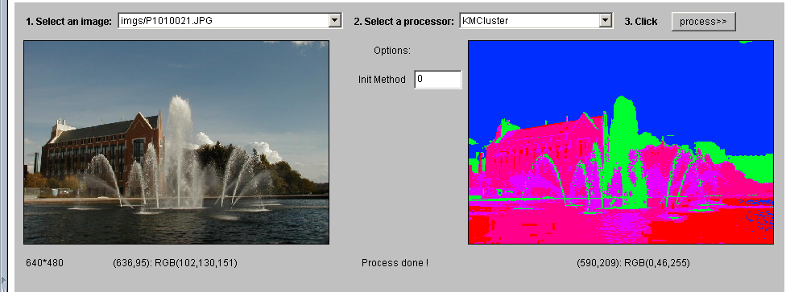
K-Means Example 2

Slide 58
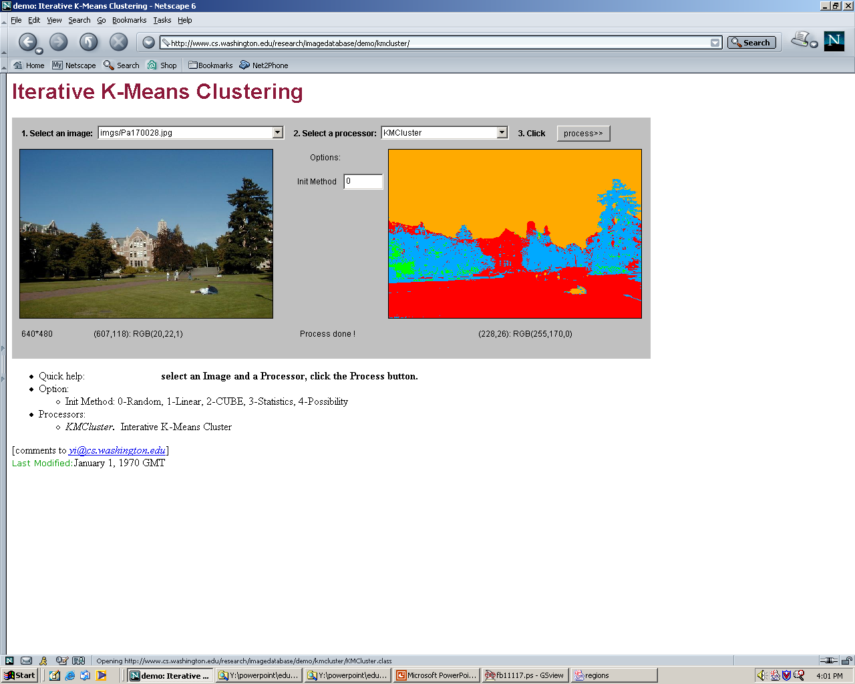
K-Means Example 3

Slide 59
K-means Variants
Different ways to initialize the means
Different stopping criteria
Dynamic methods for determining the right number of clusters (K) for a given image
The EM Algorithm: a probabilistic formulation of K-means

Slide 60

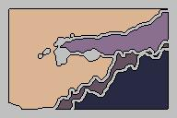
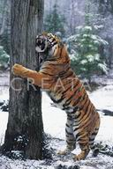

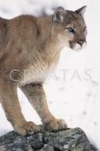
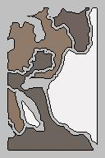
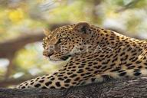
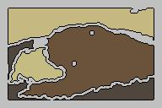
Blobworld: Sample Results using color, texture, and EM

Slide 61
Graph-Partitioning Clustering
An image is represented by a graph whose nodes
are pixels or small groups of pixels.
The goal is to partition the vertices into disjoint sets so
that the similarity within each set is high and
across different sets is low.

Slide 62
Minimal Cuts
Let G = (V,E) be a graph. Each edge (u,v) has a weight w(u,v)
that represents the similarity between u and v.
Graph G can be broken into 2 disjoint graphs with node sets
A and B by removing edges that connect these sets.
Let cut(A,B) = ∑ w(u,v).
One way to segment G is to find the minimal cut.
uεA, vεB

Slide 63
Cut(A,B)
cut(A,B) = ∑ w(u,v)
uεA, vεB
B
A
w1
w2

Slide 64
Normalized Cut
Minimal cut favors cutting off small node groups,
so Shi proposed the normalized cut.
cut(A, B) cut(A,B)
Ncut(A,B) = ------------- + -------------
asso(A,V) asso(B,V)
normalized
cut
asso(A,V) = ∑ w(u,t)
u∈A, t∈V
How much is A connected
to the graph as a whole.

Slide 65
Example Normalized Cut
A
B
2
2
2
2
2
2
2
2
1
4
3
1
2
2
2
3
3 3
Ncut(A,B) = ------- + ------
21 16

Slide 66
Shi turned graph cuts into an eigenvector/eigenvalue problem.
Set up a weighted graph G=(V,E)
  V is the set of (N) pixels
  E is a set of weighted edges (weight w_{ij} gives the similarity between nodes i and j)
  Length N vector d: d_{i} is the sum of the weights from node i to all other nodes
  N x N matrix D: D is a diagonal matrix with d on its diagonal
  N x N symmetric matrix W: W_{ij} = w_{ij}

Slide 67
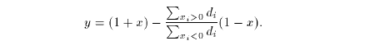
Let x be a characteristic vector of a set A of nodes
  x_{i} = 1 if node i is in a set A
  x_{i} = -1 otherwise
Let y be a continuous approximation to x
Solve the system of equations
  (D – W) y = λ D y
  for the eigenvectors y and eigenvalues λ
Use the eigenvector y with second smallest eigenvalue to bipartition the graph (y => x => A)
If further subdivision is merited, repeat recursively

Slide 68
How to define the weights
Jianbo Shi defined the edge weights w(i,j) by
w(i,j) = e *
-||X(i)-X(j)||2 / σX
-||F(i)-F(j)||2 / σI
e if ||X(i)-X(j)||2 < r
0 otherwise
where X(i) is the spatial location of node i
F(i) is the feature vector for node I
which can be intensity, color, texture, motion…
The formula is set up so that w(i,j) is 0 for nodes that
are too far apart.

Slide 69
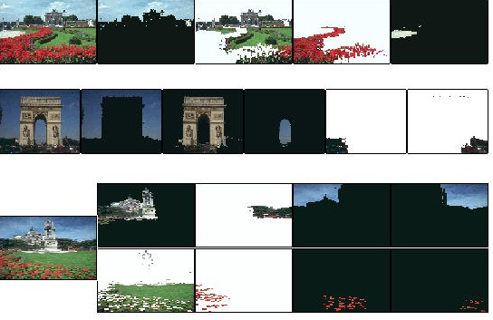
Examples of
Shi Clustering

