Slide 1
Skin and Face Detection
Linda Shapiro
EE/CSE 576

Slide 2
What’s Coming
Review of Bakic flesh detector
Fleck and Forsyth flesh detector
Details of Rowley face detector
Review of the basic AdaBoost algorithm
The Viola Jones face detector features
The modified AdaBoost algorithm that is used in Viola-Jones face detection

Slide 3
Object Detection
Example: Face Detection
Example: Skin Detection
(Rowley, Baluja & Kanade, 1998)
(Jones & Rehg, 1999)

Slide 4
Review: Bakic Flesh Finder
Convert pixels to normalized (r,g) space
Train a binary classifier to recognize pixels in this space as skin or not skin by giving it lots of examples of both classes.
On test images, have the classifier label the skin pixels.
Find large connected components.

Slide 5
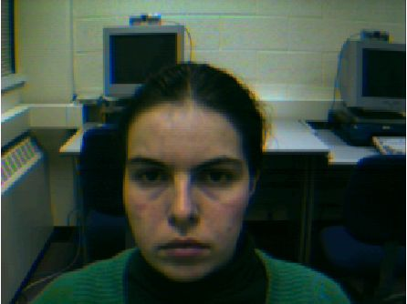
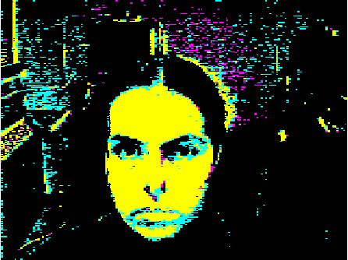
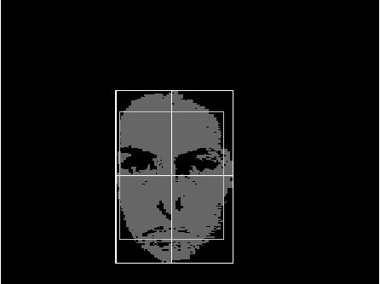
Finding a face in a video frame
input video frame pixels classified in largest connected
normalized r-g space component with aspect
similar to a face
(all work contributed by Vera Bakic)

Slide 6
Fleck and Forsyth’s
Flesh Detector
Convert RGB to HSI
Use the intensity component to compute a texture map
texture = med2 ( | I - med1(I) | )
If a pixel falls into either of the following ranges,
it’s a potential skin pixel
texture < 5, 110 < hue < 150, 20 < saturation < 60
texture < 5, 130 < hue < 170, 30 < saturation < 130
median filters of
radii 4 and 6
* Margaret Fleck, David Forsyth, and Chris Bregler (1996)
“Finding Naked People,” 1996 European Conference on
Computer Vision , Volume II, pp. 592-602.

Slide 7
Algorithm
Skin Filter: The algorithm first locates images containing large areas
whose color and texture is appropriate for skin.
2. Grouper: Within these areas, the algorithm finds elongated regions
and groups them into possible human limbs and connected groups
of limbs, using specialized groupers which incorporate substantial
amounts of information about object structure.
3. Images containing sufficiently large skin-colored groups of
possible limbs are reported as potentially containing naked people.
This algorithm was tested on a database of 4854 images: 565 images
of naked people and 4289 control images from a variety of sources.
The skin filter identified 448 test images and 485 control images as
containing substantial areas of skin. Of these, the grouper identified
241 test images and 182 control images as containing people-like shapes.

Slide 8
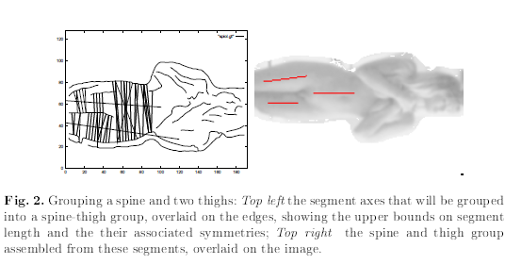
Grouping

Slide 9

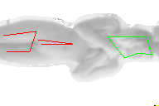
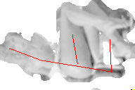
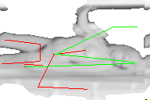

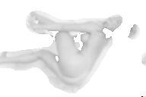

Results
Some True Positives
False Negatives True Negative

Slide 10
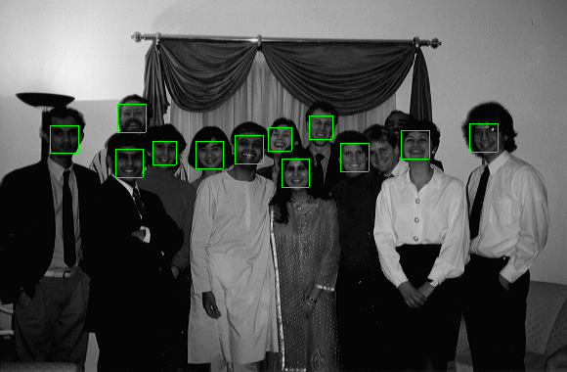
Object Detection:
Rowley’s Face Finder
1. convert to gray scale
2. normalize for lighting
3. histogram equalization
4. apply neural net(s)
trained on 16K images
What data is fed to
the classifier?
20 x 20 windows in
a pyramid structure

Slide 11
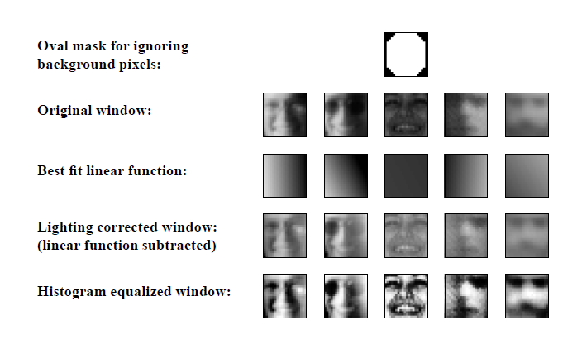
Preprocessing

Slide 12
Image Pyramid Idea
even lower resolution (1/16 of original)
lower resolution image (1/4 of original)
original image (full size)

Slide 13
Training the Neural Network
Positive Face Examples
Nearly 1051 face examples collected from
face databases at CMU, Harvard, and WWW
Faces of various sizes, positions, orientations, intensities
Eyes, tip of nose, corners and center of mouth labeled
manually and used to normalize each face to the same
scale, orientation, and position
Result: set of 20 X 20 face training samples

Slide 14
Training the Neural Network
Negative Face Examples
Generate 1000 random nonface images and
apply the preprocessing
Train a neural network on these plus the face images
Run the system on real scenes that contain no faces
Collect the false positives
Randomly select 250 of these and apply preprocessing
Label them as negative and add to the training set

Slide 15
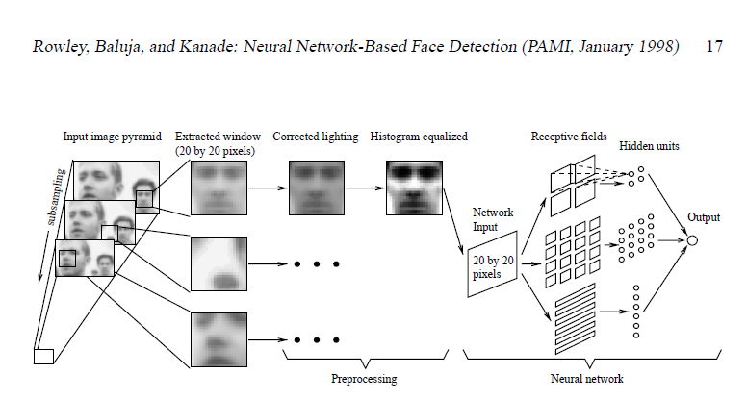
Overall Algorithm

Slide 16
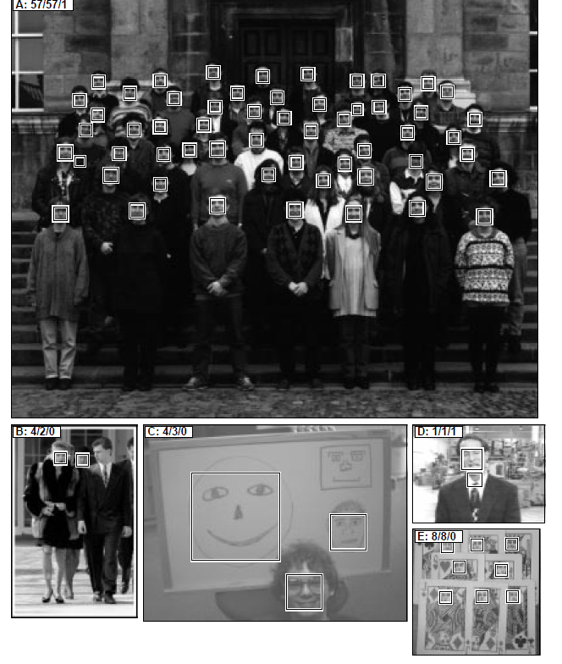
More Pictures

Slide 17
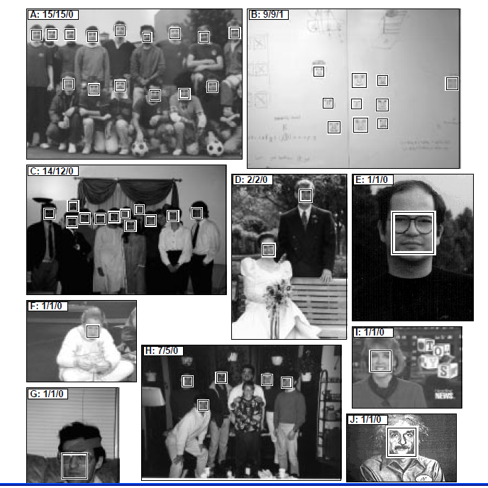
Even More

Slide 18
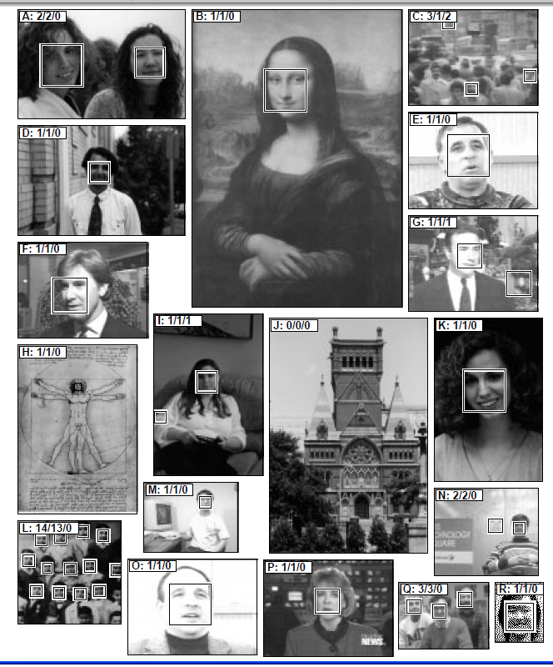
And More
Accuracy: detected
80-90% on different
image sets with an
“acceptable number” of
false positives
Fast Version: 2-4 seconds
per image (in 1998)

Slide 19
Learning from weighted data
sample class
1.5 2.6 I
2.3 8.9 II
2.3 8.9 II
2.3 8.9 II
sample class weight
1.5 2.6 I 1/4
2.3 8.9 II 3/4
Consider a weighted dataset
  W_{i} – weight of i th training example (x^{i},y^{i})
  Interpretations:
    i th training example counts as if it occurred W_{i} % times
    If I were to “resample” data, I would get more samples of “heavier” data points
Now, always do weighted calculations:

Slide 20
Basic AdaBoost Overview
Input is a set of training examples (X_{i}, y_{i}) i = 1 to m.
We train a sequence of weak classifiers, such as decision trees, neural nets or SVMs. Weak because not as strong as the final classifier.
The training examples will have weights, initially all equal.
At each step, we use the current weights, train a new classifier, and use its performance on the training data to produce new weights for the next step (normalized).
But we keep ALL the weak classifiers.
When it’s time for testing on a new feature vector, we will combine the results from all of the weak classifiers.

Slide 21
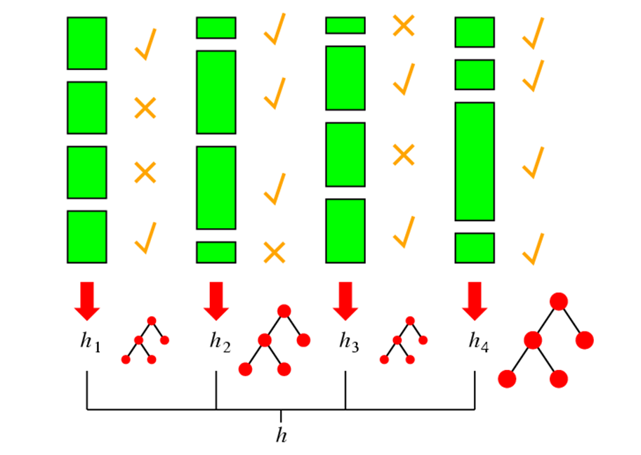
Idea of Boosting
(from AI text)
But Viola Jones
will make the
weights of the
correct samples
smaller instead
of making the
weights of the
incorrect ones
bigger.

Slide 22
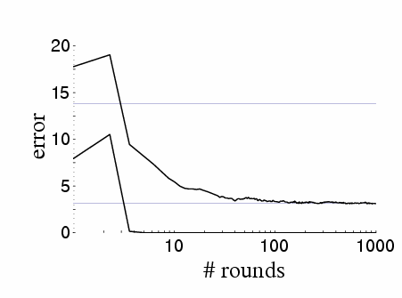
Boosting results – Digit recognition
[Schapire, 1989]
Test error
Training error
Boosting:
  Seems to be robust to overfitting
  Test error can decrease even after training error is zero!!!

Slide 23
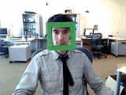
Face detection
State-of-the-art face detection demo
(Courtesy Boris Babenko)

Slide 24


Face detection and recognition
Detection
Recognition
“Sally”

Slide 25
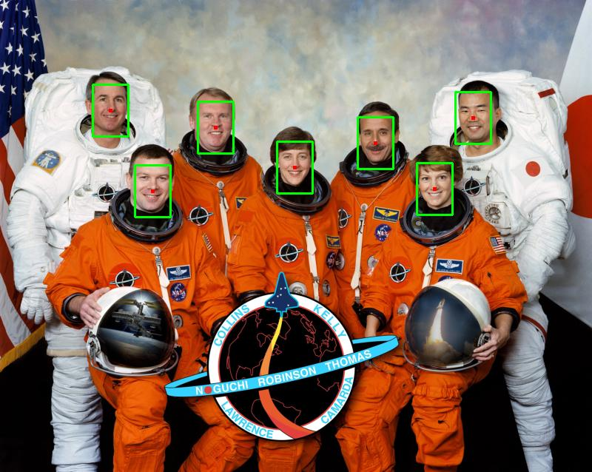
Face detection
Where are the faces?

Slide 26
Face Detection
What kind of features?
Rowley: 32 x 32 subimages at different levels of a pyramid
Viola/Jones: rectangular features
What kind of classifiers?
Rowley: neural nets
Viola/Jones: Adaboost over simple one-node decision trees (stumps)

Slide 27
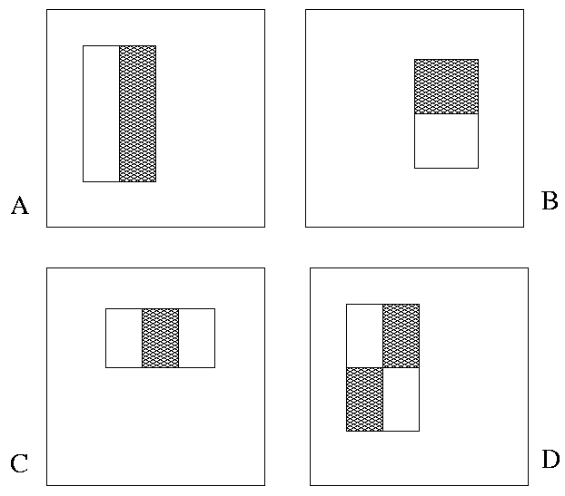
Image Features
“Rectangle filters”
+1
-1
People call them Haar-like features,
since similar to 2D Haar wavelets.
Value =
∑ (pixels in white area) –
∑ (pixels in black area)

Slide 28


Feature extraction
“Rectangular” filters
  Filters can be different sizes.
  Filters can be anywhere in the
  box being analyzed.
  Feature output is very simple
  convolution.
  Requires sums of large boxes.
  Efficiently computable with integral image: any sum can be computed in constant time
  Avoid scaling images scale features directly for same cost
Viola & Jones, CVPR 2001
K. Grauman, B. Leibe
Notes:
28

Slide 29
Recall: Sums of rectangular regions
How do we compute the sum of the pixels in the red box?
243 | 239 | 240 | 225 | 206 | 185 | 188 | 218 | 211 | 206 | 216 | 225
242 | 239 | 218 | 110 | 67 | 31 | 34 | 152 | 213 | 206 | 208 | 221
243 | 242 | 123 | 58 | 94 | 82 | 132 | 77 | 108 | 208 | 208 | 215
235 | 217 | 115 | 212 | 243 | 236 | 247 | 139 | 91 | 209 | 208 | 211
233 | 208 | 131 | 222 | 219 | 226 | 196 | 114 | 74 | 208 | 213 | 214
232 | 217 | 131 | 116 | 77 | 150 | 69 | 56 | 52 | 201 | 228 | 223
232 | 232 | 182 | 186 | 184 | 179 | 159 | 123 | 93 | 232 | 235 | 235
232 | 236 | 201 | 154 | 216 | 133 | 129 | 81 | 175 | 252 | 241 | 240
235 | 238 | 230 | 128 | 172 | 138 | 65 | 63 | 234 | 249 | 241 | 245
237 | 236 | 247 | 143 | 59 | 78 | 10 | 94 | 255 | 248 | 247 | 251
234 | 237 | 245 | 193 | 55 | 33 | 115 | 144 | 213 | 255 | 253 | 251
248 | 245 | 161 | 128 | 149 | 109 | 138 | 65 | 47 | 156 | 239 | 255
190 | 107 | 39 | 102 | 94 | 73 | 114 | 58 | 17 | 7 | 51 | 137
23 | 32 | 33 | 148 | 168 | 203 | 179 | 43 | 27 | 17 | 12 | 8
17 | 26 | 12 | 160 | 255 | 255 | 109 | 22 | 26 | 19 | 35 | 24
After some pre-computation, this can be done in constant time for any box.
This “trick” is commonly used for computing Haar wavelets (a fundemental building block of many object recognition approaches.)

Slide 30
Sums of rectangular regions
The trick is to compute an “integral image.” Every pixel is the sum of its neighbors to the upper left.
Sequentially compute using:

Slide 31
Sums of rectangular regions
 |  | A |  |  |  |  |  |  | B
 |  | C |  |  |  |  |  |  | D
Solution is found using:
A + D – B - C
What if the position of the box lies between pixels?
Use bilinear interpolation.

Slide 32
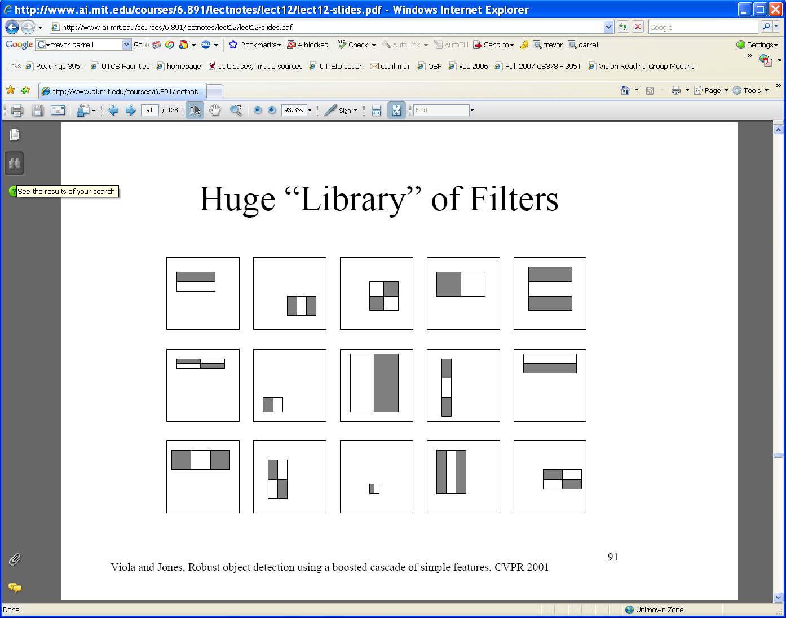
Large library of filters
  Considering all possible filter parameters: position, scale, and type:
160,000+ possible features associated with each 24 x 24 window
Use AdaBoost both to select the informative features and to form the classifier
Viola & Jones, CVPR 2001
Notes:
32

Slide 33
Feature selection
For a 24x24 detection region, the number of possible rectangle features is ~160,000!
At test time, it is impractical to evaluate the entire feature set
Can we create a good classifier using just a small subset of all possible features?
How to select such a subset?

Slide 34
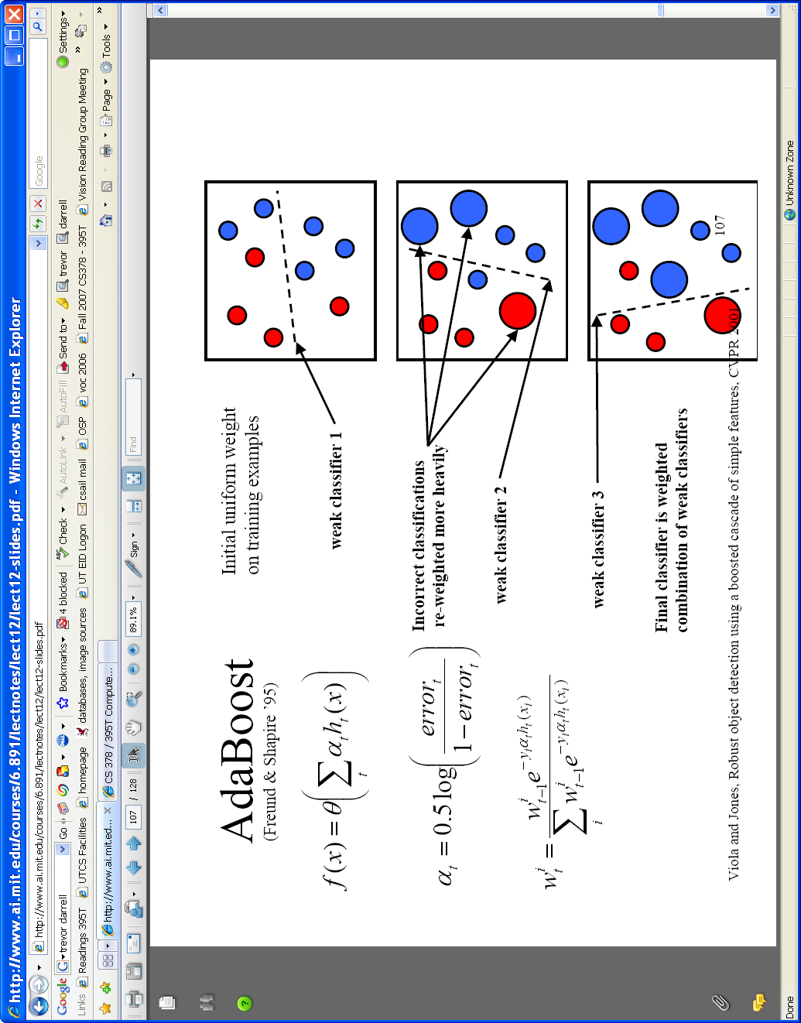

AdaBoost for feature+classifier selection
Want to select the single rectangle feature and threshold that best separates positive (faces) and negative (non-faces) training examples, in terms of weighted error.
θ_{t} is a threshold for classifier h_{t}
Resulting weak classifier:
0
For next round, reweight the examples according to errors, choose another filter/threshold combo.
…
Outputs of a possible rectangle feature on training examples x (faces and non faces)
Viola & Jones, CVPR 2001
Notes:
34

Slide 35
Weak Classifiers
Each weak classifier works on exactly one rectangle feature.
Each weak classifier has 3 associated variables
  its threshold θ
  its polarity p
  its weight α
The polarity can be 0 or 1 (in our code)
The weak classifier computes its one feature f
  When the polarity is 1, we want f > θ for face
  When the polarity is 0, we want f < θ for face
The weight will be used in the final classification by AdaBoost.

Slide 36
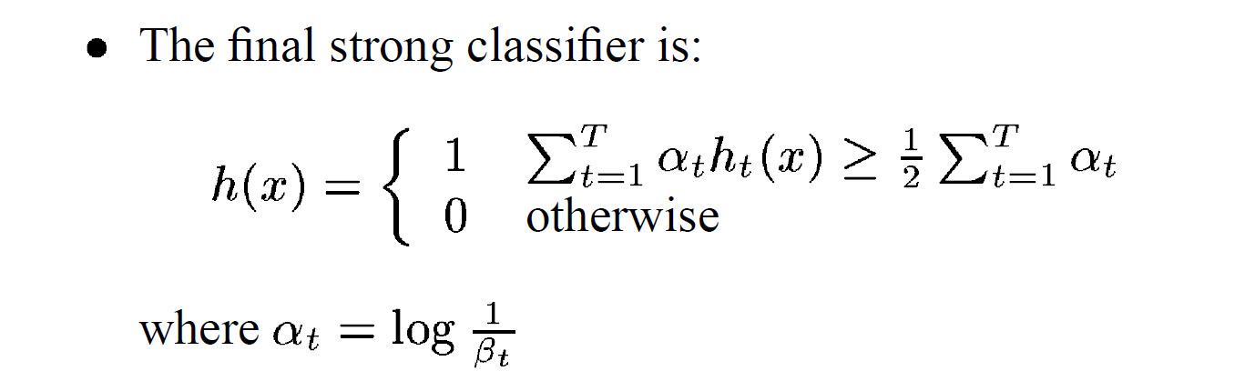
β_{t} = ε_{t} / (1- ε_{t}): the training error of the classifier h_{t}
Final classifier is combination of the weak ones, weighted according to error they had.
The code computes a SCORE based on the difference of the two above summations.

Slide 37
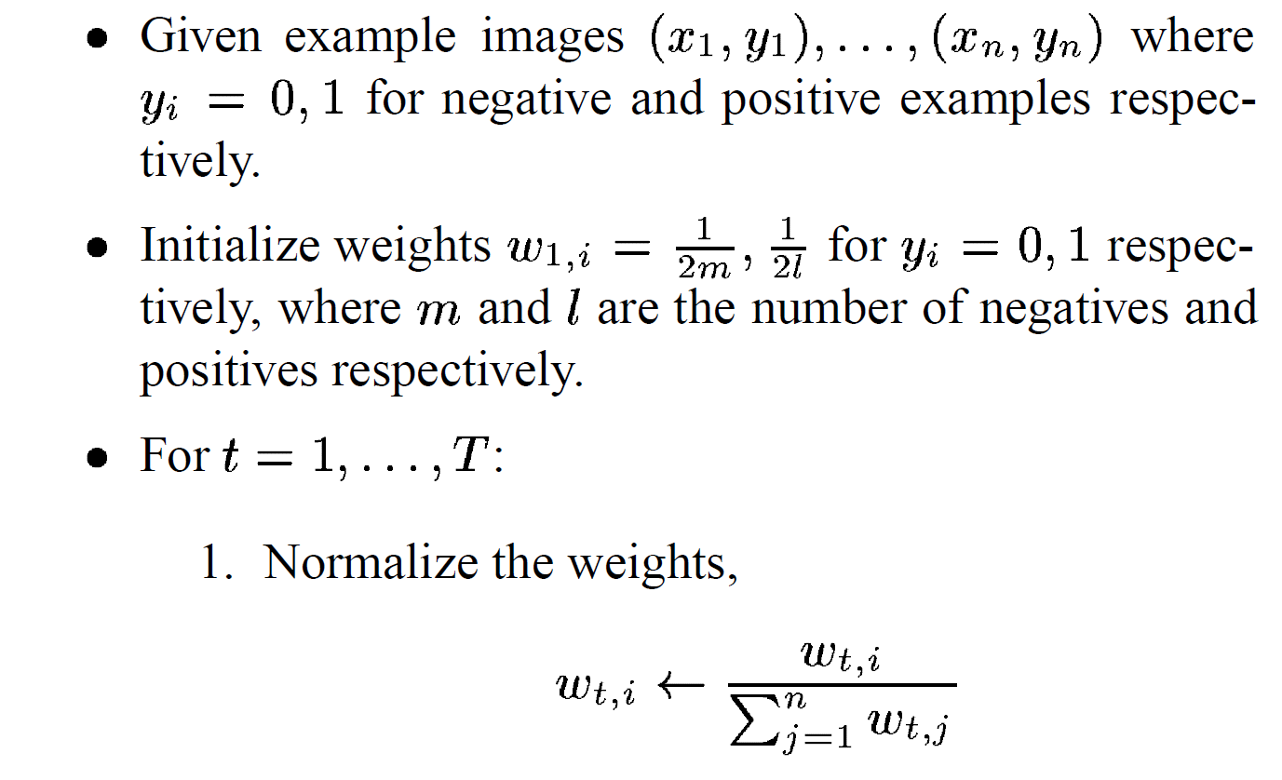
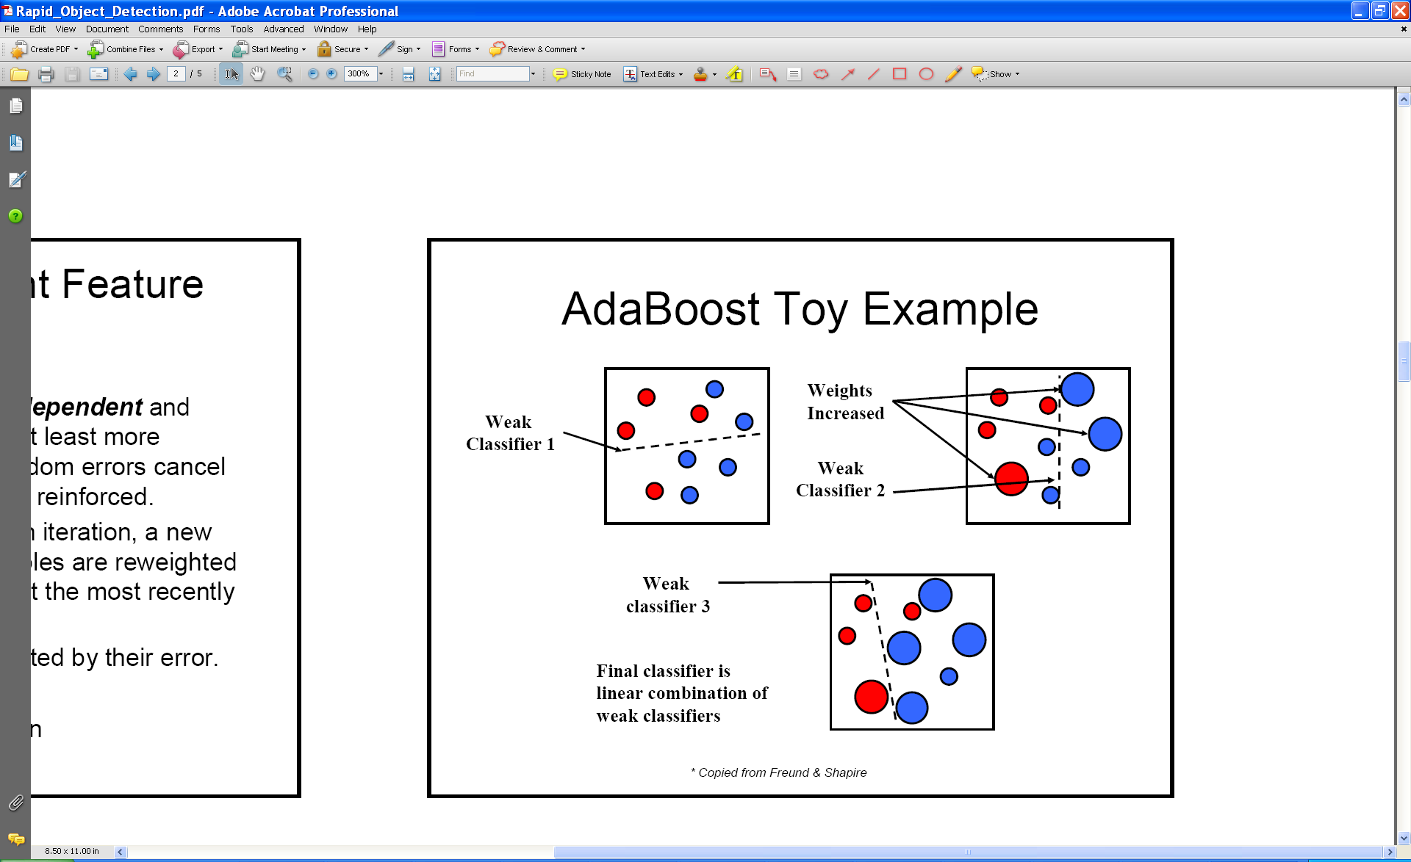
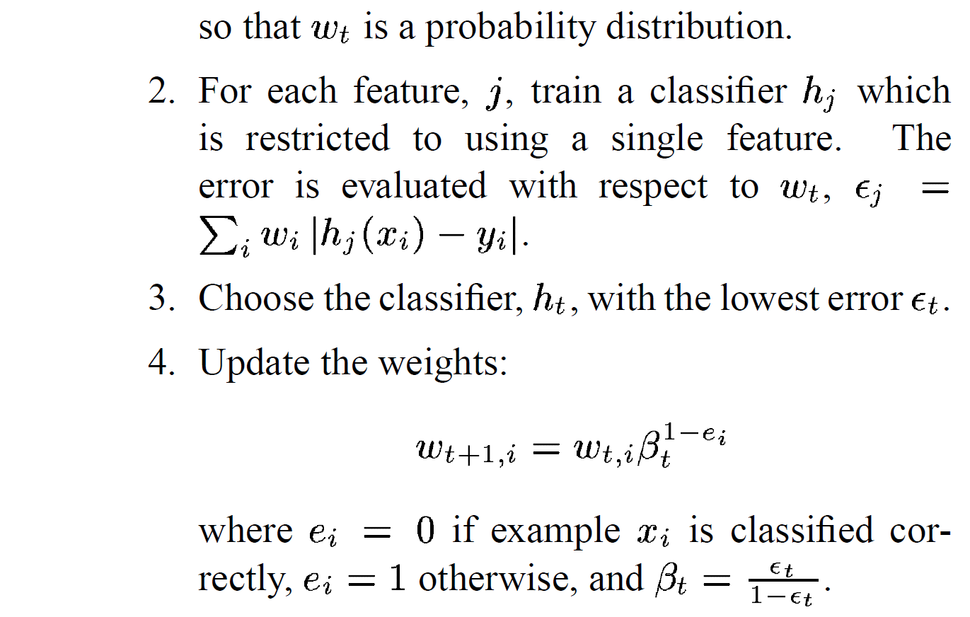
AdaBoost Algorithm modified by Viola Jones
NOTE: Our code
uses equal weights
for all samples
{x₁,…x_{n}}
For T rounds:
meaning we will
construct T weak
classifiers
Normalize weights
Find the best threshold and polarity for each feature, and return error ε.
sum over training samples
Re-weight the examples:
Incorrectly classified -> more weight
Correctly classified -> less weight
Notes:
37

Slide 38
Updating the Weights
Suppose a weak classifier i has error e_{i}.
The weight alpha for this classifier is
α = ln((1-e_{i})/e_{i})
The updating formula for the weight w_{i} for classifier i is given as
w_{t+1,i} = w_{t,i} β_{t}^{1-ei}
where e_{i} = 0 if example x_{i} is classified correctly else 1.
And β_{t} = exp(-α_{t}) which is e_{i}/(1-e_{i})
After the weights are updated, they are normalized by the sum of all of them.

Slide 39
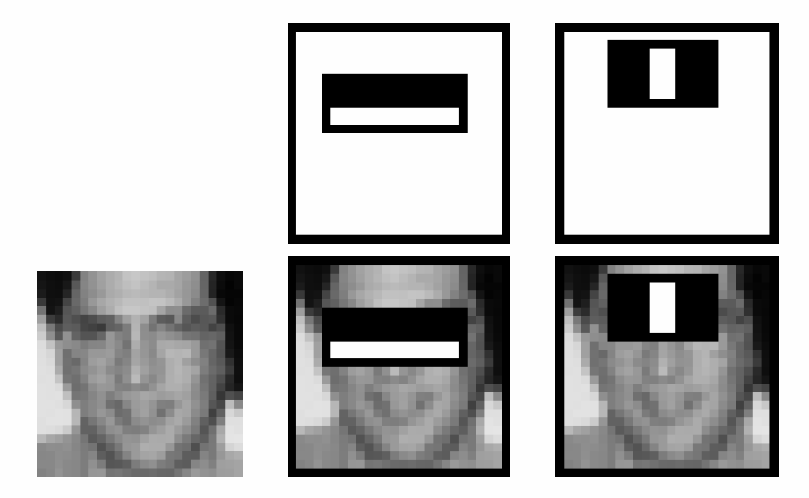
Recall
Classification
  Decision Trees and Forests
  Neural Nets
  SVMs
  Boosting
  ....
Face Detection
  Simple Features
  Integral Images
  Boosting
 |  | A |  |  |  |  |  |  | B
 |  | C |  |  |  |  |  |  | D

Slide 40

Picking the threshold for the best classifier: the idea
The features are actually sorted
in the code according to numeric
value!
Efficient single pass approach:
At each sample compute:
= min ( S + (T – S), S + (T – S) )
Find the minimum value of , and use the value of the corresponding sample as the threshold.
S = sum of weights of samples with feature value below the current sample
T = total sum of all samples
S and T are for faces; S and T are for background.

Slide 41
Picking the threshold for the best classifier: the details for coding
The features for the training samples are actually sorted in the code according to numeric value!
Algorithm:
find AFS, the sum of the weights of all the face samples
find ABG, the sum of the weights of all the background samples
set to zero FS, the sum of the weights of face samples so far
set to zero BG, the sum of the weights of background samples so far
go through each sample s in a loop IN THE SORTED ORDER
At each sample, add weight to FS or BG and compute:
= min (BG + (AFS – FS), FS + (ABG – BG))
Find the minimum value of e, and use the feature value of the corresponding sample as the threshold.

Slide 42
What’s going on?
error = min (BG + (AFS – FS), FS + (ABG –BG))
left right
Let’s pretend the weights on the samples are all 1’s.
The samples are arranged in ascending order by feature value
and we know which ones are faces (f) and background (b).
Left is the number of background patches so far plus the number
of faces yet to be encountered.
Right is the number of faces so far plus the number of background
patches yet to be encountered.
1+5-0
0+5-1
b b b f b f f b f f
(6,4) (7,3) (8,2) (7,3) (8,2) (7,3) (4,4) (7,3) (6,4) (5,5)
min 4 3 2 3 2 3 4 3 4 5

Slide 43
Setting the Polarity
error = min (BG + (AFS – FS), FS + (ABG –BG))
left right
left is the number of background patches so far plus the number
of faces yet to be encountered.
right is the number of faces so far plus the number of background
patches yet to be encountered.
When left < right, set polarity to 0
Else set polarity to 1

Slide 44
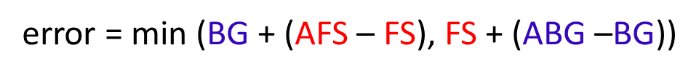
Threshold and Polarity Example
samples
labels
features
weight
index
0 1 2 3 4
F B F B B
3 10 2 1
1/5 1/5 1/5 1/5 1/5
4 3 1 0 2
initialize
AFS = 0
ABG = 0
besterr = 999999
AFS becomes sum of face sample weights = 2/5; ABG = 3/5
step 0: idx = 4; FS stays 0; BG = 1/5
error = min(1/5 + (2/5-0), 0 + (3/5-1/5))= 2/5
besterr = 2/5; bestpolarity = 1; bestthreshold=1
step 1: idx = 3; FS stays 0; BG = 2/5
error = min(2/5 + (2/5-0), 0 + (3/5-2/5))= 1/5
besterr = 1/5; bestpolarity = 1; bestthreshold=2

Slide 45
Threshold and Polarity Example
samples
labels
features
weight
index
0 1 2 3 4
F B F B B
3 10 2 1
1/5 1/5 1/5 1/5 1/5
4 3 1 0 2
initialize
AFS = 0
ABG = 0
besterr = 999999
step 2: idx = 1; FS stays 0; BG = 3/5
error = min(3/5 + (2/5-0), 0 + (3/5-3/5))= 0
besterr = 0; bestpolarity = 1; bestthreshold=3
RESULT
step 3: idx = 0; FS = 1/5; BG = 3/5
error = min(3/5 + (2/5-1/5), 1/5 + (3/5-3/5))= 1/5
NO CHANGE
1 2 3 6 10
θ > 3
step 4: idx = 2; FS = 2/5; BG = 3/5
error = min(3/5 + (2/5-2/5), 2/5+ (3/5-3/5))= 2/5
NO CHANGE

Slide 46
Measuring classification performance
Confusion matrix
Accuracy
  (TP+TN)/
  (TP+TN+FP+FN)
True Positive Rate=Recall
  TP/(TP+FN)
False Positive Rate
  FP/(FP+TN)
Precision
  TP/(TP+FP)
F1 Score
  2*Recall*Precision/
  (Recall+Precision)
 |  | Predicted class
 |  | Class1 | Class2 | Class3
Actual class | Class1 | 40 | 1 | 6
 | Class2 | 3 | 25 | 7
 | Class3 | 4 | 9 | 10
 |  | Predicted
 |  | Positive | Negative
Actual | Positive | True Positive | False Negative
 | Negative | False Positive | True Negative
Notes:
Compare to the output of classifier to the actual label
In the case of binary classification, postive and negative
Confusion matrix, each entry show the frequency of will show actual value, predicted value.
True positive, the number of positive examples that has been correctly classified as positive. False positive, negative, positive

Slide 47
Boosting for face detection
First two features selected by boosting:
This feature combination can yield 100% detection rate and 50% false positive rate

Slide 48
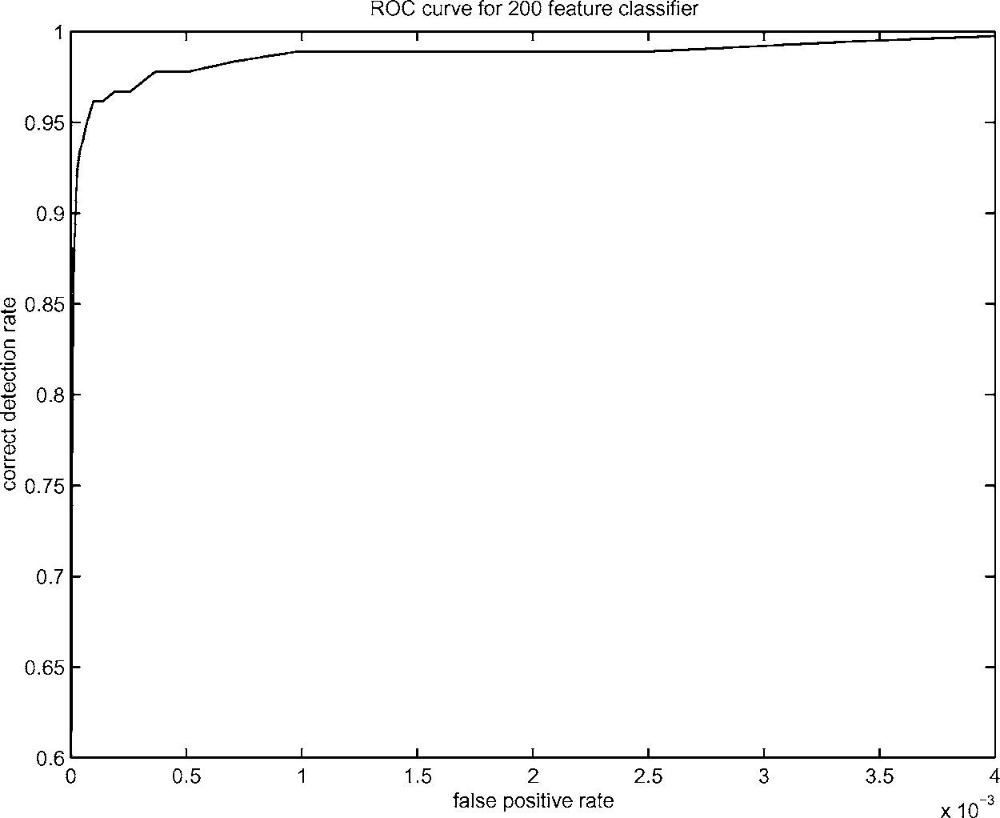
Boosting for face detection
A 200-feature classifier can yield 95% detection rate and a false positive rate of 1 in 14084
Is this good enough?
Receiver operating characteristic (ROC) curve

Slide 49
Attentional cascade (from Viola-Jones)
We start with simple classifiers which reject many of the negative sub-windows while detecting almost all positive sub-windows
Positive response from the first classifier triggers the evaluation of a second (more complex) classifier, and so on
A negative outcome at any point leads to the immediate rejection of the sub-window
T
T
T
IMAGE
SUB-WINDOW
T
FACE
Classifier 1
Classifier 2
Classifier 3
F
F
F
NON-FACE
NON-FACE
NON-FACE

Slide 50
Attentional cascade
Chain of classifiers that are progressively more complex and have lower false positive rates:
Receiver operating characteristic
% False Pos
0
50
vs
false
neg
determined by
0 100
% Detection
T
T
T
IMAGE
SUB-WINDOW
T
FACE
Classifier 1
Classifier 2
Classifier 3
F
F
F
NON-FACE
NON-FACE
NON-FACE
Notes:
In general simple classifiers, while they are more efficient, they are also weaker.
We could define a computational risk hierarchy (in analogy with structural risk minimization)…
A nested set of classifier classes
The training process is reminiscent of boosting…
- previous classifiers reweight the examples used to train subsequent classifiers
The goal of the training process is different
- instead of minimizing errors minimize false positives

Slide 51
Attentional cascade
The detection rate and the false positive rate of the cascade are found by multiplying the respective rates of the individual stages
A detection rate of 0.9 and a false positive rate on the order of 10⁻⁶ can be achieved by a
10-stage cascade if each stage has a detection rate of 0.99 (0.99¹⁰ ≈ 0.9) and a false positive rate of about 0.30 (0.3¹⁰ ≈ 6×10⁻⁶)
T
T
T
IMAGE
SUB-WINDOW
T
FACE
Classifier 1
Classifier 2
Classifier 3
F
F
F
NON-FACE
NON-FACE
NON-FACE

Slide 52
Training the cascade
Set target detection and false positive rates for each stage
Keep adding features to the current stage until its target rates have been met
  Need to lower AdaBoost threshold to maximize detection
  (as opposed to minimizing total classification error)
  Test on a validation set
If the overall false positive rate is not low enough, then add another stage
Use false positives from current stage as the negative training examples for the next stage

Slide 53
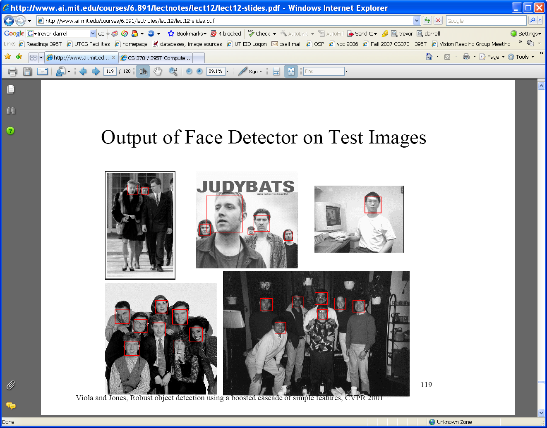
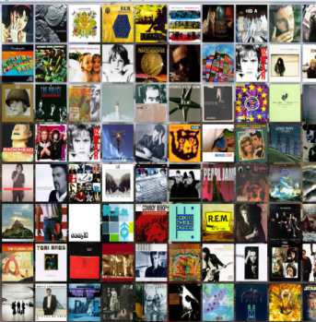





Viola-Jones Face Detector: Summary
Train cascade of classifiers with AdaBoost
Apply to each subwindow
Faces
New image
Selected features, thresholds, and weights
Non-faces
Train with 5K positives, 350M negatives
Real-time detector using 38 layer cascade
6061 features in final layer
[Implementation available in OpenCV: http://www.intel.com/technology/computing/opencv/]
Notes:
53

Slide 54

The implemented system
Training Data
  5000 faces
    All frontal, rescaled to
    24x24 pixels
  300 million non-faces
    9500 non-face images
  Faces are normalized
    Scale, translation
Many variations
  Across individuals
  Illumination
  Pose
Notes:
This situation with negative examples is actually quite common… where negative examples are free.

Slide 55
System performance
Training time: “weeks” on 466 MHz Sun workstation
38 layers, total of 6061 features
Average of 10 features evaluated per window on test set
“On a 700 Mhz Pentium III processor, the face detector can process a 384 by 288 pixel image in about .067 seconds”
  15 Hz
  15 times faster than previous detector of comparable accuracy (Rowley et al., 1998)

Slide 56
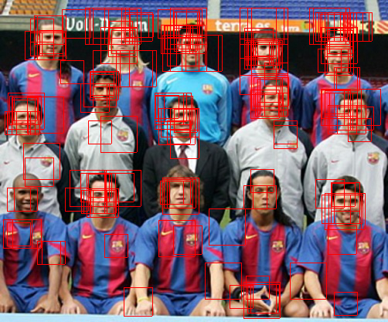
Non-maximal suppression (NMS)
Many detections above threshold.

Slide 57
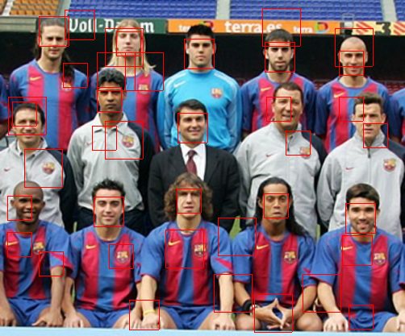
Non-maximal suppression (NMS)

Slide 58
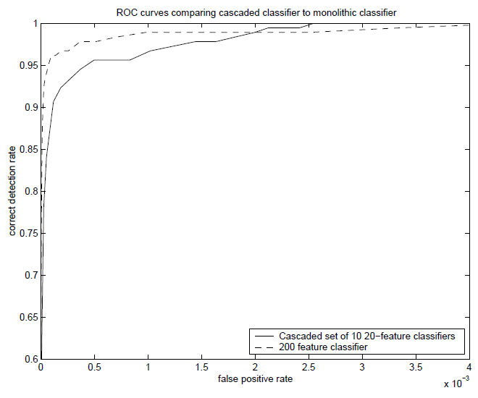
Is this good?
Similar accuracy, but 10x faster

Slide 59
Viola-Jones Face Detector: Results
Notes:
59

Slide 60
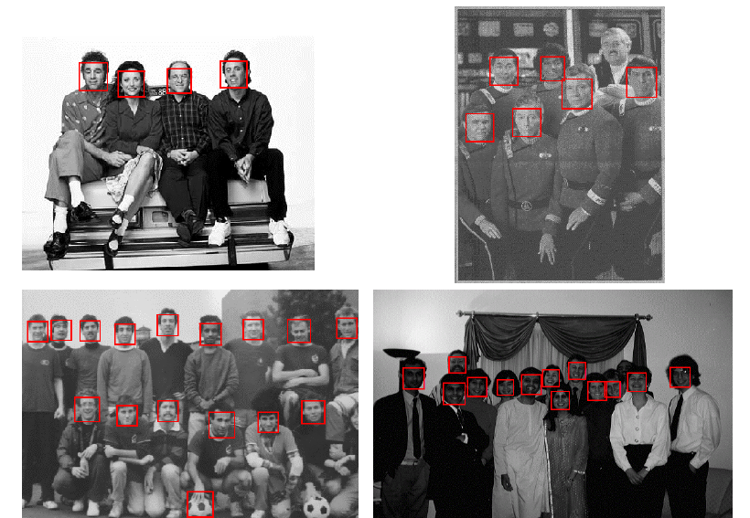
Viola-Jones Face Detector: Results
Notes:
60

Slide 61
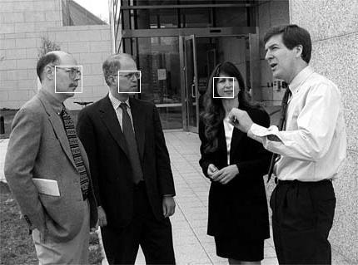
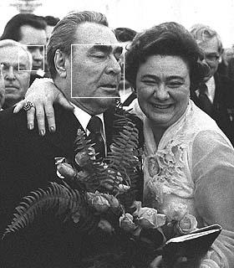
Viola-Jones Face Detector: Results

Slide 62
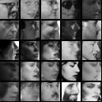
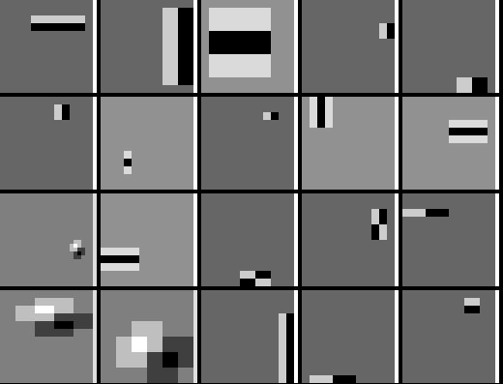
Detecting profile faces?
Detecting profile faces requires training separate detector with profile examples.

Slide 63
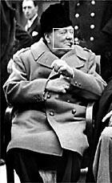

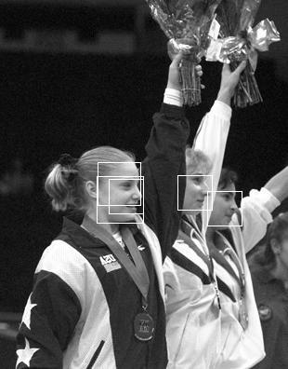
Viola-Jones Face Detector: Results
Paul Viola, ICCV tutorial

Slide 64
Summary: Viola/Jones detector
Rectangle features
Integral images for fast computation
Boosting for feature selection
Attentional cascade for fast rejection of negative windows

