Slide 1
Cameras and Stereo
EE/CSE 576
Linda Shapiro

Slide 2

Müller-Lyer Illusion
http://www.michaelbach.de/ot/sze_muelue/index.html
What do you know about perspective projection?
Vertical lines?
Other lines?

Slide 3
Image formation
Object
Film
Let’s design a camera
  Idea 1: put a piece of film in front of an object
  Do we get a reasonable image?

Slide 4
Pinhole camera
Object
Barrier
Film
Add a barrier to block off most of the rays
  This reduces blurring
  The opening known as the aperture
  How does this transform the image?

Slide 5
Adding a lens
“circle of
confusion”
A lens focuses light onto the film
  There is a specific distance at which objects are “in focus”
    other points project to a “circle of confusion” in the image
  Changing the shape of the lens changes this distance

Slide 6

Lenses
F
focal point
optical center
(Center Of Projection)
A lens focuses parallel rays onto a single focal point
  focal point at a distance f beyond the plane of the lens
    f is a function of the shape and index of refraction of the lens
  Aperture of diameter D restricts the range of rays
    aperture may be on either side of the lens
  Lenses are typically spherical (easier to produce)
  Real cameras use many lenses together (to correct for aberrations)

Slide 7
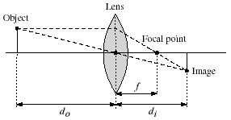
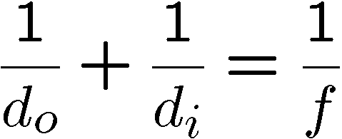
Thin lenses
Thin lens equation:
  Any object point satisfying this equation is in focus
Notes:
manipulate eq to show shape of focus region

Slide 8

Digital camera
A digital camera replaces film with a sensor array
  Each cell in the array is a Charge Coupled Device (CCD)
    light-sensitive diode that converts photons to electrons
  CMOS is becoming more popular (esp. in cell phones)
    http://electronics.howstuffworks.com/digital-camera.htm

Slide 9
Issues with digital cameras
Noise
    big difference between consumer vs. SLR-style cameras
    low light is where you most notice noise
Compression
    creates artifacts except in uncompressed formats (tiff, raw)
Color
    color fringing artifacts from Bayer patterns
Blooming
    charge overflowing into neighboring pixels
In-camera processing
    oversharpening can produce halos
Interlaced vs. progressive scan video
    even/odd rows from different exposures
Are more megapixels better?
    requires higher quality lens
    noise issues
Stabilization
    compensate for camera shake (mechanical vs. electronic)
More info online, e.g.,
http://electronics.howstuffworks.com/digital-camera.htm
http://www.dpreview.com/

Slide 10
Projection
Mapping from the world (3d) to an image (2d)
Can we have a 1-to-1 mapping?
How many possible mappings are there?
An optical system defines a particular projection. We’ll talk about 2:
Perspective projection (how we see “normally”)
Orthographic projection (e.g., telephoto lenses)

Slide 11
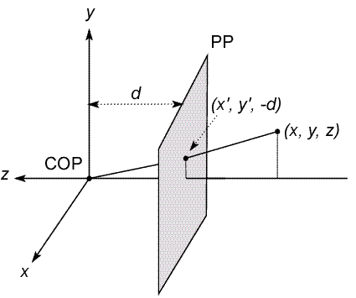

Modeling projection
3D point
C
negative z axis
The coordinate system
  We will use the pin-hole model as an approximation
  Put the optical center (Center Of Projection) at the origin
  Put the image plane (Projection Plane) in front of the COP
  The camera looks down the negative z axis
    we need this if we want right-handed-coordinates

Slide 12
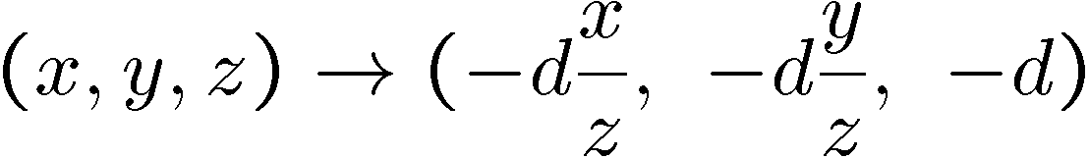
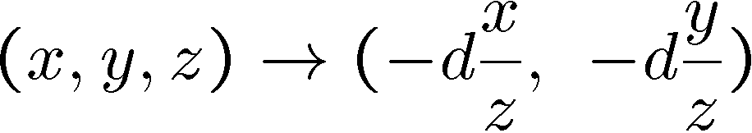
Modeling projection
y/z = y´/-d
y´ = -d(y/z)
Projection equations
  Compute intersection with PP of ray from (x,y,z) to COP
  Derived using similar triangles
We get the projection by throwing out the last coordinate:
(x´,y´)

Slide 13




Homogeneous coordinates
Is this a linear transformation?
no—division by z is nonlinear
Trick: add one more coordinate:
homogeneous image
coordinates
homogeneous scene
coordinates
Converting from homogeneous coordinates

Slide 14
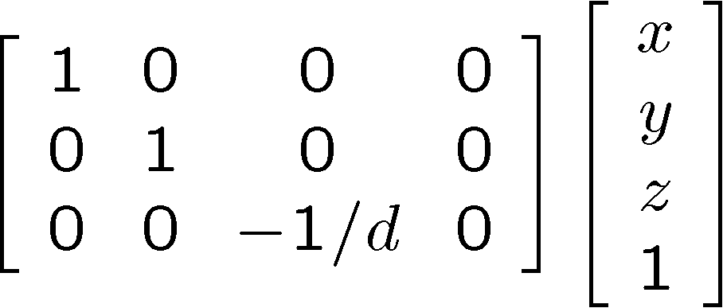
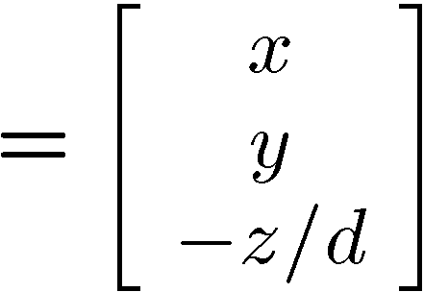
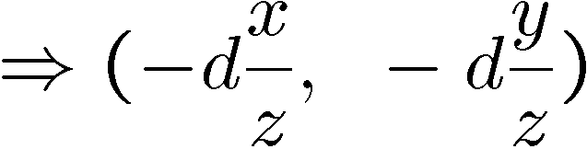
Perspective Projection
Projection is a matrix multiply using homogeneous coordinates:
divide by third coordinate
projection matrix 3D point 2D point
This is known as perspective projection
The matrix is the projection matrix

Slide 15
Perspective Projection Example
1. Object point at (10, 6, 4), d=2
2. Object point at (25, 15, 10)
Perspective projection is not 1-to-1!

Slide 16
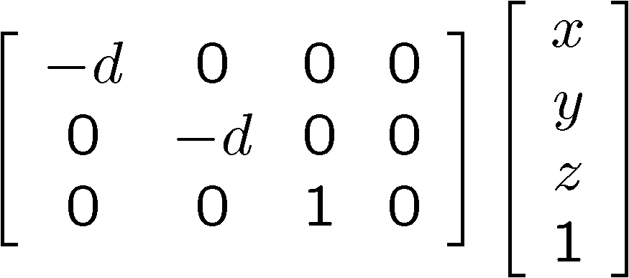
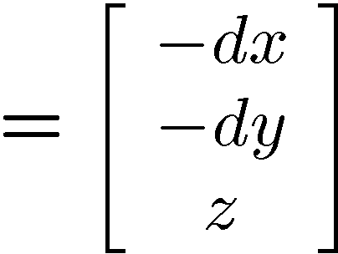
Perspective Projection
How does scaling the projection matrix change the transformation?
SAME

Slide 17
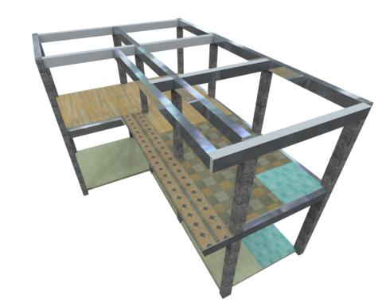
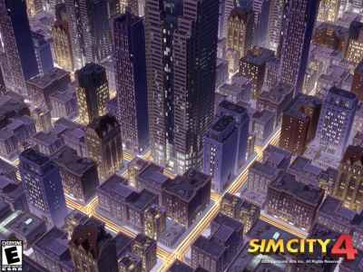
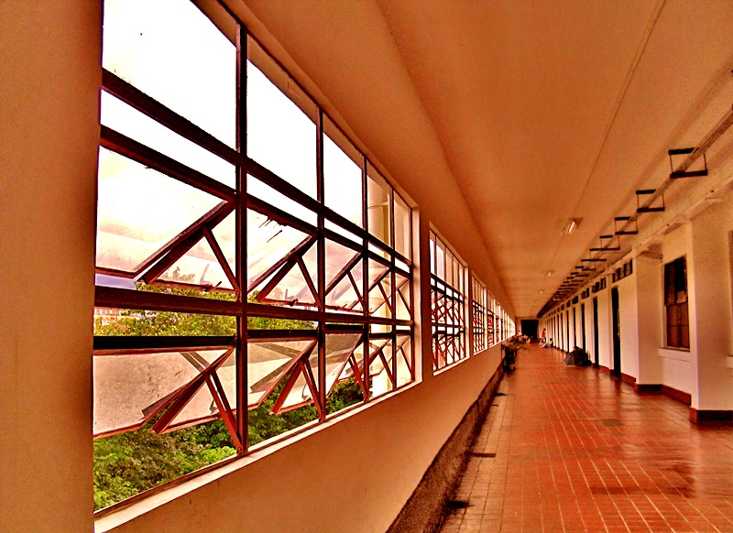
Perspective Projection
What happens to parallel lines?
What happens to angles?
What happens to distances?

Slide 18
Perspective Projection
What happens when d➔∞?

Slide 19
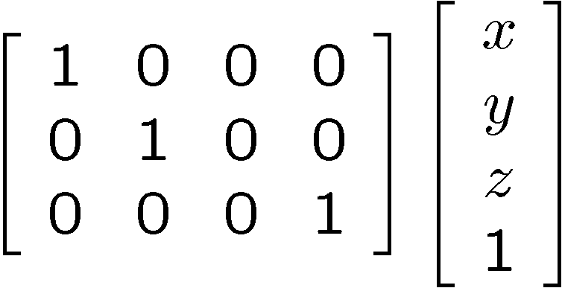
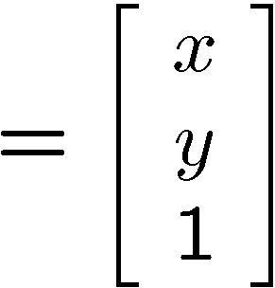

Orthographic projection
Special case of perspective projection
  Distance from the COP to the PP is infinite
  Good approximation for telephoto optics
  Also called “parallel projection”: (x, y, z) → (x, y)
  What’s the projection matrix?
Image
World

Slide 20
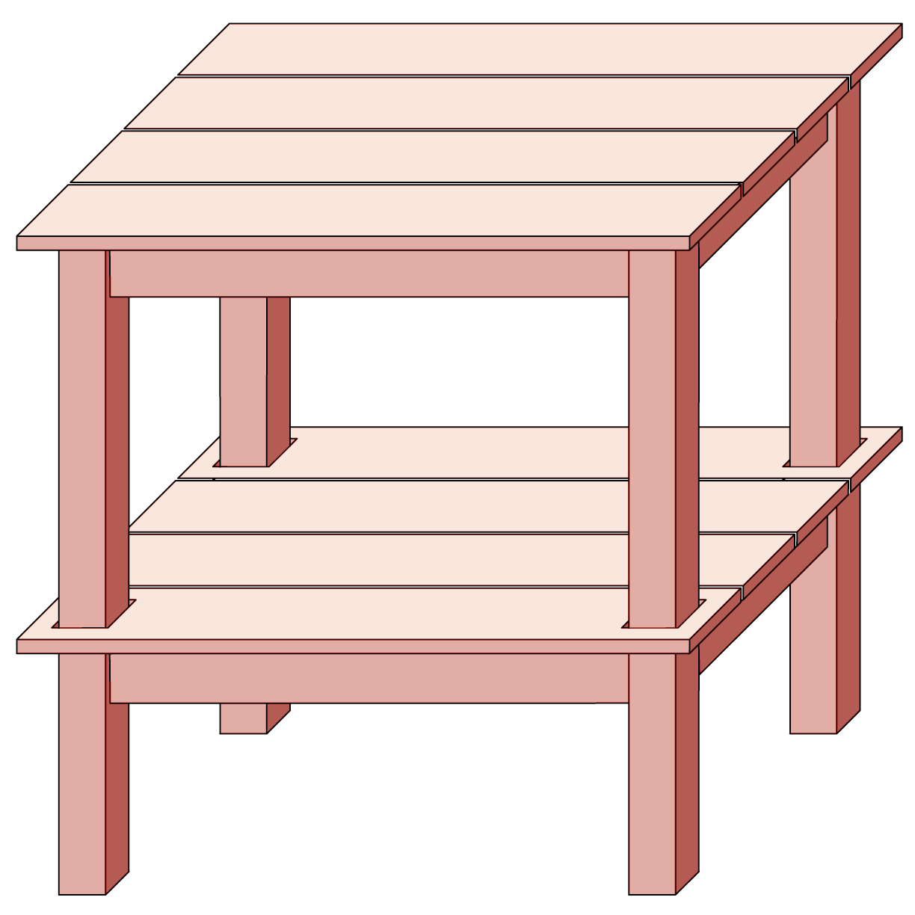

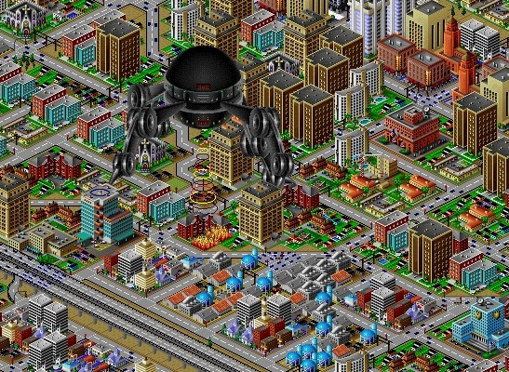
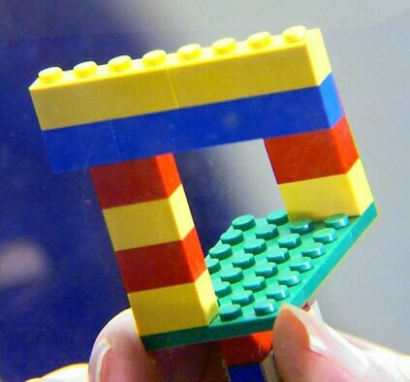
Orthographic Projection
What happens to parallel lines?
What happens to angles?
What happens to distances?

Slide 21
Camera parameters
How many numbers do we need to describe a camera?
We need to describe its pose in the world
We need to describe its internal parameters

Slide 22

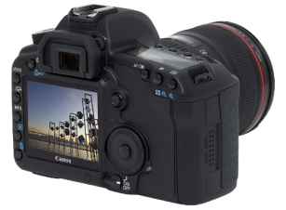
A Tale of Two Coordinate Systems
v
y
COP
u
Camera
w
o
x
Two important coordinate systems:
1. World coordinate system
2. Camera coordinate system
z
“The World”

Slide 23
Camera parameters
To project a point (x,y,z) in world coordinates into a camera
First transform (x,y,z) into camera coordinates
Need to know
  Camera position (in world coordinates)
  Camera orientation (in world coordinates)
Then project into the image plane
  Need to know camera intrinsics
These can all be described with matrices

Slide 24
3D Translation
3D translation is just like 2D with one more coordinate
x′ 1 0 0 tx x
y′ = 0 1 0 ty y
z′ 0 0 1 tz z
1 0 0 0 1 1
= [x+tx, y+ty, z+tz, 1]^{T}

Slide 25
3D Rotation (just the 3 x 3 part shown)
About X axis: 1 0 0 About Y: cosθ 0 sinθ
0 cosθ –sinθ 0 1 0
0 sinθ cosθ -sinθ 0 cosθ
About Z axis: cosθ –sinθ 0
sinθ cosθ 0
0 0 1
General (orthonormal) rotation matrix used in practice:
r11 r12 r13
r21 r22 r23
r31 r32 r33

Slide 26

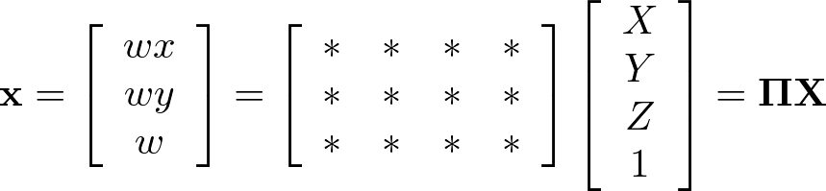




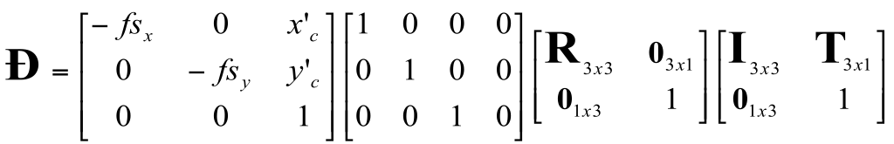
Camera parameters
A camera is described by several parameters
Translation T of the optical center from the origin of world coords
Rotation R of the image plane
focal length f, principal point (x’_{c}, y’_{c}), pixel size (s_{x}, s_{y})
blue parameters are called “extrinsics,” red are “intrinsics”
Projection equation
The projection matrix models the cumulative effect of all parameters
Useful to decompose into a series of operations
identity matrix
[tx, ty, tz]^{T}
intrinsics
projection
rotation
translation
The definitions of these parameters are not completely standardized
especially intrinsics—varies from one book to another

Slide 27







Extrinsics
How do we get the camera to “canonical form”?
  (Center of projection at the origin, x-axis points right, y-axis points up, z-axis points backwards)
Step 1: Translate by -c
image
plane
0
camera

Slide 28
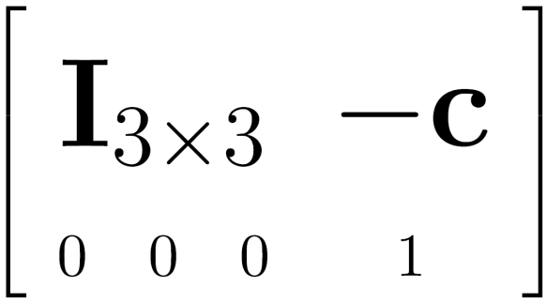

Extrinsics
How do we get the camera to “canonical form”?
  (Center of projection at the origin, x-axis points right, y-axis points up, z-axis points backwards)
Step 1: Translate by -c
How do we represent translation as a matrix multiplication?
0

Slide 29
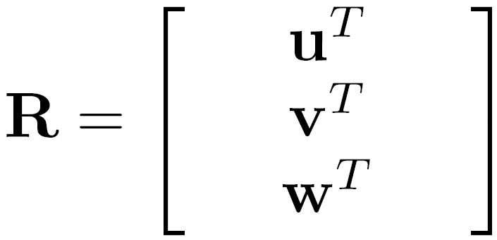
Extrinsics
How do we get the camera to “canonical form”?
  (Center of projection at the origin, x-axis points right, y-axis points up, z-axis points backwards)
Step 1: Translate by -c
Step 2: Rotate by R
0
3x3 rotation matrix

Slide 30
Extrinsics
How do we get the camera to “canonical form”?
  (Center of projection at the origin, x-axis points right, y-axis points up, z-axis points backwards)
Step 1: Translate by -c
Step 2: Rotate by R
0

Slide 31
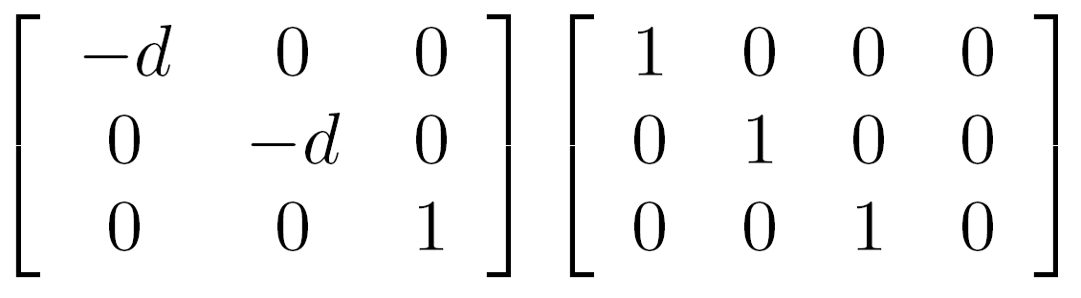
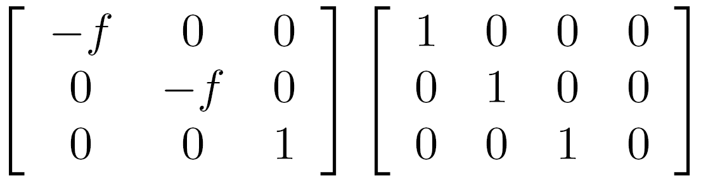

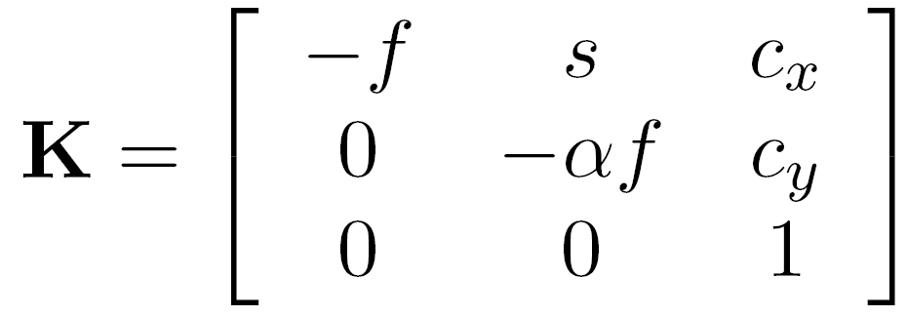



Perspective projection
(converts from 3D rays in camera coordinate system to pixel coordinates)
(intrinsics)
in general,
f is the focal
length of the camera
: aspect ratio (1 unless pixels are not square)
: skew (0 unless pixels are shaped like rhombi/parallelograms)
: principal point ((0,0) unless optical axis doesn’t intersect projection plane at origin)

Slide 32
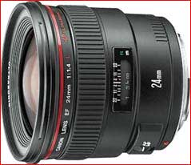



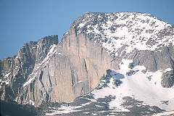
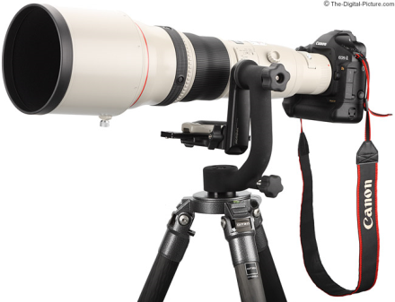
Focal length
Can think of as “zoom”
Related to field of view
24mm
50mm
200mm
800mm

Slide 33
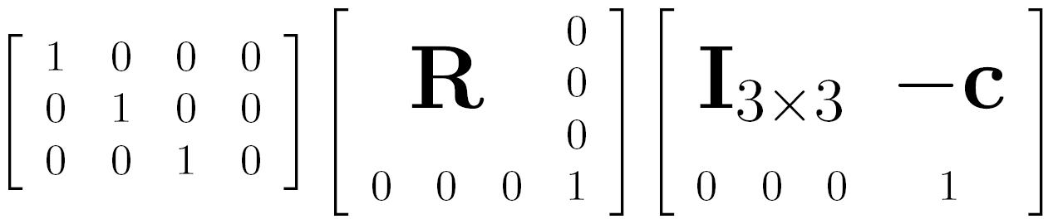

Projection matrix
intrinsics
projection
rotation
translation

Slide 34



Projection matrix
arbitrary 3D point
=
image plane
0
(in homogeneous image coordinates)

Slide 35
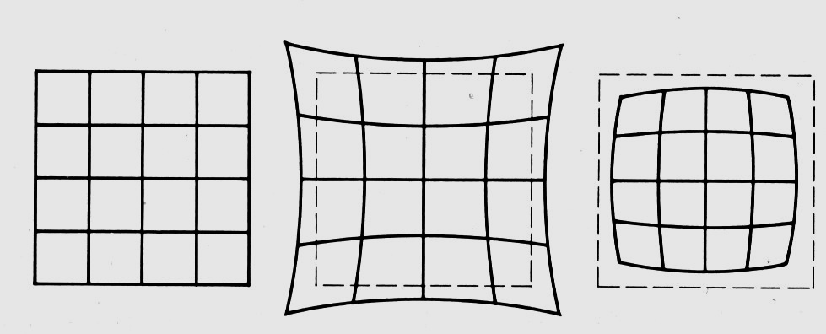
Distortion
No distortion
Pin cushion
Barrel
Radial distortion of the image
  Caused by imperfect lenses
  Deviations are most noticeable for rays that pass through the edge of the lens
Notes:
Many wide –angle lenses have radial distortion – visible curvature in the projection of straight lines. To create good reconstructions / panoramas etc. this distortion shouldbe taken into account. Barrel usually a product of wide angle lenses and pincushion usually in telephoto lenses.

Slide 36
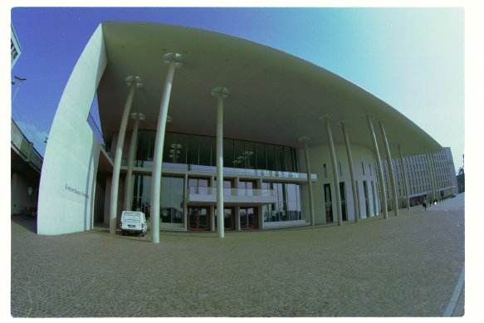
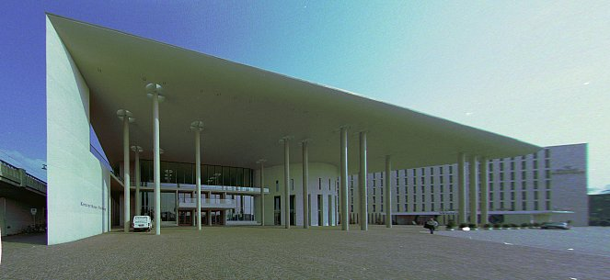
Correcting radial distortion
from Helmut Dersch

Slide 37
Where does all this lead?
We need it to understand stereo
And 3D reconstruction
It also leads into camera calibration, which is usually done in factory settings to solve for the camera parameters before performing an industrial task.
The extrinsic parameters must be determined.
Some of the intrinsic are given, some are solved for, some are improved.

Slide 38
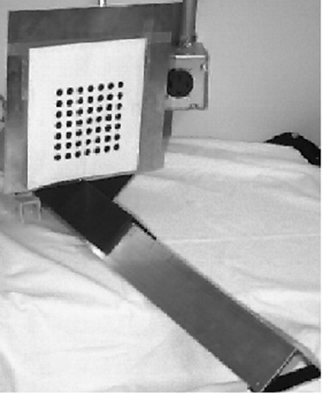
Camera Calibration
The idea is to snap
images at different
depths and get a
lot of 2D-3D point
correspondences.
x1, y1, z1, u1, v1
x2, y2, z1, u2, v2
.
.
xn, yn, zn, un, vn
Then solve a system
of equations to get
camera parameters.

Slide 39
Stereo

Slide 41
Amount of horizontal movement is …
…inversely proportional to the distance from the camera

Slide 42
Depth from Stereo
Goal: recover depth by finding image coordinate x’ that corresponds to x
X
X
x
z
x
x’
x'
f
f
C
Baseline
B
C’

Slide 43
Depth from disparity
X
z
x
x’
f
f
O
Baseline
B
O’
Disparity is inversely proportional to depth.

Slide 44
Depth from Stereo
Goal: recover depth by finding image coordinate x’ that corresponds to x
Sub-Problems
  Calibration: How do we recover the relation of the cameras (if not already known)?
  Correspondence: How do we search for the matching point x’?
X
x
x'

Slide 45


Correspondence Problem
x
?
We have two images taken from cameras with different intrinsic and extrinsic parameters
How do we match a point in the first image to a point in the second? How can we constrain our search?

Slide 46

Key idea: Epipolar constraint
X
X
X
x
x’
x’
x’
Potential matches for x have to lie on the corresponding line l’.
Potential matches for x’ have to lie on the corresponding line l.

Slide 47

Epipolar geometry: notation
X
x
x’
Baseline – line connecting the two camera centers
Epipoles
= intersections of baseline with image planes
= projections of the other camera center
Epipolar Plane – plane containing baseline (1D family)

Slide 48
Epipolar geometry: notation
X
x
x’
Baseline – line connecting the two camera centers
Epipoles
= intersections of baseline with image planes
= projections of the other camera center
Epipolar Plane – plane containing baseline (1D family)
Epipolar Lines - intersections of epipolar plane with image
planes (always come in corresponding pairs)

Slide 49



Example: Converging cameras

Slide 50



Example: Motion parallel to image plane

Slide 51
Epipolar constraint
X
x
x’
If we observe a point x in one image, where can the corresponding point x’ be in the other image?

Slide 52
Epipolar constraint
X
X
X
x
x’
x’
x’
Potential matches for x have to lie on the corresponding
epipolar line l’.
Potential matches for x’ have to lie on the corresponding
epipolar line l.

Slide 53
Epipolar constraint example

Slide 54
Epipolar constraint: Calibrated case
X
x
x’
Assume that the intrinsic and extrinsic parameters of the cameras are known
We can multiply the projection matrix of each camera (and the image points) by the inverse of the calibration matrix to get normalized image coordinates
We can also set the global coordinate system to the coordinate system of the first camera. Then the projection matrices of the two cameras can be written as [I | 0] and [R | t]

Slide 55
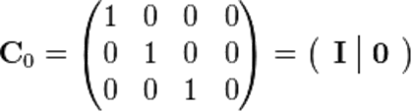

Simplified Matrices for the 2 Cameras
= (R | T)

Slide 56
Epipolar constraint: Calibrated case
X
= (x,1)^{T}
x
x’ = Rx+t
t
R
The vectors Rx, t, and x’ are coplanar
Notes:
X’ is X in the second camera’s coordinate system
We can identify the non-homogeneous 3D vectors X and X’ with the homogeneous coordinate vectors x and x’ of the projections of the two points into the two respective images

Slide 57
Epipolar constraint: Calibrated case
X
x
x’
Essential Matrix E
(Longuet-Higgins, 1981)
The vectors Rx, t, and x’ are coplanar

Slide 58
Epipolar constraint: Calibrated case
X
x
x’
E x is the epipolar line associated with x (l' = E x)
E^{T}x' is the epipolar line associated with x' (l = E^{T}x')
E e = 0 and E^{T}e' = 0
E is singular (rank two)
E has five degrees of freedom

Slide 59
Epipolar constraint: Uncalibrated case
X
x
x’
The calibration matrices K and K’ of the two cameras are unknown
We can write the epipolar constraint in terms of unknown normalized coordinates:

Slide 60
Epipolar constraint: Uncalibrated case
X
x
x’
Fundamental Matrix
(Faugeras and Luong, 1992)

Slide 61

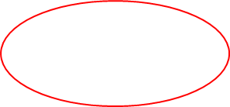
Epipolar constraint: Uncalibrated case
X
x
x’
F x is the epipolar line associated with x (l' = F x)
F^{T}x' is the epipolar line associated with x' (l' = F^{T}x')
F e = 0 and F^{T}e' = 0

Slide 62
The eight-point algorithm
A
Smallest eigenvalue of A^{T}A
Minimize:
under the constraint
||F||²=1

Slide 63

Comparison of estimation algorithms
 | 8-point | Normalized 8-point | Nonlinear least squares
Av. Dist. 1 | 2.33 pixels | 0.92 pixel | 0.86 pixel
Av. Dist. 2 | 2.18 pixels | 0.85 pixel | 0.80 pixel

Slide 64

Moving on to stereo…
Fuse a calibrated binocular stereo pair to produce a depth image
image 1
image 2
Dense depth map
Many of these slides adapted from Steve Seitz and Lana Lazebnik

Slide 65
Depth from disparity
X
z
x
x’
f
f
O
Baseline
B
O’
Disparity is inversely proportional to depth.

Slide 66

Basic stereo matching algorithm
If necessary, rectify the two stereo images to transform epipolar lines into scanlines
For each pixel x in the first image
  Find corresponding epipolar scanline in the right image
  Search the scanline and pick the best match x’
  Compute disparity x-x’ and set depth(x) = fB/(x-x’)

Slide 67
Basic stereo matching algorithm
For each pixel in the first image
  Find corresponding epipolar line in the right image
  Search along epipolar line and pick the best match
  Triangulate the matches to get depth information
Simplest case: epipolar lines are scanlines
  When does this happen?

Slide 68
Simplest Case: Parallel images
Epipolar constraint:
R = I t = (T, 0, 0)
x
x’
t
The y-coordinates of corresponding points are the same

Slide 69
Stereo image rectification

Slide 70
Stereo image rectification
Reproject image planes onto a common plane parallel to the line between camera centers
Pixel motion is horizontal after this transformation
Two homographies (3x3 transform), one for each input image reprojection
C. Loop and Z. Zhang. Computing Rectifying Homographies for Stereo Vision. IEEE Conf. Computer Vision and Pattern Recognition, 1999.

Slide 71
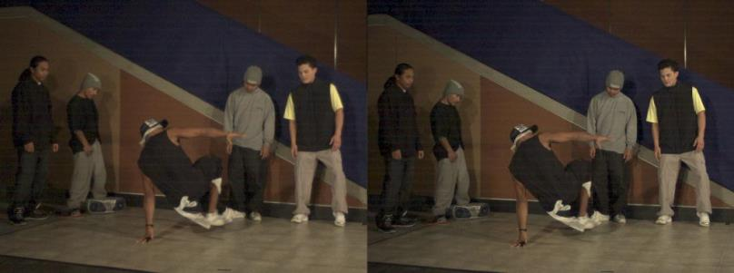
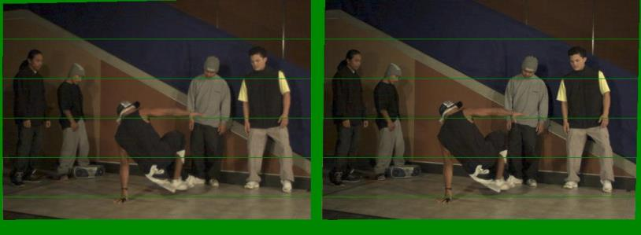
Example
Unrectified
Rectified

Slide 72


Left
Right
scanline
Matching cost
disparity
Slide a window along the right scanline and compare contents of that window with the reference window in the left image
Matching cost: SSD, SAD, or normalized correlation

Slide 73
Correspondence search
Left
Right
scanline
SSD

Slide 74
Correspondence search
Left
Right
scanline
Norm. corr

Slide 75


Effect of window size
W = 3
W = 20
Smaller window
  + More detail
  More noise
Larger window
  + Smoother disparity maps
  Less detail
  Fails near boundaries
Notes:
smaller window: more detail, more noise
bigger window: less noise, more detail

Slide 76


Failures of correspondence search
Textureless surfaces
Occlusions, repetition
Non-Lambertian surfaces, specularities

Slide 77



Results with window search
Data
Window-based matching
Ground truth

Slide 78
How can we improve window-based matching?
So far, matches are independent for each point
What constraints or priors can we add?

Slide 79
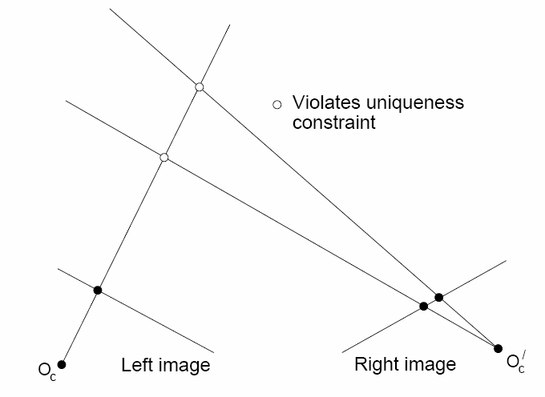
Stereo constraints/priors
Uniqueness
  For any point in one image, there should be at most one matching point in the other image

Slide 80
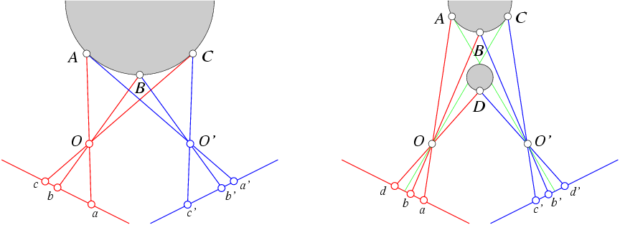
Stereo constraints/priors
Uniqueness
  For any point in one image, there should be at most one matching point in the other image
Ordering
  Corresponding points should be in the same order in both views

Slide 81
Stereo constraints/priors
Uniqueness
  For any point in one image, there should be at most one matching point in the other image
Ordering
  Corresponding points should be in the same order in both views
Ordering constraint doesn’t hold

Slide 82
Priors and constraints
Uniqueness
  For any point in one image, there should be at most one matching point in the other image
Ordering
  Corresponding points should be in the same order in both views
Smoothness
  We expect disparity values to change slowly (for the most part)

Slide 83
Stereo as energy minimization
What defines a good stereo correspondence?
  Match quality
    Want each pixel to find a good match in the other image
  Smoothness
    If two pixels are adjacent, they should (usually) move about the same amount

Slide 84





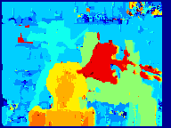



Matching windows:
Similarity Measure | Formula
Sum of Absolute Differences (SAD)
Sum of Squared Differences (SSD)
Zero-mean SAD
Locally scaled SAD
Normalized Cross Correlation (NCC)
SAD
SSD
NCC
Ground truth
http://siddhantahuja.wordpress.com/category/stereo-vision/
Notes:
smaller window: more detail, more noise
bigger window: less noise, more detail

Slide 85
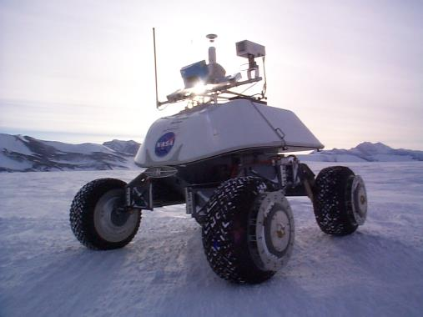
Real-time stereo
Nomad robot searches for meteorites in Antartica
  http://www.frc.ri.cmu.edu/projects/meteorobot/index.html
Used for robot navigation (and other tasks)
  Several software-based real-time stereo techniques have been developed (most based on simple discrete search)

Slide 86
Stereo reconstruction pipeline
Steps
  Calibrate cameras
  Rectify images
  Compute disparity
  Estimate depth
What will cause errors?
  Camera calibration errors
  Poor image resolution
  Occlusions
  Violations of brightness constancy (specular reflections)
  Large motions
  Low-contrast image regions

Slide 87
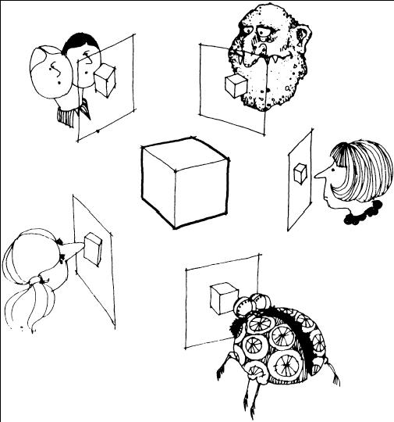
Multi-view stereo ?

Slide 88

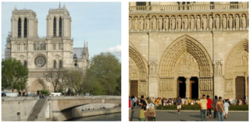
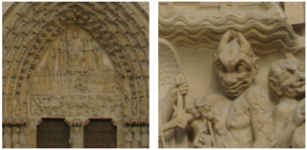
Using more than two images
Multi-View Stereo for Community Photo Collections
M. Goesele, N. Snavely, B. Curless, H. Hoppe, S. Seitz
Proceedings of ICCV 2007,

