Slide 1
Images and Filters
CSE 576
Ali Farhadi
Many slides from Steve Seitz and Larry Zitnick

Slide 2
Your plan is …
You have till the end of the day
Email Dun-Yu with your plan
Expect late penalty …..
You have till next Monday to give us a paragraph on your final project.

Slide 3
Project Ideas
Seam Carving
Detecting Shadows
Features
Learning Features
Features for regions
Comparison of features in the literature
Action Recognition
Human pose
Objects and Interactions
Using Kinect
Detecting unattended luggages
Egocentric
Grab cut
Video Stabilization
RGBD object Detection
Object Detection in Videos
Video Google
Matching Images and Videos in the wild
Reading Street Signs
Wearable Cameras for visually impaired users
Auto Zooming
Visual Odometer
Smart stop lights
Language & Vision

Slide 4
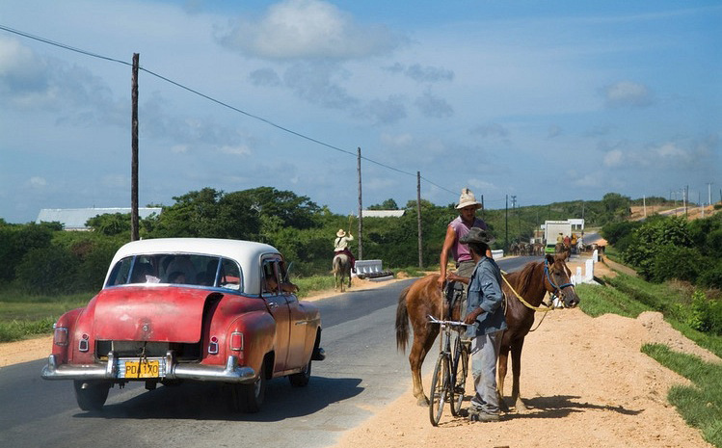
What is an image?

Slide 7
Image Operations
(functions of functions)
F( ) =

Slide 8
Image Operations
(functions of functions)
F( ) =

Slide 9
Image Operations
(functions of functions)
0.1
0
0.8
0.9
0.9
0.9
0.2
0.4
0.3
0.6
0
0
0.1
0.5
0.9
0.9
0.2
0.4
0.3
0.6
0
0
0.1
0.9
0.9
0.2
0.4
0.3
0.6
0
0
0.1
0.5
F( ) =

Slide 10
Image Operations
(functions of functions)
F( , ) =
0.23

Slide 11
Local image functions
F( ) =

Slide 12
Image filtering
1
1
1
1
1
1
1
1
1
0 | 0 | 0 | 0 | 0 | 0 | 0 | 0 | 0 | 0
0 | 0 | 0 | 0 | 0 | 0 | 0 | 0 | 0 | 0
0 | 0 | 0 | 90 | 90 | 90 | 90 | 90 | 0 | 0
0 | 0 | 0 | 90 | 90 | 90 | 90 | 90 | 0 | 0
0 | 0 | 0 | 90 | 90 | 90 | 90 | 90 | 0 | 0
0 | 0 | 0 | 90 | 0 | 90 | 90 | 90 | 0 | 0
0 | 0 | 0 | 90 | 90 | 90 | 90 | 90 | 0 | 0
0 | 0 | 0 | 0 | 0 | 0 | 0 | 0 | 0 | 0
0 | 0 | 90 | 0 | 0 | 0 | 0 | 0 | 0 | 0
0 | 0 | 0 | 0 | 0 | 0 | 0 | 0 | 0 | 0
 | 0
0 | 0 | 0 | 0 | 0 | 0 | 0 | 0 | 0 | 0
0 | 0 | 0 | 0 | 0 | 0 | 0 | 0 | 0 | 0
0 | 0 | 0 | 90 | 90 | 90 | 90 | 90 | 0 | 0
0 | 0 | 0 | 90 | 90 | 90 | 90 | 90 | 0 | 0
0 | 0 | 0 | 90 | 90 | 90 | 90 | 90 | 0 | 0
0 | 0 | 0 | 90 | 0 | 90 | 90 | 90 | 0 | 0
0 | 0 | 0 | 90 | 90 | 90 | 90 | 90 | 0 | 0
0 | 0 | 0 | 0 | 0 | 0 | 0 | 0 | 0 | 0
0 | 0 | 90 | 0 | 0 | 0 | 0 | 0 | 0 | 0
0 | 0 | 0 | 0 | 0 | 0 | 0 | 0 | 0 | 0
Credit: S. Seitz

Slide 13
Image filtering
1
1
1
1
1
1
1
1
1
0 | 0 | 0 | 0 | 0 | 0 | 0 | 0 | 0 | 0
0 | 0 | 0 | 0 | 0 | 0 | 0 | 0 | 0 | 0
0 | 0 | 0 | 90 | 90 | 90 | 90 | 90 | 0 | 0
0 | 0 | 0 | 90 | 90 | 90 | 90 | 90 | 0 | 0
0 | 0 | 0 | 90 | 90 | 90 | 90 | 90 | 0 | 0
0 | 0 | 0 | 90 | 0 | 90 | 90 | 90 | 0 | 0
0 | 0 | 0 | 90 | 90 | 90 | 90 | 90 | 0 | 0
0 | 0 | 0 | 0 | 0 | 0 | 0 | 0 | 0 | 0
0 | 0 | 90 | 0 | 0 | 0 | 0 | 0 | 0 | 0
0 | 0 | 0 | 0 | 0 | 0 | 0 | 0 | 0 | 0
 | 0 | 10
0 | 0 | 0 | 0 | 0 | 0 | 0 | 0 | 0 | 0
0 | 0 | 0 | 0 | 0 | 0 | 0 | 0 | 0 | 0
0 | 0 | 0 | 90 | 90 | 90 | 90 | 90 | 0 | 0
0 | 0 | 0 | 90 | 90 | 90 | 90 | 90 | 0 | 0
0 | 0 | 0 | 90 | 90 | 90 | 90 | 90 | 0 | 0
0 | 0 | 0 | 90 | 0 | 90 | 90 | 90 | 0 | 0
0 | 0 | 0 | 90 | 90 | 90 | 90 | 90 | 0 | 0
0 | 0 | 0 | 0 | 0 | 0 | 0 | 0 | 0 | 0
0 | 0 | 90 | 0 | 0 | 0 | 0 | 0 | 0 | 0
0 | 0 | 0 | 0 | 0 | 0 | 0 | 0 | 0 | 0
Credit: S. Seitz
Notes:
ones, divide by 9

Slide 14
Image filtering
1
1
1
1
1
1
1
1
1
0 | 0 | 0 | 0 | 0 | 0 | 0 | 0 | 0 | 0
0 | 0 | 0 | 0 | 0 | 0 | 0 | 0 | 0 | 0
0 | 0 | 0 | 90 | 90 | 90 | 90 | 90 | 0 | 0
0 | 0 | 0 | 90 | 90 | 90 | 90 | 90 | 0 | 0
0 | 0 | 0 | 90 | 90 | 90 | 90 | 90 | 0 | 0
0 | 0 | 0 | 90 | 0 | 90 | 90 | 90 | 0 | 0
0 | 0 | 0 | 90 | 90 | 90 | 90 | 90 | 0 | 0
0 | 0 | 0 | 0 | 0 | 0 | 0 | 0 | 0 | 0
0 | 0 | 90 | 0 | 0 | 0 | 0 | 0 | 0 | 0
0 | 0 | 0 | 0 | 0 | 0 | 0 | 0 | 0 | 0
 | 0 | 10 | 20
0 | 0 | 0 | 0 | 0 | 0 | 0 | 0 | 0 | 0
0 | 0 | 0 | 0 | 0 | 0 | 0 | 0 | 0 | 0
0 | 0 | 0 | 90 | 90 | 90 | 90 | 90 | 0 | 0
0 | 0 | 0 | 90 | 90 | 90 | 90 | 90 | 0 | 0
0 | 0 | 0 | 90 | 90 | 90 | 90 | 90 | 0 | 0
0 | 0 | 0 | 90 | 0 | 90 | 90 | 90 | 0 | 0
0 | 0 | 0 | 90 | 90 | 90 | 90 | 90 | 0 | 0
0 | 0 | 0 | 0 | 0 | 0 | 0 | 0 | 0 | 0
0 | 0 | 90 | 0 | 0 | 0 | 0 | 0 | 0 | 0
0 | 0 | 0 | 0 | 0 | 0 | 0 | 0 | 0 | 0
Credit: S. Seitz
Notes:
ones, divide by 9

Slide 15
Image filtering
1
1
1
1
1
1
1
1
1
0 | 0 | 0 | 0 | 0 | 0 | 0 | 0 | 0 | 0
0 | 0 | 0 | 0 | 0 | 0 | 0 | 0 | 0 | 0
0 | 0 | 0 | 90 | 90 | 90 | 90 | 90 | 0 | 0
0 | 0 | 0 | 90 | 90 | 90 | 90 | 90 | 0 | 0
0 | 0 | 0 | 90 | 90 | 90 | 90 | 90 | 0 | 0
0 | 0 | 0 | 90 | 0 | 90 | 90 | 90 | 0 | 0
0 | 0 | 0 | 90 | 90 | 90 | 90 | 90 | 0 | 0
0 | 0 | 0 | 0 | 0 | 0 | 0 | 0 | 0 | 0
0 | 0 | 90 | 0 | 0 | 0 | 0 | 0 | 0 | 0
0 | 0 | 0 | 0 | 0 | 0 | 0 | 0 | 0 | 0
 | 0 | 10 | 20 | 30
0 | 0 | 0 | 0 | 0 | 0 | 0 | 0 | 0 | 0
0 | 0 | 0 | 0 | 0 | 0 | 0 | 0 | 0 | 0
0 | 0 | 0 | 90 | 90 | 90 | 90 | 90 | 0 | 0
0 | 0 | 0 | 90 | 90 | 90 | 90 | 90 | 0 | 0
0 | 0 | 0 | 90 | 90 | 90 | 90 | 90 | 0 | 0
0 | 0 | 0 | 90 | 0 | 90 | 90 | 90 | 0 | 0
0 | 0 | 0 | 90 | 90 | 90 | 90 | 90 | 0 | 0
0 | 0 | 0 | 0 | 0 | 0 | 0 | 0 | 0 | 0
0 | 0 | 90 | 0 | 0 | 0 | 0 | 0 | 0 | 0
0 | 0 | 0 | 0 | 0 | 0 | 0 | 0 | 0 | 0
Credit: S. Seitz

Slide 16
Image filtering
1
1
1
1
1
1
1
1
1
0 | 0 | 0 | 0 | 0 | 0 | 0 | 0 | 0 | 0
0 | 0 | 0 | 0 | 0 | 0 | 0 | 0 | 0 | 0
0 | 0 | 0 | 90 | 90 | 90 | 90 | 90 | 0 | 0
0 | 0 | 0 | 90 | 90 | 90 | 90 | 90 | 0 | 0
0 | 0 | 0 | 90 | 90 | 90 | 90 | 90 | 0 | 0
0 | 0 | 0 | 90 | 0 | 90 | 90 | 90 | 0 | 0
0 | 0 | 0 | 90 | 90 | 90 | 90 | 90 | 0 | 0
0 | 0 | 0 | 0 | 0 | 0 | 0 | 0 | 0 | 0
0 | 0 | 90 | 0 | 0 | 0 | 0 | 0 | 0 | 0
0 | 0 | 0 | 0 | 0 | 0 | 0 | 0 | 0 | 0
 | 0 | 10 | 20 | 30 | 30
Credit: S. Seitz

Slide 17
Image filtering
1
1
1
1
1
1
1
1
1
0 | 0 | 0 | 0 | 0 | 0 | 0 | 0 | 0 | 0
0 | 0 | 0 | 0 | 0 | 0 | 0 | 0 | 0 | 0
0 | 0 | 0 | 90 | 90 | 90 | 90 | 90 | 0 | 0
0 | 0 | 0 | 90 | 90 | 90 | 90 | 90 | 0 | 0
0 | 0 | 0 | 90 | 90 | 90 | 90 | 90 | 0 | 0
0 | 0 | 0 | 90 | 0 | 90 | 90 | 90 | 0 | 0
0 | 0 | 0 | 90 | 90 | 90 | 90 | 90 | 0 | 0
0 | 0 | 0 | 0 | 0 | 0 | 0 | 0 | 0 | 0
0 | 0 | 90 | 0 | 0 | 0 | 0 | 0 | 0 | 0
0 | 0 | 0 | 0 | 0 | 0 | 0 | 0 | 0 | 0
 | 0 | 10 | 20 | 30 | 30
?
Credit: S. Seitz

Slide 18
Image filtering
1
1
1
1
1
1
1
1
1
0 | 0 | 0 | 0 | 0 | 0 | 0 | 0 | 0 | 0
0 | 0 | 0 | 0 | 0 | 0 | 0 | 0 | 0 | 0
0 | 0 | 0 | 90 | 90 | 90 | 90 | 90 | 0 | 0
0 | 0 | 0 | 90 | 90 | 90 | 90 | 90 | 0 | 0
0 | 0 | 0 | 90 | 90 | 90 | 90 | 90 | 0 | 0
0 | 0 | 0 | 90 | 0 | 90 | 90 | 90 | 0 | 0
0 | 0 | 0 | 90 | 90 | 90 | 90 | 90 | 0 | 0
0 | 0 | 0 | 0 | 0 | 0 | 0 | 0 | 0 | 0
0 | 0 | 90 | 0 | 0 | 0 | 0 | 0 | 0 | 0
0 | 0 | 0 | 0 | 0 | 0 | 0 | 0 | 0 | 0
 | 0 | 10 | 20 | 30 | 30
 |  |  |  | 50
?
Credit: S. Seitz

Slide 19
Image filtering
1
1
1
1
1
1
1
1
1
0 | 0 | 0 | 0 | 0 | 0 | 0 | 0 | 0 | 0
0 | 0 | 0 | 0 | 0 | 0 | 0 | 0 | 0 | 0
0 | 0 | 0 | 90 | 90 | 90 | 90 | 90 | 0 | 0
0 | 0 | 0 | 90 | 90 | 90 | 90 | 90 | 0 | 0
0 | 0 | 0 | 90 | 90 | 90 | 90 | 90 | 0 | 0
0 | 0 | 0 | 90 | 0 | 90 | 90 | 90 | 0 | 0
0 | 0 | 0 | 90 | 90 | 90 | 90 | 90 | 0 | 0
0 | 0 | 0 | 0 | 0 | 0 | 0 | 0 | 0 | 0
0 | 0 | 90 | 0 | 0 | 0 | 0 | 0 | 0 | 0
0 | 0 | 0 | 0 | 0 | 0 | 0 | 0 | 0 | 0
 | 0 | 10 | 20 | 30 | 30 | 30 | 20 | 10
 | 0 | 20 | 40 | 60 | 60 | 60 | 40 | 20
 | 0 | 30 | 60 | 90 | 90 | 90 | 60 | 30
 | 0 | 30 | 50 | 80 | 80 | 90 | 60 | 30
 | 0 | 30 | 50 | 80 | 80 | 90 | 60 | 30
 | 0 | 20 | 30 | 50 | 50 | 60 | 40 | 20
 | 10 | 20 | 30 | 30 | 30 | 30 | 20 | 10
 | 10 | 10 | 10 | 0 | 0 | 0 | 0 | 0
Credit: S. Seitz

Slide 20
Box Filter
What does it do?
Replaces each pixel with an average of its neighborhood
Achieve smoothing effect (remove sharp features)
1
1
1
1
1
1
1
1
1
Slide credit: David Lowe (UBC)

Slide 21
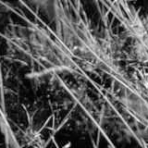
Smoothing with box filter

Slide 22
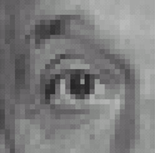
Practice with linear filters
0
0
0
?
0
1
0
0
0
0
Original
Source: D. Lowe

Slide 23
Practice with linear filters
0
0
0
0
1
0
0
0
0
Original
Filtered
(no change)
Source: D. Lowe

Slide 24
Practice with linear filters
0
0
0
?
0
0
1
0
0
0
Original
Source: D. Lowe

Slide 25
Practice with linear filters
0
0
0
0
0
1
0
0
0
Original
Shifted left
By 1 pixel
Source: D. Lowe

Slide 26
Practice with linear filters
0
0
0
-
1
1
1
?
0
2
0
1
1
1
0
0
0
1
1
1
(Note that filter sums to 1)
Original
Source: D. Lowe

Slide 27
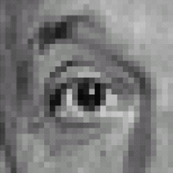
Practice with linear filters
0
0
0
-
1
1
1
0
2
0
1
1
1
0
0
0
1
1
1
Original
Sharpening filter
Accentuates differences with local average
Source: D. Lowe

Slide 28
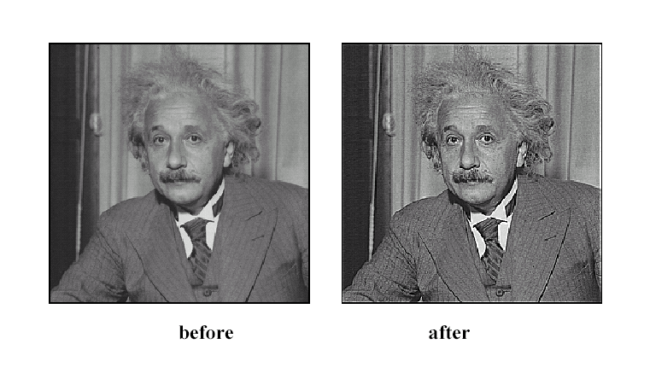
Sharpening
Source: D. Lowe

Slide 29
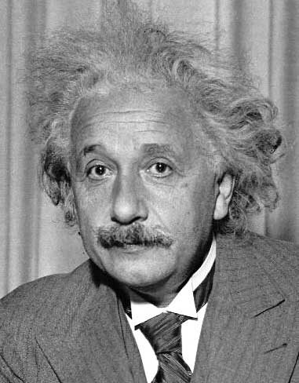
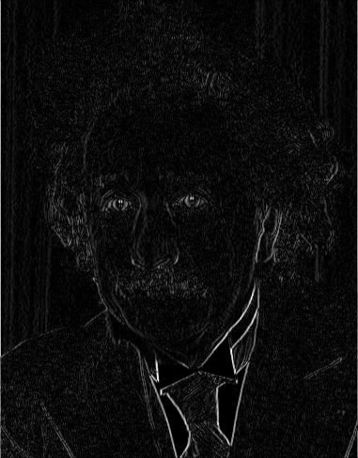
Other filters
1
0
-1
2
0
-2
1
0
-1
Sobel
Vertical Edge
(absolute value)

Slide 30
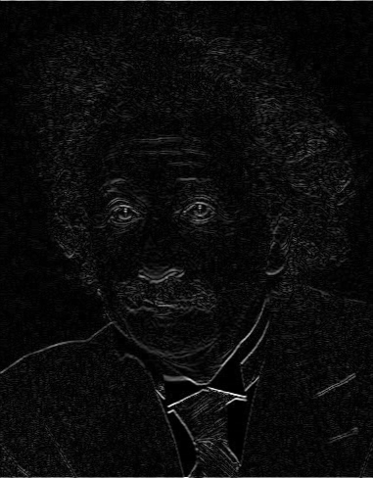
Other filters
1
2
1
0
0
0
-1
-2
-1
Sobel
Horizontal Edge
(absolute value)

Slide 31
Basic gradient filters
Horizontal Gradient
Vertical Gradient
0
0
0
0
1
0
-1
0
1
-1
0
1
0
0
0
or
0
0
0
0
-1
0
or
-1
0
1

Slide 32
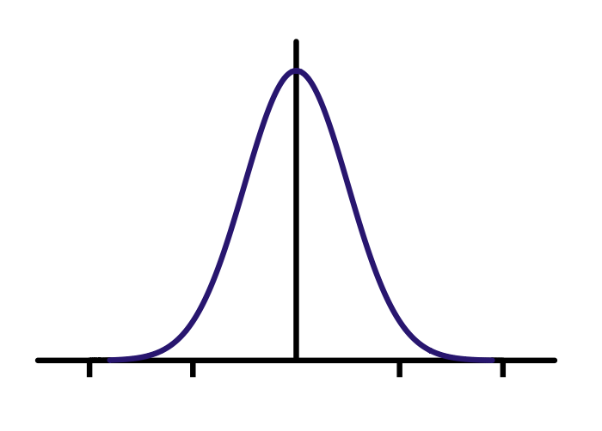
Gaussian filter
Compute empirically
=
*
Filter h
Input image f
Output image g

Slide 33
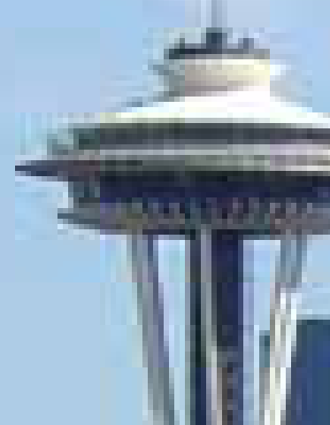
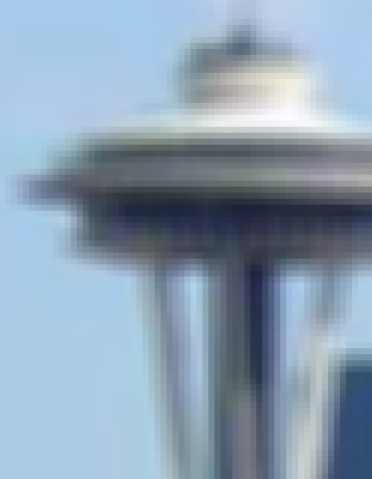
Gaussian vs. mean filters
What does real blur look like?

Slide 34
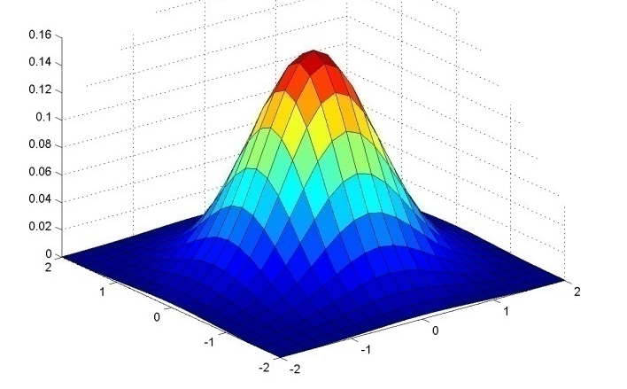
Important filter: Gaussian
Spatially-weighted average
0.003 0.013 0.022 0.013 0.003
0.013 0.059 0.097 0.059 0.013
0.022 0.097 0.159 0.097 0.022
0.013 0.059 0.097 0.059 0.013
0.003 0.013 0.022 0.013 0.003
5 x 5, σ = 1
Slide credit: Christopher Rasmussen

Slide 35
Smoothing with Gaussian filter

Slide 36
Smoothing with box filter

Slide 37
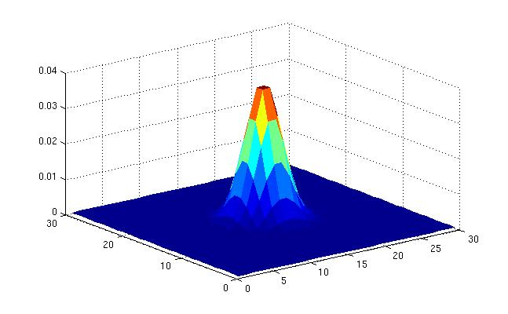
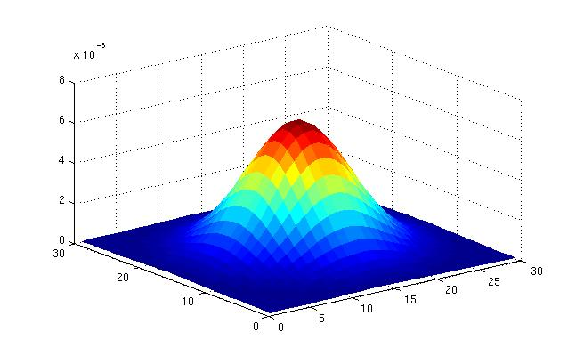
Gaussian filters
What parameters matter here?
Variance of Gaussian: determines extent of smoothing
Source: K. Grauman

Slide 38
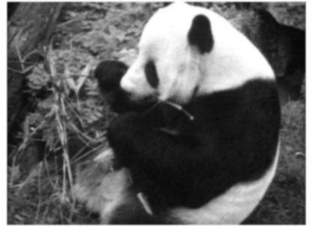
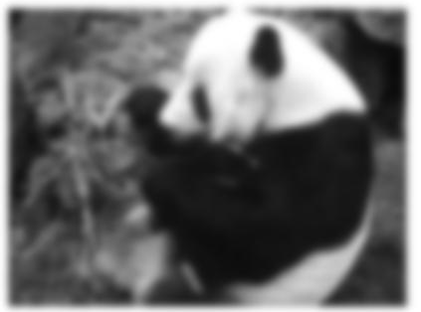
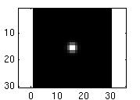
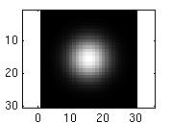
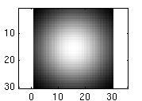
Smoothing with a Gaussian
Parameter σ is the “scale” / “width” / “spread” of the Gaussian kernel, and controls the amount of smoothing.
…
Source: K. Grauman

Slide 39
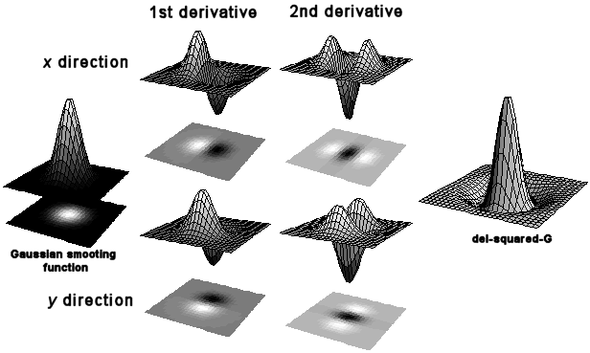
First and second derivatives
=
*

Slide 40
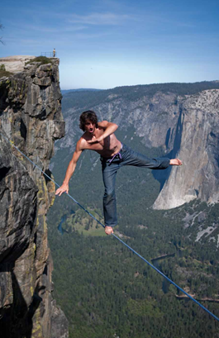
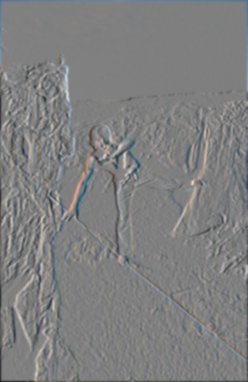
First and second derivatives
What are these good for?
Original
First Derivative x
Second Derivative x, y

Slide 41
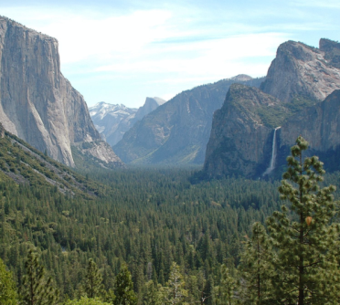
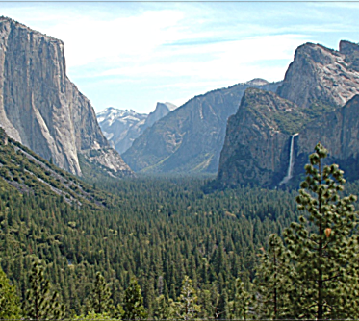
Subtracting filters
Original
Second Derivative
Sharpened

Slide 42
Combining filters
for some
0 | 0 | 0 | 0 | 0
0 | 0 | 0 | 0 | 0
0 | -1 | 0 | 1 | 0
0 | 0 | 0 | 0 | 0
0 | 0 | 0 | 0 | 0
=
*
0 | 0 | 0 | 0 | 0
0 | 0 | -1 | 0 | 0
0 | -1 | 4 | -1 | 0
0 | 0 | -1 | 0 | 0
0 | 0 | 0 | 0 | 0
=
*
It’s also true:

Slide 43
Combining Gaussian filters
=
*
?
More blur than either individually (but less than )

Slide 44
Separable filters
Compute Gaussian in horizontal direction, followed by the vertical direction.
Much faster!
=
*
Not all filters are separable. Freeman and Adelson, 1991

Slide 45
Sums of rectangular regions
How do we compute the sum of the pixels in the red box?
243 | 239 | 240 | 225 | 206 | 185 | 188 | 218 | 211 | 206 | 216 | 225
242 | 239 | 218 | 110 | 67 | 31 | 34 | 152 | 213 | 206 | 208 | 221
243 | 242 | 123 | 58 | 94 | 82 | 132 | 77 | 108 | 208 | 208 | 215
235 | 217 | 115 | 212 | 243 | 236 | 247 | 139 | 91 | 209 | 208 | 211
233 | 208 | 131 | 222 | 219 | 226 | 196 | 114 | 74 | 208 | 213 | 214
232 | 217 | 131 | 116 | 77 | 150 | 69 | 56 | 52 | 201 | 228 | 223
232 | 232 | 182 | 186 | 184 | 179 | 159 | 123 | 93 | 232 | 235 | 235
232 | 236 | 201 | 154 | 216 | 133 | 129 | 81 | 175 | 252 | 241 | 240
235 | 238 | 230 | 128 | 172 | 138 | 65 | 63 | 234 | 249 | 241 | 245
237 | 236 | 247 | 143 | 59 | 78 | 10 | 94 | 255 | 248 | 247 | 251
234 | 237 | 245 | 193 | 55 | 33 | 115 | 144 | 213 | 255 | 253 | 251
248 | 245 | 161 | 128 | 149 | 109 | 138 | 65 | 47 | 156 | 239 | 255
190 | 107 | 39 | 102 | 94 | 73 | 114 | 58 | 17 | 7 | 51 | 137
23 | 32 | 33 | 148 | 168 | 203 | 179 | 43 | 27 | 17 | 12 | 8
17 | 26 | 12 | 160 | 255 | 255 | 109 | 22 | 26 | 19 | 35 | 24
After some pre-computation, this can be done in constant time for any box.
This “trick” is commonly used for computing Haar wavelets (a fundemental building block of many object recognition approaches.)

Slide 46
Sums of rectangular regions
The trick is to compute an “integral image.” Every pixel is the sum of its neighbors to the upper left.
Sequentially compute using:

Slide 47
Sums of rectangular regions
 |  | A |  |  |  |  |  |  | B
 |  | C |  |  |  |  |  |  | D
Solution is found using:
A + D – B - C

Slide 48
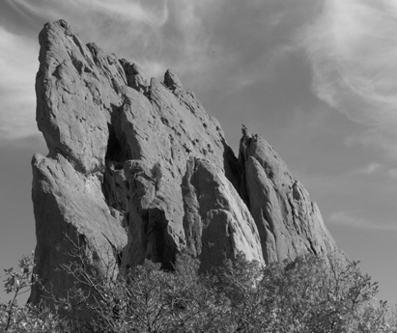
Constant blur
*
input
output
*
*
Same Gaussian kernel everywhere.
Slides courtesy of Sylvian Paris

Slide 49
Bilateral Filter Definition: an Additional Edge Term
Same idea: weighted average of pixels.
normalization factor
space weight
range weight
I

Slide 50
Illustration a 1D Image
1D image = line of pixels
Better visualized as a plot
pixel intensity
pixel position

Slide 51
Gaussian Blur and Bilateral Filter
Gaussian blur
p
q
space
space
Bilateral filter [Aurich 95, Smith 97, Tomasi 98]
p
range
q
space
range
normalization
space

Slide 52
Bilateral Filter on a Height Field
output
input
reproduced from [Durand 02]

Slide 53
Space and Range Parameters
space σ_{s} : spatial extent of the kernel, size of the considered neighborhood.
range σ_{r} : “minimum” amplitude of an edge

Slide 54
Influence of Pixels
Only pixels close in space and in range are considered.
space
range
p

Slide 55
Spatially varying filters
Some filters vary spatially.
Durand, 02
Useful for deblurring.

Slide 56
Constant blur
*
input
output
*
*
Same Gaussian kernel everywhere.
Slides courtesy of Sylvian Paris

Slide 57
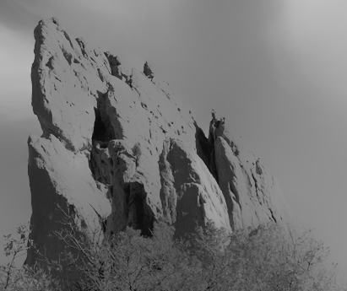
Bilateral filter
Maintains edges when blurring!
*
input
output
*
*
The kernel shape depends on the image content.
Slides courtesy of Sylvian Paris

Slide 58
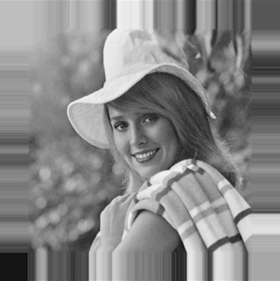
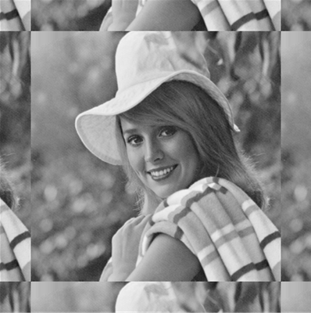
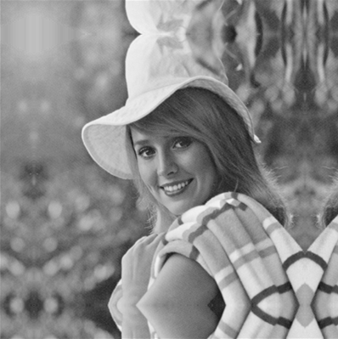
Borders
What to do about image borders:
black
fixed
periodic
reflected

