Slide 1
GPS systems (slides from nirupam roy)
Notes:
The nominal GPS configuration consists of a network of 24 satellites in high orbits around the Earth, but up to 30 or so satellites may be on station at any given time. Each satellite in the GPS constellation orbits at an altitude of about 20,000 km from the ground, and has an orbital speed of about 14,000 km/hour (the orbital period is roughly 12 hours - contrary to popular belief, GPS satellites are not in geosynchronous or geostationary orbits). The satellite orbits are distributed so that at least 4 satellites are always visible from any point on the Earth at any given instant (with up to 12 visible at one time).
Geostationary orbits are near the equator and hence does not provide enough coverage.

Slide 3
Trilateration
base1
base2
d
d’
observer

Slide 4
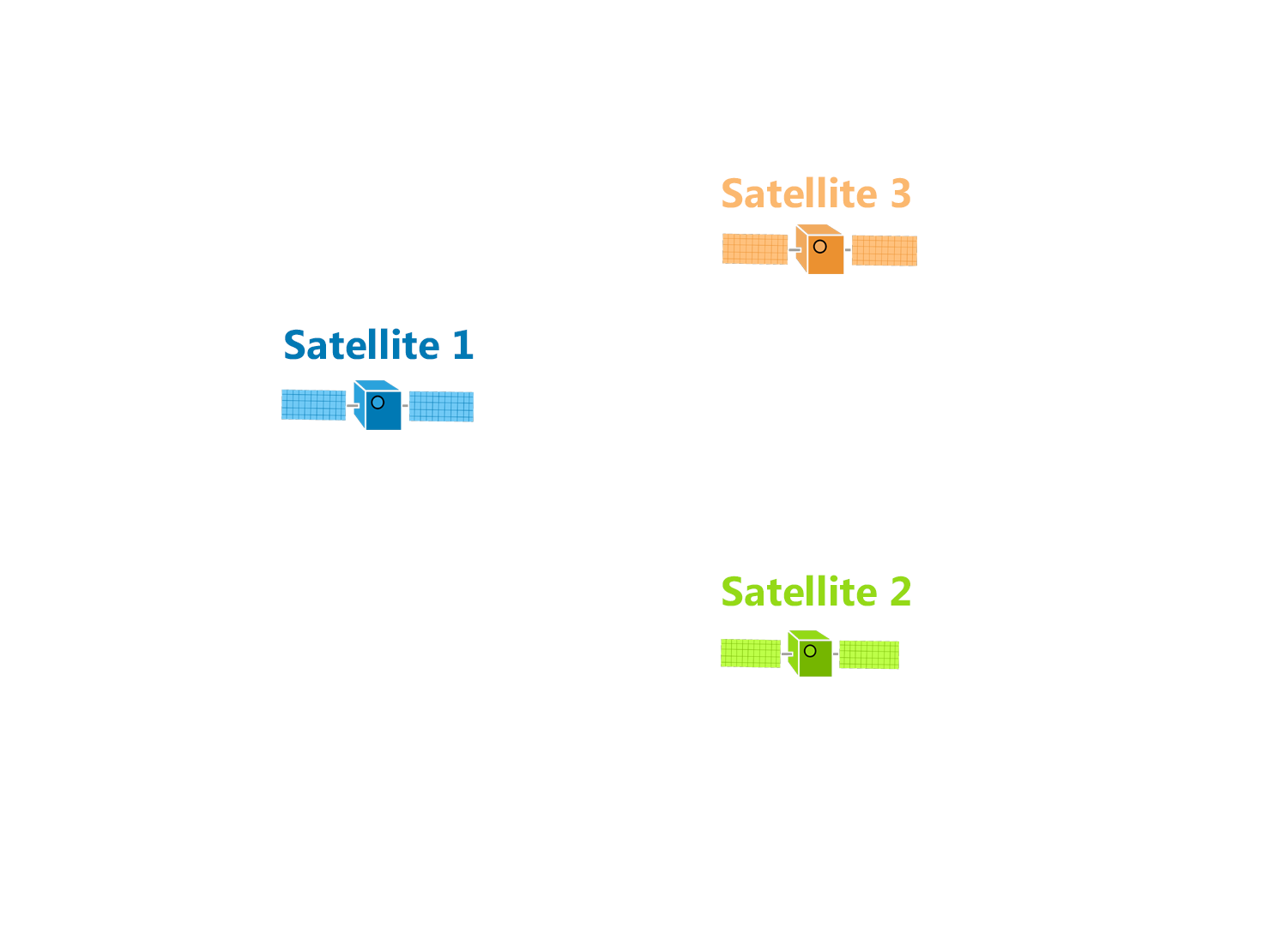
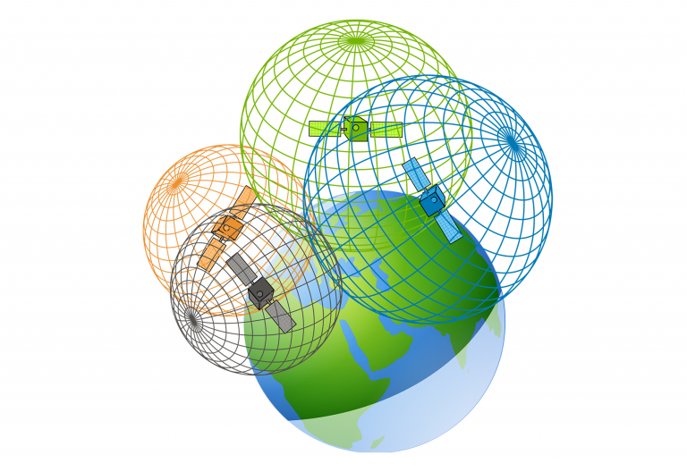
Trilateration

Slide 5
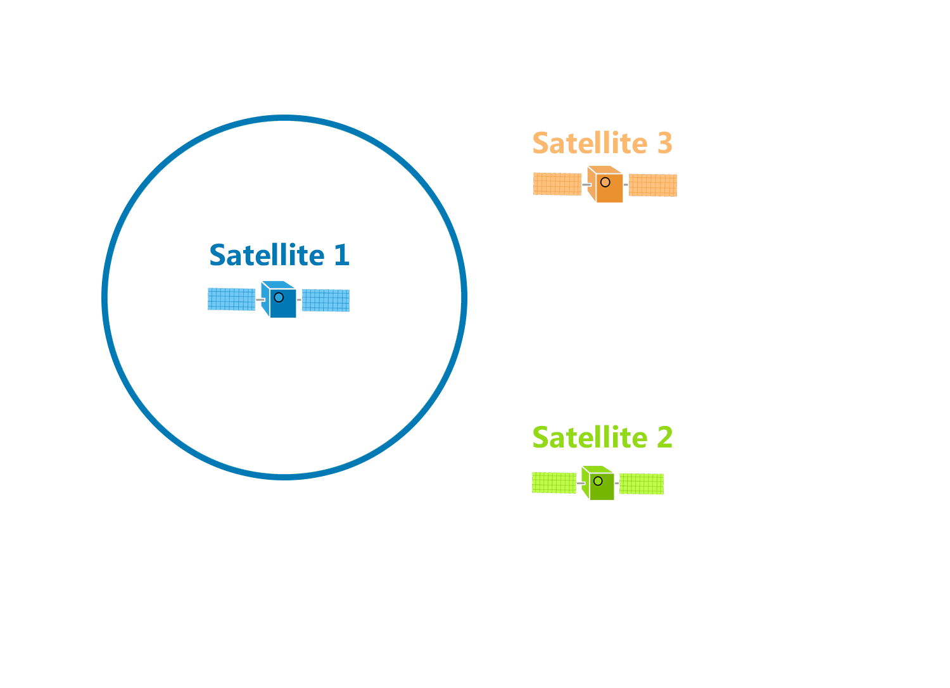
Trilateration
d

Slide 6
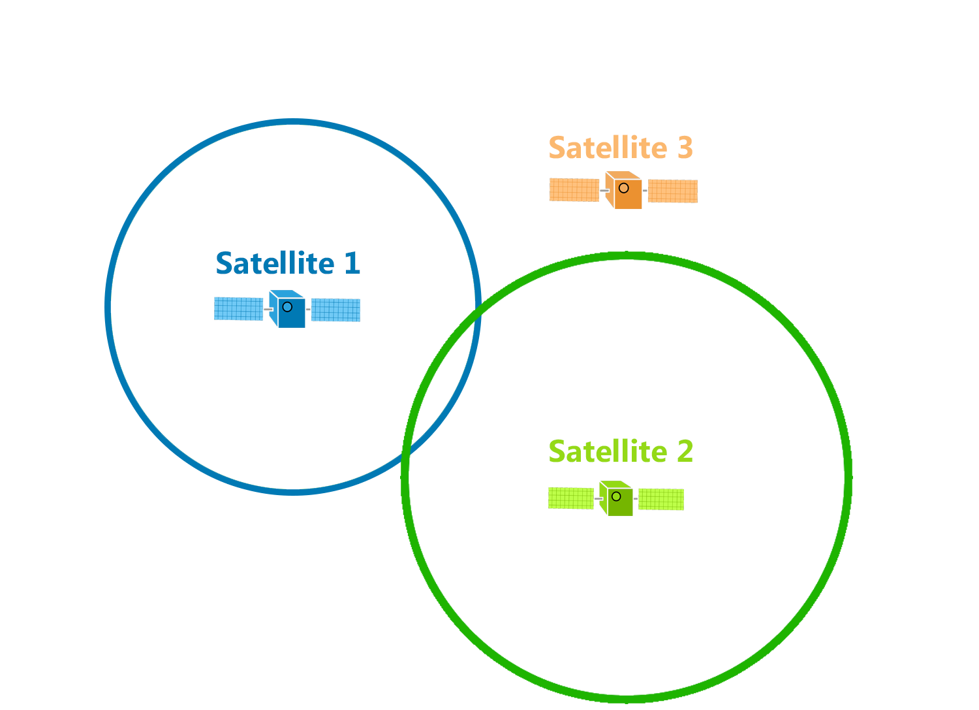
Trilateration
d

Slide 7
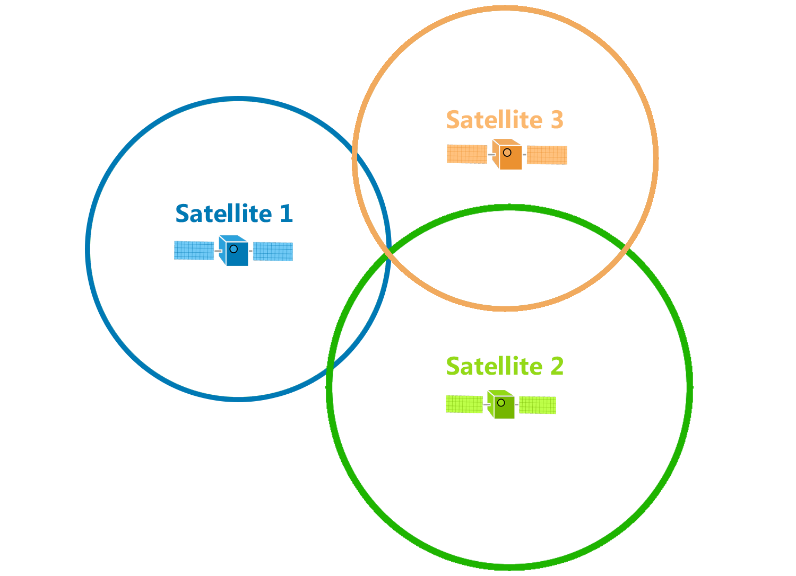
Trilateration
d

Slide 8
Trilateration

Slide 9
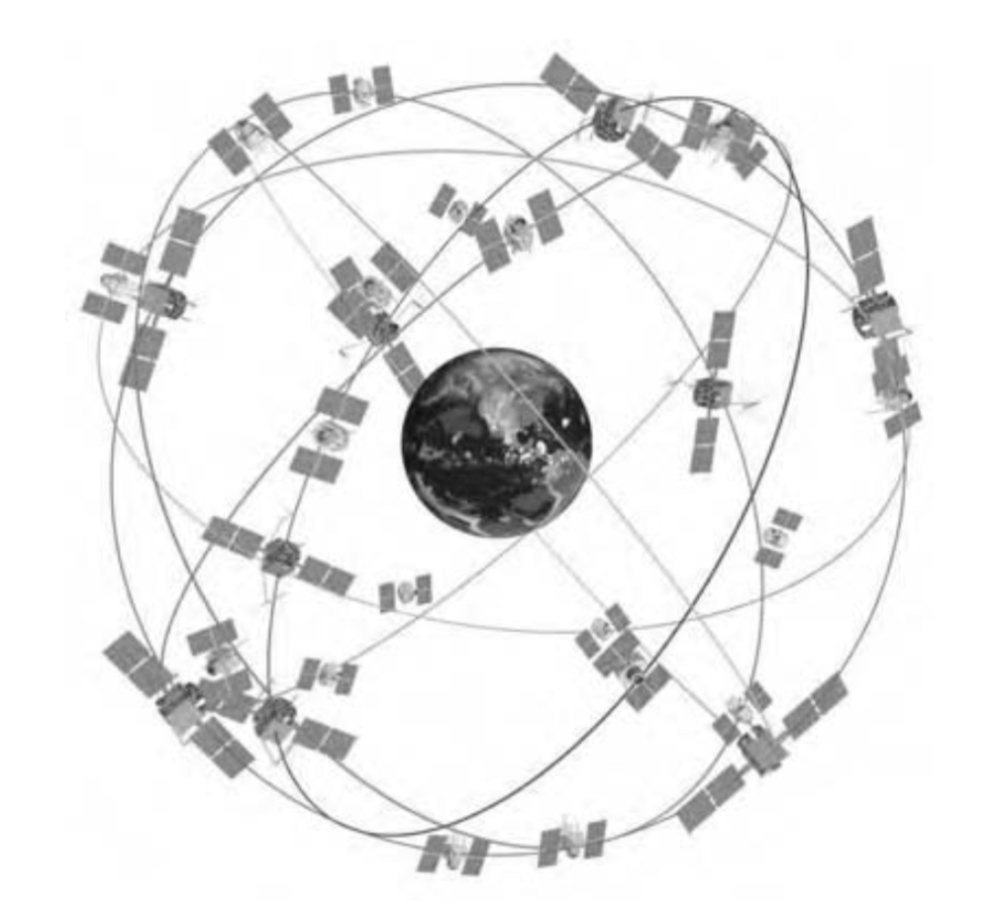
GPS Satellite Constellation
Baseline configuration
-- 24 satellites
-- 6 orbital planes, 4 satellites in each plane
-- 60° separation between planes
-- Orbital radius approx. 26,600 km
Geo-stationary ?
Notes:
https://www.gpsworld.com/origins-gps-part-1/
https://pdfs.semanticscholar.org/d6f5/812c9f91d68862cf3e2a8af6a3f9db14ba2b.pdf

Slide 10
GPS Satellite Constellation
Baseline configuration
-- 24 satellites
-- 6 orbital planes, 4 satellites in each plane
-- 60° separation between planes
-- Orbital radius approx. 26,600 km
-- Orbital period 11h 58m (half day)
At least 4 satellites are always visible from any point on the Earth at any given instant

Slide 11
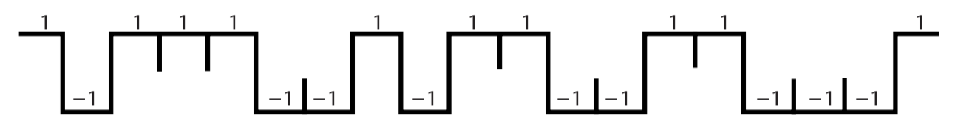
Pseudo-Random Noise (PRN) code
Each satellite is assigned a unique PRN code.
PRN code (Coarse/Acquisition or C/A code)
Notes:
In 1928, Warren Marrison of Bell Telephone Laboratories developed the first quartz-crystal clock. With accuracies of up to 1 second in 30 years
Atomic clock:
Use of GPS clock: Wireless communication, TV broadcast, timestamping business transaction, frequency hopping

Slide 12
Signal detection
Amplitude
Amplitude
Time/Sample
Time/Sample
Transmitter signal
Receiver signal

Slide 13
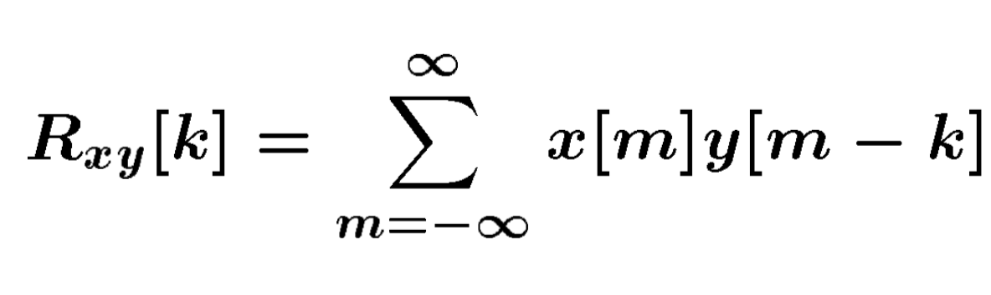
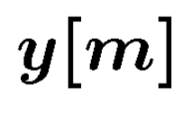
Signal detection
Received signal
Signal matching
Transmit signal template

Slide 14
Signal detection
Received signal
Signal matching
Transmit signal template
Correlation

Slide 15
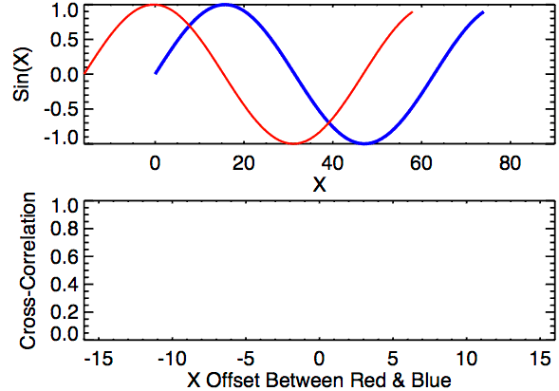
Signal detection
Correlation

Slide 16
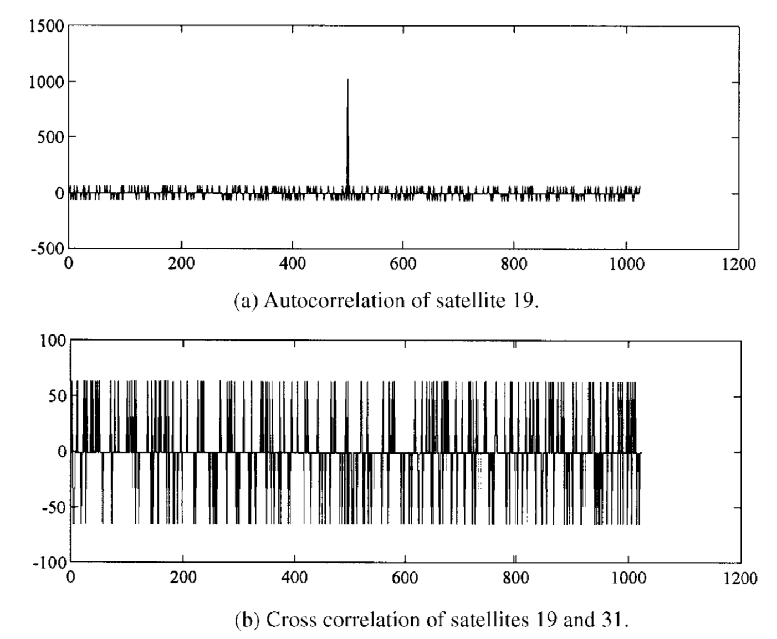
Pseudo-Random Noise (PRN) code
Notes:
In 1928, Warren Marrison of Bell Telephone Laboratories developed the first quartz-crystal clock. With accuracies of up to 1 second in 30 years
https://pdfs.semanticscholar.org/d6f5/812c9f91d68862cf3e2a8af6a3f9db14ba2b.pdf
Atomic clock:
Use of GPS clock: Wireless communication, TV broadcast, timestamping business transaction, frequency hopping

Slide 17
Propagation Delay
or
Time of Flight (ToF)

Slide 18
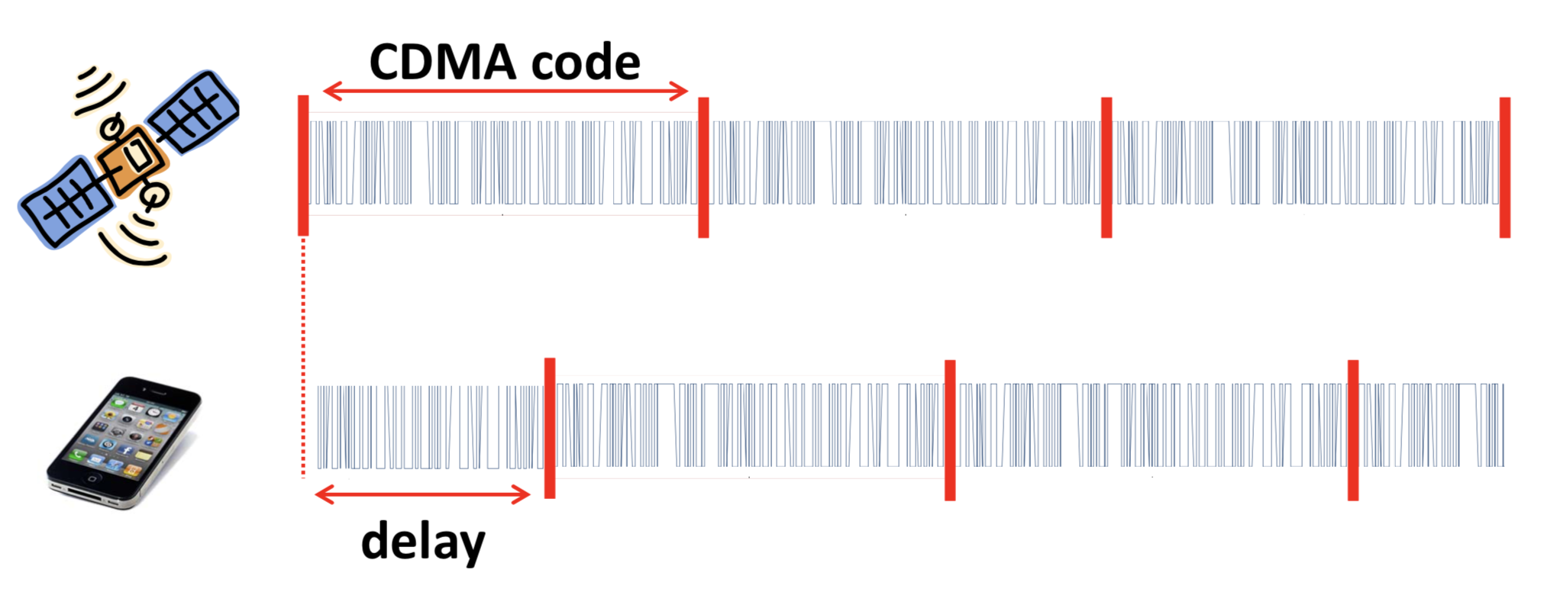
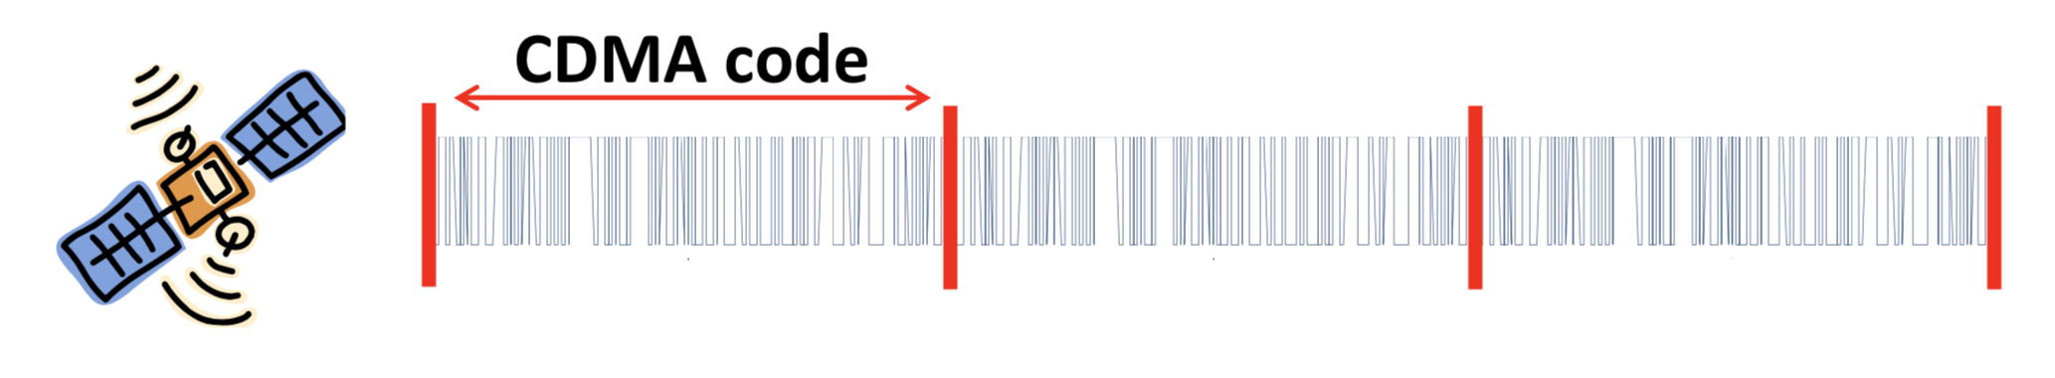
Time of Flight (ToF)
Known starting time of the code

Slide 19
Time of Flight (ToF)

Slide 20
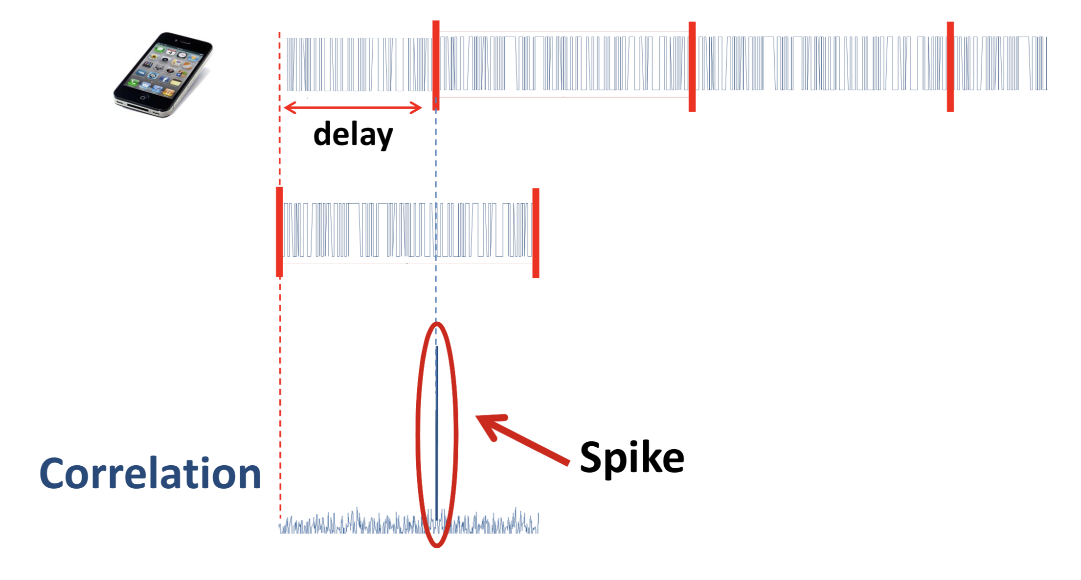
Time of Flight (ToF)

Slide 21
Time of Flight (ToF)
Δt

Slide 22
Range = propagation delay X speed of light
= Δt x C (C = speed of light, ~ 3x10⁸ m/s)

Slide 23
Time of Flight (ToF)
Starting time, t
Δt

Slide 24
Pseudo-Random Noise (PRN) code
PRN code
Clock period t
Notes:
In 1928, Warren Marrison of Bell Telephone Laboratories developed the first quartz-crystal clock. With accuracies of up to 1 second in 30 years
Atomic clock:
Use of GPS clock: Wireless communication, TV broadcast, timestamping business transaction, frequency hopping

Slide 25
Clock
Mechanical clock: Oscillation of pendulum
Crystal clock: Electrical circuit that uses a piezoelectric crystal vibrating at a precise frequency.
(accuracy of 1 second in 30 years)
Atomic clock: Duration of 9,192,631,770 periods of the radiation from a Cesium 133 atom.
(accuracy of 1 second in more than 100 million years)
Notes:
In 1928, Warren Marrison of Bell Telephone Laboratories developed the first quartz-crystal clock. With accuracies of up to 1 second in 30 years
Atomic clock:
Use of GPS clock: Wireless communication, TV broadcast, timestamping business transaction, frequency hopping

Slide 26
GPS satellites uses atomic clock
Atomic clocks are used onboard GPS satellites that orbit the Earth, but even they must be sent updates two times per day to correct the clocks' natural drift.
Those updates come from more stable atomic clocks on the ground that are large (often the size of a refrigerator and 50 times more stable) and not designed to survive the physical demands of going to space.
Notes:
In 1928, Warren Marrison of Bell Telephone Laboratories developed the first quartz-crystal clock. With accuracies of up to 1 second in 30 years
Atomic clock:
Use of GPS clock: Wireless communication, TV broadcast, timestamping business transaction, frequency hopping

Slide 27
Satellite clock and receiver clocks are not synchronized
Estimated propagation delay X speed of light
= Pseudo-Range

Slide 28
Calculating range
Pseudo-range from i^{th} satellite = 𝝆_{i}
Satellite’s location = (x_{i}, y_{i}, z_{i})
User’s true location = (x_{u}, y_{u}, z_{u})

Slide 29
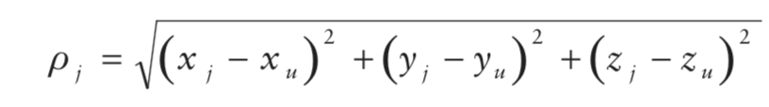
Calculating range
Pseudo-range from i^{th} satellite = 𝝆_{i}
Satellite’s location = (x_{i}, y_{i}, z_{i})
User’s true location = (x_{u}, y_{u}, z_{u})

Slide 30
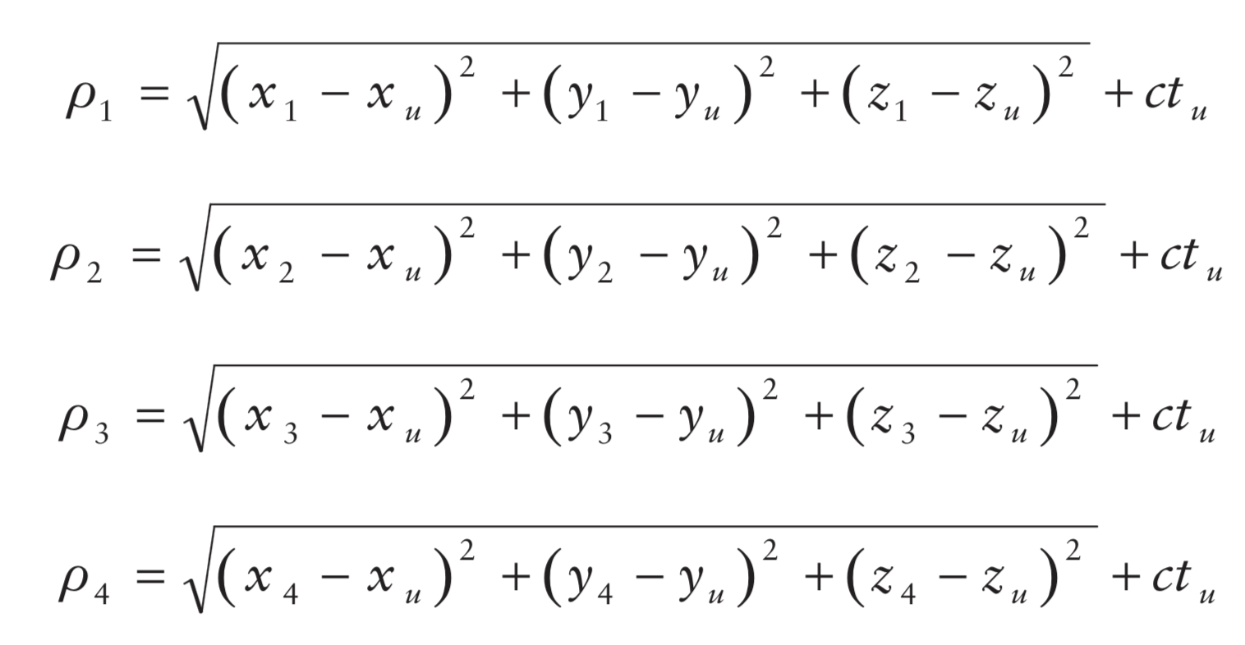
Calculating range
Pseudo-range from i^{th} satellite = 𝝆_{i}
Satellite’s location = (x_{i}, y_{i}, z_{i})
User’s true location = (x_{u}, y_{u}, z_{u})

Slide 31
Calculating range
Pseudo-range from i^{th} satellite = 𝝆_{i}
Satellite’s location = (x_{i}, y_{i}, z_{i})
User’s true location = (x_{u}, y_{u}, z_{u})
User’s time offset from satellite = t_{u}

Slide 32
Calculating range
Pseudo-range from i^{th} satellite = 𝝆_{i}
Satellite’s location = (x_{i}, y_{i}, z_{i})
User’s true location = (x_{u}, y_{u}, z_{u})
User’s time offset from satellite = t_{u}

Slide 33
Calculating range
Pseudo-range from i^{th} satellite = 𝝆_{i}
Satellite’s location = (x_{i}, y_{i}, z_{i})
User’s true location = (x_{u}, y_{u}, z_{u})
User’s time offset from satellite = t_{u}

Slide 34
How to find the satellite’s location
Information about the satellite’s precise location and trajectory are embedded in the transmitted data.

Slide 35
Time-to-First-Fix
Time-To- First-Fix (TTFF) is the elapsed time between turning on a receiver and obtaining the first location fix.

Slide 36
Time-to-First-Fix
Time-To- First-Fix (TTFF) is the elapsed time between turning on a receiver and obtaining the first location fix.
1. Satellite Acquisition
Search with all satellites PRN codes (Coarse/Acquisition or C/A code) to find which satellites are visible at that time. Once found need to decode satellite location and timing information. Need to adjust for unknown Doppler shifts.

Slide 37
Time-to-First-Fix
Time-To- First-Fix (TTFF) is the elapsed time between turning on a receiver and obtaining the first location fix.
1. Satellite Acquisition
Search with all satellites PRN codes (Coarse/Acquisition or C/A code) to find which satellites are visible at that time. Once found need to decode satellite location and timing information. Need to adjust for unknown Doppler shifts.
2. Location estimation
Finding propagation delay and solve the set of equations for location.

Slide 38
Time-to-First-Fix
Time-To- First-Fix (TTFF) is the elapsed time between turning on a receiver and obtaining the first location fix.
1. Satellite Acquisition
Doppler freq.
Code delay
Satellite Acquisition is a computationally intensive process due to the large code phase and Doppler search space. It may take more than 5 minutes.

Slide 39
Assisted GPS (A-GPS or aGPS)

Slide 40
Notes:
MSC = Mobile Switching Center

Slide 41
Differential GPS

Slide 42
GPS ranging error

Slide 43
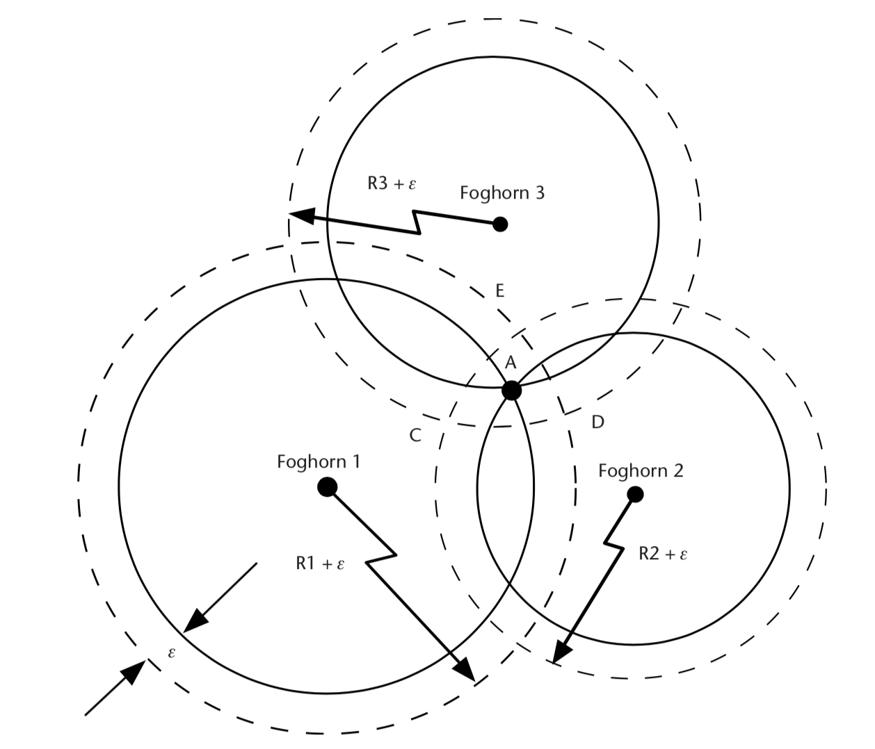
GPS ranging error
Error due to unpredictable signal delay

Slide 44
GPS uses two frequencies
L1 frequency: 1575.42 MHz
L2 frequency: 1227.60 MHz
Redundancy in case of jamming
Ionosphere affect signal propagation depending on frequency
So use of dual frequency receivers can help account for the effect of ionosphere

Slide 45
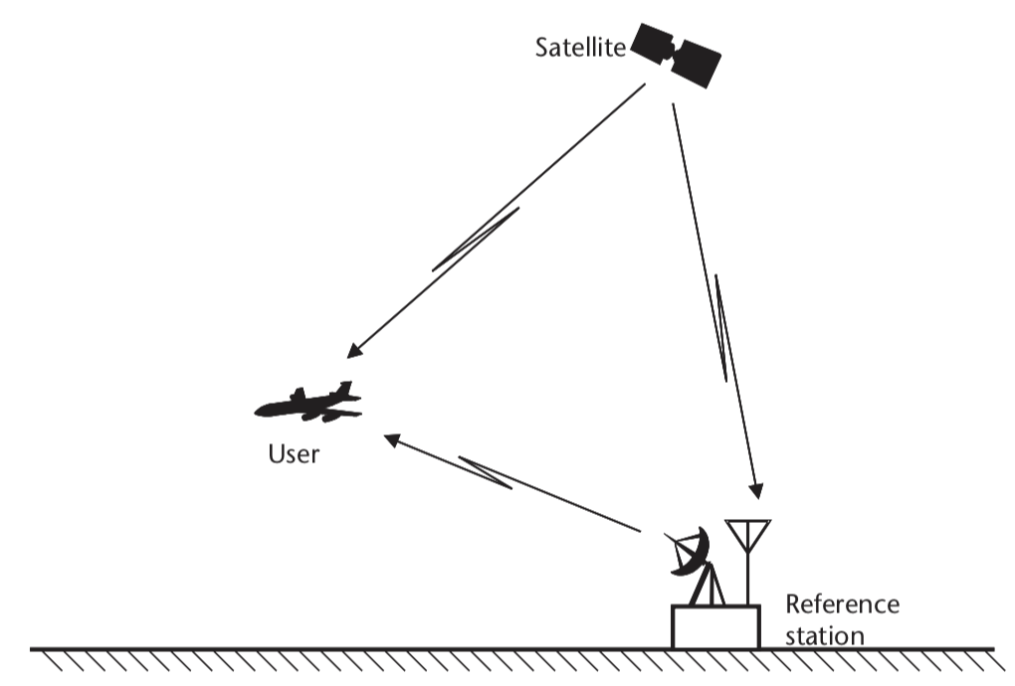
Differential GPS

Slide 46
Differential GPS
(1) Estimate the correct location of the reference
e.g., long term average of GPS location
24 hour estimated location scatter plot

Slide 47
Differential GPS
(1) Estimate the correct location of the reference
e.g., long term average of GPS location

Slide 48
Differential GPS
(2) Estimate the error in received GPS signal using the location of the base station and location of the satellite.
Repeat for all visible satellites
Error

Slide 49
Differential GPS
(3) Apply adjustment to the received GPS signal to reduce error
Send the adjustment info.

Slide 50
Differential GPS
Regular GPS estimate (red)
Differential GPS
with geo-stationary satellite (green)
meter
Differential GPS
with static base station (purple)
meter
24 hour estimated location scatter plot

Slide 51
Inertial Sensor (IMU) Integrated GPS

Slide 52
GPS blockage and multipath in cities

Slide 53
GPS blockage and multipath in cities
Regions of unreliable GPS location

Slide 54
Dead reckoning
Location estimate drifts
-- Use reliable GPS estimates to correct inertial drift
-- Use inertial dead-reckoning in GPS regions
Track movements with inertial sensors

