Slide 1
CSE 562: Mobile & Agentic Systems
Quals Course – Systems OR ML
Shyam Gollakota
Notes:
Chapter 1

Slide 2
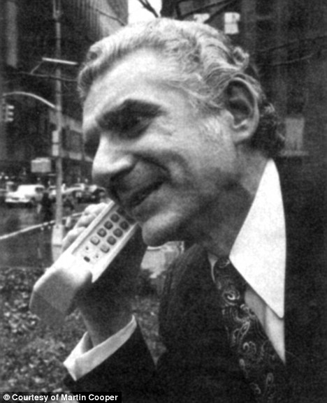
First Mobile Phone 1973

Slide 3
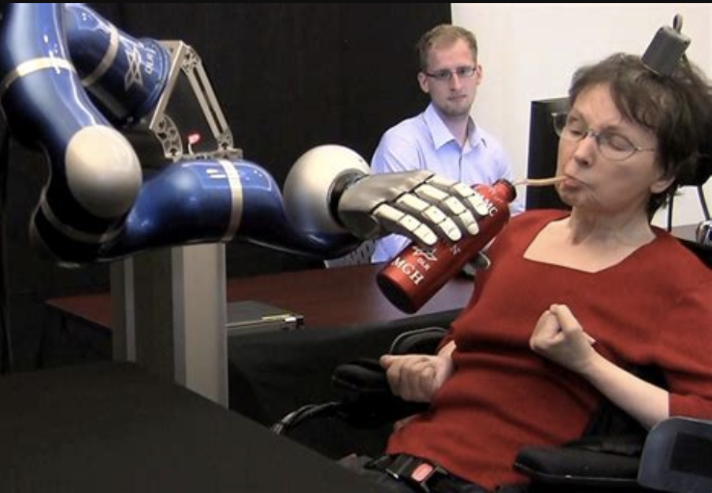

Slide 5
Goal of this course
Have an understanding of what are the physical sensors available on mobile devices
Explore what the future of mobile devices will be when we have AI agents/workflows running on them

Slide 6
What are agents?
Workflows are systems where LLMs and tools are orchestrated through predefined code paths.
Agents, are systems where LLMs dynamically direct their own processes and tool usage, maintaining control over how they accomplish tasks.
https://www.anthropic.com/engineering/building-effective-agents

Slide 7
When (and when not) to use agents
Agentic systems often trade latency and cost for better task performance, and you should consider when this tradeoff makes sense.
Workflows offer predictability and consistency for well-defined tasks, whereas agents are the better option when flexibility and model-driven decision-making are needed at scale.
For many applications, however, optimizing single LLM calls with retrieval and in-context examples is usually enough.
https://www.anthropic.com/engineering/building-effective-agents

Slide 8
Frameworks to implement Agents
LangGraph from LangChain
Amazon Bedrock's AI Agent framework
Rivet, a drag and drop GUI LLM workflow builder
Vellum, another GUI tool for building and testing complex workflows.
https://www.anthropic.com/engineering/building-effective-agents

Slide 9
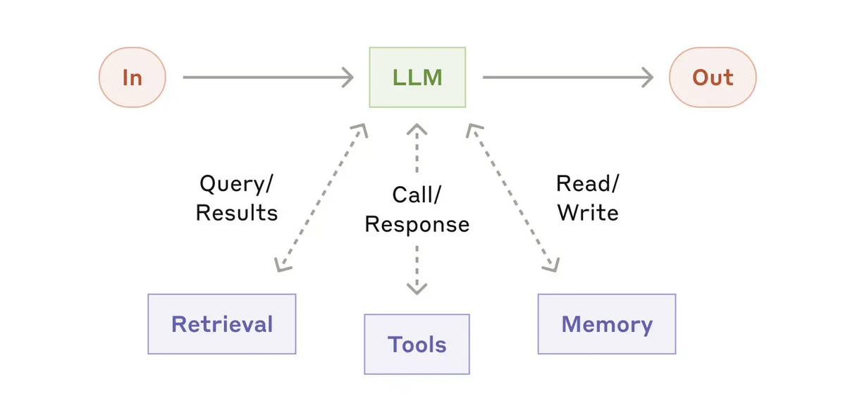
Building blocks for agents: The augmented LLM
Generating their own search queries, selecting appropriate tools, and determining what information to retain.
Anthropic’s Model Context Protocol, allows developers to integrate with a growing ecosystem of third-party tools with a client implementation.

Slide 10
Frameworks to implement Agents
LangGraph from LangChain
Amazon Bedrock's AI Agent framework
Rivet, a drag and drop GUI LLM workflow builder
Vellum, another GUI tool for building and testing complex workflows.
https://www.anthropic.com/engineering/building-effective-agents

Slide 11
Workflow: Prompt chaining
Decompose a task into a sequence of steps, where each LLM call processes the output of the previous one. You can add programmatic checks (see "gate”) on any intermediate steps to ensure that the process is still on track.
Examples:
Writing an outline of a document, checking that the outline meets certain criteria, then writing the document based on the outline.
https://www.anthropic.com/engineering/building-effective-agents

Slide 12
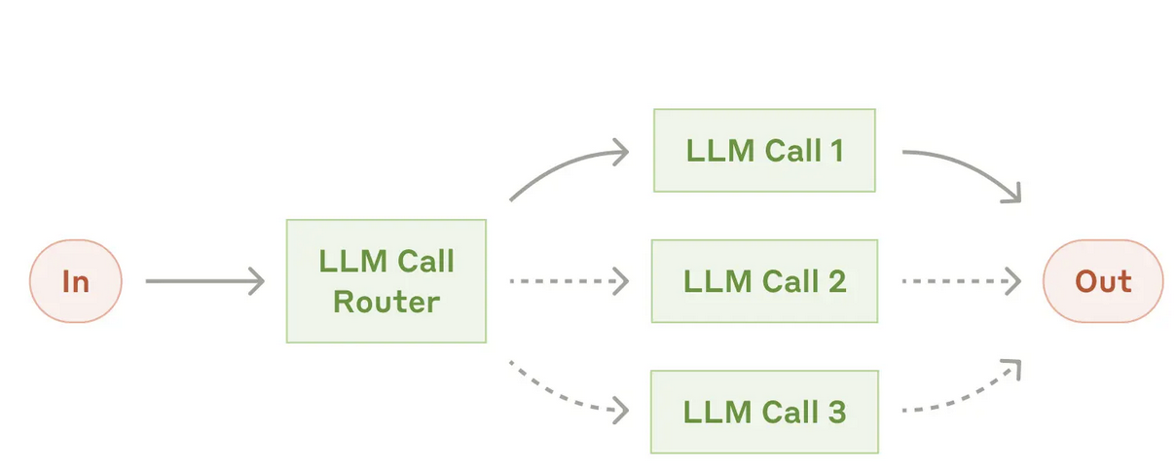
Workflow: Routing
classifies an input and directs it to a specialized followup task. Without this workflow, optimizing for one kind of input can hurt performance on other inputs.
Examples:
Routing easy/common questions to smaller models like Claude 3.5 Haiku and hard/unusual questions to more capable models like Claude 3.5 Sonnet to optimize cost and speed.
https://www.anthropic.com/engineering/building-effective-agents

Slide 13
Workflow: Routing
classifies an input and directs it to a specialized followup task. Without this workflow, optimizing for one kind of input can hurt performance on other inputs.
Examples:
Routing easy/common questions to smaller models like Claude 3.5 Haiku and hard/unusual questions to more capable models like Claude 3.5 Sonnet to optimize cost and speed.
https://www.anthropic.com/engineering/building-effective-agents

Slide 14
Workflow: Parallelization
work simultaneously on a task and have their outputs aggregated programmatically
Examples:
Implementing guardrails where one model instance processes user queries while another screens them for inappropriate content or requests. This tends to perform better than having the same LLM call handle both guardrails and the core response.
https://www.anthropic.com/engineering/building-effective-agents

Slide 15
Workflow: Orchestrator-workers
a central LLM dynamically breaks down tasks, delegates them to worker LLMs, and synthesizes their results. key difference from parallelization is its flexibility—subtasks aren't pre-defined, but determined by the orchestrator based on the specific input.
Examples:
complex tasks where you can’t predict the subtasks needed (in coding, for example, the number of files that need to be changed and the nature of the change in each file likely depend on the task)
https://www.anthropic.com/engineering/building-effective-agents

Slide 16
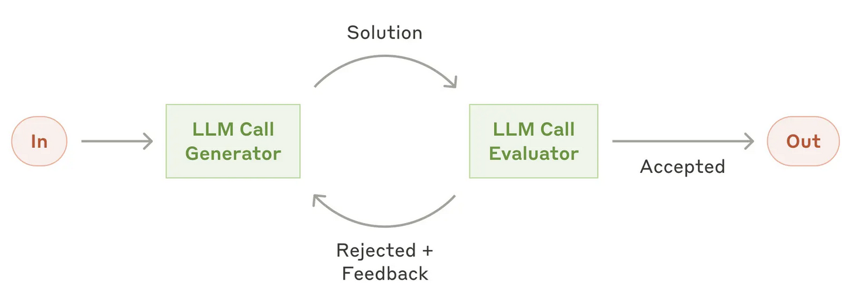
Workflow: Evaluator-optimizer
one LLM call generates a response while another provides evaluation and feedback in a loop. analogous to the iterative writing process a human writer might go through when producing a polished document.
Examples:
Literary translation where there are nuances that the translator LLM might not capture initially, but where an evaluator LLM can provide useful critiques.
https://www.anthropic.com/engineering/building-effective-agents

Slide 17
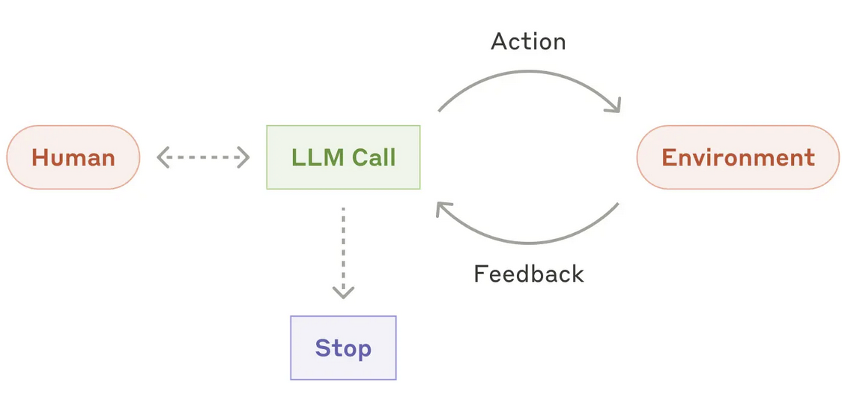
Agents
understanding complex inputs, engaging in reasoning and planning, using tools reliably, and recovering from errors.
https://www.anthropic.com/engineering/building-effective-agents

Slide 18
Agents
Agents begin their work with either a command from, or interactive discussion with, the human user.
Once the task is clear, agents plan and operate independently, potentially returning to the human for further information or judgement.
During execution, it's crucial for the agents to gain “ground truth” from the environment at each step (such as tool call results or code execution) to assess its progress.
Agents can then pause for human feedback at checkpoints or when encountering blockers.
The task often terminates upon completion, but it’s also common to include stopping conditions (such as a maximum number of iterations) to maintain control.

Slide 19
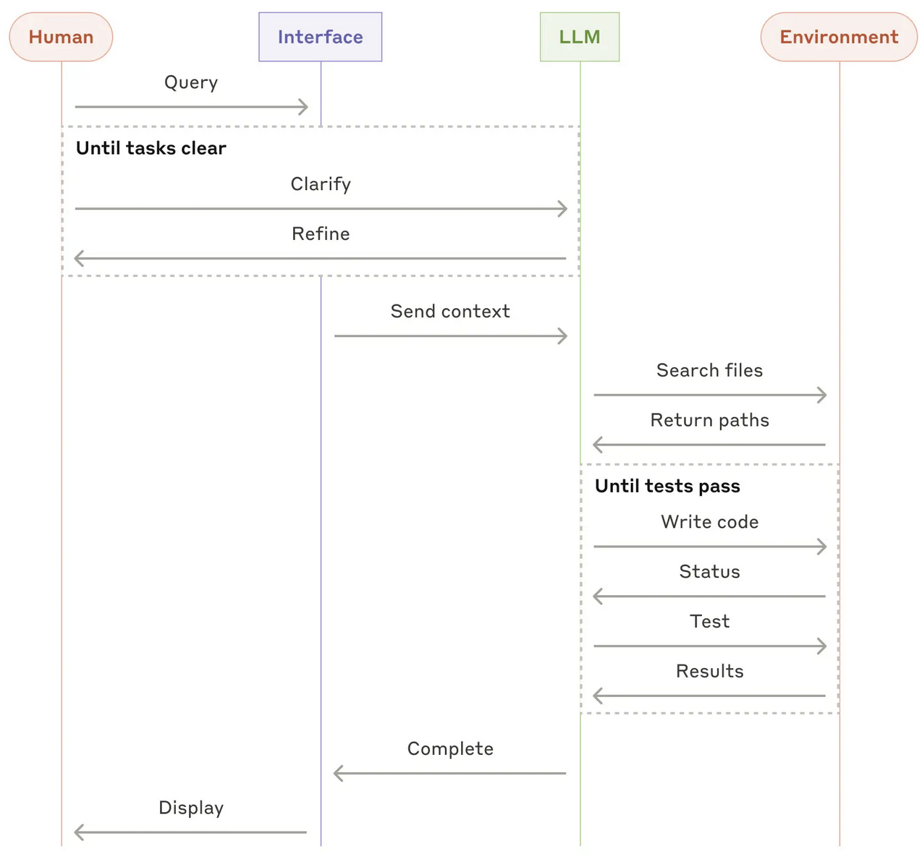
Agents

Slide 20
Agents

Slide 23
Course material

Slide 24
Fundamental methods and tools
Understanding Waves Android/iPhone
Programming Using Microphones/Speakers as Sensors
Multi-Microphone/Speaker Applications
Deep Learning for Enhanced Hearing
Programming Deep learning Models on Phones
IMU & GPS systems

Slide 25
AI and agentic systems
Real-time Translation systems
Proactive Agents
LLMs as Judges for agentic systems
Augmenting LLMs with Tool Use & Actions
AI Scientist systems
Benchmarks & Challenges in Evaluating Agents
GUI Agents

Slide 26
Grading
2 hands-on assignments (20+20%)
Implementing head tracking using smartphone IMUs
Implementing Yolo video model on smartphone
Project (40%)
Project pitch/proposal (5%)
Project demo (30%)
Evaluation metrics (5%)
Class presentation of papers (15%)
Class participation + asking questions (5%)

Slide 27
Class webpage
https://courses.cs.washington.edu/courses/cse562/25sp/

