Slide 1
Waves
Slides adapted from Nirupam Roy

Slide 2
Sound
Visible light
Physical vibrations
WiFi signal
Ripples in water
Infrared
…
…

Slide 3
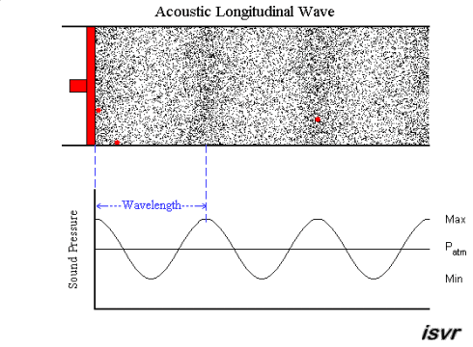
Mechanical Wave
Electromagnetic Wave
Sound
Visible light
Physical vibrations
WiFi signal
Ripples in water
Infrared
…
…

Slide 4
Waves made this possible

Slide 5
Waves made this possible

Slide 6
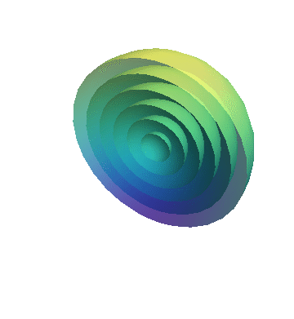
Equation of waves in time and space

Slide 7
Equation of waves in time and space
Temporal variation of the wave’s amplitude

Slide 8
Equation of waves in time and space

Slide 9
Frequency, Amplitude, and Phase

Slide 10
Frequency, Amplitude, and Phase
$$f cycles per second$$
$$2π angles per cycle$$
Time

Slide 11
Frequency, Amplitude, and Phase
$$2π angles per cycle$$
$$f cycles per second$$
$$One full cycle in T seconds$$
i.e., $f$ = $\frac{1}{T}$
A
𝚹
Phase
time = t second
$Ψ$(t)
$$=$$
$$A . sin⁡(θ(t))$$
$$A . sin⁡(\frac{2π}{T}t)$$
$$=$$
$$A . sin⁡(2πft)$$
$$=$$

Slide 12
Equation of waves in time and space

Slide 13
Equation of waves in time and space

Slide 14
Equation of waves in time and space

Slide 15
Equation of waves in time and space
$$distance from the source (x)$$
$$space$$

Slide 16
Equation of waves in time and space
Amplitude here
$$distance from the source (x)$$
$$space$$
is a delayed version of
the amplitude here.

Slide 17
Equation of waves in time and space
Amplitude here
$$distance from the source (x)$$
$$space$$
is a delayed version of
the amplitude here.

Slide 18
Equation of waves in time and space
Amplitude here
The delay depends
on the distance.
$$distance from the source (x)$$
$$space$$
is a delayed version of
the amplitude here.

Slide 19
Equation of waves in time and space
Amplitude here
The delay depends
on the distance.
$$distance from the source (x)$$
$$space$$
is a delayed version of
the amplitude here.
$$A . sin⁡(\frac{2π}{T}t)$$
$Ψ$(t)
$$=$$
$$A . sin⁡(2πft)$$
$$=$$

Slide 20
Equation of waves in time and space
Amplitude here
The delay depends
on the distance.
$$distance from the source (x)$$
$$space$$
is a delayed version of
the amplitude here.
$Ψ$(t, x)
$$=$$
$$A . sin⁡(2πft−θ(x))$$
Why is this negative?

Slide 21
Equation of waves in time and space
$wavelength$ = λ
$$distance from the source (x)$$
$$space$$
$Ψ$(t, x)
$$=$$
$$A . sin⁡(2πft−θ(x))$$

Slide 22
Equation of waves in time and space
$wavelength$ = λ
$$f number of cycles per second$$
$$C meters of distance per second$$
$$(speed of the wave)$$
$distance per cycle=\text{λ}$ = $C$/ $f$

Slide 23
Equation of waves in time and space
$wavelength$ = λ
$$f number of cycles per second$$
$$C meters of distance per second$$
$$(speed of the wave)$$
$distance per cycle=\text{λ}$ = $C$/ $f$
$$2π radians of angle is covered per cycle$$

Slide 24
$wavelength$ = λ
Equation of waves in time and space
$$f number of cycles per second$$
$$C meters of distance per second$$
$$(speed of the wave)$$
$distance per cycle=\text{λ}$ = $C$/ $f$
$$2π radians of angle is covered per cycle$$
$$\frac{2π}{\text{λ}}radians of angle is covered per unit distance$$

Slide 25
Equation of waves in time and space
$wavelength$ = λ
$$distance from the source (x)$$
$$space$$
$Ψ$(t, x)
$$=$$
$$A . sin⁡(2πft−θ(x))$$
$$A . sin⁡(2πft−\frac{2π}{\text{λ}}x)$$
$$=$$

Slide 26
Time and space
Cycles per sec = frequency = f Hz
Distance per cycle = wavelength = λ meters
Distance per second = speed = C meters/sec
C = f . λ
Speed of sound in air: 343 m/s
Speed of sound in water: 1493 m/s
Speed of sound in iron: 5130 m/s
Speed of electromagnetic waves: 3*10⁸ m/s
(~ a million times faster than sound)

Slide 27
Reflection of waves

Slide 28
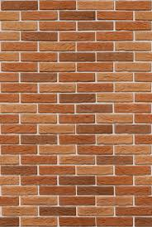
Reflection

Slide 29
Reflection
$$Θ$$
$$Θ$$

Slide 30
Reflection
d1
$$Θ$$
$$Θ$$
d2

Slide 31
Reflection
Absorption
+
Reflection
echo

Slide 32
Reflection
Time = t1

Slide 33
Reflection
Time = t1
Absorption
+
Reflection

Slide 34
Reflection
Time = t1
Absorption
+
Reflection
echo
t2

Slide 35
Reflection
Time = t1
Absorption
+
Reflection
d
echo
t2
Sound travelled (2d) distance

Slide 36
Reflection
Time = t1
Absorption
+
Reflection
d
echo
t2
Sound travelled (2d) distance
C.(t2-t1) = 2d

Slide 37
Reflection
Time = t1
Absorption
+
Reflection
d
Echolocation
echo
t2
Sound travelled (2d) distance
C.(t2-t1) = 2d

Slide 38
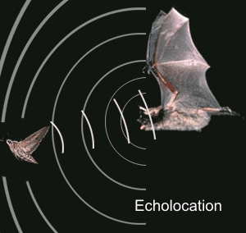
Echolocation in nature
Bat

Slide 39
Echolocation in nature
Beluga whale

Slide 40
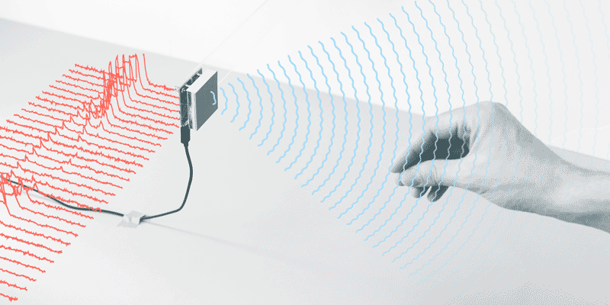
Waves for gesture detection [Project Soli]

Slide 41
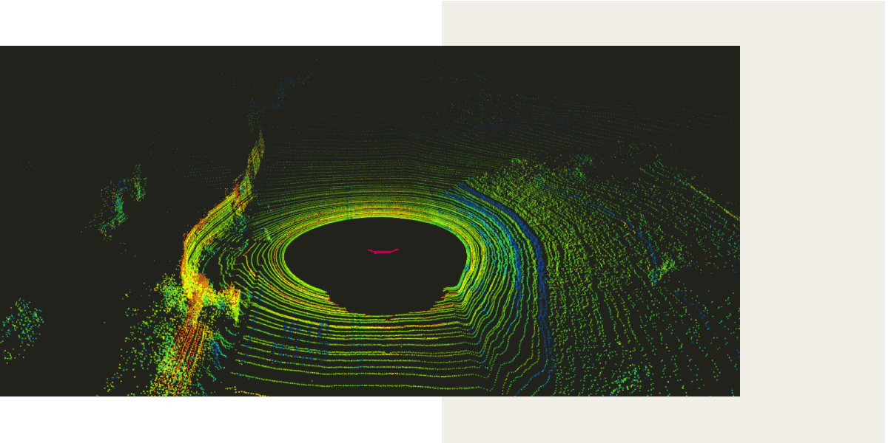
LiDAR (Light Detection and Ranging)

Slide 42
LiDAR (Light Detection and Ranging)

Slide 43
Acoustic imaging

Slide 44
Acoustic imaging
Sonogram

Slide 45
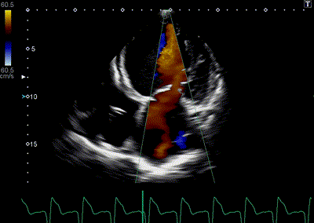
Acoustic imaging
Sonogram

Slide 46
Multipath

Slide 47
Multipath

Slide 48
Multipath

Slide 49
Multipath: Convolution
Amplitude
Time (sec)
0.00
0.25
0.50
0.75
1.00
1.25

Slide 50
Multipath: Convolution
Amplitude
Time (sec)
0.00
0.25
0.50
0.75
1.00
1.25
Direct path
Amplitude
Time (sec)
0.00
0.25
0.50
0.75
1.00
1.25

Slide 51
Multipath: Convolution
Amplitude
Time (sec)
0.00
0.25
0.50
0.75
1.00
1.25
Direct path
Echo
Amplitude
Time (sec)
0.00
0.25
0.50
0.75
1.00
1.25

Slide 52
Multipath: Convolution
Amplitude
Time (sec)
0.00
0.25
0.50
0.75
1.00
1.25
Direct path
Echo
Amplitude
Time (sec)
0.00
0.25
0.50
0.75
1.00
1.25

Slide 53
Multipath: Convolution
Amplitude
Time (sec)
0.00
0.25
0.50
0.75
1.00
1.25
Direct path
Echo
Amplitude
Time (sec)
0.00
0.25
0.50
0.75
1.00
1.25

Slide 54
Multipath: Convolution
Amplitude
Time (sec)
0.00
0.25
0.50
0.75
1.00
1.25
Amplitude
Time (sec)
0.00
0.25
0.50
0.75
1.00
1.25

Slide 55
Multipath: Convolution
Amplitude
0.00
0.75
Time (sec)

Slide 56
Multipath: Convolution
Amplitude
0.00
0.75
Time (sec)

Slide 57
Impulse response
Impulse/ Dirac delta function
$δ$(x-a)
Amplitude
Environment
(reflections, absorption, attenuation etc.)
Time (sec)
a
Impulse Response

Slide 58
Linear Time Invariant (LTI) System

Slide 59
Linear Time Invariant (LTI) System
Amplitude
0.00
0.75
Time (sec)
+
+
=

Slide 60
Impulse response

Slide 61
Impulse response
Impulse
SYSTEM
Impulse Response

Slide 62
Impulse response
Impulse Response
Input
SYSTEM
*
Input
Convolution
operator

Slide 63
Convolution operator

Slide 64
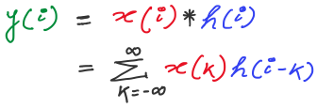
Convolution operator: Definition

Slide 65
Convolution operator: Properties

Slide 66
Convolution operator

Slide 67
A simple acoustic ranging technique
BeepBeep – SenSys 2007

Slide 68
Distance = d
Device A
Device B

Slide 69
Time = t1
Distance = d
Device A
Device B

Slide 70
Time = t1
Time = t2
Distance = d
Device A
Device B

Slide 71
Bluetooth/WiFi
Time = t1
Time = t1
Time = t2
Distance = d
Device A
Device B

Slide 72
Bluetooth/WiFi
Time = t1
Time = t1
Time = t2
Distance = d
Device A
Device B
d = C . (t2-t1)

Slide 73
Bluetooth/WiFi
Time = t1
Time = t1
Time = t2
Distance = d
Problem: Clock synchronization
Device A
Device B
d = C . (t2-t1)

Slide 74
The root cause of inaccuracy – three uncertainties
Clock synchronization uncertainty
time

Slide 75
The root cause of inaccuracy – three uncertainties
Clock synchronization uncertainty
Sending uncertainty
time

Slide 76
Sound production and recording

Slide 77
Sound recording with microphone
Sound

Slide 78
Sound recording with microphone
Analog signal (voltage)
Sound
ADC
ADC = Analog-to-Digital Converter

Slide 79
Sound recording with microphone
Analog signal (voltage)
Sound
ADC
S6 S5 S4 S3 S2 S1 S0
Audio Sample Buffer
ADC = Analog-to-Digital Converter

Slide 80
Sound production with speaker
S6 S5 S4 S3 S2 S1 S0
Audio Sample Buffer

Slide 81
Sound production with speaker
S6 S5 S4 S3 S2 S1 S0
Analog signal (voltage)
Audio Sample Buffer
DAC
DAC = Digital-to-Analog Converter

Slide 82
Sound production with speaker
S6 S5 S4 S3 S2 S1 S0
Analog signal (voltage)
Audio Sample Buffer
DAC
Sound
DAC = Digital-to-Analog Converter

Slide 83
The root cause of inaccuracy – three uncertainties
Clock synchronization uncertainty
Sending uncertainty
software issuing command
...
t0 = wall_clock();
write(sound_dev, signal);
...
time

Slide 84
The root cause of inaccuracy – three uncertainties
Clock synchronization uncertainty
Sending uncertainty
software issuing command
...
t0 = wall_clock();
write(sound_dev, signal);
...
unknown delays (software, system, driver, hardware, …) ?
sound leaves
speaker
time

Slide 85
The root cause of inaccuracy – three uncertainties
Clock synchronization uncertainty
Sending uncertainty
Receiving uncertainty
software issuing command
...
t0 = wall_clock();
write(sound_dev, signal);
...
unknown delays (software, system, driver, hardware, …) ?
sound leaves
speaker
time

Slide 86
The root cause of inaccuracy – three uncertainties
Clock synchronization uncertainty
Sending uncertainty
Receiving uncertainty
software issuing command
...
t0 = wall_clock();
write(sound_dev, signal);
...
unknown delays (software, system, driver, hardware, …) ?
sound leaves
speaker
sound
reaches mic
time

Slide 87
The root cause of inaccuracy – three uncertainties
Clock synchronization uncertainty
Sending uncertainty
Receiving uncertainty
software issuing command
...
t0 = wall_clock();
write(sound_dev, signal);
...
unknown delays (software, system, driver, hardware, …) ?
sound leaves
speaker
sound
reaches mic
unknown delays (hardware, interrupt, driver, scheduling, …) ?
time

Slide 88
The root cause of inaccuracy – three uncertainties
Clock synchronization uncertainty
Sending uncertainty
Receiving uncertainty
software issuing command
software aware of arrival
...
t0 = wall_clock();
write(sound_dev, signal);
...
...
read(sound_dev, signal);
t1 = wall_clock();
...
unknown delays (software, system, driver, hardware, …) ?
sound leaves
speaker
sound
reaches mic
unknown delays (hardware, interrupt, driver, scheduling, …) ?
time

Slide 89
Beepbeep’s basic procedure
Device A emits a beep while both recording
Device B emits another beep while both continue recording
Both devices detect TOA of the two beeps and obtain respective ETOAs
Exchange ETOAs and calculate the distance
Device A
Device B
A’s recording
B’s recording
ETOA_{A}
ETOA_{B}

Slide 90
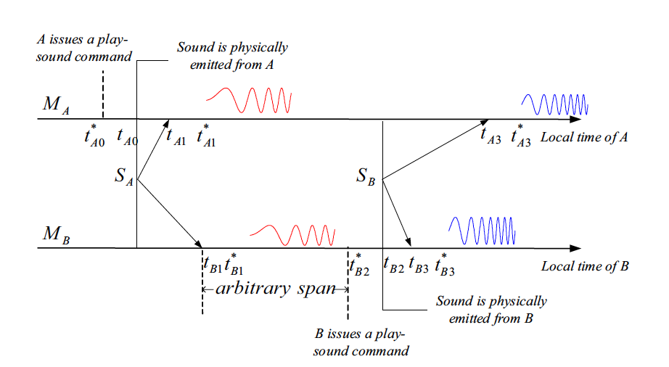
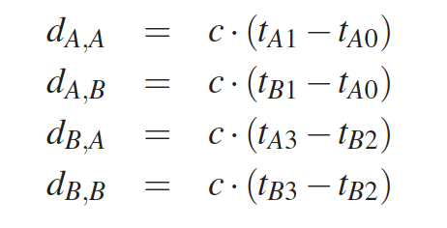
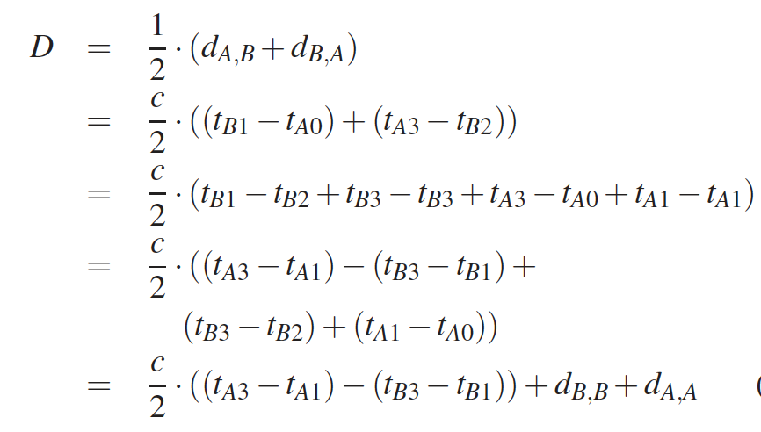
Dx,y is distance between x’s speaker to y’s microphone

