Slide 1
Model for a signal (frequency, amplitude, and phase)

Slide 2
Model for a signal (frequency, amplitude, and phase)
$$A . sin⁡(θ)$$
$$A . cos⁡(θ)$$

Slide 3
Model for a signal (frequency, amplitude, and phase)
1
$$sin⁡(θ)$$
𝚹
$$cos⁡(θ)$$
$$f cycles per second$$
$$θ=2πft$$
$$2π angles per cycle$$

Slide 4
Frequency, Amplitude, and Phase
$$2π angles per cycle$$
$$f cycles per second$$
A
𝚹
Phase
time = t second
$$=$$
$$A . sin⁡(θ)$$
$$=$$
$$A . sin⁡(2πft)$$
$$A . sin⁡(2πft+φ)$$
-- with initial/additional phase ϕ

Slide 5
Frequency, Amplitude, and Phase
Frequency: 2Hz
Amplitude
Time (sec)
0.00
0.25
0.50
0.75
1.00
1.25
Frequency: 4Hz
Amplitude
Time (sec)
0.00
0.25
0.50
0.75
1.00
1.25

Slide 6
Frequencies of an arbitrary signal
Frequency: 2Hz
Amplitude
Time (sec)
0.00
0.25
0.50
0.75
1.00
1.25
Amplitude
Time (sec)
0.00
0.25
0.50
0.75
1.00
1.25

Slide 7
The concept of the Fourier series
Amplitude
Time (sec)
0.00
0.25
0.50
0.75
1.00
1.25
Amplitude
Time (sec)
0.00
0.25
0.50
0.75
1.00
1.25

Slide 8
Time Domain and Frequency Domain
Approx. square wave
$$1 .\sin\left(2πft\right)$$
$$\frac{1}{3} .\sin\left(2π.3ft\right)$$
$$\frac{1}{5} .\sin\left(2π.5ft\right)$$
$$\frac{1}{7} .\sin\left(2π.7ft\right)$$

Slide 9
Time Domain and Frequency Domain
Time domain view
Frequency domain view

Slide 10
Analogy: Food coloring chart
Basis for food colors
Notes:
Emphasize basis and coefficient using Color analogy

Slide 11
Analogy: Food coloring chart
Basis for food colors
Notes:
Emphasize basis and coefficient using Color analogy

Slide 12
Analogy: Food coloring chart
Basis for food colors
Notes:
Emphasize basis and coefficient using Color analogy

Slide 13
Analogy: Food coloring chart
Basis for food colors
Notes:
Emphasize basis and coefficient using Color analogy

Slide 14
Time Domain and Frequency Domain
Amplitude
Time (sec)
0.00
0.25
0.50
0.75
1.00
1.25
$$= A1 .\sin\left(2πf1t\right)+B1 . cos⁡(2πf1t)$$
$$+ A2 .\sin\left(2πf2t\right)+B2 . cos⁡(2πf2t)$$
$$+ A3 .\sin\left(2πf3t\right)+B3 . cos⁡(2πf3t)$$
$$+ …$$

Slide 15
Time Domain and Frequency Domain
Fourier Transform
FFT
Amplitude
Amplitude
IFFT
0.00
0.25
0.50
0
2
4
6
8
Time
Frequency (Hz)
Time domain
Frequency domain
FFT = Fast Fourier Transform
IFFT = Inverse Fast Fourier Transform

Slide 16
A simple acoustic ranging technique
BeepBeep – SenSys 2007

Slide 17
Distance = d
Device A
Device B

Slide 18
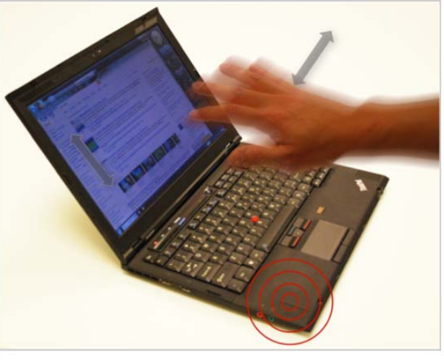
Device-free tracking

Slide 19
Doppler radar effect
Limitations of Doppler
Algorithms to get better resolution

Slide 20
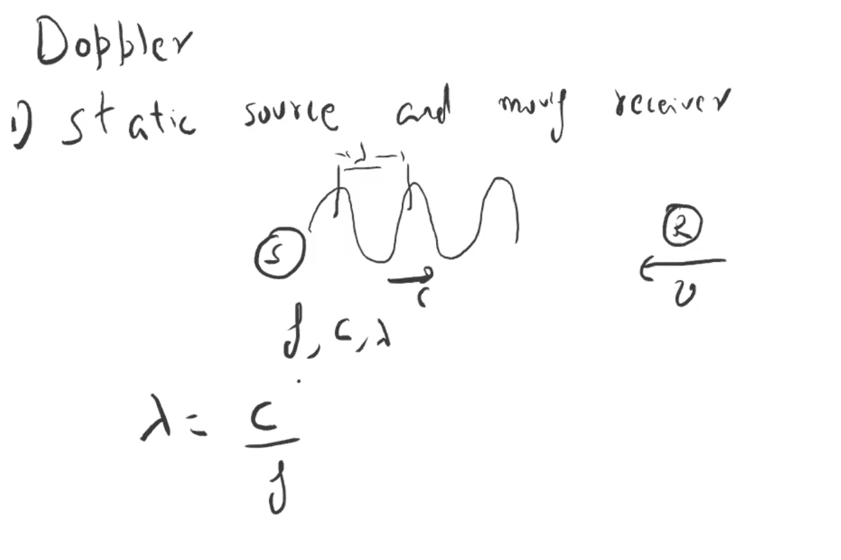

Slide 21
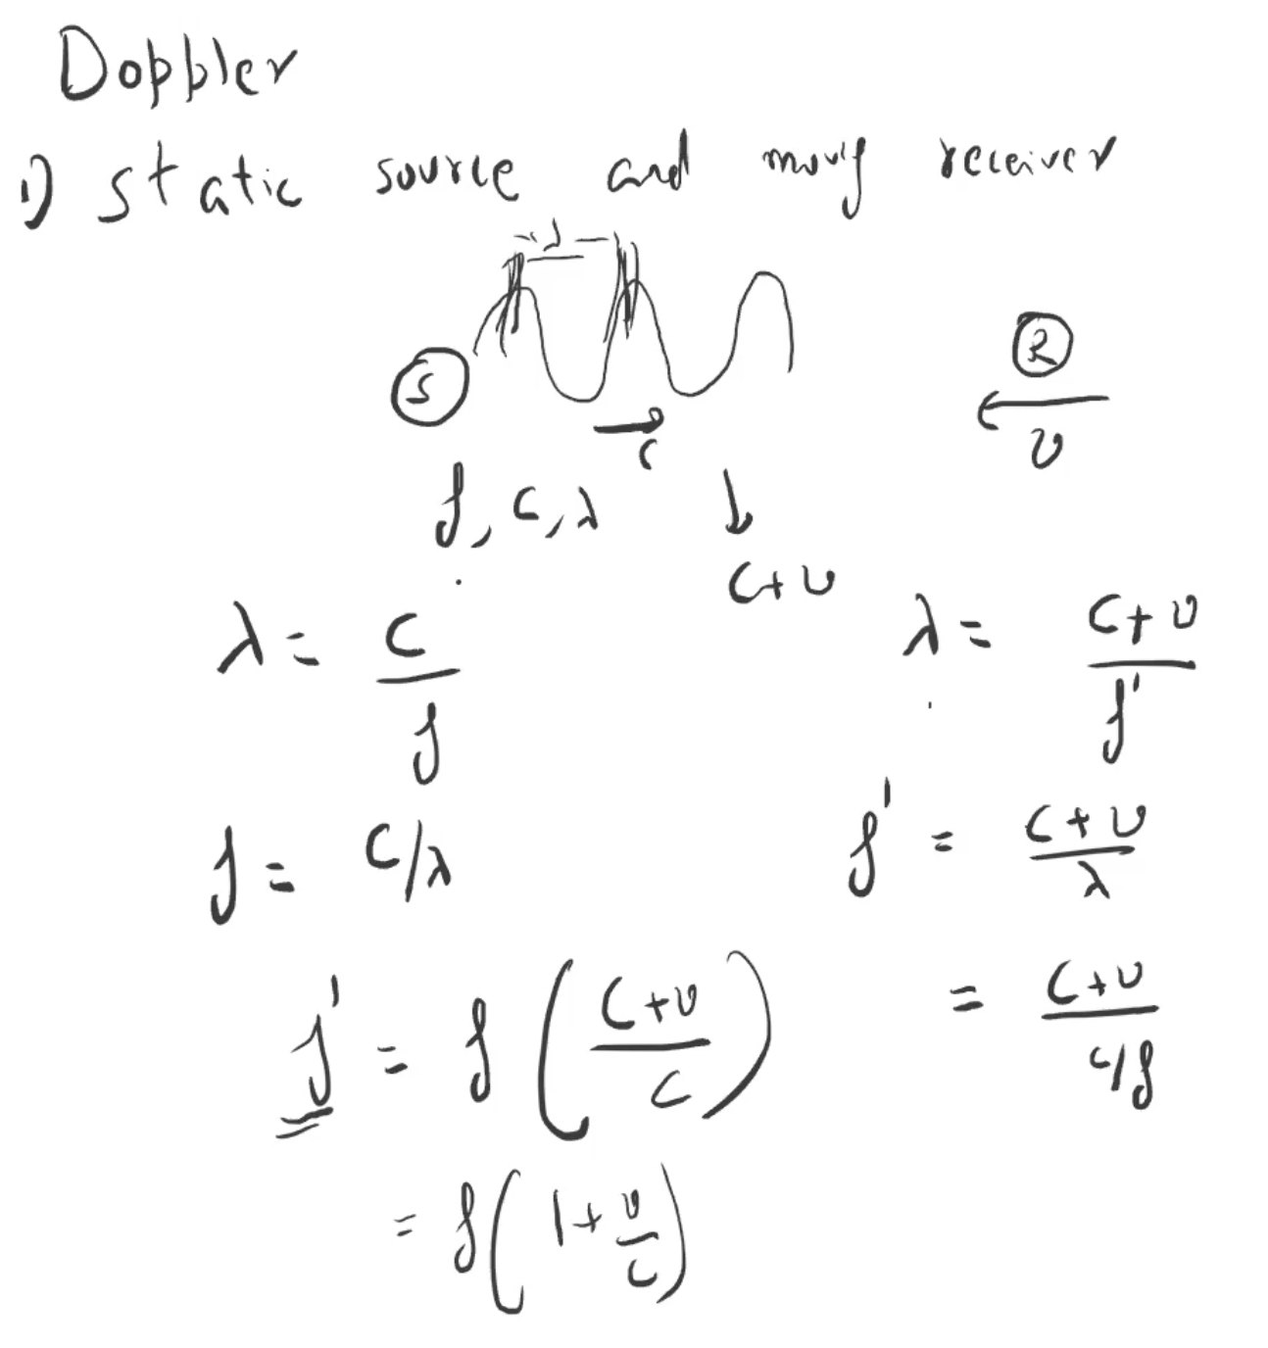

Slide 22
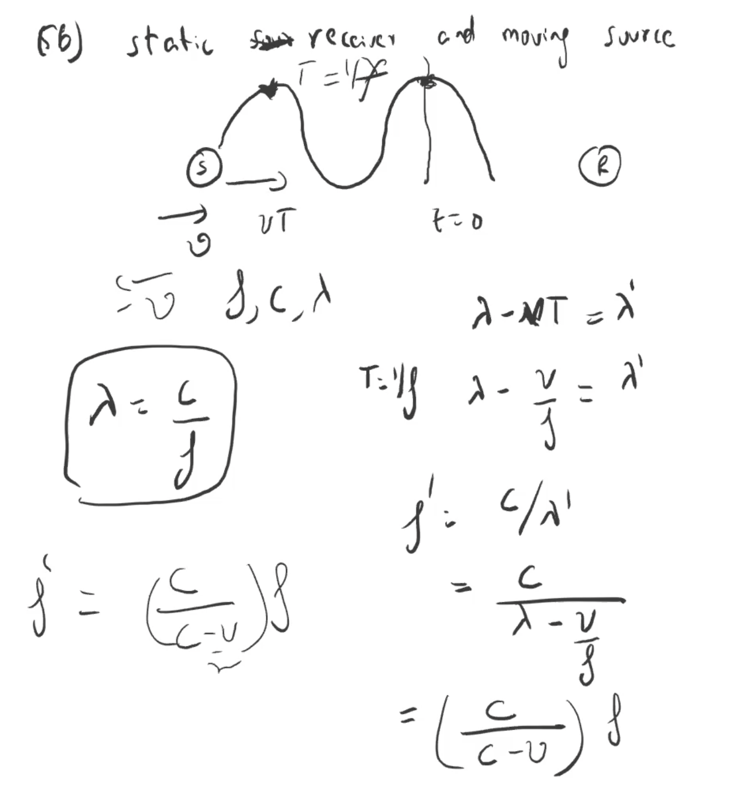

Slide 23
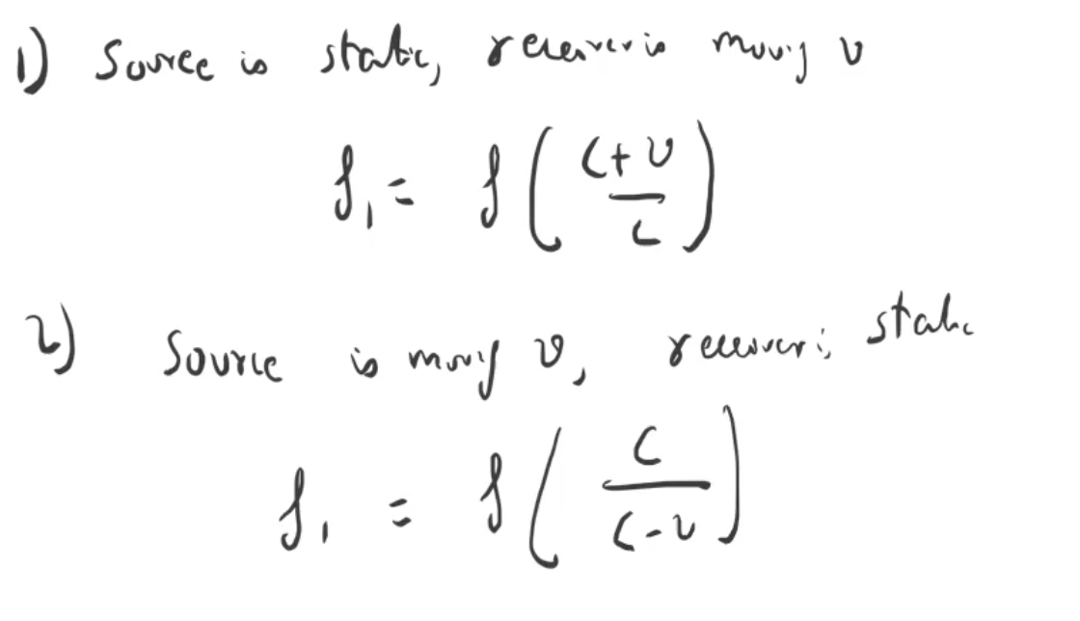

Slide 24
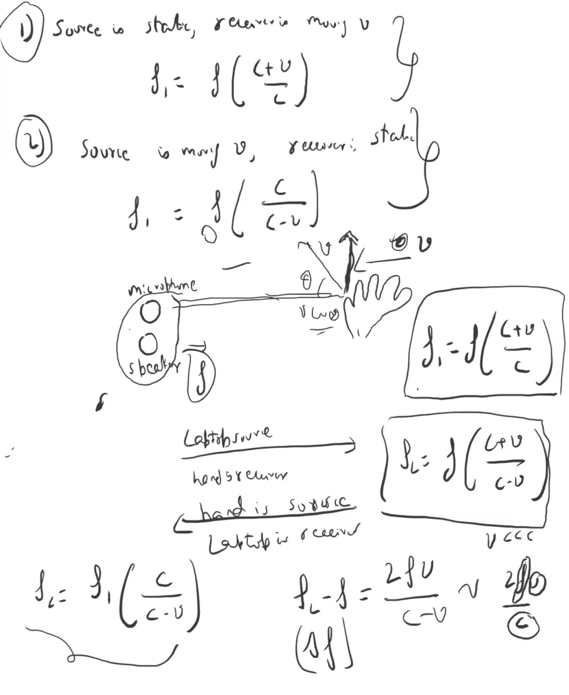

Slide 25
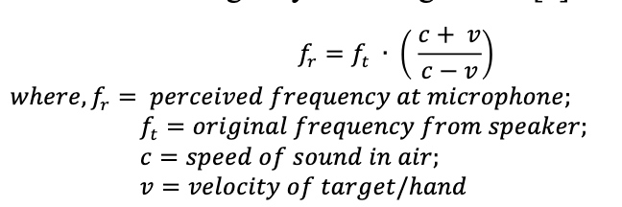
SoundWave
Transmit 18-20 kHz signals from laptop speaker
Capture reflections on the laptop microphone at 48 kHz sampling rate
Perform a 4800 point FFT over a sliding window

Slide 26
Doppler radar effect
Limitations of Doppler
Algorithms to get better resolution

Slide 27
DFT properties
Sampling frequency = f_{s} (i.e., f_{s} samples per second)
Slowest frequency ($\frac{2π}{N}$ radians per step) = N samples per rotation
= (N/ f_{s}) seconds per rotation
Therefore, the slowest frequency = (f_{s} /N) Hz
Higher frequencies are integer multiple of (f_{s} /N) Hz
0, $\frac{\text{f}\text{s}}{N}\text{, }\frac{\text{2}\text{f}\text{s}}{N}$ , $\frac{\text{3}\text{f}\text{s}}{N}$ , $\frac{\text{4}\text{f}\text{s}}{N}$, … ,

Slide 28
The resolution and the highest frequency
Magnitude/Phase of z_{m}
-4
-3
-2
-1
1
3
m = 0
2
4
Frequency
Resolution
= minimum observable frequency difference =
$\frac{\text{f}\text{s}}{N}$
What if the actual frequency falls in between two frequency bins?

Slide 29
