Slide 1
Signal processing basics
(Slides by Nirupam Roy)
Notes:
Chapter 1

Slide 2
Model for a signal (frequency, amplitude, and phase)

Slide 3


Model for a signal (frequency, amplitude, and phase)
$$A . sin⁡(θ)$$
$$A . cos⁡(θ)$$

Slide 4
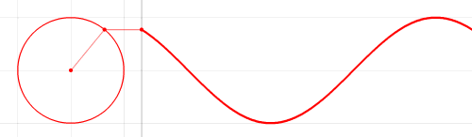





Model for a signal (frequency, amplitude, and phase)
1
$$sin⁡(θ)$$
𝚹
$$cos⁡(θ)$$
$$f cycles per second$$
$$θ=2πft$$
$$2π angles per cycle$$

Slide 5






Frequency, Amplitude, and Phase
$$2π angles per cycle$$
$$f cycles per second$$
A
𝚹
Phase
time = t second
$$=$$
$$A . sin⁡(θ)$$
$$=$$
$$A . sin⁡(2πft)$$
$$A . sin⁡(2πft+φ)$$
-- with initial/additional phase ϕ

Slide 6
Frequency, Amplitude, and Phase
Frequency: 2Hz
Amplitude
Time (sec)
0.00
0.25
0.50
0.75
1.00
1.25
Frequency: 4Hz
Amplitude
Time (sec)
0.00
0.25
0.50
0.75
1.00
1.25

Slide 7
Frequencies of an arbitrary signal
Frequency: 2Hz
Amplitude
Time (sec)
0.00
0.25
0.50
0.75
1.00
1.25
Amplitude
Time (sec)
0.00
0.25
0.50
0.75
1.00
1.25

Slide 8
The concept of the Fourier series
Amplitude
Time (sec)
0.00
0.25
0.50
0.75
1.00
1.25
Amplitude
Time (sec)
0.00
0.25
0.50
0.75
1.00
1.25

Slide 9




Time Domain and Frequency Domain
Approx. square wave
$$1 .\sin\left(2πft\right)$$
$$\frac{1}{3} .\sin\left(2π.3ft\right)$$
$$\frac{1}{5} .\sin\left(2π.5ft\right)$$
$$\frac{1}{7} .\sin\left(2π.7ft\right)$$

Slide 10
Time Domain and Frequency Domain
Time domain view
Frequency domain view

Slide 11
Analogy: Food coloring chart
Basis for food colors
Notes:
Emphasize basis and coefficient using Color analogy

Slide 12
Analogy: Food coloring chart
Basis for food colors
Notes:
Emphasize basis and coefficient using Color analogy

Slide 13
Analogy: Food coloring chart
Basis for food colors
Notes:
Emphasize basis and coefficient using Color analogy

Slide 14
Analogy: Food coloring chart
Basis for food colors
Notes:
Emphasize basis and coefficient using Color analogy

Slide 15




Time Domain and Frequency Domain
Amplitude
Time (sec)
0.00
0.25
0.50
0.75
1.00
1.25
$$= A1 .\sin\left(2πf1t\right)+B1 . cos⁡(2πf1t)$$
$$+ A2 .\sin\left(2πf2t\right)+B2 . cos⁡(2πf2t)$$
$$+ A3 .\sin\left(2πf3t\right)+B3 . cos⁡(2πf3t)$$
$$+ …$$

Slide 16
Time Domain and Frequency Domain
Fourier Transform
FFT
Amplitude
Amplitude
IFFT
0.00
0.25
0.50
0
2
4
6
8
Time
Frequency (Hz)
Time domain
Frequency domain
FFT = Fast Fourier Transform
IFFT = Inverse Fast Fourier Transform

Slide 17


Frequency band
Amplitude
0
2
4
6
8
Frequency (kHz)
A 4 kHz frequency band starting at 2 kHz
What is bandwidth?
What is center frequency?

Slide 18
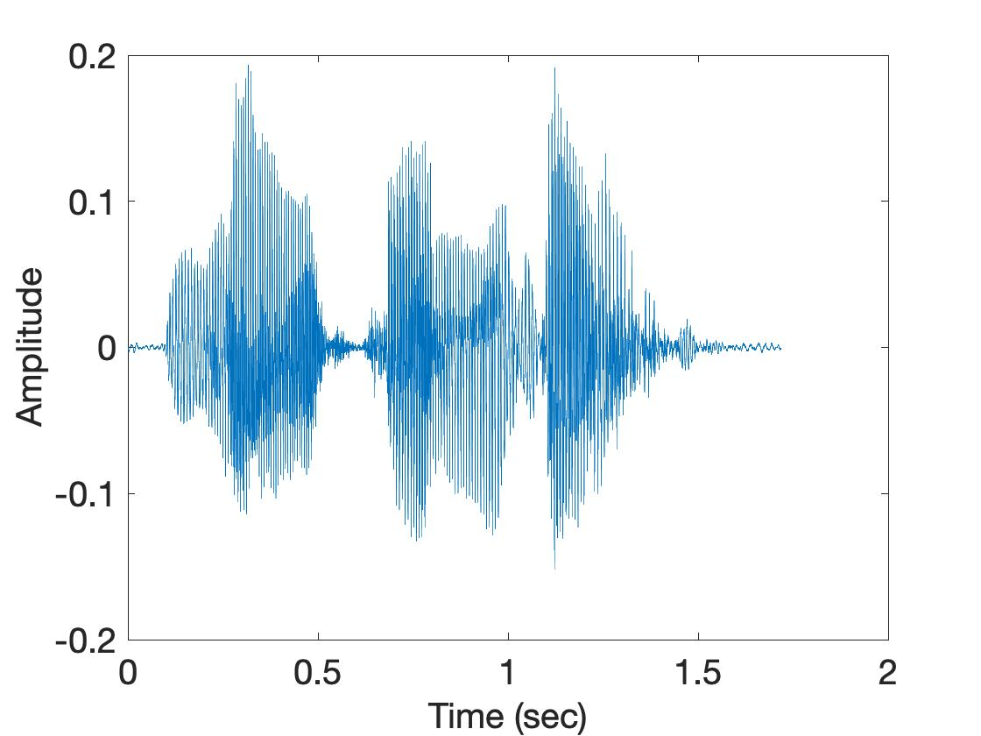
Spectrogram

Slide 19
Spectrogram
[
[
[
FFT of overlapping windows
of samples
(Spectrogram)
[
FFT
FFT
FFT
FFT

Slide 20
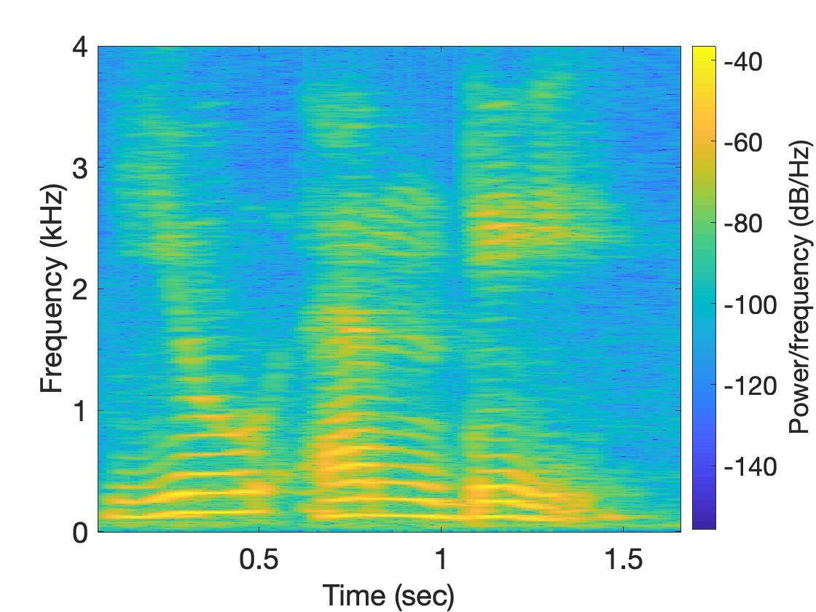
Spectrogram

Slide 21
Analog
Digital
Physical signal
(voice)
Spectrogram plot
on computer
FFT
Time varying voltage
signal
A collection of numbers

Slide 22
Analog vs Digital World
Temperature
Voltage
Thermo-couple
Time
Analog
Digital

Slide 23
Analog
Digital
Physical signal
(voice)
Spectrogram plot
on computer
FFT
Time varying voltage
signal
A collection of numbers
?

Slide 24
Analog
Digital
Physical signal
(voice)
Spectrogram plot
on computer
FFT
Time varying voltage
signal
A collection of numbers
ADC
Analog-to-Digital Converter

Slide 25
Sampling theorem
Amplitude
Time (sec)
0.00
0.25
0.50
0.75
1.00
1.25

Slide 26
Sampling theorem
Amplitude
Time (sec)
0.00
0.25
0.50
0.75
1.00
1.25
Amplitude
Time (sec)
0.00
0.25
0.50
0.75
1.00
1.25
[ 0.34 0.22 0.09 0.21 0.30 0.08 0.09 ]

Slide 27
Sampling theorem
Amplitude
Time (sec)
0.00
0.25
0.50
0.75
1.00
1.25
T = Sampling interval
f_{s}= 1/T = Sample rate (or sampling frequency)
Clock

Slide 28
1-dimensional sampling

Slide 29
1-dimensional sampling
2-dimensional sampling

Slide 30
1-dimensional sampling
2-dimensional sampling
3-dimensional sampling

Slide 31
Sampling theorem
Amplitude
Time (sec)
0.00
0.25
0.50
0.75
1.00
1.25
Amplitude
Time (sec)
0.00
0.25
0.50
0.75
1.00
1.25

Slide 32
Sampling theorem
Amplitude
Time (sec)
0.00
0.25
0.50
0.75
1.00
1.25
Aliasing: Two signals become indistinguishable
after sampling
Amplitude
Time (sec)
0.00
0.25
0.50
0.75
1.00
1.25

Slide 33
Aliasing
Amplitude
Time (sec)
0.00
0.25
0.50
0.75
1.00
1.25
Amplitude
Time (sec)
0.00
0.25
0.50
0.75
1.00
1.25

Slide 34
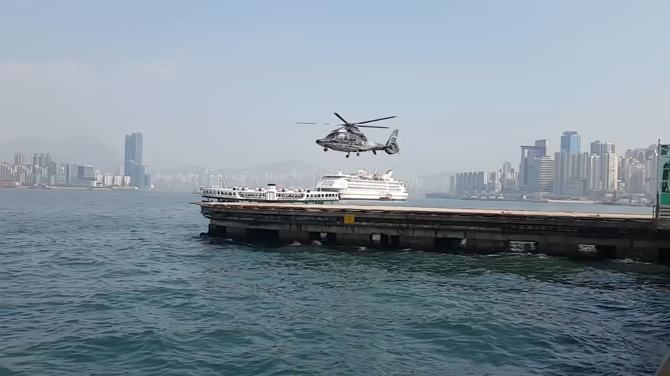
Aliasing

Slide 35
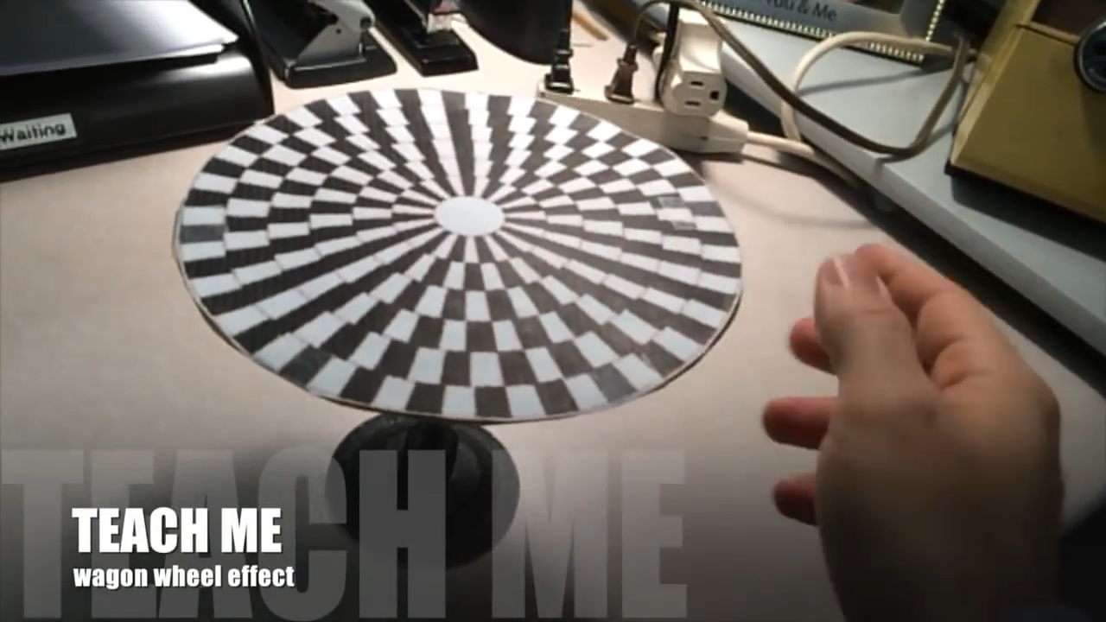
Aliasing in real life
https://www.youtube.com/watch?v=QOwzkND_ooU

Slide 36
How to find a good sample rate?

Slide 37
How to find a good sample rate?
Nyquist sampling theorem:
In order to uniquely represent a signal F(t) by a set of samples, the sampling rate must be more than twice the highest frequency component present in F(t).
If sample rate is f_{s} and maximum frequency we want
record is f_{max} , then
f_{s} > 2f_{max}

Slide 38
Amplitude
Time (sec)
0.00
0.25
0.50
0.75
1.00
1.25
Nyquist frequency = Maximum alias-free frequency for a given sample rate.
Nyquist rate = Lower bound of sample rate for a signal

Slide 39
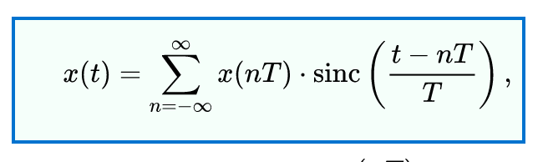

Slide 40
Nyquist
f_{max} = 12 Hz
f_{max} = 6000 Hz
Amplitude
Amplitude
0
4
8
12
16
0
2
4
6
8
Frequency (Hz)
Frequency (kHz)
A 4 kHz frequency band starting at 2 kHz

Slide 41
Commonly, the maximum frequency in human voice is 4 kHz, what sample rate will you use in your audio recorder?

Slide 42
Model for a signal (frequency, amplitude, and phase)
1
$$sin⁡(θ)$$
𝚹
$$cos⁡(θ)$$
How can we incorporate both Sine and Cosine in the equation?

Slide 43

Model for a signal (frequency, amplitude, and phase)
1
$$sin⁡(θ)$$
𝚹
$$cos⁡(θ)$$
1.
$$\cos\left(θ\right)+sin⁡(θ)$$

Slide 44
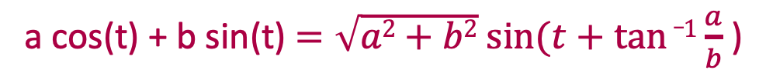
What is the issue with weighted sum?
A sine function with phase shift can be written as a weighted combination of sine and cosine:
a cos(t) + b sin(t) $=\sqrt{a2+b2} sin⁡(t+tan⁡_1\frac{a}{b}$ )

Slide 45

Model for a signal (frequency, amplitude, and phase)
1
$$sin⁡(θ)$$
𝚹
$$cos⁡(θ)$$
1.
$$\cos\left(θ\right)+sin⁡(θ)$$
2.
$$<cos\left(θ\right), \sin\left(θ\right)>$$

Slide 46

Model for a signal (frequency, amplitude, and phase)
1
$$sin⁡(θ)$$
𝚹
$$cos⁡(θ)$$
1.
$$\cos\left(θ\right)+sin⁡(θ)$$
2.
$$<cos\left(θ\right), \sin\left(θ\right)>$$
3.
$$\cos\left(θ\right)+j \sin\left(θ\right)$$

Slide 47
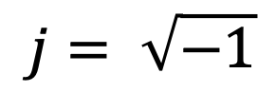
Complex numbers
Imaginary
$$j= \sqrt{−1}$$

Slide 48
Complex numbers

Slide 49
Complex numbers

Slide 50
Complex numbers

Slide 51
Complex numbers and Natural exponential
…

Slide 52
Complex numbers and Natural exponential
…
…

Slide 53
Complex numbers and Natural exponential
…
…
…

Slide 54


Complex numbers and Natural exponential
…
…
…
$$\cos\left(∅\right)$$
$$j sin\left(∅\right)$$

Slide 55
Complex numbers and Natural exponential

Slide 56



Model for a signal (frequency, amplitude, and phase)
$$\cos\left(θ\right)+j \sin\left(θ\right)$$
$$=$$
$$ejθ$$

Slide 57
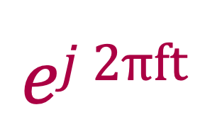

Model for a signal (frequency, amplitude, and phase)
$$ej 2πft$$
$$\cos\left(θ\right)+j \sin\left(θ\right)$$
$$=$$
$$ejθ$$
$$=$$

Slide 58
Model for a signal (frequency, amplitude, and phase)
$$ej 2πft$$
$$\cos\left(θ\right)+j \sin\left(θ\right)$$
$$=$$
$$ejθ$$
$$=$$

Slide 59
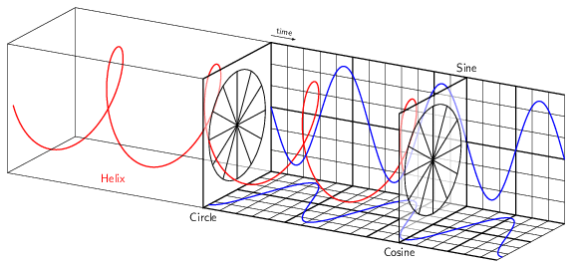

Model for a signal (frequency, amplitude, and phase)
$$ej 2πft$$

Slide 60


Model for a signal (frequency, amplitude, and phase)
$$ej 2πft$$
$$e_j 2πft$$

Slide 61









Model for a signal (frequency, amplitude, and phase)
$$ejθ$$
$$=$$
$$\cos\left(θ\right)+j \sin\left(θ\right)$$
$$e_jθ$$
$$=$$
$$\cos\left(θ\right)− j \sin\left(θ\right)$$
How about real sinusoids?
$$\cos\left(θ\right)$$
$$=$$
$$?$$
$$\sin\left(θ\right)$$
$$=$$
$$?$$

Slide 62








Presenting real signal with the complex model
$$ejθ$$
$$=$$
$$\cos\left(θ\right)+j \sin\left(θ\right)$$
$$e_jθ$$
$$=$$
$$\cos\left(θ\right)− j \sin\left(θ\right)$$
$$ejθ$$
$$+$$
$$e_jθ$$
$$\cos\left(θ\right)$$
$$=$$
2
$$ejθ$$
$$−$$
$$e_jθ$$
$$\sin\left(θ\right)$$
$$=$$
2j

Slide 63
Presenting real signal with the complex model

Slide 64












Presenting real signal with the complex model
$$ej 2πft$$
$$=$$
$$\cos\left(2πft\right)+j \sin\left(2πft\right)$$
$$e_j 2πft$$
$$=$$
$$\cos\left(2πft\right)− j \sin\left(2πft\right)$$
$$ej 2πft$$
$$+$$
$$e_j 2πft$$
$$\cos\left(2πft\right)$$
$$=$$
2
$$ej 2πft$$
$$−$$
$$e_j 2πft$$
$$\sin\left(2πft\right)$$
$$=$$
2j

Slide 65
Time Domain and Frequency Domain
Fourier Transform
FFT
Amplitude
Amplitude
IFFT
0.00
0.25
0.50
0
2
4
6
8
Time
Frequency (Hz)
Time domain
Frequency domain
FFT = Fast Fourier Transform
IFFT = Inverse Fast Fourier Transform

Slide 66
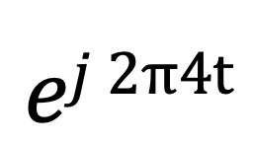
Time Domain and Frequency Domain
Fourier Transform
$$ej 2π4t$$
FFT
Amplitude
0
2
4
6
8
Frequency (Hz)
Time domain
Frequency domain
FFT = Fast Fourier Transform
IFFT = Inverse Fast Fourier Transform

Slide 67

Time Domain and Frequency Domain
Fourier Transform
FFT
?
$$\cos\left(2πft\right)$$
Amplitude
0
2
4
6
8
Frequency (Hz)
Time domain
Frequency domain
FFT = Fast Fourier Transform
IFFT = Inverse Fast Fourier Transform

Slide 68




Time Domain and Frequency Domain
Fourier Transform
FFT
?
$$\cos\left(2πft\right)$$
Amplitude
$$ej 2πft$$
$$+$$
$$e_j 2πft$$
$$=$$
2
0
2
4
6
8
Frequency (Hz)
Time domain
Frequency domain
FFT = Fast Fourier Transform
IFFT = Inverse Fast Fourier Transform

Slide 69
Time Domain and Frequency Domain
Fourier Transform
FFT
$$\cos\left(2πft\right)$$
Amplitude
$$ej 2πft$$
$$+$$
$$e_j 2πft$$
$$=$$
2
-6
-4
-2
0
2
4
6
8
Frequency (Hz)
Time domain
Frequency domain
FFT = Fast Fourier Transform
IFFT = Inverse Fast Fourier Transform

Slide 70

Time Domain and Frequency Domain
Fourier Transform
FFT
$$\cos\left(2π4t\right)$$
Amplitude
$$ej 2πft$$
$$+$$
$$e_j 2πft$$
$$=$$
2
-6
-4
-2
0
2
4
6
8
Frequency (Hz)
Time domain
Frequency domain
FFT = Fast Fourier Transform
IFFT = Inverse Fast Fourier Transform

Slide 71
Matlab demo
function fft_test()
freq = 200;
sampleRate = 1000;
time_ticks = 0:1/sampleRate:1;
realSignal = sin(2*pi*freq*time_ticks);
plot_fft(realSignal, sampleRate);
complexSignal = exp(j*2*pi*freq*time_ticks);
plot_fft(complexSignal, sampleRate);
end

