Slide 1
CSE 562: Mobile Systems & Applications
Quals Course – Systems OR ML/Apps
Shyam Gollakota
Notes:
Chapter 1

Slide 2
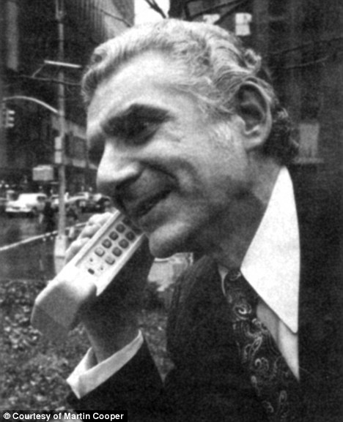
First Mobile Phone 1973

Slide 3
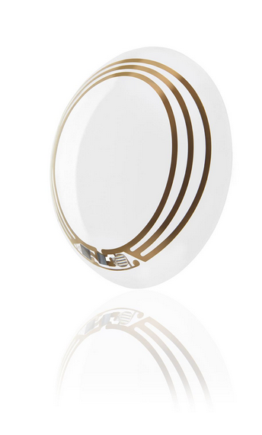
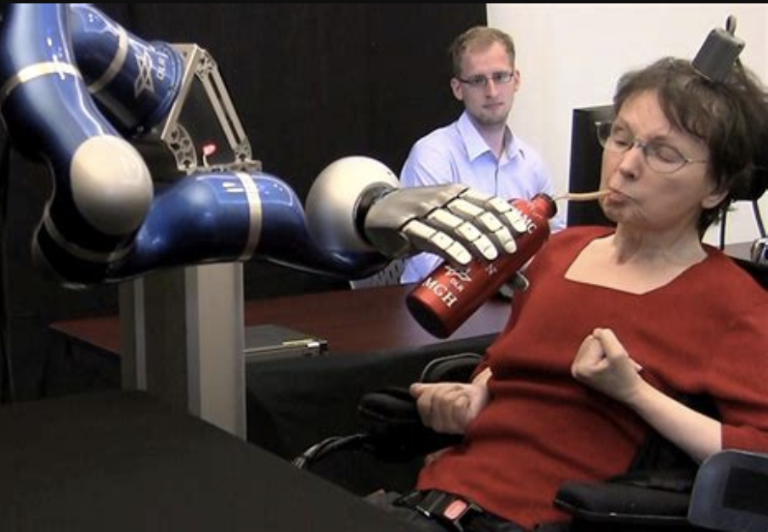

Slide 5
Goal of this course
Have an understanding of state of the art mobile systems research
Explore applications that are capable with mobile devices

Slide 6
Course material
Signal processing fundamentals
Acoustic device and device-free tracking
Physiological sensing using phones and speakers
IMW tracking and GPS localization
Earable computing
Mobile health

Slide 7
Course material
7. ML for acoustic and video mobile processing
8. Mobile ML
9. Mobile security and privacy

Slide 8
Grading
4 hands-on assignments (10+20+25+30% in all)
First one will be on ”hello world” on phone
Requires programming phones
Class presentation of one paper (10%)
Class participation (5%)

Slide 9
Class webpage
https://courses.cs.washington.edu/courses/cse562/22sp/

Slide 10
IMU systems

Slide 11
Doppler and gesture recognition

Slide 12
Doppler and gesture recognition

Slide 13
Doppler and gesture recognition

Slide 14
Doppler and gesture recognition

Slide 15
FMCW and physiological sensing

Slide 16
FMCW and physiological sensing

Slide 17
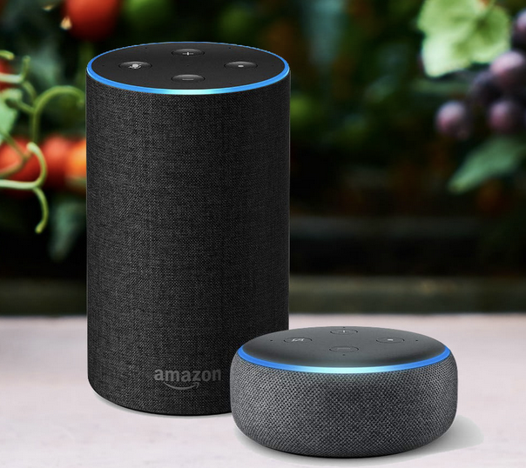
Sensor arrays

Slide 18
ML for source separation

Slide 19
Earable Computing

Slide 20
Mobile Health

Slide 21
Mobile Health

Slide 22
Mobile Health

