Slide 1
Sensor Arrays (slides from Nirupam Roy)

Slide 2
Spatial filtering

Slide 3
Spatial filtering

Slide 4
Spatial filtering

Slide 5
Applications of spatial filtering

Slide 6
Interference of Waves
[Reference] https://www.youtube.com/watch?v=Iuv6hY6zsd0

Slide 7
Superimposition of sinusoids
$$A1 . sin⁡(2πf1t+Θ1)$$
Amplitude
Amplitude
$$A2 . sin⁡(2πf2t+Θ2)$$

Slide 8
Superimposition of sinusoids
$$A1 . sin⁡(2πf1t+Θ1)$$
Amplitude
Amplitude
$$A2 . sin⁡(2πf2t+Θ2)$$
$Received signal= A1 .\sin\left(2πf1t+Θ1\right)$ $+A2 . sin⁡(2πf2t+Θ2)$

Slide 9
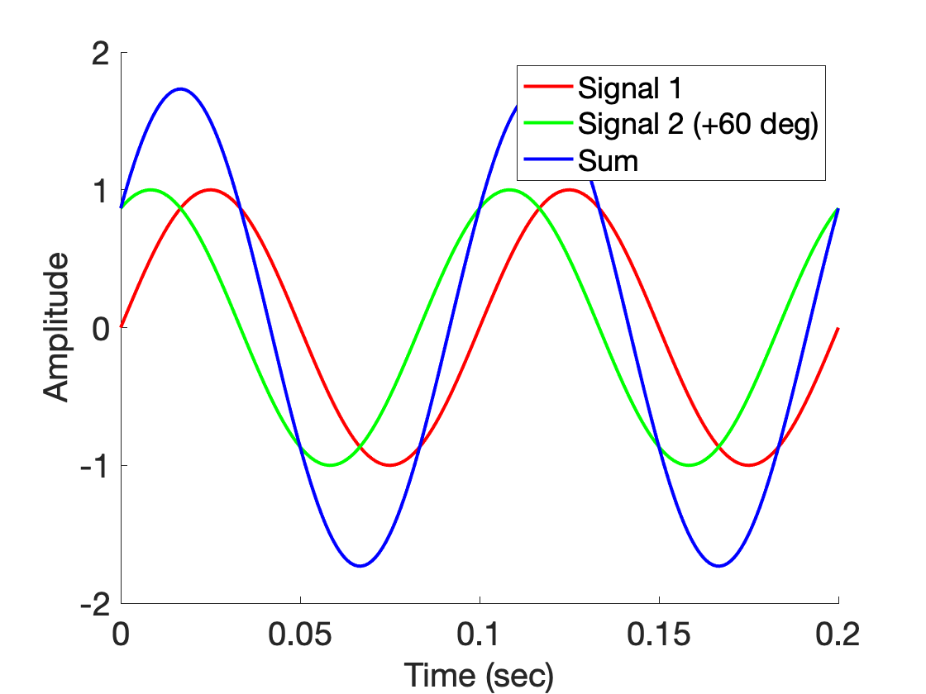
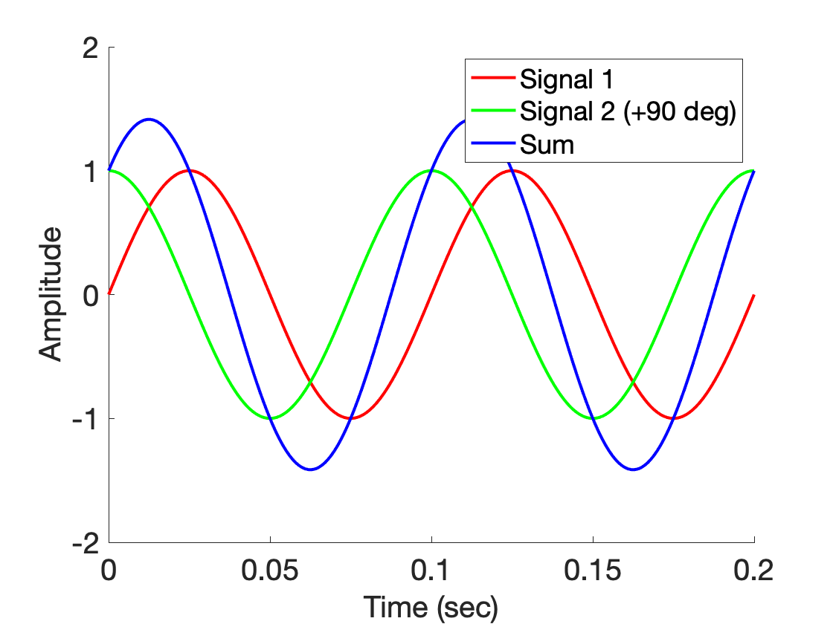
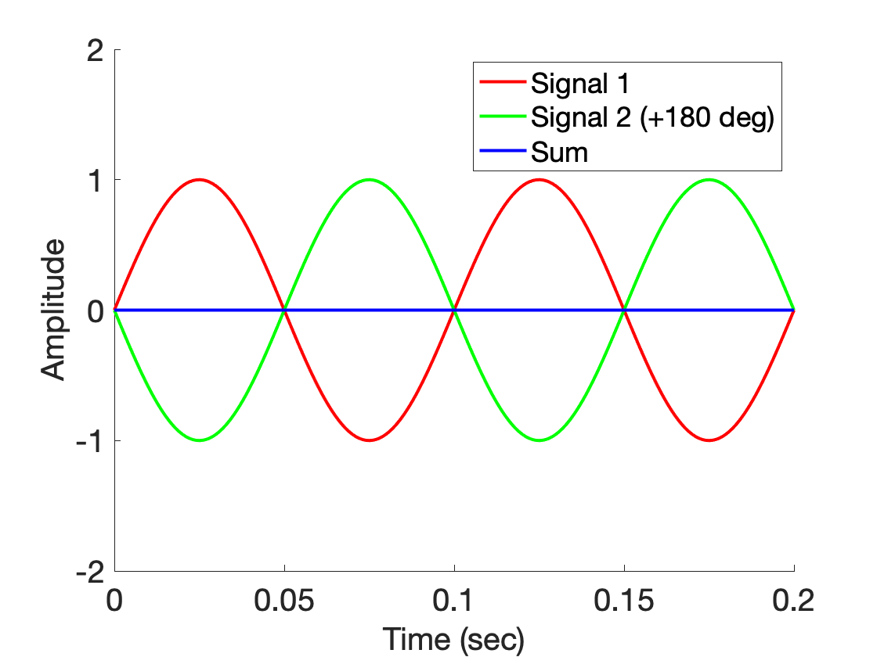
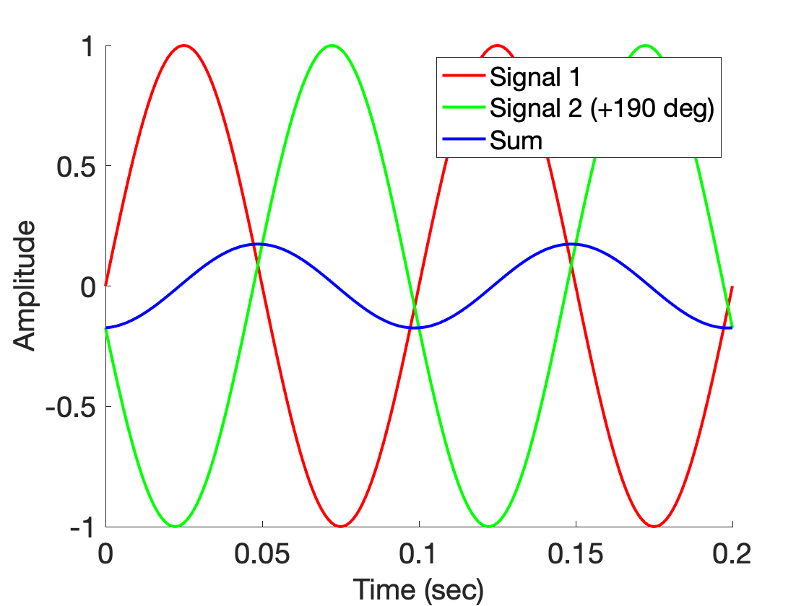
Superimposition of sinusoids

Slide 10
Superimposition of sinusoids
$$sin⁡(2πft)$$

Slide 11
Superimposition of sinusoids
$$sin⁡(2πft)$$
$$d$$
$$sin⁡(2πft+2πd/λ)$$

Slide 12
Superimposition of sinusoids
Signal amplified
(perfect constructive interference)
$$sin⁡(2πft)$$
$$d=λ/2$$
$$\sin\left(2πft+\frac{2πd}{λ}\right)$$
= $\sin\left(2πft+π\right)$
= $− sin\left(2πft\right)$
Signal nullified
Signal nullified

Slide 13
Superimposition of sinusoids: Gain
Power gain due to the array structure
Distance from the center of the array
$$−λ/4$$
$$0$$
$$λ/4$$
$$d=λ/2$$
Constant phase difference of $\frac{2πd}{λ}$

Slide 14
Superimposition of sinusoids: Gain
Beamforming in 1D space
Power gain due to the array structure
Distance from the center of the array
Controlling spatial signal gain using multiple signal sources or receivers.
$$−λ/4$$
$$0$$
$$λ/4$$
The gain depends on distance between the elements and signal wavelength.
$$d=λ/2$$
Constant phase difference of $\frac{2πd}{λ}$

Slide 15
Beamforming in 2D space

Slide 16
Beamforming in 2D space
$$d$$

Slide 17
Beamforming in 2D space
$$φ$$
$$d$$

Slide 18
Beamforming in 2D space
Phase difference between these two paths
$$φ$$
$$d$$

Slide 19
Beamforming in 2D space
Approximation for ‘far field’
$$φ$$
$$?$$
$$d$$

Slide 20
Beamforming in 2D space
Approximation for ‘far field’
$$φ$$
$d sin$($φ$)
$$?$$
$$φ$$
$$d$$

Slide 21
Beamforming in 2D space
Approximation for ‘far field’
$$φ$$
Along this line
$d sin$($φ$)
$$φ$$
$$d$$
Combined signal = $\sin\left(2πft\right) + \sin\left(2πft+ \frac{2π d sin (φ)}{λ}\right)$
= $e^{j\left(2πft\right)}{ }+e^{j\left(2πft+ \frac{2π d sin(φ)}{λ}\right)}{ }$

Slide 22
Beamforming in 2D space
Approximation for ‘far field’
Parameters: d, $φ$, $λ$ (or f)
Does the gain depend on the distance from the array?
$$φ$$
Along this line
$d sin$($φ$)
$$φ$$
$$d$$
Combined signal = $\sin\left(2πft\right) + \sin\left(2πft+ \frac{2π d sin (φ)}{λ}\right)$
= $e^{j\left(2πft\right)}{ }+e^{j\left(2πft+ \frac{2π d sin(φ)}{λ}\right)}{ }$

Slide 23
Beamforming in 2D space
$$φ$$
$$d$$

Slide 24
Beamforming in 2D space
$$φ$$
$$d$$
+
Combined signal
= $e^{j\left(2πft\right)}{ }+e^{j\left(2πft + \frac{2π d sin(φ)}{λ}\right)}{ }$

Slide 25
Beamforming in 2D space
Directional gain of an array

Slide 26
Beamforming in 2D space

Slide 27
Uniform Linear Array (ULA)

Slide 28
Beamforming in 2D space
$d sin$($φ$)
$$E1$$
$$E2$$
$$E3$$
$$E4$$
…
N elements
$$d$$
$$d$$
$$d$$
Interelement distance = d

Slide 29
Beamforming in 2D space
$3d sin$($φ$)
$2d sin$($φ$)
$d sin$($φ$)
$$E1$$
$$E2$$
$$E3$$
$$E4$$
…
N elements
$$d$$
$$d$$
$$d$$
Interelement distance = d

Slide 30
Beamforming in 2D space
$3d sin$($φ$)
$2d sin$($φ$)
$d sin$($φ$)
$$E1$$
$$E2$$
$$E3$$
$$E4$$
…
N elements
$$d$$
$$d$$
$$d$$
Path difference with n^{th} element:
$\left(n−1\right)d sin$($φ$)
Phase difference with n^{th} element:
$\left(n−1\right)d sin$($φ$) 2Π/λ

Slide 31
$3d cos$($φ$)
$2d sin$($φ$)
Beamforming in 2D space
$d sin$($φ$)
$$φ$$
$$E1$$
$$E2$$
$$E3$$
$$E4$$
…
N elements
$$d$$
$$d$$
$$d$$
Path difference with n^{th} element:
$\left(n−1\right)d sin$($φ$)
Phase difference with n^{th} element:
$\left(n−1\right)d sin$($φ$) 2Π/λ
Original signal:
$e^{j\left(2πft\right)}{ }$
Combined signal:

Slide 32
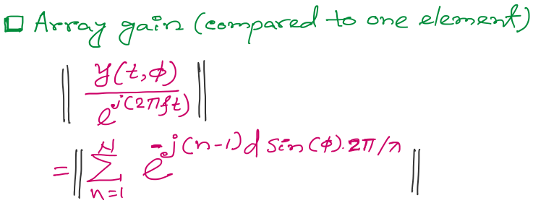
Beamforming in 2D space
Notes:
http://www.waves.utoronto.ca/prof/svhum/ece422/notes/15-arrays2.pdf

Slide 33
Beamforming in 2D space
Notes:
http://www.waves.utoronto.ca/prof/svhum/ece422/notes/15-arrays2.pdf

Slide 34
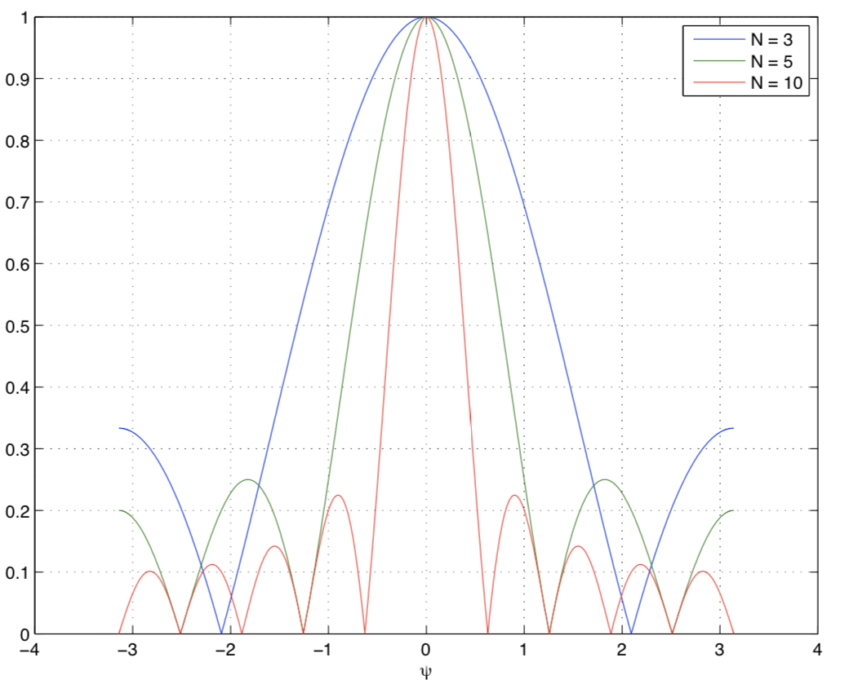
Beamforming in 2D space
Gain
-90 -60 -30 0 30 60 90
Angle
Notes:
http://www.waves.utoronto.ca/prof/svhum/ece422/notes/15-arrays2.pdf

Slide 35
Beamforming in 2D space
Notes:
http://www.waves.utoronto.ca/prof/svhum/ece422/notes/15-arrays2.pdf

Slide 36
Beam-steering
Delay-sum beamformer or Phased array
Notes:
http://www.waves.utoronto.ca/prof/svhum/ece422/notes/15-arrays2.pdf

Slide 37
Beam-steering
Delay-sum beamformer or Phased array
Add additional phase:
-$\left(n−1\right)d sin$(𝚹_{s}) 2Π/λ
Notes:
http://www.waves.utoronto.ca/prof/svhum/ece422/notes/15-arrays2.pdf

Slide 38
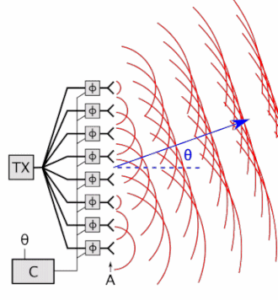
Beam-steering
Delay-sum beamformer or Phased array
Notes:
http://www.waves.utoronto.ca/prof/svhum/ece422/notes/15-arrays2.pdf

Slide 39
Angle-of-Arrival (AoA)

Slide 40
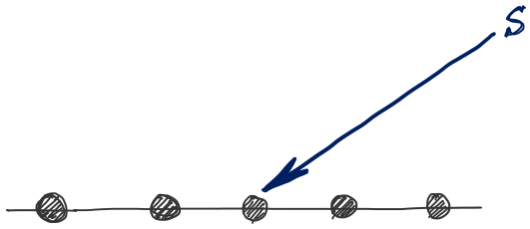
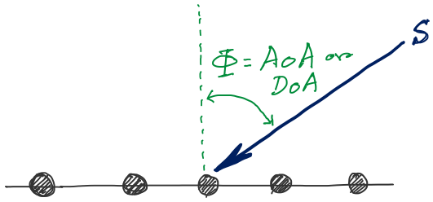
DoA Estimation
d
d
d
d
Notes:
http://www.waves.utoronto.ca/prof/svhum/ece422/notes/15-arrays2.pdf

Slide 41
AoA Estimation
$3d sin$($φ$)
$2d sin$($φ$)
$d sin$($φ$)
$$E1$$
$$E2$$
$$E3$$
$$E4$$
…
N elements
$$d$$
$$d$$
$$d$$
Interelement distance = d

Slide 42
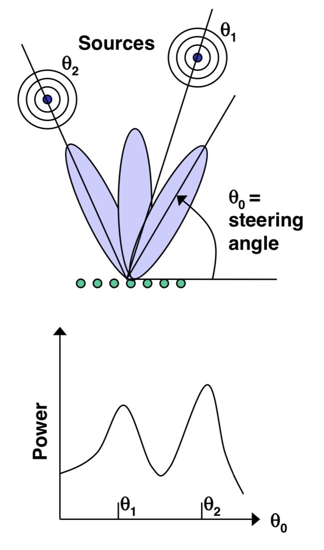
AoA Estimation: Beam-scanning

Slide 43
AoA Estimation
Notes:
http://www.waves.utoronto.ca/prof/svhum/ece422/notes/15-arrays2.pdf

Slide 44
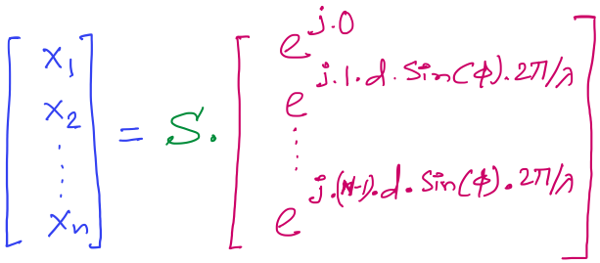
AoA Estimation
Received signals in all elements:
Steering vector
Notes:
http://www.waves.utoronto.ca/prof/svhum/ece422/notes/15-arrays2.pdf

Slide 45
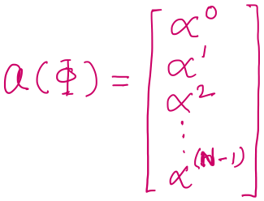
AoA Estimation
Received signals in all elements:
Notes:
http://www.waves.utoronto.ca/prof/svhum/ece422/notes/15-arrays2.pdf

Slide 46
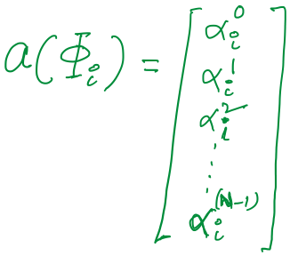
AoA Estimation

Slide 47
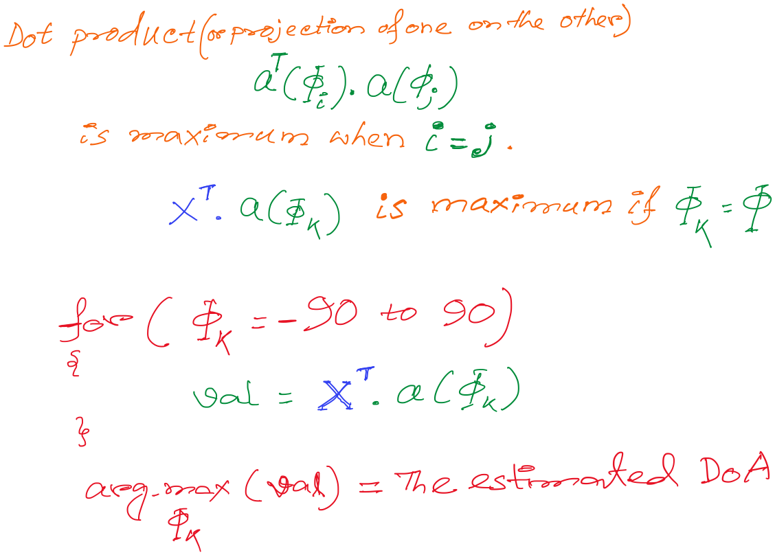
AoA Estimation

Slide 48
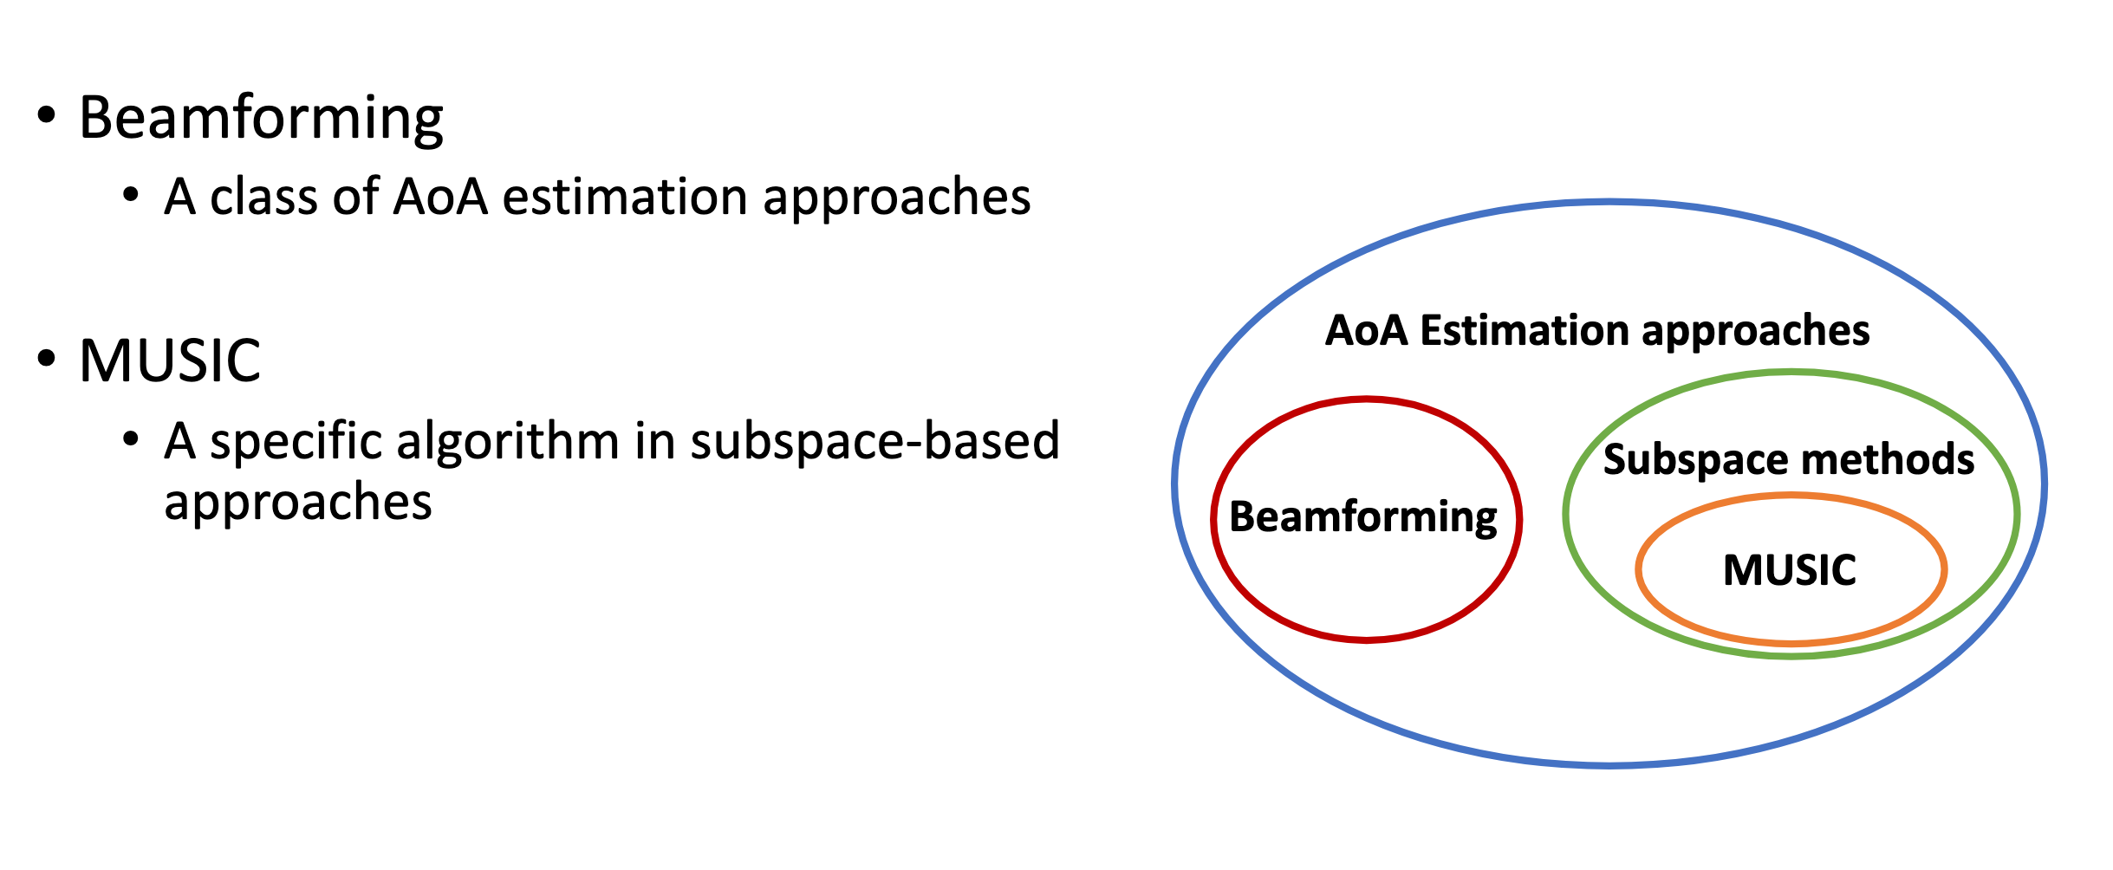
Slides from Wenguang Mao

Slide 49
Approaches
Beamforming
Bartlett method
MVDR
Linear prediction
Subspace based approaches
Music and its variants
ESPIRIT

Slide 50
Approaches

Slide 54
Bartlett beamforming

Slide 55
Can we leverage the properties of the transmitted signal, to perform better?

Slide 56
Can we leverage the properties of the transmitted signal, to perform better?

Slide 57
Can we leverage the properties of the transmitted signal, to perform better?

Slide 58
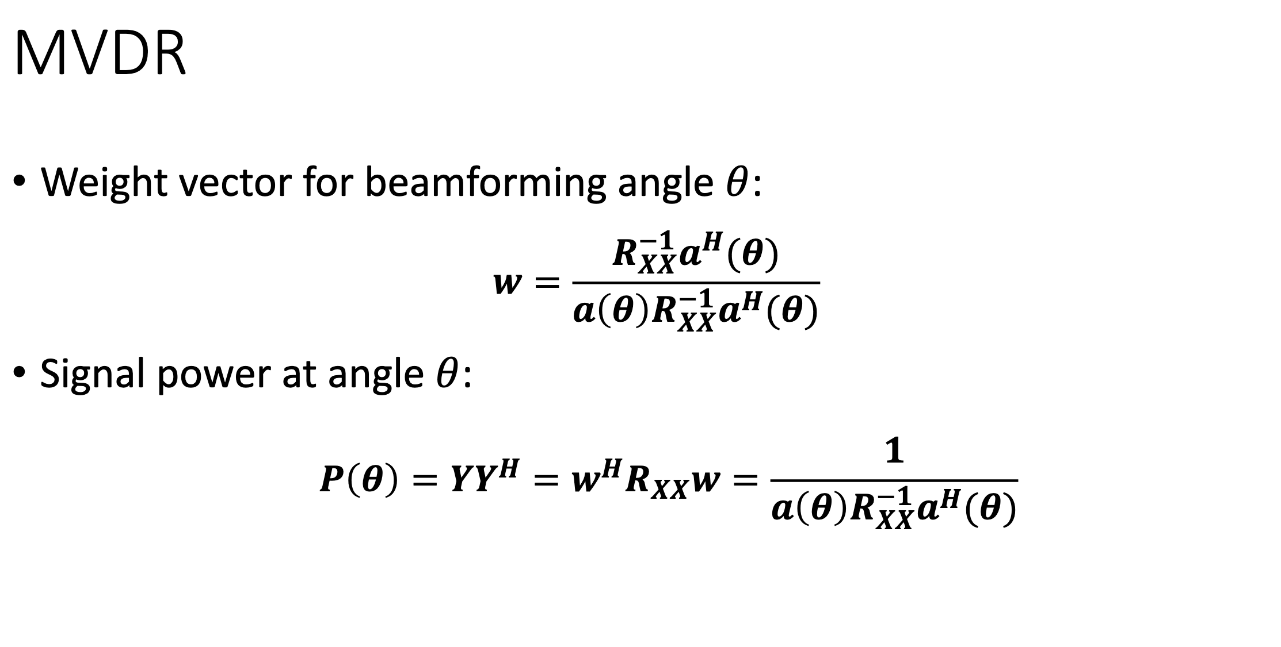
Can we leverage the properties of the transmitted signal, to perform better?

Slide 62
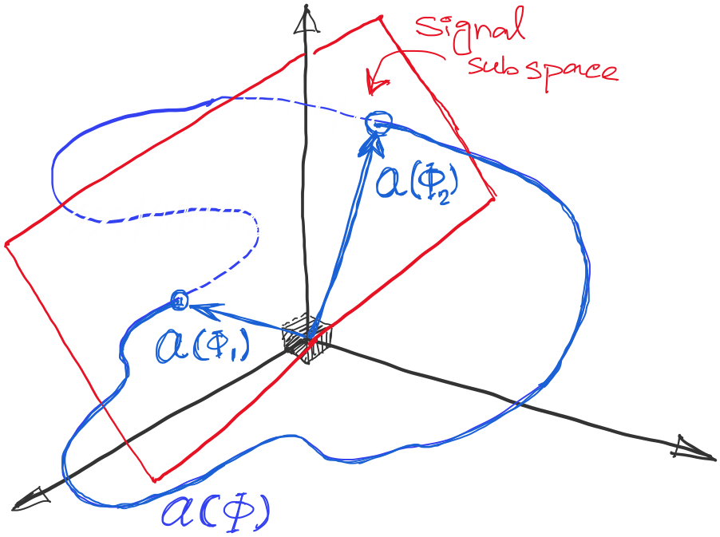
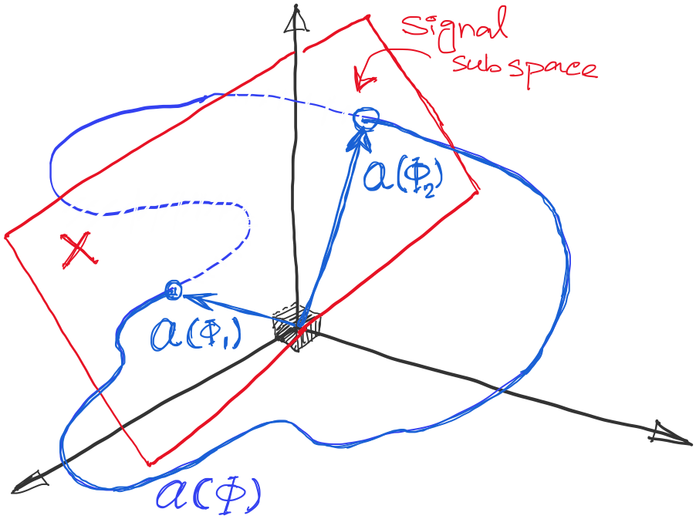
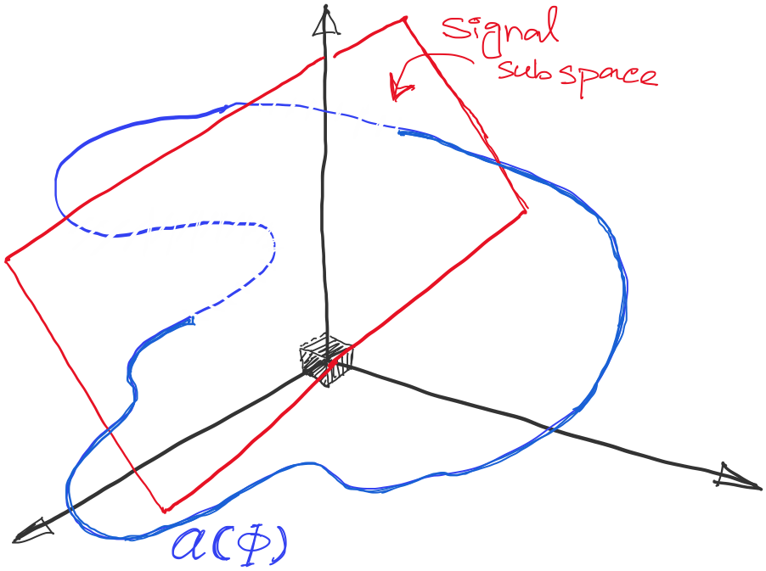
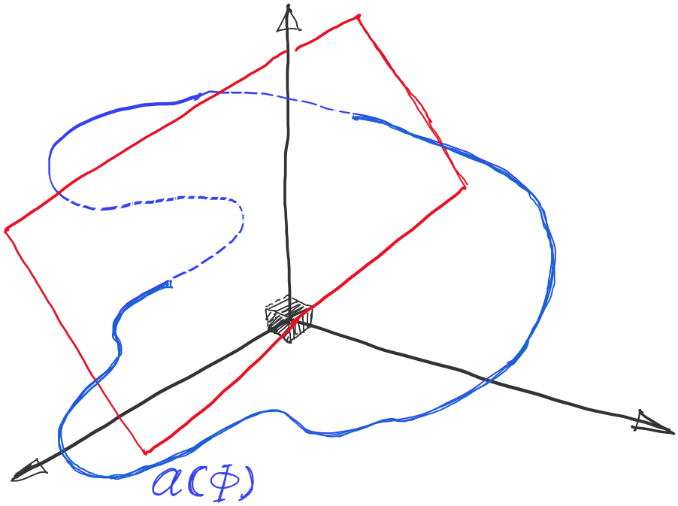
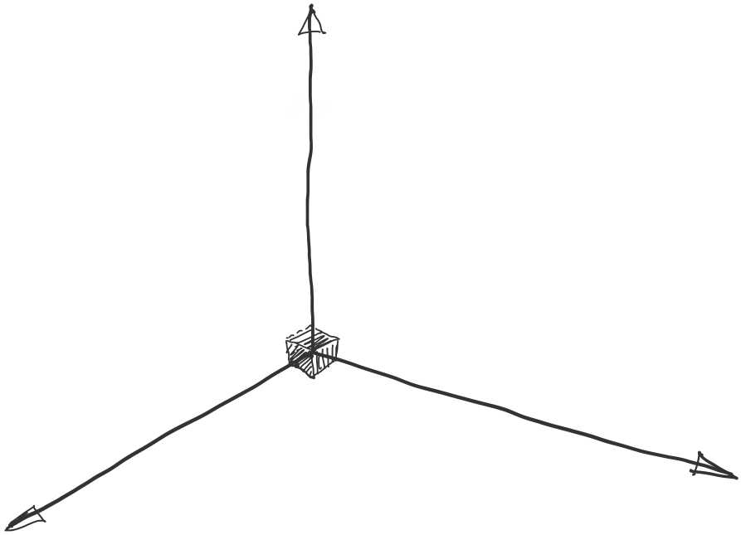
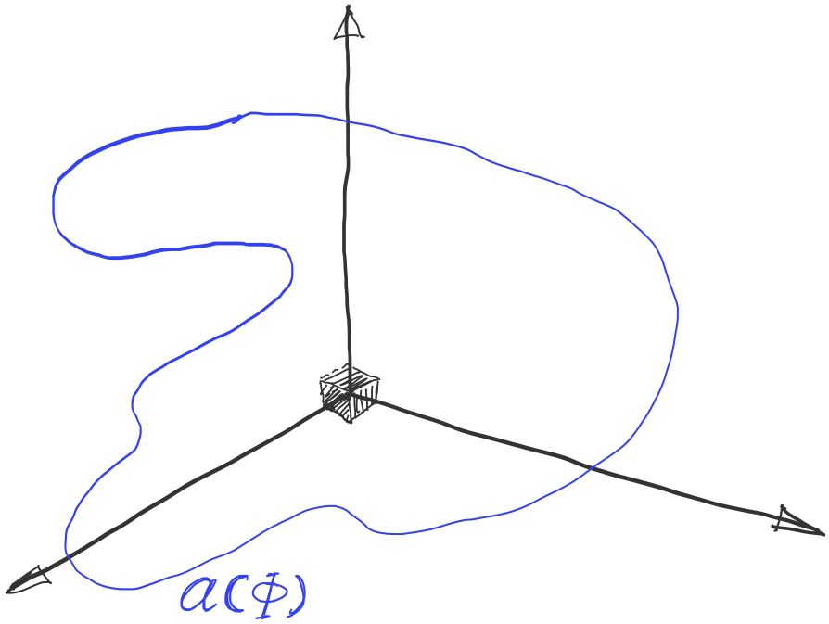
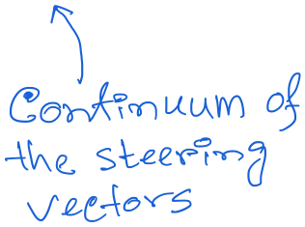
DoA Estimation: MUSIC Algorithm

Slide 63
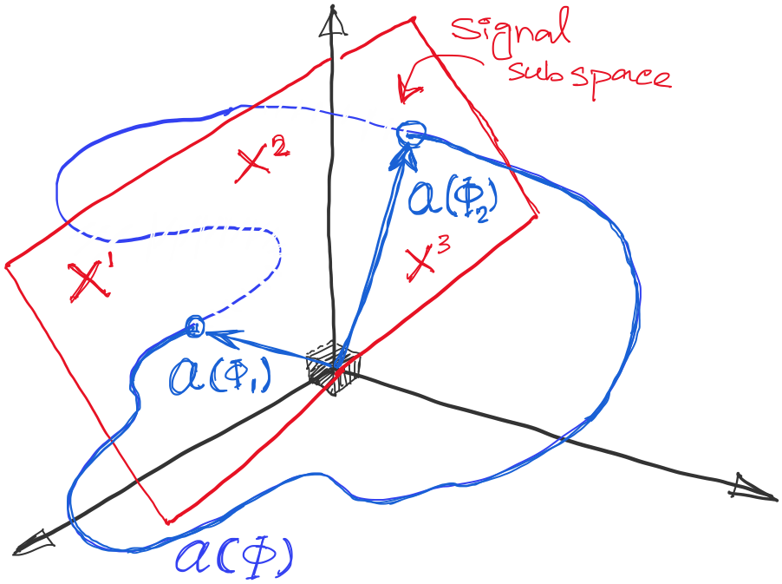
DoA Estimation: MUSIC Algorithm

Slide 64
DoA Estimation: MUSIC Algorithm
Mx1
Steering matrix

Slide 65
DoA Estimation: MUSIC Algorithm

Slide 66
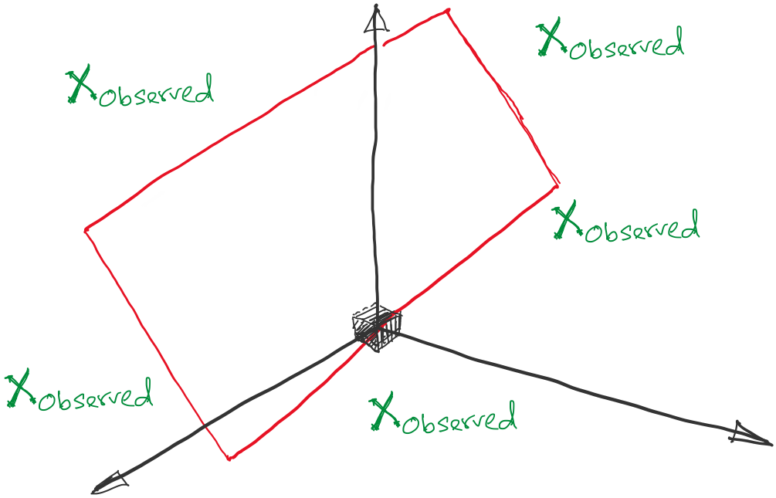
DoA Estimation: MUSIC Algorithm

Slide 67
DoA Estimation: MUSIC Algorithm

Slide 68
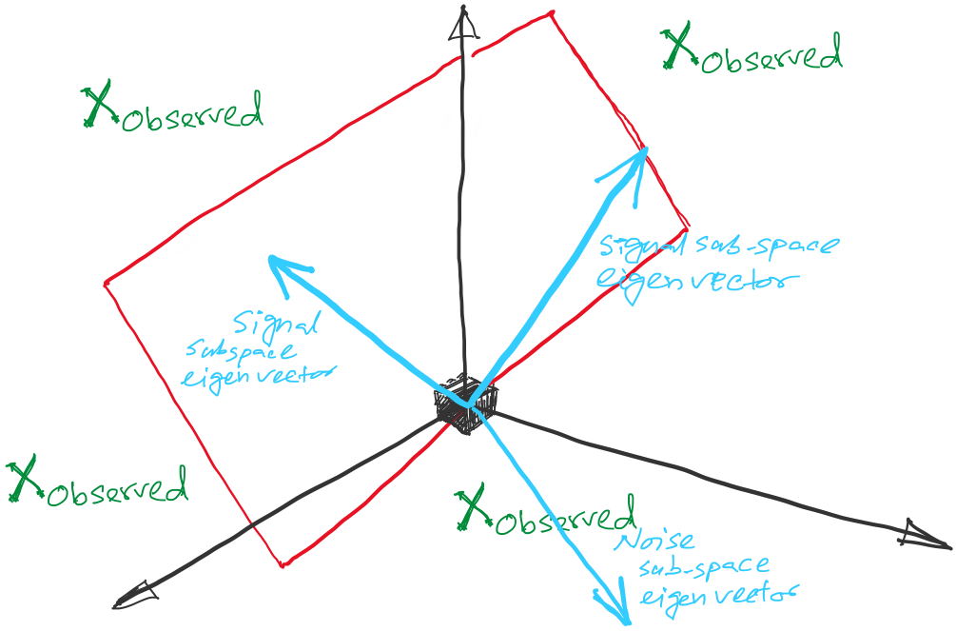
DoA Estimation: MUSIC Algorithm

Slide 69
DoA Estimation: MUSIC Algorithm

Slide 70
DoA Estimation: MUSIC Algorithm

Slide 71
DoA Estimation: MUSIC Algorithm

Slide 72
DoA Estimation: MUSIC Algorithm

Slide 74
