Slide 1
Topology Design
CSE 561, Winter 2021
Radhika Niranjan Mysore

Slide 2

What we read
How data center topology design can impact lifecycle cost
Deploy
Operate
Expand
Time to bring up network
Ordering components, cabling
O(types), O(connections)
Cost of the network
O(components)
Time spent on management tasks
Planned: configuring, control
O(failure domains), O(controllers), O(heterogeneity), O(corner cases)
Unplanned: debugging
O(1/visibility)
Time to bring up new network
Ordering, cabling
O(types), O(connections)
Duration of degraded capacity
O(1/redundant capacity)
Cost of new network
O(components)
Notes:
Write down polynomial time complexity

Slide 3
What we didn’t read (my hypothesis)
How data center topology design can impact lifecycle cost
Upgrade
Operate
Decommission
Time to bring up network
Ordering components, cabling
O(types), O(connections)
Duration of degraded capacity
O(size of network upgraded)
Cost of upgraded network
O(components)
Time spent on management tasks
Planned: configuring, control
O(failure domains), O(controllers), O(heterogeneity), O(corner cases)
Unplanned: debugging
O(1/visibility)
Time to tear down network
Cabling
O(connections)
Duration of degraded capacity
O(1/redundant capacity)

Slide 4
What we didn’t read (my hypothesis)
How data center topology design can impact lifecycle cost
Upgrade
Operate
Decommision
Time to bring up network
Ordering components, cabling
O(types), O(connections)
Duration of degraded capacity
O(size of network upgraded)
Cost of upgraded network
O(components)
Time spent on management tasks
Planned: configuring, control
O(failure domains), O(controllers), O(heterogeneity), O(corner cases)
Unplanned: debugging
O(1/visibility)
Time to tear down network
Cabling
O(connections)
Duration of degraded capacity
O(1/redundant capacity)

Slide 5
This talk
Design of data center network topologies
*Topology: L1-L3 structure and components
Inputs
What parameters do you usually start with?
Trade-off considerations
What choices do you have to make?
Outputs
What kinds of network designs emerge?
Design constructs
What are certain recurring abstractions of network design?

Slide 6
This talk
Design of data center network topologies
*Topology: L1-L3 structure and components
Inputs
What parameters do you usually start with?
Trade-off considerations
What choices do you have to make?
Connecting DCs to campus/WAN (Iris SIGCOMM 2020)
Reacting to failures
Moving to optical cores (Sirius SIGCOMM 2020)
Outputs
What kinds of network designs emerge?
Design constructs
What are certain recurring abstractions of network design?

Slide 7
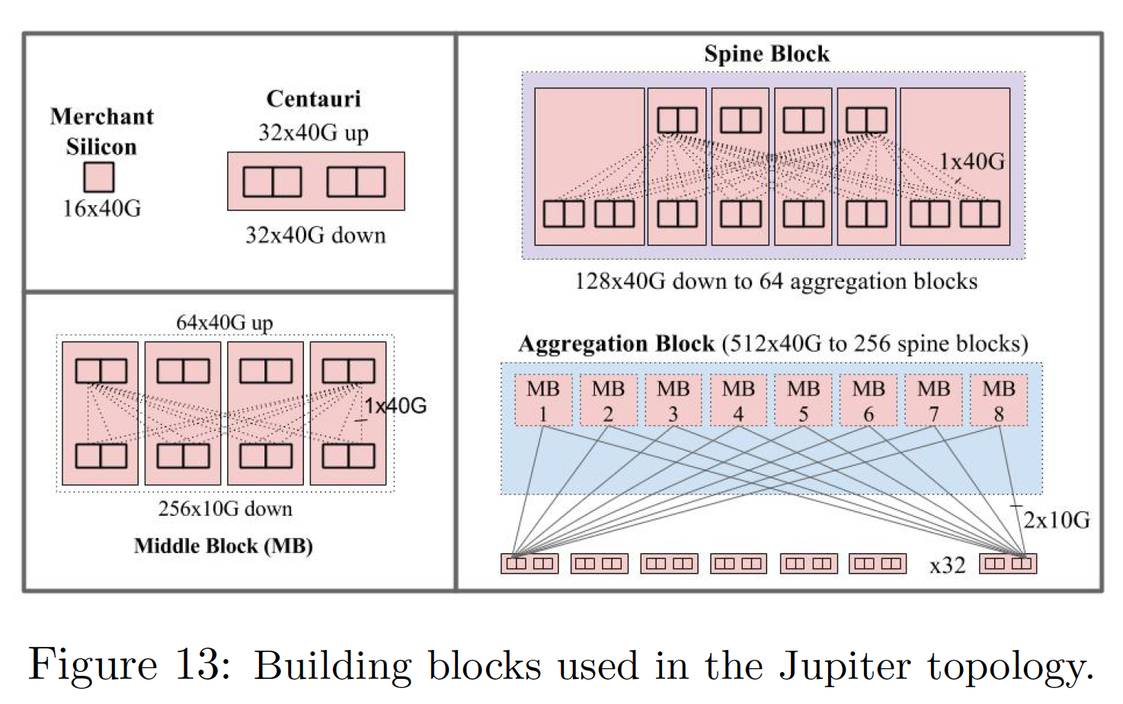
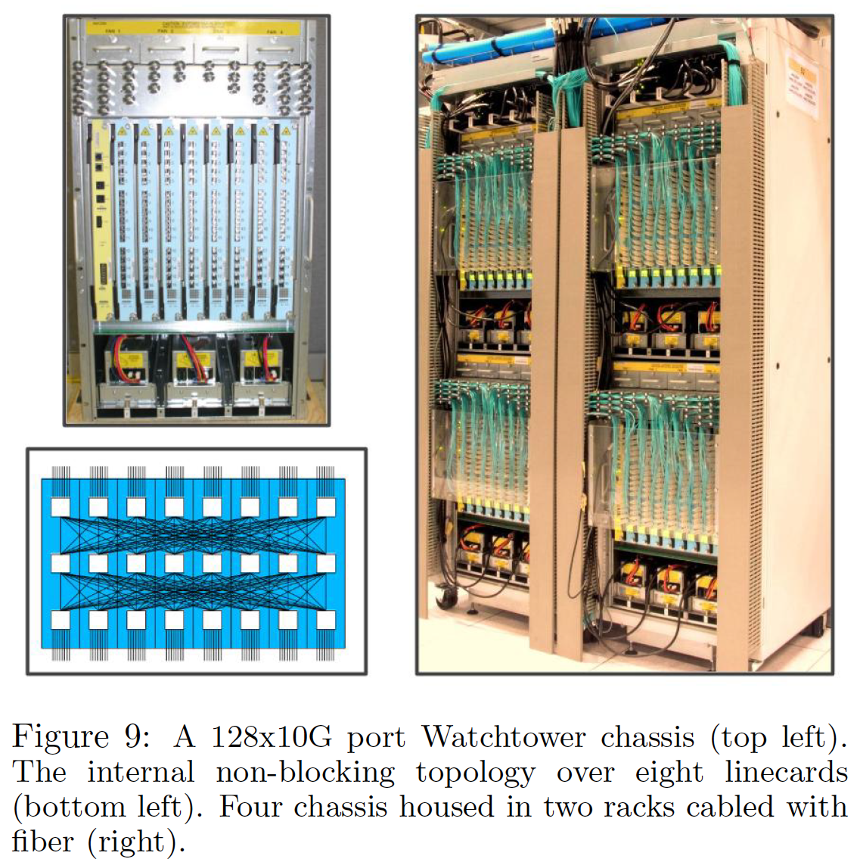
Topology design constructs in the paper
Wiring
Expansion
Deployment
Chassis backplane
Cable bundles (regularity)
Fat Edge
Building blocks (modularity)
Northbound links
Switches
Southbound links
Servers
Figure 9 and 13 from Jupiter Rising: A Decade of Clos Topologies and Centralized Control in Google’s Datacenter Network, SIGCOMM 2015

Slide 8
This talk
WCMP: Weighted Cost Multipathing for Improved Fairness in Data Centers, Eurosys 2014
Jupiter Rising: A Decade of Clos Topologies and Centralized Control in Google’s Datacenter Network, SIGCOMM 2015
Experience with B4: Google's Private SDN Backbone, Subhasree Mandal, Usenix ATC 2015
Pluggable DWDM: Considerations For Campus and Metro DCI Applications, ECOC 2016
Sirius: A Flat Datacenter Network with Nanosecond Optical Switching, SIGCOMM 2020
Beyond the mega-data center: networking multi-data center regions, SIGCOMM 2020
Condor: Better Topologies Through Declarative Design, SIGCOMM 2015
Understanding Lifecycle Management Complexity of Datacenter Topologies, NSDI 2019

Slide 9
Problem: Designing (data center) networks
How do you connect compute, memory, storage so that it …
.. fits power budgets (including cooling)
.. fits space constraints
.. leverages current and emerging network hardware
.. supports current and future application traffic
.. is resilient to failures
.. is cheap to build (deploy, upgrade, expand, decommission)
.. is cheap to operate

Slide 10
Problem: Designing (data center) networks with CSE 561
How do you connect compute, memory, storage so that it …
.. fits power budgets (including cooling)
.. fits space constraints
.. leverages current and emerging hardware
Congestion control (buffers, table sizes, switching elements)
.. supports current and future application traffic
Application placement, routing, traffic (topology) engineering
.. is resilient to failures
Routing, traffic (topology) engineering
.. is cheap to build (deploy, upgrade, expand, decommission)
Reading for this talk
.. is cheap to operate
SDN control, BGP, MPLS, ECMP, WCMP, L2, monitoring and diagnosis, modularity and function decoupling (Jupiter SIGCOMM 2015, B4 ATC 2015), configuration (DAC 2010), out-of-band network management …
Input

Slide 11
Data center design inputs (rough)
Inputs | Determined by | Example
Server or compute count (scale) | Space and power constraints | 500-4000 servers
Rack space specification | Space and power constraints | 52U rack
Candidate hardware (switches, cable, patch panels/OCS) | Existing hardware, scale, budget/vendor partnership considerations | 32 port 100G switches
Oversubscription ratio | Application requirements (projected), end-host hardware | 3:1
Internal connectivity requirements | Application requirements (projected) | Full bisection bandwidth within DC
External connectivity requirements | Application requirements (projected) | 20-30% Egress bandwidth to Campus, WAN network
Initial server deployment count | Application requirements (current vs. projected) | ~500

Slide 12
Connectivity
Network building blocks
For each block
Decide the number of layers or desired port count out of the block
More layers ➔ more scale
Split switch ports into downlinks and uplinks
Server links, WAN links
WAN link placement (Jupiter SIGCOMM 2015)
Identify which switches WAN controller must talk to
Explore trade-offs
More switches ➔ More updates, controller bugs impact all switches (blast radius)
More switches ➔ More resilient to switch failures
Bouncing WAN traffic across spines allows opportunities for loadbalancing

Slide 13
Connecting the data center in blocks
1
3
Spine
..4..
4x32 downlinks
2x32 downlinks
2x32 downlinks
Spine
..16..
Spine
ToR
..16..
16x8 uplinks
..4..
..4..
4x16 downlinks
4x16 downlinks
20x2 servers, 4 WAN links per ToR
Even more space
Much larger applications
Much more resilience
~30% WAN bandwidth
~640 servers in one block
More space
Larger applications
More resilience
Equivalent (~20%) WAN bandwidth
4x16 uplinks
4x16 uplinks
2
Aggregation
Aggregation
..4..
4x16 downlinks
..4..
4x16 downlinks
..16..
Spine
.. 8..
8x32 downlinks
ToR
..32..
32x16 uplinks
8x8 uplinks
8x8 uplinks
ToR
..8..
ToR
..8..
24x2 servers (blue ToR x 26), 6 WAN ToRs
24x2 servers
To Campus/WAN
~1040 servers in one block
~320 servers in one block
4 Campus/WAN blocks
~3840 servers in one block

Slide 14
Connecting the data center in blocks
1
Spine
..4..
Small power/space footprint (mini DC)
Suitable for colos, edge
*Small application footprint
~20% WAN bandwidth out of each ToR
Limited WAN burst bandwidth, but more resilient to ToR failures
Changes to WAN fabric connectivity will be reflected in the ToR switches (blast radius)
4x32 downlinks
ToR
..16..
16x8 uplinks
20x2 servers, 4 WAN links per ToR
~640 servers in one block

Slide 15
Connecting the data center in blocks
1
Spine
..4..
Small power/space footprint (mini DC)
Suitable for colos, edge.
*Small application footprint
~20% WAN bandwidth from reserved ToRs
WAN traffic bounces off spines ➔ flexible burst bandwidth
Changes to WAN fabric connectivity will be reflected in the WAN ToRs *and* spines (blast radius)
4x32 downlinks
ToR
..16..
16x8 uplinks
20x2 servers, 4 WAN links per ToR
~640 servers in one block
More space
Larger applications
More resilience
2
Spine
.. 8..
8x32 downlinks
ToR
..32..
32x16 uplinks
24x2 servers (blue ToR x 26), 6 WAN ToRs
~1040 servers in one block

Slide 16
Connecting the data center in blocks
3
Large power/space footprint
Large application footprint
~30% egress bandwidth out of Campus/ WAN blocks
WAN traffic routed to WAN blocks ➔ flexible burst bandwidth
Changes to WAN fabric connectivity will be reflected in WAN blocks (blast radius)
Spine
2x32 downlinks
..16..
Spine
2x32 downlinks
..4..
..4..
4x16 downlinks
4x16 downlinks
4x16 uplinks
4x16 uplinks
Aggregation
Aggregation
..4..
4x16 downlinks
..4..
4x16 downlinks
..16..
ToR
..8..
8x8 uplinks
ToR
..8..
8x8 uplinks
24x2 servers
To Campus/WAN
~320 servers in one block
4 Campus/WAN blocks
~3840 servers in one block

Slide 17
Design construct: Wan connectivity design
Keep WAN blocks separate (blast radius)
Bugs in WAN controllers do not impact intra-data center traffic
Design full bisection bandwidth to WAN blocks to absorb bursts
Spine
2x32 downlinks
..16..
Spine
2x32 downlinks
..4..
..4..
4x16 downlinks
4x16 downlinks
4x16 uplinks
4x16 uplinks
Aggregation
Aggregation
..4..
4x16 downlinks
..16..
..4..
4x16 downlinks
ToR
..8..
8x8 uplinks
ToR
..8..
24x2 servers
To Campus/WAN
~320 servers in one block
4 Campus/WAN blocks
~3840 servers in one block

Slide 18
Connecting the data center in blocks
4
Replace spines by direct optical links
Reduced bisection bandwidth but reduced cost
WCMP, non-shortest path routing to utilize links effectively
Spine
2x32 downlinks
..4..
Spine
2x32 downlinks
..4..
..4..
4x16 downlinks
4x16 downlinks
4x16 uplinks
4x16 uplinks
4x16 uplinks
Aggregation
Aggregation
Aggregation
..4..
4x16 downlinks
..4..
4x16 downlinks
..4..
4x16 downlinks
..16..
ToR
..8..
ToR
..8..
8x8 uplinks
ToR
..8..
8x8 uplinks
24x2 servers
24x2 servers
To Campus/WAN
~320 servers in one block
~320 servers in one block
4 Campus/WAN blocks
~3840 servers in one block

Slide 19
Resilience
1
Spine
.. 8..
Identify switches impacted by failure (blast radius)
Identify how controller will handle the failure
How many updates are required to change the routing tables?
How much space will the new routing table occupy?
ToR
..32..
Link failure
2
Spine
.. 8..
ToR
..32..
Spine switch failure
3
Spine
.. 8..
ToR
..32..
WAN link failure

Slide 20
Resilience: blast radius
1
Spine
.. 8..
Identify switches impacted by failure (blast radius)
Identify how controller will handle the failure
How many updates are required to change the routing tables?
How much space will the new routing table occupy?
ToR
..32..
Link failure
2
Spine
.. 8..
ToR
..32..
Spine switch failure
3
Spine
.. 8..
ToR
..32..
WAN link failure

Slide 21
Resilience: control decision
1
Spine
.. 8..
Use WCMP to avoid drops at spine
Blacklist spine (trade-off redundancy for table updates)
ToR
..32..
Link failure
2
Spine
.. 8..
Avoid spine
ToR
..32..
Spine switch failure
3
Spine
.. 8..
Readjust reachable prefixes in every spine
Use supertrunks to avoid prefix explosion (B4, ATC 2015)
Use WCMP to readjust load to supertrunk
ToR
..32..
WAN link failure

Slide 22
Design construct: Supertrunks
.. 8..
Multiple links between switches combined into a “trunk” with single prefix (trade-off WAN increment granularity for table space)
Single link failure masked by trunk
Prefix is still reachable but with reduced capacity
..32..
WAN router

Slide 23
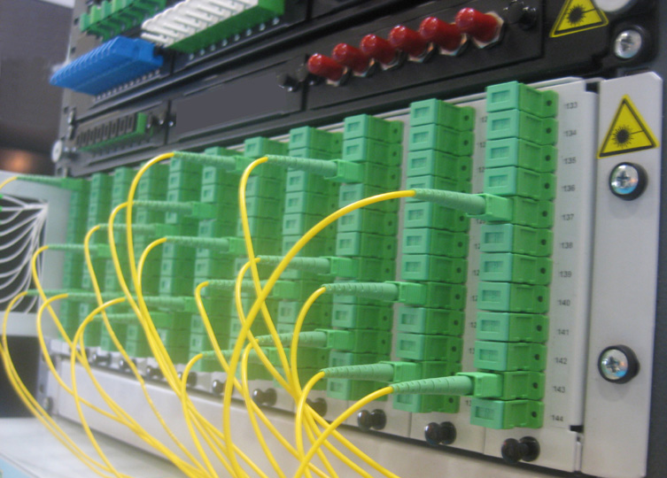
Using optical cores for connectivity
To connect mini data centers within a region (120km radius)
Beyond the mega-data center: networking multi-data center regions, SIGCOMM 2020
Within the datacenter
Sirius: A Flat Datacenter Network with Nanosecond Optical Switching, SIGCOMM 2020
*Thoughts are my own, contact authors for clarifications
Trade-off ease of connectivity/routing for reduced power, lower latency
Optical switches require establishing n² connections
A 128 port optical switch can connect 64 server pairs at a time. In contrast a 128 port electrical switch can connect all 128 servers to each other (16256 server pairs)
http://www.fiber-optical-networking.com/how-to-arrange-the-fiber-cables-in-the-fibre-optic-patch-panel.html

Slide 24
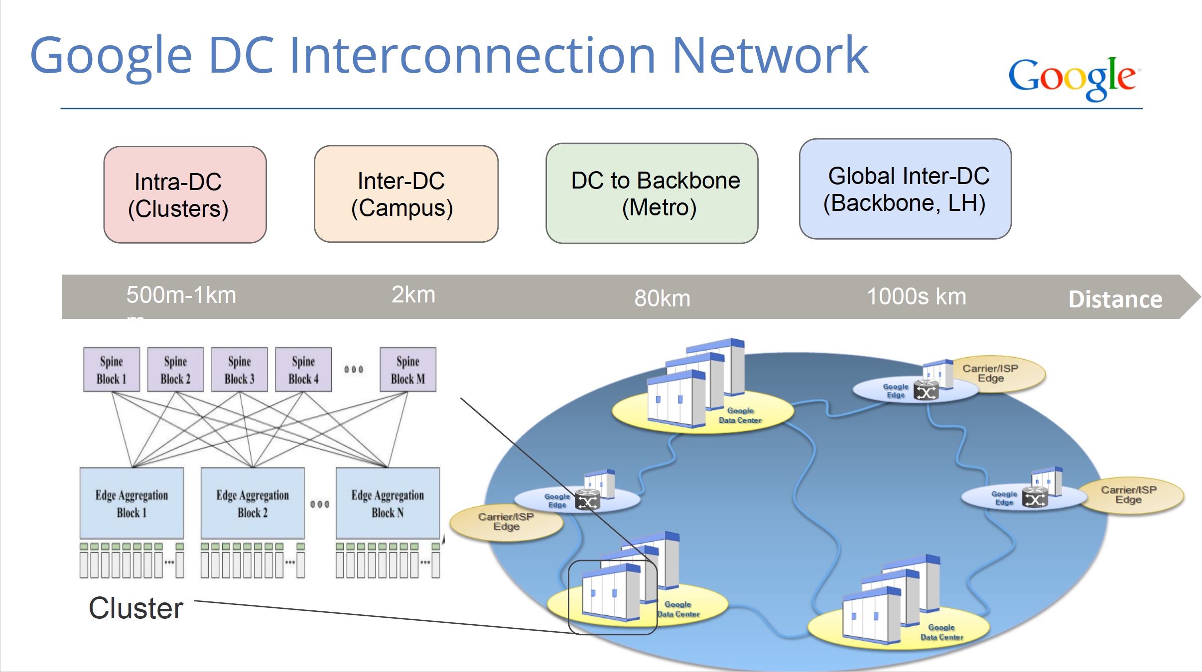
Connecting data centers (Google)
Figure from Pluggable DWDM: Considerations For Campus and Metro DCI Applications, ECOC 2016

Slide 25
Connecting data centers (Google)
Sirius
Iris
Figure from Pluggable DWDM: Considerations For Campus and Metro DCI Applications, ECOC 2016

Slide 26
Iris: Connecting datacenters within 120km
Motivation
Data center space premium, cannot build mega data centers
Large amounts of unlit fiber already deployed in metro regions
A
Fiber hut
Spine
.. 8..
8x32 downlinks
Fiber hut
C
ToR
..32..
32x16 uplinks
Spine
.. 8..
8x32 downlinks
24x2 servers (blue ToR x 26), 6 WAN ToRs
ToR
..32..
32x16 uplinks
Spine
.. 8..
8x32 downlinks
24x2 servers (blue ToR x 26), 6 WAN ToRs
B
ToR
..32..
32x16 uplinks
24x2 servers (blue ToR x 26), 6 WAN ToRs

Slide 27
Iris: Connecting datacenters within 120km
Problem: what network connectivity must we overlay to manage traffic between data centers?
Solution 1: Use electrical switches at fiber huts to route traffic
Solution 2: Use optical switches
A
Fiber hut
Spine
.. 8..
8x32 downlinks
Fiber hut
C
ToR
..32..
32x16 uplinks
Spine
.. 8..
8x32 downlinks
24x2 servers (blue ToR x 26), 6 WAN ToRs
ToR
..32..
32x16 uplinks
Spine
.. 8..
8x32 downlinks
24x2 servers (blue ToR x 26), 6 WAN ToRs
B
ToR
..32..
32x16 uplinks
24x2 servers (blue ToR x 26), 6 WAN ToRs

Slide 28
Iris: Connecting datacenters within 120km
Solution: Use optical switches
Electrical switches require optical transceivers to convert light to electrical signal and vice versa. Transceiver cost increases with cable length
Trade-off # of optical transceivers by using extra fiber (additional capacity) between DCs
Challenge: Managing amplification for light from optical cables of different length
Design construct:
power-limiters before each amplifier to bound input optical power
amplified spontaneous emission noise for unused spectrum

Slide 29
Sirius: Connecting ToRs with optics
Motivation
End of Dennard scaling (+slowing of Moore’s law) ➔ mega data centers with electrical switches are much more power hungry than data centers with optical switches
Spine
2x32 downlinks
..16..
Spine
2x32 downlinks
..4096..
..4..
..4..
ToR
4x16 downlinks
Much more space
Much larger scale
64 port 400-800G ToR
16 x 16 downlinks
4x16 downlinks
4x16 uplinks
4x16 uplinks
Gratings
..16..
Aggregation
Aggregation
..4..
4x16 downlinks
..4..
4x16 downlinks
..16..
..8..
8x8 uplinks
..8..
16 x 16 uplinks
ToR
ToR
ToR
..4096..
24x2 servers
To Campus/WAN
~320 servers in one block
4 Campus/WAN blocks
65536-131072 servers (16-32 servers per ToR)
~3840 servers in one block

Slide 30
Sirius: Connecting ToRs with optics
Key Ideas
Each ToR port connects twice (logically?) to 16 gratings (shown as uplink and downlink)
Each ToR port connects to a different destination ToR port by cycling through 16 wavelengths
Disaggregated tunable laser
Switching wavelengths takes 1ns
Packets can bounce of intermediate ToRs on their way to destination
Exercise parameters
64 port 800Gbps ToR switches
576B cells/packets
Switching time 1 ns
..4096..
ToR
16 x 16 downlinks
Gratings
..16..
16 x 16 uplinks
ToR
..4096..
65536-131072 servers (16-32 servers per ToR)

Slide 31
Sirius: Connecting ToRs with optics
Exercise parameters
64 port 800Gbps ToR switches
576B cells/packets
Switching time 1ns
Reachability: How are 4096 ToRs connected to each other?
..4096..
ToR
16 x 16 downlinks
Gratings
..16..
16 x 16 uplinks
ToR
..4096..
65536-131072 servers (16-32 servers per ToR)

Slide 32
Sirius: Connecting ToRs with optics
Exercise parameters
64 port 800Gbps ToR switches
576B cells/packets
Switching time 1 ns
Reachability: How are 4096 ToRs connected to each other?
Each ToR port reaches 16 different ports using 16 wavelengths, one at a time ⬅ Spread through time
Each ToR has 16 uplinks ➔ Each ToR reaches 16 wavelengths * 16 ports = 256 different ToRs
If these are intermediate ToRs, each of the 256 ToRs can reach 16 other ToRs via their uplinks ➔ 256 * 16 = 4096 ToR switches ⬅ Spread through time
Contrast to equivalent electrical switches
Any switch can reach any other switch (spatial)
Paths have latency corresponding to switching latency
..4096..
ToR
16 x 16 downlinks
Gratings
..16..
16 x 16 uplinks
ToR
..4096..
65536-131072 servers (16-32 servers per ToR)

Slide 33
Sirius: Connecting ToRs with optics
Exercise parameters
64 port 800Gbps ToR switches
576B cells/packets
Switching time 1 ns
Throughput: What is the effective bandwidth of each port?
..4096..
ToR
16 x 16 downlinks
Gratings
..16..
16 x 16 uplinks
ToR
..4096..
65536-131072 servers (16-32 servers per ToR)

Slide 34
Sirius: Connecting ToRs with optics
Exercise parameters
64 port 800Gbps ToR switches
576B cells/packets
Switching time 1ns
Throughput: What is the effective bandwidth of each port?
Transmission time of 576B packet
Time to transmit 16, 576B packets to 16 destinations
Throughput of the port
..4096..
ToR
16 x 16 downlinks
Gratings
..16..
16 x 16 uplinks
ToR
..4096..
65536-131072 servers (16-32 servers per ToR)

Slide 35
Sirius: Connecting ToRs with optics
Exercise parameters
64 port 800Gbps ToR switches
576B cells/packets
Switching time 1ns
Throughput: What is the effective bandwidth of each port?
Transmission time of 576B packet
576*8/800 = 5.76ns
Time to transmit 16, 576B packets to 16 destinations
(5.76ns + 1ns) * 16 = 108.16ns
Throughput of the port
16 packets * 576 *8 bits/ 108.16 ns = 681.7Gbps
Contrast to equivalent electrical switches
Each port will be 800Gbps
..4096..
ToR
16 x 16 downlinks
Gratings
..16..
16 x 16 uplinks
ToR
..4096..
65536-131072 servers (16-32 servers per ToR)

Slide 36
Sirius: Connecting ToRs with optics
Exercise parameters
64 port 800Gbps ToR switches
576B cells/packets
Switching time 1ns
100ns FEC
Buffering: How much receive buffering do you need at intermediate ToRs?*
..4096..
ToR
16 x 16 downlinks
Gratings
..16..
16 x 16 uplinks
ToR
..4096..
65536-131072 servers (16-32 servers per ToR)
*Calculation depends on ToR hardware design

Slide 37
Sirius: Connecting ToRs with optics
Exercise parameters
64 port 800Gbps ToR switches
576B cells/packets
Switching time 1ns
100ns FEC
Buffering: How much receive buffering do you need at intermediate ToRs?*
Total time to receive 16 576B packets from 16 ports
Number of packets received in that time
Amount of buffering needed to absorb 10us of that delay
..4096..
ToR
16 x 16 downlinks
Gratings
..16..
16 x 16 uplinks
ToR
..4096..
65536-131072 servers (16-32 servers per ToR)
*Calculation depends on ToR hardware design

Slide 38
Sirius: Connecting ToRs with optics
Exercise parameters
64 port 800Gbps ToR switches
576B cells/packets
Switching time 1ns
100ns FEC
Buffering: How much receive buffering do you need at intermediate ToRs?*
Total time to receive 16 576B packets from 16 ports
6.76ns + 100ns = 106.76ns
Number of packets received in that time
106.76 ns / 6.76 ns * 16 = 252.69 packets (145547.36B)
Amount of buffering needed to absorb 10us of that delay
10000 ns * 145547.36 B/106.76 ns = 13633136.09B = 13.63MB
Contrast to equivalent electrical switches
Tomahawk 3 ( 64port 200Gbps switch) already has 64MB buffering (40us)
Backpressure Flow Control, arXiv 2019
Sirius might need additional buffering for intermediate switching
..4096..
ToR
16 x 16 downlinks
Gratings
..16..
16 x 16 uplinks
ToR
..4096..
65536-131072 servers (16-32 servers per ToR)
*Calculation depends on ToR hardware design

Slide 39
This talk
Design of data center network topologies
Inputs
What parameters do you usually start with?
Trade-off considerations
What choices do you have to make?
Connecting DCs to campus/WAN (Iris SIGCOMM 2020)
Reacting to failures
Moving to optical cores (Sirius SIGCOMM 2020)
Outputs
What kinds of network designs emerge?
Design constructs
What are certain recurring abstractions of network design?

Slide 40
Happy to connect and chat more
rniranjan@vmware.com

Slide 41
Examples of component features influencing topology structure
Number of hash functions in a chip ➔ number of effective outgoing links for ECMP
North/South port connection restrictions in patch panels
Table size, e.g., number of WCMP/ECMP entries in a table

