Slide 1


Towards ML-Driven Networked Systems
Mohammad Alizadeh

Slide 2
Today’s networked systems rely on many
resource management algorithms

Slide 3







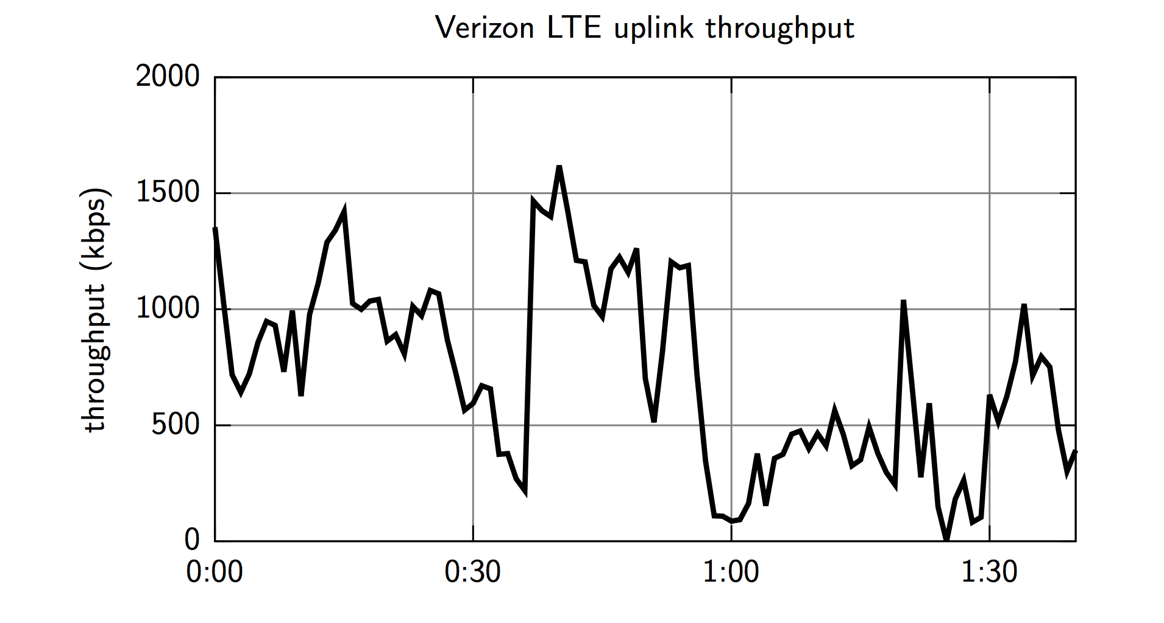
Internet Video Delivery
CDN Server Selection
720P
Content Distribution
& Caching
Bitrate Adaptation
Encoding
Congestion Control

Slide 4
Trends
End of Moore’s law “free lunch”
Extreme performance requirements
Interactivity has become a must; users leave if experience isn’t seamless
Latency is king
Small & rare hiccups matter (e.g., microseconds at the tail)
Explosion of data, AI at scale
Significant diversity
In networks, hardware, software, user preferences

Slide 5
Can machine learning help tame the complexity
of designing high performance systems?

Slide 6
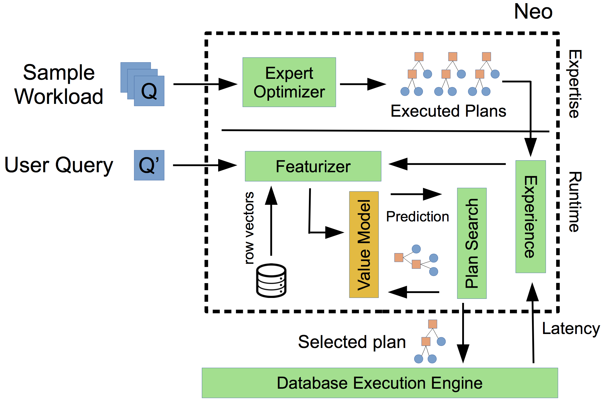
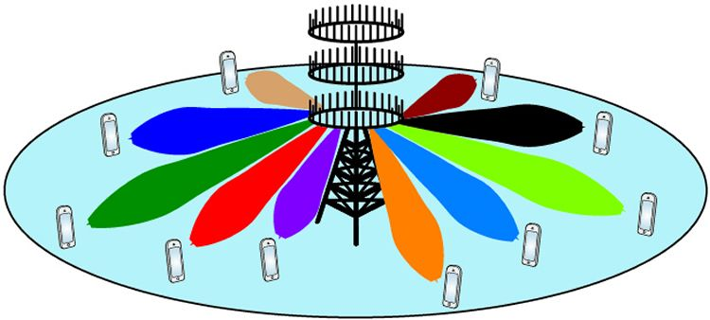

ML-Driven Systems
Video Streaming
[SIGCOMM’17]
Cluster Scheduling
[SIGCOMM’19]
ML Task Placement
[NeurIPS’19]
Query Optimization
[VLDB’19, SIGMOD’21]
Massive MIMO
Signal Detection [ToW’20]
Jobs
Servers
Bandwidth
Time
720P
Reinforcement Learning

Slide 7
Benefits of ML-Based Systems
Tailor policies for a specific environment; examples:
Video streaming app that adapts to the network (nature of bandwidth variation)
Database that adapts to query/data distribution
Handle hard-to-model system dynamics
E.g., interference between workloads on shared resources like CPU caches
Optimize for high-level system objectives directly
E.g., job completion time, rather than low-level metrics like server utilization
Learn data-driven heuristics for hard algorithmic problems
E.g., scheduling often involves combinatorial optimization problems with no general efficient algorithms

Slide 8


Decima: A Learned Cluster Scheduler
Learns workload-specific scheduling algorithms for jobs with dependencies (represented as DAGs)
Node: “Stage” of computation, comprising of multiple parallel tasks
Executor 1
Executor 2
Scheduler
Edge: Data dependency
Job 2
Job 3
Executor m
Job DAG

Slide 9
Decima: A Learned Cluster Scheduler
Learns workload-specific scheduling algorithms for jobs with dependencies (represented as DAGs)
Server 1
Server 2
Scheduler
Goal: Decide, at any time, which node to execute on each server to optimize performance (e.g., minimize average job completion time).
Server m
Job 3
Job 2
Job 1

Slide 10
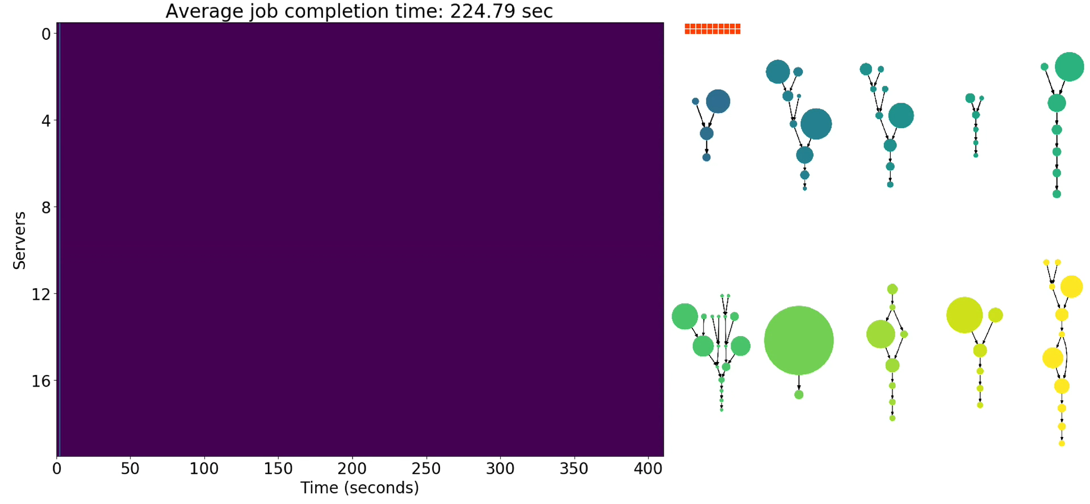
Scheduling policy: FIFO
Number of servers working on this job
Average Job Completion Time:
225 sec

Slide 11
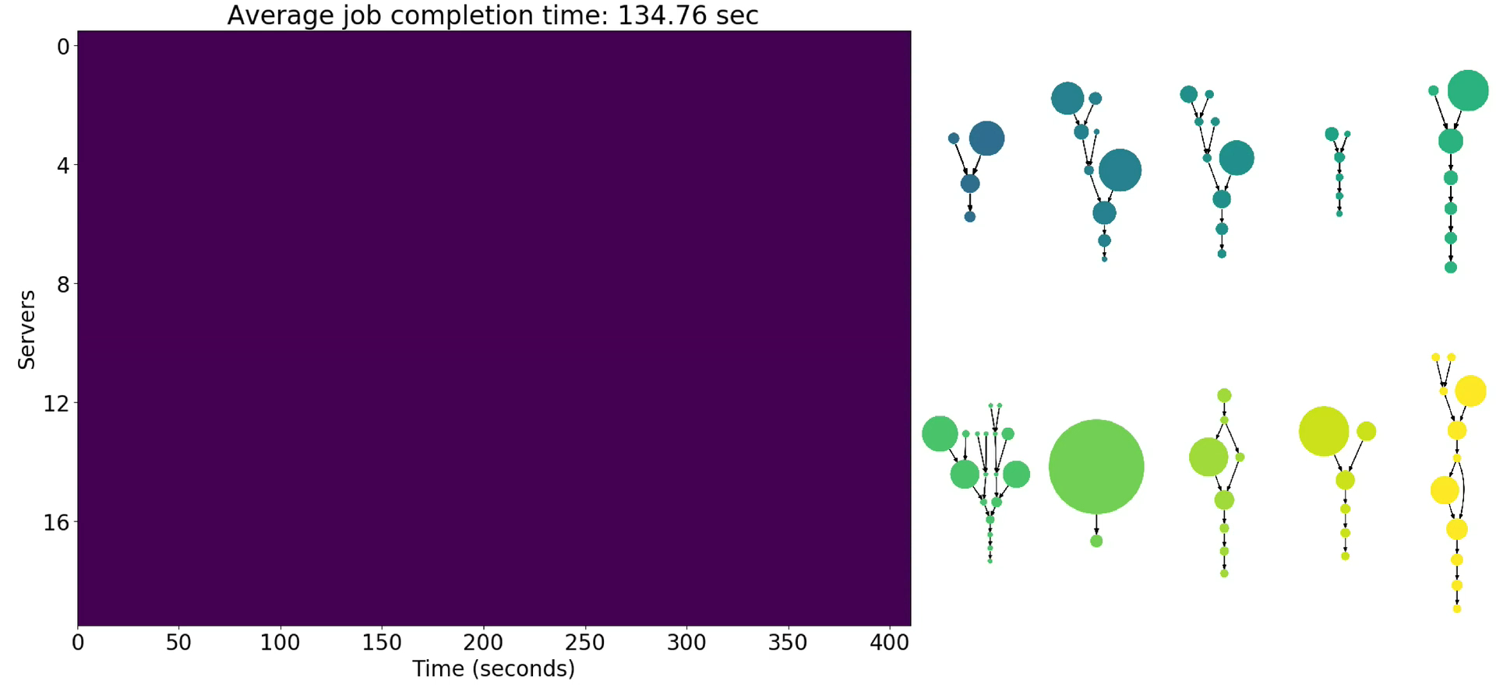
Scheduling policy: Shortest-Job-First
Average Job Completion Time:
135 sec

Slide 12
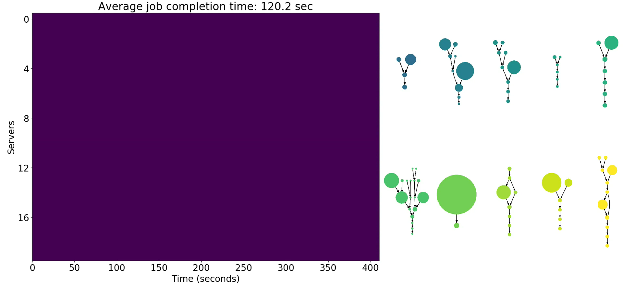
Scheduling policy: Fair
Average Job Completion Time:
120 sec

Slide 13
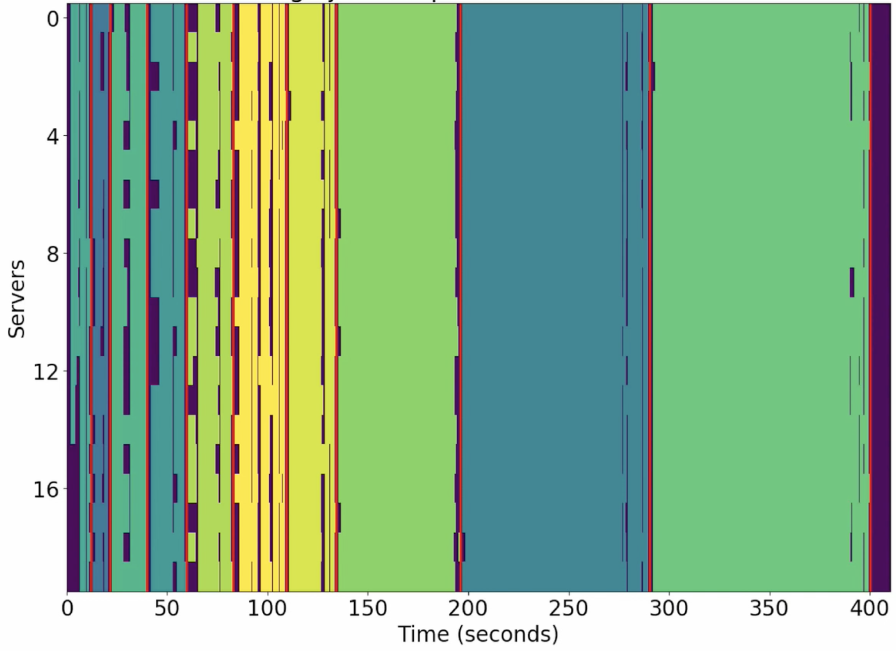
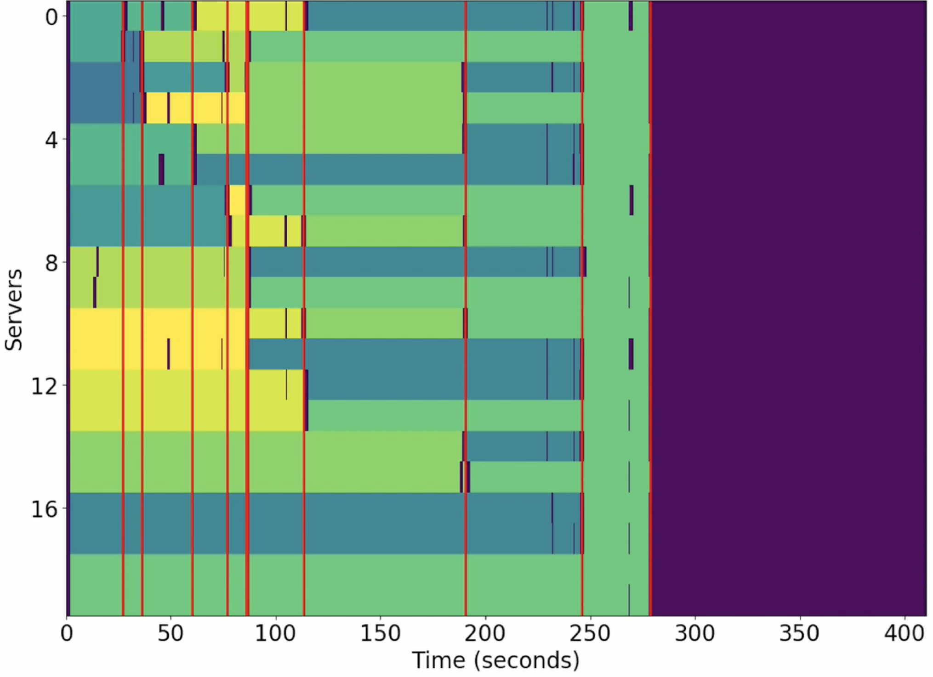
Shortest-Job-First
Fair
Average Job Completion Time:
135 sec
Average Job Completion Time:
120 sec

Slide 14

Scheduling policy: Decima
Average Job Completion Time:
98 sec

Slide 15
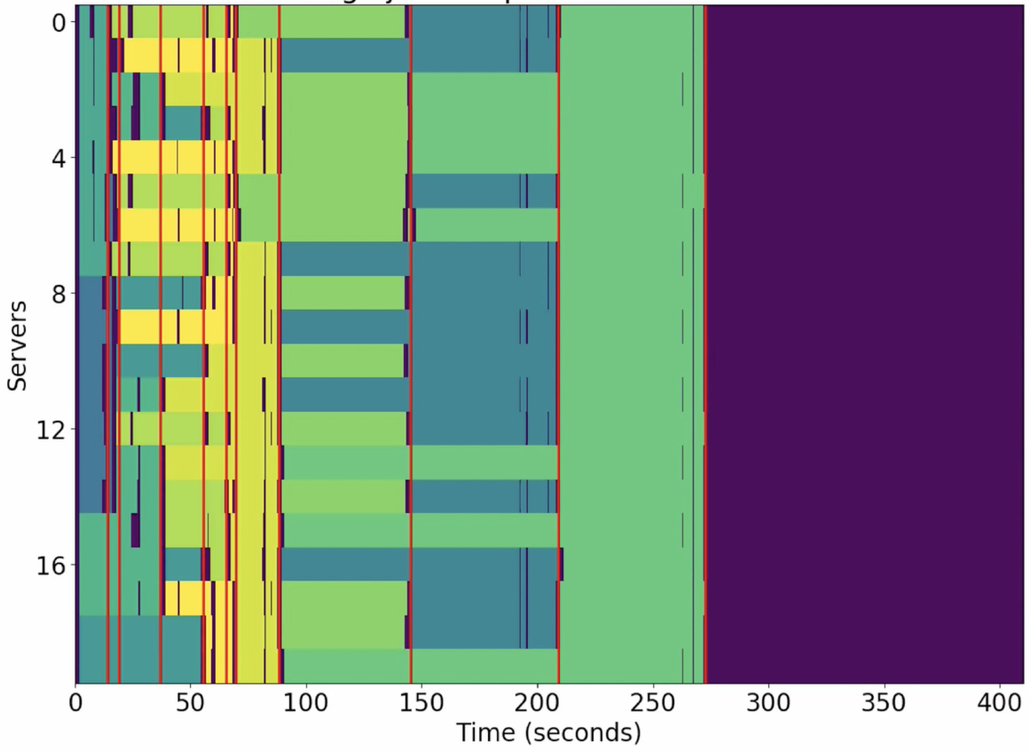
Decima
Fair
Average Job Completion Time:
98 sec
Average Job Completion Time:
120 sec

Slide 16
Decima
it=0
166 sec
20 Spark jobs (TPC-H queries), 50 executors

Slide 17
Decima
it=3000
160 sec

Slide 18
Decima
it=6000
148 sec

Slide 19
Decima
it=9000
145 sec

Slide 20
Decima
it=12000
142 sec

Slide 21
Decima
it=15000
126 sec

Slide 22
Decima
it=18000
111 sec

Slide 23
Decima
it=21000
108 sec

Slide 24
Decima
it=24000
107 sec

Slide 25
Decima
it=27000
93 sec

Slide 26
Decima
it=30000
89 sec

Slide 27
Decima’s Design
Notes:
\

Slide 28

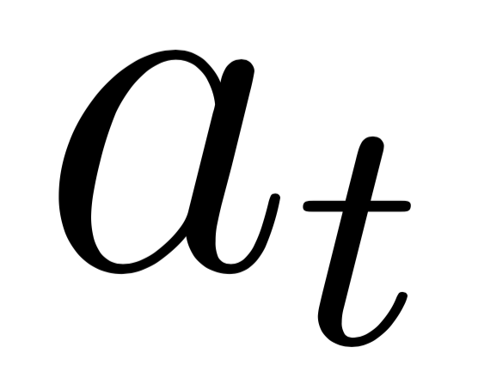

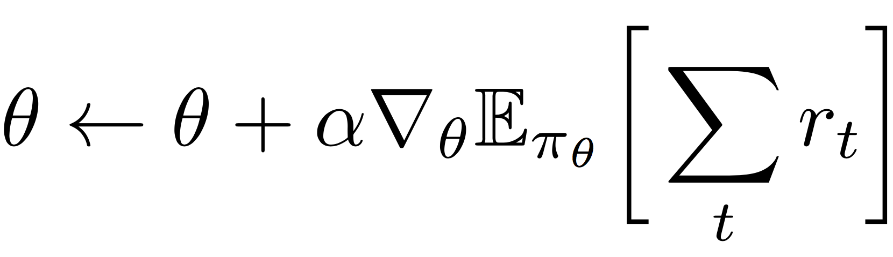
Reinforcement Learning: Learn by interacting with the environment
Reward
Take action
Agent
Environment
Observe state
Goal: maximize expected total future reward

Slide 29
Design Overview
Reward
State
Scheduling Agent
Objective
Environment
p[
Runnable Node
Policy
Neural Network
Data Analytics System
(e.g., Spark, Hadoop, Tez, Druid, Scope, …)
action
Job DAG 1
Job DAG n
# of machines
8
Server 1
Server m
Observation of jobs and cluster status
Decima uses a neural network to pick (1) node to schedule, (2) how many servers to use
Trains policy using 10s of thousands of trace-driven simulations

Slide 30
Design Overview
Reward
State
Scheduling Agent
Objective
Environment
p[
Runnable Node
Policy
Neural Network
Data Analytics System
(e.g., Spark, Hadoop, Tez, Druid, Scope, …)
action
Job DAG 1
Job DAG n
# of machines
8
Challenges and Ideas:
1. Huge state and action space → Compact encoding of scheduling policy
2. Training for online, stochastic job arrivals → New learning techniques for RL in “input-driven” systems
Server 1
Server m
Observation of jobs and cluster status

Slide 31
Decima Agent Design
Scheduling Events
Executor 1
Job DAG 1
Node features:
# of tasks
avg. task duration
# of executors currently assigned to the node
are free executors local to this job?
Executor 2
Set of identical
free executors
Executor 3
x_{v}
Executor 4
Job DAG n
How to encode scheduling decisions as actions?
Executor m

Slide 32
Option 1: Assign all Executors in 1 Action
Executor 1
Job DAG 1
Executor 2
Executor 3
Executor 4
Job DAG n
Problem: huge action space
Executor m

Slide 33
Option 2: Assign 1 Executor per Action
Executor 1
Job DAG 1
Executor 2
Executor 3
Executor 4
Job DAG n
Problem: long action sequences
Executor m

Slide 34
Decima: Assign Groups of Executors per Action
Executor 1
Use 1 executor
Job DAG 1
Executor 2
Use 1 executor
Executor 3
Use 3 executors
Executor 4
Job DAG n
Action = (node, parallelism limit)
Executor m

Slide 35
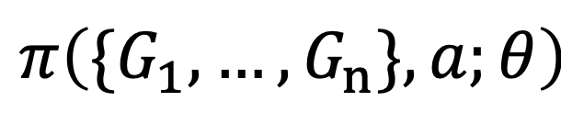
Policy Representation
Job DAG 1
G₁
policy parameters
Arbitrary number of jobs
$$π\left({\{G}_{1},…,G_{n}\},a;θ\right)$$
Probability of action a
schedule a node v,
with parallelism limit l
Job DAG n
G_{n}
Decima uses a graph neural network to represent the policy

Slide 36
Graph Neural Network
8
6
3
2
Score on each node
Job DAG

Slide 37
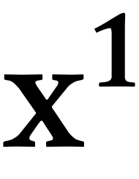
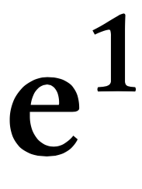
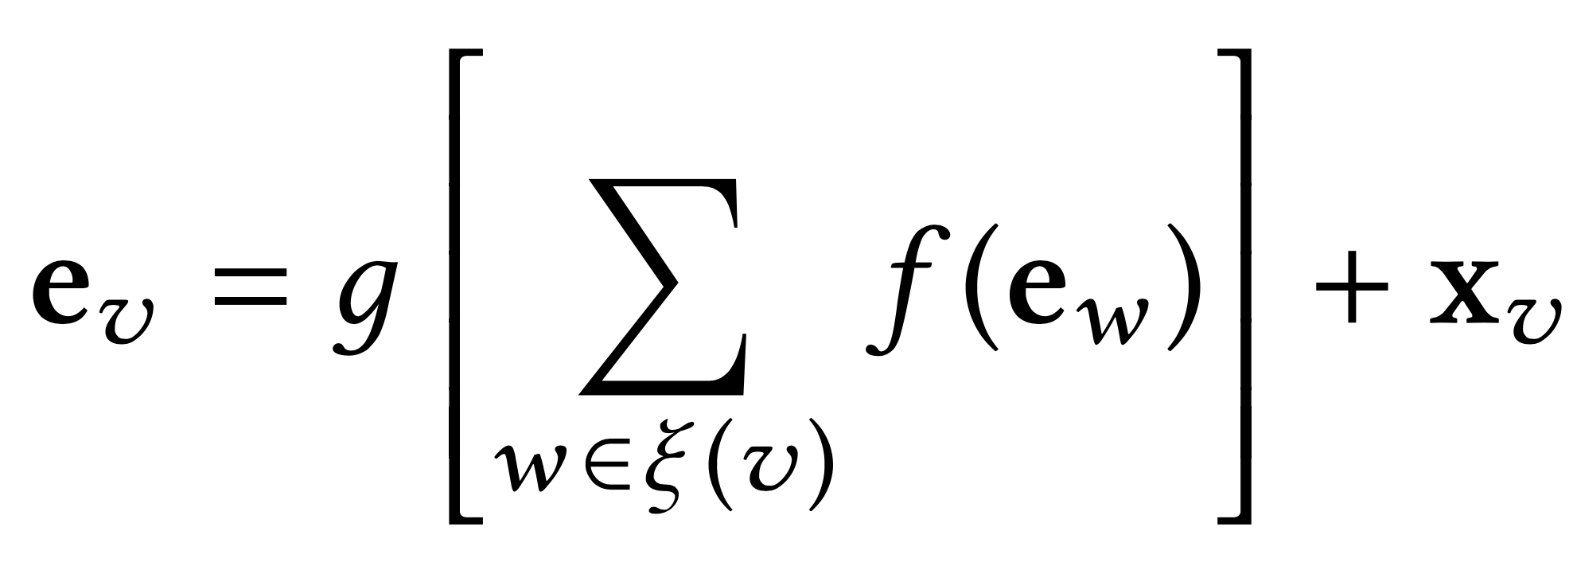
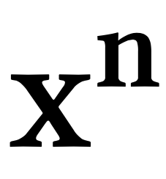

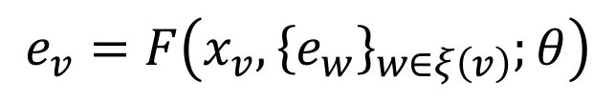
Graph Neural Network
f(.) and g(.) are small Neural Nets
$$e_{v}=F\left(x_{v},{\left\{e_{w}\right\}}_{w∈ξ\left(v\right)};θ\right)$$
Job DAG 1
Step 1
Step 2
Children of v
Same aggregation applied to all nodes for each DAG
Job DAG n
Step 1
Step 2

Slide 38
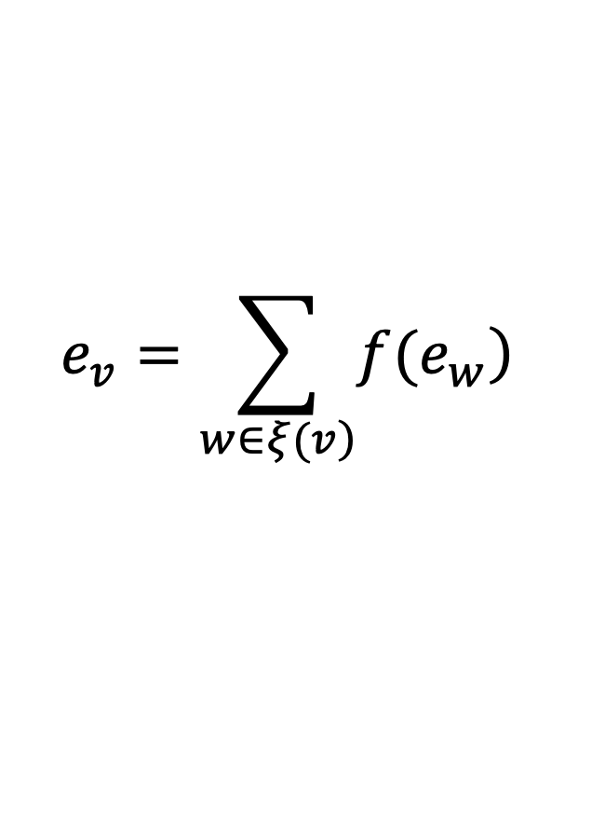
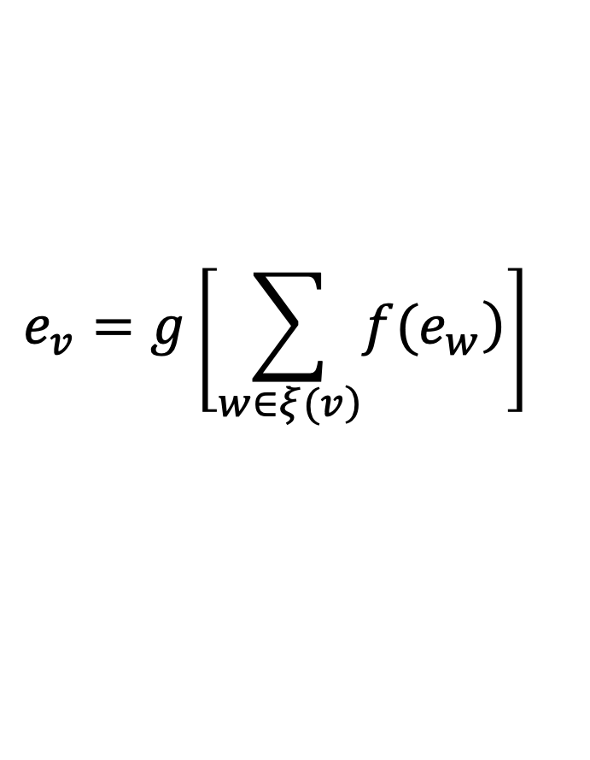
Policy Representation is Key
Critical path
Sum pooling
$$e_{v}=\sum_{\left.w∈ξ(v\right)}{\left.f(e_{w}\right)}$$
max
Non-linear pooling
max
$$e_{v}=g\left[\sum_{\left.w∈ξ(v\right)}{\left.f(e_{w}\right)}\right]$$
max
Tip: use supervised learning to verify a representation

Slide 39
Policy Representation is Key
Sum pooling
Supervised learning training curve
$$e_{v}=\sum_{\left.w∈ξ(v\right)}{\left.f(e_{w}\right)}$$
Sum pooling
Non-linear pooling
Non-linear pooling
$$e_{v}=g\left[\sum_{\left.w∈ξ(v\right)}{\left.f(e_{w}\right)}\right]$$
Tip: use supervised learning to verify the representation

Slide 40

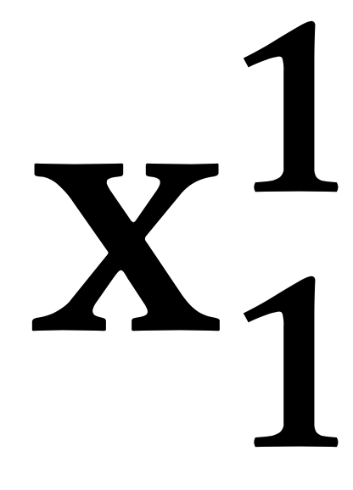
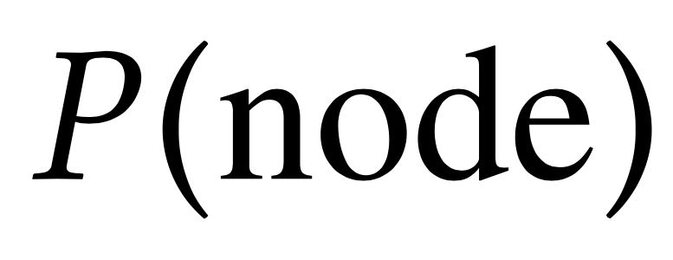
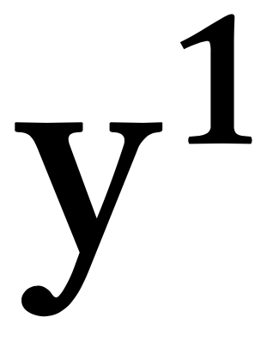
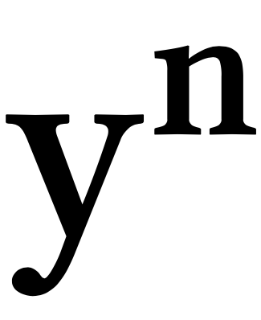
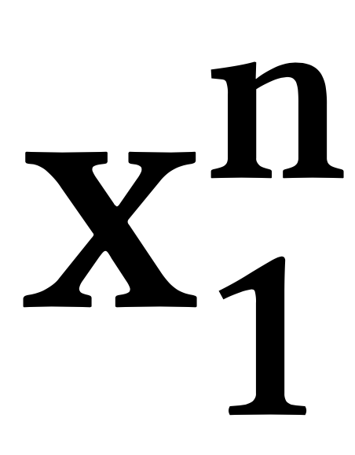
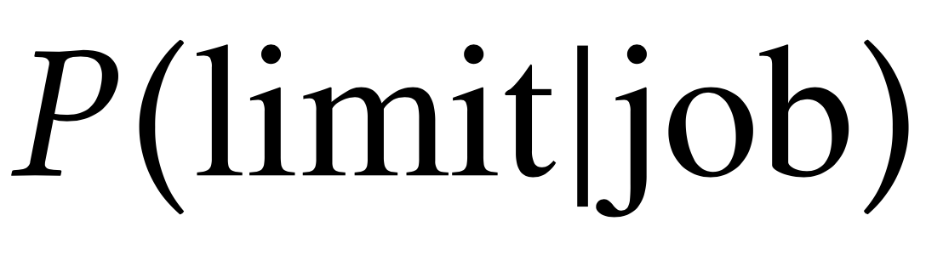

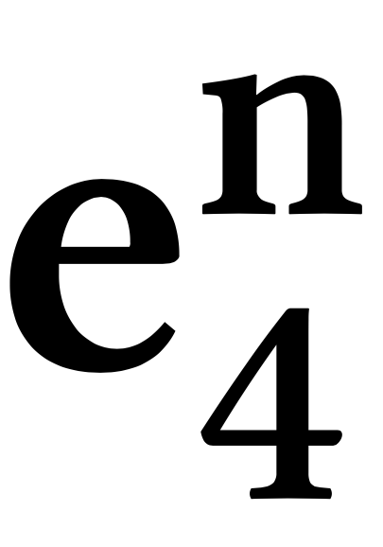
Decima’s Neural Network Policy
Graph Neural Net
Node Embedding
Softmax
DAG Embedding
Job DAG 1
Job 1
DAG Embedding
Softmax
Node Embedding
Job DAG n
Softmax
Job 2

Slide 41


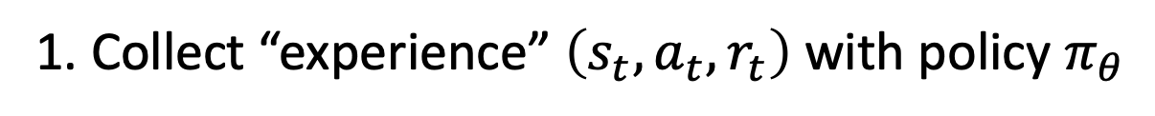
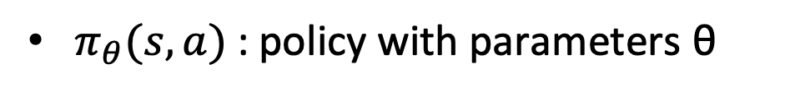
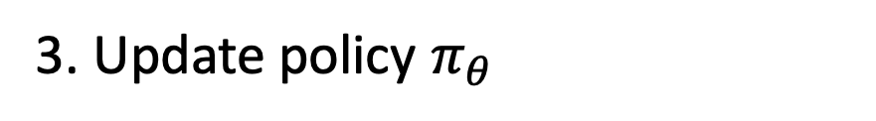

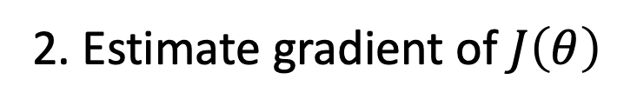
Training
Goal: maximize $J\left(θ\right)=𝔼_{π_{θ}}\left[\sum_{t=0}^{T−1}{r_{t}}\right]$
$π_{θ}(s,a)$ : policy with parameters θ
1. Collect “experience” $\left(s_{t},a_{t},r_{t}\right)$with policy $π_{θ}$
Decima agent
cluster
2. Estimate gradient of $J\left(θ\right)$
3. Update policy $π_{θ}$

Slide 42
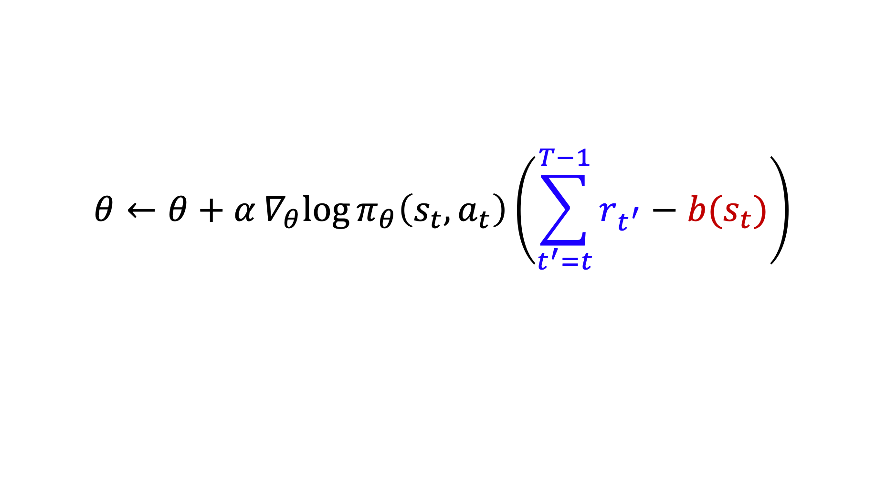
Review: Policy Gradient RL Methods
$$θ←θ+α∇_{θ}log{π_{θ}\left(s_{t},a_{t}\right)\left(\sum_{t^{′}=t}^{T−1}{r_{t^{′}}}−b(s_{t})\right)}$$
“return” from step t
“baseline”
Expected return from state s_{t}
Increase probability of actions with better-than-expected returns

Slide 43
Training for Continual, Stochastic Job Arrivals
The scheduler must handle an infinite, random sequence of jobs
Scheduler
Real workloads have high variance (e.g., heavy-tailed job sizes & inter-arrival times)
→ this can throw off RL training

Slide 44
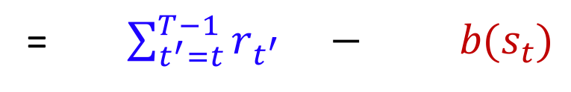
Problem: High Variance from Job Arrival Process
Future
workload #1
action a_{t}
Job size
Must consider future job sequence to score actions
Future
workload #2
Time
t
Score for action a_{t} = (return after a_{t}) $−$ (baseline for s_{t})
= $\sum_{t^{′}=t}^{T−1}{r_{t^{′}}} − b(s_{t})$

Slide 45
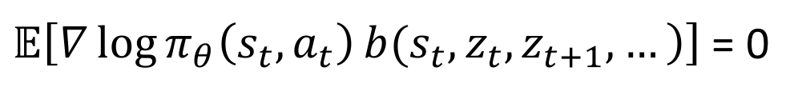
Input-Dependent Baseline
Score for action a_{t} = $\sum_{t^{′}=t}^{T−1}{r_{t^{′}}} − b(s_{t})$
Score for action a_{t} = $\sum_{t^{′}=t}^{T−1}{r_{t^{′}}} − b(s_{t},z_{t},z_{t+1},…)$
Expected reward for trajectories from state s_{t} with input sequence z_{t}, z_{t+1}, …
Theorem: Input-dependent baselines reduce variance without adding bias
$𝔼\left[\left.∇\log{π_{θ}\left(s_{t},a_{t}\right)}b({s_{t},z}_{t},z_{t+1},…\right)\right]$ = 0
Variance reduction for reinforcement learning in input-driven environments. Hongzi Mao, Shaileshh Bojja Venkatakrishnan, Malte Schwarzkopf, Mohammad Alizadeh. International Conference on Learning Representations (ICLR), 2019.

Slide 46
Results

Slide 47
Decima with Continual Job Arrivals
1000 jobs arrives as a Poisson process with avg. inter-arrival time = 25 sec
Better
Decima achieves 28% lower average JCT than best heuristic,
and 2X better JCT in overload

Slide 48
What is Decima Doing?

Slide 49
Performance: Alibaba Workload
Industrial trace (Alibaba): 20,000 jobs from production cluster
4 types of executors:
1 core + {0.25, 0.5, 0.75, 1} memory units

Slide 50
Flexibility: Different Objectives & Systems
Objective: Avg JCT
Objective: Makespan

Slide 51
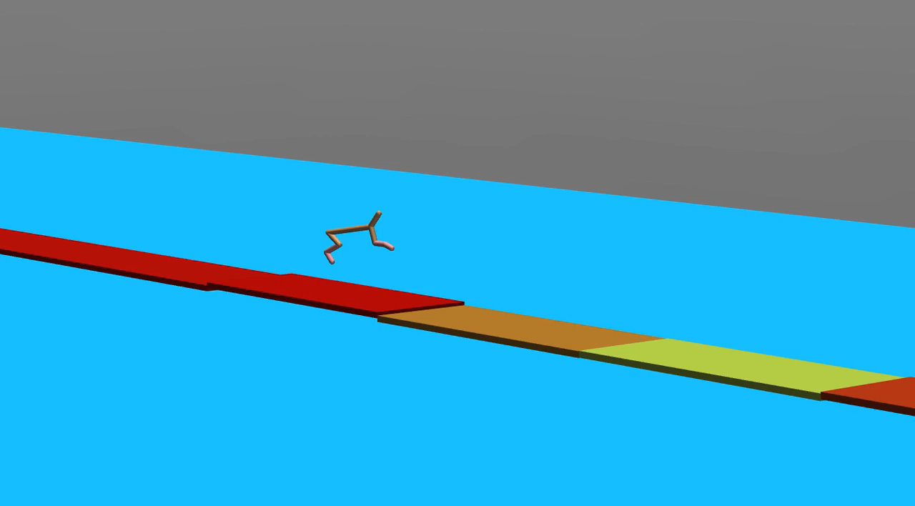
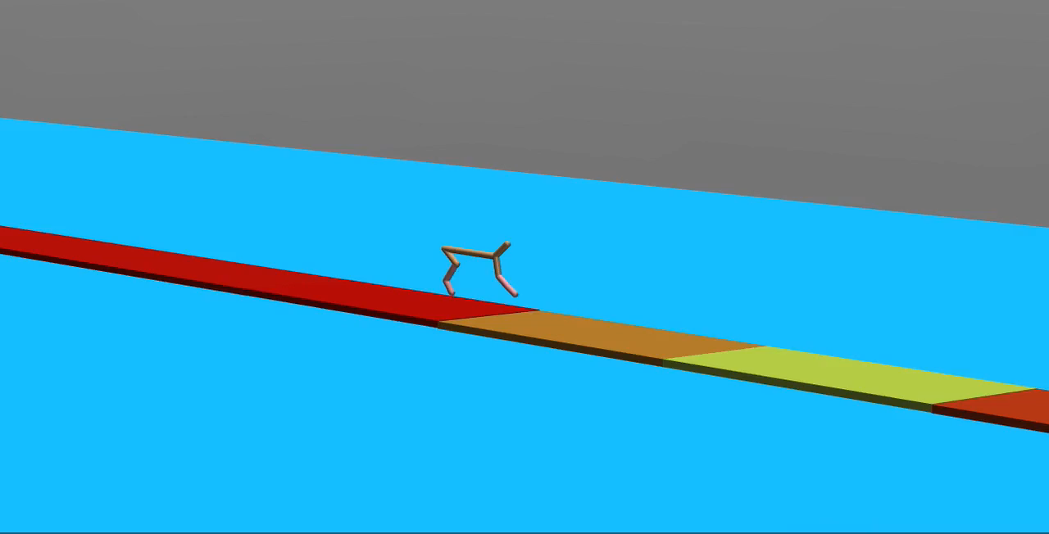
Other Applications of Input-Dependent Baselines
Broadly applicable to environments with exogenous processes:
Adaptive video streaming, load balancing, caching, robotics with disturbance…
Train with standard baseline
Train with input-dependent baseline
Variance reduction for reinforcement learning in input-driven environments. Hongzi Mao, Shaileshh Bojja Venkatakrishnan, Malte Schwarzkopf, Mohammad Alizadeh. International Conference on Learning Representations (ICLR), 2019.

Slide 52
Lessons for Applying RL to Systems
Understand the system deeply
Build intuition by developing your own heuristics
Ask what specifically could ML do better than your heuristics
Helps you formulate the problem (e.g., states and actions)
Think carefully about ML model
Need to balance expressive power and model complexity
Good test: can the model imitate good known policies (supervised learning)?
Visualize training data
E.g., freeze policy at different stages of training, plot rewards for several episodes
How good is the reward signal? Is there any “noise” that can be removed?

Slide 53
Road to Deployment: What is Missing?
Generalization and safety are key hurdles
Most existing systems are trained offline, in simulators or trace-driven experiments on dedicated infrastructure
But no amount of offline training can capture all possible dynamics of a complex system

Slide 54
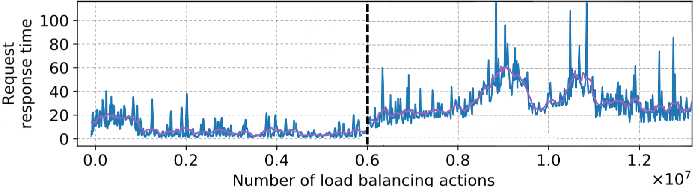
Simple Example: Load Balancing Proxy
Job size ~ Pareto(shape = 1.5)
Arrival ~ Poisson(λ = 60)
Effective load: 72%
Job size ~ Pareto(shape = 1.5)
Arrival ~ Poisson(λ = 30)
Effective load: 36%

Slide 55
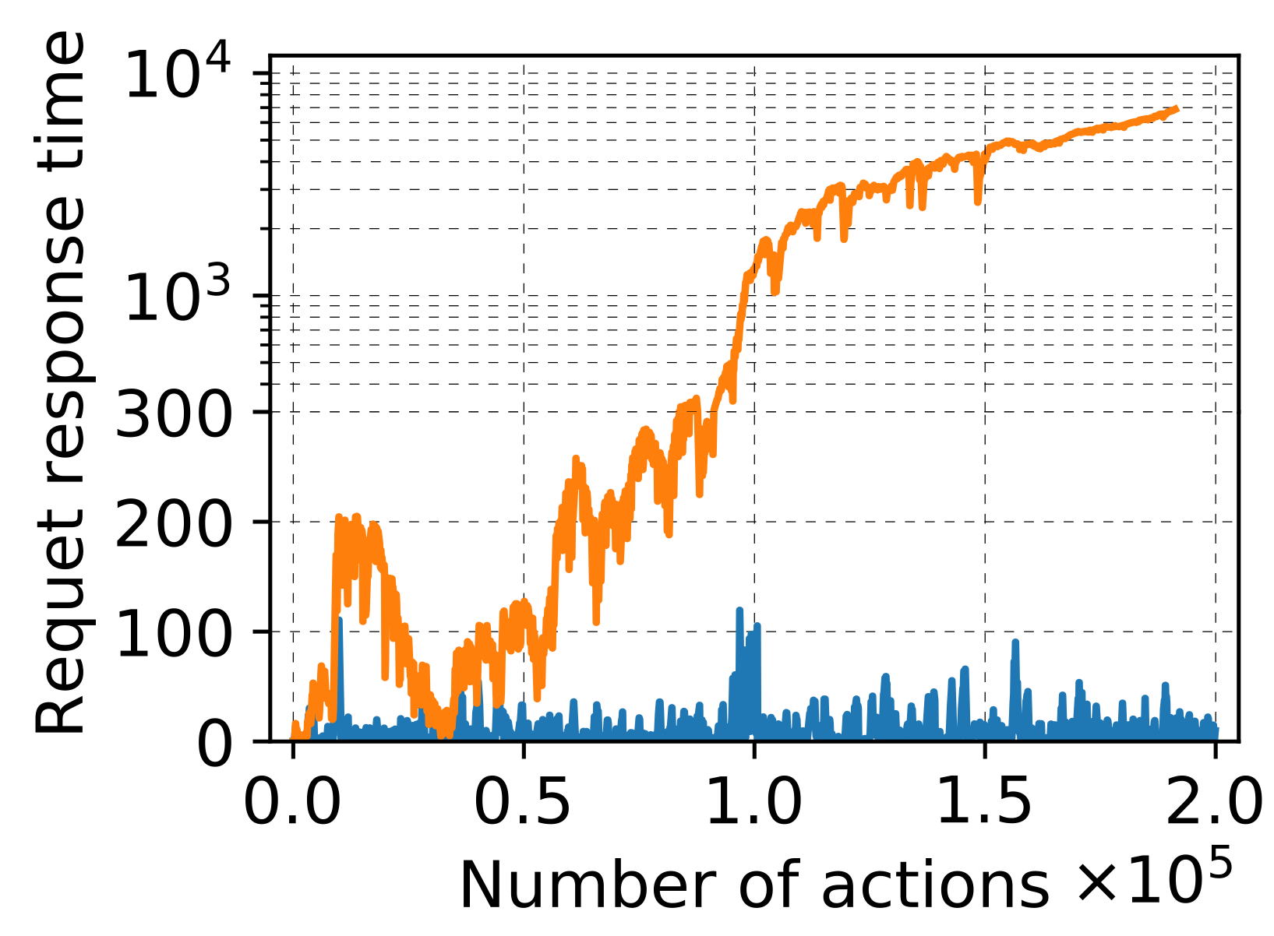
What if we train online in a live system?
Online training
Offline training

Slide 56
Some Ideas – nothing settled in this space
Learn robust models
Formally prove safety properties
Adversarial learning techniques
Design systems to be resilient to errors in learned components
Detect misbehaving models / distribution shifts and switch to default algorithms
Combine models with human-designed algorithms
Learn parameters in an existing algorithm
Learn to rank decisions output by several existing algorithms
Learn to predict some aspects of system (e.g., job perf vs. parallelism); then use standard planners/schedulers

Slide 57
Looking Ahead
ML has the potential to change how we design systems
But, many questions remain
Robustness
Safe training & deployment
Interpretability
…
Success will hinge on systematic & reliable design methodologies
Exciting research area for both systems and ML

