Slide 1
DCTCP and DCQCN

Slide 2
How to read a systems/networking paper*
*Measurement papers excluded

Slide 3
What’s your problem? What are you trying to solve, really?
Okay, fine. Why should anyone care about this problem?
But .. there is so much prior work. That wasn’t enough?
FINE. What’s your secret sauce?
Right …right. You are so smart. Prove to me that your secret sauce indeed works as promised.
Umm … is anyone really using it? What next?
I would have done this so differently, and so much better …

Slide 4
DCTCP
Presenting work of many teams in Microsoft

Slide 5
What’s your problem? What are you trying to solve, really?
Okay, fine. Why should anyone care about this problem?
But .. there is so much prior work. That wasn’t enough?
FINE. What’s your secret sauce?
Right …right. You are so smart. Prove to me that your secret sauce indeed works as promised.
Umm … is anyone really using it? What next?

Slide 6
Poor search performance due to TCP incast resulting from partition/aggregate pattern

Slide 7
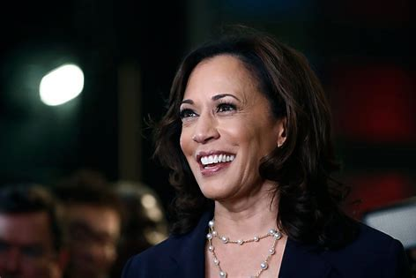

Wikipedia, news, tweets, ….
Bing
Kamala Harris?
Web search ….

Slide 8

Kamala Harris?
Top level aggregator (TLA)
Mid level aggregator (MLA)
Mid level aggregator (MLA)
Mid level aggregator (MLA)
Twitter ..
Web index
Images
Workers
Workers
Workers

Slide 9
Wikipedia, news, tweets, ….
Top level aggregator (TLA)
Mid level aggregator (MLA)
Mid level aggregator (MLA)
Mid level aggregator (MLA)
Twitter ..
Web index
Images
Workers
Workers
Workers

Slide 10
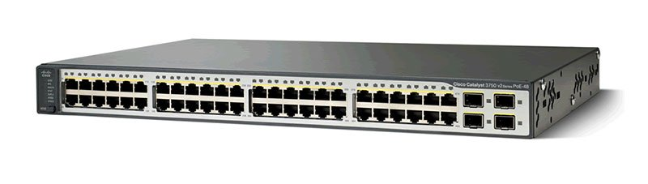
Top of Rack (ToR) Router
…
W
MLA
W
W
W
W

Slide 11
Top of Rack (ToR) Router
…
W
MLA
W
W
W
W

Slide 12

W
W
MLA
W
W
ASIC inside the ToR Router

Slide 13
Why is this loss a problem?
Because responses are short (few KB)
Packet loss on short flows → TCP timeout
TCP minimum timeout (used to be) 300ms on Windows …

Slide 14

Are you convinced that this is a real problem?

Slide 15

What’s your problem? What are you trying to solve, really?
Okay, fine. Why should anyone care about this problem?
But .. there is so much prior work. That wasn’t enough?
FINE. What’s your secret sauce?
Right …right. You are so smart. Prove to me that your secret sauce indeed works as promised.
Umm … is anyone really using it? What next?

Slide 16
Time is money
Return results “quickly” else no adclicks
TLA and MLAs have tight latency budgets
Results from “late” workers ignored
Poor quality results: no adclicks
The Cost of Latency – Perspectives (mvdirona.com)

Slide 17
In summary
Partition/aggregate → Incast
Incast → Packet loss
Loss → TCP Timeouts
TCP Timeouts → Delayed/missing results
Delayed/missing results → loss of revenue

Slide 18
Do you agree that this problem is worth solving?

Slide 19
What’s your problem? What are you trying to solve, really?
Okay, fine. Why should anyone care about this problem?
But .. there is so much prior work. That wasn’t enough?
FINE. What’s your secret sauce?
Right …right. You are so smart. Prove to me that your secret sauce indeed works as promised.
Umm … is anyone really using it? What next?

Slide 20
How would you solve the problem?
Poor search performance due to TCP incast resulting from partition/aggregate pattern

Slide 21
Don’t do scatter/gather
No other way to “scale horizontally”
More MLAs do not fundamentally fix incast
Caching etc. possible but not always feasible

Slide 22
Use more workers
Take first “N” who finish
Often used as a strategy to deal with “stragglers”
Good idea if “straggling” not coorelated with load
Bad idea here: makes incast worse!

Slide 23
Schedule flows centrally to avoid collision
Proposed by MIT and Facebook
Does not scale

Slide 24
RTS/CTS to avoid collision
Request to send/clear to send
This (partly) how WiFi works
Adds latency – trading median for tail
Used by Microsoft to beat sorting record

Slide 25
Jitter to avoid collision
Workers add random delay before responding
This is (partly) how WiFi protocol works
Adds latency – trading median for tail
Original solution attempted at Bing

Slide 26
Bigger buffers at routers
Router buffer has to support line rates
64x100G ➔ 6.4 Tbps read/write bandwidth!
Very expensive and power hungry!

Slide 27
Reduce TCP timeout
Microsecond timers can be CPU expensive
Does not avoid drops!
Must retransmit dropped packets
Proposed by CMU

Slide 28
What else can you think of?

Slide 29
What’s your problem? What are you trying to solve, really?
Okay, fine. Why should anyone care about this problem?
But .. there is so much prior work. That wasn’t enough?
FINE. What’s your secret sauce?
Right …right. You are so smart. Prove to me that your secret sauce indeed works as promised.
Umm … is anyone really using it? What next?

Slide 30
Prior work oversimplified the problem by focusing only on short flows

Slide 31
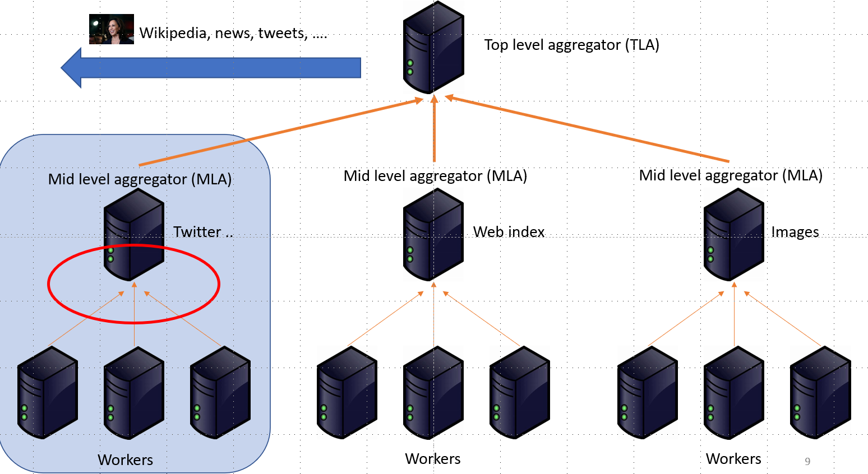
Database held by workers is continuously being refreshed
Long-lived, throughput sensitive flows
these flows also eat up switch buffer

Slide 32
DCTCP
Key Insights
Congestion from two sources:
  Long flows: throughput
  Short query flows: Latency
Convey congestion as soon as possible
  long flows react quickly
  short flows have chance to react
Maintain persistently low buffer occupancy

Slide 33
DCTCP at a glance
Ack
Reaction
Point (RP)
See paper for more details
Notification Point (NP)
Congestion Point (CP)
Data
Data
Sender
Router
Receiver
Estimate fraction of marked packets
Adjust cwnd accordingly
If qlen >= K, mark ECN
Echo ECN to RP

Slide 34
What would you have done differently?

Slide 35
What’s your problem? What are you trying to solve, really?
Okay, fine. Why should anyone care about this problem?
But .. there is so much prior work. That wasn’t enough?
FINE. What’s your secret sauce?
Right …right. You are so smart. Prove to me that your secret sauce indeed works as promised.
Umm … is anyone really using it? What next?

Slide 36
Results Summary (see paper for details)
Comparison to TCP w/o RED, and w/ RED
High throughput for long flows, short FCT for query flows
Lower queue length
Better/comparable convergence and fairness

Slide 37
Used by
Microsoft
Google
Morgan Stanley
….
IETF standard

Slide 38
What’s your problem? What are you trying to solve, really?
Okay, fine. Why should anyone care about this problem?
But .. there is so much prior work. That wasn’t enough?
FINE. What’s your secret sauce?
Right …right. You are so smart. Prove to me that your secret sauce indeed works as promised.
Umm … is anyone really using it? What next?

Slide 39
DCTCP was about Bing.
We will now switch to Azure.

Slide 40

Forget everything about DCTCP.

Slide 41
RDMA
Remote Direct Memory Access
Presenting work of many teams in Microsoft

Slide 42
What’s your problem? What are you trying to solve, really?
Okay, fine. Why should anyone care about this problem?
But .. there is so much prior work. That wasn’t enough?
FINE. What’s your secret sauce?
Right …right. You are so smart. Prove to me that your secret sauce indeed works as promised.
Umm … is anyone really using it? What next?

Slide 43
High throughput, low-latency Disk I/O with minimal CPU overhead

Slide 44
How does Azure make money?
We buy CPUs from Intel and AMD in bulk
We rent them out (VMs)
Minimize cores spent on non-chargeable tasks

Slide 45
Public cloud VMs
VMs “run” on compute servers
  Lots of cores, lots of RAM and some flash
Mount disks from dedicated storage servers
  Few cores, some RAM, and a ton of flash drives
Allows for better resource management, fault tolerance etc.
wee bit of disaggregated computing

Slide 46
Disk I/O traffic
“east-west”
Dominant traffic in data centers (bytes, packets, flows ..)
Affects performance of databases, Spark clusters …
We own “both ends”

Slide 47
“Write the block of data to remote disk y, address z”
CPU
CPU
Packetize
Stream
Post
Indicate
Interrupt
Copy
Application
TCPIP
TCPIP
Application
TCP: Waste of CPU, high latency due to CPU processing

Slide 48
Reducing CPU usage for disk IO
More cores left to sell on compute VMs
Can buy fewer/cheaper storage servers
Millions of dollars to our bottom line
Better performance for customers

Slide 49
Do you agree that this is a real problem, worth solving?

Slide 50
What’s your problem? What are you trying to solve, really?
Okay, fine. Why should anyone care about this problem?
But .. there is so much prior work. That wasn’t enough?
FINE. What’s your secret sauce?
Right …right. You are so smart. Prove to me that your secret sauce indeed works as promised.
Umm … is anyone really using it? What next?

Slide 51
Nope…not when we started
Public clouds were (still) relatively new
The scale, the cost equations, customer expectations, were rapidly evolving
Somewhat akin to research in DC fabric design
Lot of recent work, some which we will cover

Slide 52
How would you solve the problem?
High throughput, low-latency Disk I/O with minimal CPU overhead

Slide 53
Improve TCP performance
Stack optimizations
Large Send Offload
Not enough – latency due to context switch remains

Slide 54
Some other transport protocol
We do own both ends …
Congestion control etc. is not the key issue
If it burns CPUs, same problem

Slide 55
DPDK
Low latency, yes.
Low CPU: most definitely not
If cores become cheap, this may the way to go

Slide 56
What’s your problem? What are you trying to solve, really?
Okay, fine. Why should anyone care about this problem?
But .. there is so much prior work. That wasn’t enough?
FINE. What’s your secret sauce?
Right …right. You are so smart. Prove to me that your secret sauce indeed works as promised.
Umm … is anyone really using it? What next?

Slide 57
“Write the block of data to remote disk y, address z”
CPU
CPU
Packetize
Stream
Post
Indicate
Interrupt
Copy
Application
TCPIP
TCPIP
Application
TCP: Waste of CPU, high latency due to CPU processing
Write local buffer at Address A to remote
buffer at Address B
Buffer B is filled
Application
Application
DMA
DMA
Memory
Memory
Buffer A
Buffer B
  RDMA: NIC handles all transfers via DMA

Slide 58
Microbenchmarks
High throughput
without CPU
overhead
Low latency

Slide 59
Do you agree that RDMA is the way to go?

Slide 60
But ….
Prior RDMA deployments:
  Small scale – O(1K) servers only
  InfiniBand: Not compatible with Ethernet/IP
How to run RDMA over standard Ethernet/IP at datacenter scale?

Slide 61
Challenges
Mapping IB to Ethernet/IP
Scaled-out lossless fabric
Congestion control
Switch buffer management
Deadlocks
…….

Slide 62
RoCEv2
Routable RDMA over Converged Ethernet
RoCEv2 packet format
Ethernet
IP
UDP
InfiniBand L4
Payload
Very efficient, but
requires a lossless* fabric
for optimal performance
*Lossless: no congestion packet drop

Slide 63
Why Lossless Fabric
Fast start
  Reduce short flow latency in common cases
No retransmission due to congestion drop
  Reduce tail latency
  Simplifies transport protocol
ACK consolidation
  Improve efficiency

Slide 64
Lossless Ethernet
RoCEv2 packet format
Ethernet
IP
UDP
InfiniBand L4
Payload
Needs a lossless fabric
for fast start, no retransmission…
Lossless Ethernet
Priority-based Flow Control (PFC)
IEEE 802.1Qbb

Slide 65
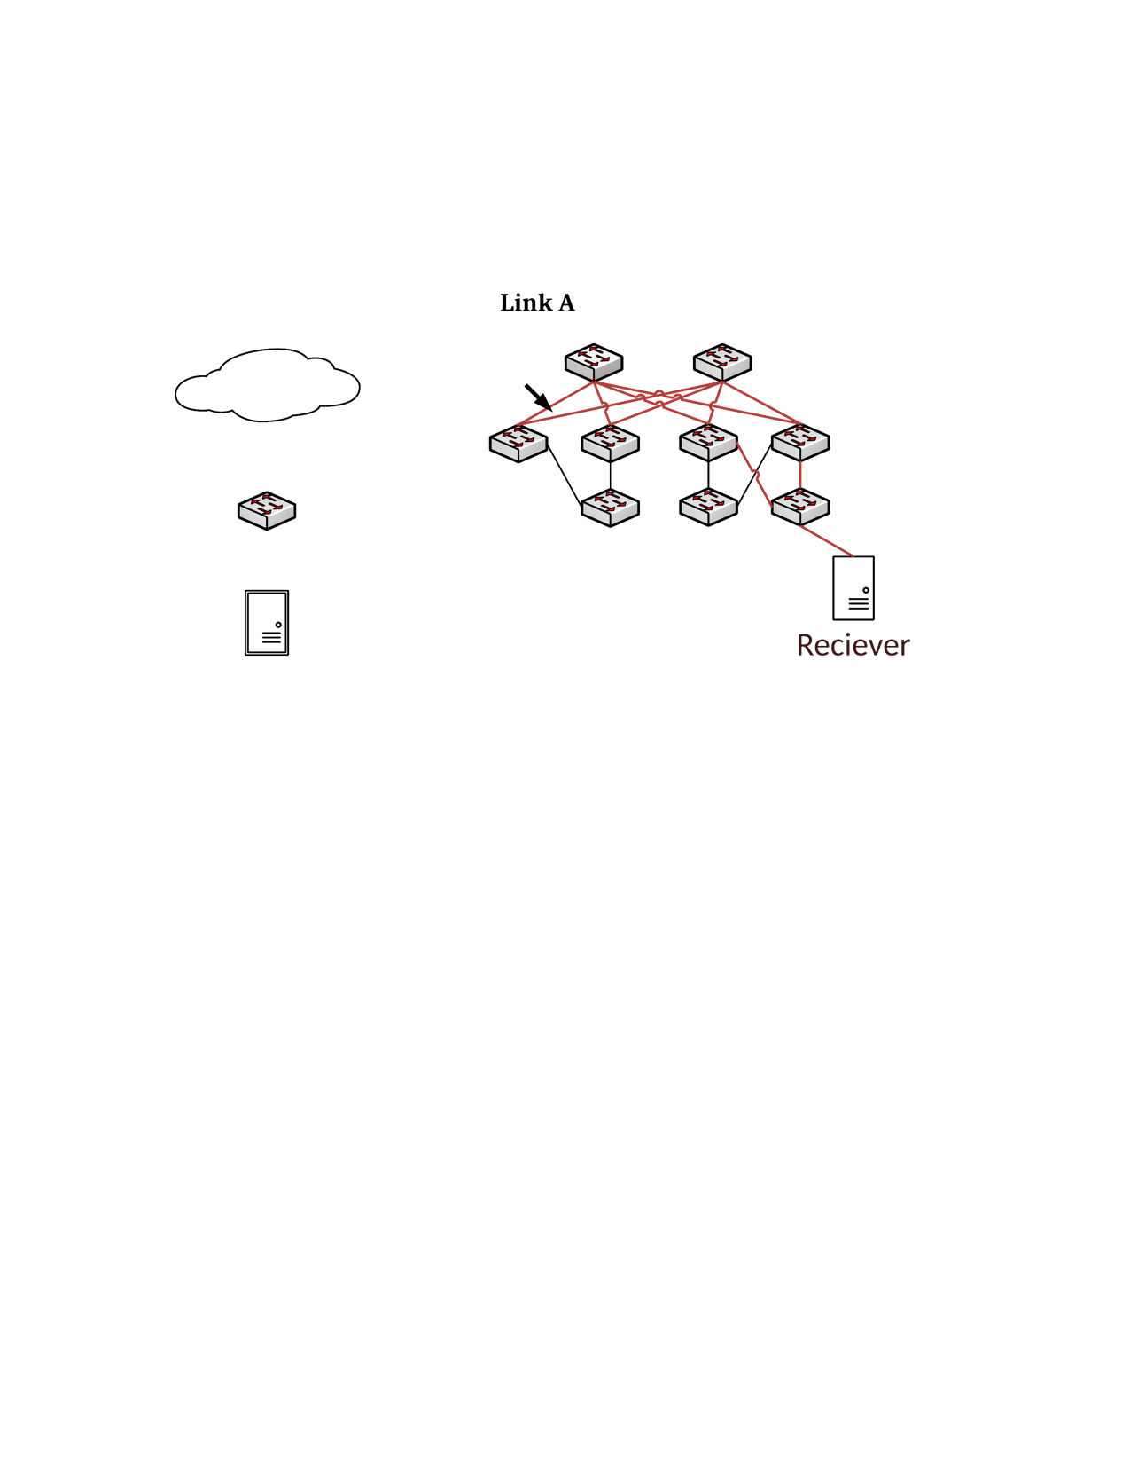
Priority-based Flow Control (PFC)
PAUSE
Congestion
PFC PAUSE threshold: 3
PAUSE upstream neighbor when queue size reaches PFC threshold
  No congestion packet drop
PFC troublesome in large-scale deployments

Slide 66
PFC problems
Need headroom reservation
  Enough to buffer all packets in flight
  Lots of buffer needed if link is loing
Deadlock (A->B->C->B->A)
  Circular buffer dependdency
Victim flows …

Slide 67
Victim Flow Problem
3
2
30
Ideal throughput 40-13.3=26.6Gbps
4
1
20
Throughput (Gbps)
40/3=13.3Gbps
10
0
S
H1 H2 H3
D
S
H1
H2
H3
R
Host
Cascading link PAUSEing
PFC operates on port-level, instead of flow-level
Red flow is victimized

Slide 68
Possible Solutions
Don’t use PFC
  We’ll come back to this later if we have time
Separate priorities for each flow
  Not scalable

Slide 69

Our Solution
PFC as last resort
Keep PFC
Use per-flow E2E congestion control
Per flow CC reduces PFC generation
BUT… lossless→ fast start, no retransmission, ...

Slide 70
What kind of CC do we need?
Must work with commodity hardware
Must be configurable to minimize PFC generation
Can’t rely on packet drops
Easy to implement in hardware

Slide 71
If you can’t rely on packet drops
ECN
Delay
Explicit feedback from routers

Slide 72
Remember DCTCP?
Forget everything about DCTCP.

Slide 73
DCQCN at a glance
Ack
Reaction
Point (RP)
See paper for more details
Notification Point (NP)
Congestion Point (CP)
Data
Data
Sender
Router
Receiver
Count CNPs
Adjust rate accordingly
Mark ECN
Kmin, Kmax and Pmax adjusted to ensure ECN before PFC
Echo ECN to RP
Via CNP

Slide 74
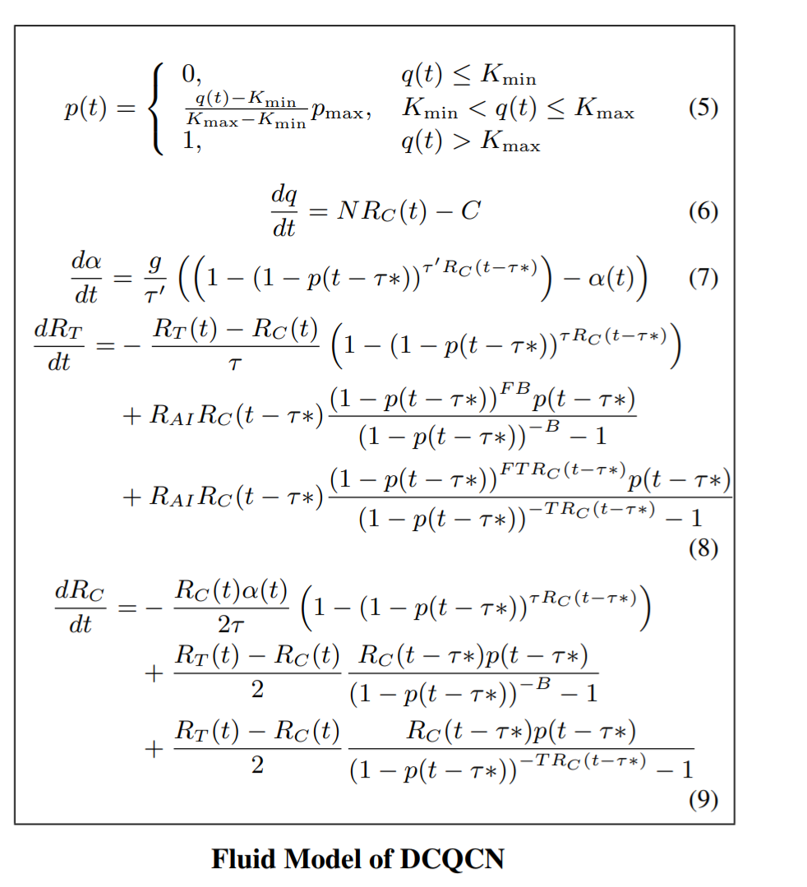
Just to impress you with our math skills ….

Slide 75
In summary
Azure makes money by renting CPUs
TCP wastes CPU
Hence need RDMA
RDMA needs PFC
PFC causes problems
Hence DCQCN

Slide 76
What would you have done?

Slide 77
What’s your problem? What are you trying to solve, really?
Okay, fine. Why should anyone care about this problem?
But .. there is so much prior work. That wasn’t enough?
FINE. What’s your secret sauce?
Right …right. You are so smart. Prove to me that your secret sauce indeed works as promised.
Umm … is anyone really using it? What next?

Slide 78
Results summary
DCQCN reduce PFCs by a factor of 1000
Unfairness, deadlock etc. not seen
Azure RDMA deployment would have been impossible without DCQCN
67% of Azure traffic is on RDMA : O(10¹⁸) bytes /day
TCP is a distant second
The trend will accelerate

Slide 79
Finally
(we believe that) Azure has the world’s largest RDMA deployment
Took lot more than just DCQCN to make it work
See our papers for more … (and more will be written)
Lot of ongoing work: customized rdma, long-haul, many other domains, RDMA to VMs …

Slide 80
What’s your problem? What are you trying to solve, really?
Okay, fine. Why should anyone care about this problem?
But .. there is so much prior work. That wasn’t enough?
FINE. What’s your secret sauce?
Right …right. You are so smart. Prove to me that your secret sauce indeed works as promised.
Umm … is anyone really using it? What next?

Slide 81
Questions? we are hiring …
H/T Sarah McClure, for comments and editing

