Slide 1
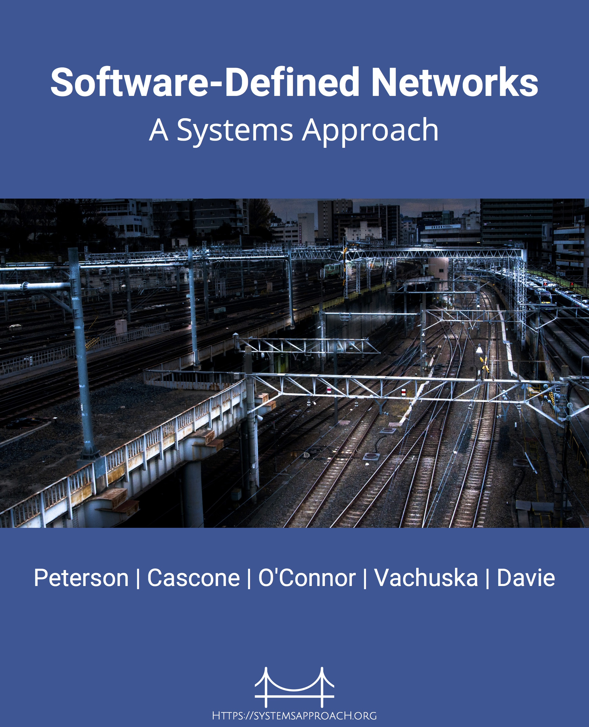
Software-Defined Networks
A Systems Approach
Bruce Davie
Systems Approach, LLC

Slide 2
What is SDN?
There’s a simple answer:
SDN (software-defined networking) is the separation of control and data planes
The separation allows control topology to be independent of physical network topology
The more interesting question is:
Why would anyone want to do this?
That question has a lot of answers…
Logically centralized control plane
e.g. OpenFlow
Data Plane
Notes:
CP is important; OF is a detail

Slide 3
Outline
History of SDN
Challenges faced by IP networks
SDN architecture
Case Studies:
Network Virtualization
Traffic Engineering
SD-WAN
Bare metal switching

Slide 4
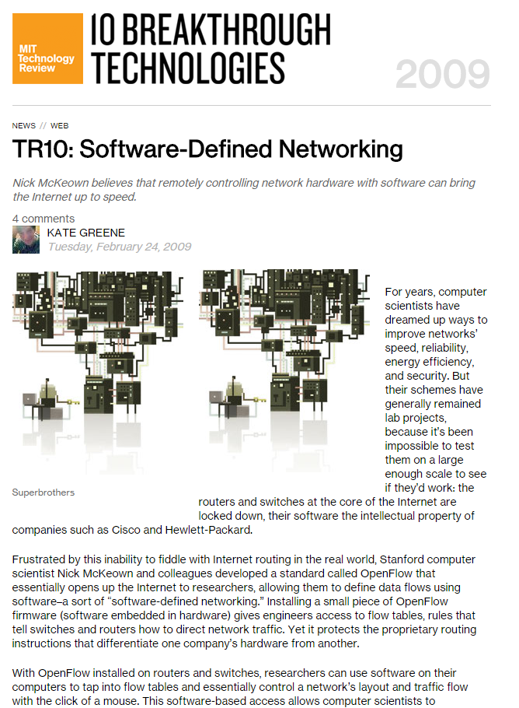
A Revolution in Networking

Slide 5
Foundations of SDN
4D, Greenberg et al. – part of a broader set of “Clean Slate” initiatives
Ipsilon General Switch Management Protocol – RFC 2297 (1996)
IETF Forces WG (2001-2015!!)
Ethane (2007)

Slide 6
Challenges with IP networks
Lack of abstractions
Inability to express intent
Unpredictable outcome from complex distributed algorithms
Interactions among protocols (e.g. IGP & EGP)
Can’t manage a device unless it’s properly configured
bootstrap issue – control & management plane dependent on correct data plane
Fragility, risk of change
Glacial pace of innovation

Slide 7
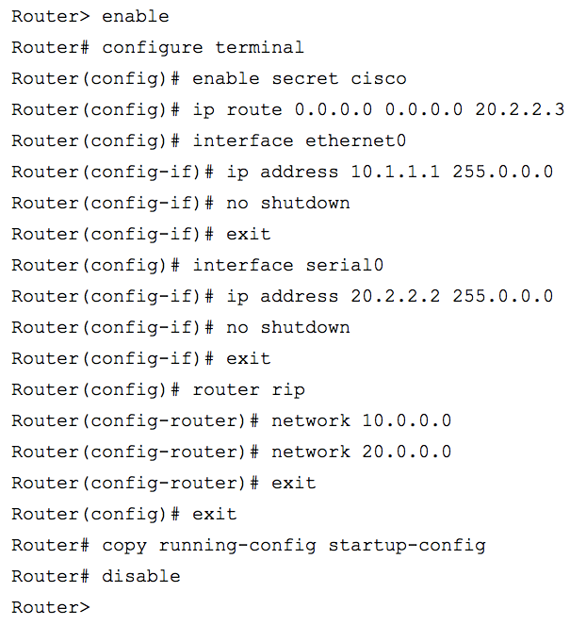
Evolution of network provisioning: 1996-2016
1996
2016
Terminal Protocol: Telnet
Terminal Protocol: SSH
Notes:
Could mention MPLS as example of how hard innovation was pre SDN

Slide 8
Key SDN Insights
Centralizing the control plane enables more powerful abstractions
E.g. X and Y should be able to communicate
Express intent network-wide
Distributed systems techniques to make central control scalable and fault tolerant
Central control means a single API for the network, rather than an API per box
Networks provisioned by software, not humans
Disaggregation → innovation
Network-wide intent → better security

Slide 9
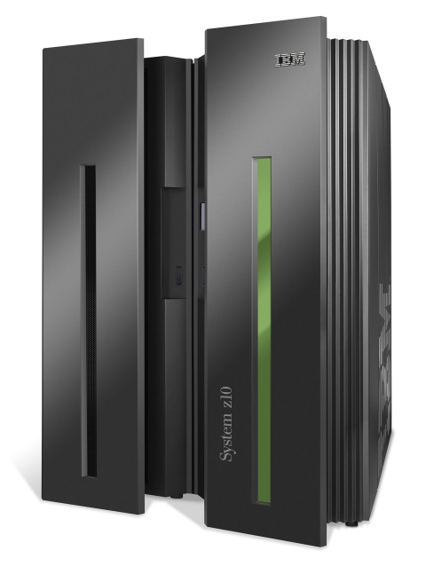
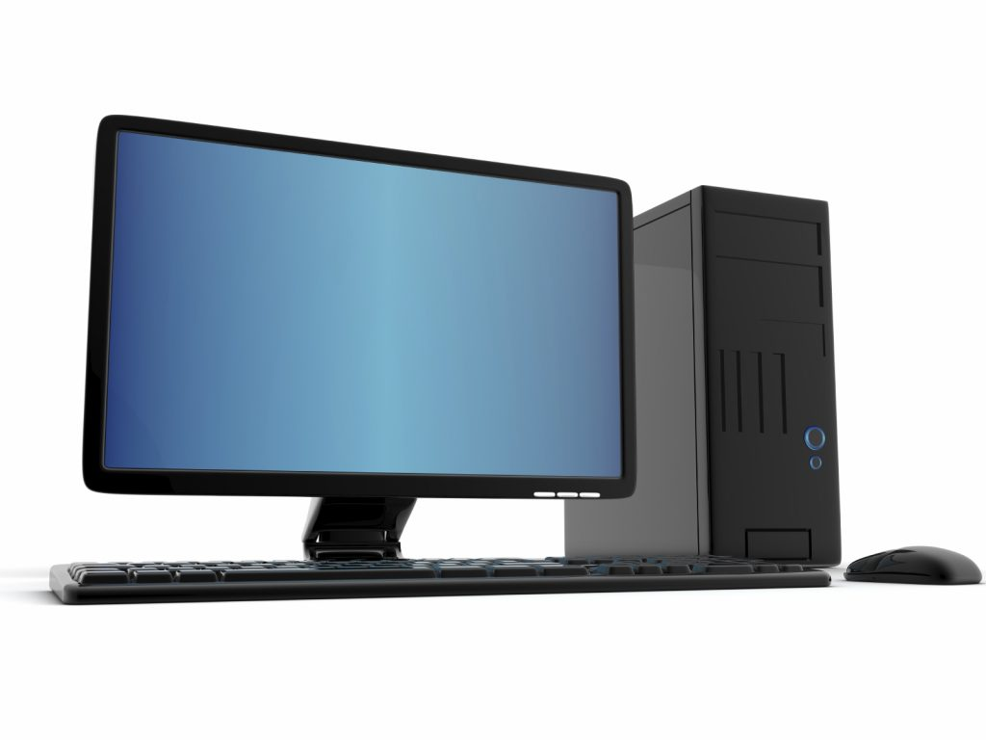
Disaggregation of computing Industry
App
App
App
App
App
App
Specialized
Applications
Open Interface
Windows
Linux
Mac
OS
Specialized
OS
or
or
Open Interface
Specialized
Hardware
Microprocessors

Slide 10
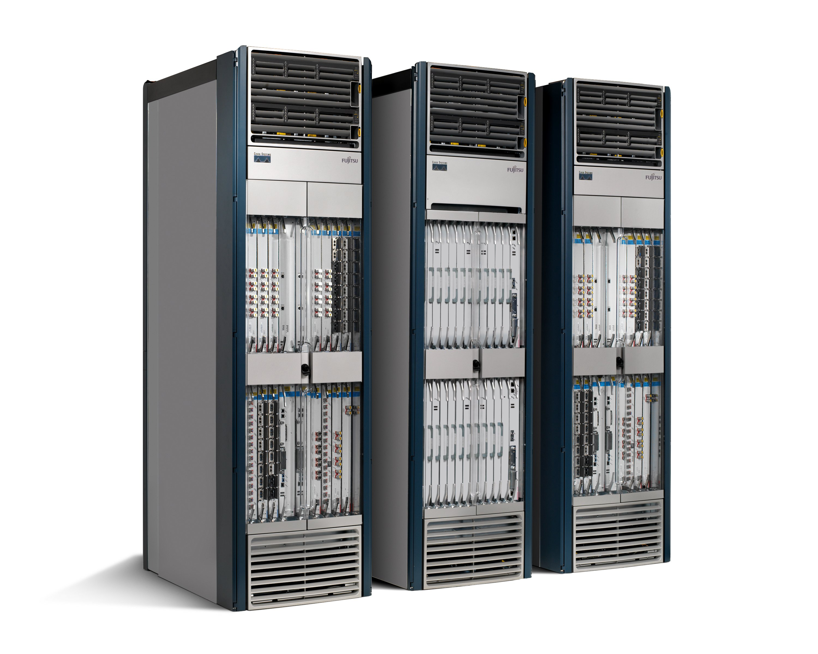
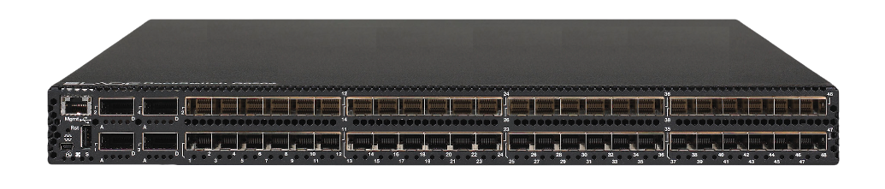
Disaggregation of networking Industry
App
App
App
App
App
App
Specialized
Applications
Open Interface
Network
OS
Network
OS
Network
OS
Specialized
OS
or
or
Open Interface
Specialized
Hardware
Merchant Silicon
Switching Chips

Slide 11
Random side observation
Just because an idea has been tried before without success doesn’t mean it’s a bad idea

Slide 12
SDN Architecture

Slide 13
Traditional Control and Data Planes
Control Plane
Protocols: BGP, OSPF, RIP
RIB: Collection of Link/Path Attributes
Northbound Configuration Interface
e.g., Cisco CLI
Data Plane
Protocols: IP
FIB: Optimized for Fast Lookup
Northbound Control Interface
Historically Private/Internal
Routing Table
(RIB)
Control Plane
Forwarding Table
(FIB)
Data Plane

Slide 14
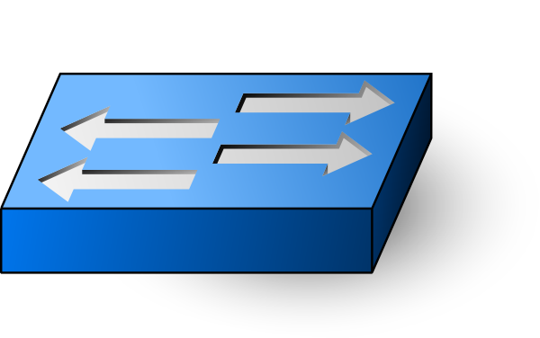
SDN Control and Data Planes
Control
App
Control
App
Control
App
Control
App
. . .
Network OS
Global
Network
Map
Control Plane
Data Plane
Flow Rules

Slide 15
OpenFlow-style data plane
OpenFlow Switch
Packet
In
Table
0
Packet +
Metadata
Table
1
Table
n
Execute
Action
Set
Packet
Out
. . .
Packet
Action
Set = {}
Action
Set
Action
Set
(MAC)
(VLAN)
(IP)
MAC
Header
IP
Header
TCP/UDP
Header
Dst
Addr
Src
Addr
Type
…
Proto
…
Src
Addr
Dst
Addr
…
Src
Port
Dst
Port
…
… Payload …
Type
Ctl
VLAN ID
Optional 802.1Q VLAN Tag
Notes:
Non intuitive: you need a model of the data plane to be able to separate it from control

Slide 16
PISA: Protocol Independent Switching Architecture
Programmable
Parser
Programmable Match-Action Pipeline
Programmable
Deparser
Memory
ALU
Memory
ALU
Memory
ALU
Memory
ALU
Memory
ALU
Memory
ALU
Memory
ALU
Memory
ALU
Memory
ALU
Memory
ALU
Memory
ALU
Memory
ALU
Memory
ALU
Memory
ALU
Memory
ALU
Memory
ALU
Memory
ALU
Memory
ALU
Memory
ALU
Memory
ALU
Memory
ALU
Memory
ALU
Memory
ALU
Memory
ALU

Slide 17
SDN Software Stack
Control
App
Control
App
Control
App
Trellis
gRPC
Network Operating System
gNMI + gNOI + FlowObjectives
API
forward.p4
arch.p4
ONOS
P4
Compiler
gRPC
Programmable Switch
gNMI + gNOI + P4Runtime/OpenFlow
API
Switch OS
Stratum + ONL
Merchant Silicon
Tofino (Barefoot),
Tomahawk (Broadcom)

Slide 18
Scaling the Central Control Plane
Transport Network
WebService API
Persistent Storage
Logical Network
Controller
Controller
Controller
Controller
Controller
Controller
Cluster
Node1
Node2
Node3
Node4
Node5

Slide 19
Summary
Definition of SDN
A network in which the control plane is physically separate from the forwarding plane, and a single control plane controls several forwarding devices. – Nick McKeown (2013)
Dimensions
Disaggregated Control and Data planes
Centralized vs Decentralized Control Plane
Fixed-Function vs Programmable Data Plane
Phases of SDN
Phase 1: Network operators took ownership of the control plane.
Phase 1a: Non-traditional entrants to the networking business (via disaggregation)
Phase 2: Network operators are taking ownership of the data plane.

Slide 20
Use Cases
Network Virtualization
SD-WAN
Traffic Engineering
Bare Metal Switching
Inband Network Telemetry

Slide 21
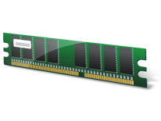
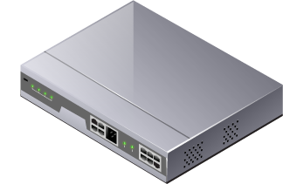
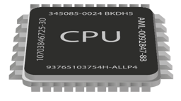
Network Virtualization – An Analogy
Application
Application
Application
Workload
Workload
Workload
x86 Environment
L2, L3, L4-7 Network Services
Virtual Machine
Virtual Machine
Virtual Machine
Virtual Network
Virtual Network
Virtual Network
Hypervisor
Decoupled
Network Virtualization Platform
Requirement: x86
Requirement: IP Transport
Physical Compute & Memory
Physical Network

Slide 22
2009

Slide 23
2012

Slide 24



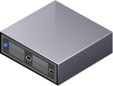
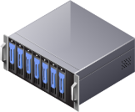
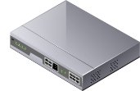
Virtual Machines to Virtual Networks
vSwitch
Hypervisor
vSwitch
Hypervisor
vSwitch
Hypervisor
vSwitch
vSwitch
Hypervisor
Hypervisor
Virtualization layer
vSwitch
Hypervisor
vSwitch
Network, storage, compute
Hypervisor
vSwitch
Hypervisor

Slide 25


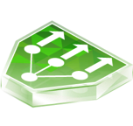
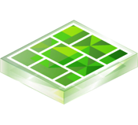







Virtual Machines to Virtual Networks
vSwitch
Hypervisor
Virtual Data Centers
vSwitch
Hypervisor
vSwitch
“Network hypervisor”
Hypervisor
vSwitch
vSwitch
Hypervisor
Hypervisor
Virtualization layer
vSwitch
Hypervisor
vSwitch
Network, storage, compute
Hypervisor
vSwitch
Hypervisor

Slide 26






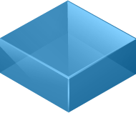

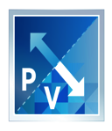
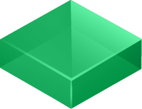
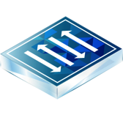
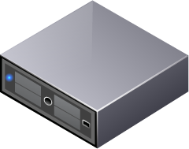
Network Virtualization Components
Cloud Consumption
Self Service Portal
OpenStack, Kubernetes, etc
Manager
Single configuration portal
REST API entry-point
Manages Logical networks
Run-time state
Scale out, HA
Separation of Control and Data Plane
Controller
Data Plane
High–Performance Data Plane
Scale-out Distributed Forwarding Model
Distributed Services
Virtual Edge
Logical Switch
Distributed Logical Router
Firewall
Load Balancer
vSwitch
Hypervisor
Notes:
Hyperv possible

Slide 27
Management, Control and Data Planes
Network topology request
Request stored and acknowledged
MANAGEMENT
PLANE
CONTROL
PLANE
Desired State
Calculate data plane state
Discovered State
Translated State
DATA
PLANE
Identify data plane resources
Realized State
Notes:
Show a logical topology getting mapped from top to bottom with animation

Slide 28

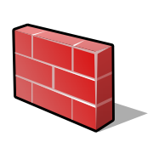

Problem: Data Center Network Security
Perimeter-centric network security has proven insufficient
Data Center Perimeter
Internet
VM
VM
VM
VM
VM
VM
VM
Today’s security model focuses on perimeter defense
But continued security breaches show this model is not enough

Slide 29

Microsegmentation and Zero Trust
Perimeter firewall
DMZ VLAN
VM
VM
VM
VM
VM
VM
Inside
firewall
App VLAN
Finance
HR
IT
VM
VM
VM
VM
VM
VM
Finance
HR
IT
DB VLAN
VM
VM
VM
VM
VM
VM
Finance
HR
IT
Services VLAN
VM
VM
VM
VM
VM
AD
NTP
DHCP
DNS
CERT
Notes:
All Apps on a VLAN can communicate freely
Once one App is compromised, lateral movement cannot be restricted
Micro-segmentation can granularly control apps even on shared VLAN

Slide 30
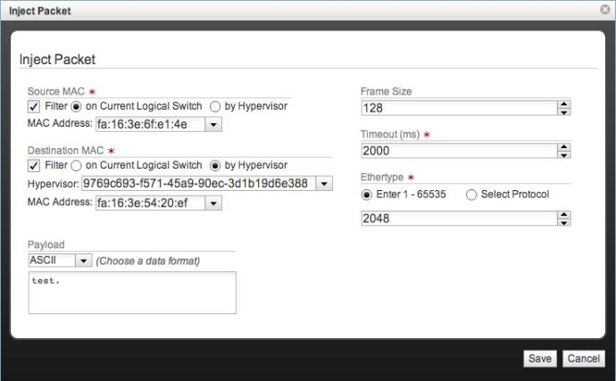
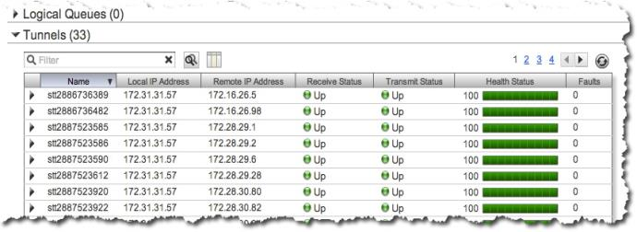
Visibility: changing the laws of physics
Historically challenging to troubleshoot connectivity between VMs
Is the problem in vswitch or physical network?
What’s the path through the physical network?
Is there a (misconfigured) middlebox in the path?
Network virtualization gives us tools to handle this:
Decomposition: separate the physical from the virtual
Global view: see all the logical network state (port stats, drops, etc.) and tunnel health from the controller API
Synthetic traffic: insert packets at vswitch as if the VM generated them

Slide 31
Network Virtualization – Discussion
90% of Fortune 100 have deployed network virtualization
Foundational to hyperscale data centers
Network configuration no longer the “long pole”
A key step towards better network security (but much work remains)
Increasingly important for microservices, kubernetes etc.
Commodifying effect on physical networking
Service Mesh can be viewed as a form of Network Virtualization

Slide 32

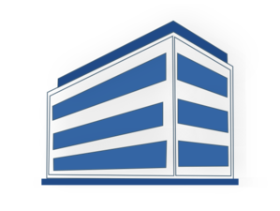
SD-WAN
Network Policies
SD-WAN Controller
Cloud Services
Corporate
Datacenter
Branch
Overlay Tunnel
SD-WAN Edge
Main Office

Slide 33
Traffic Engineering
Network Policies
Controller
Datacenter
Datacenter
Datacenter

Slide 34
Datacenter Switching Fabric
Internet
Leaf-Spine Topology
Leaf Switches = Top-of-Rack (ToR)
Optimized for East-West Traffic
Built-in Redundancy (not shown)
Scale with additional layers
Well-Established in Commodity Clouds
Bare-Metal Switches
Control Plane running in the cloud
Spine
Spine
Spine
Leaf
Leaf
Leaf
Leaf

Slide 35
Leaf-Spine Switching Fabric
Spine
Spine
Spine
Trellis Design
Intra-Rack: L2 Domain within L3 Subnet
Inter-Rack: L3 Routing between Subnets
Segment Routing across Fabric
Trellis Features
VLANs / QinQ
End-to-End L2 Tunnels
IPv4 / IPv6 Routing
Multicast (with IGMP)
ARP (IPv4) / NDP (IPv6)
DHCPv4 / DHCPv6
High Availability
Leaf
Leaf
Leaf
Leaf

Slide 36
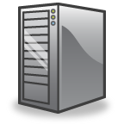
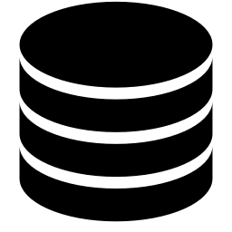
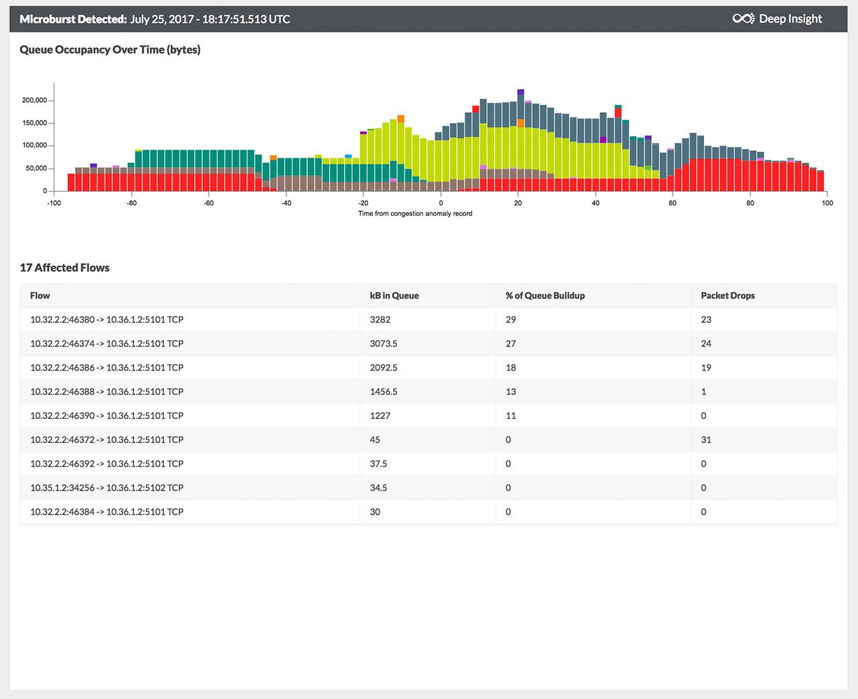
Inband Network Telemetry (INT)
Add Switch ID, arrival time, departure, queue delay, etc.
Generate report with switch metadata
Header
Header
Metadata S1
Metadata S1
Metadata S2
Header
Payload
S2
Payload
Header
Payload
Payload
S1
S3
S5
Metadata S1
Fine-Grain Telemetry
Flow Rule(s) that matched
Queuing delays of individual packets
Other flows being buffered
…
Uses
Verify correct behavior
Identify micro-bursts
…
Metadata S2
S4
Metadata S5
Log, analyze, replay, visualize

Slide 37
SDN Challenges
Scale
Stability & Correctness
Timeliness
Inter-domain
Notes:
Scale example – from NSX-mh to NSX-T (fewer hosts etc), API scale for NSX-T

Slide 38
Discussion
Notes:
What do you think is next? – Fully automated networks?
Does the innovation argument hold up?
How does BGP play into this? Interdomain still seems broken.
Architecture papers are the exception. Networking people love protocols.

