Slide 1
CORFU & Tango
Concurrent, Consistent Applications over a Distributed Shared Log

Slide 2
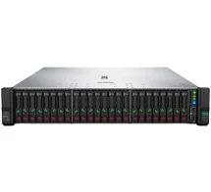
Paxos is an
“application framework”
that employs replication for availability.
It offers no scalability.
Paxos

Slide 3
Paxos
Paxos
Paxos
Paxos

Slide 4
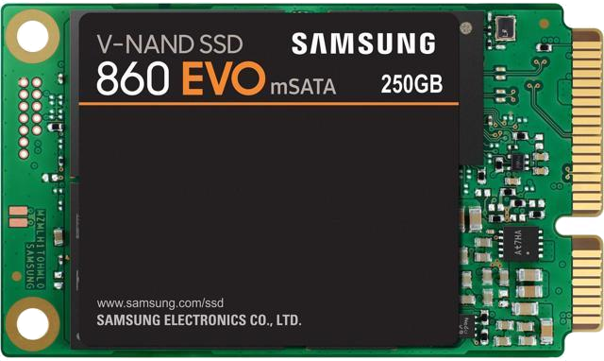
Corfu/Tango is an
“application framework”
that employs replication for availability and scalability.
Tango
Corfu

Slide 5
Skim the Tango paper.

Slide 6
Look for...
atomicity semantics across applications
requirements on the “sequencer node”
how does reconfiguration work, preserving serializability?
where does state-machine execution happen?
observe client-driven activity

