Slide 1



SQL is Dead; Long Live SQL:
Smart Services for
Ad Hoc Databases
Bill Howe
Garret Cole
Alicia Key
Nodira Khoussainova
Luke Zettlemoyer
Yuan Zhou
Patrick Michaud
Kevin Pittman
Charlon Palacay
Notes:
Spreadsheets to Databases
Other Large Scale
Query Services
Ad Hoc Research Data
Cloud-based
Ad Hoc Integration
Dataspace
Cloud-sourced integration
SQLShare: Database as a Service for Ad Hoc Science Data

Slide 2
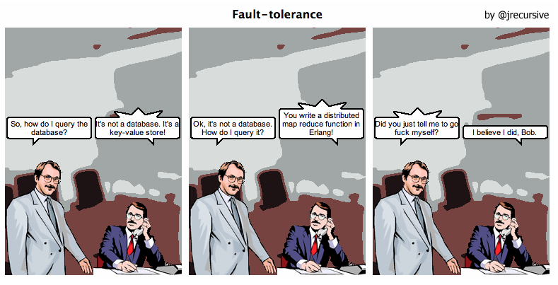
The NoSQL Movement

Slide 3


Slide 4
http://escience.washington.edu

Slide 5
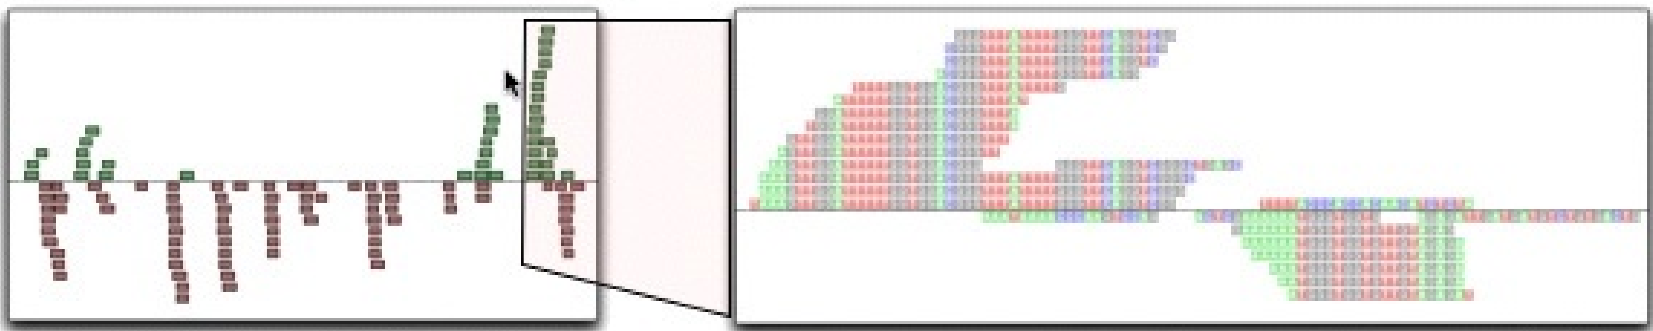
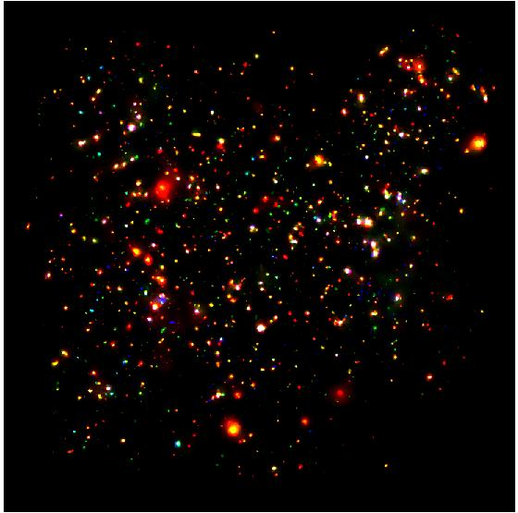
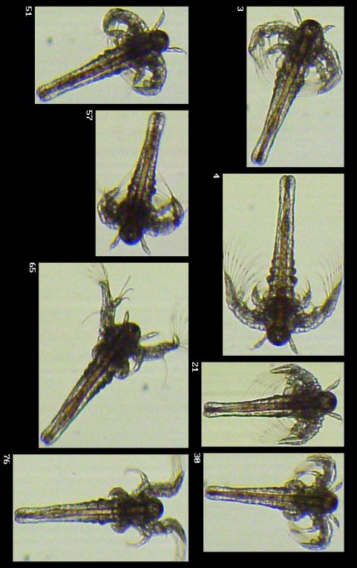
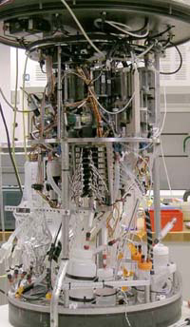
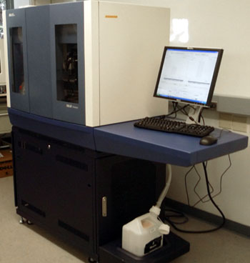

Science is reducing to querying databases
Old model: “Query the world” (Data acquisition coupled to a specific hypothesis)
New model: “Download the world, query the DB” (Data acquired en masse, to support many hypotheses)
  Astronomy: High-resolution, high-frequency sky surveys (SDSS, LSST, PanSTARRS)
  Oceanography: high-resolution models, cheap sensors, satellites
  Biology: lab automation, high-throughput sequencing,
Notes:
Drowning in data; starving for information
We’re at war with these engineering companies. FlowCAM is bragging about the amount of data they can spray out of their device. How to use this enormous data stream to answer scientific questions is someone else’s problem.
“Typical large pharmas today are generating 20 terabytes of data daily. That’s probably going up to 100 terabytes per day in the next year or so.”
“tens of terabytes of data per day” -- genome center at Washignton University
Increase data collection exponentially with flowcam

Slide 6
Context: The Long Tail [Wired 2004]
LSST (~100PB)
Researchers with growing data management challenges but limited resources for cyberinfrastructure
No dedicated IT staff
Overreliance on desktop tools (e.g., spreadsheets)
CERN (~15PB/year)
PanSTARRS (~40PB)
The long tail is getting fatter:
notebooks become spreadsheets (MB), spreadsheets become databases (GB), databases become clusters (TB) clusters become clouds (PB)
data size
SDSS (~100TB)
Ocean Modelers
CARMEN (~50TB)
Seis-mologists
Microbiologists
citizen science
rank
Notes:
The long tail of eScience -- huge number of scientists who struggle with data management, but do not have access to IT reesources -- no clusters, no system administrators, no programmers, and no computer scientists.
They rely on spreadsheets, email, and maybe a shared file system.
Their data challenges have more to do with heterogeneity than size: tens of spreadsheets from different sources.
However: the long tail is becoming the fat tail. Tens of spreadsheets are growing to hundreds, and the number of records in each goes from hundreds to thousands. How many of you know someone who was forced to split a large spreadsheet into multiple files in order to get around the 65k record limit in certain versions of Excel?
Further, medium data (gigabytes) becomes big data (terabytes). Ocean modelers are moving from regional-focus to meso-scale simulations to global simulations.

Slide 7
Problem
How much time do you spend “handling data” as opposed to “doing science”?
Mode answer?
90%
Notes:
(granted we had a minute for Bill (clearly Bill) to describe this new eScience movement)
We want to give a little background of our project before we launch into it, so we will discuss the problem we are trying to solve.
Essentially, we want to remove the speed-bump of data handling from the scientists.

Slide 8
Example: Environmental Metagenomics
5/18/10
Garret Cole, eScience Institute

Slide 9
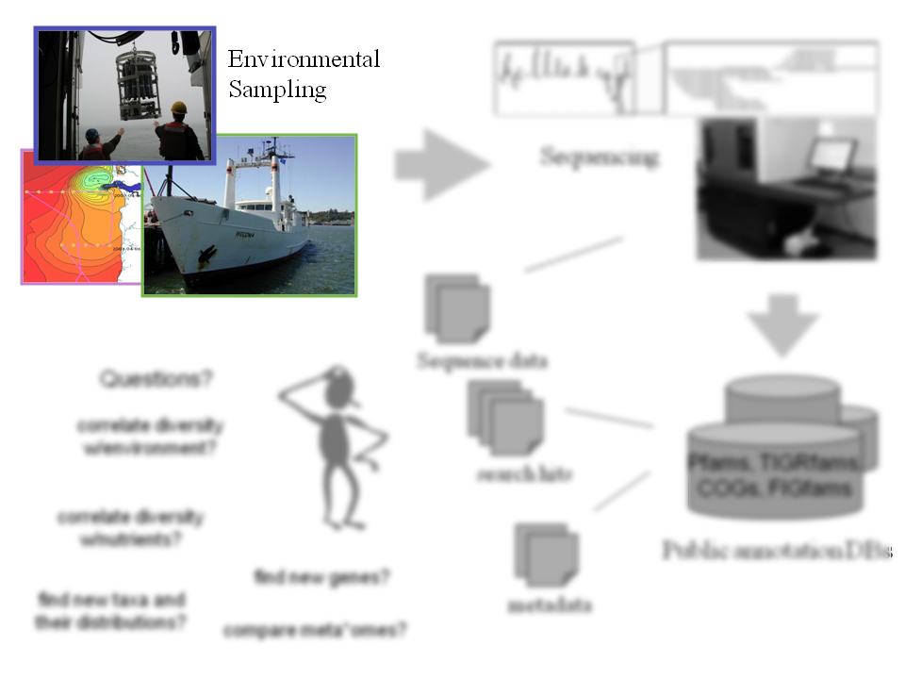
5/18/10
Garret Cole, eScience Institute
Notes:
9
Lets see how heterogeneous some of this data can actually get before its ready to be digested into a database.
In Enviromental Metagenomics, we start by collecting by taking samples from the water

Slide 10
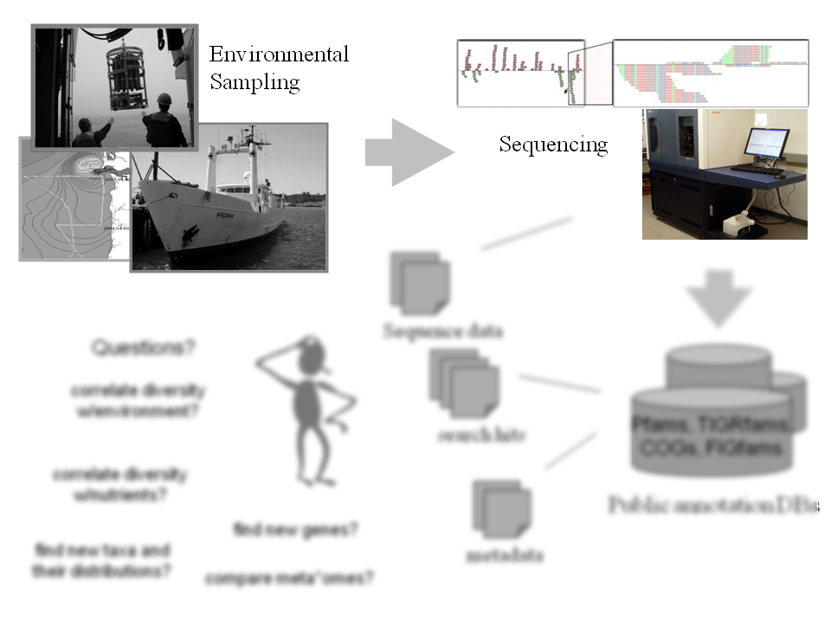
5/18/10
Garret Cole, eScience Institute
Notes:
The DNA material in the samples taken from the water are then sequenced in a machine to produce millions of short strings
10

Slide 11
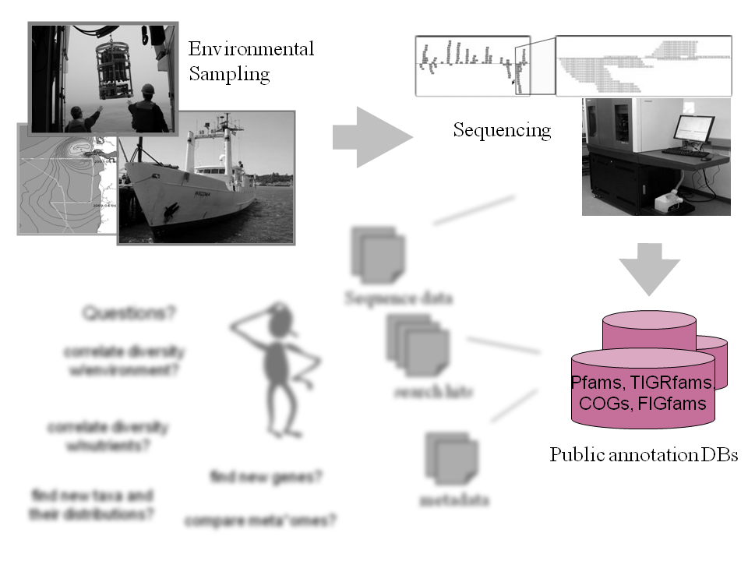
5/18/10
Garret Cole, eScience Institute
Notes:
These DNA reads can then be cross-referenced in public databases to determine what organisms were present in the water, and what genes were being expressed
11

Slide 12
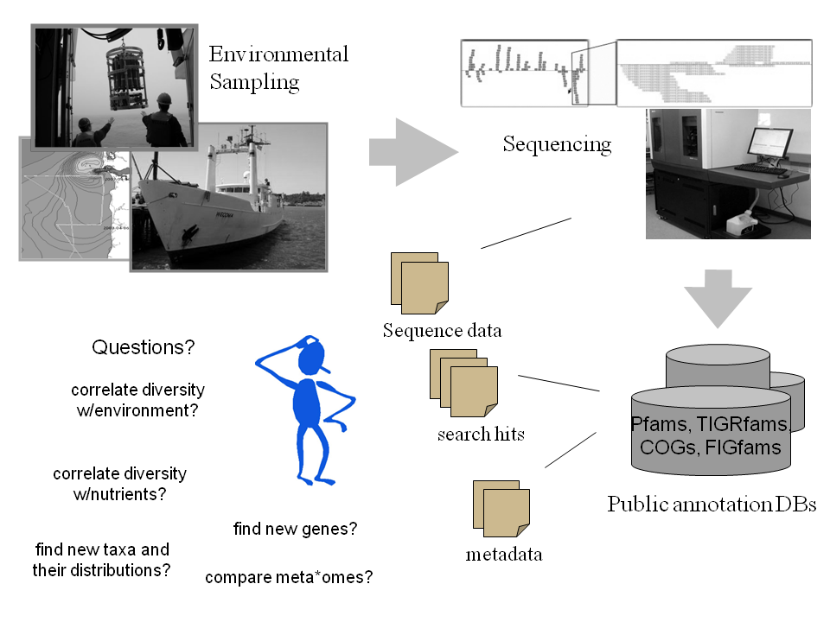
measurements
sequence data
search results
Notes:
Each step generates a bunch of “residual” data, usually in the form of spreadsheets or text files.
This process is repeated many times, leading to 100s of spreadsheets
At this point, the actual science questions are answered using these spreadsheets by computing “manual joins”, creating plots, searching and filtering, copying and pasting, etc.
It’s a mess -- when asked how much time is spent “handling data” as opposed to “doing science”!
We’ve heard that 90% of their work is manipulating the data before they can actually answer a question!
12

Slide 13
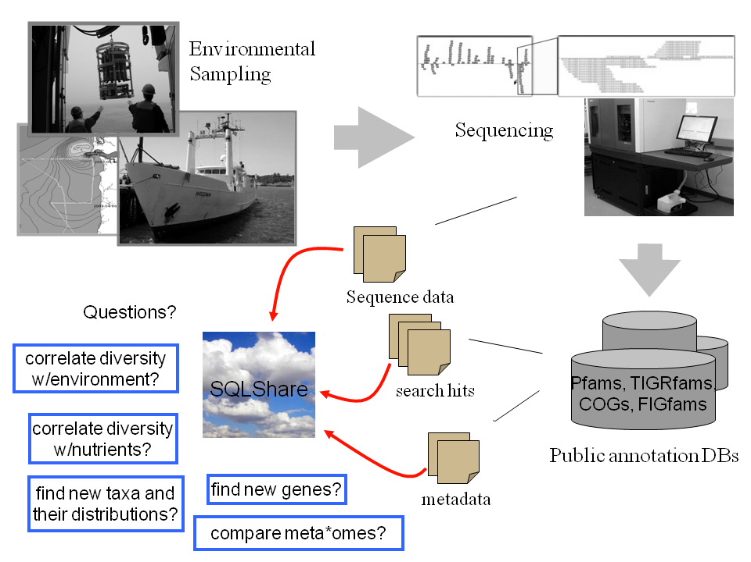
SQL
5/18/10
Garret Cole, eScience Institute
Notes:
13
At this point, we try to relieve the scientists of having to deal with multiple spreadsheets and file formats by just “dumping everything” into this mystical program that unifies everything under one banner.
With no schema design to constrain the data, everything is uploaded “as is” and is ready to be queried upon.
-- How?
1) Use the cloud to logically and physically co-locate all data across all labs -- no more islands
2) Let queries be saved and shared
3) Log everything and do machine learning on the log to perform “Query autocomplete” (Nodira and Magda’s work)
4) Automatically adapt queries for use on ‘similar’ datasets (change table names, etc.)
many more ideas….

Slide 14
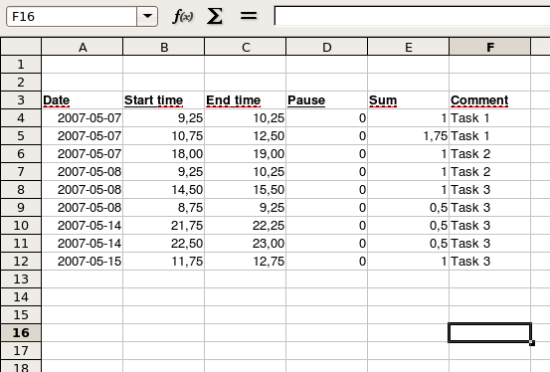
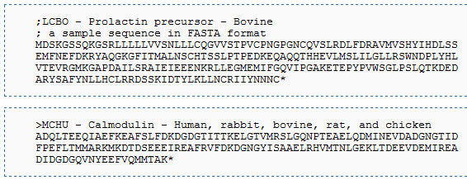
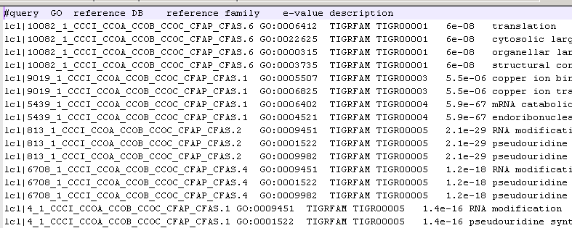
Ad Hoc Research Data
Spreadsheets
Fasta
ASCII
Notes:
What exactly is Ad Hoc Research data?
It is data that can come in any size shape or form, where the data is heterogeneous within its structure, format, quality, and more.

Slide 15
Simple Example
ANNOTATIONSUMMARY-COMBINEDORFANNOTATION16_Phaeo_genome
COGAnnotation_coastal_sample.txt
SELECT * FROM Phaeo P, Coastal C WHERE P.hit = C.hit
Notes:
Previously, researchers had to manually cross-reference data between spreadsheets.
We’ve heard that this process in particular could take a week to do depending on the number of data sources.
But as common database users, we recognize that the join between these datasets is trivially expressed in SQL

Slide 16
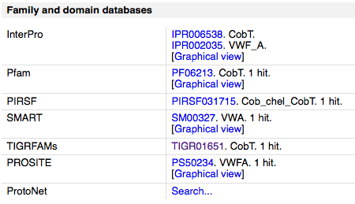
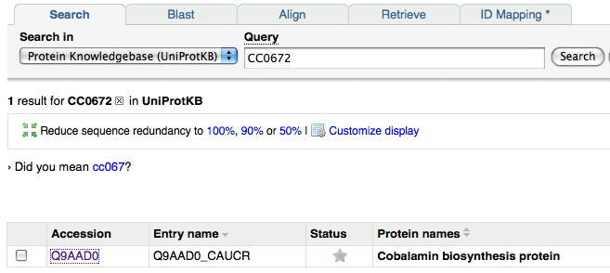
Complex Example
ANNOTATIONSUMMARY-COMBINEDORFANNOTATION16_Phaeo_genome
coastal sample
Browser Cross-Reference
COG database
SwissProt web service
coastal sample
TIGRFAM to GO Mapping
TIGR01650 GO:0051116 contributes_to
TIGR01651 GO:0009236 NULL
TIGR01651 GO:0051116 NULL
TIGR01660 GO:0008940 NULL
TIGR01660 GO:0009061 NULL
TIGR01660 GO:0009325 NULL
TIGR01663 GO:0000012 NULL
TIGR01663 GO:0046403 NULL
Notes:
In the previous case, the same source of database identifiers were used; when they differ the process can be more complicated.
Here we have two datasets: Phaeo gene annotations again, and set of sample annotations with references to the TIGRFam database.
The workflow here might look like:
Find an annotation of interest in Phaeo dataset
Look up COG Id to get Protein Name
Search for Protein Name in various online databases (here we use SwissProt) to collect additional information
Browse to cross-reference information to find TIGRFam Id,
Find Gene Ontology synonym of the TIGRFam Id to collect additional metadata (other metadata not shown -- another step)
Finally, match TIGRFam Ids back to original sample.
By putting all of this data into a database, you can write these expressions as joins. More importantly, you can go beyond “lookup” tasks and express the actual science questions directly:
What percentage of Phaeo genes are present in this sample? What metabolic processes are those genes involved in?
Note that we do NOT want to attempt to create “YAUDB” (yet another universal database). these data are uploaded and manipulated in an exploratory, task-specific manner. We aim to provide SQL over YOUR data, not a universal reference database from scratch.
(That being said, our research involves learning a universal database schema -- incrementally and organically -- based on the upoloaded data, the executed queries, and any available user input.
Bill

Slide 17
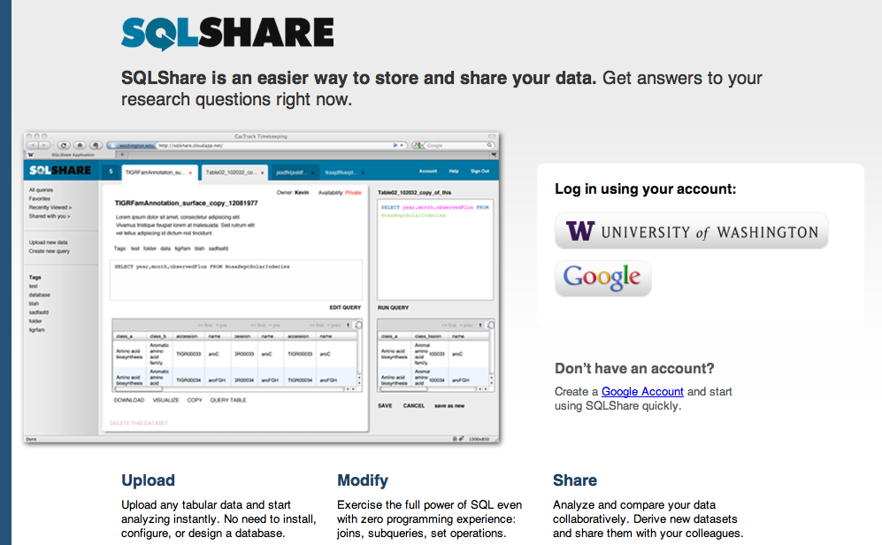

Slide 18
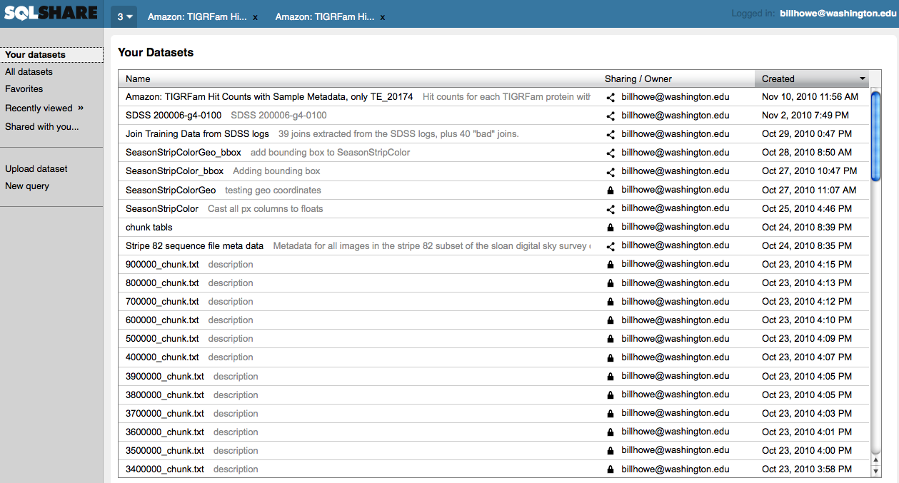

Slide 19
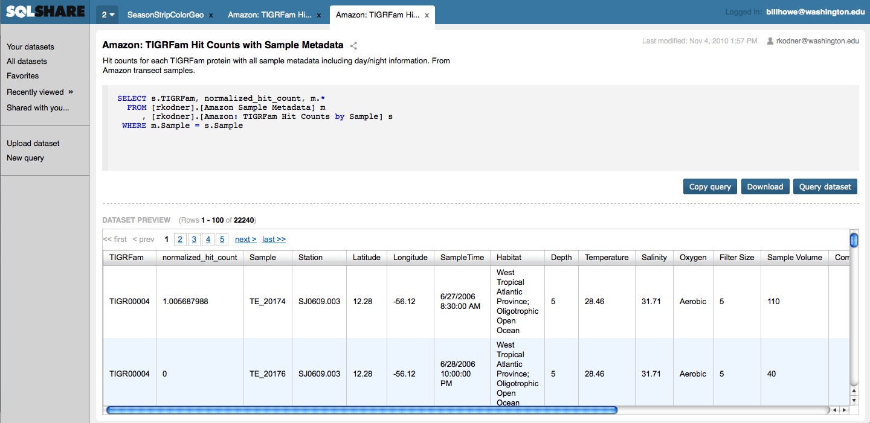
Demo

Slide 20
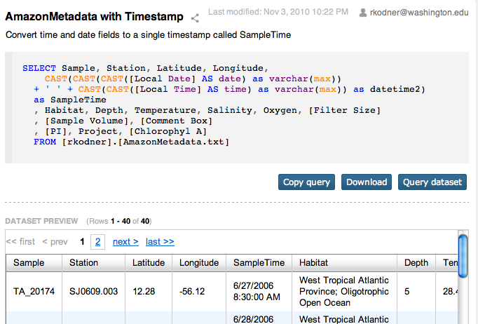
share status
name
owner
description
SQL
actions
preview
Notes:
The roots of a dataset is built on a SQL query (SQL).
Meta data we use for both the application and database side is the
Name = becomes the target name of the view definition built on this SQL query
Share status = to share with other users, or if this query should not be released to others for viewing
Because each dataset is built on top of a view, some views are quite expensive to process each time a user visits the dataset. We address this issue by caching a snapshot of n-rows of this query so that when this dataset is visited, a preview is instantly generated and delivered to the client.
Actions allow the user to interact with the query such as, if they wish to edit the SQL directly, or derive a query on top of this dataset.
The download link allows a user to download the whole dataset as a structured delimited file if they wish to open up directly into Excel for chart creation.
On the road: Excel addon to bypass this extra step of downloading and opening.

Slide 21
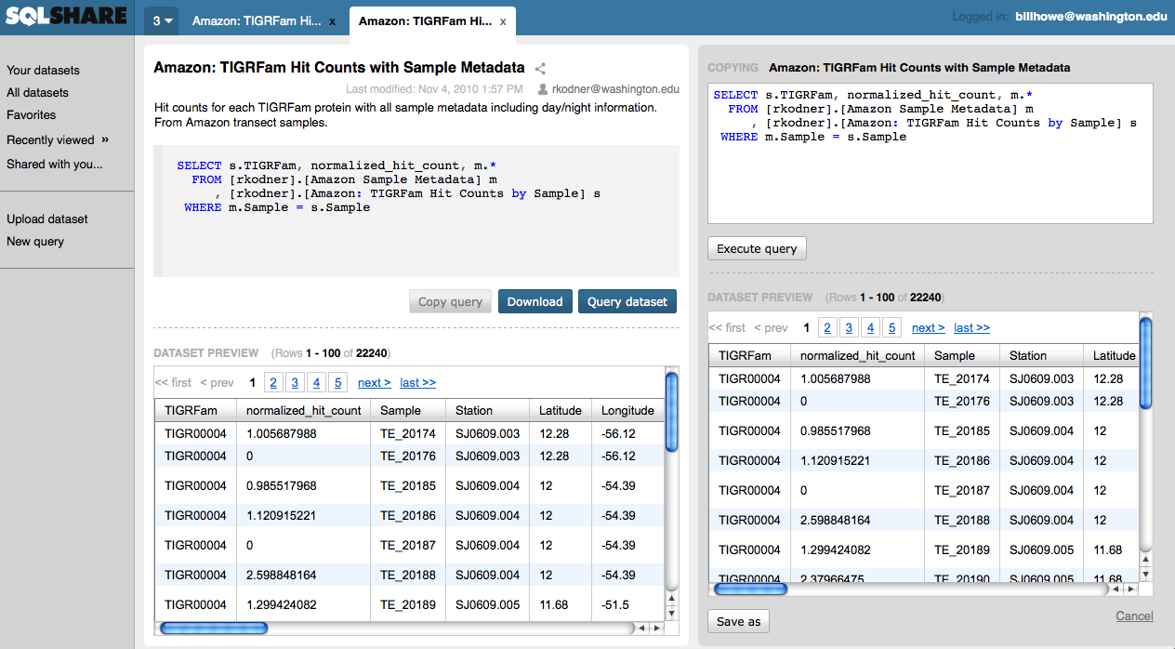

Slide 22
Architecture
Excel Addin
ASPX App
REST
Windows Azure
SQL Azure
Silverlight Uploader
Python API
SQL Server on EC2
“Flagship” SQLShare App
(PHP) on EC2

Slide 23




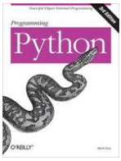



API Authentication
Step 1
UI
Step 2
REST
(Authenticated)
Request API key
Authenticate with API key
REST
REST
API Keys
OK!
Notes:
Like many social network that use a similar way of outsourcing login credentials, we need to define our own trusted user system using API keys. These keys will still need to be obtained from the GUI front end, but once obtained, it can be used in the Authorization header inside the REST HTTP call to authenticate the user to work within the SQL Share REST interface.

Slide 24

Sharing data
Share with Postdoc
Publish a paper
Scientist
Researcher
View X
View Y
Data space
Notes:
The scenario:
A scientist collecting data wants to share a dataset [View X] with the Researcher. The Researcher wants to publish a paper with the a filtered version of the set that the scientist wants to share. Although the scientist wants to share with the researcher who knows they will publish to the public, they do not want to share the original dataset

Slide 25


1
Scientist
2
Researcher
3
View X
View Y
BAD!
Data space
Notes:
Achieving these results seems rather trivial,
Allow the researcher to select on View X
The researcher then creates a view upon the shared object
The researcher grants SELECT ON visibility to the world (public)
You would think that other users in the database would be able to SELECT from Researcher’s View Y, however the case is that is NOT true. The error message (as shown (click) ) appears when
The only way to allow the rest of the users to see View Y which is built on View X is for the owner of View X to grant its SELECT ON permission to public. That’s bad! It compromises the original goal

Slide 26
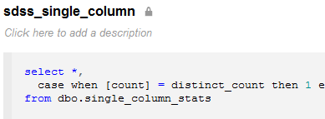
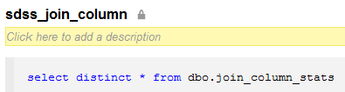
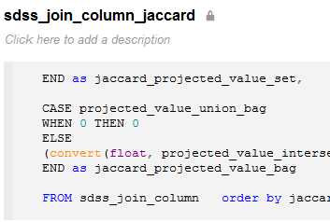
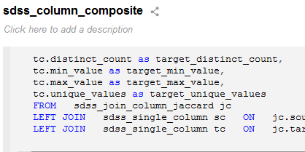
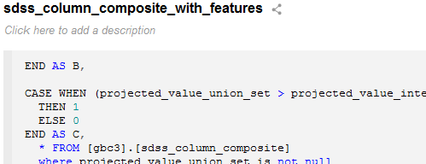
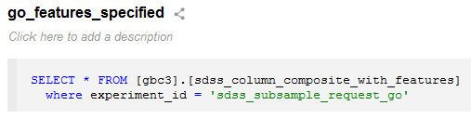
View-oriented workflow
Notes:
You can see, as we go into depth into our queries, we can do seemingly complicated things but make them look relatively easy when broken up into individual queries

Slide 27
More examples
Which samples have not been cloned?
How often does each RNA hit appear inside the annotated surface group?
How many plasmids were bombarded in July and have a rescue and expression?
SELECT *
FROM plasmiddb
WHERE NOT (ISDATE(cloned)
OR cloned = ‘yes’)
SELECT hit, COUNT(*) as cnt
FROM tigrfamannotation_surface
GROUP BY hit
ORDER BY cnt DESC
SELECT count(*)
FROM [bombardment_log]
WHERE bomb_date BETWEEN
’7/1/2010' AND ’7/31/2010'
AND rescue clone IS NOT NULL
AND [expression?] = 'yes'
Notes:
To begin, we ask, what kind of questions would you ask your data once you have it ready to be worked on?
Just about EVERY question that we have heard a scientist would ask, we have found an equivalent SQL statement counterpart.
If we could just turn their questions in SQL our job would be done, but there are many other problems to solve before that becomes a reality. For example, their data may not reside in a relational database.
This brings us to part of our next problem: how can we bring the power of SQL to the scientists to solve their questions without the overhead of everything that a database administrator would need to do.
27

Slide 28
My favorite example
Find all TIGRFam ids (proteins) that are missing from at least one of three samples (relations)
SELECT col0 FROM [refseq_hma_fasta_TGIRfam_refs]
UNION
SELECT col0 FROM [est_hma_fasta_TGIRfam_refs]
UNION
SELECT col0 FROM [combo_hma_fasta_TGIRfam_refs]
EXCEPT
SELECT col0 FROM [refseq_hma_fasta_TGIRfam_refs]
INTERSECT
SELECT col0 FROM [est_hma_fasta_TGIRfam_refs]
INTERSECT
SELECT col0 FROM [combo_hma_fasta_TGIRfam_refs]

Slide 29
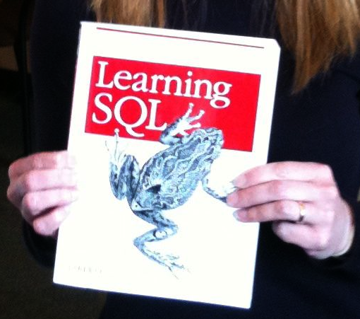
So what’s the point?
Databases appear underused in (long tail) science
Conventional wisdom says “Scientists wont write SQL”
  This is utter horseshit
  c.f. SDSS, Life Under Your Feet, UW eScience
Instead, we blame the up-front costs
  installation
  configuration
  schema design
  performance tuning
  loading
  app-building
So we ask:
What kind of platform can deliver SQL to scientists?

Slide 30
Desiderata for a “SQL Delivery Vector”
Logical data independence is a good idea; let’s do more of that
Loading data is always a pain; let’s make that easier
No updates to science data; let’s cache aggressively and support append/replace only
Scale is small (O(100) spreadsheets); let’s not worry too much about physical tuning
Reliable schemas are elusive at the frontier of research; let’s worry about that later (or not at all)
SQL is not difficult to learn – given a set of relevant “starter queries” to build from

Slide 31
Status
about 6 months old, no active advertising
4 groups associated with have data uploaded
50 unique users
566 uploaded tables
181 views
16GB of data
3 short/demo papers; “flagship” paper underway
Interested parties
  NatureMapping project, Washington Sea Grant, H2O, HIV Global Enterprise, San Juan country MRC, NatureMapping Project, MSR in various contexts
“quiet” release underway; wide announcement pending scalability planning – we need advice!

Slide 32
Use cases we are seeing
Poor man’s LIMS
  Enter data via spreadsheets, upload to SQLShare for holistic analysis
Pilot Projects
  Before investing in a conventional database design project, throw your data in SQLShare to understand what you’re working with
Collaborative Query Management System*
  YouTube for SQL Queries
Data “Instrument”**
  Put your scattered data under the “SQLScope”
Citizen Science
  Stage 1: Democratization of Data Collection
  Stage 2: Democratization of Data Analysis
*Khoussinova, CIDR 2009
**credit: Alex Szalay

Slide 33
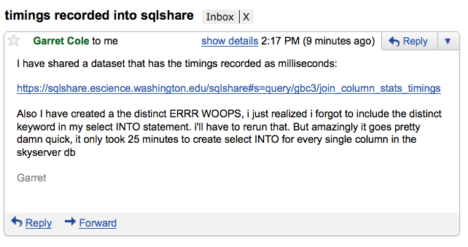
Eating our own dogfood

Slide 34
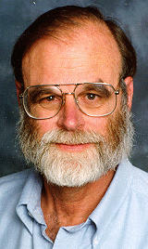
Bootstrapping new users
A mini version of Jim Gray’s 20 questions methodology
Give us your data
Give us 20 questions in English
Our job
  upload the data
  translate the queries
  share them in SQLShare
This process has been demonstrably successful, but doesn’t scale

Slide 35
Automating the Process
Automatic Starter Queries
  Garret Cole (Research Programmer)
  Nodira Khoussinova (CSE, Phd student)
  Leilani Battle (CSE, Ugrad)
  with Phil Bernstein (MSR)
Automatic Web Visualization
  Alicia Key (Research Programmer)
SQL Autocomplete
  Nodira Khoussinova (CSE, Phd student)
  Magda Balazinska (CSE faculty)
Automatic English to SQL
  Luke Zettlemoyer (CSE faculty) and
  Shaminoo Kapoor (Applied Math, masters student)
Personalized Query Recommendation
  Yuan Zhou (Applied Math, masters student)

Slide 36
Automatic Starter Queries
We find that Starter queries are sufficient for users to “self-serve”
But DB experts must provide these, and this doesn’t scale
Hypothesis: We can automatically derive a set of “good” starter queries directly from the data
Challenge: With an ad hoc database, we cannot assume a schema, query logs, or prior user input

Slide 37
Potential Goals for Starter Queries
SQL training
Database profiling
  Ex:
  Ex:
Bootstrapping logical design
  Ex: Reconstruct partitioned tables
SELECT a, COUNT(*) FROM R HAVING COUNT(*) > 1
SELECT * FROM R INTERSECTION SELECT * FROM S
SELECT * FROM [East Sound]
UNION
SELECT * FROM [Presidents Channel]
…
SELECT *
FROM [Men's 12M - Alcohol/Drug] a,
  [Men's 12M – Demographics] d,
  …
  WHERE a.patient = d.patient
  …
Notes:
Ex: [East Sound SR Counts.txt] ∪ [Presidents Channel SR Counts.txt]
Ex: [Men's 12M - Alcohol/Drug] ⨝ [Men's 12M - Demographics]

Slide 38
Desiderata for a set of starter queries
Coverage of SQL idioms
Coverage of data
Coverage of query complexity

Slide 39
Approach for Joins
Derive heuristics on what a “good query” means
Examples of join heuristics:
  Two columns exhibiting a foreign key relationship
  Two columns with high Jaccard similarity
  Two columns with similar active domains, where one has higher cardinality, indicates a 1:N join
  many more
Relative influence of these heuristics unclear
So: Extract features from the data covering all cases, and learn a model from existing “starter query” examples

Slide 40
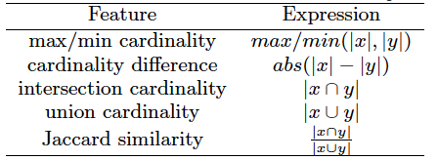
Features Extracted
Compute all of these for both set and bag semantics

Slide 41
Experimental Design
SDSS DB: Learn a decision tree on these features, using the joins present in the query logs as ground truth
Test the decision tree on the sample queries provided on the SDSS website
Gene Ontology DB: Extract features on the Gene Ontology database
Test the same decision tree on the sample queries from the GO website

Slide 42
Preliminary Results
SDSS Database:
  recall and precision both around 91%
GO Database:
  Recall 93%: 28/30 joins in sample queries classified correctly
  Precision 96%: 11/12 “bad” joins classified correctly

Slide 43
Decision Tree
| (1)jaccard_projected_value_set < 0.002: 1.016
| | (2)source_unique_values < 0.5: 1.246
| | (2)source_unique_values >= 0.5: -0.623
| | | (5)projected_value_union_set < 592.5: 0.441
| | | (5)projected_value_union_set >= 592.5: -0.512
| | | | (7)target_count < 100541: -0.406
| | | | (7)target_count >= 100541: 0.23
| | (4)source_distinct_count < 195851: 0.985
| | | (6)projected_value_union_bag < 1030.5: -0.086
| | | (6)projected_value_union_bag >= 1030.5: 0.707
| | (4)source_distinct_count >= 195851: -1.137
| (1)jaccard_projected_value_set >= 0.002: -1.253
| | (3)source_count < 55: 2.076
| | (3)source_count >= 55: -2.363
Tree size (total number of nodes): 22
Leaves (number of predictor nodes): 15

Slide 44
Ongoing work
Collaborative Features
  Favorites, Likes
  “People who ran this query also ran…”
  Annotations
Mining clicklogs
  with Hazeline Asuncion at UW Bothell
Visualization
New collaborations
  Citizen science
  Global Enterprise HIV Vaccine

Slide 45
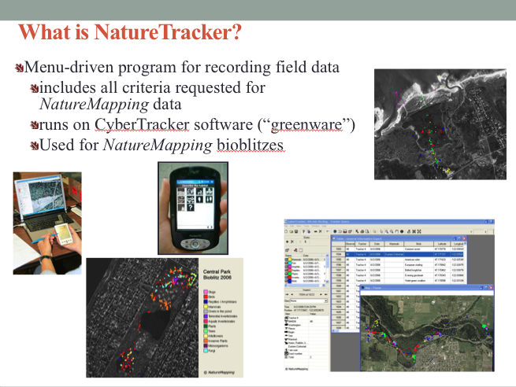

Slide 46
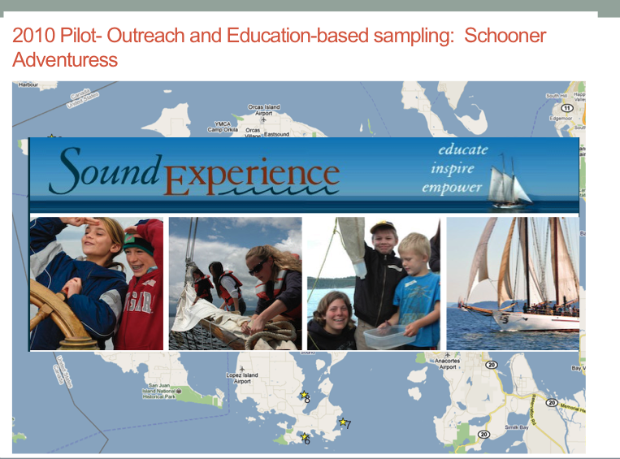

Slide 47
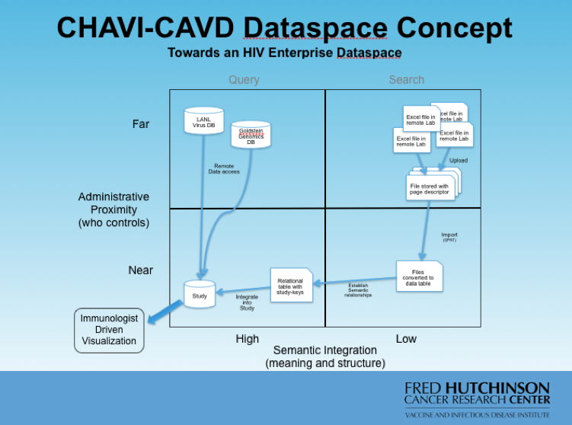

Slide 48
http://sqlshare.escience.washington.edu
(Ask me about the “NoSQL” movement)

Slide 49





23rd International Conference on
Scientific and Statistical Database Management
(SSDBM 2011) http://www.ssdbm2011.ssdbm.org
Portland, Oregon, USA
July 20 – 22, 2011
Abstracts due: January 31, 2011
Papers due: February 7, 2011
Notes:
Wed - Fri

Slide 50
Backup slides

Slide 51
Desiderata
Schema-Later
  Pay-as-you-go by creating and sharing views
Dataset-level CRUD ops
  Append and Replace, not update
Easy ingest
  Parse “obvious” file formats automatically
  Excel Add In
  LearnPADS [Fisher 2009-2010]
“Starter Queries” for bootstrapping analysis
Social/Collaborative/Participatory
Easy Visualization

Slide 52
Digression: Relational Database History
Pre-Relational: if your data changed, your application broke.
“Activities of users at terminals and most application programs should remain unaffected when the internal representation of data is changed and even when some aspects of the external representation are changed.”
-- Codd 1979
Key Ideas: Programs that manipulate tabular data exhibit an algebraic structure allowing reasoning and manipulation independently of physical data representation
Notes:
It provides a means of describing data with its natural structure only--that is, without superimposing any additional structure for machine representation purposes. Accordingly, it provides a basis for a high level data language which will yield maximal independence between programs on the one hand and machine representation on the other.

Slide 53
Key Idea: Data Independence
SELECT *
FROM my_sequences
views
logical data independence
SELECT seq
FROM ncbi_sequences
WHERE seq = ‘GATTACGATATTA’;
relations
physical data independence
f = fopen(‘table_file’);
fseek(10030440);
while (True) {
fread(&buf, 1, 8192, f);
if (buf == GATTACGATATTA) {
. . .
files and pointers

Slide 54
Key Idea: An Algebra of Tables
select
project
join
join
Other operators: aggregate, union, difference, cross product
Notes:
It turns out that you can express a wide variety of computations using only a handful of operators.

Slide 55
Key Idea: Algebraic Optimization
N = ((z*2)+((z*3)+0))/1
Algebraic Laws:
1. (+) identity: x+0 = x
2. (/) identity: x/1 = x
3. (*) distributes: (n*x+n*y) = n*(x+y)
4. (*) commutes: x*y = y*x
Apply rules 1, 3, 4, 2:
N = (2+3)*z
two operations instead of five, no division operator
Same idea works with the Relational Algebra!

Slide 56
RDBMS: Summary
Intuitive data model
  “just tables”
Data cleaning, filtering, joins, aggregation, user-defined functions
Physical and logical data Independence
  Views are a good idea; let’s use more of those
Declarative query language + algebraic optimization
  Describe what you want, not how to get it
Scalability
  “SQL is the most successful parallel language in the world”
Proven results
  $15B industry
  Nearly every (non-search engine) website backed by a RDBMS
  One of the all-time best examples of CS research impact
Notes:
So what’s wrong?
Applications write queries, not users
Schema design, tuning, “protectionist” attitudes

Slide 57
Usage
about 6 months old, but not yet advertised
4 labs around UW campus
50 unique users
566 uploaded tables
181 saved queries (i.e., views)
16GB of data

Slide 58
How do we repeat the success of SDSS in the long tail?
How do we build the next 100 SDSS-like systems?

