Slide 1
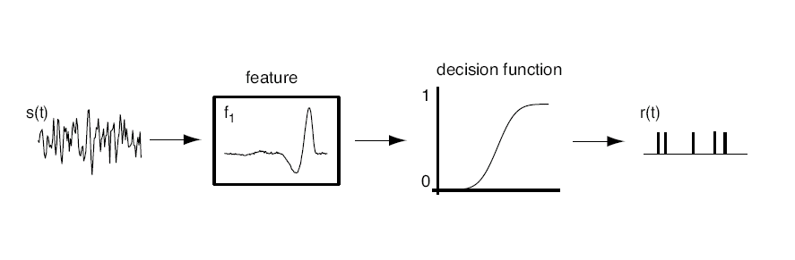
The linear/nonlinear model
s*f₁

Slide 2
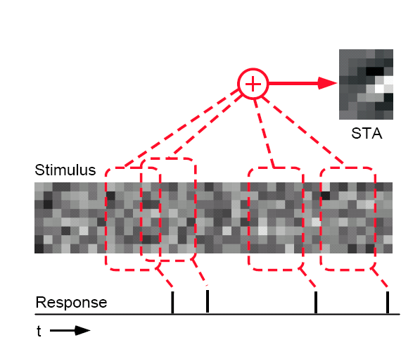
The spike-triggered average

Slide 3
Dimensionality reduction
More generally, one can conceive of the action of the neuron or
neural system as selecting a low dimensional subset of its inputs.
Start with a very high dimensional description
(eg. an image or a time-varying waveform)
and pick out a small set of relevant dimensions.
P(response | stimulus) → P(response | s₁, s₂, .., s_{n})
s₂
s(t)
s₃
s₁
s₁
s₂
s₃
s₄
s₅
s..
s..
s..
s_{n}
S(t) = (S₁,S₂,S₃,…,S_{n})

Slide 4
Linear filtering
Linear filtering = convolution = projection
s₂
s₃
s₁
Stimulus feature is a vector in a high-dimensional stimulus space

Slide 5
How to find the components of this model
s*f₁

Slide 6




Determining the nonlinear input/output function
The input/output function is:
which can be derived from data using Bayes’ rule:

Slide 7
Nonlinear input/output function
Tuning curve: P(spike|s) = P(s|spike) P(spike) / P(s)
Tuning curve: P(spike|s) = P(s|spike) P(spike) / P(s)
P(s)
P(s|spike)
P(s)
P(s|spike)
s
s

Slide 8
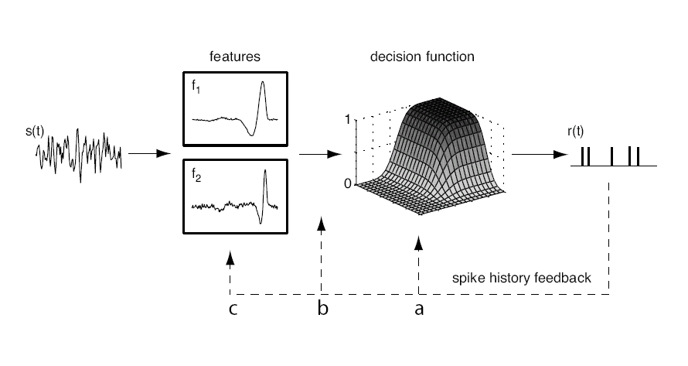
Models with multiple features
Linear filters & nonlinearity: r(t) = g(f₁*s, f₂*s, …, f_{n}*s)

Slide 9
Determining linear features from white noise
Gaussian prior
stimulus distribution
covariance
Spike-triggered
average
Spike-conditional
distribution

Slide 10
Identifying multiple features
The covariance matrix is
Spike-triggered stimulus
correlation
Spike-triggered
average
Stimulus prior
Properties:
The number of eigenvalues significantly different from zero
  is the number of relevant stimulus features
The corresponding eigenvectors are the relevant features
  (or span the relevant subspace)
Bialek et al., 1988; Brenner et al., 2000; Bialek and de Ruyter, 2005

Slide 11
Inner and outer products
u • v = Σ u_{i} v_{i}
u • v = projection of u onto v
u • u = length of u
u x v = M where M_{ij} = u_{i} v_{j}

Slide 12
Eigenvalues and eigenvectors
M u = λ u

Slide 13
Singular value decomposition
n
m
M
=
U
x
Σ
x
V

Slide 14
Principal component analysis
M M^{* =} (U Σ V)(V*Σ*U*)
⁼ U Σ (V V*) Σ*U*
⁼ U Σ Σ*U*
C ⁼ U Λ U*

Slide 15
Identifying multiple features
The covariance matrix is
Spike-triggered stimulus
correlation
Spike-triggered
average
Stimulus prior
Properties:
The number of eigenvalues significantly different from zero
  is the number of relevant stimulus features
The corresponding eigenvectors are the relevant features
  (or span the relevant subspace)
Bialek et al., 1988; Brenner et al., 2000; Bialek and de Ruyter, 2005

Slide 16
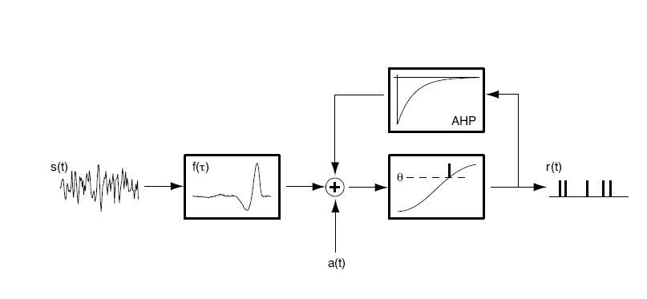
A toy example: a filter-and-fire model
Let’s develop some intuition for how this works: a filter-and-fire threshold-crossing model with AHP
Keat, Reinagel, Reid and Meister, Predicting every spike. Neuron (2001)
Spiking is controlled by a single filter, f(t)
Spikes happen generally on an upward threshold crossing of
the filtered stimulus
➔ expect 2 relevant features, the filter f(t) and its time derivative f’(t)

Slide 17
Covariance analysis of a filter-and-fire model
STA
f(t)
f'(t)

Slide 18
Some real data
Example: rat somatosensory (barrel) cortex
Ras Petersen and Mathew Diamond, SISSA
Record from single units in barrel cortex

Slide 19
White noise analysis in barrel cortex
Spike-triggered average:
Normalised velocity
Pre-spike time (ms)

Slide 20
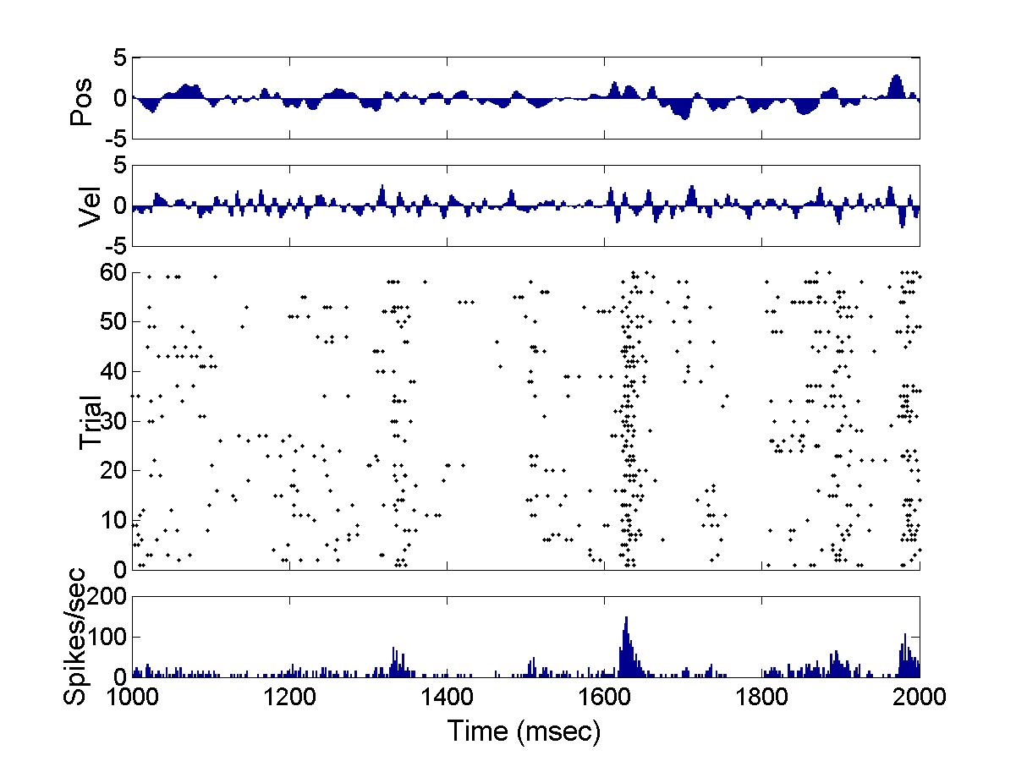
White noise analysis in barrel cortex
Is the neuron simply not very responsive to a white noise stimulus?

Slide 21
Covariance matrices from barrel cortical neurons
Prior
Spike-
triggered
Difference

Slide 22
Eigenspectrum from barrel cortical neurons
Eigenspectrum
Leading modes
0.4
0.3
0.2
0.1
Velocity
0
-0.1
-0.2
-0.3
-0.4
150
100
50
0
Pre-spike time (ms)

Slide 23
Input/output relations from barrel cortical neurons
Input/output
relations wrt
first two filters,
alone:
and in quadrature:

Slide 24
Less significant eigenmodes from barrel cortical neurons
How about the other modes?
Next pair with +ve eigenvalues
Pair with -ve eigenvalues
0.4
0.3
0.2
Velocity (arbitrary units)
0.1
0
-0.1
-0.2
-0.3
150
100
50
0
Pre-spike time (ms)

Slide 25
Negative eigenmode pair
Input/output relations for negative pair
Firing rate decreases with increasing projection:
suppressive modes

Slide 26
Salamander retinal ganglion cells perform a variety of computations
Michael Berry

Slide 27
Almost filter-and-fire-like

Slide 28
Not a threshold-crossing neuron

Slide 29
Complex cell like

Slide 30
Bimodal: two separate features are encoded as either/or

Slide 31
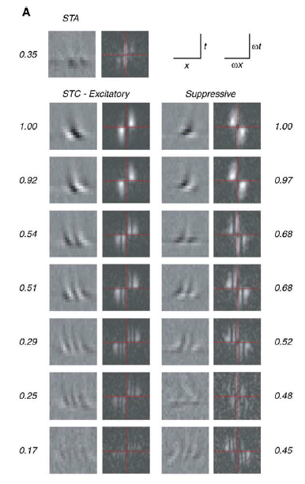
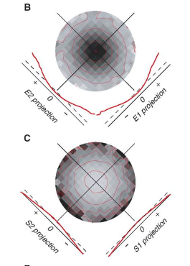
Complex cells in V1
Rust et al., Neuron 2005

Slide 32
Basic types of computation
integrators
    H1, some single cortical neurons
differentiators
    Retina, simple cells, HH neuron, auditory neurons
frequency-power detectors
    V1 complex cells, somatosensory, auditory, retina

Slide 33
When have you done a good job?
When the tuning curve over your variable is interesting.
How to quantify interesting?

Slide 34
When have you done a good job?
Tuning curve: P(spike|s) = P(s|spike) P(spike) / P(s)
Tuning curve: P(spike|s) = P(s|spike) P(spike) / P(s)
Boring: spikes unrelated to stimulus
Interesting: spikes are selective
P(s)
P(s|spike)
P(s)
P(s|spike)
s
s
Goodness measure: D_{KL}(P(s|spike) | P(s))

Slide 35
Maximally informative dimensions
Sharpee, Rust and Bialek, Neural Computation, 2004
Choose filter in order to maximize D_{KL} between
spike-conditional and prior distributions
Equivalent to maximizing mutual information between
stimulus and spike
Does not depend
on white noise inputs
Likely to be most appropriate
for deriving models from
natural stimuli
P(s)
P(s|spike)
s = I*f

Slide 36
Finding relevant features
Single, best filter determined by the first moment
A family of filters derived using the second moment
Use the entire distribution: information theoretic methods
Removes requirement for Gaussian stimuli

Slide 37
Less basic coding models
Linear filters & nonlinearity: r(t) = g(f₁*s, f₂*s, …, f_{n}*s)
…shortcomings?

Slide 38
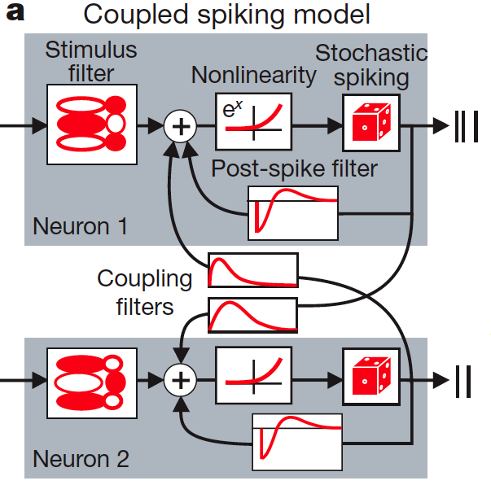
Less basic coding models
GLM: r(t) = g(f₁*s + f₂*r)
Pillow et al., Nature 2008; Truccolo, .., Brown, J. Neurophysiol. 2005

Slide 39
Less basic coding models
GLM: r(t) = g(f*s + h*r)
…shortcomings?

Slide 40
Less basic coding models
GLM: r(t) = g(f₁*s + h₁*r₁ + h₂*r₂ +…)
…shortcomings?

Slide 41
Poisson spiking

Slide 42
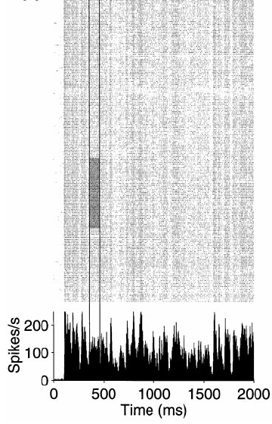
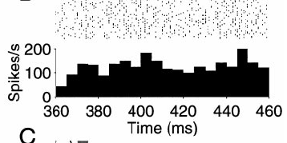
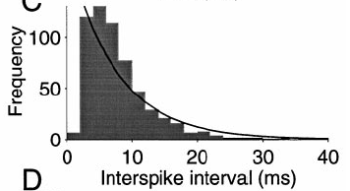
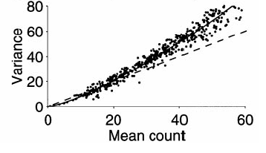
Poisson spiking
Shadlen and Newsome, 1998

Slide 43
Poisson spiking
Properties:
Distribution: P_{T}[k] = (rT)^{k} exp(-rT)/k!
Mean: <x> = rT
Variance: Var(x) = rT
Fano factor: F = 1
Interval distribution: P(T) = r exp(-rT)

Slide 44
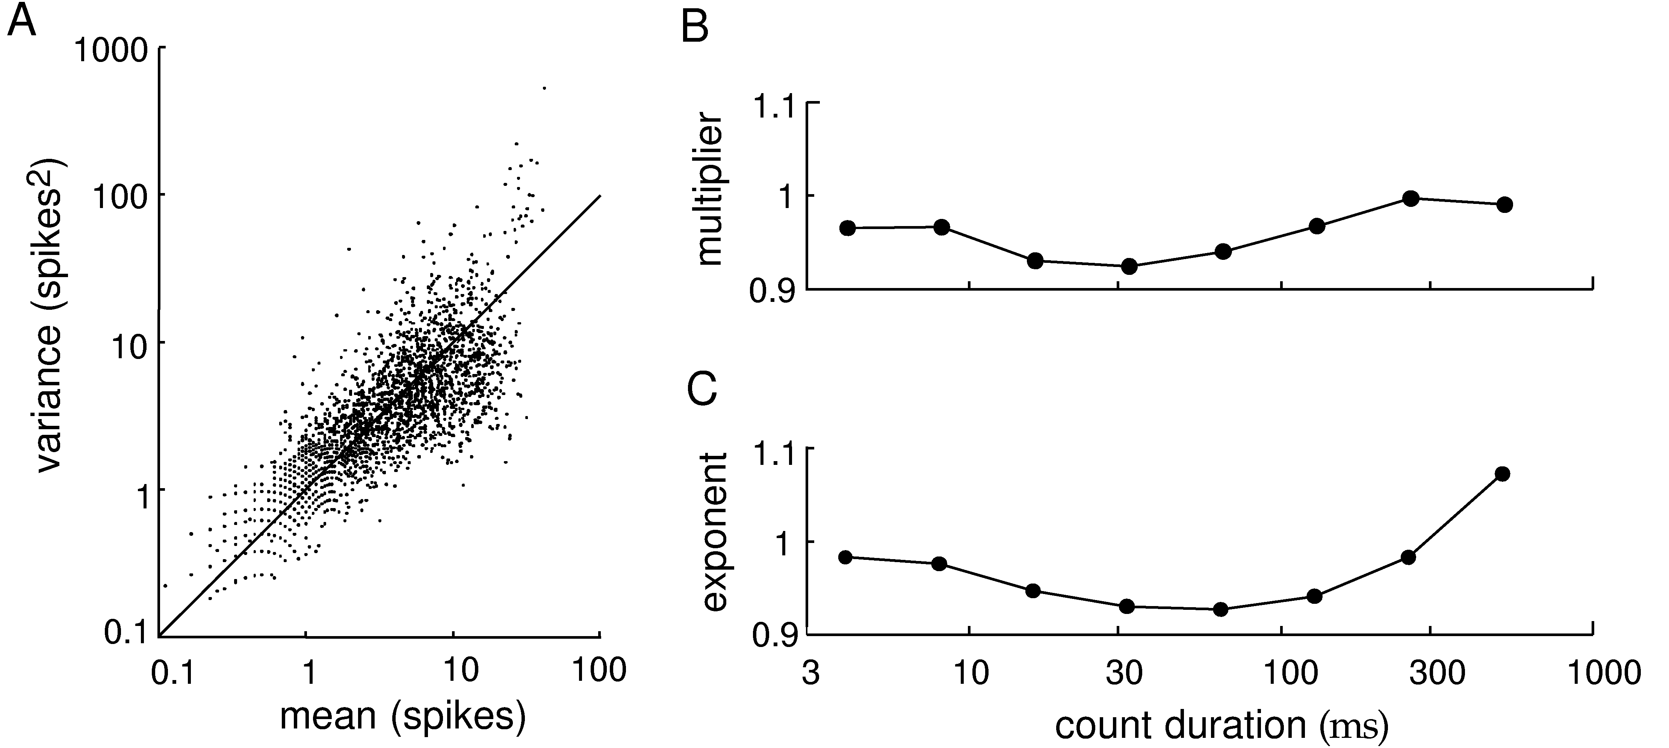
Poisson spiking in the brain
Area MT
A
B
Fano factor
Data fit to:
variance = A × mean^{B}

Slide 45
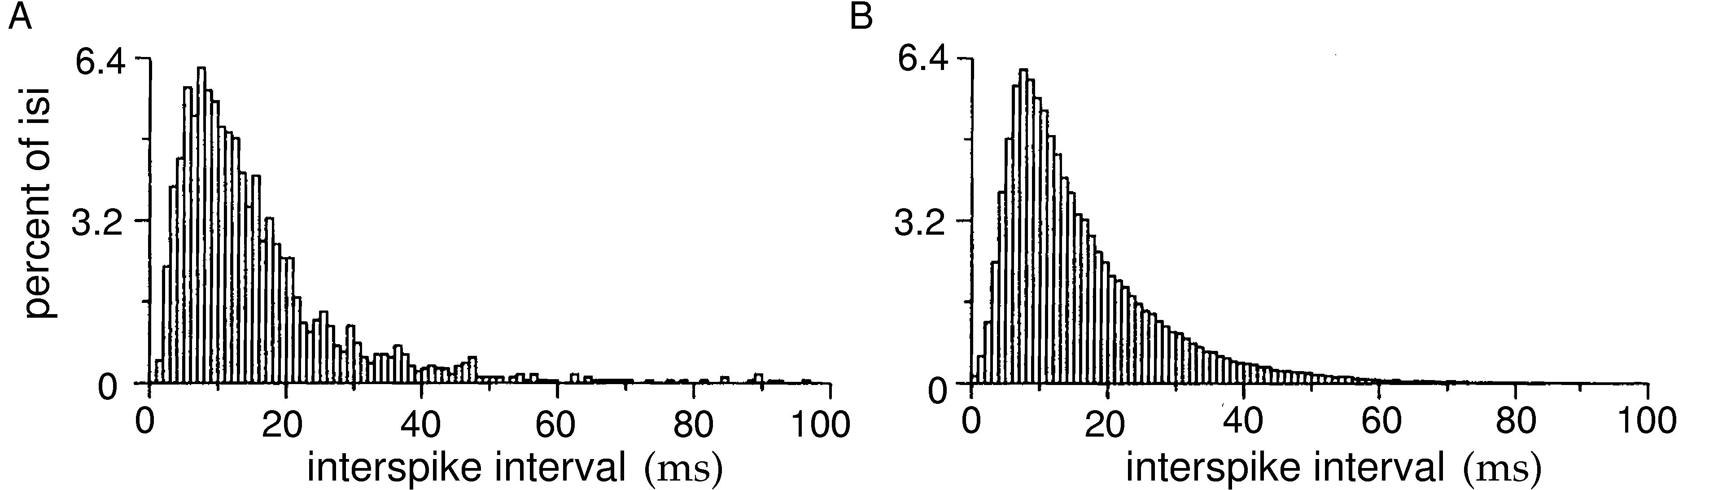
How good is the Poisson model? ISI analysis
Poisson spiking in the brain
ISI Distribution from an area MT Neuron
ISI distribution generated from a Poisson model with a Gaussian refractory period

Slide 46
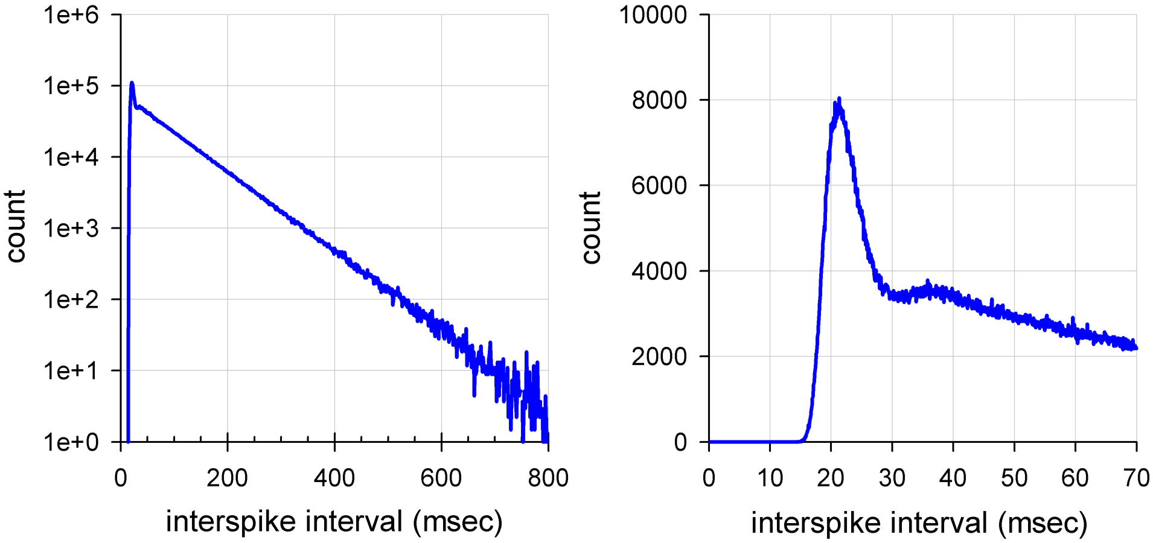
Hodgkin-Huxley neuron driven by noise

