Slide 1
Auto-active verification
K. Rustan M. Leino
Senior Principal Applied Scientist Automated Reasoning Group (ARG), Amazon Web Services
Guest lecture in Emina Torlak’s CSE 507, Computer-Aided Reasoning for Software 6 Nov 2019, UW, Seattle, WA, USA

Slide 2
Static program verification
What is the state-of-art in program verifiers?
How to build a program verifier

Slide 3
Program verification: 1949
Source: “An Early Program Proof by Alan Turing” by F.L. Morris and C.B. Jones, Annals of the History of Computing, 1984

Slide 4
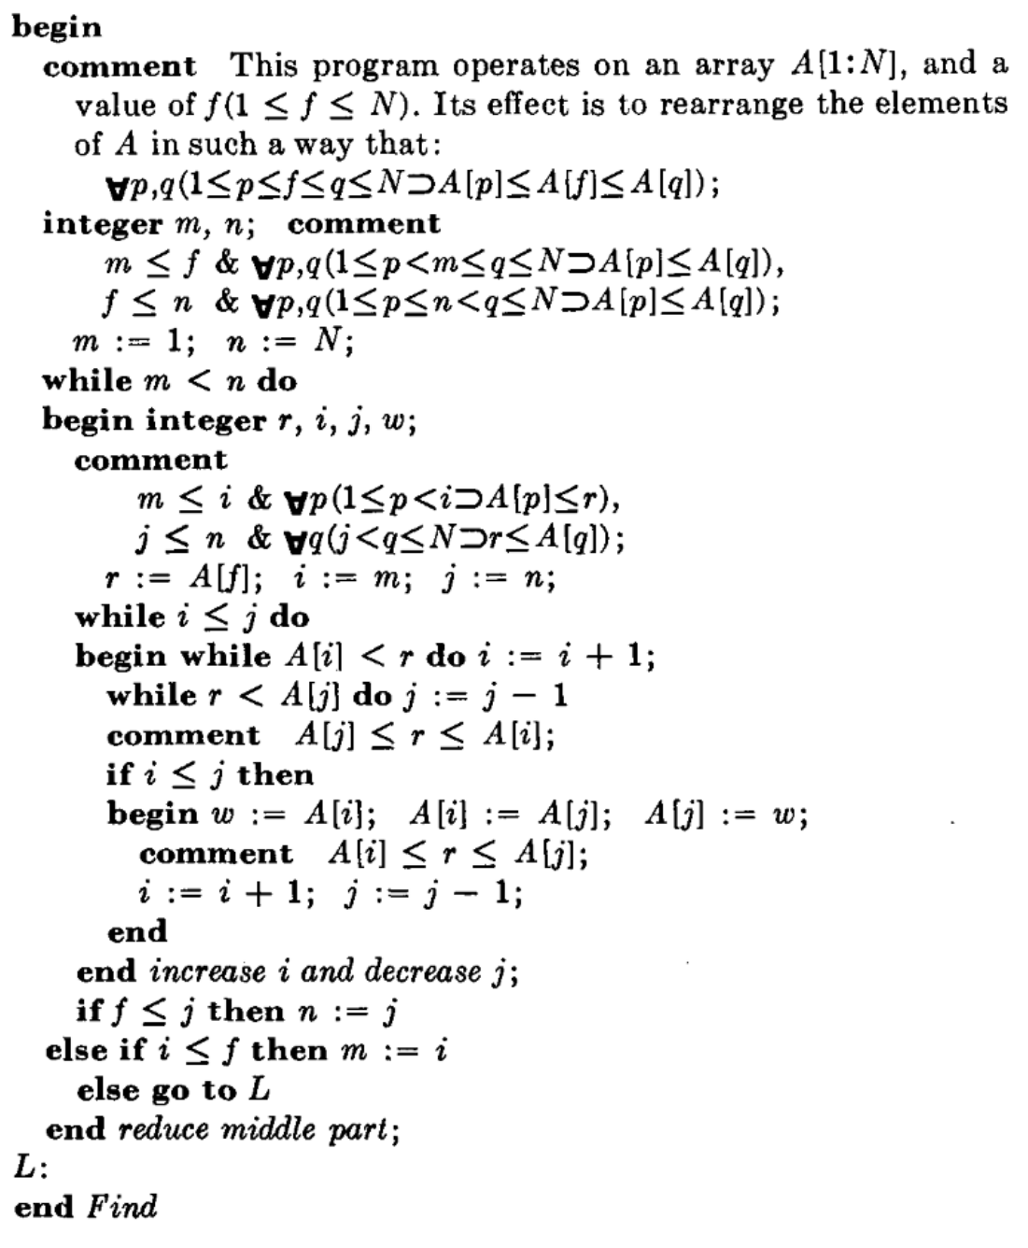
Program verification: 1971
Source: “Proof of a program: FIND” by C.A.R. Hoare, CACM, 1971

Slide 5
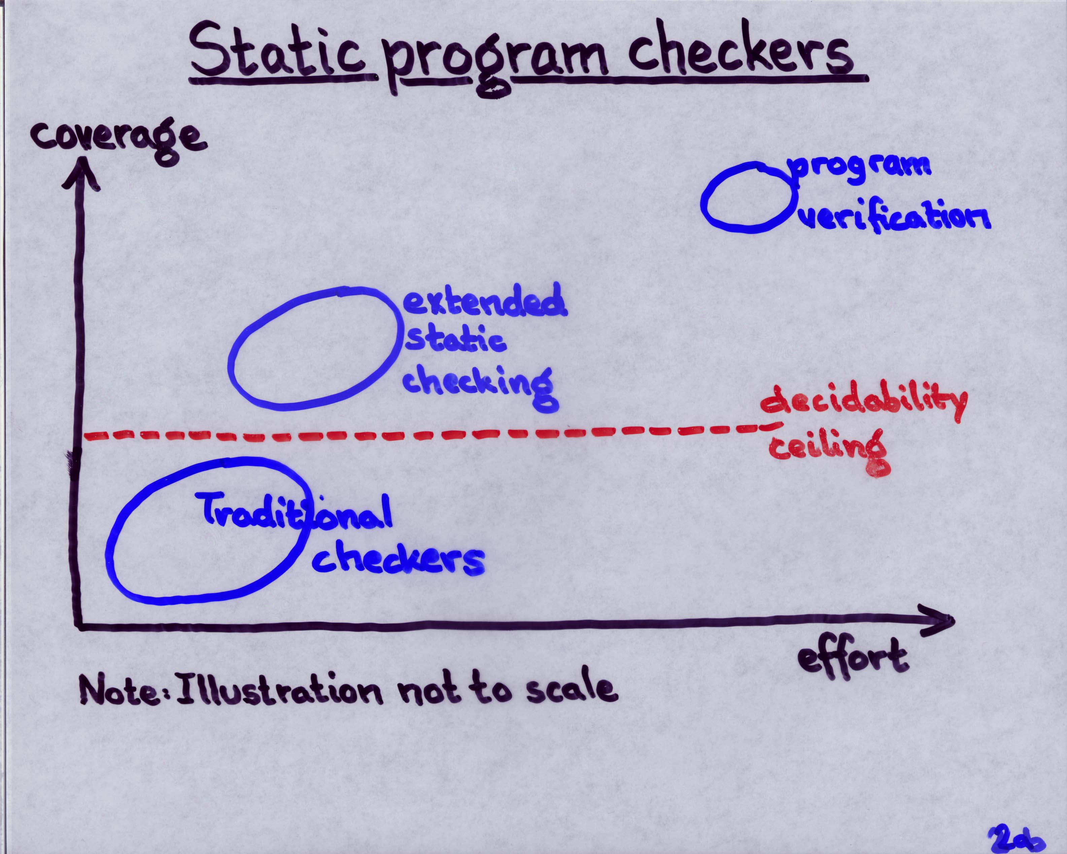
Program verification: 1998
Source: Invited talk “ESC/Java” by K.R.M. Leino at Larch User’s Group Meeting, FM’99, Toulouse, France, Sep 1999

Slide 6
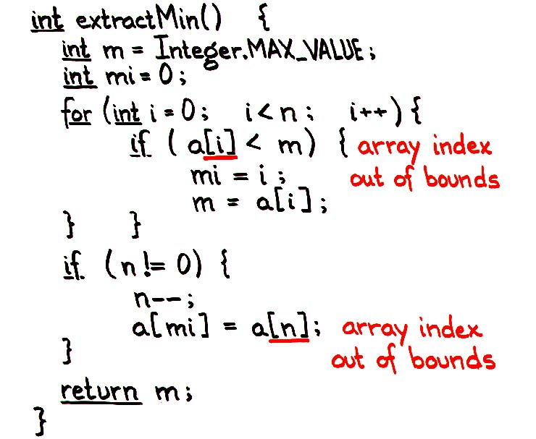
Program verification: 1998
Source: Talk and first (pre-tool) ESC/Java demo by K.R.M. Leino to Hopper et al. at DEC WRL, “Extended Static Checking for Java”, March 1998

Slide 7
Program verification: 2008
Auto-active verification
Source: Paper presentation on Dafny by K.R.M. Leino at LPAR-16, Dakar, Senegal, April 2010

Slide 8
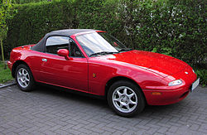
2010s
Annotated program text alone is not enough
Need ability to formalize models, state lemmas, and assist in proof authoring
This has always been possible in interactive proof assistants
Coq, Isabelle/HOL, Agda, …
Now it has come to automated program verifiers as well
Dafny, VeriFast, WhyML, F*, Liquid Haskell, …

Slide 9
Dafny
Put reasoning about programs first
Language aimed at reasoning
Constructs for recording design decisions
Tool support
Static program verifier enforces design decisions
Integrated development environment
Tools help in reasoning process
Verification is not an afterthought

Slide 10
Dafny
Imperative programming
if, while, :=, class, …
Functional programming
function, datatype, codatatype, …
Proof authoring
lemma, calc, refines, inductive predicate, …

Slide 11
Encryption Libraries
AWS Encryption SDK
Java, Python, C, JavaScript, …
S3 Encryption Client
Java, C/C++, .NET, PHP, Ruby, …

Slide 12
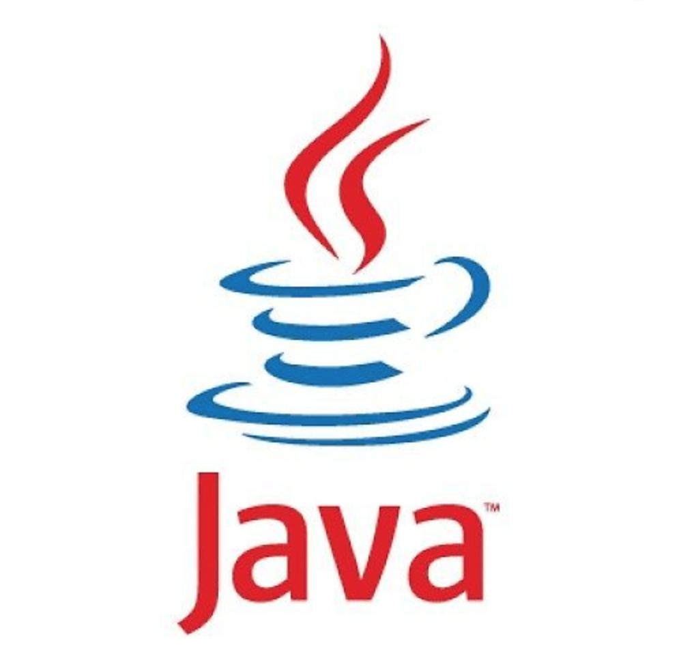
Engineering Challenges
Maintain many platforms, extend to more platforms
Provide consistent functionality across platforms
Ensure correctness
…
Java verifier
JavaScript verifier
Go verifier
C# verifier
Art credits: github.com/exercism, pluspng.com, redbubble.com, songfromtheuproar.com, clipart-library.com

Slide 13
Write and Verify Once, Compile to Many
Art credits: github.com/exercism, pluspng.com, redbubble.com, songfromtheuproar.com, clipart-library.com
Logo credits: github.com/exercism, pluspng.com, redbubble.com, songfromtheuproar.com, clipart-library.com

Slide 14
Message frames
1
2
56
0xFFFF_FFFF
data
data
data
57
…
length
data

Slide 15
function Fib(n: nat): nat {
if n < 2 then n else Fib(n-2) + Fib(n-1)
}
method FibSquared(n: nat) returns (x: nat)
ensures x == Fib(n) * Fib(n)
{
x := 0;
var i, y, k := 0, 1, 0;
assert k < y;
while i != n
invariant 0 <= i <= n
invariant x == Fib(i) * Fib(i)
invariant y == Fib(i+1) * Fib(i+1)
invariant k == 2*Fib(i+1)*Fib(i)
{
x, y, k := y, y + k + x, y + y + k;
i := i + 1;
}
}

Slide 16
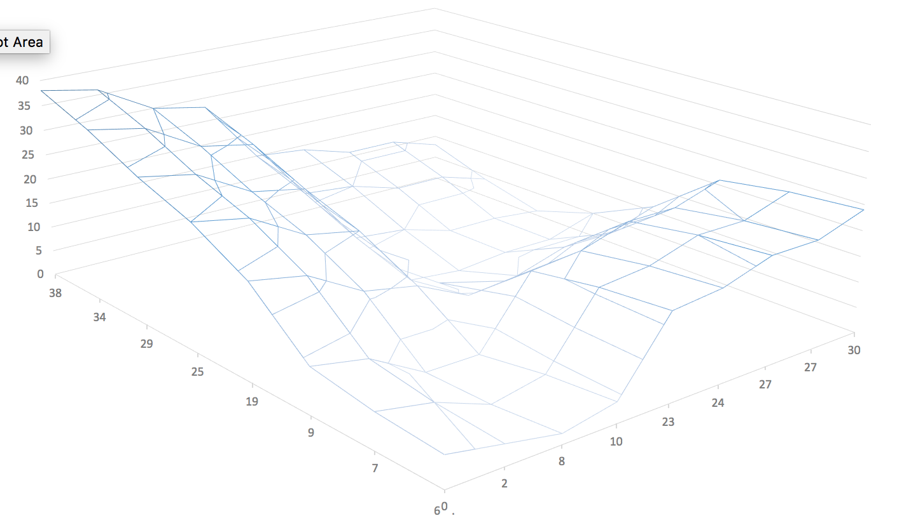

Slide 19
b.Length
0
0
a.Length

Slide 20
b.Length
0
0
a.Length

Slide 21
b.Length
n
0
0
m
a.Length

Slide 22
a[m] <= b[n]
b.Length
n
0
0
m
a.Length

Slide 23
function method Dist(x: int, y: int): int {
if x < y then y - x else x - y
}
function method Min(x: int, y: int): int {
if x < y then x else y
}

Slide 24
method CanyonSearch(a: array<int>, b: array<int>) returns (d: int)
requires a.Length != 0 && b.Length != 0
requires forall i,j :: 0 <= i < j < a.Length ==> a[i] <= a[j]
requires forall i,j :: 0 <= i < j < b.Length ==> b[i] <= b[j]
ensures exists i,j :: 0 <= i < a.Length && 0 <= j < b.Length && d == Dist(a[i], b[j])
ensures forall i,j :: 0 <= i < a.Length && 0 <= j < b.Length ==> d <= Dist(a[i], b[j])
{
d := Dist(a[0], b[0]);
var m, n := 0, 0;
while m != a.Length && n != b.Length
invariant 0 <= m <= a.Length && 0 <= n <= b.Length
invariant exists i,j :: 0 <= i < a.Length && 0 <= j < b.Length &&
d == Dist(a[i], b[j])
invariant forall i,j :: 0 <= i < a.Length && 0 <= j < b.Length ==>
d <= Dist(a[i], b[j]) || (m <= i && n <= j)
decreases a.Length - m + b.Length - n
{
d := Min(d, Dist(a[m]));
if
case a[m] <= b[n] =>
m := m + 1;
case b[n] <= a[m] =>
n := n + 1;
}
}

Slide 25
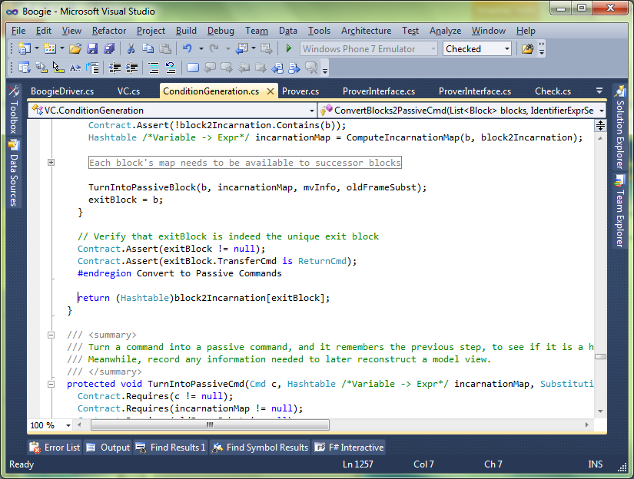
Separation of concerns
Java
Java
Intermediate representation
Intermediate verification language
Compiler
Verifier
SMT solver

Slide 26
Verification architecture
Dafny
Intermediate Verification Language
Boogie
SMT solver

Slide 27
Take-home messages
Automatic + Interactive = Auto-active
An auto-active verifier focuses on the problem, not the underlying logic
To build a verifier, use an intermediate verification language (IVL)
Dafny is a programming language for verification
Write correct programs
Formalize math and semantics
Use Dafny yourself in VS Code
Watch Verification Corner on YouTube

