Slide 1
Web-Based Malware
Jason Ganzhorn
5-12-2010

Slide 2
Background
A large number of transactions take place over the Internet
Shopping
Communication
Browse News
It’s likely that you perform some of these transactions as well.

Slide 3
Scenario (Setup)
You like to read articles about the latest developments in gadgetry.
Many blogs allows readers to comment on articles, and typically these comments will load along with the page when you load up the article.
You also use IE 6 because you don’t believe in newfangled browsers (but you still like gadgets).

Slide 4
Scenario (Security Breaches)
A fairly popular tech blog known as tech.gadget is mostly funded by advertising and pulls ads from a common online advertising agency.
A hacker pays the agency to distribute an ad containing malicious code to test a package of exploits on viewers’ computers.

Slide 5
Scenario (Download Stage)
It so happens that your IE 6 has one of the targeted vulnerabilities.
You search for tech news, find a cool article at tech.gadget, and then read it, ignoring the hacker’s ad.
However, one of the ad’s exploits kicks in and a piece of malware is transferred to your machine.

Slide 6
Scenario (Finale)
Now there is a piece of malicious software running on your computer.
This could be:
a keylogger
a bot
a browsing history tracker
Obviously, this is not good.

Slide 7
So What?
None of us are more than a few minor version numbers behind (and almost certainly not running IE 6), so why is this a big deal?
Many people don’t understand why security updates are important. Why update if I don’t see something broken?

Slide 8
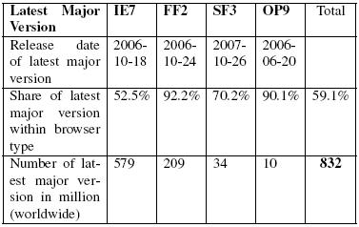
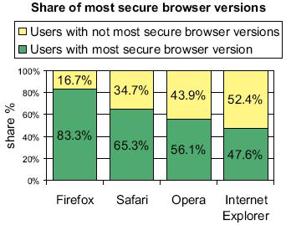
The Update Problem
As you can see from these charts, some people simply do not update their browsers.
Why not?
Ignorance – not everyone is tech savvy enough to know that security patches are a good thing.
Difficulty – for a large company, a major version upgrade can be quite the IT hassle.
Notes:
Why are Firefox’s numbers so high? Firefox’s auto-update.

Slide 9
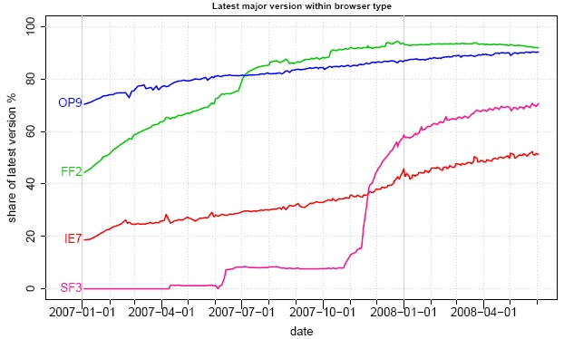
Slow Update Adoption
Charts on last two slides from: http://www.techzoom.net/publications/insecurity-iceberg/
Notes:
Measure of the percentage of browser users who use the latest major version in that browser type. The spike in Safari 3 is due to Apple’s inclusion of the major update into auto-updating for some of their other software.

Slide 10
What to Do?
There’s a lot of people out there with potentially vulnerable browsers.
It would be nice if there were a way to identify sites that could potentially infect you with malicious software before you just blindly click on them from search results, without having to update your browser.
It turns out that some people from Google have been looking into just that.

Slide 11
The Ghost In The Browser
Analysis of Web-based Malware
Niels Provos, Dean McNamee, Panayiotis Mavrommatis, Ke Wang, Nagendra Modadugu

Slide 12
The Goal
Google has an extensive repository of pages on the web.
Utilizing these resources, the researchers are trying to identify which of those pages could potentially be malicious.

Slide 13
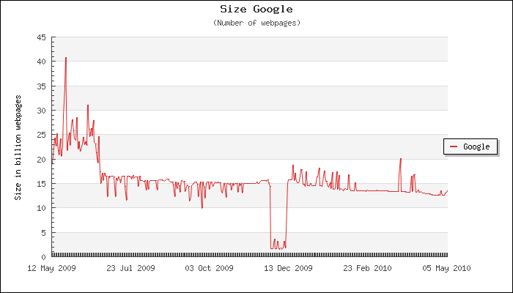
Size of the Google Index
Go here for more information on how the index size was estimated.
Note that Google does not appear to officially release the size of their search index any more.
Notes:
Image obtained from http://www.worldwidewebsize.com
The large drop in Dec 2009 may be due to Operation Aurora – it was hard to find much information and I’m not sure how much I trust the estimate anyway.

Slide 14
Potential Problems
Impact of false positives – if a legitimate website is marked as a potential distributor of malware, that could be bad for its business.
Sheer number of pages on the web.
Netcraft reports in their April 2010 survey that they received responses from 205,368,103 sites.
The Google index has somewhere around 15 billion pages.
Notes:
The paper does not address the first point.

Slide 15
Dealing with the Web
There are a lot of pages on the web. How can this number be pared down to something that is reasonable to examine?
The Google researchers apply simple heuristics to each page to determine whether a page attempts to exploit a web browser.
Pages that test positive under these heuristics are then examined more closely.

Slide 16
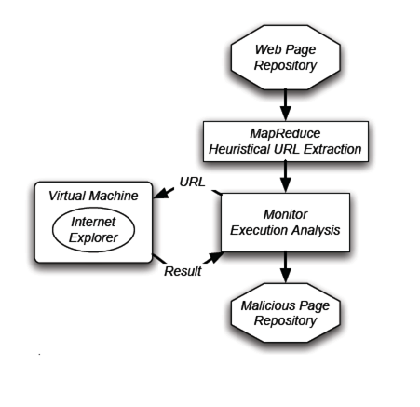
Detection Architecture Diagram

Slide 17
MapReduce Description
A programming model that operates in two stages.
Map stage: a sequence of key-value pairs is read as input and a sequence of intermediate key-value pairs is output
Reduce stage: All intermediate values associated with the same intermediate key are merged and output as a final sequence of key-value pairs.

Slide 18
MapReduce Process in this Paper
<mal.ici.ous.com, mal.ici.ous.com/totallynotsuspect.cgi?q=345>
<mal.ici.ous.com, mal.ici.ous.com/v2.php?a=10>
<cnn.com/news/tech/index.htm, mal.ici.ous.com/v2.php?a=14>
<engadget.com, mal.ici.ous.com/totallynotsuspect.cgi?q=100>
... and so on...
Map Stage
Reduce Stage
<mal.ici.ous.com, mal.ici.ous.com/totallynotsuspect.cgi?q=345>
<cnn.com/news/tech/index.htm, mal.ici.ous.com/v2.php?a=14>
<engadget.com, mal.ici.ous.com/totallynotsuspect.cgi?q=100>
... and so on...

Slide 19
Map Stage
The Map stage is run on all crawled web pages.
The URL of each analyzed web page is a key.
The HTML in each page is parsed; links in known suspicious elements such as iframes pointing to malware-distributing hosts are stored as values.

Slide 20
Map Stage (cont’d.)
Another heuristic used to identify suspicious links at this stage relies on detection of abnormalities such as heavy obfuscation.
On completion, this stage yields an intermediate list of URLs as keys and all links from that page to possibly malicious URLs as values.

Slide 21
MapReduce Process in this Paper
<mal.ici.ous.com, mal.ici.ous.com/totallynotsuspect.cgi?q=345>
<mal.ici.ous.com, mal.ici.ous.com/v2.php?a=10>
<cnn.com/news/tech/index.htm, mal.ici.ous.com/v2.php?a=14>
<engadget.com, mal.ici.ous.com/totallynotsuspect.cgi?q=100>
... and so on...
Map Stage
Reduce Stage
<mal.ici.ous.com, mal.ici.ous.com/totallynotsuspect.cgi?q=345>
<cnn.com/news/tech/index.htm, mal.ici.ous.com/v2.php?a=14>
<engadget.com, mal.ici.ous.com/totallynotsuspect.cgi?q=100>
... and so on...

Slide 22
Reduce Stage
The Reduce stage is run on all the intermediate key-value pairs.
It is very simple – all but the first intermediate value is discarded for each intermediate key.
On completion, this stage yields a list of potentially malicious URLs and an example of a possibly suspect link from each of them.

Slide 23
MapReduce Results
This MapReduce process pares the number of web pages to process from several billion to a few million.
The number of web pages to process can in fact be reduced farther, using a second MapReduce step to sample by site instead of by page.

Slide 24
Detection Architecture Diagram

Slide 25
Exploit Confirmation
Even after the MapReduce step, there are still several million pages with possible links to exploits.
How to confirm whether these pages actually cause a web browser exploit?

Slide 26
Exploit Testing
Each URL is fed to a copy of Internet Explorer running in a virtual machine.
All HTTP fetches and state changes in the VM can be tracked. These state changes include:
New process startup
Registry changes
File system changes

Slide 27
Potential Exploit Scoring
Each recorded component is scored to provide an overall score.
Example: each HTTP fetch is classified using a number of different anti-virus engines.
Each individual score is then summed up to form an overall score for the analysis
If the majority of URLs on a site are malicious, some or all of the site might be labeled as harmful when shown as a search result.

Slide 28
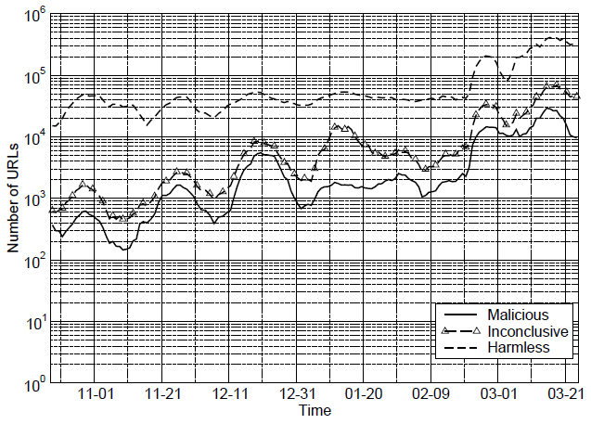
Evaluation – Throughput
Notes:
Remember, this data does not necessarily indicate any rise in the incidence of malicious or other kinds or URLs, but merely an increase in the processing rate.

Slide 29
Evaluation - Throughput
This analysis originally processed 50,000 unique URLs per day.
Optimizations increased this rate to 300,000 per day.
In-depth analysis of 4.5 million URLs at the time of writing.
450,000 engaged in drive-by-downloads.
700,000 more seemed malicious but with lower confidence.
Notes:
Paper does not mention anything about what those optimizations were.

Slide 30
Content Control and Dependencies
How can you lose control of content on your page?
Web server insecurity – if an adversary can take control of the server, they can modify its content, such as its templating system
User-contributed content – poor sanitization of input can lead to injected code. The researchers discovered several bulletin boards that allowed the insertion of arbitrary HTML.
Notes:
Often web servers are compromised due to vulnerable scripting applications like phpBB2 or InvisionBoard. Exploited vulnerabilities can lead to the compromise of every web server running on the host, which is extremely damaging in the case of large virtual hosting farms. For user-contributed content, the researchers saw automated scripts that exploited vulnerabilities to post thousands of times with malicious iframes.

Slide 31
Content Control and Dependencies
Advertising – “sub-letting” trust issues
Here‘s a real-life example:
A banner advertisement from a large American advertising company was delivered in the form of JS that generated more JS.
This new JS chained through another large American agency and then a smaller one that apparently used geo-targeting.
The geo-targeted ad resulted in an iframe pointing to a Russian advertising company.
That iframe requested encrypted JS from an IP address that attempted several exploits, some of which were successful.
Trust is not transitive.
Notes:
Replace this mass of text with a graphic flow chart?

Slide 32
Content Control and Dependencies
Web masters sometimes include external JS or iframes to provide additional functionality.
The paper gives an example of a page that linked to a free statistics counter.
The counter worked benignly for about four years.
Then the linked JS was changed to instead try to exploit every visitor to pages linking to the supposed counter.
Another trust issue – even if you trust the original content provider, you have no control over what happens to the external code you link to.

Slide 33
Exploitation Mechanisms
Sometimes malicious JS targets specific vulnerabilities.
Microsoft Data Access Component vulnerability (required only about 20 lines of JS to reliably launch an arbitrary binary on a vulnerable installation)
Microsoft WebViewFolderIcon vulnerability exploited using JS heap spraying techniques

Slide 34
Exploitation Mechanisms
Exploiting one vulnerability is limiting. Multi-exploit kits are typically more effective.
An example is the MPack kit produced by Russian crackers.
Commercial software ($500 - $1000)
Technical support
Software vulnerability updates
Customized attacks to victim browsers, including IE, Firefox, and Opera.
More fascinating details here.
Notes:
Mpack was typically loaded into an iframe placed on a defaced website. When the defaced page is visited, the Mpack server-side software sends a script that determines if vulnerabilities exist and can be exploited

Slide 35
Exploitation Mechanisms
What if the user has no discoverable exploitable vulnerabilities?
Fall back on good old social engineering and promise the user content they might find intriguing.
Example: Offer the user copyrighted video content for “free” and then claim a “codec” is needed to correctly play the video.

Slide 36
Trends in Malware
In the arms race between malware generation and detection, some trends have emerged.
Exploit code is often obfuscated
The paper gives an example of a VBScript exploit that was escaped twice using JavaScript escaping.
Even some reputable web pages serve obfuscated JavaScript.
Notes:
Why do reputable web pages serve obfuscated JS? See google.com source – at least appears obfuscated in the interest of saving transfer space.

Slide 37
Trends in Malware
The authors also attempted to classify the different types of malware that use the web to deploy. The stated goal was to discover whether web-based malware was being used to construct botnets.
Their automated analysis seems very rough, with only “Trojan,” “Adware,” and “Unknown/Obfuscated” categories.
Notes:
Multiple AV engines were used to consensually identify malware. With the rough results obtained, it doesn’t seem as if they achieved their goal of discovering whether malware binaries were being used to form botnets. However, they claim that non-automated techniques examining non-browser HTTP requests from infected machines revealed occasional binary updates and instruction retrieval. They say almost nothing about this “non-automated” technique, however.

Slide 38
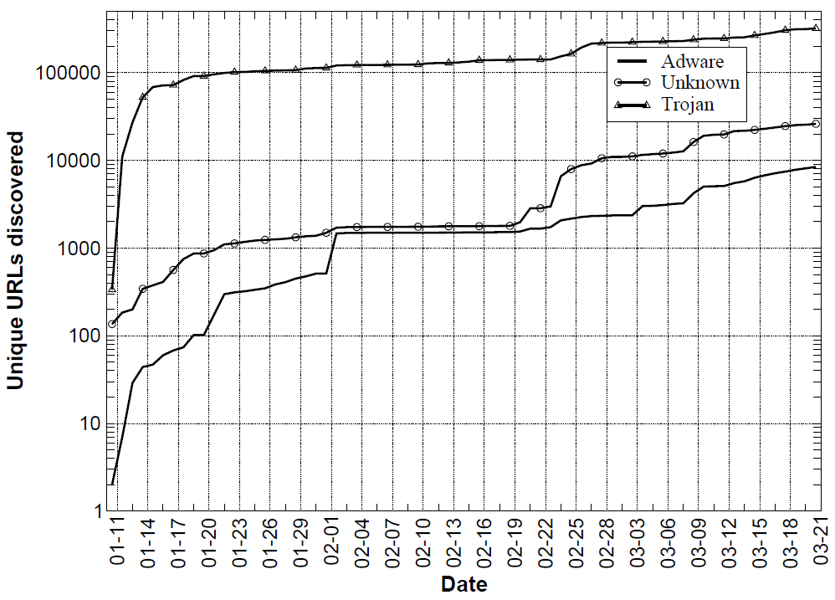
Trends in Malware

Slide 39
Trends in Malware
Most of the examined exploits were hosted on third-party servers and not on the compromised web site.
Occasionally, all requests to the legitimate site were redirected to a malicious site.
Many exploits are hosted on multiple servers as well, to minimize the chance of failure.
A few of the malicious URLs pointed to rapidly changing malware binaries.
Notes:
Hosting the exploit on a dedicated server can ease monitoring and generation of statistics for the exploit, as well as ease updating the exploit.
Rapidly changing binaries can thwart an AV filter. The ability of the researchers to measure statistic was hampered by the fact that the malicious URLs were often quite short-lived.

Slide 40
Detection and Analysis of Drive-by-Download Attacks and Malicious JavaScript Code
Marco Cova, Christopher Kruegel, Giovanni Vigna

Slide 41
Summary
The problem is that malicious JavaScript code can be very difficult to identify due to the dynamic nature of JavaScript.
The paper presents a solution built around anomaly detection with emulation.
Machine-learning techniques are used to establish profiles of “normal” JavaScript code.

Slide 42
Detection Technique
Detection is based on finding anomalies which include:
Redirection chains.
Differences in served JS based on reported browser version.
Differences in the JS served to the same IP for consecutive identical requests.
Environment preparation (including heap spraying)
Exploitation patterns (such as odd plugin-loading behavior)
Extensive deobfuscation (one feature to look for is an abnormal amount of dynamic code execution)

Slide 43
Simple Code Obfuscation Example
var a="Hello World!";
function MsgBox(msg)
{
alert(msg+"\n"+a);
}
MsgBox("OK");
This is a very basic example of code obfuscation.
Real obfuscated code is often polymorphic and dynamically generated.
eval(function(p,a,c,k,e,d){e=function(c){return c};if(!''.replace(/^/,String)){while(c--){d[c]=k[c]||c}k=[function(e){return d[e]}];e=function(){return'\\w+'};c=1};while(c--){if(k[c]){p=p.replace(new RegExp('\\b'+e(c)+'\\b','g'),k[c])}}return p}('4 0="3 5!";9 2(1){6(1+"\\7"+0)}2("8");',10,10,'a|msg|MsgBox|Hello|var|World|alert|n|OK|function'.split('|'),0,{}))

Slide 44
Use of Models
Models are constructs designed to assign a probability score to a feature value, given some established model of “normality.”
Example: suppose there are 70 instantiated plugins/ActiveX controls on a page. The “normal” number has been established to be roughly 4-5, so the model assigns a very low probability that 70 is a normal value.

Slide 45
Use of Models
Models operate in either:
Detection mode.
Training mode.
There are a few different types of models utilized – paper has much more detailed information.
Overall anomaly score assigned as weighted sum of all model scores.
Notes:
Detection mode – model determines an anomaly score for each observed feature value.
Training mode – model learns characteristics of normal events and determines threshold between normal and anomalous feature values.

Slide 46
Use of Emulation
Emulation is designed to reveal the true behavior of the JavaScript code.
HtmlUnit – Java-based framework for testing web applications.
Implements standard browser functionality (except visual page rendering).
Models HTML documents.
Supports JavaScript using Mozilla Rhino interpreter.
HtmlUnit and Rhino were instrumented to extract the features used in the anomaly detection.
Notes:
HtmlUnit was used instead of an instrumented traditional browser for a few different reasons; (1) easy to simulate multiple browser personalities (handy for testing one of the features), (2) possible to simulate arbitrary system environment and configuration, and (3) it allowed the researchers to implement basic anti-cloaking mechanisms.

Slide 47
Diagram of Analysis Method
HtmlUnit + Rhino
Emulation
Web Page
Models
Events/Features
Page Anomaly Score

Slide 48
Evaluation of JSAND System
Proposal was implemented as a system called JSAND.
System can classify exploits used by a malicious page.
System can use classification information to generate exploit signatures for other tools.

Slide 49
Evaluation - Datasets
Known-good dataset – used to train models, determine anomaly thresholds, and compute false positives.
Known-bad dataset – components are described in paper.
Uncategorized datasets – no ground truth about the maliciousness of contained pages is available.

Slide 50
Evaluation – False Positive Rates
 | # URLs Tested | # Reported Malicious URLs | # False Positives
Known-Good Subset | 3,508 | 0 | 0
Crawling Set | 115,706 | 137 | 15
The majority of the false positives uncovered on the crawling set were due to more different ActiveX controls being used on a benign page than had been seen in the training session, according to the authors.

Slide 51
Evaluation – False Negative Rates
The authors compared JSAND’s false negative rate to that of three other tools that utilize different detection approaches.
Dataset | Samples (#) | JSAND FN | ClamAV FN | PhoneyC FN | Capture-HPC FN
Spam Trap | 257 | 1 (0.3%) | 243 (94.5%) | 225 (87.5%) | 0 (0.0%)
SQL Injection | 23 | 0 (0.0%) | 19 (82.6%) | 17 (73.9%) | -
Malware Forum | 202 | 1 (0.4%) | 152 (75.2%) | 85 (42.1%) | -
Wepawet-bad | 341 | 0 (0.0%) | 250 (73.3%) | 248 (72.7%) | 31 (9.1%)
Total | 823 | 2 (0.2%) | 664 (80.6%) | 575 (69.9%) | 31 (5.2%)
Capture-HPC was not used for the SQL injection and Malware forum datasets because the exploit binaries were hosted at sites that are no longer reachable.

Slide 52
Evaluation
Capture-HPC and JSAND were run side-by-side on the 16,894 URLs in the Wepawet-uncat dataset.
Capture-HPC found 285 confirmed malicious URLs, of which JSAND missed 25.
JSAND flagged 8,714 URLs as anomalous (identifying 1 or more exploit for 762 of those URLs). Capture-HPC did not flag 8,454 of those.
Notes:
The authors attribute 18 of the false negatives to subtle differences between normal browsers and their custom browser.
The authors manually analyzed the different results from Capture-HPC and JSAND by sampling 100 random URLs from the set. Capture-HPC’s missed detections seemed to be mostly due to unsuccessful attacks, unreliable exploits, and evasion, according to the authors.

Slide 53
Performance
JSAND analyzed the Wepawet-bad dataset (341 samples) in 2:22 hours vs. Capture-HPC’s time of 2:59 hours.
Parallelization to three computers reduced the time to 1 hour.
This still seems pretty uncomfortably long for 341 samples.

Slide 54
Conclusion
It’s quite likely that the Google Safe Browsing API is based on a blacklist of suspected phishing and malware pages built using the technology described in the first paper.
Anomalous behavior discovery from the second paper could be used or borrowed from in the heuristical analysis from the first paper.
Ultimately these techniques seem promising, if somewhat difficult to operate quickly.
Notes:
If the precision of the heuristical analysis from the first paper could be increased, the false negative rate would drop. However, the direct usage of JSAND is likely to be far too slow. Perhaps elements of JSAND could be borrowed?

