Slide 1
Symbolic Execution
Kevin Wallace, CSE504
2010-04-28

Slide 2
Problem
Attacker-facing code must be written to guard against all possible inputs
There are many execution paths; not a single one should lead to a vulnerability
Current techniques are helpful, but have weaknesses
Notes:
Current techniques:
Manual review, manual/random testing -- don't guarantee 100% coverage Dynamic analysis -- needs manually-written test cases Static analysis -- has path coverage, but doesn't reason well about values

Slide 3
Symbolic Execution
Insight: code can generate its own test cases
Run program on ‘symbolic’ input
When execution path diverges, fork, adding constraints on symbolic values
When we terminate (or crash), use a constraint solver to generate concrete input

Slide 4
Advantages
Tests many code paths
Generates concrete attacks
Zero false positives

Slide 5
Fuzzing
Idea: randomly apply mutations to well-formed inputs, test for crashes or other unexpected behavior
Problem: usually, mutations have very little guidance, providing poor coverage
if(x == 10) bug(); -- fuzzing has a 1 in 2³² chance of triggering a bug

Slide 6
Today
EXE
Fast - uses a custom constraint-to-SAT converter (STP)
Whitebox fuzz testing (SAGE)
Targeted execution - focuses search around a user-provided execution path

Slide 7
EXE: Automatically Generating Inputs of Death

Slide 8
Using EXE
Mark which regions of memory hold symbolic data
Instrument code with exe-cc source-to-source translator
Compile instrumented code with gcc, run

Slide 9
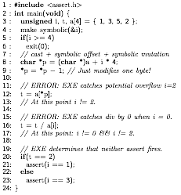
Mark i as symbolic

Slide 10
Fork, add constraints
Constraint:
i >= 4
Constraint:
i < 4
exit(0)
...
Notes:
If the new constraint set is unsolvable, abandon the branch

Slide 11
Add constraints:
“p equals (char*)a + i * 4”
“p[0]’ equals p[0] - 1”
Notes:
Caveat: no real pointers, array hack
Uses SSA (static single assignment)

Slide 12
Could cause invalid dereference or division.
Fork, add constraints for invalid/valid cases.

Slide 13
Fork, add constraints.
On false branch, emit error

Slide 14
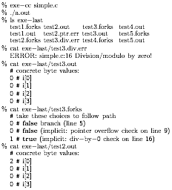
Using exe-cc
Notes:
int represented as 4 8-bit bitvectors

Slide 15
Constraint solving: STP
Insight: if memory is a giant array of bits, constraint solving can be reduced to SAT
Idea: turn set of constraints on memory regions into a set of boolean clauses in CNF
Feed this into an off-the-shelf SAT solver (MiniSAT)

Slide 16
Caveat - pointers
STP doesn’t directly support pointers
EXE takes a similar approach to CCured and tags each pointer with a ‘home’ region
Double-dereferences resolved with concretization, at the cost of soundness
Notes:
In **p, choose one possible value for *p based on constraints, and follow that.
“We are working on removing it”

Slide 17
STP results
(Pentium 4 machine at 3.2 GHz, with 2 GB of RAM and 512 KB of cache)
Notes:
Substitution: eliminate (read(A, c) = e) where c is constant (array substitution)
Refinement: optimistically decouple references to the same array at different points in the program
Simplifications: boolean and mathematical identities

Slide 18
EXE Results
(number of test cases generated, times in minutes on a dual-core 3.2 GHz Intel Pentium D machine with 2 GB of RAM, and 2048 KB of cache)
Notes:
Cache: cache STP queries between all forked processes
Independence: break conjunctions into multiple sub-queries, to maximize cache hits
STP cost is time spent in STP vs program
pcre helped most by optimizations, udhcpd hurt (!)

Slide 19
Results (detail)
Notes:
pcre kind case (small input, small % both branches feasible, low path length)
udhcpd pathological case (large input, large % both branches feasible, large path length)
Note: tcpdump is the only program we lost soundness in due to double pointers

Slide 20
Search heuristics
Need to limit the number of simultaneously running forked processes
(unless you like forkbombs)
What order do we run forked processes in?
Currently using a modified best-first search
Notes:
Modified BFS:
Pick the process blocked at the line of code run the fewest number of times, and run it in DFS for a while. Then, repeat.

Slide 21
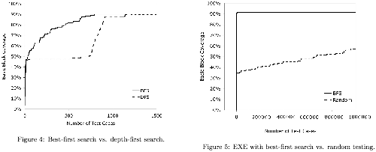
Search heuristics

Slide 22
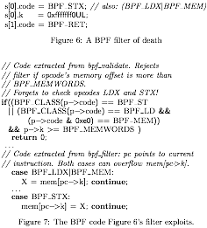
EXE finds real bugs
FreeBSD BPF accepts filter rules in custom opcode format
Forgets to check memory read/write offset in some cases, leading to arbitrary kernel memory access

Slide 23
EXE finds real bugs
2 buffer overflows in BSD Berkeley Packet Filter
4 errors in Linux packet filter
5 errors in udhcpd
A class of errors in pcre
Errors in ext2, ext3, JFS drivers in Linux

Slide 24
Automated Whitebox Fuzz Testing

Slide 25
Whitebox fuzz testing
Insight: valid input gets us close to the interesting code paths
Idea: execute with valid input, record constraints that were made along the way
Systematically negate these constraints one-by-one, and observe the results

Slide 26
Example
With input “good”, we collect the constraints i0 ≠ b, i1 ≠ a, i2 ≠ d, i3 ≠ !
Generate all inputs that don’t match this, choose one to use as next input, repeat

Slide 27
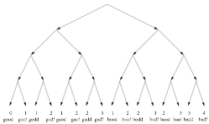
Search space

Slide 28
Limitations
Path explosion
n constraints leads to 2^{n} paths to explore
Must prioritize
Imperfect symbolic execution
Calls to libraries/OS, pointer tricks, etc. make perfect symbolic execution difficult

Slide 29
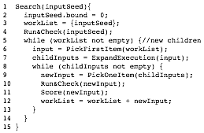
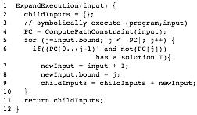
Generational search
BFS with a heuristic to maximize block coverage
Score returns the number of new blocks covered

Slide 30
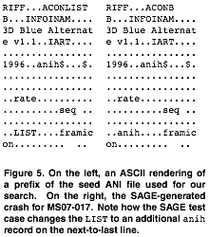
ANI bug
Failure to check the length of the second anih record
Was blackbox fuzz tested, but no test case had more than one anih
Zero-day exploit of this bug was used in the wild

Slide 31
Crash triage
Idea: most found bugs can be uniquely identified by the call stack at time of error
Crashes are bucketed by stack hash, which includes information about the functions on the call stack, and the address of the faulting instruction

Slide 32
Results
Notes:
10 NULL
38 ReadAV
3 WriteAV
SearchTime is HUGE

Slide 33
Results
Most crashes found within a few generations

Slide 34
Discussion
Generational search is better than DFS
Bogus files find few bugs
Different files find different bugs
Block coverage heuristic doesn’t help much
Generation much better heuristic

Slide 35
Comparison
Generational search vs. modified BFS
Bad input is usually only a few mutations away from good
Incomplete search, but can effectively find bugs in large applications without source
EXE closer to sound - how much does this matter?

